Slide 1
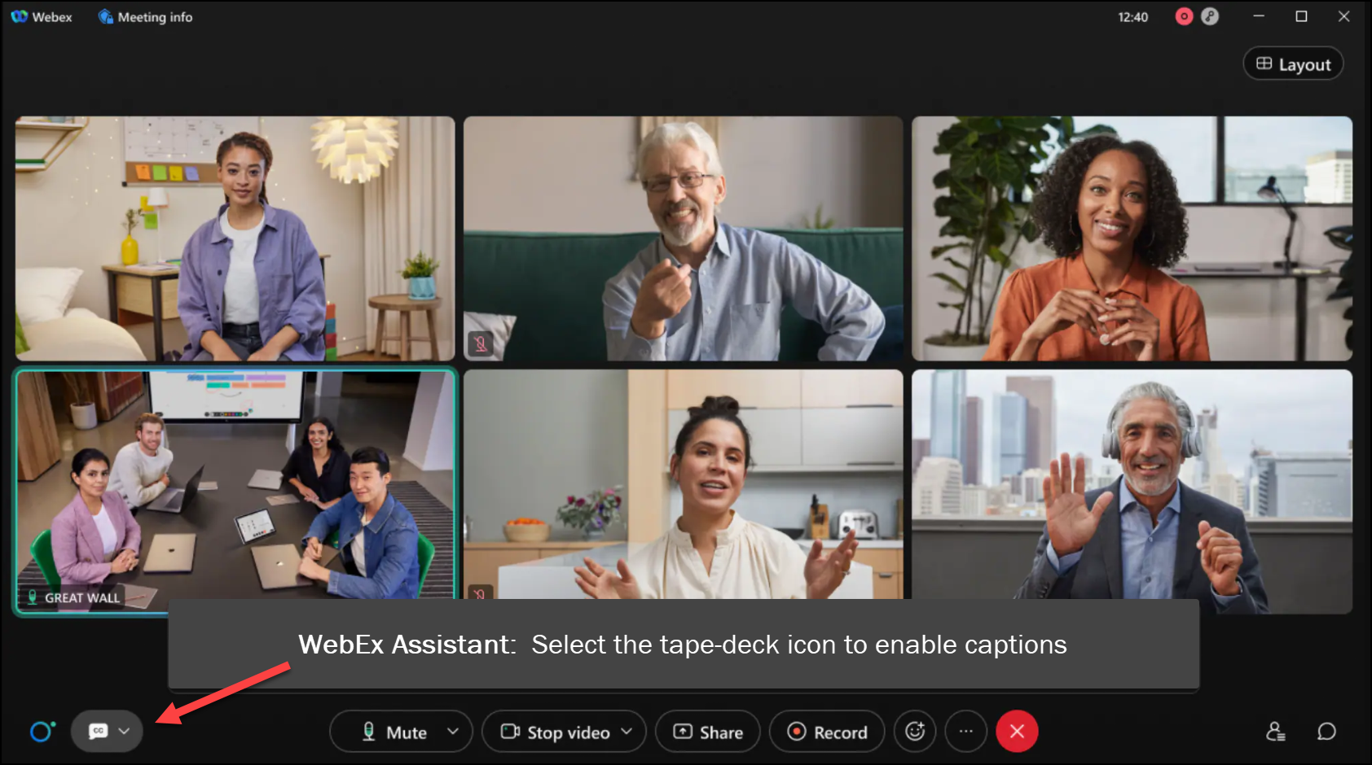
MEETING
RECORDING
NOTICE
The law requires consent prior to recording a person’s participation in an event. Your participation in this video conference (training) equals consent to be recorded, as required by law.
If you do not consent to being recorded but choose to participate, please turn your camera off and use the chat feature to interact with the other participants.

Slide 2
PELL RECONCILIATION REFRESHER
Kelly Forsberg
ctcLink Functional Trainer | Financial Aid
November 2023

Slide 3
Objectives
After today’s training, you should be able to:
Understand the steps to run the Pell Reconciliation report
Understand the steps to process the Pell Statement of Accounts File (PGAS)
Understand the steps to process the Pell School Account Statement (SAS) Files (PGSM)

Slide 4
PELL RECONCILIATION
REPORT IMPRT

Slide 5
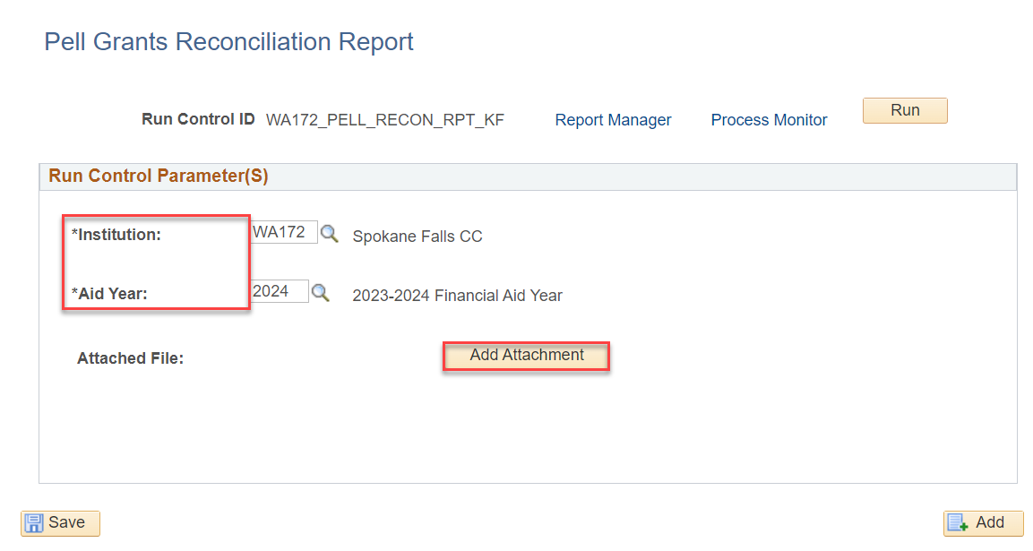
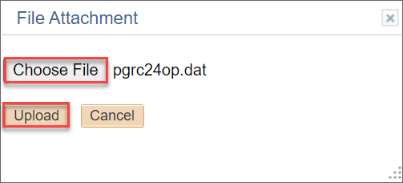
RUN SBCTC PELL RECON REPORT
ONE STEP PROCESS
Navigation: Financial Aid > CTC Custom > CTC Reports > Pell Reconciliation Imprt
Select the Add Attachment button and select the file you wish to upload. Select the Upload button.

Slide 6
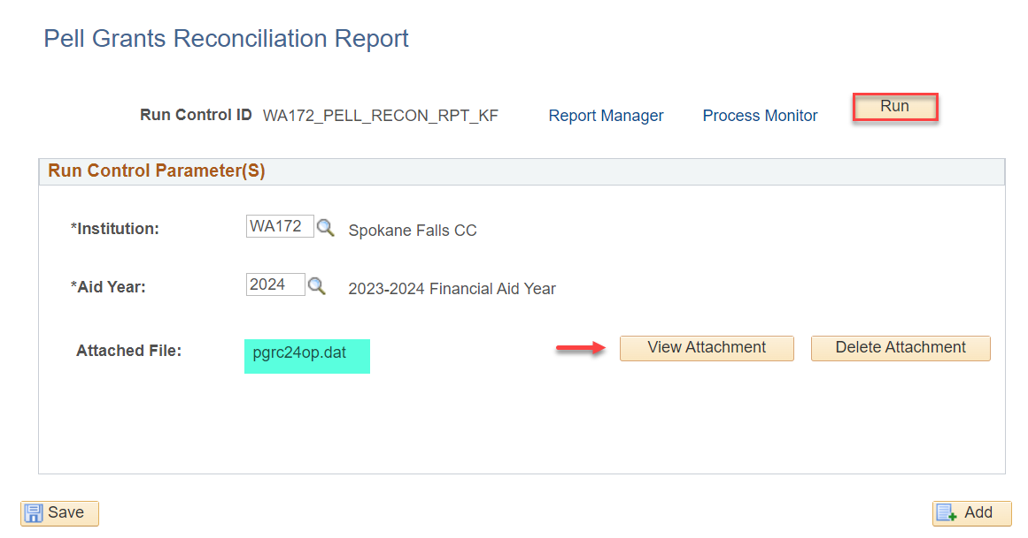
RUN SBCTC PELL RECON REPORT CONT’D
ONE STEP PROCESS
You can view the attachment or delete it as desired – select the Run button.

Slide 7
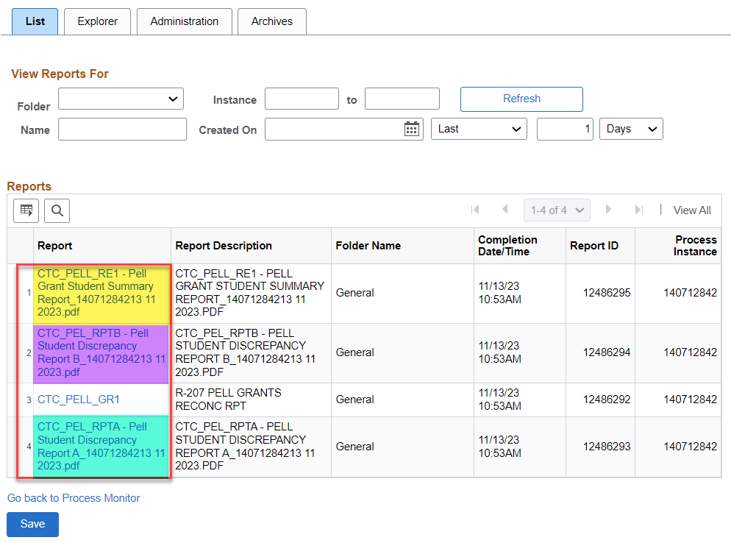
RUN SBCTC PELL RECON REPORT CONT’D
REPORT MANAGER
Review the Summary Report, the Discrepancy Report A & Discrepancy Report B

Slide 8
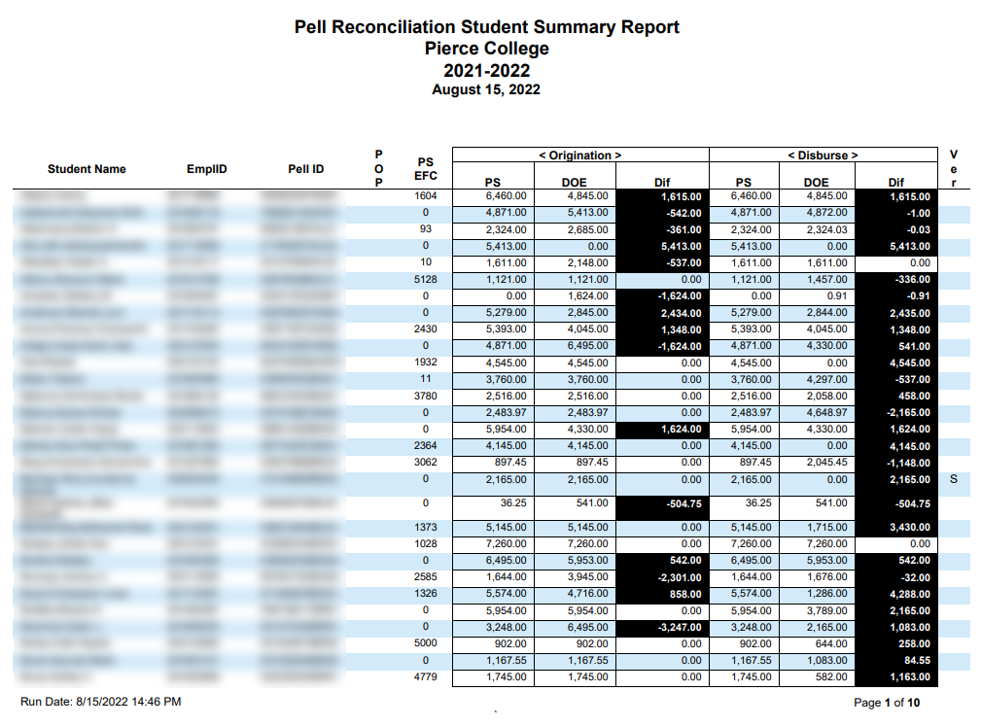
SBCTC PELL REPORT CONT’D
PELL SUMMARY REPORT
Pell Student Summary Report provides all info for students and compares PS data to COD data.
Also has indicators if award is impacted by POP, and displays whether the record is selected for Verification (Ver)

Slide 9
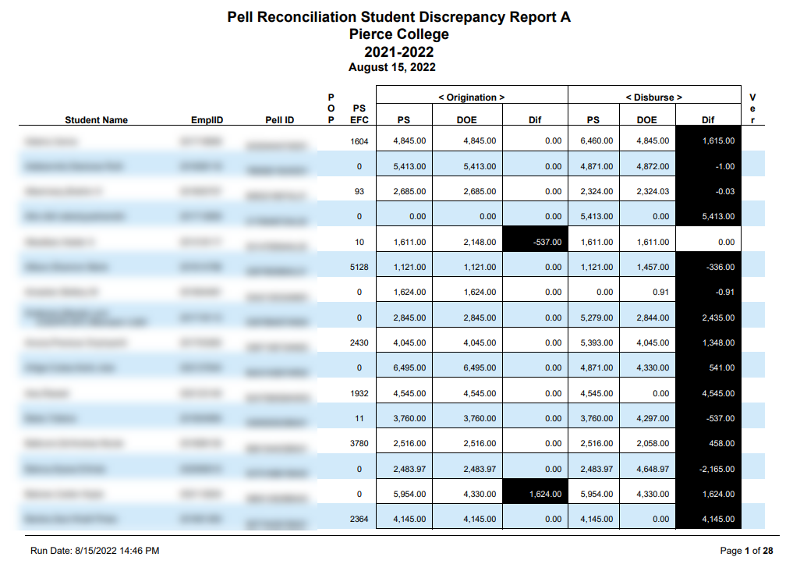
SBCTC PELL REPORT CONT’D
Student Discrepancy Report A is an annual discrepancy report. First section of the report displays discrepancies for Originations and Disbursements, with amount > 0
Second section lists students who have Pell payment info in PS but not in COD.
Third section lists students who have record information in COD but no Pell payment info in PS
PELL STUDENT DISCREPANCY REPORT A

Slide 10
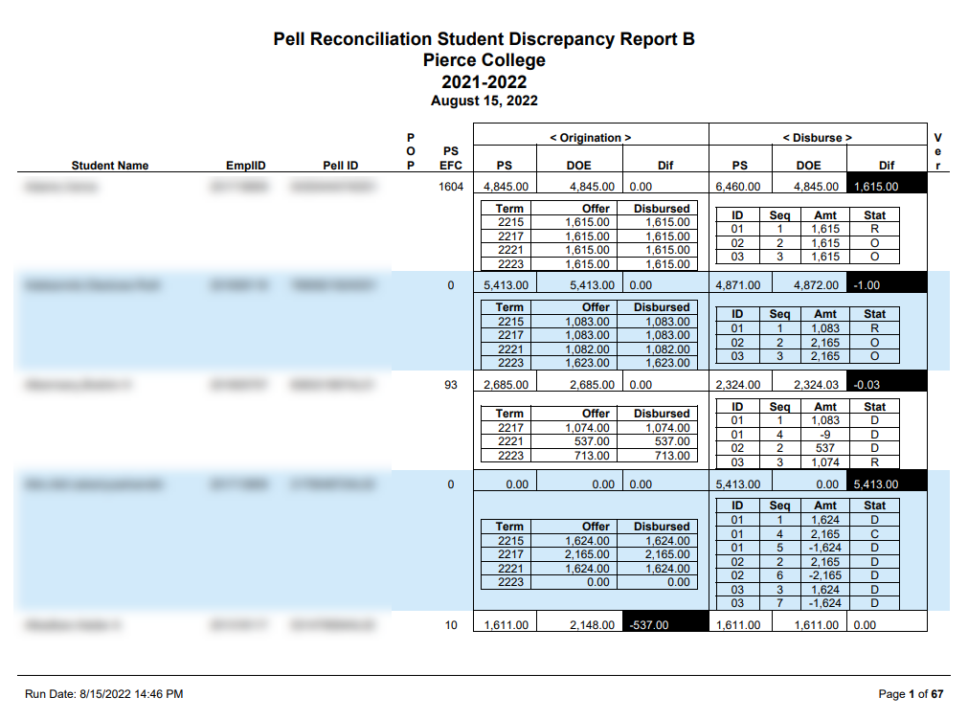
SBCTC PELL REPORT CONT’D
PELL STUDENT DISCREPANCY REPORT B
Student Discrepancy Report B compares PS data and COD data for each term.
This report contains the same three sections as Report A, but the Disbursed Pell Awards per term are pulled from Award page, and from the Pell Disbursement tab on Manage Pell Payment page.

Slide 11
PROCESSING
PELL STATEMENT
OF ACCOUNTS FILE

Slide 12
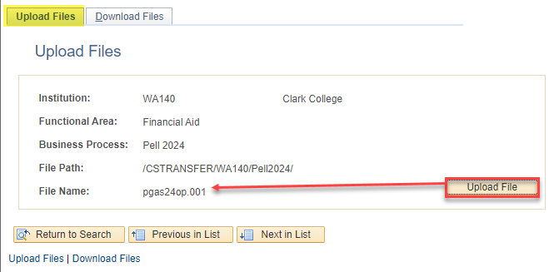
Processing pell STATEMNT OF ACCT FILE
UPLOAD PGAS FILE
Navigation: PeopleTools > CTC Custom > Extensions > Upload/Download Files
Select the pgas file from where you saved it on your network drive or desktop, and Upload it

Slide 13
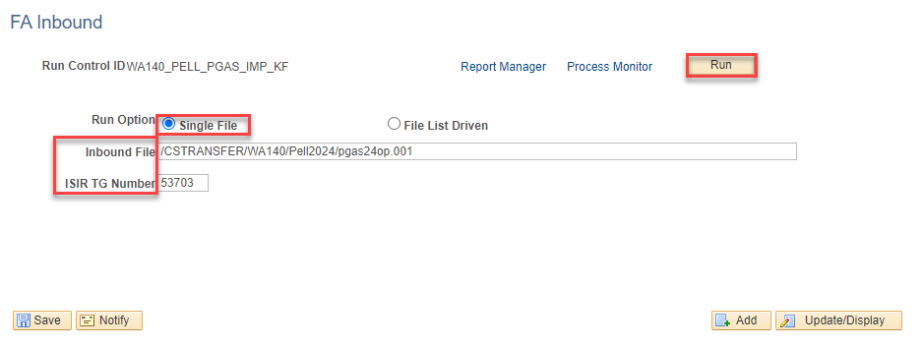
Processing pell STATEMNT OF ACCT FILE
IMPORT PGAS FILE
Navigation: Financial Aid > File Management > Import Federal Data Files
Tip! Copy and paste your file path and file name from the upload/download page

Slide 14
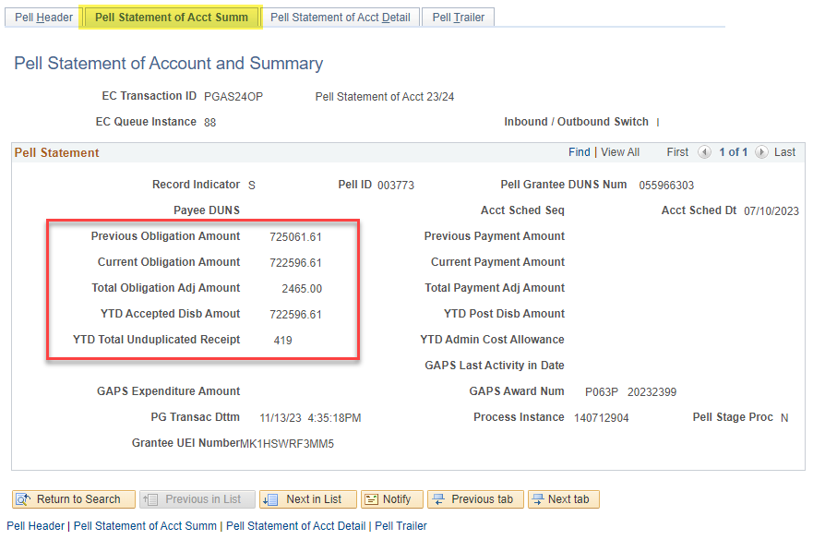
Processing pell STATEMENT OF ACCT FILE
STMNT OF ACCT SUMMARY
Navigation: Financial Aid > Pell Payment > Cash Management Reports > Review Statement of Account
Review the previous obligation amount and the current obligation amount – note that the Total Obligation Adj Amount is $2465 in this example.
Next, review the Statement of Account Detail tab

Slide 15
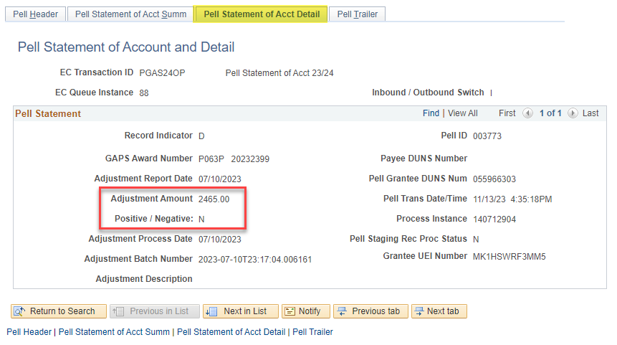
Processing pell STATEMNT OF ACCT FILE
STATEMNT OF ACCT DETAIL
The Statement of Acct Detail shows that there is an Adjustment Amount needed, which is a Negative Amt.
Should this money be returned to ED or drawn down?

Slide 16
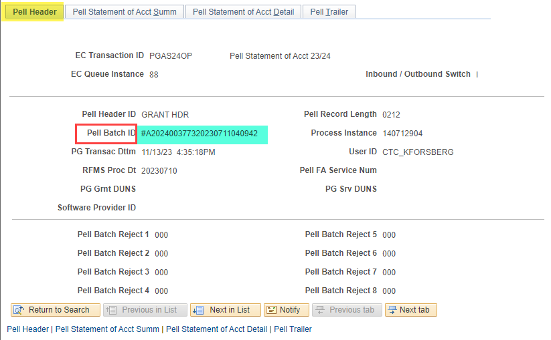
Processing pell STATEMNT OF ACCT FILE
PELL HEADER TAB – PELL BATCH ID
Copy the Pell Batch ID because you will use it in the next step to print the Pell Statement of Account

Slide 17
PRINT PELL
STATEMENT OF
ACCOUNT

Slide 18
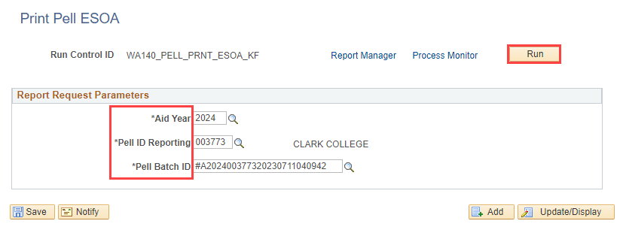
PRINT PELL STATEMENT OF ACCOUNT
PELL ESOA
Navigation: Financial Aid > Pell Payment > Cash Management Reports > Print Grant ESOA

Slide 19
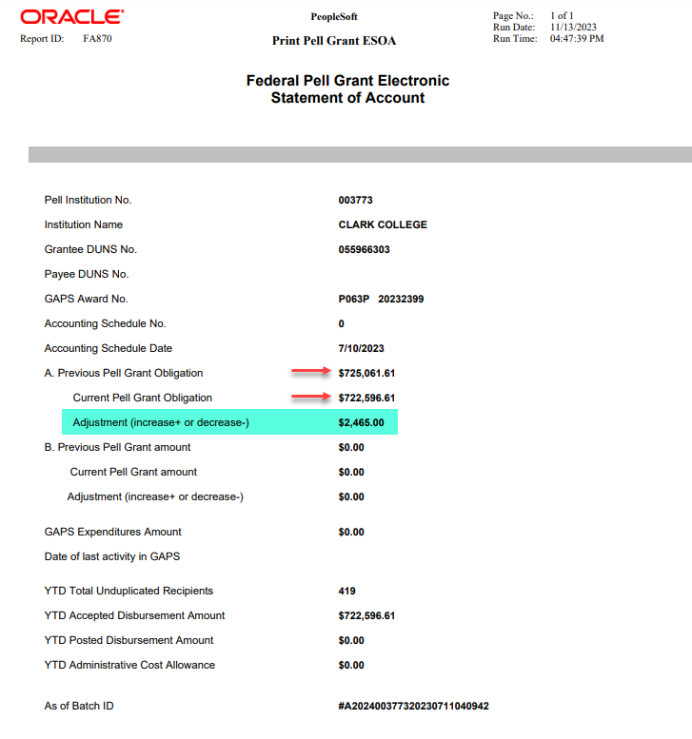
PRINT PELL STATEMENT OF ACCOUNT
PELL ESOA
Use this report to work with Finance to process cash receipts (draw downs) or to deobligate funds

Slide 20
PROCESSING PELL
SCHOOL ACCOUNT
STATEMENT
FILES

Slide 21
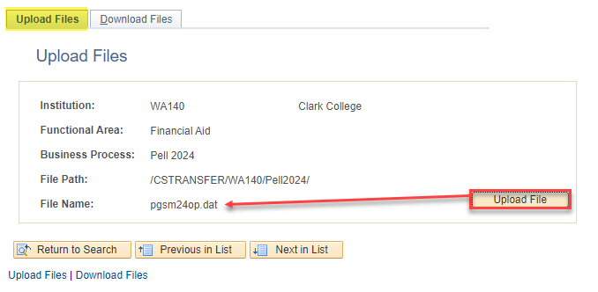
Processing pell sas files
UPLOAD PGSM FILE
Navigation: PeopleTools > CTC Custom > Extensions > Upload/Download Files

Slide 22
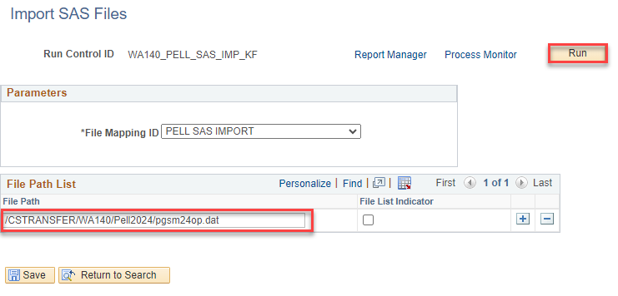
Processing pell sas files
IMPORT SAS FILES
Navigation: Financial Aid > Pell Payment > Cash Management Reports > SAS Reports > Import SAS Files

Slide 23
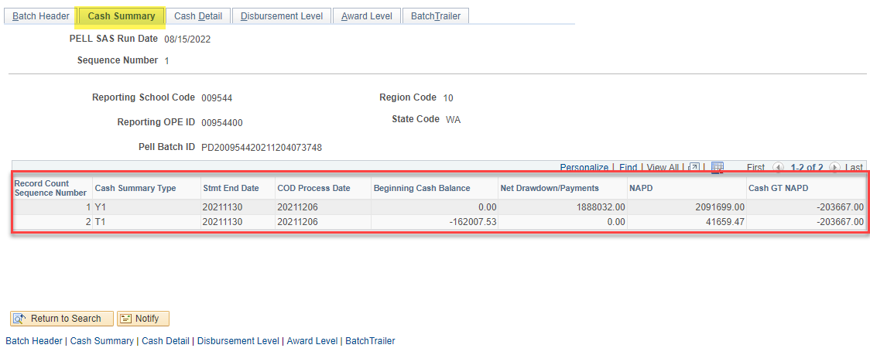
Processing pell sas files
CASH SUMMARY
Navigation: Financial Aid > Pell Payment > Cash Management Reports > SAS Reports > Review Pell SAS Summary
NAPD = Net Accepted and Posted Disbursement
Cash Summary Type:
Y1 = Year-To-Date Cash Summary Total
T1 = Monthly Cash Summary Total

Slide 24
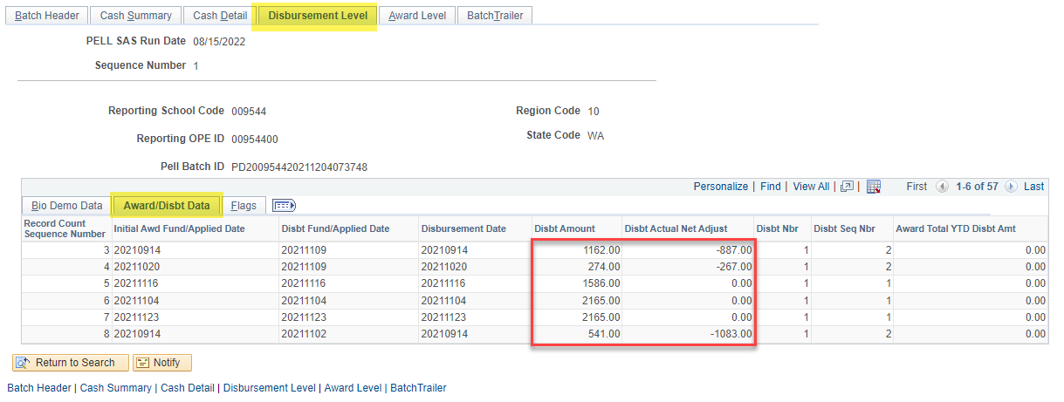
Processing pell sas files
DISBURSEMENT LEVEL

Slide 25
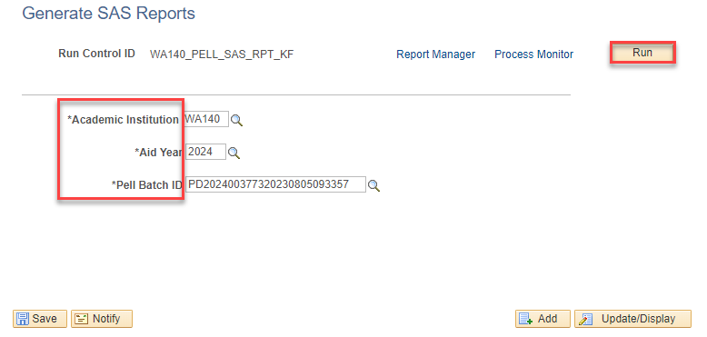
Processing pell sas files
GENERATE PELL SAS REPORT
Navigation: Financial Aid > Pell Payment > Cash Management Reports > SAS Reports > Generate SAS Reports

Slide 26
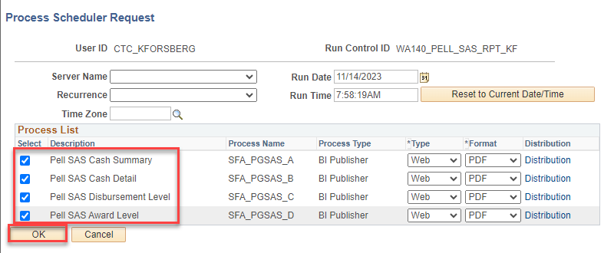
Processing pell sas files
PROCESS SCHEDULER REQ

Slide 27
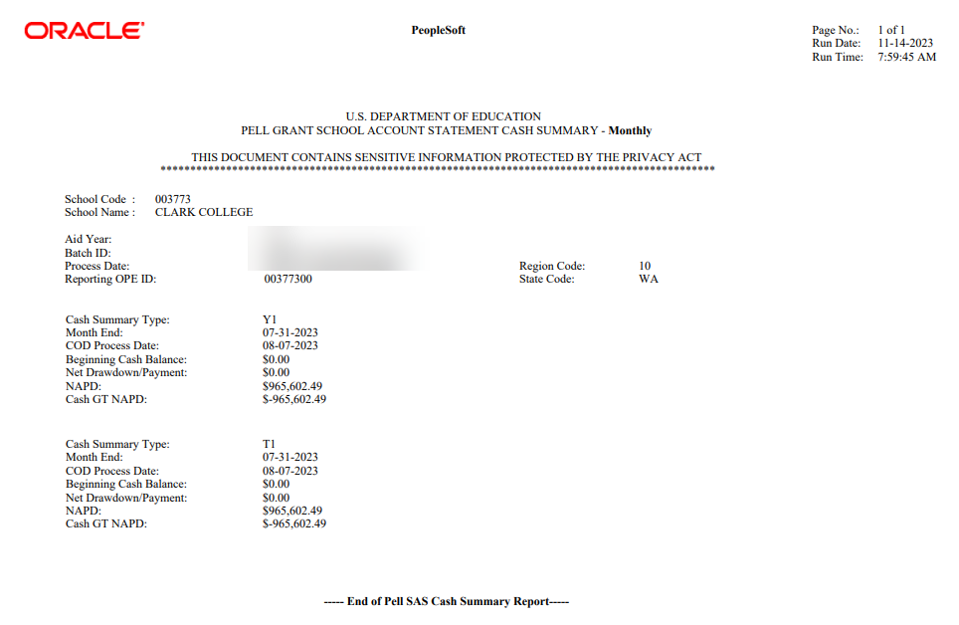
Processing pell sas files
CASH SUMMARY PDF

Slide 28
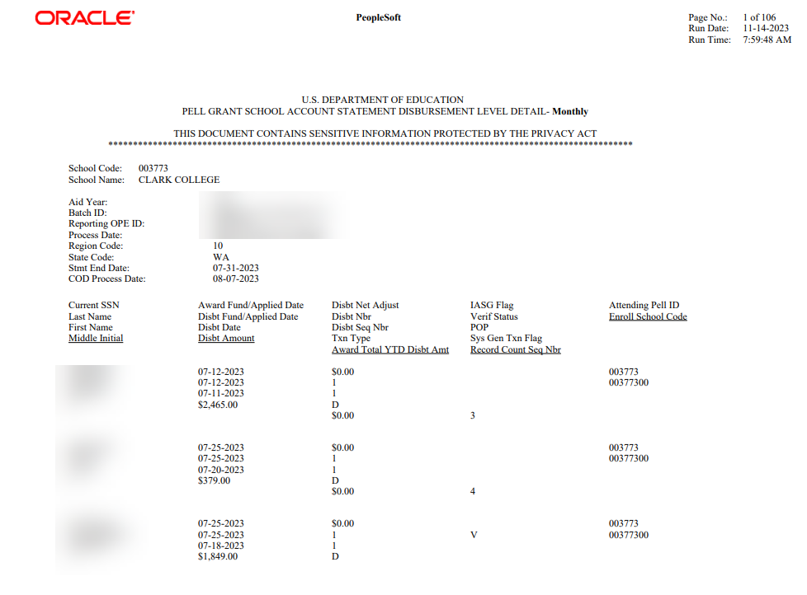
Processing pell sas files
DISBURSEMENT DETAIL

Slide 29
PELL RECORD
VIEW PAGES

Slide 30
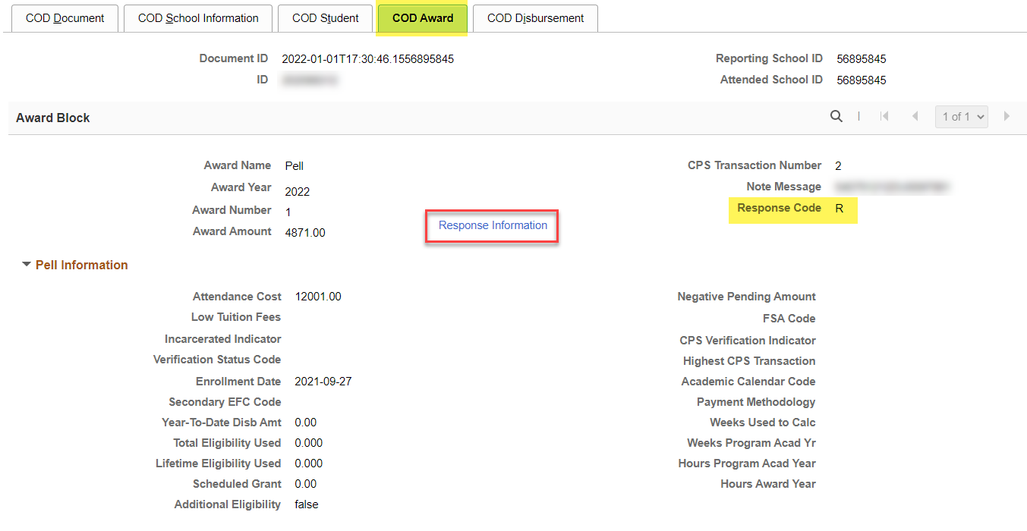
PELL RECORD VIEW PAGES
Navigation: Financial Aid > File Management > Full COD Participant > View COD Data
VIEW COD DATA PAGE
If Response Information fields are blank, go to Manage Pell Payment page.

Slide 31
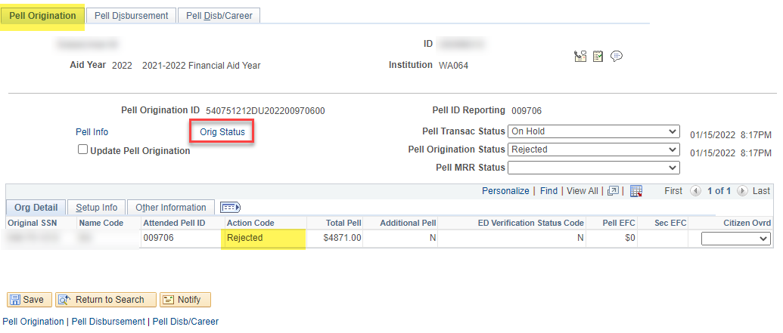
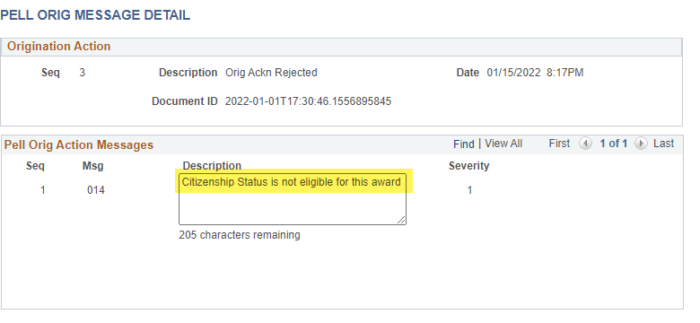
Pell record view pages CONT’D
Navigation: Financial Aid > Pell Payments > Manage Pell Payment
MANAGE PELL PAYMENT

Slide 32
Outcomes
After today’s training, you should be able to:
Understand the steps to run the Pell Reconciliation report
Understand the steps to process the Pell Statement of Accounts File (PGAS)
Understand the steps to process the Pell School Account Statement (SAS) Files (PGSM)

Slide 33
Congratulations!
Pell Grant Reconciliation Refresher Training Complete!
Please work from the Pell Processing Business Processing Guide in the reference center as you progress through students to prep for reconciliation
Thank you for your participation today!

