Slide 1
SF/FA Cross-Pillar Work Session: CHARGE PRIORITY LIST’S (CPL’S) Part II
November 9th, 2023 (1:00pm – 3:00pm)

Slide 3
Ground Rules
Session is being recorded - Find session recording in the ctcLink Pillar Work Session Information Canvas Course
The captions for this recording are auto-generated. If additional assistance is needed to receive an increased level of access, please contact Alec Risk (arisk@sbctc.edu).
Please mute your line when not speaking
Be ready to participate & ask questions
If we move too quickly, ask us to slow down or to revisit a topic

Slide 4
Introductions
SBCTC SF Support
SBCTC FA Support
SBCTC Policy and Accounting

Slide 5
Objectives
After completing this training, you should be able to:
Understand the reconciliation queries used in FA to track what is ‘unapplied’ to Customer Accounts.
Understand CPLs, Payment Priority, Tree Nodes, and more, in depth.
Understand how to review available queries which shows Item Type priority conflicts.
Understand the need to refurbish your institution’s FA Item Type CPLs based on the review resources shared at the session.

Slide 6
Problem:
Financial Aid Item Types may be displaying on the Customer Account as unapplied or misapplied. This is due to possible Item Type refundability options, competing Payment Priority numbers, Charge Priority Set Up, and Item Type Trees.
These problems may cause Financial Aid to be delayed or misapplied to charges/refunds on the student account.
Solution:
The focus on reviewing and refining parameters that make up item types ensures accurate charge priority lists and establishes the working order of payment priority.
This practice will help to instill the healthy practice of reviewing item type functionality for continuous improvement.

Slide 7
Student Account/GL
Item Type Tree
SF Item Type (CPL, PPP, Refundability)
CPL Set-Up
FA Item Types

Slide 8
Financial Aid Reconciliation

Slide 9
Weekly CUST ACCOUNT Reconciliation Queries
CTC_FA_SF_DISCREPANCY_LIST
Shows discrepancies on Item Types with ‘unapplied’ amounts to the Customer Account
QCS_SF_FA_SA_APPLIED_DETAILS
Shows discrepancies between SF disbursements and FA disbursements
Shows Item Types and what charges to which it applied
Formally known as CTC_SF_FINAID_REFUND_DETAILS

Slide 10
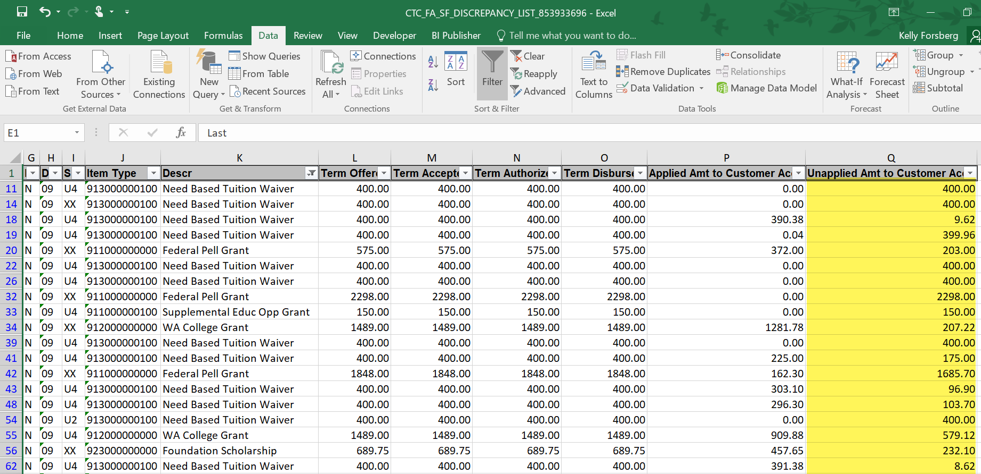
CTC_FA_SF_DISCREPANCY_LIST
Unapplied Amt is the outstanding amount that has not been posted to the Customer Account

Slide 11
REASONS WHY FUNDS MAY NOT HAVE APPLIED
Payment Priorities may be conflicting
Charge Priority List and Item Type Tree may need review/adjustment
Book awards that were not fully spent on charges
Tuition Waivers where tuition amount was less than the FA award
Refund amount from student dropping classes and a No Refund Service Indicator exists, amounts need to be reduced in FA award page

Slide 12
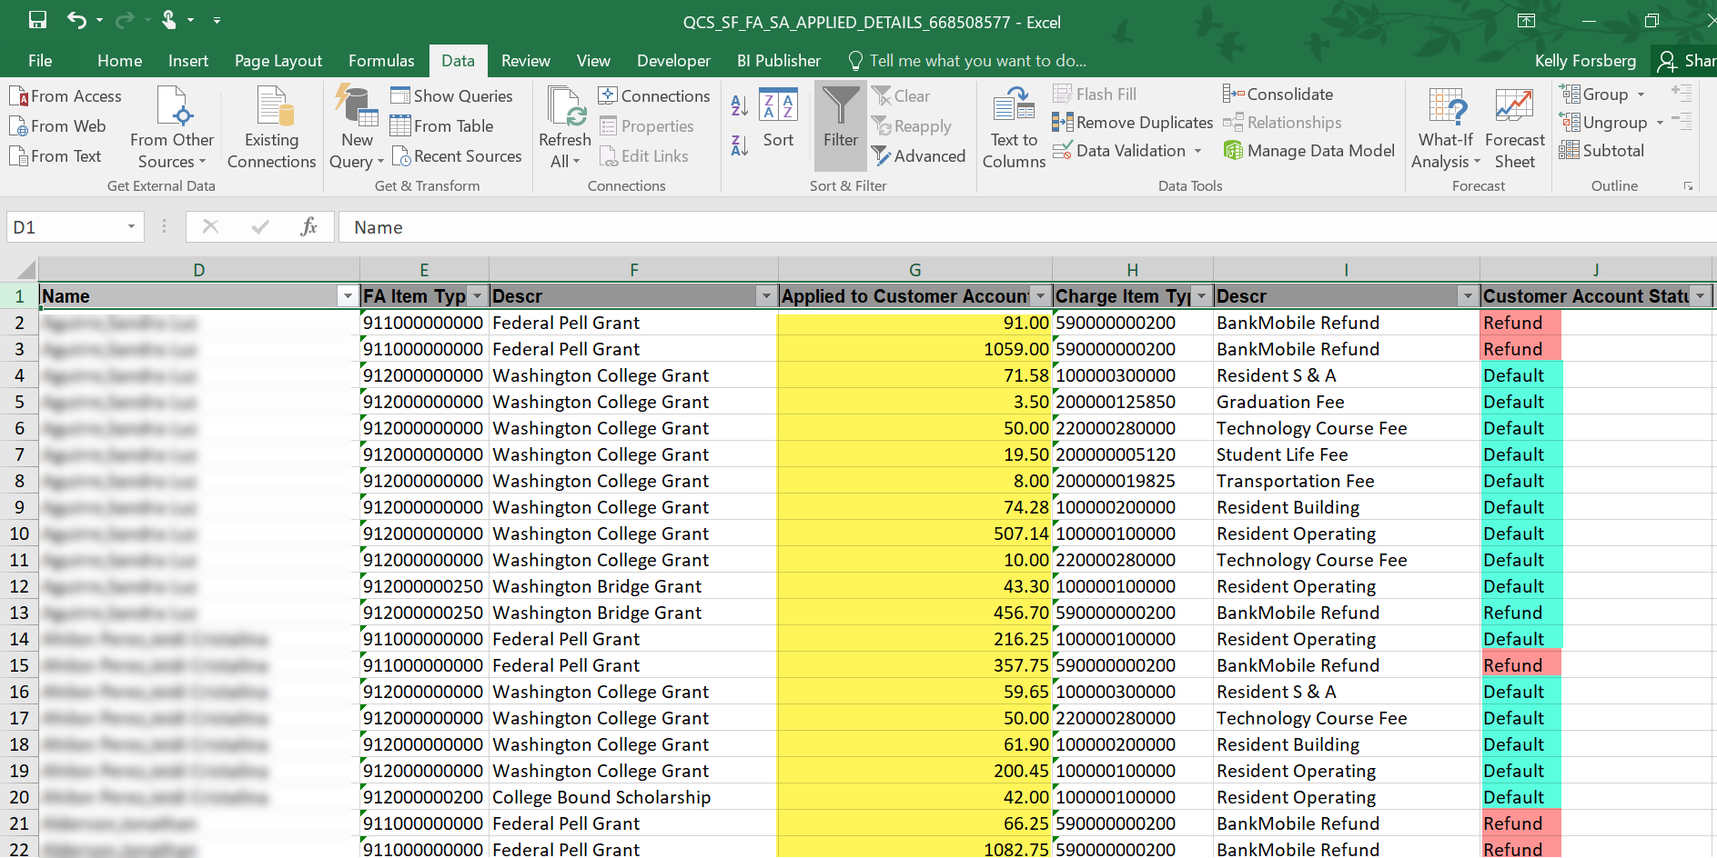
QCS_SF_FA_SA_APPLIED_DETAILS
Default row displays charges paid
Refund displays the amount the student rec’d in a refund

Slide 13
DEMONSTRATION

Slide 14
Addt’l queries to assist in WHY charges did not apply to CUSTOMER ACCOUNTS
QCS_SF_CREDIT_BAL_NONREF - Identifies students with a credit balance from nonrefundable item types
QCS_SF_ITM_TYPE_GL_INTERFACE – Lists item-type set-up including charge priority, payment priority, etc.

Slide 15
DEMONSTRATION

Slide 16
Student Financials Configuration

Slide 17
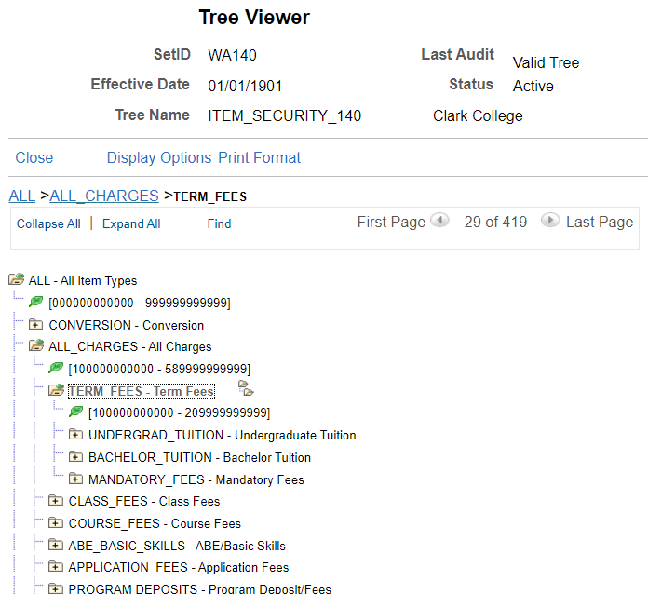
Alec’s Definition of: Tree Node
Navigation: Tree Manager > Tree Viewer
Tree Node
A group of item types located within your respective “Tree.” Can be any branch (folder) of your tree.

Slide 18
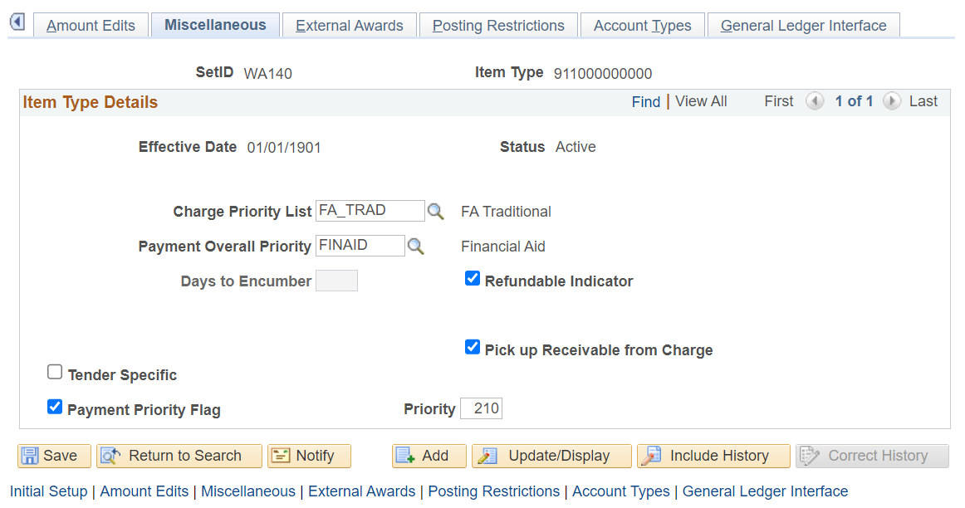
Item Types Configuration: Miscellaneous Tab
Navigation: Set Up SACR > Product Related > Student Financials > Item Types > Item Types
The fields in the image above can be configured on “Payment” Item Types:
Payments, Financial Aid, and Waivers are examples of “Payment” Classifications.

Slide 19
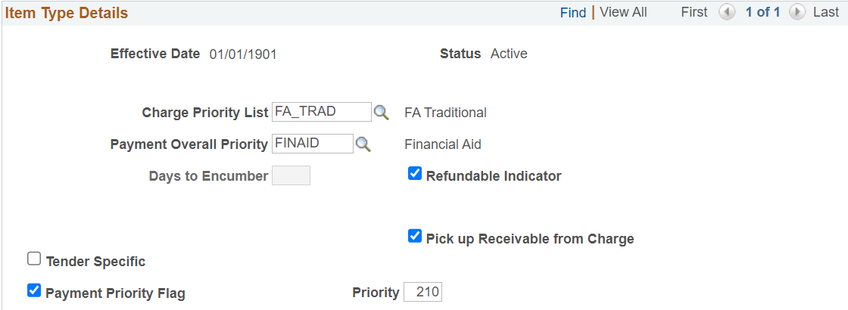
Alec’s Definition of: Payment Priority Flag
Payment Priority Flag:
Payments debating over who is going to pay the bill. Also known for the “Payment Shuffle.”

Slide 20
Alec’s (Sapien’s) Definition of: Priority
Priority:
“You are at the DMV. You take a ticket from the counter and your number is 347. They are currently on number 52...”

Slide 21
Alec’s Definition of: Refundable Indicator
Refundable Indicator
Allows students to get that money refunded to THEM! Or a Sponsor…

Slide 22
Alec’s Definition of: Charge Priority List
Charge Priority List
A group of charge item types that a “payment” item type will pay. Also known as a “CPL.”

Slide 23
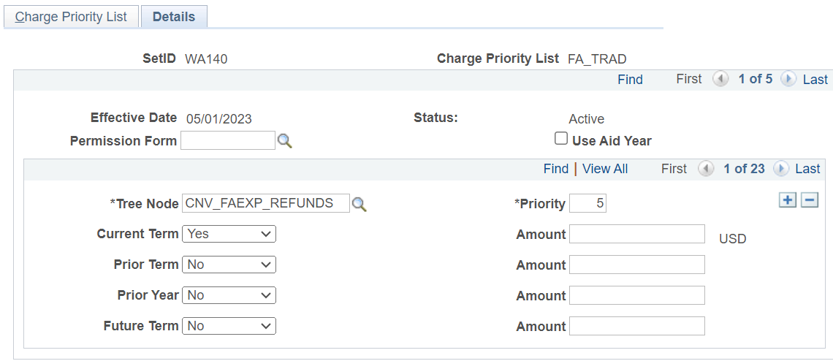
Charge Priority List
Navigation: Set Up SACR > Product Related > Student Financials > Charges and Payments > Charge Priority List
You will notice lots of rows on the Details tab. Each new row may include a new/different Tree Node.

Slide 24
Charge Priority List (Continued)
Each row will have a Priority. This means the “Payment” Item Type will determine which group of charges to pay first.

Slide 25
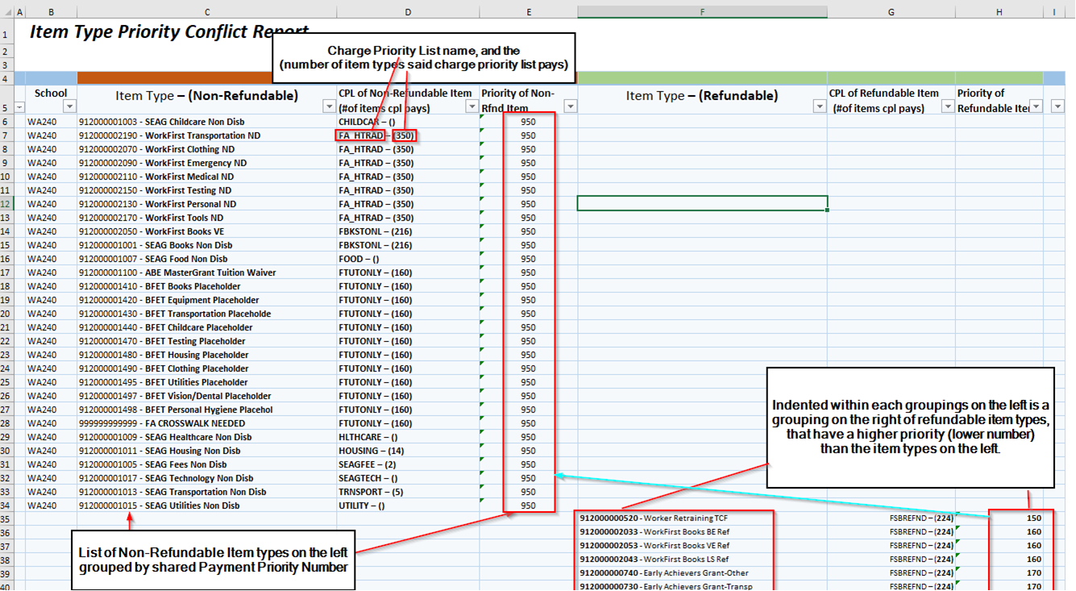

Slide 26
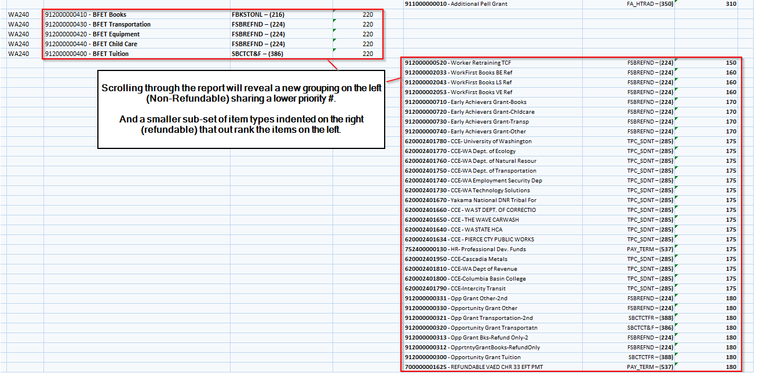

Slide 27
Next Steps/Call to Action!
The Student Financials and Financial Aid Teams are eager to collaborate with you to review and refine any problematic item types.
Step 1: Initiate the Process
Open a support ticket with the request type of: ctcLink Support > SF/FA > SF/FA: Item Types
In the subject line, please include "Fin Aid Item Type Review WAXXX."
Step 2: Data Sharing
Following your ticket submission, the Student Financials team will respond by providing you with two spreadsheets, as presented by Charles and Charles today. In addition, these 6 steps will be included.
Step 3: Review and Consideration
Take the time to review the enclosed data together with your team. Evaluate the information and determine when it would be suitable to adjust the item type parameters.
Step 4: Confirmation of Review
Reply to the ticket, indicating that you and your team have reviewed the spreadsheets and are prepared to discuss the results.
Step 5: Schedule a Meeting
The State Board will collaborate with you to schedule a convenient meeting time. During this meeting, we will engage in a discussion and, if necessary, create a list of item type parameter adjustments.
Step 6: Testing and Implementation
To conclude the review process, we will work together to ensure that any adjustments are properly tested and seamlessly implemented.
This streamlined process will allow us to efficiently address and refine any problematic item types, ultimately enhancing our systems' performance and efficiency.

Slide 28
Resources/Queries
QCS_SF_ITEM_TYPE_TREE_NODE
QCS_SF_ITEMTYPES_TO_CPL
QCS_SF_CPL_NODE_ITEMTYPES
QCS_SF_CREDIT_BAL_NONREF
QCS_SF_ITM_TYPE_GL_INTERFACE
QCS_SF_FA_SA_APPLIED_DETAILS
CTC_FA_SF_DISCREPANCY_LIST
Understanding Item Types QRG

Slide 29
Outcomes
At training completion, you should be able to:
Understand the reconciliation queries used in FA to track what is ‘unapplied’ to Customer Accounts.
Understand CPLs, Payment Priority, Tree Nodes, and more, in depth.
Understand how to review available queries which shows Item Type priority conflicts.
Understand the need to refurbish your institution’s FA Item Type CPLs based on the review resources shared at the session.

Slide 31
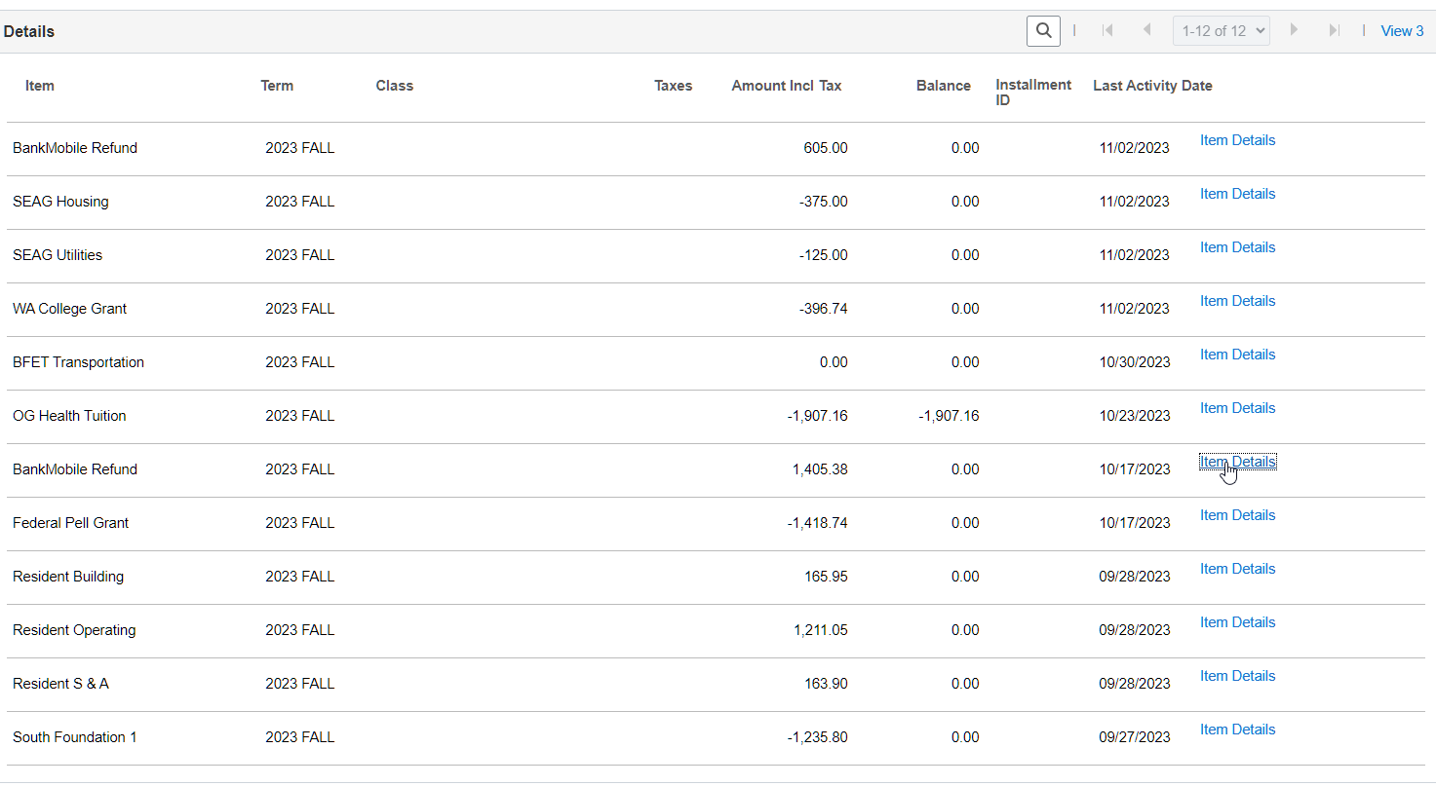
Appendix (where you can see aid is paying a refund)

Slide 32
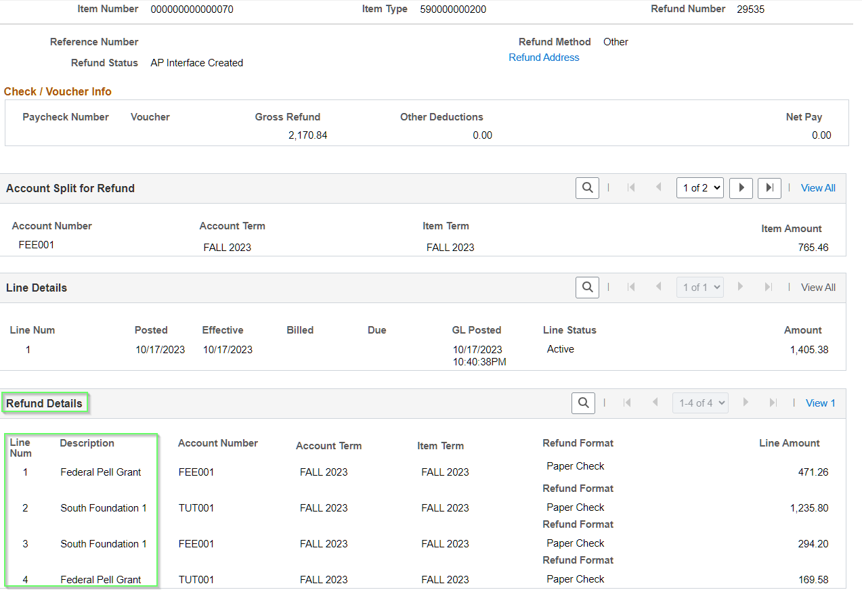
Once a refund is processed they are linked and the source of refund will show here. However this is the original refund detail and if that aid is undisbursed this would not be what is currently sourcing your refund. See: QCS_SF_FA_REFUNDS_DUE to see Refunds Due.

Slide 33
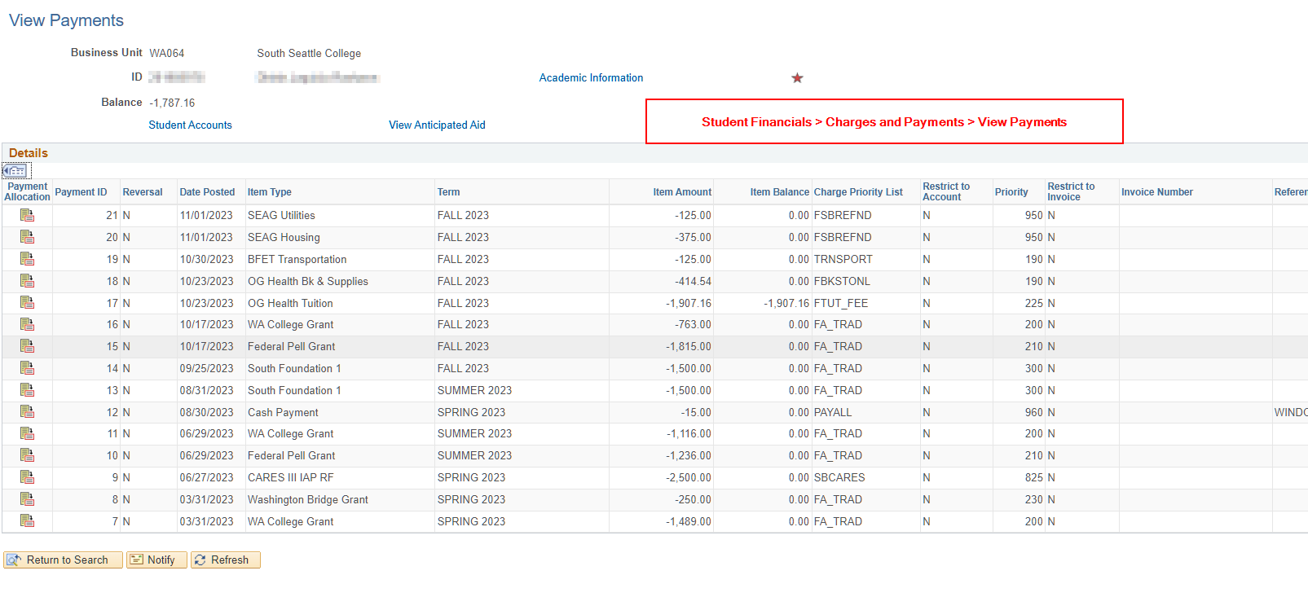
Other Helpful Views:

Slide 34
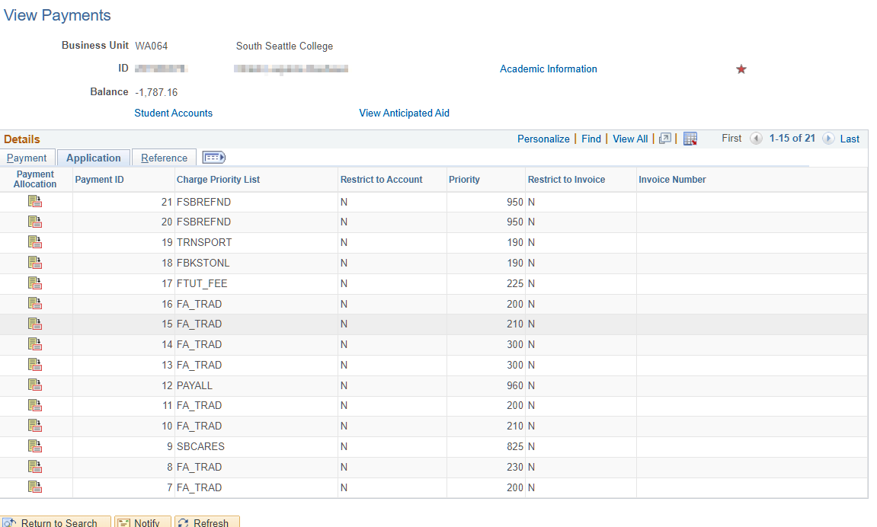
Other Helpful Views:

Slide 35
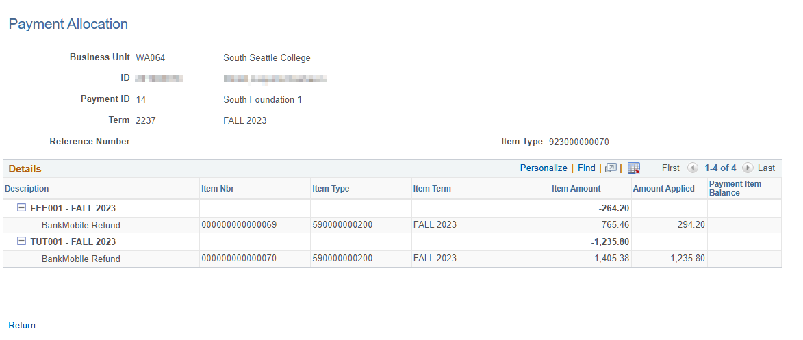
Other Helpful Views:

