Slide 1
DIRECT LOAN reconciliation Refresher
Kelly Forsberg
ctcLink Functional Trainer | Financial Aid
October 2023

Slide 2
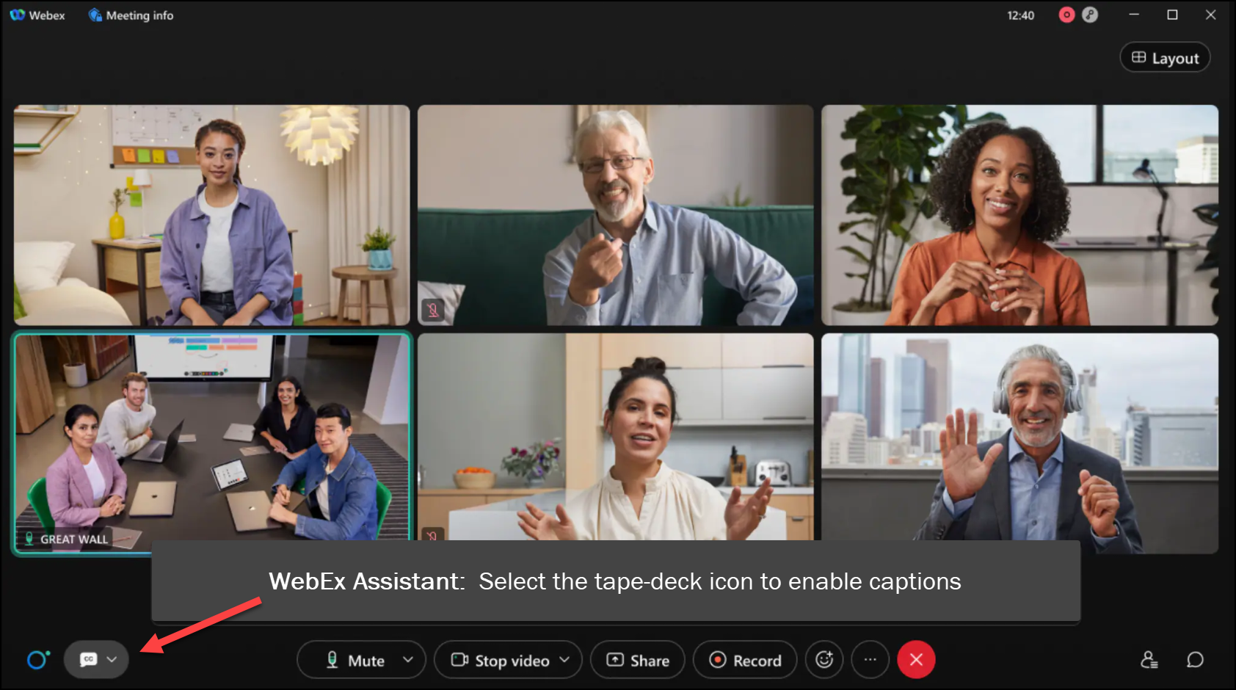
MEETING
RECORDING
NOTICE
The law requires consent prior to recording a person’s participation in an event. Your participation in this video conference (training) equals consent to be recorded, as required by law.
If you do not consent to being recorded but choose to participate, please turn your camera off and use the chat feature to interact with the other participants.

Slide 3
Objectives
After today’s training, you should be able to:
Understand the steps to produce the Direct Loan Reconciliation report in ctcLink
Upload/Download File Process
Import Federal Data Files
Running SBCTC DL Recon Reports
Understand how to view and work the DL Recon reports

Slide 4
SBCTC DL RECONCILIATION
REPORT

Slide 5
DIRECT LOAN RECONCILIATION PROCESS
3-STEP PROCESS
Step 1: Upload dsdf file to ctcLink
Step 2: Import Federal Data File
Step 3: Run SBCTC DL Recon Rpt

Slide 6
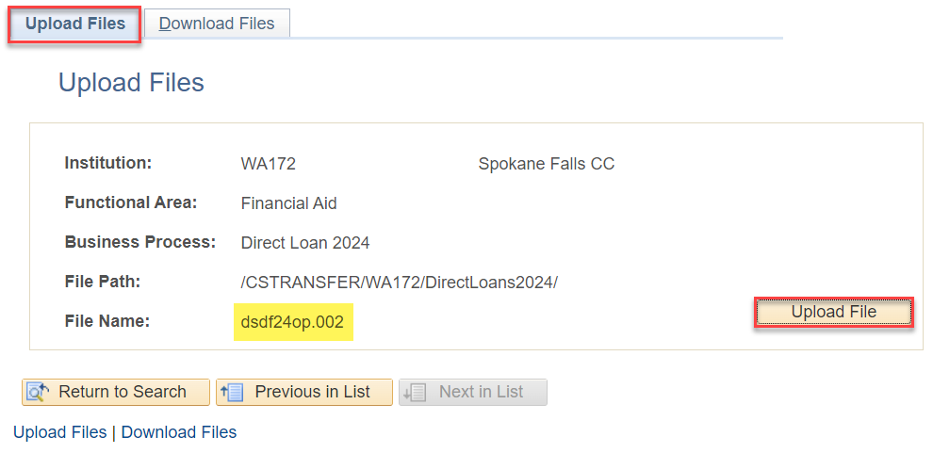
Upload file to ctclink
DSDF MESSAGE CLAS FILE
Navigation: PeopleTools > CTC Custom > Extensions > Upload/Download Files
If you have not seen a dsdf file in your SAIG mailbox, you will need to contact SAIG and/or COD customer service to request the file. The dsdf file is typically delivered every 1st Saturday of the month. The first file may come in as a dsyf file; which is a YTD version of the dsdf file

Slide 7
DIRECT LOAN RECONCILIATION PROCESS
3-STEP PROCESS
Step 1: Upload dsdf file to ctcLink
Step 2: Import Federal Data File
Step 3: Run SBCTC DL Recon Rpt

Slide 8
IMPORT FEDERAL DATA FILES
Navigation: Financial Aid > File Management > Import Federal Data Files
Tip! Copy the file path, and file name from the Upload/Download page; doing so reduces the occurrence of errors in processing this step.

Slide 9
DIRECT LOAN RECONCILIATION PROCESS
3-STEP PROCESS
Step 1: Upload dsdf file to ctcLink
Step 2: Import Federal Data File
Step 3: Run SBCTC DL Recon Rpt

Slide 10
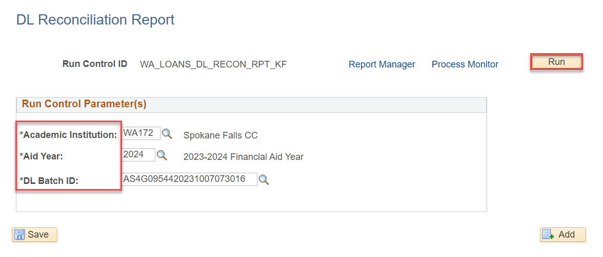
RUN SBCTC DL RECON REPORT
CTC CUSTOM PAGE
Navigation: Financial Aid > CTC Custom > CTC Reports > SBCTC DL Reconciliation
Select the available DL Batch ID and select Run

Slide 11
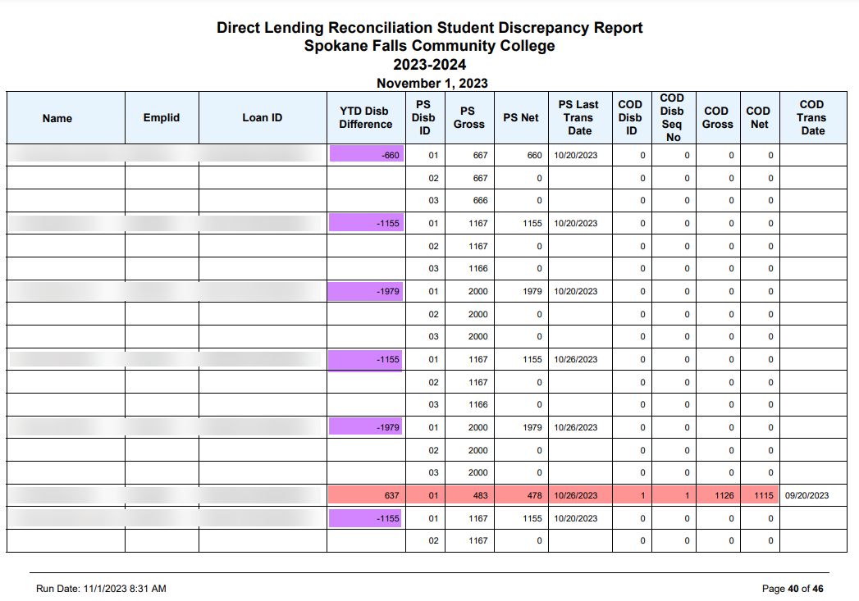
RUN SBCTC DL RECON REPORT CONT’D
EXAMPLE 1
Review the YTD Disb Difference and compare the PS Gross/Net to the COD Gross/Net

Slide 12
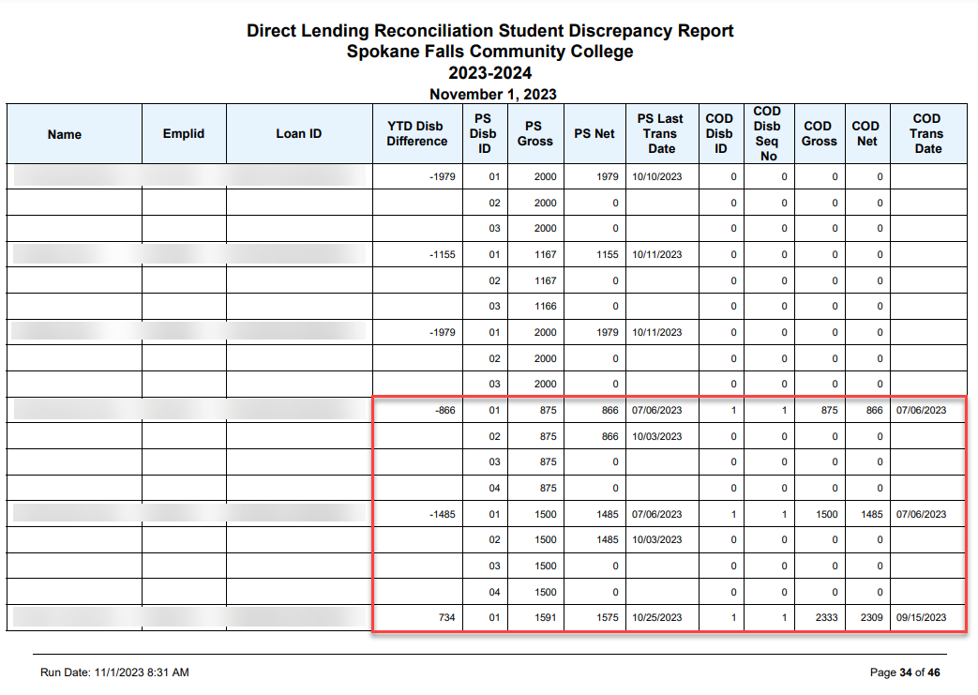
RUN SBCTC DL RECON REPORT CONT’D
CHECK YOUR KNOWLEDGE
Which disbursements in these groups needs to be reconciled?

Slide 13
DEMONSTRATION

Slide 14
LOAN ORIGINATION
REPORTS

Slide 15
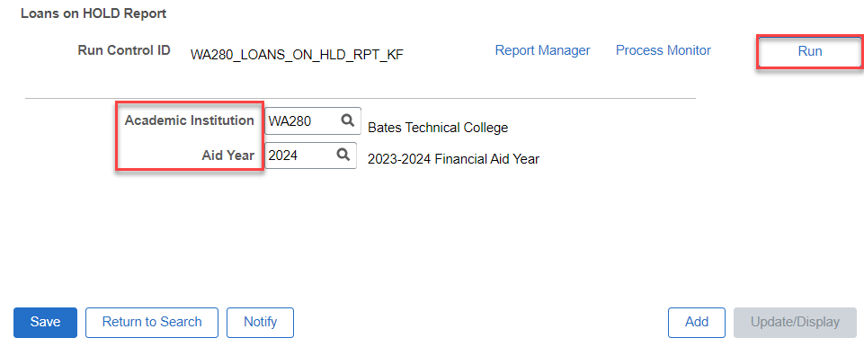
LOAN origination reports
LOANS ON HOLD REPORT
Navigation: Financial Aid > Loans > Direct Lending Reconciliation > Loans on Hold Report

Slide 16
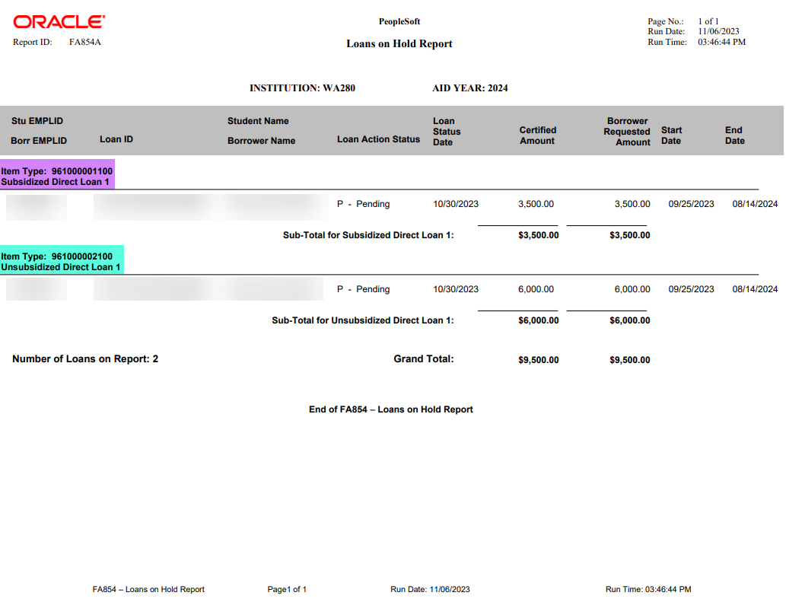
LOAN orig reports
LOANS ON HOLD REPORT
Notes:
Note the Loan Action Status = P. You can view the Loan Action Status Codes in the View Loan Action Codes page. In this example, the P = Pending Origination

Slide 17
LOAN VALIDATION ERROR
REPORT

Slide 18
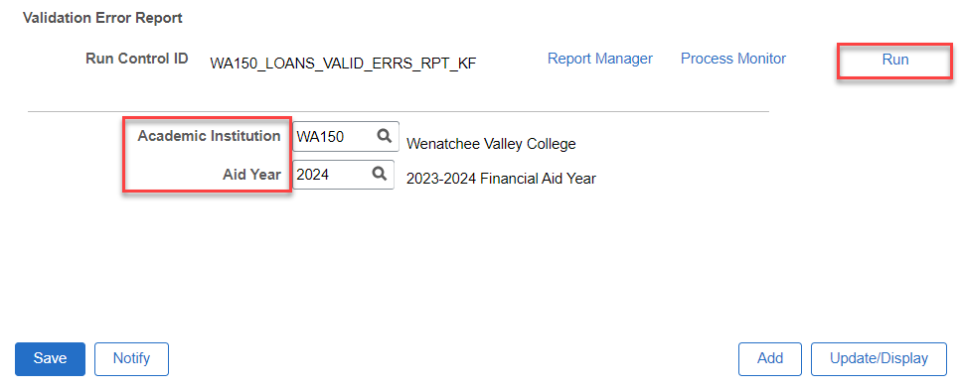
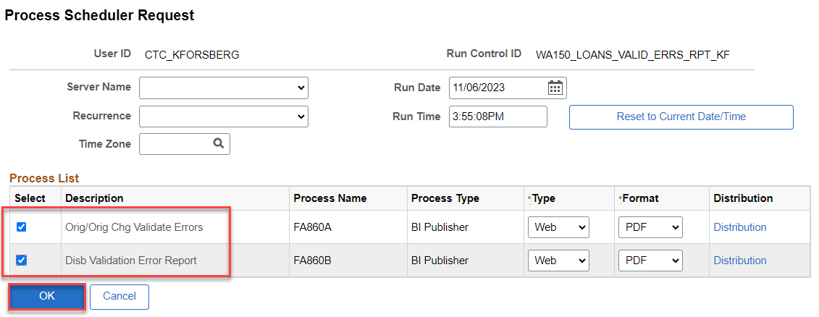
LOAN VALIDATION ERROR REPORT
ORIG & DISBRSMNT ERRORS
Navigation: Financial Aid > Loans > Direct Loan Reconciliation > Validation Errors Report

Slide 19
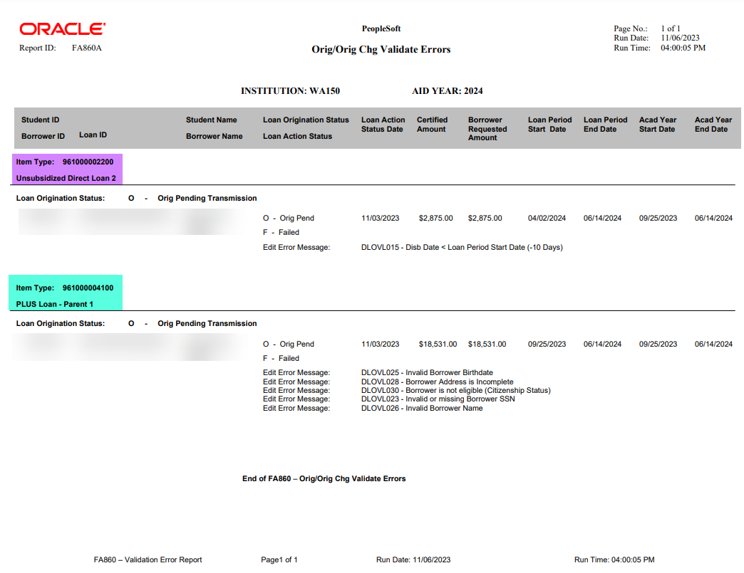
LOAN VALIDATION ERROR REPORT CONT’D
ORIGINATION ERRORS RPT
Navigation: Financial Aid > Loans > Direct Loan Reconciliation > Validation Errors Report

Slide 20
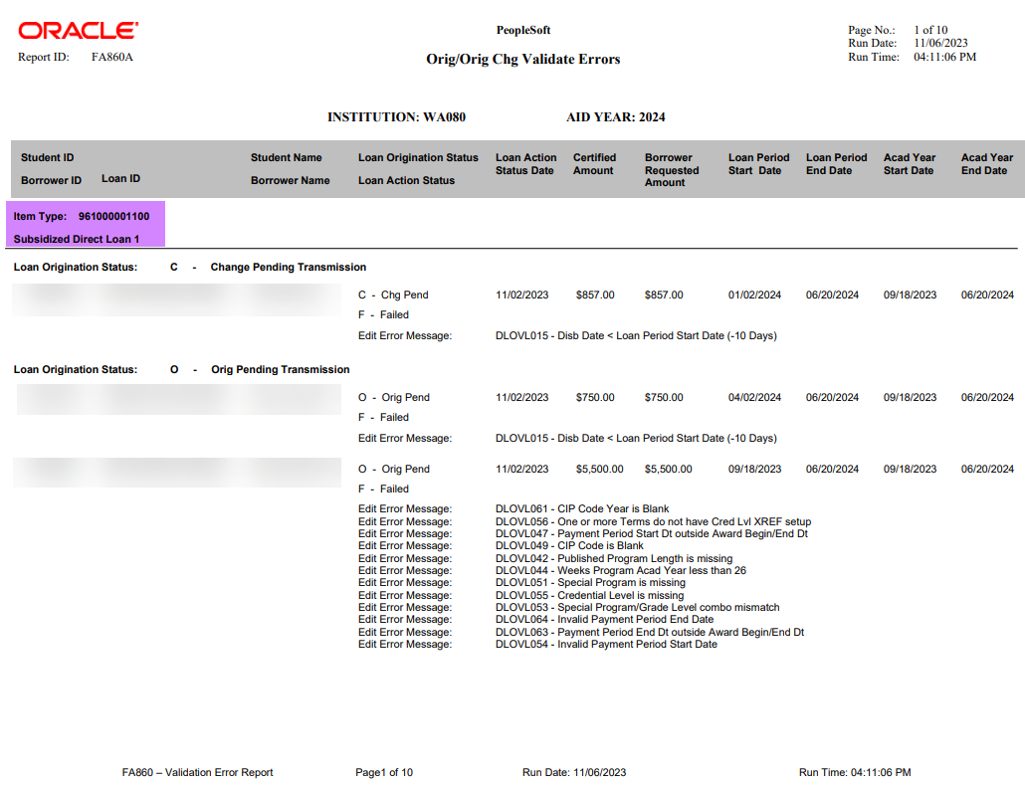
LOAN VALIDATION ERROR REPORT CONT’D
ORIGINATION ERRORS RPT CONT’D

Slide 21
LOAN VIEW PAGES

Slide 22
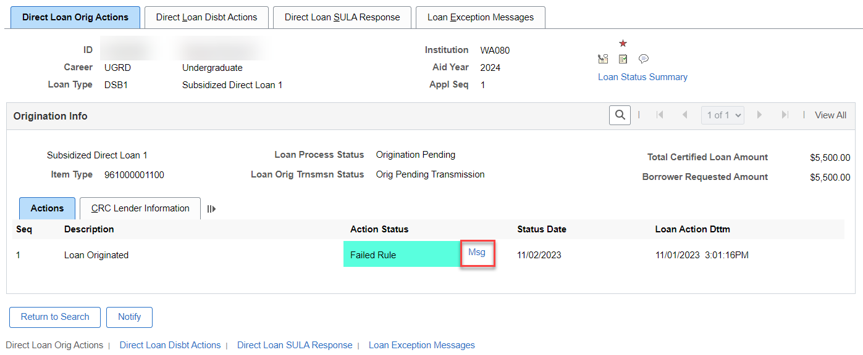
VIEW LOAN PROCESSING ACTIONS
Navigation: Financial Aid > Loans > Manage Direct Lending > View Loan Processing Actions
DL ORIG ACTIONS TAB
This page is also helpful to view why loans are being rejected, or what their origination or booking status is

Slide 23
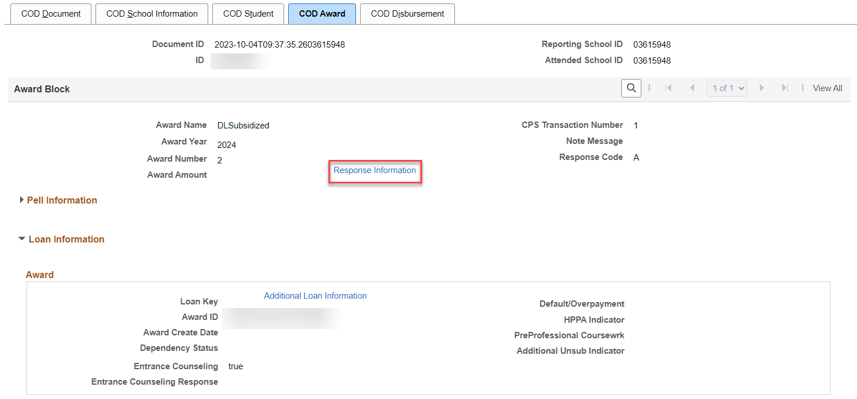
VIEW COD DATA PAGE
Navigation: Financial Aid > File Management > Full COD Participant > View COD Data
COD AWARD TAB
This page is good to assist in troubleshooting, to view the COD response

Slide 24
Outcomes
At the completion of the Direct Loan Reconciliation Refresher Training, you should now be able to:
Understand the steps to produce the Direct Loan Reconciliation report in ctcLink
Upload/Download File Process
Import Federal Data Files
Running SBCTC DL Recon Reports
Understand how to view and work the DL Recon reports

Slide 25
Congratulations!
Direct Loans Reconciliation Refresher Training Complete!
Please review the videos and additional resources in your canvas course material and the reference center as you progress through Direct Loan reconciliation
Thank you for your participation today!

