Slide 1
College User Acceptance Testing
SAP Item #6B: Legacy Transfer Units in MAXT Course Exclusions
Amanda Hoover (presenter)
October 31, 2023

Slide 2
Agenda
Project Overview of SAP Item #6B Legacy Transfer Units in MAXT Course Exclusions
A note about the updated Solution Design Document
Delivered Maximum Attempted Units Test functionality
Solution Design
User Acceptance Testing
Next Steps

Slide 3
Project Overview
SAP Item #6B: Legacy Transfer Units in Maximum Attempted Units (MAXT) Course Exclusions

Slide 4
Implementation Timeline
College User Acceptance Testing | Oct 31 to Nov 13
College Testing Sign Off | Nov 13, end of day
Targeted Production Release Date | Nov 28

Slide 5
SAP Item #6B: Legacy Transfer Units in MAXT Course Exclusions
Problem Statement
If a student returns to a college and has previous enrollment records that were not captured in the conversion to ctcLink, the legacy data manually entered as Transfer Units is not calculated correctly in the Maximum Attempted Units Test (MAXT). Remedial units entered manually are not being excluded from the MAXT evaluation (up to the Max Remedial Units to Exclude value set by colleges) under Course Exclusions in their SAP configurations.
Solution
Create a custom view to identify legacy units and corresponding course information added manually in ctcLink. Clone the delivered PeopleSoft Financial Aid SAP Application Engine (AE) for the Maximum Attempted Units Test. Modify the copied code to compare the custom view against additional delivered enrollment tables to pull the data points necessary to compare these legacy transfer units to the Course Exclusions configuration. Update the SAP AE Process Setup configuration page for each institution to point to the custom code.

Slide 6
Solution Design Document Updates
Language clarifications
All terminology referring to the calculation outcome from the Maximum Attempted Units have been updated to “Maximum Attempted Units value” to provide more clarity on the intent of this customization work.
Title updated to specify that only legacy units on the transfer credit table are impacted by this customization. Regular transfer units will follow delivered functionality.
Updated version is available on the SAP Project Information guide on the ctcLink Reference Center.

Slide 7
Maximum Attempted Units Test
Delivered SAP Functionality Impacted

Slide 8
Maximum Attempted Units Test
Calculates the attempted units prior to the term being evaluated
Rules allow colleges to specify at what point a student fails this test
Complemented by Course Exclusions SAP configuration
Allows colleges to specify courses that should not count toward Maximum Attempted Units value
Allows colleges to specify a maximum number of units that can be excluded from the Maximum Attempted Units value
Two Course Types: Remedial and ESL
Course Exclusions do not apply to any other SAP Test or calculation

Slide 9
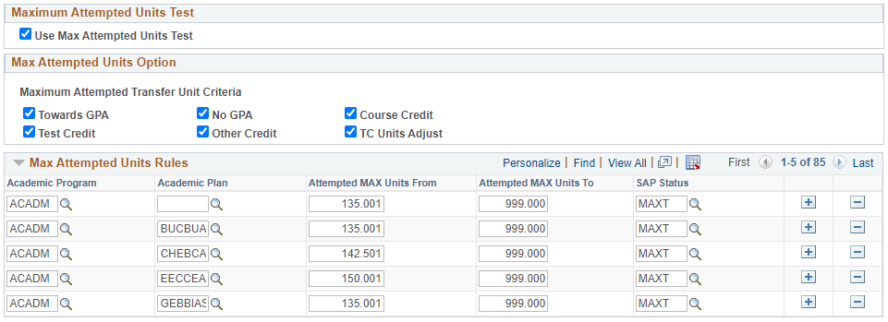
Maximum Attempted Units Test Setup
Checkbox to enable SAP process to use this test
Types of transfer/other units to be included in the Maximum Attempted Units value calculation
Range of Maximum Attempted Units this test will apply to
SAP Status to be assigned if student meets these criteria
Navigation: Set Up SACR > Product Related > Financial Aid > Satisfactory Academic Progress > Define Set Up Criteria >> Criteria 1 tab

Slide 10
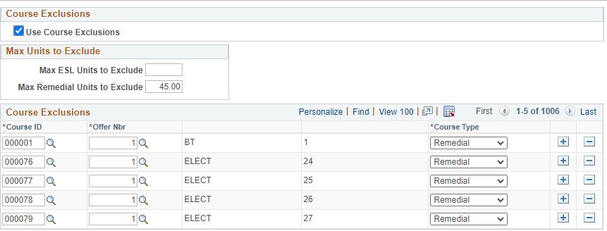
Course Exclusions Setup
Checkbox to enable SAP process to use this configuration (works with the Maximum Attempted Units Test only)
Maximum number of units that can be excluded from the total Maximum Attempted Units value, based on Course Type in the configuration below. (Blank means no limit.)
Course Type options (Remedial or ESL). These correspond to the Max Units to Exclude configurations.
List of Courses to be excluded from the total Maximum Attempted Units value and categorized by Course Type
Navigation: Set Up SACR > Product Related > Financial Aid > Satisfactory Academic Progress > Define Set Up Criteria >> Exclusions tab

Slide 11
Maximum Attempted Units – Student SAP Page
Displays the total Maximum Attempted Units value up to the term being evaluated
Course Exclusions apply to this value, per local configurations
Displays information in the “Rule Range” fields if the student matches a Max Attempted Units Rule
Navigation: Financial Aid > Satisfactory Academic Progress > Maintain Student SAP Data

Slide 12
Maximum Attempted Units Value Calculation
Unit totals from Student Term History (STDNT_CAR_TERM)
Student Enrollment data (STDNT_ENRL) compared to the Course Exclusions configurations
Attempted Units
Attempted ESL Units to Exclude*
Attempted Remedial Units to Exclude*
Transfer Units**
Maximum Attempted Units
*These values are subject to the Max Units to Exclude values in setup
**All items checked in the Maximum Attempted Transfer Unit Criteria configuration are considered by the SAP test as part of the Transfer Units value calculated here (Towards GPA, No GPA, Course Credit, Test Credit, Other Credit, and TC Units Adjust).

Slide 13
The Problem
SAP Item #6B: Legacy Transfer Units in MAXT Course Exclusions

Slide 14
The Problem
Non-converted legacy data is manually entered by the college as transfer credit
This legacy data is not stored in the student’s enrollment record
MAXT is designed to exclude courses on the enrollment record
MAXT does not exclude courses entered in as transfer credit
Legacy courses at the college are not excluded from the final Maximum Attempted Units value, per local college configuration
Students may inaccurately fail the Maximum Attempted Units Test

Slide 15
The Problem – Student Example
This student has 8 units of remedial courses manually entered from legacy that should be excluded from the Maximum Attempted Units value.

Slide 16
The Problem – Student Example
The Maximum Attempted Units value is unaffected by the Course Exclusions logic, as the only courses to exclude for this student are manually entered legacy units.
8 legacy remedial units should be excluded
Student has failed the MAXT Test

Slide 17
The Solution
SAP Item #6B: Legacy Transfer Units in MAXT Course Exclusions

Slide 18
Customized Calculation of Maximum Attempted Units Value
Add logic to include a custom view to identify and evaluate non-converted, manually entered legacy transfer units against Course Exclusions
Attempted Units
Attempted ESL Units to Exclude*
Attempted Remedial Units to Exclude*
Transfer Units
Maximum Attempted Units
ESL Units to Exclude
(Enrollment)
Legacy ESL Units to Exclude
(Transfer)
Remedial Units to Exclude
(Enrollment)
Legacy Remedial Units to Exclude
(Transfer)
*Note: These values are still subject to the Max Units to Exclude values in setup

Slide 19
Before
Solution – Student Example
After
8 legacy remedial units removed
Student now meets MAXT

Slide 20
User Acceptance Testing
Testing Timeframe: October 31 to November 13
Testing Sign-off Due: November 13, end of day

Slide 21
Testing Scope
In Scope
Maximum Attempted Units Test
Students with non-converted, manually entered legacy units for courses listed in the local college Course Exclusions configuration
Out of Scope
Other SAP Tests
Students with converted legacy units – these are already being excluded as desired per the local college Course Exclusions configuration

Slide 22
Overview of Testing Steps
Review Maximum Attempted Units Test setup for your college
Review Course Exclusions setup for your college
Define test scenarios
Run query to find test students
Run query for information on manually entered legacy data
Compare legacy units to Course Exclusions
Process SAP
Manually build SAP for test student
Run SAP in batch or Report Mode

Slide 23
Step 1 - Review Maximum Attempted Units Test Setup
Review Maximum Attempted Transfer Unit Criteria
We recommend that all boxes are checked
Review Max Attempted Units Rules
Review Attempted MAX Units From and Attempted MAX Units To ranges
Ensure there are no overlapping ranges for each Academic Program/Academic Plan combination

Slide 24
Step 1 - Review Maximum Attempted Units Test Setup
We recommend that all of these boxes are checked. If not, then some types of transfer units will not be included in the Maximum Attempted Units calculation
Ensure there are no overlapping From/To ranges for each Academic Program/Academic Plan combination
Navigation: Set Up SACR > Product Related > Financial Aid > Satisfactory Academic Progress > Define Set Up Criteria >> Criteria 1 tab

Slide 25
Step 2 - Review Course Exclusions Setup
Review Max Units to Exclude
Max ESL Units to Exclude – Most colleges leave this value blank, meaning any courses with a Course Type of ‘ESL’ will be excluded.
Max Remedial Units to Exclude – Most colleges set this to 45, meaning that all courses with a Course Type of ‘Remedial” will be excluded up to a total of 45 units. Any beyond that number will be included in the Maximum Attempted Units value.
Review Course Exclusions list
Most colleges do not currently have courses coded as ‘ESL’ in ctcLink, likely due to previous functionality issues addressed by the SAP #3 MAXT bug fix project.
We have identified ESL courses that were already in your college’s Course Exclusions list and changed them to the ‘ESL’ Course Type to support UAT testing. We will not make these changes in the production environment.

Slide 26
Step 2 - Review Course Exclusions Setup
Export the list of courses to exclude to an Excel sheet to review courses and identify any that need to be added or adjusted
Confirm the Max Units to Exclude values – these apply to both the legacy units and the student’s enrollment data in ctcLink
Navigation: Set Up SACR > Product Related > Financial Aid > Satisfactory Academic Progress > Define Set Up Criteria >> Exclusions tab

Slide 27
Step 3 – Define Test Scenarios
Suggestions:
Student with only enrolled courses to exclude
Student with only legacy courses to exclude
Student with both enrolled and legacy courses to exclude
Student with no courses to exclude
Student with ESL or Remedial or both Course Types to exclude
Student who has exceeded the Max Remedial Units to Exclude value
Student with Career Exceptions

Slide 28
Other Questions to Consider
Do your college’s configurations align with your college’s posted SAP policy?
Does this customization align with your college’s SAP policy?
Does this customization present new scenarios that need to be accounted for?
Think of students that are often manually adjusted after SAP has been run – can they be resolved with this customization?

Slide 29
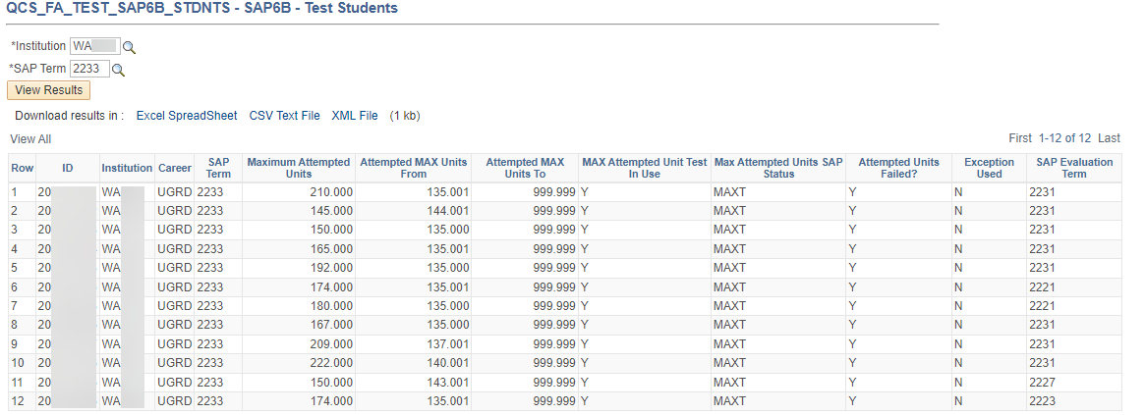
Step 4 – Run Query to Find Test Students
Testing Query: QCS_FA_TEST_SAP6B_STDNTS
Selects students who have failed the Maximum Attempted Units test and have manually entered legacy units that likely could be excluded
SAP Term calculated
Source term for SAP calculation
This query is for testing only, and will not be migrated to the production environment
Navigation: Reporting Tools > Query > Query Viewer

Slide 30
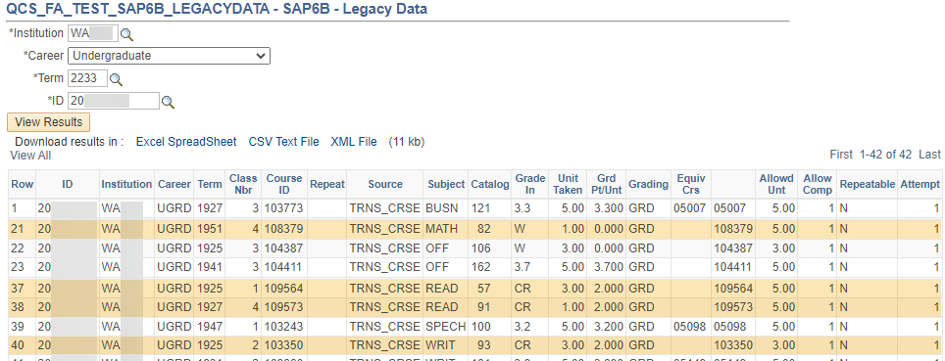
Step 5 – Run Query for Legacy Units Information
Testing Query: QCS_FA_TEST_SAP6B_LEGACYDATA
Selects manually entered legacy units on the transfer credit table prior to the SAP term being calculated
SAP Term calculated
Key information for determining how many legacy units should be excluded from the Maximum Attempted Units value
Test student ID
This query is for testing only, and will not be migrated to the production environment
Navigation: Reporting Tools > Query > Query Viewer

Slide 31
Step 6 – Compare Legacy Units to Course Exclusions Configurations
Export the list of Courses Exclusion to an Excel sheet for looking up courses
Take note of Max Units to Exclude values – these apply to both the legacy units and the student’s enrollment data in ctcLink
Navigation: Set Up SACR > Product Related > Financial Aid > Satisfactory Academic Progress > Define Set Up Criteria >> Exclusions tab

Slide 32
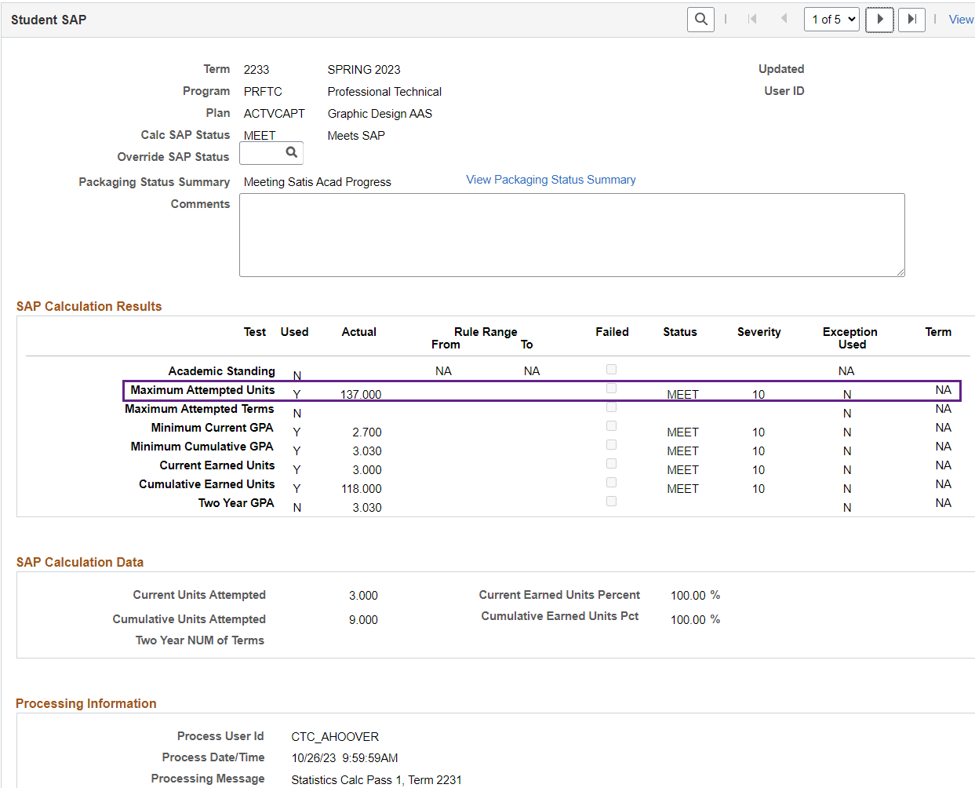
Step 7A – Calculate SAP Per Student
QRG - https://ctclinkreferencecenter.ctclink.us/m/92428/l/926757-9-2-calculating-sap-per-student
Note Maximum Attempted Units value
Set SAP Term and select Calculate button
Confirm Maximum Attempted Units value has updated to the expected amount
If the Maximum Attempted Units value isn’t as expected
Double check the legacy units for any other courses that might be on the Course Exclusions list
Check to see if the ESL/Remedial Max Units to Exclude has been exceeded by other courses the student has attempted that are not legacy units
Navigation: Financial Aid > Satisfactory Academic Progress > Maintain Student SAP Data

Slide 33
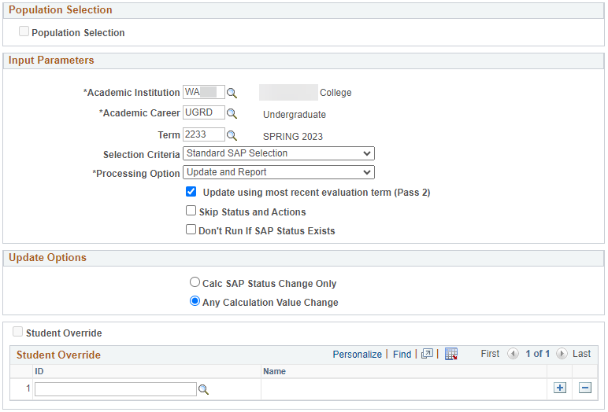
Step 7B – Process SAP in Batch
QRG - https://ctclinkreferencecenter.ctclink.us/m/92428/l/939595-9-2-process-sap-in-batch
Be sure this box is unchecked. For testing, we want the batch SAP Process to update students whose Maximum Attempted Units Tests have already been processed previously to see the outcome in a batch situation with the customization in place.
Review SAP results and ensure that other SAP tests and business processes for your college are not impacted by this customization
Confirm no errors in Process Monitor
Spot-check SAP report for anything that looks out of the ordinary
Be sure to select this option, as Maximum Attempted Units values may be updated by the customization, but still not have an impact on the final SAP Status outcome.
Navigation: Financial Aid > Satisfactory Academic Progress > Process SAP

Slide 34
Asking Questions & Reporting Issues
Trouble Logging In?
Email Caitlin Stein cstein@sbctc.edu
Questions?
Email Amanda Hoover ahoover@sbctc.edu CC Ana Ybarra aybarra@sbctc.edu
Found Issues/Errors?
Submit a ticket to Service Desk https://servicedesk.sbctc.edu/
Request Type: ctcLink Support > Testing
Subject: UAT – FA SAP Legacy Data in MAXT – [description of issue]
Include screenshots, IDs used, and detailed steps taken
UAT – FA SAP Legacy Data in MAXT – [description]

Slide 35
Testing Environment and Login Information
PQA Test Environment: https://pt-pqa.peoplesoft-nonprod-aws.ctclink.sbctc.edu/psp/ptpqa/?cmd=login
Environment Availability: Monday to Friday, 7am to 7pm
Environment Last Refreshed: 10/19/2023
Logging In:
Username = Your EMPLID
Password = [testers check email after this session]

Slide 36
Sign-Off
Survey Monkey link: https://www.surveymonkey.com/r/WKMPWG6
One response per college
Complete by end of day on November 13th

Slide 37
Testing Resources
UAT Testing Materials page
https://ctclinkreferencecenter.ctclink.us/m/98421/l/1722924-sap-item-6b-transfer-units-in-maxt-course-exclusions
More detailed information than in this slide deck
Additional resources linked on the page

Slide 38
Next Steps
SAP Item #6B: Legacy Transfer Units in MAXT Course Exclusions

Slide 39
Next Steps
Follow-up Communications
Slide deck and recording link to ctcLinkFinAidSupport and DirFinAid eLists
Email to testers with their passwords and sign off survey link
User Acceptance Testing October 31 to November 13
Sign Off Due end of day November 13
Implementation (if approved by testing colleges)
Target: November 28, 2023
Email announcement to ctcLinkFinAidSupport and DirFinAid eLists
SAP Information Guide updates
https://ctclinkreferencecenter.ctclink.us/m/PMO_Info/l/1625563-fa-satisfactory-academic-progress-sap-project-information-guide

Slide 40
Thank you for Testing!

