Slide 1
Aid Year Rollover (AYRO) Prep
Jedidiah Lara
ctcLink Functional Analyst | Financial Aid
October 2023

Slide 2
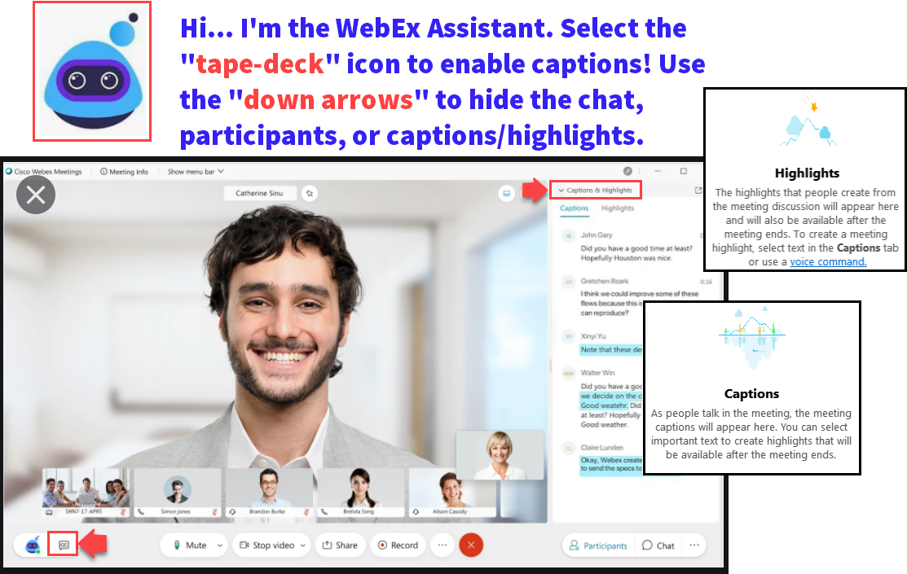

Slide 3
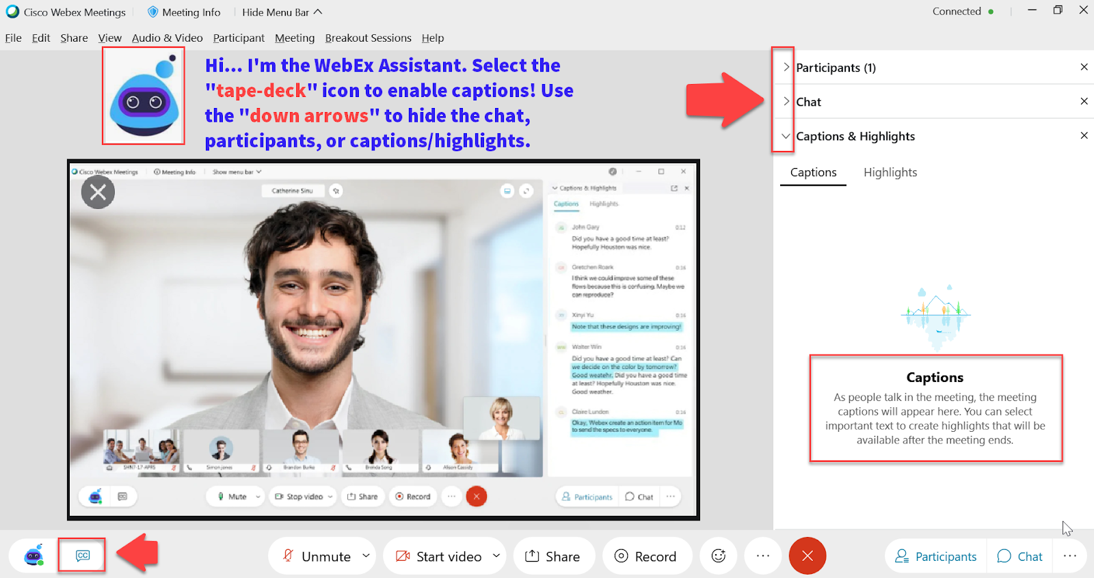

Slide 4
Logistics and Agenda
Times | Activity
13:00 – 13:10 | Greet/Attendance/Objectives
13:15 – 13:30 | Loading 2024-2025 ISIRs early
13:30 – 13:45 | Timeline of upcoming events leading up to turning on ISIR Jobsets
13:45 – 14:45 | AYRO College List Review
14:45 – 15:00 | Session Wrap-Up

Slide 5
ground rules
Be ready to participate
Remove external distractions
Mute your line when not speaking
Do NOT place Webex line on hold. Use Mute.
Please leave your line on Mute unless you are speaking
Sessions are being recorded
Allow your peers to complete their thoughts before beginning yours

Slide 6
Objectives
During this work session, we will be walking through the following:
How to load 2024-2025 ISIRs early
Aid Year Rollover College Review List
Timeline of upcoming events leading up to turning on ISIR Jobsets

Slide 7
Loading 2024-2025 ISIRs early

Slide 8
The situation
2024-2025 ISIRs submission may open in December but the 2024-2025 PRP does not go into the system until end of December
By the time 2024-2025 AYRO is completed and Odd-Year ISIR Jobset parameters are updated, colleges have hundreds of ISIR files to load
Due to the system being shared by 33 colleges and the ISIR Jobset slowing the system down significantly, colleges are asked to be mindful on how many ISIR files are loaded in one instance so that all ISIR Jobsets finish running between 5PM – 7AM Monday - Friday. Depending on the size of the college, this leads to weeks or months of loading backlogged ISIR files
Colleges have the option of requesting an Year-to-Date ISIR file
Notes:
New aid year image is released from Oracle at the end of October. After SBCTC receives the image, testing starts and issues and bugs are logged. Oracle releases patches late November so early December is our quickest turnaround for uploading the aid year image.

Slide 9
What isir process does not require an aid year image?
PS ISIR Processing has three steps with two of them requiring an aid year image to be added into the system (late December)
File Upload/Download
Import Federal Data Files Requires 2024-2025 Image
Process ISIRS
Requires 2024-2025 Image

Slide 10
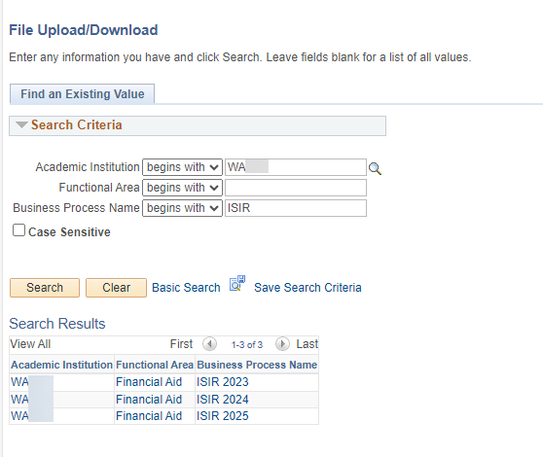
We will create the ISIR 2025 folders in production by December so that colleges can start loading 2024-2025 ISIR Files on the pS server!!
Navigation: Navigator > People Tools > CTC Custom > Extensions > Upload/Download Files
If you are a college that has been and will continue to request Year-to-Date ISIR files, please feel free to continue doing so. ☺
We will create the ISIR2025 folders for colleges that want to start loading all the 2024-2025 ISIR files they receive from Edconnect.

Slide 11
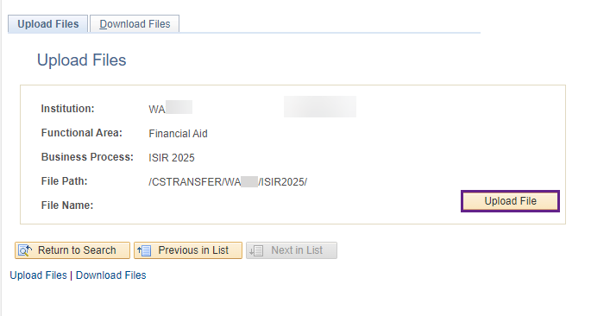
What you Can DO when you get your 2024-2025 ISIR File Upload 2024-2025 isir files into the ISIR2025 folder in the order of when the files were received
Navigation: Navigator > People Tools > CTC Custom > Extensions > Upload/Download Files
If you upload the 2025 ISIR files out of order, you will end up with many ISIR files in suspense with the reason: Out of Sequence
Notes:
Reminder, Edconnect files expire after 90 days.

Slide 12
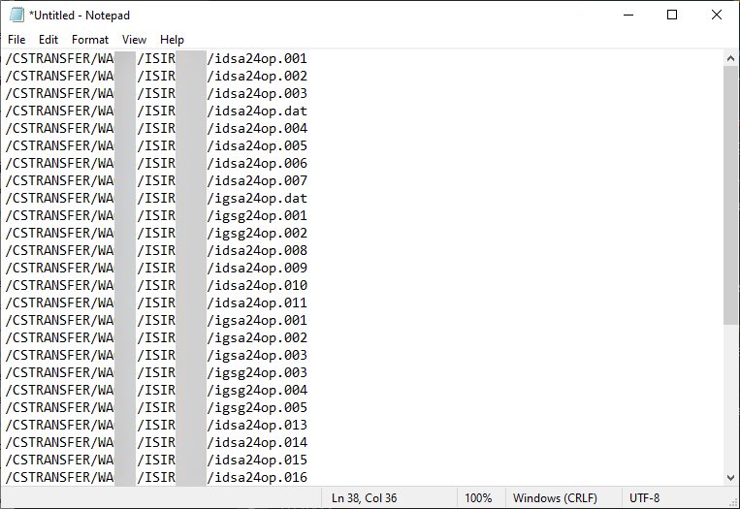
When you are ready to turn on your iSIR JOBSET SUBMIT A TICKET TO FA ERP TO GET A text file of all the files your college loaded in the ISIR2025 folder
The text file will list the ISIR files in the order the files were loaded into the ISIR2025 folder

Slide 13
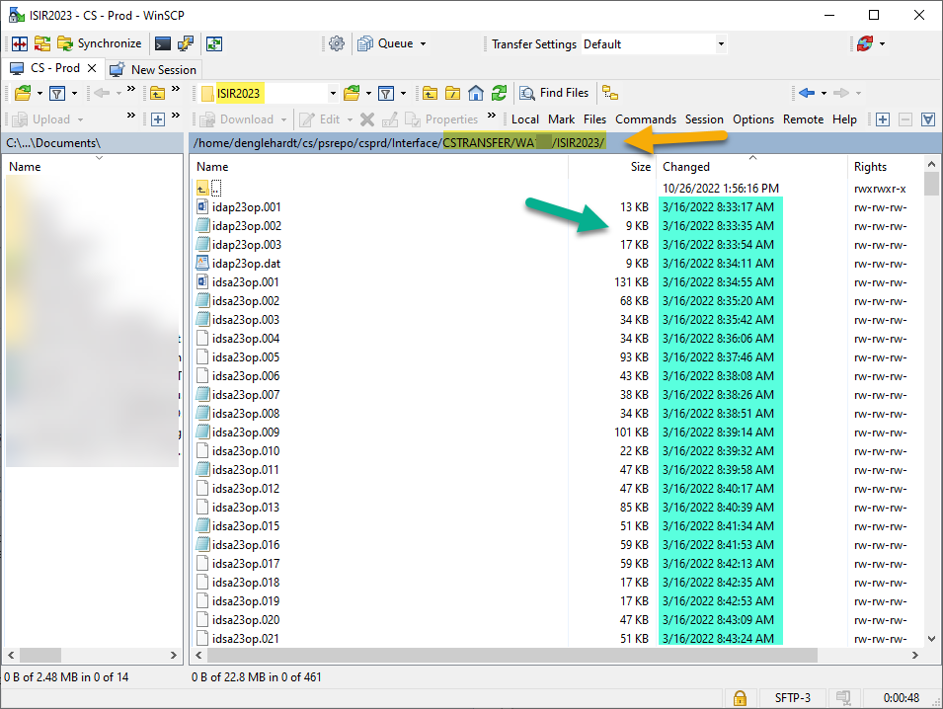
How will we make the text file?
We will grab the files names in from your college’s /CSTRANSFER/Waxxx/ISIR2025 file path
Note: The example in the screenshot is the ISIR2023 folder
We will put the file names in the order of the earliest ISIR file loaded first

Slide 14
Timeline of Upcoming Events Leading up to Turning On ISIR Jobsets

Slide 15
2024-2025 FA PRP 1
What is in the PRP
Changes to ISIR Corrections
FTI Data and Security
Need Analysis Calculator (NAC)
Changes to Awarding Federal Aid and Calculating Pell
Enrollment Intensity
Housing Selection Removed but Oracle is accounting for this
A document with more details was emailed to DirFinAid by Joshua on 09/26 titled Oracle Support
All hands-on-deck FA Support Testing period (December)
Lots of unknown

Slide 16
Tentative Timeline of upcoming events leading up to turning on ISIR jobsets
December 2023 – February 2024
Colleges complete Aid Year Rollover Part 1
January 2024 – mid March
Colleges complete Aid Year Rollover Part 2
Mid February 2024
Colleges are informed of bugs and fixes
FA Support testing PRP bugs
FA Support testing ISIR Jobsets
OY ISIR Jobsets can be turned on
Tentative due to unknowns at this point with 2024-2025 PRP 1 testing

Slide 17
AYRO PArt 1 & ayro part 2
AYRO Part 1: Self-paced (You got this!)
All colleges will be given the Part 1 guide to begin working on select items to prepare AND COMPLETE before their scheduled AYRO Part 2 session
The AYRO Part 1 guide will be available December 1st
AYRO Part 2: Work Session (Please come prepared!)
Calendar invites will be sent out to POCs for each college
The AYRO Part 2 Guide will be available by the 1st scheduled AYRO Work Session
Be sure your security is up-to-date!

Slide 18
AYRO College List Review

Slide 19
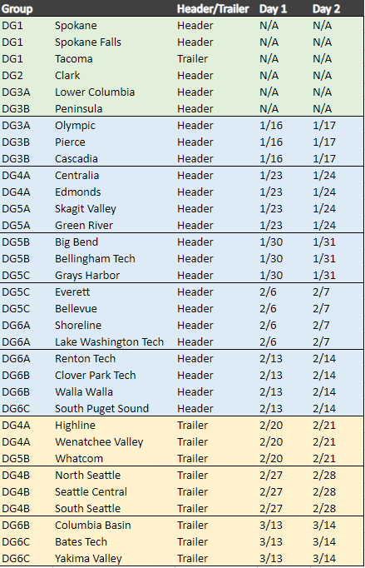
2024-2025 AYRO Schedule
The 2024-2025 AYRO Guide is still being created and will be available closer to the first 2024-2025 AYRO session
‘Save the Dates’ will go out on the listserv tomorrow. Calendar invites will be sent shortly with the agenda attached to the FA Director

Slide 20
AYRO college review Lists 2024-2025
The first two tabs are sized so that they are printer friendly for those who are wanting to print the lists. ☺
Please go to the 2024-2025 AYRO page to download the list:
https://ctclinkreferencecenter.ctclink.us/m/92436/l/1627344-2024-2025-aid-year-roll-over-prep

Slide 21
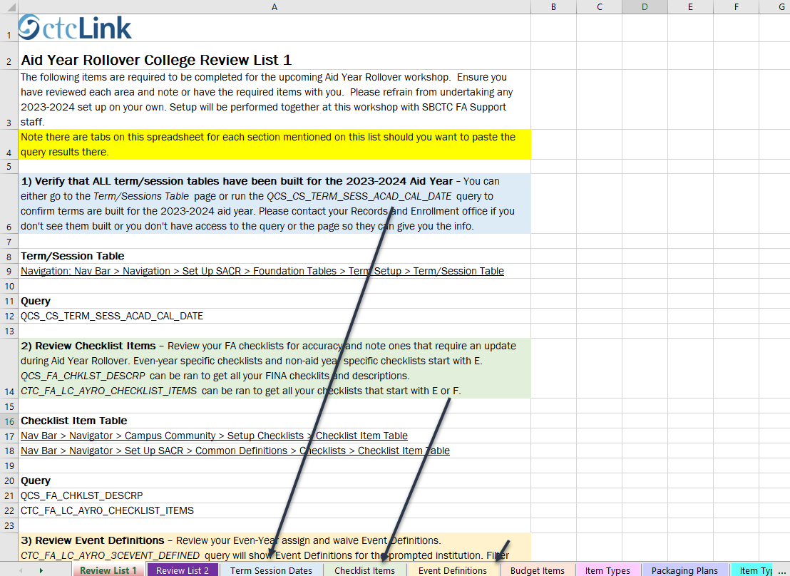
The first tab is Review list 1
Every section on List 1 has a tab associated with it so you can put your query results in there so that you don’t have to come to AYRO with multiple spreadsheets. ☺

Slide 22
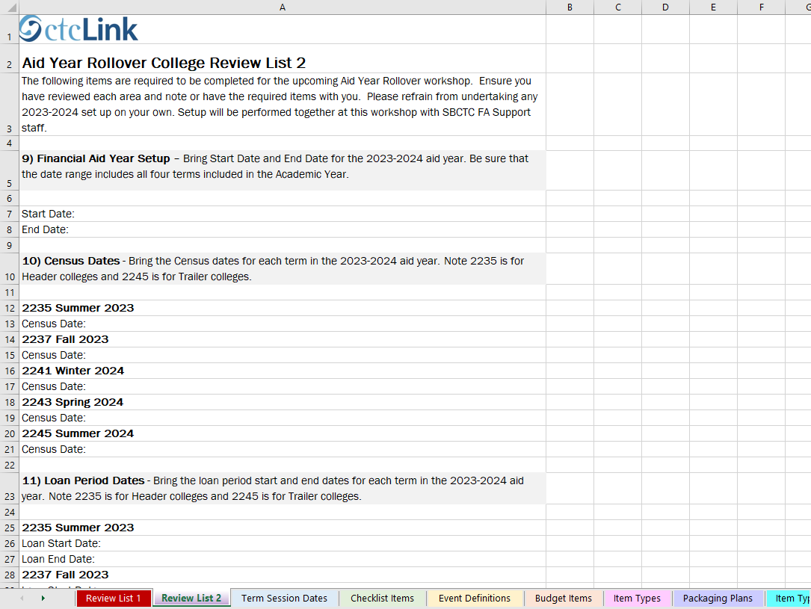
The second tab is Review list 2
List 2 sections do not have tabs associated to them but feel free to create new tabs as you see fit. 😊

Slide 23
Go ahead and start reviewing the two lists and let us know if you have any questions or need some clarification ☺

Slide 24
Outcomes
At work session completion, you should be able to:
Understand the option of loading 2024-2025 ISIRs early
Understand the timeline of upcoming events leading up to turning on ISIR Jobsets
Understand the information that needs to be gathered before attending Aid Year Rollover Day 1:
With respect and fairness to ALL colleges, colleges not fully prepared the morning of their scheduled AYRO Day 1 will need to reschedule.
Rescheduled AYRO sessions will occur AFTER the last scheduled AYRO session (Mid-March).
Understand the difference of AYRO Part 1 & AYRO Part 2

Slide 25
Congratulations!
Prepare for Aid Year Rollover Work Session complete!
Thank you for your participation today!
We look forward to working with you during your Aid Year Rollover Workshop!

