Slide 1
STATE AID RECONCILIATION
Kelly Forsberg | ctcLink Functional Trainer (Financial Aid)
September 2023
ctcLink PeopleSoft Training | Financial Aid Washington State Community and Technical Colleges

Slide 2
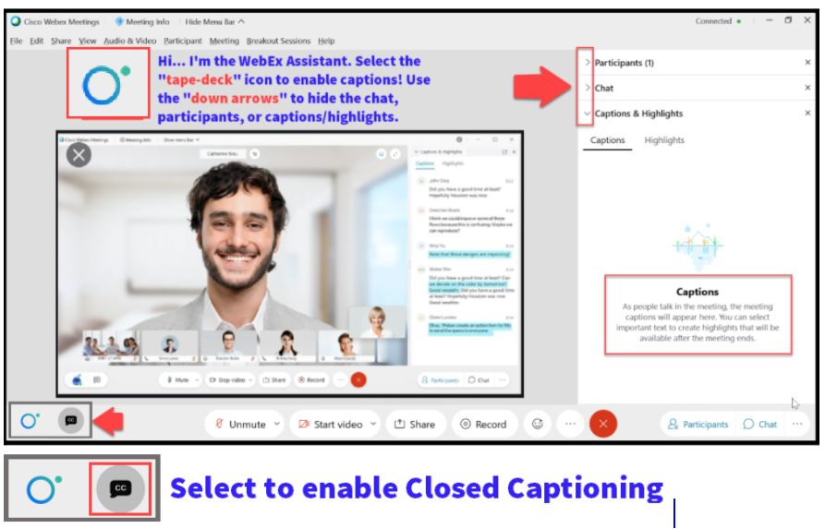

Slide 3
Logistics and Agenda
Times | Activity
9:00 – 9:05 | Sign-In/Greet/Attendance
9:05 – 9:10 | Objectives
9:10 – 10:30 | Walk Thru on running queries and reports for state aid reconciliation
10:30 – 10:50 | Tips on how to review the Fiscal Item Types page in review of funds disbursed to date
10:50 – 11:00 | Session Wrap-Up/Q&A
Some processes will have demonstrations, but due to data scrubbing, available data in the environment, demo examples are not ideal

Slide 4
GROUND RULES
Be ready to participate
Remove external distractions
Mute your line when not speaking
Do NOT place Webex line on hold. Use Mute.
Please leave your line on Mute unless you are speaking
Sessions are being recorded
Allow your peers to complete their thoughts before beginning yours

Slide 5
OBJECTIVES
After completing this training, you should be able to:
Understand what queries are available for state aid recon and what they do:
CTC _SNG_COMPARE
CTC_FA_CBS_SNG_NOT_AWARDED
CTC_FA_SNG_ELIG_NOTPKGD
Understand the clean-up reports to run prior to running recon
Fund Roster
Understand how to use the Fiscal Item Types page to help in your recon efforts
Tips for success & additional resources

Slide 6
QUERIES TO RUN
PRIOR TO REPORTS

Slide 7
QUERIES TO RUN
RUN THESE QUERIES IN CTCLINK OFTEN, AND PRIOR TO RUNNING REAL TIME REPORTING/DRAW DOWN
CTC_FA_SNG_COMPARE
CTC_FA_CBS_SNG_NOT_AWARDED
CTC_FA_SNG_ELIG_NOTPKGD
. . . And others queries in the WCG and CBS Processing Business Processing Guide

Slide 8
QUERIES TO RUN PRIOR TO RPTS CONT’D
CTC_FA_SNG_COMPARE
Navigation: Reporting Tools > Query > Query Viewer
In the Eligible column, look for Ns and Rs.
N = Not Eligible
R = Repayment

Slide 9
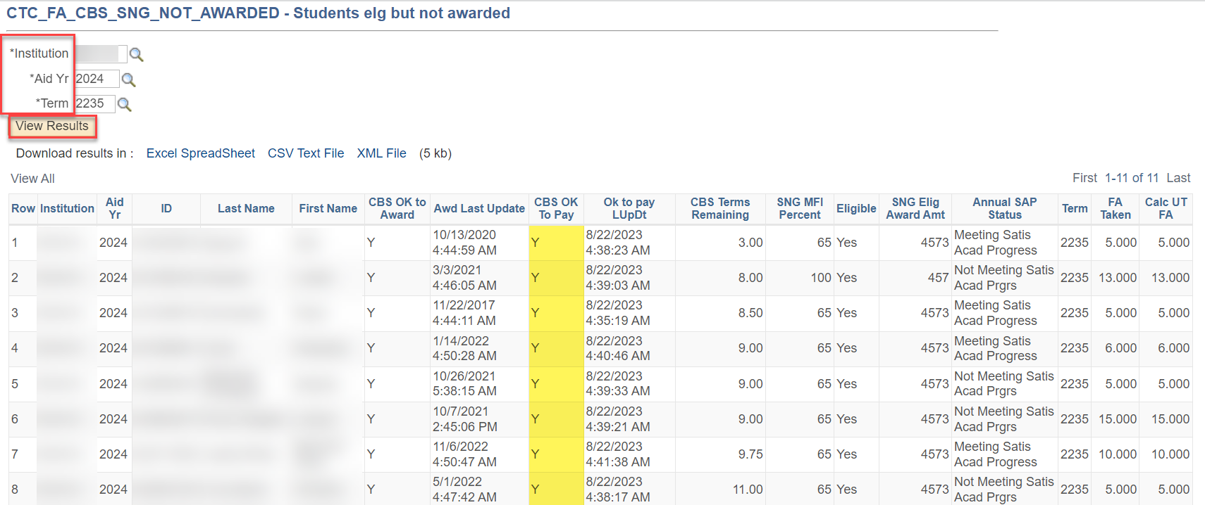
QUERIES TO RUN PRIOR TO REPORTS
CTC_FA_CBS_SNG_NOT_AWARDED
Navigation: Reporting Tools > Query > Query Viewer
In the CBS OK To Award column, look for Ys.
Y = Yes, OK to Award

Slide 10
QUERIES TO RUN PRIOR TO RPTS CONT’D
CTC_FA_SNG_ELIG_NOTPKGD
Navigation: Reporting Tools > Query > Query Viewer
In the SNG Eligible? column, look for Ys.
Y = Yes, needs an award

Slide 11
DEMONSTRATION

Slide 12
REPORTS TO RUN

Slide 13
STATE AID RECONCILIATION
FUND ROSTER Report / Query
CTC_FA920 (query) and FA920 (BI Report)
Shows Offer/Accept/Authorized/Disbursed amounts
High-level recon report
Details in the Fund Management Process Guide

Slide 14
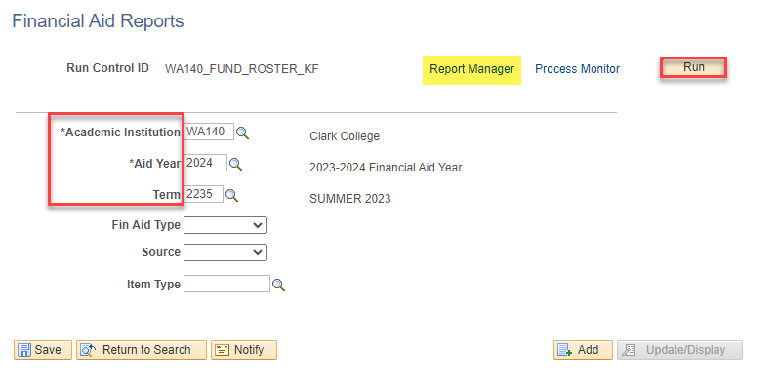
STATE AID RECONCILIATION CONT’D
FUND ROSTER
Navigation: Financial Aid > Fund Management > Fund Roster
Note: Create Run Control ID and update parameters in the Fund Roster page in the Financial Aid > Fund Management Menu – then run in Schedule Queries

Slide 15
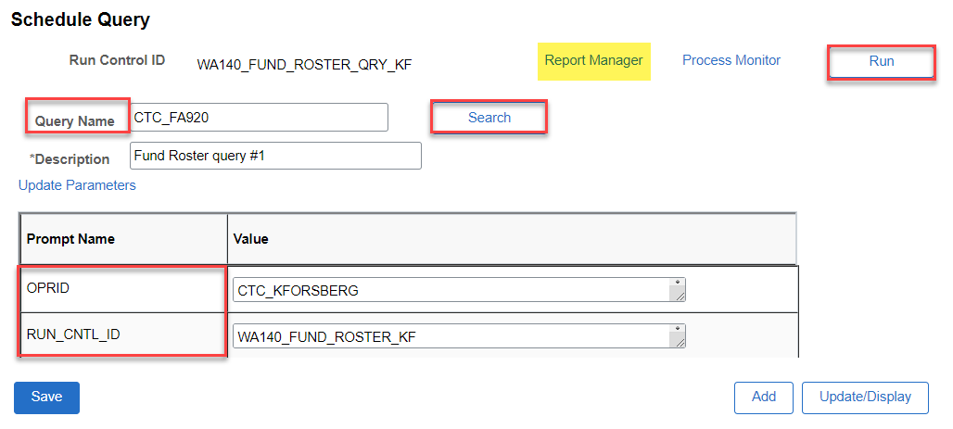
STATE AID RECONCILIATION CONT’D
FUND ROSTER – SCHEDULE QUERY
CTC_FA920

Slide 16
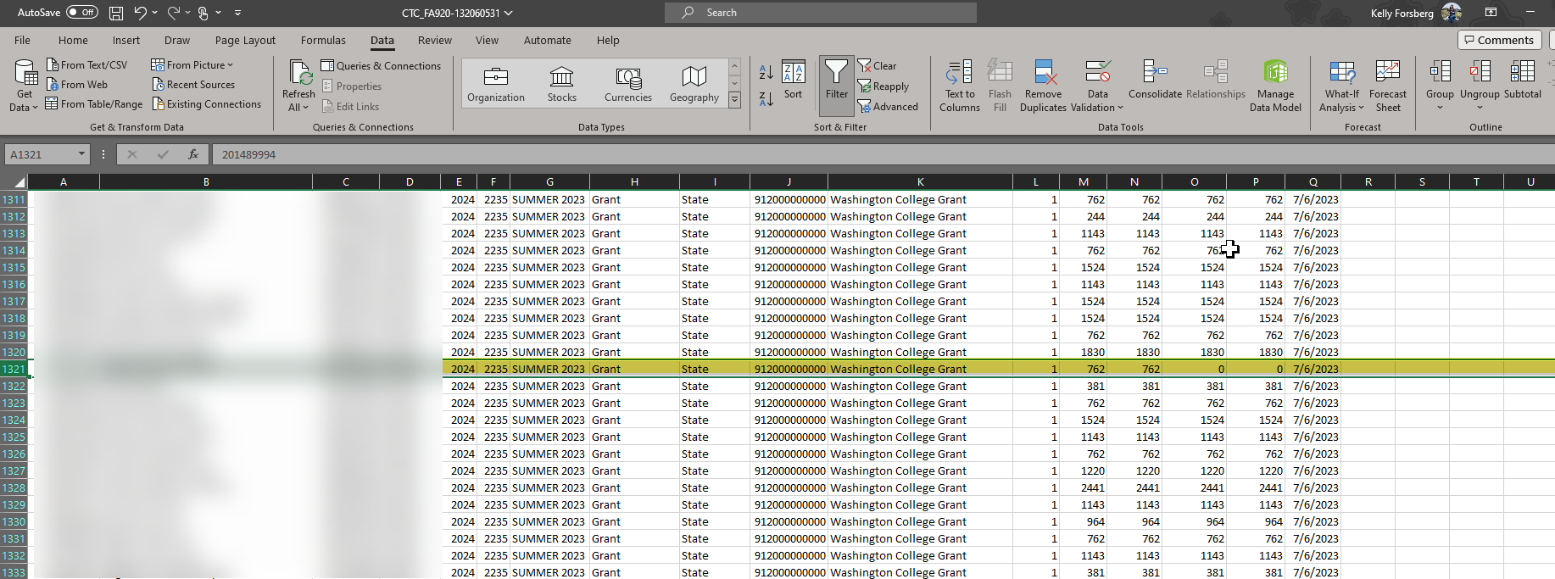
STATE AID RECONCILIATION CONT’D
FUND ROSTER – SCHEDULE QUERY
EXCEL RESULTS
Note: Look for rows with aid that has not yet been Authorized/Disbursed on WCG, CBS, WCG-Bridge, PTS awards

Slide 17
STATE AID RECONCILIATION CONT’D
WCG INTERIM REPORT
Running the WCG Interim Report
Working the Error Report
Reviewing the Combined Report
Details in the WCG Interim Reporting Business Processing Guide

Slide 18
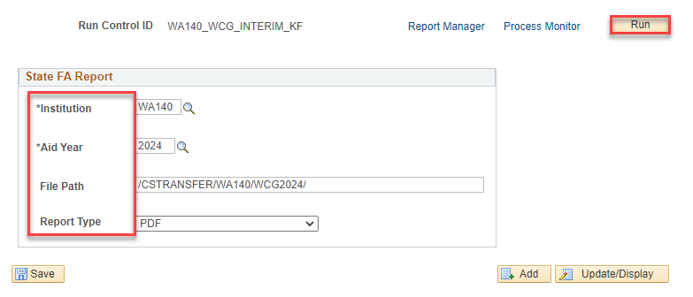
RUNNING THE WCG INTERIM REPORT
Navigation: Financial Aid > CTC Custom > State FA Reporting
Ensure the file path includes the WCG – file path is case sensitive, use the 2024 Aid Year (headers).
Tip! Copy the file path from the upload/download page to minimize keystroke errors

Slide 19
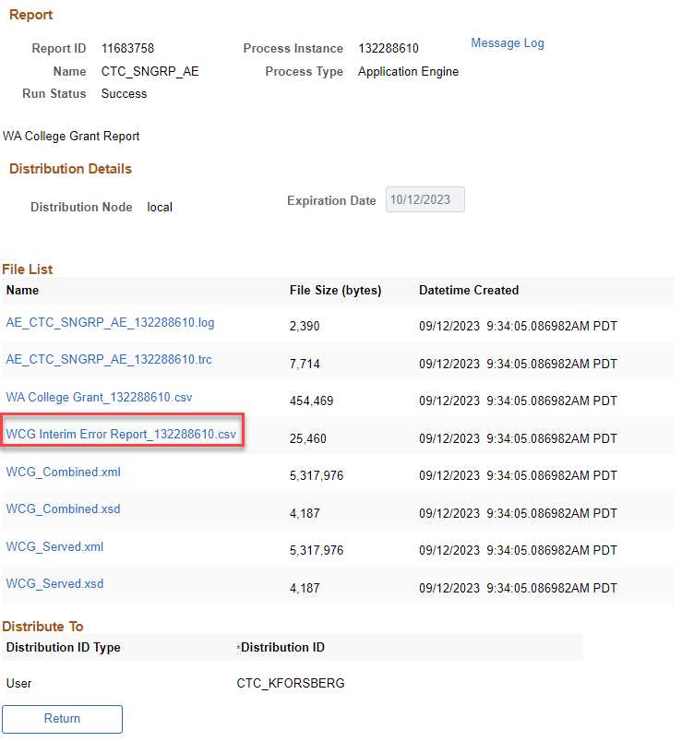
RUNNING THE WCG INTERIM RPT CONT’D DOWNLOADING THE ERROR REPORT
In the View Log/Trace pagelet, open your Work Error Report . . .
Tip! The error list should be smaller if you work your SNG_COMPARE query first.

Slide 20
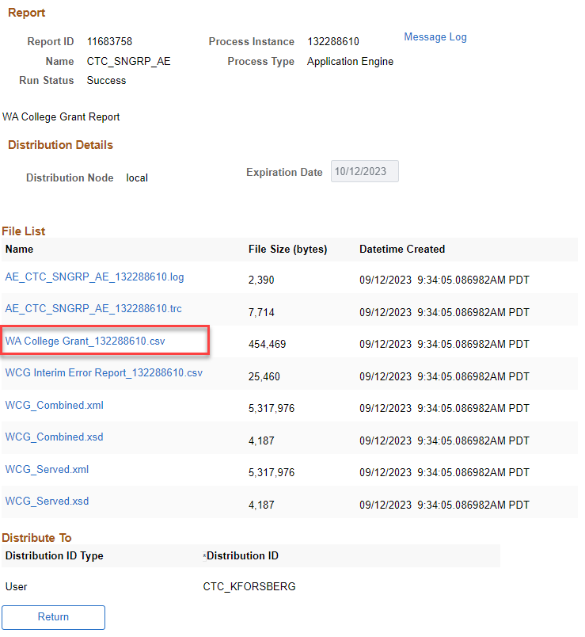
RUNNING THE WCG INTERIM RPT CONT’D DOWNLOADING THE INTERIM REPORT
In the View Log/Trace pagelet, select the WA College Grant csv.
This run is your first run while you are cleaning up the reports. Please look at your data!
Save this file, and use it to compare to your Error Report and Fund Roster

Slide 21
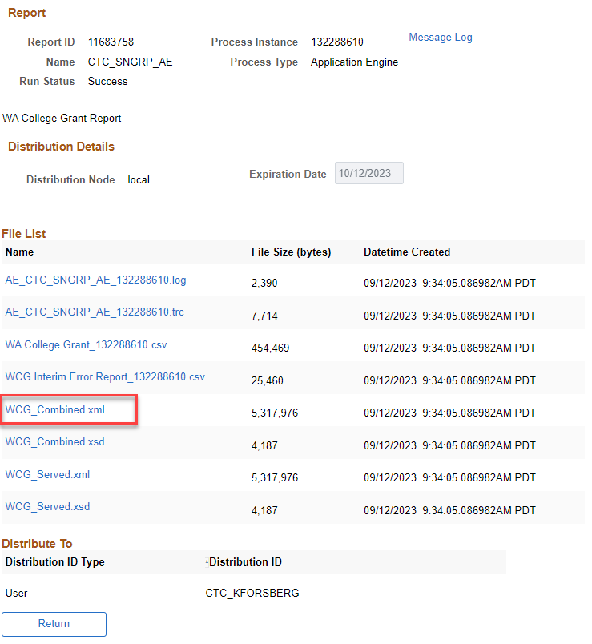
RUNNING THE WCG INTERIM RPT CONT’D DOWNLOADING THE COMBINED REPORT
In the View Log/Trace pagelet, select the WCG_Combined xml.
This file contains both the served/unserved, and error items from the previous two reports.

Slide 22
DEMONSTRATION

Slide 23
RUNNING THE WCG INTERIM RPT CONT’D IDENTIFYING STUDENTS W/O SSN
Navigation: Reporting Tools > Query > Query Viewer
Pulls a list of students without a SSN, but lists their EMPL
Look up student in View Fin Aid Status and look up WASFA of student – If ITIN is listed in WASFA, add that ITIN number to the SSN field in Add/Update a Person page.

Slide 24
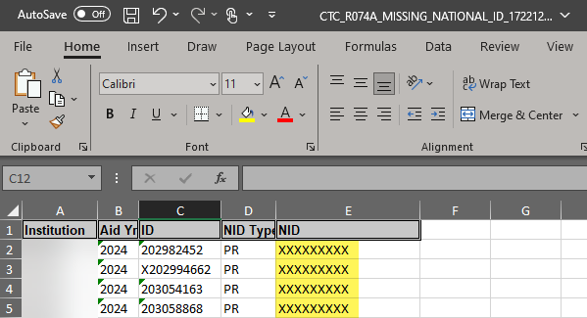
RUNNING THE WCG INTERIM RPT CONT’D IDENTIFYING STUDENTS W/O SSN CONT’D
Look up student in View Fin Aid Status and look up WASFA of student – If ITIN is listed in WASFA, add that ITIN number to the SSN field in Add/Update a Person page.

Slide 25
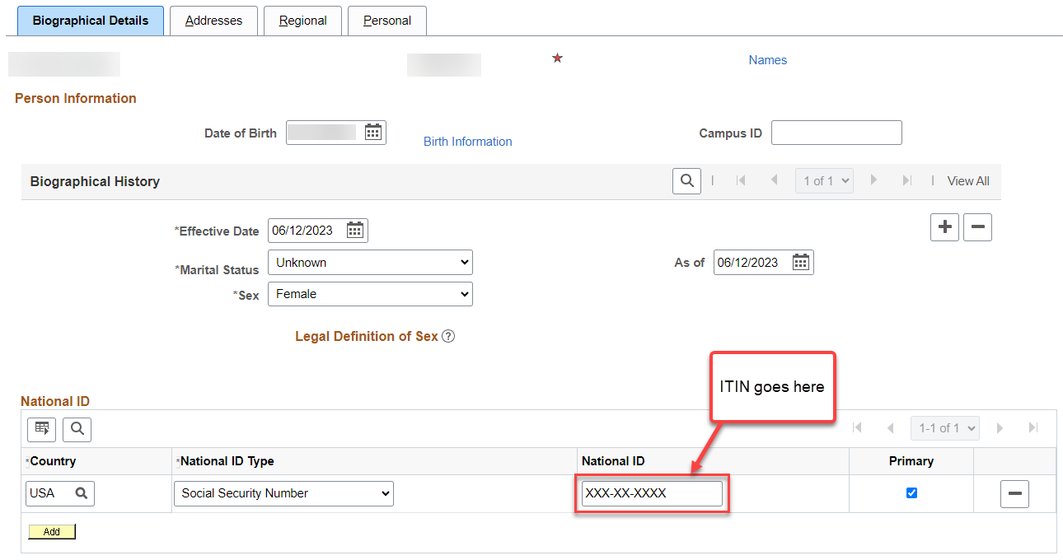
RUNNING THE WCG INTERIM RPT CONT’D ADD/UPDATE A PERSON PAGE (ITIN)
Navigation: Campus Community > Personal Information (Student) > Add/Update a Person
Note— If no ITIN exists and a 980- number was assigned at time of WASFA application, you cannot enter the 980- number in Add/Update a Person. You must manually add this information to the csv so it is recorded, or you can manually enter it in CSAW for drawdown.

Slide 26
DEMONSTRATION

Slide 27
WCG INTERIM OVERVIEW TIPS FOR SUCCESS
Tips include:
Have the WSAC WCG/CBS Manual up for reference
Have your MFI chart handy
Have your Maximum Award Amount chart handy
Work from the WCG Interim Business Processing Guide
Run clean up query CTC_FA_SNG_COMPARE
Run Interim, work your error report
Open your Interim Report, look at your data
After clean up, re-run Interim and DO NOT OPEN file

Slide 28
RUNNING THE WCG INTERIM RPT CONT’D RESOURCES
Canvas Course: FA206 WCG Interim Processing
WCG Interim Business Processing Guide
Fund Management Business Processing Guide
WSAC FAA Resources (Program Manual/MFI chart/Award chart

Slide 29
FISCAL ITEM TYPES

Slide 30
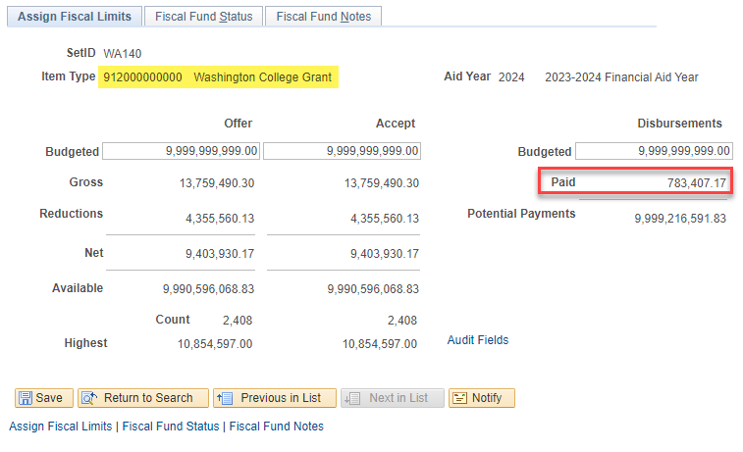
FISCAL ITEM TYPES
ASSIGN FISCAL LIMITS
Navigation: Set Up SACR > Product Related > Financial Aid > Awards > Fiscal Item Types
Use this page to track how much aid has been paid out to students in the Aid Year. i.e., WCG can be set at 9,999,999,999 because draw downs are based on how much is awarded/disbursed. Budgeted Offered/Accepted and Disbursement amounts can be a forecasted expenditure amount based on the amount disbursed in the prior aid year. Descriptions of each field are described in detail in the Fund Management Business Processing Guide.

Slide 31
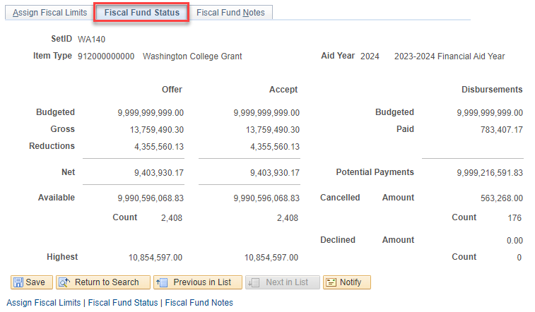
FISCAL ITEM TYPES CONT’D
FISCAL FUND STATUS
Use the Fiscal Fund Status tab to track how many dollars you have for potential payments, how many awards were cancelled, and that dollar amount, and how much was declined by students.

Slide 32
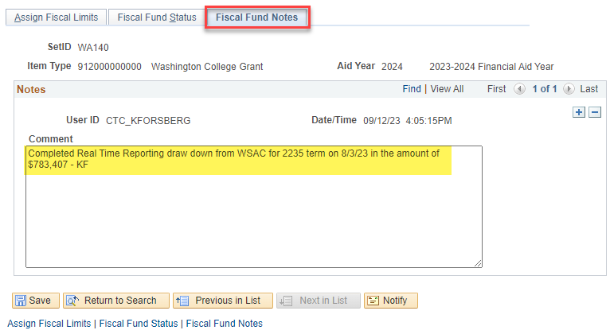
FISCAL ITEM TYPES CONT’D
FISCAL FUND NOTES
Use this page to make *notes on changes or updates to amounts of award allocations, and other. *Optional

Slide 33
OUTCOMES
At training completion, you should be able to:
Understand what queries are available for state aid recon and what they do:
CTC _SNG_COMPARE
CTC_FA_CBS_SNG_NOT_AWARDED
CTC_FA_SNG_ELIG_NOTPKGD
Understand the clean-up reports to run prior to running recon
Fund Roster
Understand how to use the Fiscal Item Types page to help in your recon efforts
Tips for success & additional resources

Slide 34
Congratulations!
State Aid Reconciliation Training complete!
Please review the videos and additional resources in your canvas course material and the business processing guide in the ctcLink reference center as you progress through students to prep for awarding
Thank you for your participation today!

