Slide 1
Post-Implementation Setup Walk-Through
SAP 11: S&P Grades Not Showing as “MEET” (Minimum Current GPA Test)
Amanda Hoover, ctcLink Senior Functional Analyst for Financial Aid
September 5 & 7, 2023

Slide 2
Agenda
Recap of SAP #11 Customization
Configuration recommendation for “NGPA” SAP Status
Review Minimum Current GPA Rules

Slide 3
SAP #11 Customization Recap
S&P Grades Not Showing as “MEET”

Slide 4
Implementation Timeline
College Approval of Solution Design | July 26
College User Acceptance Testing | Aug 9 to Aug 25
College Testing Sign Off | Aug 25
Production Release Date | Aug 31
Post-Implementation Setup Walk-Through | Sept 5 & 7

Slide 5
Student SAP Data (Problem)
Impacts students where previous term contains all “Not For GPA” grades (e.g., S, P, etc.)
SAP attempts to read GPA value associated with Attempted Units in the “For GPA” field even when no “For GPA” Attempted Units exist for that term
GPA field must have a numerical value and cannot be null
Assumes a false 0.000 for the Minimum Current GPA Test
Student fails to meet SAP on the Minimum Current GPA Test
Navigation: Financial Aid > Satisfactory Academic Progress > Maintain Student SAP Data

Slide 6
Customization
Clone original App Engine code
Customize by adding code to the beginning of the Minimum Current GPA Test to separate students that need to be addressed differently
IF none of the student’s classes have grade points that count toward the term GPA
THEN set the student's SAP status for that test to “NGPA”
IF “NGPA” SAP Status does not exist
THEN the customization will not be activated; proceed with delivered functionality

Slide 7
Student SAP Data (Solution)
Student does not fail the Minimum Current GPA Test, resulting in “NGPA” SAP Status
Students with earned 0.00 GPA adhere to local Minimum Current GPA Test configurations (dependent upon local Minimum Current GPA Rules)
Navigation: Financial Aid > Satisfactory Academic Progress > Maintain Student SAP Data

Slide 8
“NGPA” SAP Status Setup
SAP #11 Post-Implementation

Slide 9
Configure NGPA SAP Status
NGPA SAP Status needs to be configured to activate the customization
Required/Global (purple)
Add effective dated row!
Calc Status: NGPA
Short Description: NGPA
Description: S&P Grades (Not for GPA)
Considerations/College-Specific (green)
Consider Severity level as it relates to other SAP statuses
Consider SAP Status (SAP outcome that impacts awarding)
Navigation: Set Up SACR > Product Related > Financial Aid > Satisfactory Academic Progress > Define Set Up Criteria >> Setup (tab)

Slide 10
Minimum Current GPA Rules
Review/adjust Minimum Current GPA Rules
Some colleges have a Rule configured like the screenshot below
Can cause inaccurate results after the customization is in place
Do: Be sure to have a row where “MIN Cur GPA From” is set to “0.000” to assign a failing SAP Status to students with an earned 0.00 GPA
SAP 11 customization will separate out the false 0.00 GPAs and assign the NGPA Status
This rule will still capture students who should receive the WARN or SUSP status, as configured
Confirm ranges and SAP Status are in alignment with your college’s local SAP policy
Example Rule that we recommend updating
Bypasses both S&P grade students and students with an earned 0.00 GPA for the term
Navigation: Set Up SACR > Product Related > Financial Aid > Satisfactory Academic Progress > Define Set Up Criteria >> Criteria 2 (tab)

Slide 11
Resources
SAP Information Guide
https://ctclinkreferencecenter.ctclink.us/m/PMO_Info/l/1625563-fa-satisfactory-academic-progress-sap-project-information-guide
UAT Testing Materials page for colleges
https://ctclinkreferencecenter.ctclink.us/m/98421/l/1689518-sap-item-11-s-p-grades-not-showing-as-meet
SAP Process and Set Up Business Process Guide
https://ctclinkreferencecenter.ctclink.us/m/92436/l/798606-sap-process-and-set-up-business-process-guide

Slide 12
Questions?

Slide 13
The Problem
194K 11 of 19: S&P Grades Not Showing as “MEET”

Slide 14
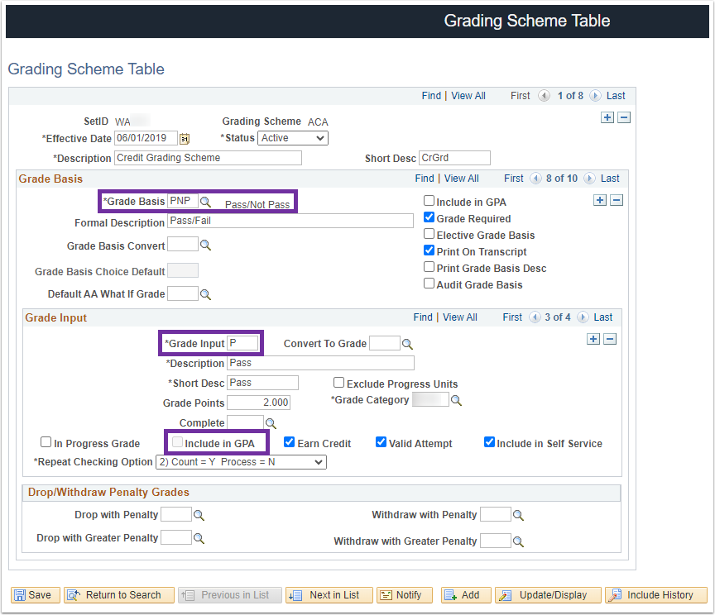
Grade Not Included in GPA
“SUS” and “PNP” Grading Bases correctly configured with the “Include in GPA” checkbox unchecked
The grades used in the “SUS” and “PNP” Grading Bases might have grade points assigned to them, but will still result in no GPA
Navigation: Set Up SACR > Foundation Tables > Academic Structure> Grading Scheme Table

Slide 15
Term Statistics Page (Records Module)
When the only classes a student attempts in a term are not included in the GPA, the system correctly posts the Attempted Units in the “Not For GPA” field on the Term Statistics page.
The only GPA provided is in the For GPA row
Navigation: Records and Enrollment > Student Term Information > Term History

Slide 16
Student SAP Data (Problem)
SAP attempts to read GPA value associated with Attempted Units in the “For GPA” field even when no “For GPA” Attempted Units exist for that term
GPA field must have a numerical value and cannot be null
Assumes a false 0.000 for the Minimum Current GPA Test
Student fails to meet SAP on the Minimum Current GPA Test
Navigation: Financial Aid > Satisfactory Academic Progress > Maintain Student SAP Data

Slide 17
Delivered Functionality Impacted
194K 11 of 19: S&P Grades Not Showing as “MEET”

Slide 18
Minimum Current GPA Test
Calculates the GPA for the term being evaluated
Local Rules allow colleges to specify at what point a student fails this test
More than half of ctcLink Colleges currently have this test enabled in their SAP Setup
Colleges with
Min Current GPA Test
enabled in SAP Setup

Slide 19
Minimum Current GPA Test Setup
Checkbox to enable SAP process to use this test
Not used in ctcLink
Range of earned units this test will apply to
Range of current GPA this test will apply to
Status to be assigned if student meets these criteria
Navigation: Set Up SACR > Product Related > Financial Aid > Satisfactory Academic Progress > Define Set Up Criteria >> Criteria 2 tab

Slide 20
Minimum Current GPA – Student SAP Page
Displays the GPA for the term being evaluated
GPA from Term History page in Student Records module
Displays information in the “Rule Range” fields if the student matches a Minimum Current GPA Rule
Navigation: Financial Aid > Satisfactory Academic Progress > Maintain Student SAP Data

Slide 21
The Solution
194K 11 of 19: S&P Grades Not Showing as “MEET”

Slide 22
Customization
Clone original App Engine
Customize by adding code to the beginning of the Minimum Current GPA Test to separate students that need to be addressed differently
IF none of the student’s classes have grade points that count toward the term GPA
THEN set the student's SAP status for that test to “NGPA”
IF “NGPA” SAP Status does not exist
THEN the customization will not be activated; proceed with delivered functionality

Slide 23
Out of Scope
Colleges will still need to review SAP for exceptions and adjust manually
Minimum Cumulative GPA Test not customized
Some colleges expressed concerns about S&P Grades impacting this test as well
Colleges to provide additional information and examples of students currently impacted
Requires additional analysis before we can determine scope of the issue and if customization is needed or if business processes can be improved

Slide 24
Student SAP Data (Solution)
Student does not fail the Minimum Current GPA Test
Resulting SAP Status for the test is “NGPA”
Students with earned 0.000 GPA adhere to local Minimum Current GPA Test configurations
Navigation: Financial Aid > Satisfactory Academic Progress > Maintain Student SAP Data

