Slide 1
BFET in ctcLink
FA/SF/FIN Training: Introduction to BFET
ctcLink PeopleSoft Training | FA/SF/FIN Washington State Community and Technical Colleges

Slide 3
FA/SF/FIN Cross-Pillar Training:
Introduction to BFET
Sessions are recorded and will be added to the aligned Canvas Courses [SF100 Tuition Calculation, FA102 Awarding Financial Aid & SAP, and GL100 General Ledger] under the Additional Resources Module > Training Videos.
Presenters:
Jennifer Dellinger – SBCTC Policy Associate, Student Services
Alec Risk – SBCTC Functional Trainer – Student Financials
Karen Ebert – SBCTC Functional Trainer - Finance
Kelly Forsberg – SBCTC Functional Trainer – Financial Aid

Slide 4
FA/SF/FIN Cross-Pillar Training: Introduction to BFET
This session aims to provide a high-level introduction to BFET and how it flows within ctcLink.
Today’s Objectives:
BFET Policy Update / Refresher
Understand what BFET is
Understand how BFET flows within ctcLink
Understand resources available to you to aid with BFET processing and reconciliation
Time allotted at the end for questions.

Slide 5
A Message from Jennifer Dellinger

Slide 6
BFET Policy Refresher Background
The BFET Program offers colleges who spend non-federal funds to serve eligible BFET students a 50% reimbursement of those expenses. Policy requires that each leveraged funding source be identified and tracked. These reimbursements are returned to BFET program to build capacity to serve students and support staff providing direct services.
BFET is often called a “grant” but, due to the policy requirements to spend from and identify leveraged funds to get a 50% reimbursement, it does not fit into the ctcLink Grants Module and still meet policy.

Slide 7
BFET Policy Update Policy Update
Effective October 1st, 2022, colleges offering BFET programs will follow a global process for the set up in Peoplesoft for leveraging BFET reimbursement on administrative costs which include staff salaries, benefits, travel, goods/services, and F&A/indirect.
This global process requires the use of the Program ChartField value in budgets and expenses and does not require changes for student expenses.

Slide 8
BFET is a Reimbursable Program
BFET = Basic Food, Employment and Training

Slide 10
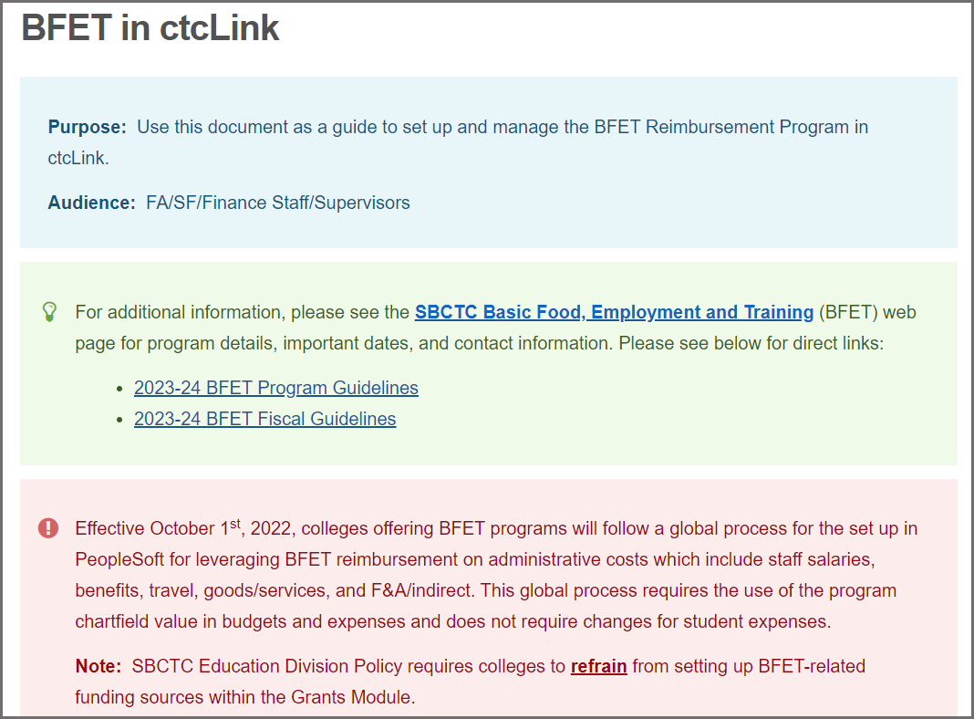
BFET in ctcLink Updated QRG is available now!
QRG:
BFET in ctcLink

Slide 11
FA/SF/FIN Cross-Pillar Training: Introduction to BFET
BFET PRE-PROCESS starts in Finance:
Step 1 - Create a BFET Program Code
Step 2 - Add BFET-related Budgets with Program Code
Step 3 - Add BFET-related Combo Codes

Slide 12
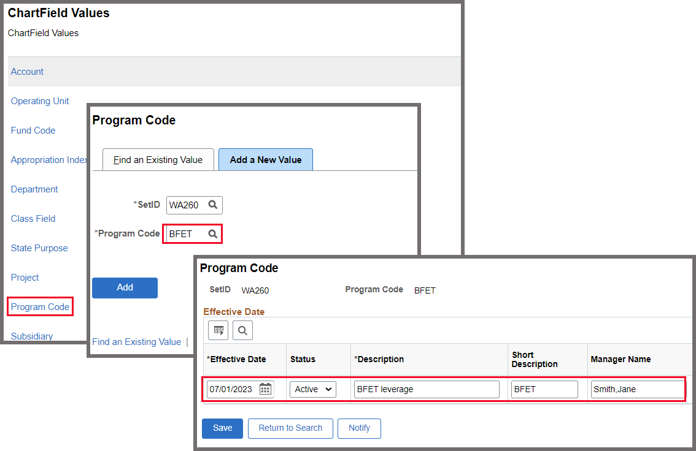
Pre-Processing BFET in Finance Step 1 – Create Program Code
QRG: Adding Programs to ChartField Definitions

Slide 13
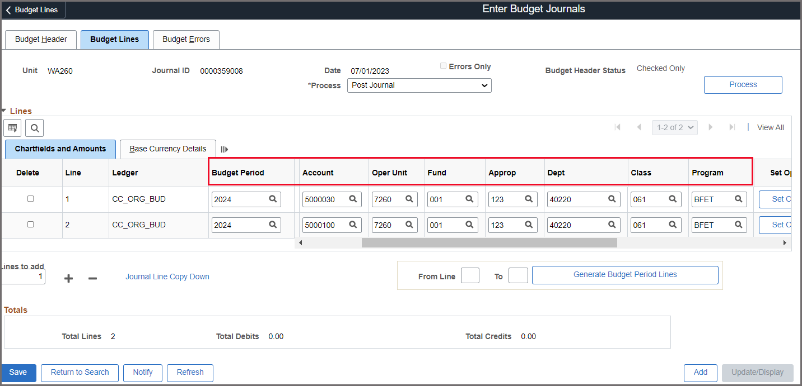
Pre-Processing BFET in Finance Step 2 – Add BFET-related Budgets
QRG: Enter or Adjust a Budget Online (Basic process)
QRG: Entering or Adjusting a Budget in Commitment Control (additional info on Budget Errors or uploading budget, etc.)

Slide 14
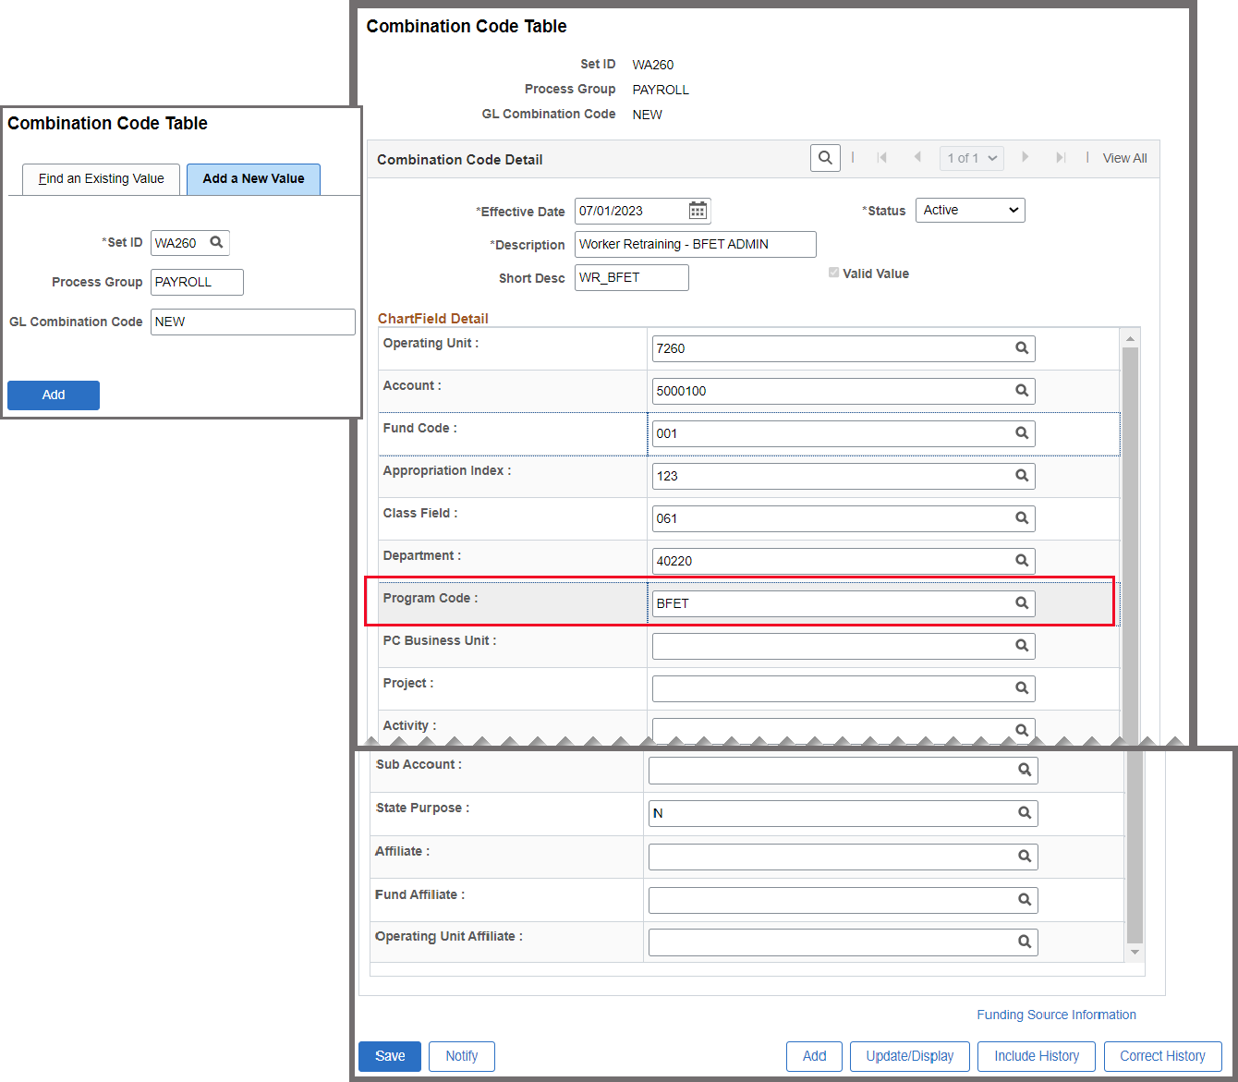
Pre-Processing BFET in Finance Step 3 – Add BFET-related Combo Codes
QRG: Creating a New Combo Code
QRG: Understanding Cross-Pillar Integration and Combo Codes

Slide 15
BFET Process: Financial Aid (FA)

Slide 16
FA/SF/FIN Cross-Pillar Training: Introduction to BFET
Financial Aid Processing
Step 1 – Student Group Assignment (CS)
Step 2 – Award BFET in Assign Awards
Step 3 – Run Batch Auth & Disbursement

Slide 17
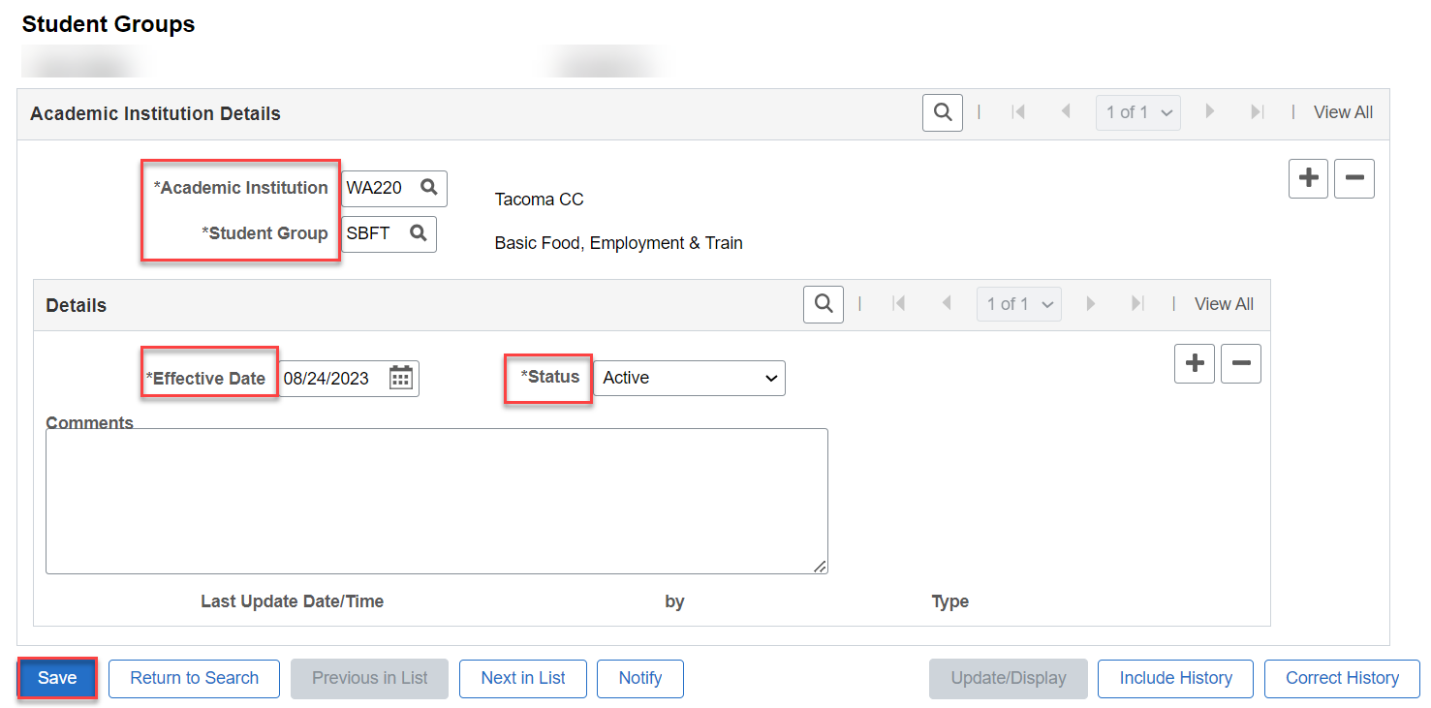
Processing BFET in Financial Aid Step 1 – CS to put student in Student Group
QRG: Adding, Updating and Viewing a Student Group
Note: FA needs to work with CS staff to add the BFET Student Group

Slide 18
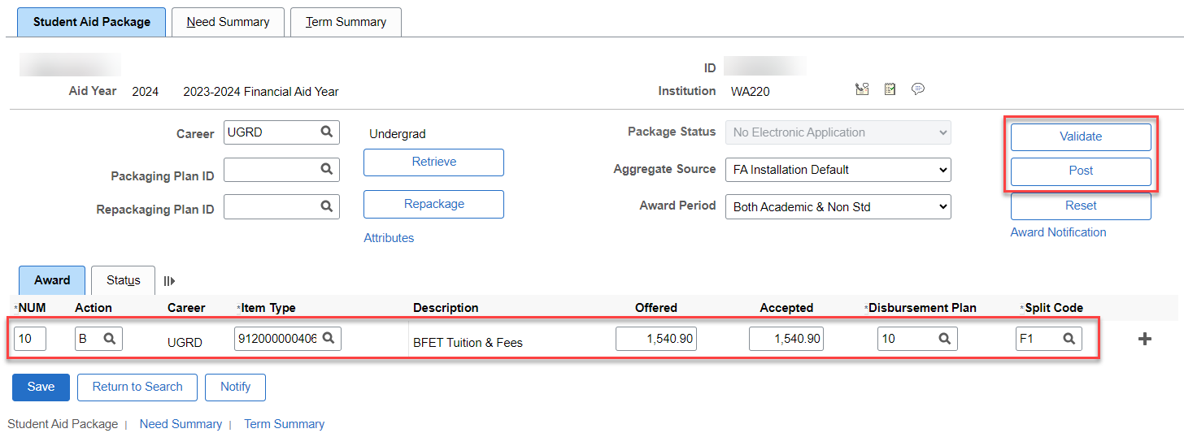
Processing BFET in Financial Aid Step 2 – Award BFET in Assign Awards to a Student
QRGS:
Manually Awarding Financial Aid Without a FAFSA
Manually Awarding Financial Aid

Slide 19
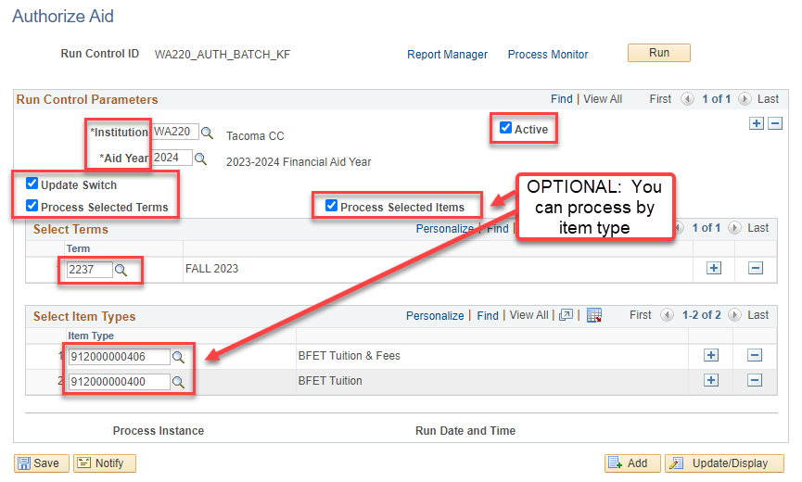
Processing BFET in Financial Aid Step 3 – Run Authorization & Disbursement
QRGS:
Process Award Authorizations

Slide 20
Processing BFET in Financial Aid Step 3 CONT’D – Run Authorization & Disbursement
QRGS:
Process Disbursements

Slide 21
FA/SF/FIN Cross-Pillar Training: Introduction to BFET
Financial Aid Reconciliation Queries
Query 1 – CTC_FA_SF_DISCREPANCY_LIST
Query 2 – QCS_FA_GRP_PAY
Query 3 –QCS_FA_AWARD_EXCEEDS_TUITFEES

Slide 22
DEMONSTRATION

Slide 23
BFET Process: Student Financials (SF)

Slide 24
Student Financials
Ensure proper configuration of Item Types, Tuition Calculation, SJS, etc.
SF may Post (Disburse) FA Awards to Student Accounts. This occurs when FA awards through Batch Disbursement. SF utilizes Post Group Transactions which post awards to the Student Account.
Utilize appropriate Queries for Student Account Reconciliation (on BFET QRG under Student Financials).

Slide 25
BFET Process in Finance (FIN)

Slide 26
FA/SF/FIN Cross-Pillar Training: Introduction to BFET
Finance Process High Overview
Step 1 - Expense Transactions Occur
Step 2 - Calculate and Post F&A/Indirect
Step 3 - Billing Analysis and Prep
Step 4 - Create PeopleSoft Invoice
Step 5 - Submit OBIS Billing

Slide 27
Processing BFET in Finance Step 1 – Expense Transactions Occur
FIN Admin-related Expenses:
Salaries and Benefits are journalized from the HCM Pillar and posted in GL.
Goods & Svc, Travel, etc. are posted to the GL from other Finance Modules.
SF Student-related Expenses:
Tuition, books, childcare, transportation, etc. are journalized from CS Pillar through the Second Journal Set process. Transactional details [student IDs, term, amounts] are found on SF-side and the summary expense totals are posted on the GL-side.

Slide 28
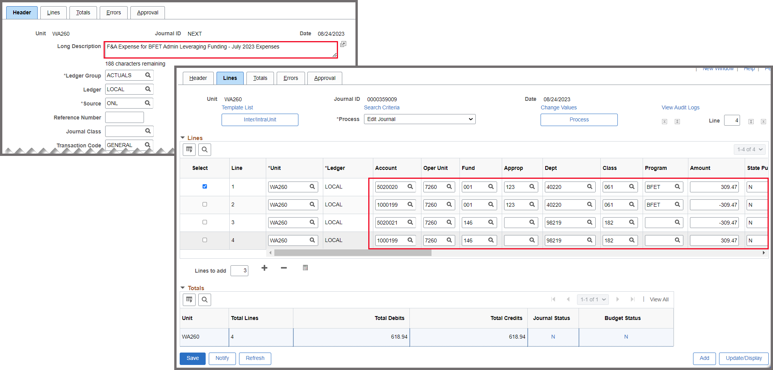
Processing BFET in Finance Step 2 – Calculate and Post F&A/Indirect
QRG Creating a Manual F and A Journal Entry Note: Please refer to the Fiscal Guidelines for guidance and updated Indirect Rate. Example below based on Indirect rate x admin expenses:

Slide 29
Processing BFET in Finance Step 3.1 – Billing Analysis and Prep: Queries
Queries for FIN Admin Expenses:
QFS_GL_PROGRAM_ACCT_ANALYSIS – Admin Expenses, like payroll, goods & services, travel, etc.
QFS_GL_PROGRAM_HR_ACCT_LINE – Payroll Details
Queries for SF Student Expenses:
CTC_SF_ACCTNG_LN_WITH_PROMPTS – Detailed Student transactions with student IDs, etc. : 1000199
QFS_GL_ACCOUNT_ANALYSIS – Summary of Student transactions : 5020080 & overall holistic view of expenditures.

Slide 30
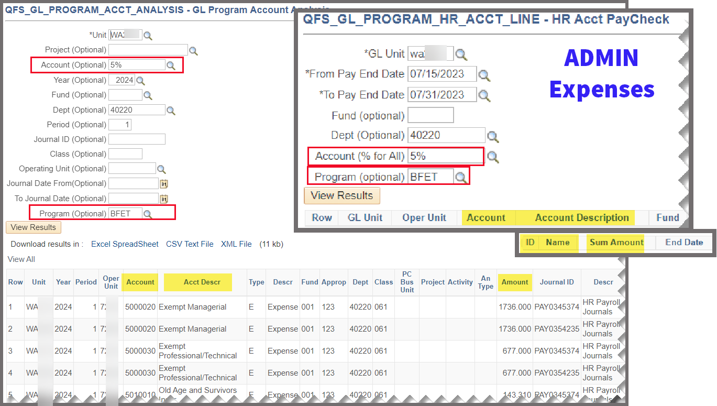
Processing BFET in Finance Step 3.2 – Billing Analysis and Prep: ADMIN

Slide 31
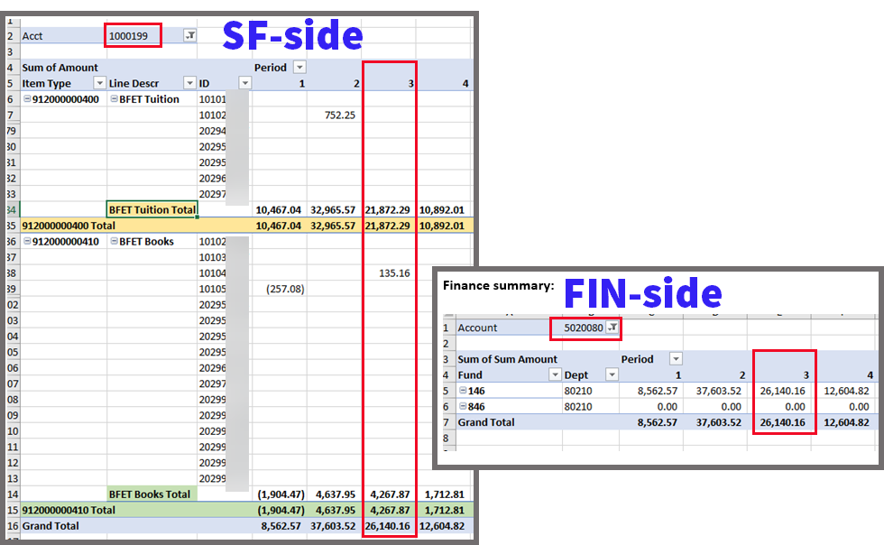
Processing BFET in Finance Step 3.3 – Billing Analysis and Prep: STUDENT
SF-side: CTC_SF_ACCTNG_LN_WITH_PROMPTS
FIN-side: GL_ACCOUNT_ANALYSIS

Slide 32
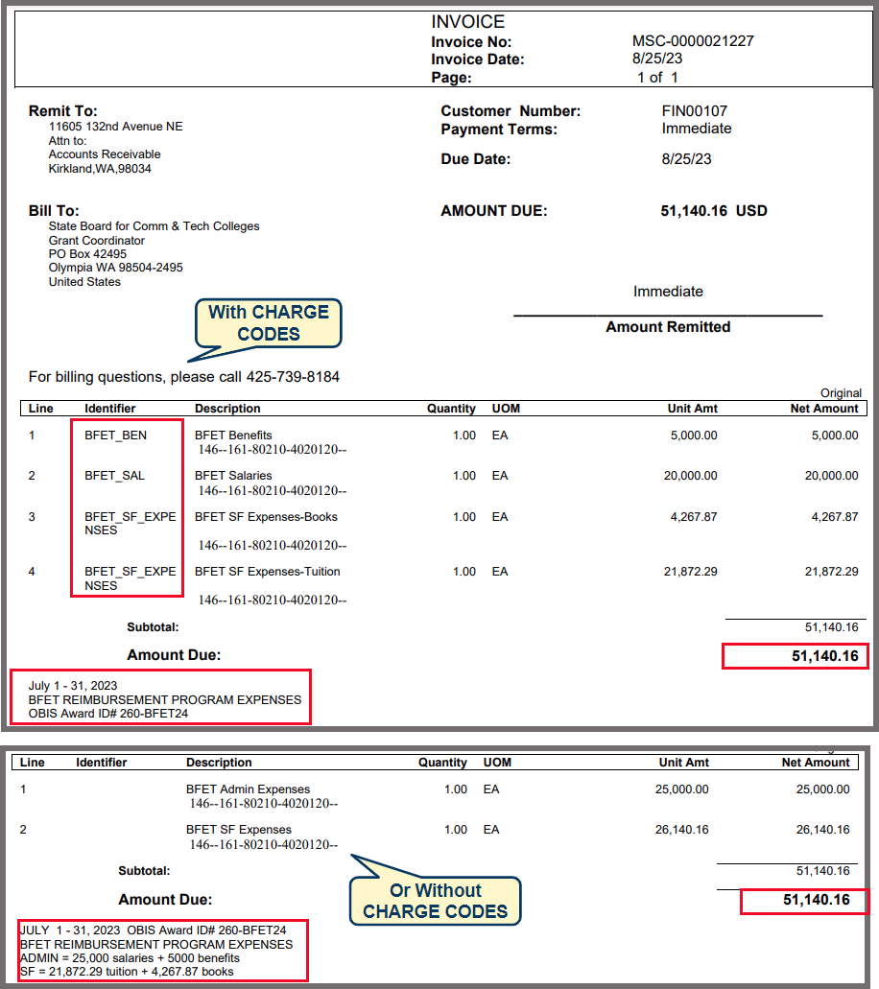
Processing BFET in Finance Step 4 – Create PeopleSoft Invoice
*Admin-related Expenses: salaries, benefits, travel, goods & services, etc.
+
*Student-related Expenses: tuition, books, childcare, etc.
=
TOTAL INVOICE
*Refer to SBCTC BFET Fiscal Guidance for details.

Slide 33
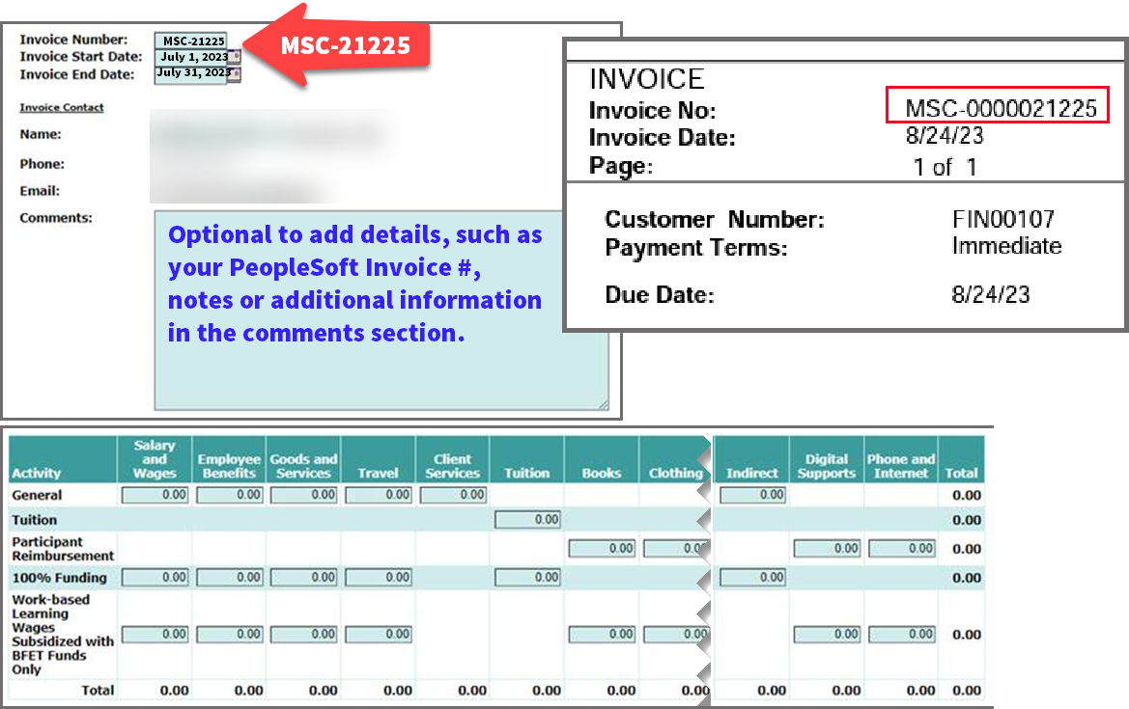
Processing BFET in Finance Step 5 – Submit OBIS Billing
Recommend using the PeopleSoft Invoice Number:
* Note: Include your Local Certification Form with OBIS Invoice

Slide 34
FA/SF/FIN Cross-Pillar Training: Introduction to BFET

Slide 35
FA/SF/FIN Cross-Pillar Training: Introduction to BFET
Thank you for your time and attention today!
You now have a high-level understanding of the BFET Reimbursement Program in ctcLink.
You should now have a better understanding of:
BFET Policy Update (Refresher)
What BFET is
How BFET flows within ctcLink
Utilize resources available to you to aid with BFET processing and reconciliation

Slide 36
Still have questions?
Additional Resources:
Basic Food, Employment and Training (BFET)
BFET Program – important dates, program guidelines, grant & fiscal guidelines
ctcLink Accounting Manual
For additional questions, please contact:
Jennifer Dellinger – jdellinger@sbctc.edu
Jackie Thoms – jthoms@sbctc.edu
Michele Rockwell – mrockwell@sbctc.edu

