Slide 1
Let’s Talk Loan Debt Letters
Financial Aid Work Session
Jed Lara, ctcLink Functional Analyst for Financial Aid
August 24, 2023

Slide 2
What is the loan debt letter?
The loan debt letter provides students with estimated information on current aid year offered/borrowed amounts:
potential payoff amount
monthly repayment amount
aggregate loan data, where applicable
Due to privacy concerns, the notification will be sent through Message Center
State Reg. reference: 5022-S.PL.pdf (wa.gov)

Slide 3
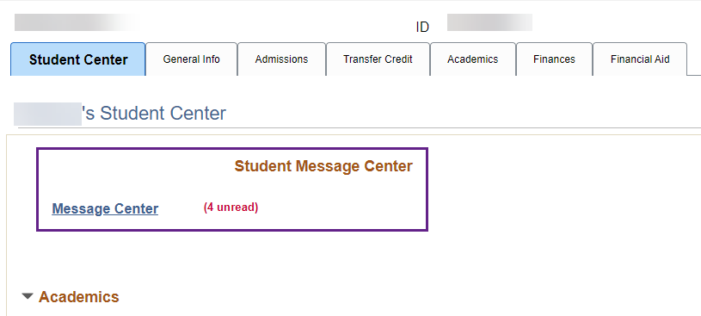
Where is it?
Loan Debt Letters are sent and viewable in the Student’s Message Center.
Not through 3C Engine

Slide 4
Where is it?... Cont’d

Slide 5
Running the process!
The full process is available in the Loan Processing Guide via the Reference Center ☺

Slide 6
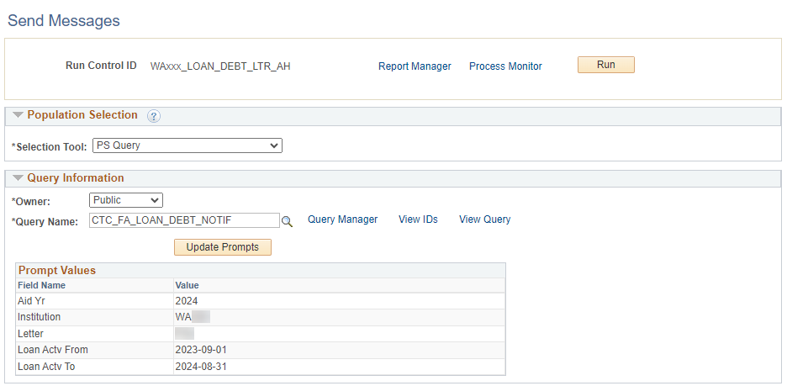
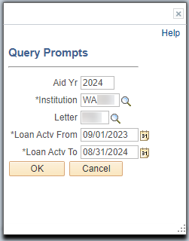
Assign & Send – Population Select
Owner: Public
Query Name: CTC_FA_LOAN_DEBT_NOTIF
Fill Query Prompts
Navigation: HighPoint > Message Center > Processes > Send Messages

Slide 7
Assign & Send – Thread Information
Must be entered prior to proceeding with other Run Control settings
Visible to students
Enter Thread Information:
Select institution
Department: Financial Aid
Regarding: [Varies by college]
Subject: [Message subject visible to students]
Staff will not receive notifications or alerts if a student replies to this message
Navigation: HighPoint > Message Center > Processes > Send Messages

Slide 8
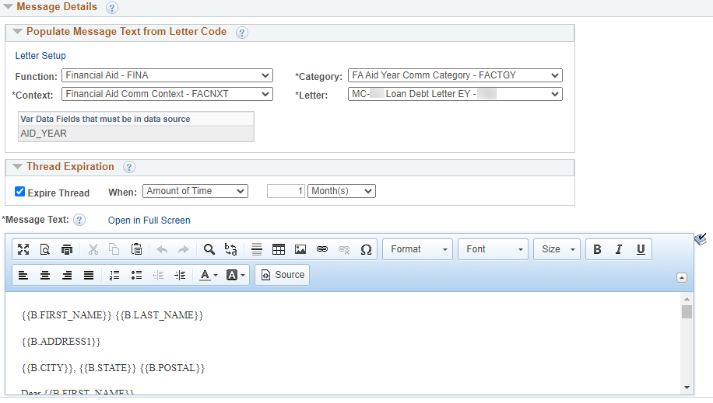
Assign & Send – Message Details
From corresponding 3C configurations for your institution Message Text will populate after the Letter code has been selected.
Pulls from Population Selection query prompt
Institutions can alter each time they run this process. Once the letter expires, it is no longer visible in Message Center
Do not alter Message Text
Navigation: HighPoint > Message Center > Processes > Send Messages

Slide 9
Assign & Send – Run and Review Process Monitor
If the process runs to No Success, do not immediately run the process again
Review Message Log
Process may have gone to error on a single student missing critical information
One student may fail, but other students in the batch will get their message in Message Center

Slide 10
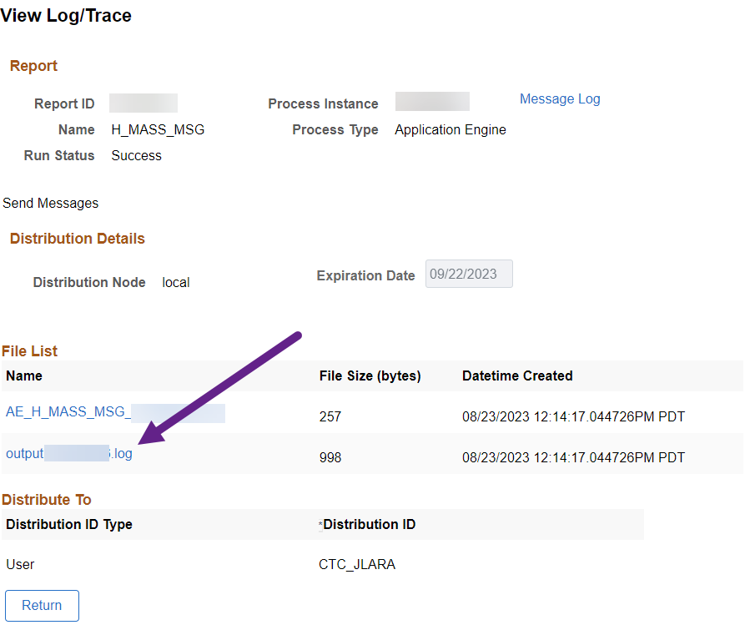
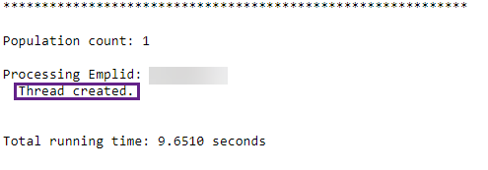
Uh oh! No success?
Review your View Log/Trace!

Slide 11
Reviewing
You can review threads
for an individual student!
Navigation: HighPoint > Message Center > Search for Threads

Slide 12
Congratulations!
You are now equipped with the knowledge to run the Loan Debt Letter Process!
Please refer to the Loan Processing Guide on the ctcLink Reference Center
Thank you for your participation today!

