Slide 1
Intermediate pell: pell multiple record reporting
Kelly Forsberg
ctcLink Functional Trainer | Financial Aid
August 2023

Slide 2
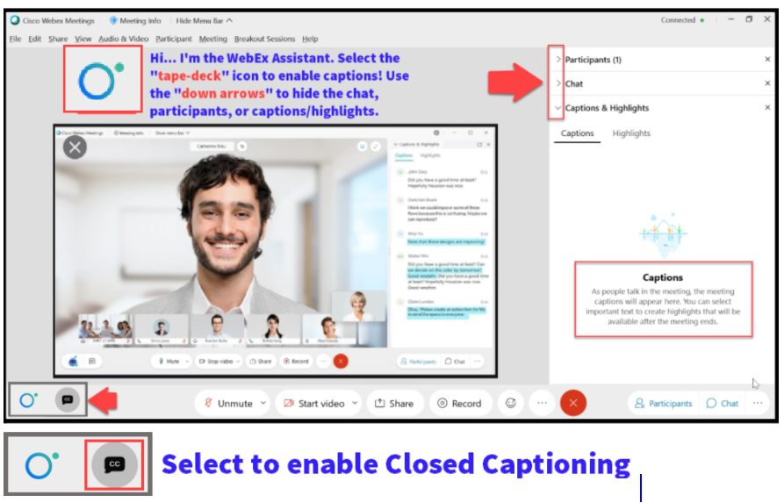

Slide 3
Logistics and Agenda
Times | Activity
9:00 – 9:02 | Sign-In/Greet/Attendance
9:02 – 9:05 | Objectives
9:05 – 10:00 | Pell PGMR Upload/Import Process
10:00 – 10:15 | Pell MRR Batch Report Process
10:15 – 10:30 | Session Wrap-Up/Q&A
Some processes will have demonstrations, but due to data scrubbing, available data in the environment, demo examples are not ideal

Slide 4
ground rules
Be ready to participate
Remove external distractions
Mute your line when not speaking
Do NOT place Webex line on hold. Use Mute.
Please leave your line on Mute unless you are speaking
Sessions are being recorded
Allow your peers to complete their thoughts before beginning yours

Slide 5
Objectives
After completing this training, you should be able to:
Understand and work the steps in the Pell MRR Process
Upload/Download Files
Import Federal Data Files
Import Pell Phase-In Data
Run Pell MRR Batch Report

Slide 6
PELL MRR
PROCESS

Slide 7
Pell mrr processing
4-STEP PROCESS
Step 1: Upload pgmr file
Step 2: Import Federal Data Files
Step 3: Pell Phase In Data
Step 4: Pell MRR Batch Report

Slide 8
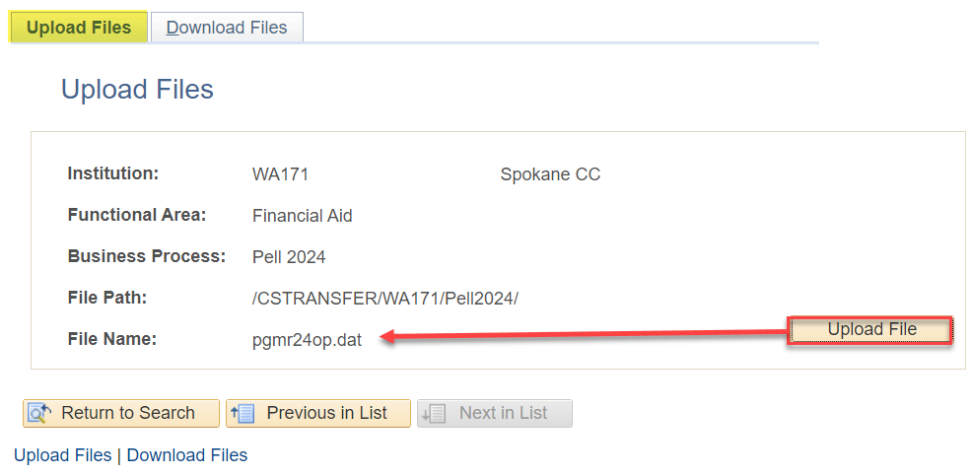
Pell mrr processing
UPLOADING PELL MRR FILE
Navigation: PeopleTools > CTC Custom > Extensions > Upload/Download File
Usually, the first AY’s file comes in as a .dat, then .001, .002, etc.

Slide 9
Pell mrr processing
4-STEP PROCESS
Step 1: Upload pgmr file
Step 2: Import Federal Data Files
Step 3: Pell Phase In Data
Step 4: Pell MRR Batch Report

Slide 10
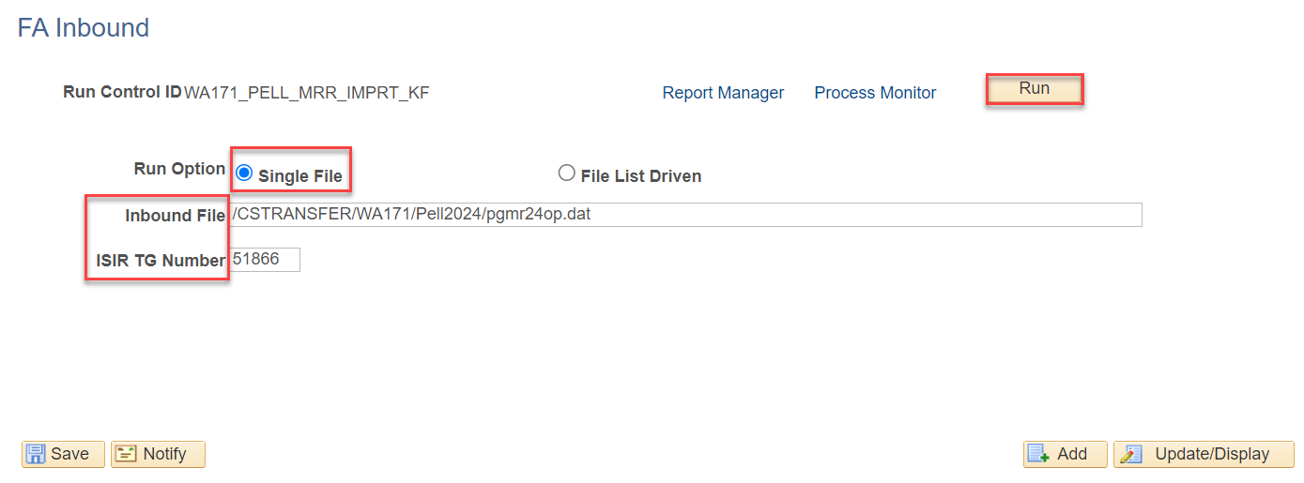
Pell mrr processing CONT’D
IMPORTING PELL MRR FILE
Navigation: Financial Aid > File Management > Import Federal Data Files
Remember that when importing files, the file name is typically lower case.

Slide 11
Pell mrr processing
4-STEP PROCESS
Step 1: Upload pgmr file
Step 2: Import Federal Data Files
Step 3: Pell Phase In Data
Step 4: Pell MRR Batch Report

Slide 12
Pell mrr processing CONT’D
PELL MRR PHASE IN
Navigation: Financial Aid > File Management > Pell Grants > Import Pell Multiple Reporting
This step moves the data into a table where batch reporting can be run

Slide 13
Pell mrr processing
4-STEP PROCESS
Step 1: Upload pgmr file
Step 2: Import Federal Data Files
Step 3: Pell Phase In Data
Step 4: Pell MRR Batch Report

Slide 14
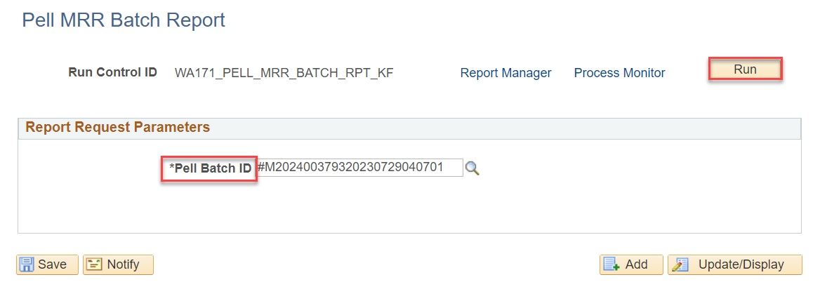
Pell mrr processing CONT’D
PELL BATCH REPORT
Navigation: Financial Aid > File Management > Pell Grants > Import Pell Multiple Reporting
Use the lookup tool to find your batch number

Slide 15
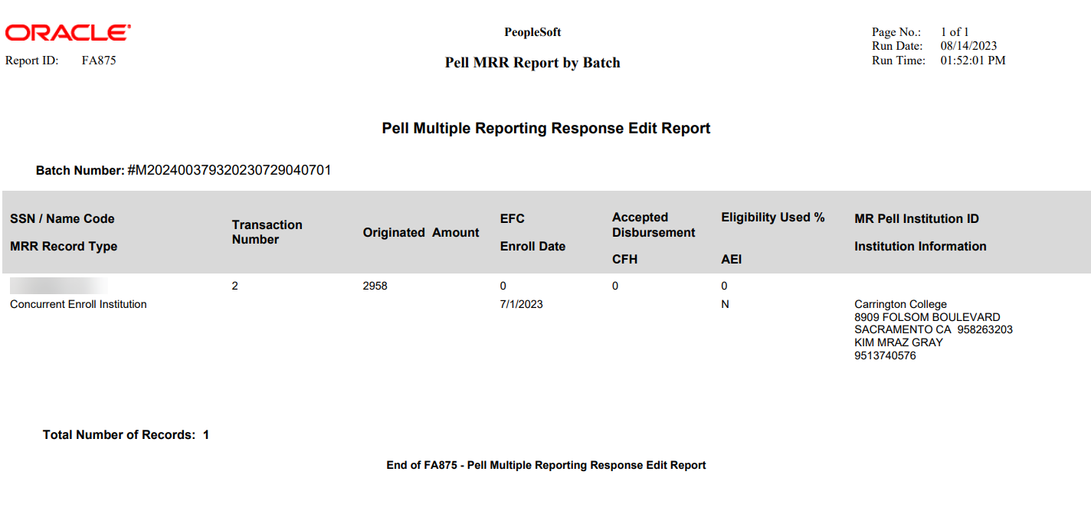
Pell mrr processing CONT’D
PELL BATCH REPORT CONT’D
CFH = Children of Fallen Heroes
AEI = Additional Eligibility Indicator

Slide 16
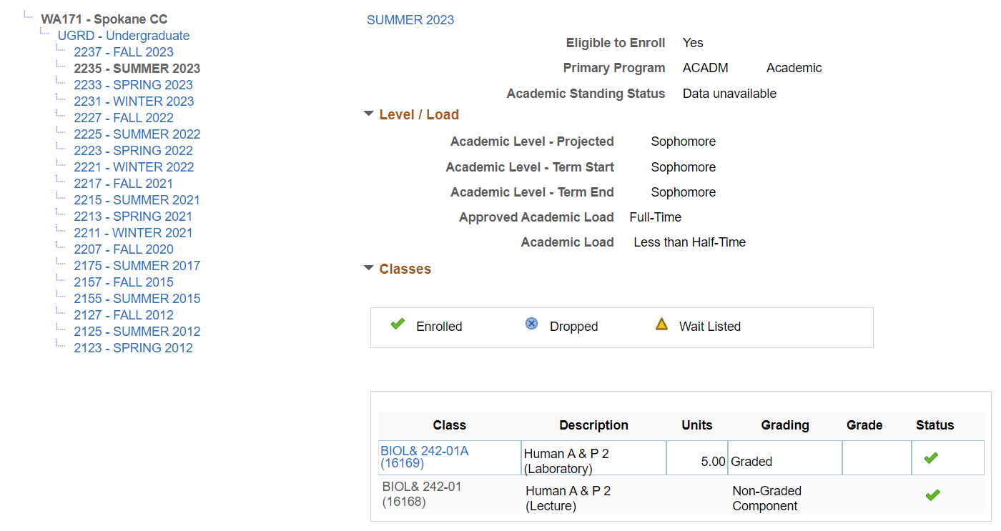
Pell mrr processing CONT’D
CHECK ENROLLMENT
Navigation: Campus Community > Student Services Center (Student)

Slide 17
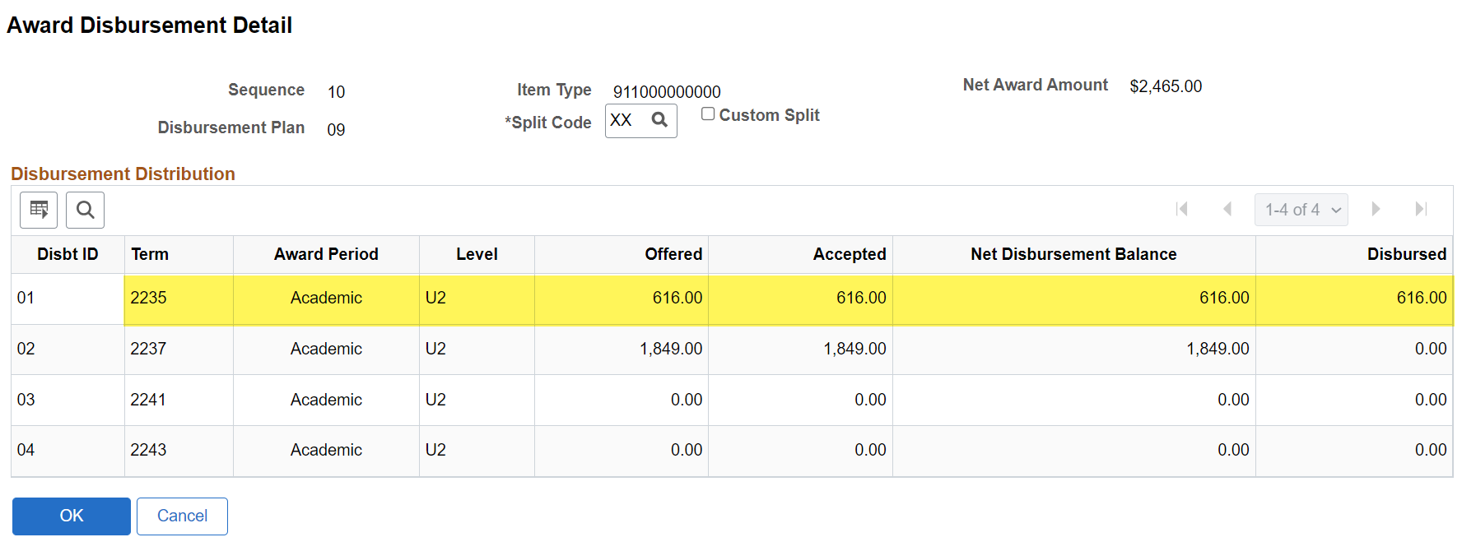
Pell mrr processing CONT’D
CHECK AWARDS
Navigation: Financial Aid > Awards > Award Processing > Assign Awards to a Student
WHAT NEXT? . . .

Slide 18
DEMONSTRATION

Slide 19
Outcomes
At training completion, you should be able to:
Understand and work the steps in the Pell MRR Process
Upload/Download Files
Import Federal Data Files
Import Pell Phase-In Data
Run Pell MRR Batch Report

Slide 20
Congratulations!
Intermediate Pell Processing - Pell MRR Processing Training Complete!
Please review the Pell Business Processing Guide in the ctcLink Reference Center as your progress through the steps
Thank you for your participation today!

