Slide 1
Intermediate pell processing: pell troubleshooting
Kelly Forsberg
ctcLink Functional Trainer | Financial Aid
August 2023

Slide 2
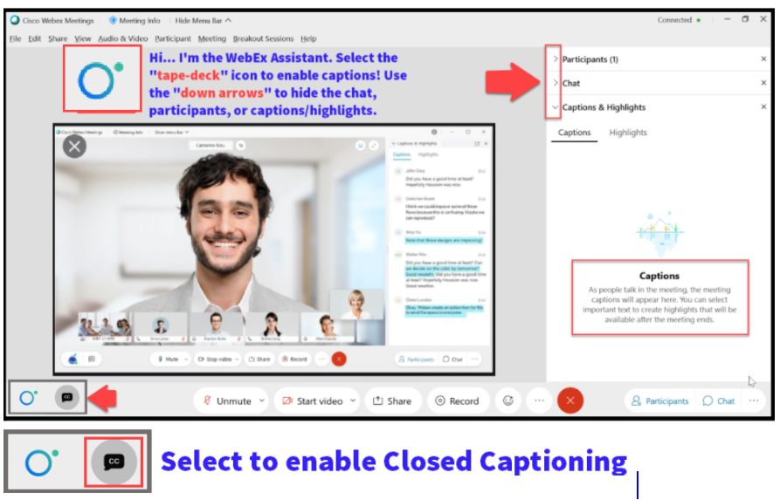

Slide 3
Logistics and Agenda
Times | Activity
9:00 – 9:05 | Sign-In/Greet/Attendance
9:05 – 9:10 | Objectives
9:10 – 9:45 | Working Examples in Pell Transaction and Status Reports
9:45 – 10:30 | Working Examples in Pell Orig and Disb Validation Error Rpts
10:30 – 10:40 | Manage Pell Payment page
10:40 – 10:50 | View COD Data page
10:50 – 11:00 | Session Wrap-Up/Q&A
Some processes will have demonstrations, but due to data scrubbing, available data in the environment, demo examples are not ideal

Slide 4
ground rules
Be ready to participate
Remove external distractions
Mute your line when not speaking
Do NOT place Webex line on hold. Use Mute.
Please leave your line on Mute unless you are speaking
Sessions are being recorded
Allow your peers to complete their thoughts before beginning yours

Slide 5
Objectives
After completing this training, you should be able to:
Understand how to read and work examples on the Pell Reports:
Pell Records by Transaction Status
Pell Records by Status
Pell Origination Validation Report
Pell Disbursement Validation Report
Understand how to perform Pell troubleshooting using various pages in ctcLink
View COD Data page
Manage Pell Payment page
COD Technical Reference Guide

Slide 6
WORKING THE
PELL TRANSACTION STATUS
REPORT

Slide 7
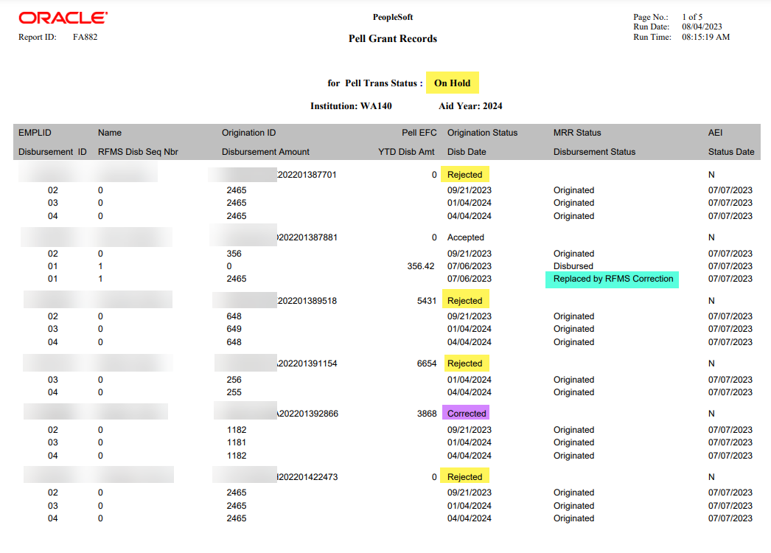
WORKING THE PELL REPORTS
TRANS STATUS: ON HOLD
Navigation: Financial Aid > Pell Payment > Origination Reports > Transaction Status
Review the columns for Origination Status and Disbursement Status

Slide 8
MANAGE PELL
PAYMENT
PAGE

Slide 9
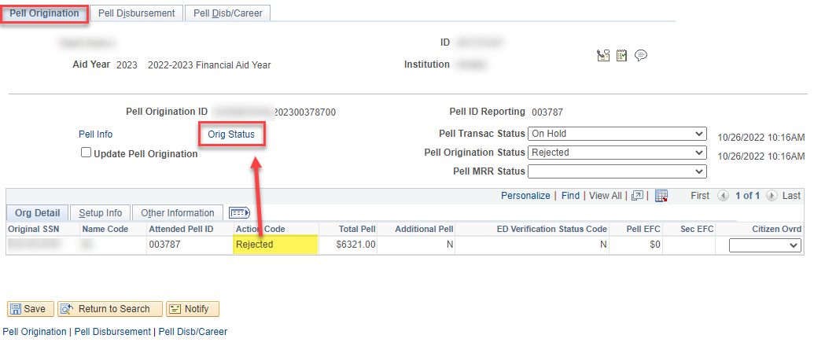
MANAGE PELL PAYMENT
ORIGINATION REJECTION
Navigation: Financial Aid > Pell Payment > Manage Pell Payment
At the Pell Origination tab, note the Action Code of Rejected. Select the Orig Status link to drill down into the message detail.

Slide 10
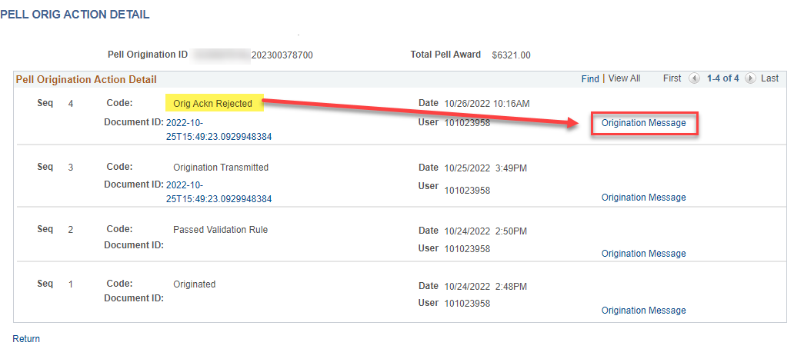
MANAGE PELL PAYMENT
ORIGINATION REJECTION CONT’D
In the Pell Origination Action Detail, note the Code of Orig Ackn Rejected. Select the Origination Message link to drill further down into the reject message.

Slide 11
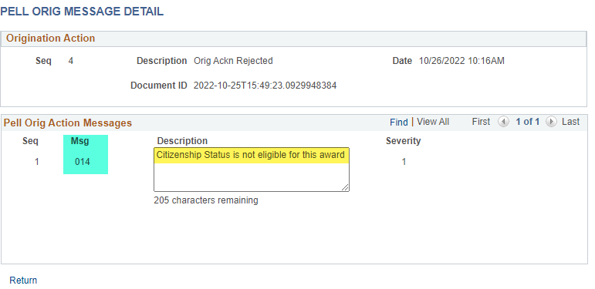
MANAGE PELL PAYMENT
ORIGINATION REJECTION CONT’D
In the Pell Origination Action Messages, note the Description of Citizenship Status is not eligible for this award.
Note the Msg 014 - this is a COD Tech Ref Guide Reject Edit Message Number.

Slide 12
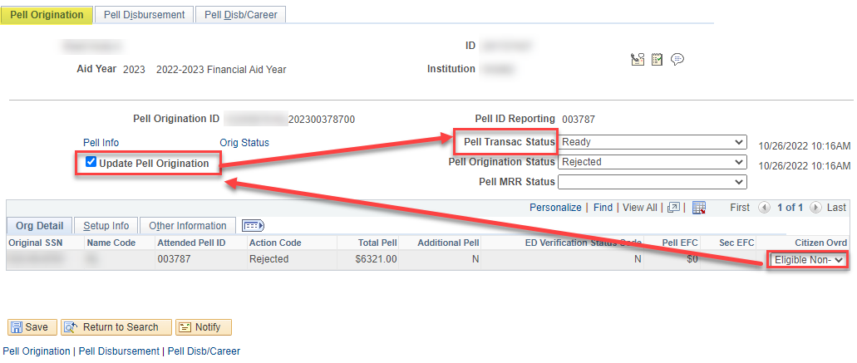
MANAGE PELL PAYMENT
RESOLVING CITIZENSHIP
Once the Citizenship Status has been resolved, change the Citizen Ovrd drop down to reflect the student’s Citizenship, select the Update Pell Origination checkbox, and change the Pell Transac Status to Ready.

Slide 13
WORKING THE
PELL VALIDATION REPORTS –
PELL DISBURSEMENT

Slide 14
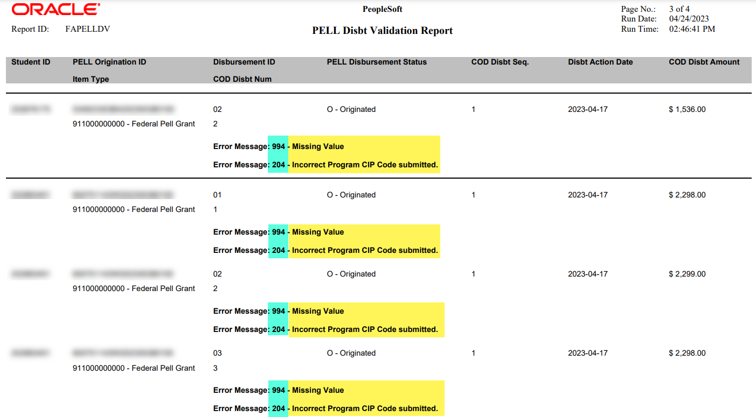
Pell disbursement validation report
REVIEWING ERRORS
Navigation: Financial Aid > Pell Payment > Pell Validation Reports
The Error Message numbers are listed in the report.
Tip! You can drill down into the COD Technical Reference Guide to review more detail on the resolution, using the reject edit error message number in the report.
Also, note the Disbursement ID number that is in question.

Slide 15
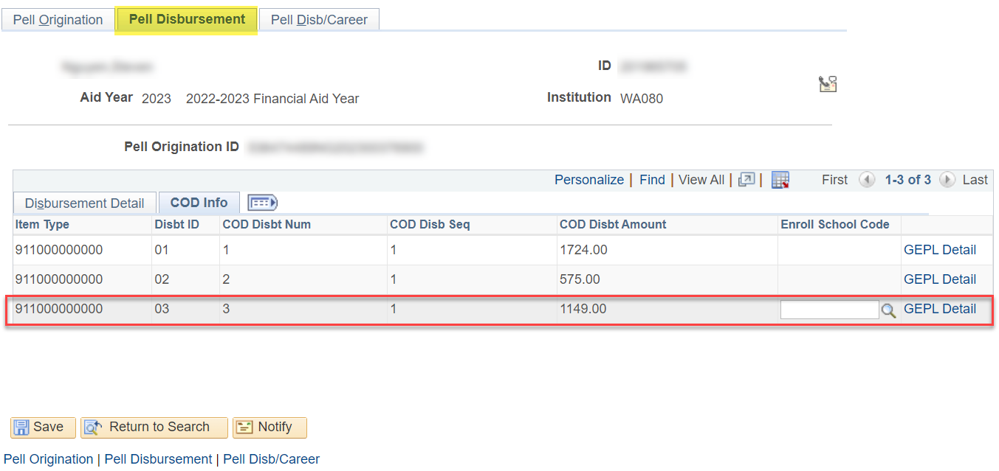
MANAGE PELL PAYMENT
DISBURSEMENT VALIDATION
Navigation: Financial Aid > Pell Payment > Manage Pell Payment
At the Pell Disbursement tab, note the COD Disbt Num row and review:
WHAT’S MISSING?

Slide 16
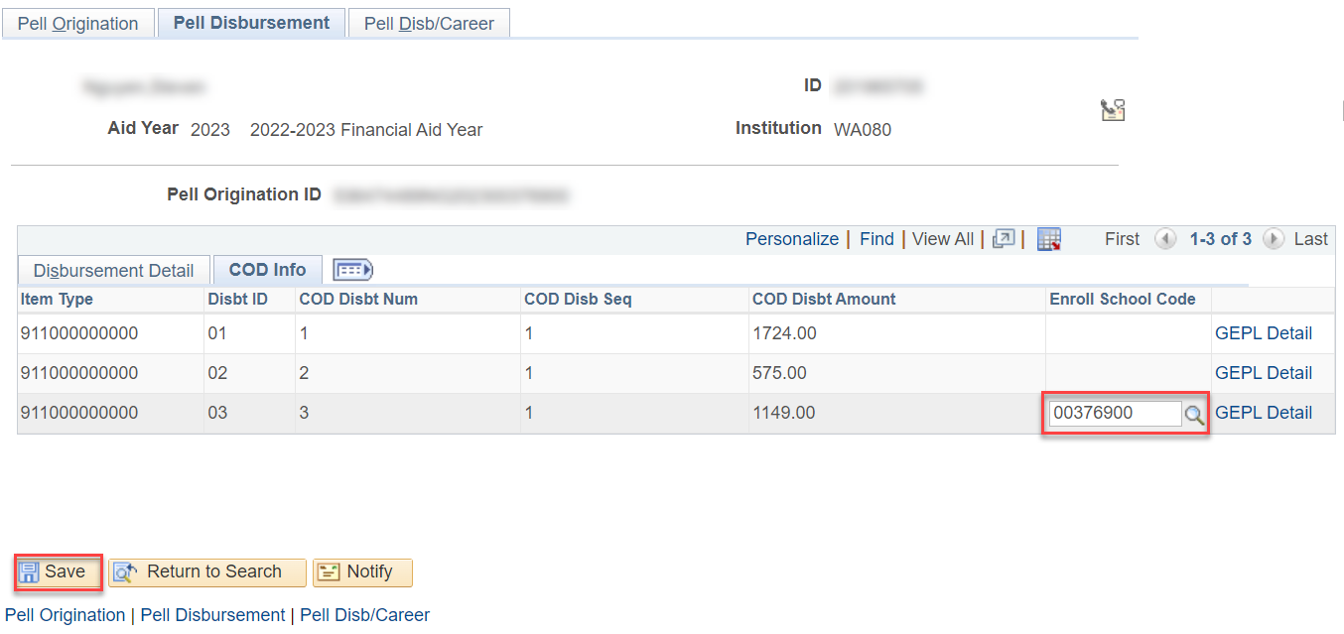
MANAGE PELL PAYMENT cont’d
DISBURSEMENT VALIDATION CONT’D
At the Pell Disbursement tab, enter in the missing information and select the Save button. Next, queue it up for Update to Origination.

Slide 17
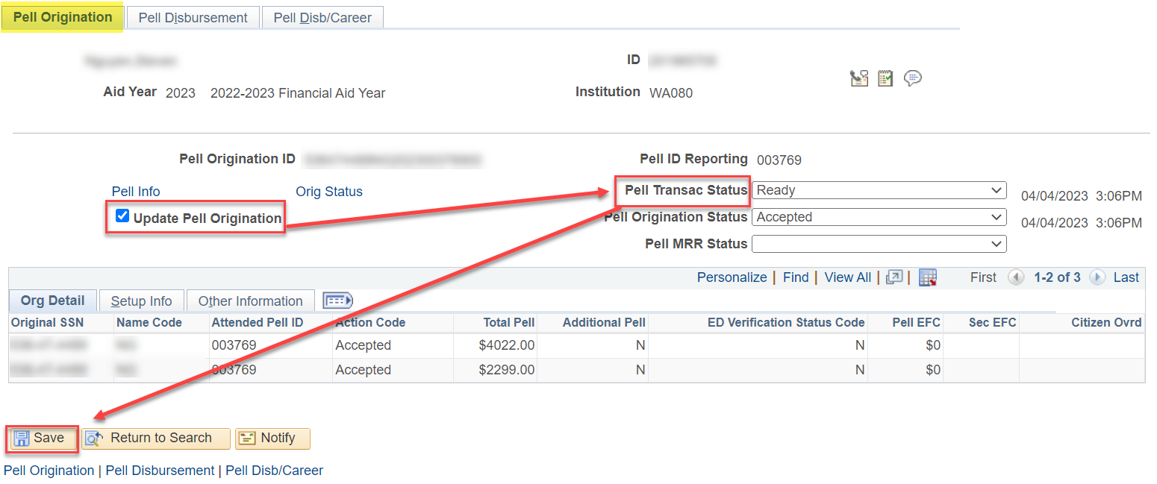
MANAGE PELL PAYMENT cont’d
DISBURSEMENT VALIDATION CONT’D
Select the Update to Origination checkbox. Ensure the Pell Transac Status is set to Ready. Select the Save button.

Slide 18
WORKING THE
PELL VALIDATION REPORTS –
PELL ORIGINATION

Slide 19
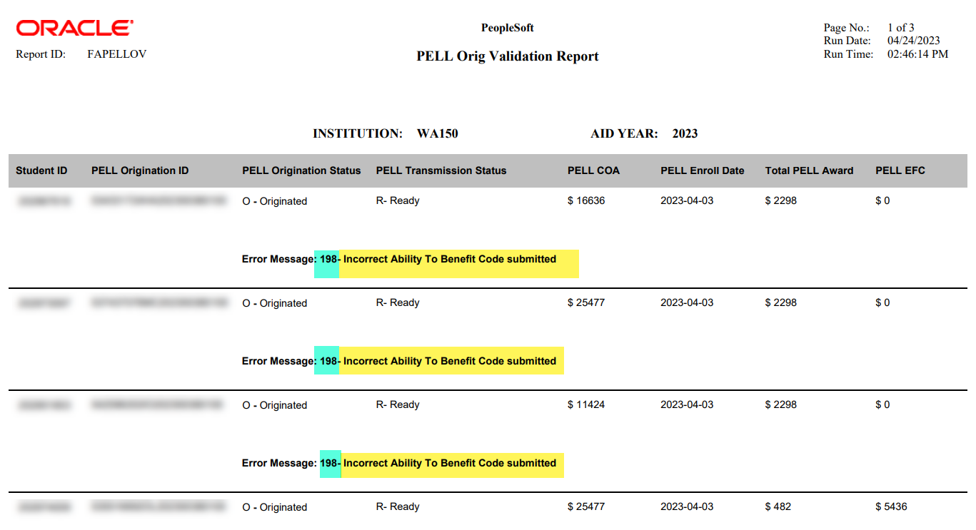
Pell origination validation report
REVIEWING ERRORS
Navigation: Financial Aid > Pell Payment > Pell Validation Reports

Slide 20
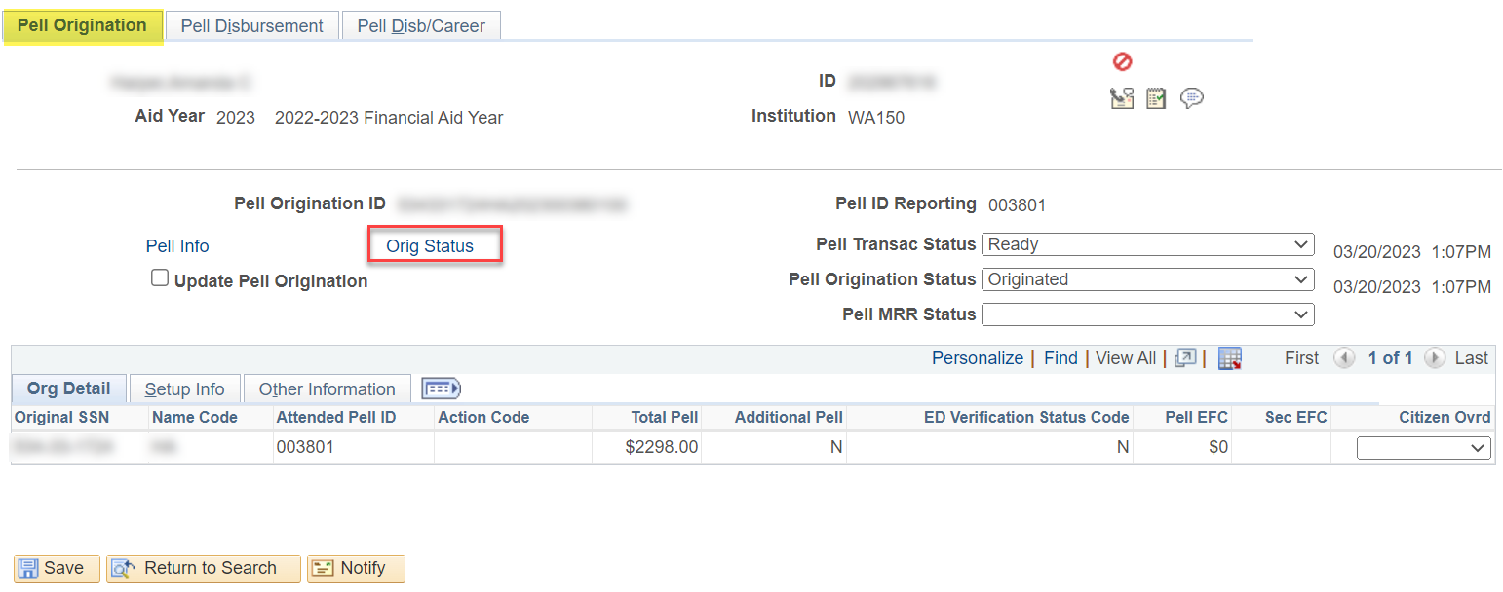
MANAGE PELL PAYMENT
ORIGINATION VALIDATION
Navigation: Financial Aid > Pell Payment > Manage Pell Payment
At the Pell Origination tab, select the Orig Status link.

Slide 21
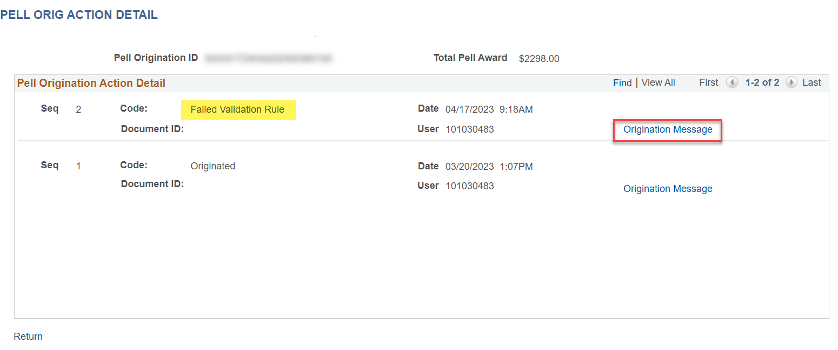
MANAGE PELL PAYMENT cont’d
ORIGINATION VALIDATION CONT’D
At the Pell Orig Action Detail pagelet, note the Failed Validation Rule Code. Select the Origination Message link to review more detail.

Slide 22
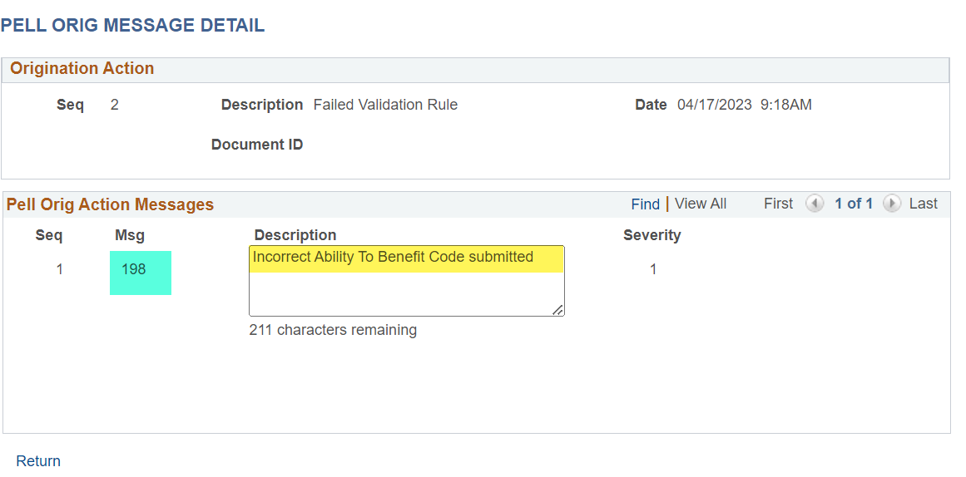
MANAGE PELL PAYMENT cont’d
ORIGINATION VALIDATION CONT’D
In the Pell Origination Action Messages, note the Description of Incorrect Ability to Benefit Code submitted.
Note the Msg 198 - this is a COD Tech Ref Guide Reject Edit Message Number.

Slide 23
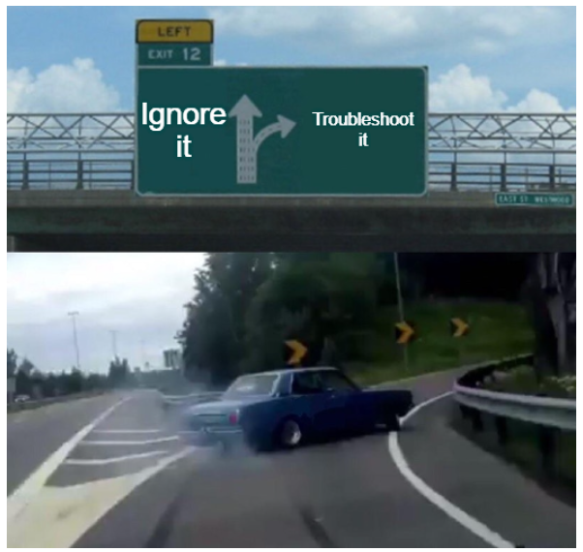
MANAGE PELL PAYMENT cont’d
ORIGINATION VALIDATION CONT’D
In what ctcLink pages would you look to troubleshoot an ATB message?
Correct 2022-2023 ISIR Records
Manage Ability to Benefit
Any others?

Slide 24
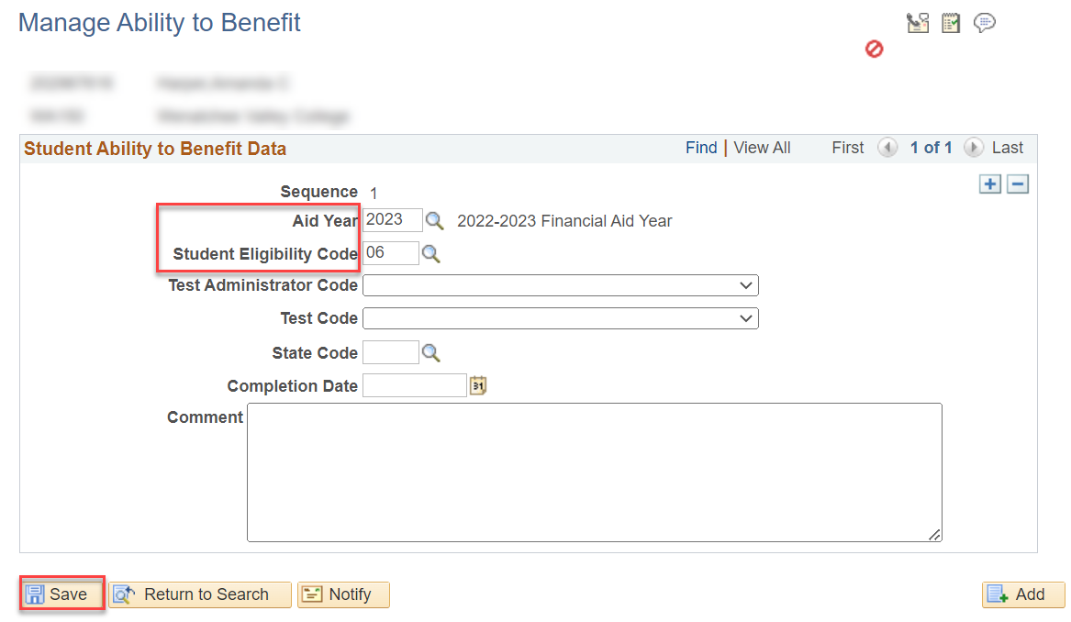
MANAGE PELL PAYMENT cont’d
MANAGE ABILITY TO BENEFIT PAGE
If no record exists, create one. If a record exists, ensure it is for the correct AY. Select Save.

Slide 25
Pell troubleshooting
NEXT STEPS IN THE PROCESS
After you are done working your reports. Run Pell Origination. Verify the EMPLs are not displaying in the Message Text detail.
Run Pell Out in Validation Mode and CONFIRM the EMPLs are not displaying in the Message Text detail.
Run Pell Out in Final Mode.
Re-run your Pell Transaction Status Report and the Pell Origination and Disbursement Validation Reports to confirm the students have dropped off the report.

Slide 26
DEMONSTRATION

Slide 27
Outcomes
At training completion, you should be able to:
Understand how to read and work examples on the Pell Reports:
Pell Records by Transaction Status
Pell Records by Status
Pell Origination Validation Report
Pell Disbursement Validation Report
Understand how to perform Pell troubleshooting using various pages in ctcLink and varying Dept of Ed Resources
View COD Data page
Manage Pell Payment page
COD Technical Reference Guide

Slide 28
Congratulations!
Intermediate Pell Processing - Pell Troubleshooting Training Complete!
Please review the videos and additional resources in the ctcLink Reference Center as your progress through the steps
Thank you for your participation today!

