Slide 1

fa/sf Cross-pillar Training:
Alternative Loans Processing
July 31st, 2023 (9:00am – 11:00am)

Slide 2
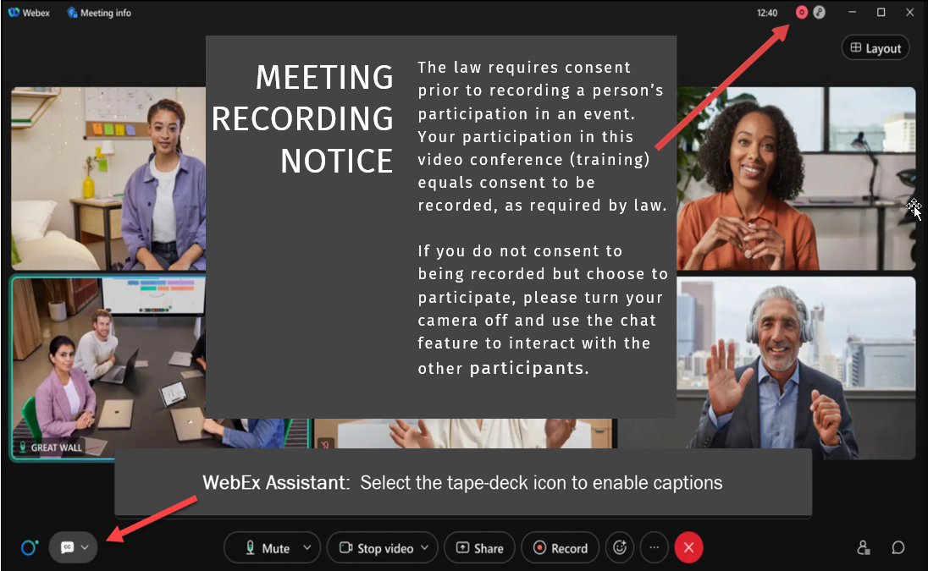

Slide 3
HOUSEKEEPING
Session is being recorded - Find session recording in the SF102 (Refunds) FA102 (Awarding and SAP) Canvas Courses
The captions for this recording are auto-generated. If additional assistance is needed to receive an increased level of access, please contact Alec Risk (arisk@sbctc.edu).
Please mute your line when not speaking
Be ready to participate & ask questions
If we move too quickly, ask us to slow down or to revisit a topic

Slide 4
FA/SF: Alternative Loans Processing
Agenda
Welcome/Backstory
Configuration Efforts
Processing
  QRG Steps 1-4
  QRG Step 5
  QRG Step 6
  Disbursement and Refunds
Q&A

Slide 5
Objectives
After completing this training, you should be able to:
Understand the steps involved with:
  FA Alternative Loans Processing (Awarding)
  SF Alternative Loans Processing (Collect Department Receipt)
  FA Alternative Loans Processing (Disbursing)
  SF Alternative Loans Processing (Refunds)

Slide 6
What are Alternative Loans and how did we end up here?
What is it?
  An alternative loan is a financial instrument that a student may use to pay for their education that exists outside of the federal financial aid program.
The beginning of (Alt Loan) time…
  Double awarding was a thing
Plan and Execution
  Individual meetings and cleanup
Notes:
Brandon to speak

Slide 7
Configuration Overview
SpeedType
  Ensure an SF SpeedType is created for Alternative Loans
Item types
  Create/Update Alt Loan Item Types for both SF and FA
  Multiple Alt Loan Item Types can be created, if needed
    Submit a ticket to SBCTC
Second Journal Set (SJS)
Notes:
Alec

Slide 8
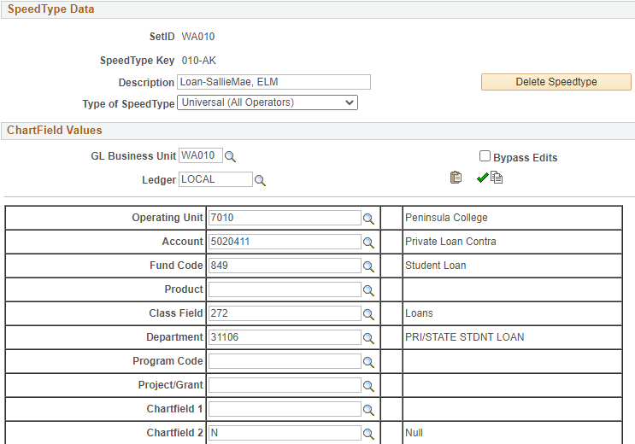
Student Financials Configuration: Speed Type
Create and Update SpeedType Keys
Navigation: Set up SACR > Product Related > Student Financials > General Ledger Interface > SpeedTypes
Ensure the use of a Contra Account
Notes:
Alec to speak

Slide 9
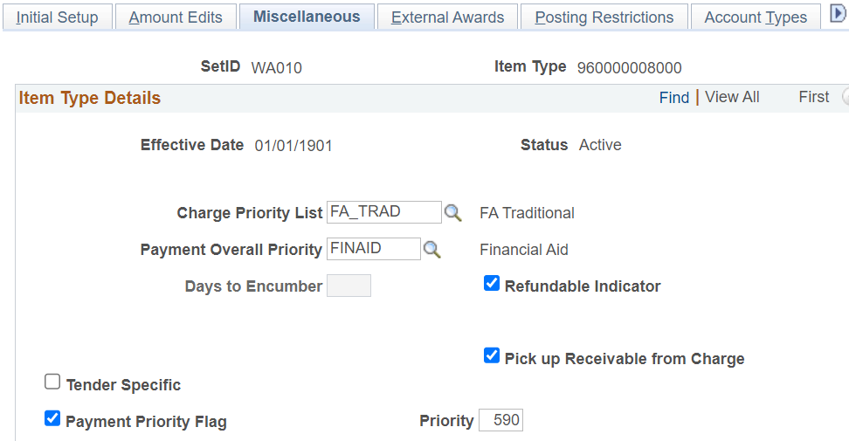
Student Financials Configuration: Item Types
Navigation: Set up SACR > Product Related > Student Financials > Item Types > Item Types
Ensure appropriate CPL, POP, PPL, Priority, and it is Refundable and Picks up Receivable from Charge
Notes:
Tamara speaks

Slide 10
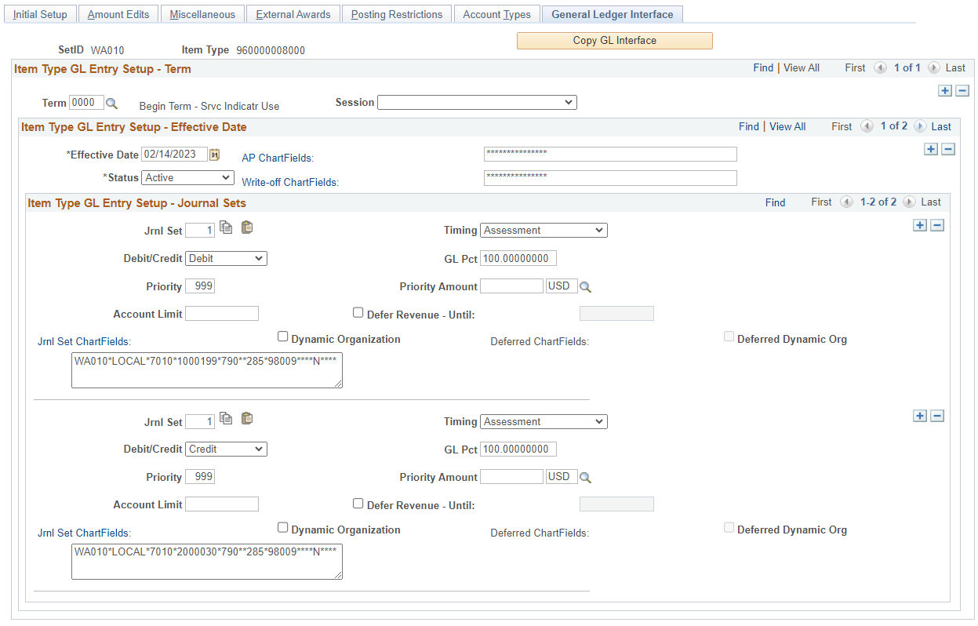
Student Financials Configuration: Item Types (Cont.)
Notes:
Tamara and Jackie speak

Slide 11
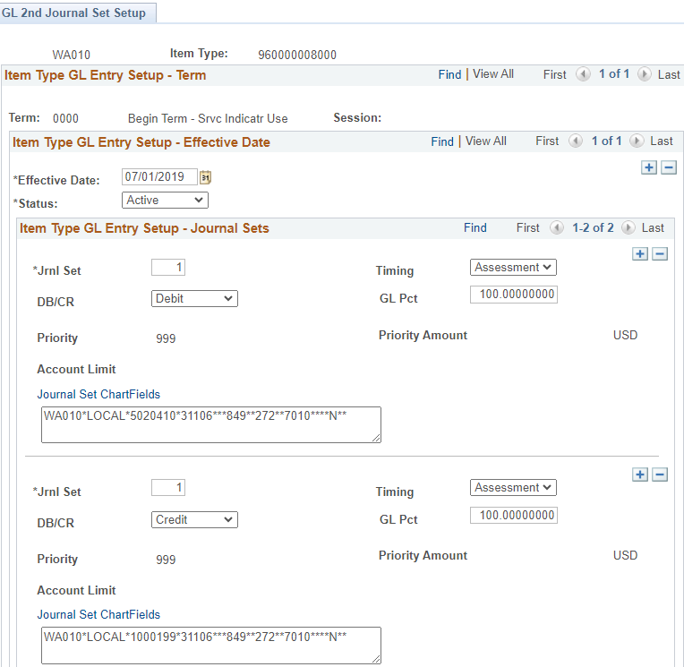
Student Financials Configuration: SJS
Navigation: Set up SACR > Product Related > Student Financials > CTC Custom > GL 2nd Journal Set Setup
Notes:
Jackie speaks

Slide 12
Alt Loan “No-No’s”
Don’t endorse an Alt Loan check directly to student.
  SAAM: 85.50.10.a
  RCW 43.01.050
Don’t post the check payment directly to the student account.
  Check Payment Item Type = BAD
Notes:
Group/Alec

Slide 13
Awarding and Processing Alternative Loans QRG Processing Steps
Steps 1 – 4 (FA)
Step 5 (SF)
Step 6 (FA)
Disbursement vs. Student Refund Process (FA-SF)

Slide 14
ALTERNATIVE LOAN QRG PROCESSING STEPS 1 - 4
Financial Aid

Slide 15
Alternative Loan Processing
FOUR-STEP PROCESS FOR FA PRIOR TO SF PROCESS
Step 1: Certify the Alternative Loan
Step 2: Review the Loan Roster to Determine Eligibility
Step 3: Award the Alternative Loan in Offered Status
Step 4: Notify SF that the funds are on the way to the school

Slide 16
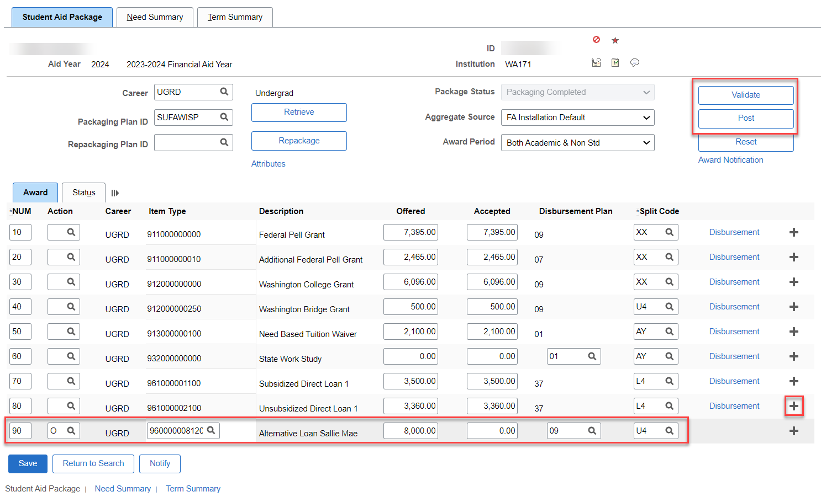
Awarding Alternative Loans Offer Status
Navigation: Financial Aid > Awards > Award Processing > Assign Awards to a Student
Award the loan in an offered status “O”

Slide 17
DEMONSTRATION

Slide 18
Alternative Loan Processing
Step 5: Post a Department Receipt
  Navigation: Student Financials > Cashiering > Collect Department Receipts.
  Ensure you utilize a pre-configured speed type.
Notes:
Alec to speak

Slide 19
Alternative Loan Processing
2-STEP PROCESS FOR FA AFTER SF PROCESS
Step 6A: Flip Award to Accepted Status
Step 6B: Disburse Aid (manual or batch)

Slide 20
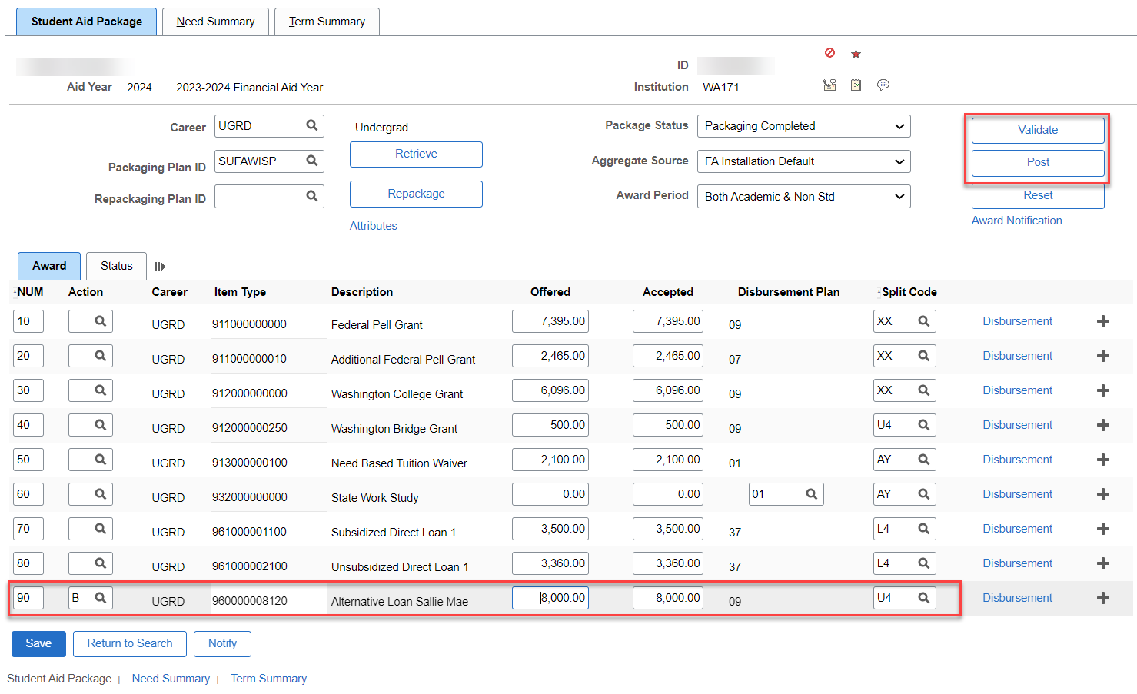
Awarding Alternative Loans: Accepted Status
Navigation: Financial Aid > Awards > Award Processing > Assign Awards to a Student
“B” the loan to offered/accepted so the loan is now able to be moved through disbursement

Slide 21
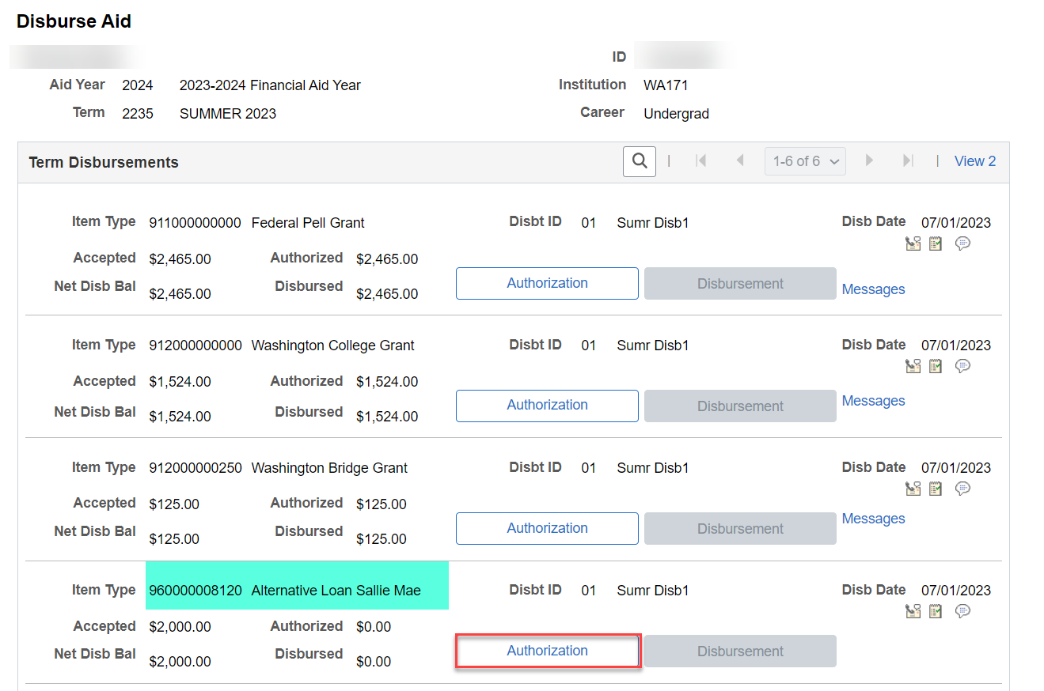
Disbursing Alternative Loans: Manual
Navigation: Financial Aid > Disbursement > Disburse Aid
Find the Alternative Loan Item Type in your Disburse Aid page for the Term. Select Authorization.

Slide 22
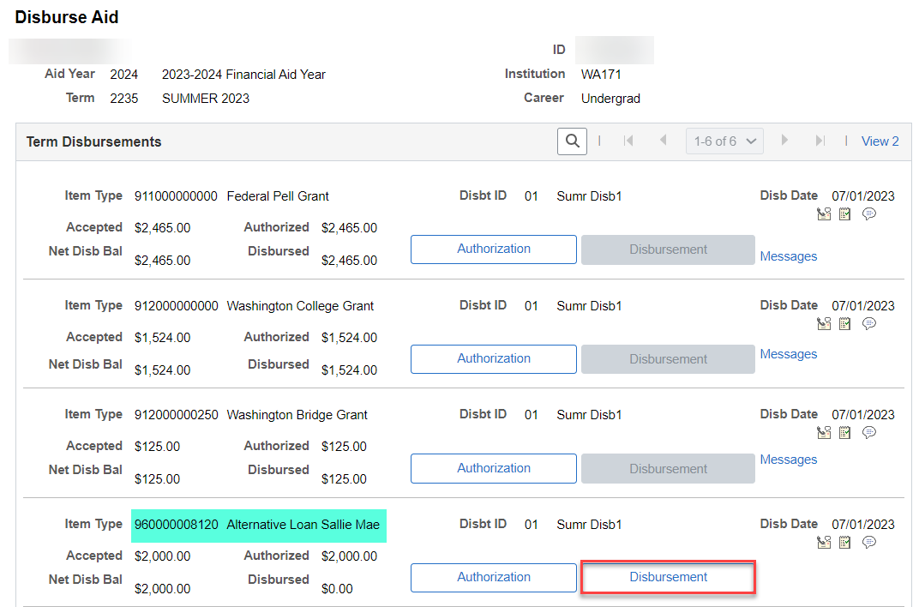
Disbursing Alternative Loans: Manual (Cont’d)
Select Disbursement to move the funds into the Disbursed row.

Slide 23
DEMONSTRATION

Slide 24
Refunds
Financial Aid has awarded/disbursed the Alternative Loan and it is now ready for Refunding to the student.
Refund Processing:
  Batch Refunds
  Individual Refunds
Important!: Ensure you update your Run Control for Batch Refunds to include Alternative Loans Item Types (tab 4 – Item Types)
Notes:
Alec to speak

Slide 25
Objectives and Outcomes
Expected Session Outcome(s)
Gained a better understanding of:
  FA Alternative Loans Processing (Awarding)
  SF Alternative Loans Processing (Collect Department Receipt)
  FA Alternative Loans Processing (Disbursing)
  SF Alternative Loans Processing (Refunds)

Slide 26


