Slide 1
USER EDIT MESSAGE FUNDAMENTALS
Kelly Forsberg
ctcLink Functional Trainer | Financial Aid
July 2023

Slide 2
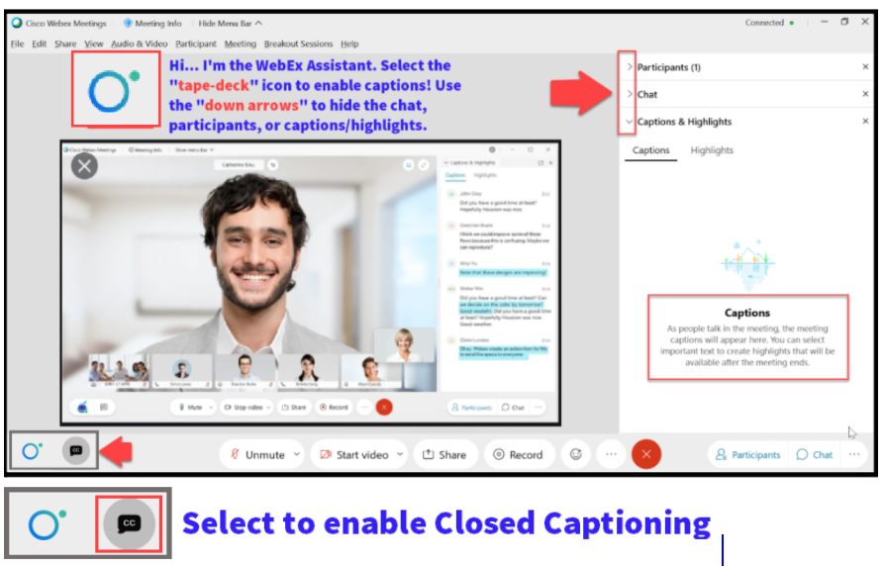

Slide 3
Logistics and Agenda
Times | Activity
9:00 – 9:05 | Sign-In/Greet/Attendance
9:05 – 9:10 | Objectives
9:10 – 9:45 | Assigning and Resolving UEMs – Manually & Batch
9:45 – 10:30 | Track Eligibility Changes Using UEMs
10:30 – 10:40 | Track Eligibility Report
10:40 – 10:50 | Available Queries/Reports
10:50 – 11:00 | Session Wrap-Up/Q&A
Some processes will have demonstrations, but due to data scrubbing, available data in the environment, demo examples are not ideal

Slide 4
ground rules
Be ready to participate
Remove external distractions
Mute your line when not speaking
Do NOT place Webex line on hold. Use Mute.
Please leave your line on Mute unless you are speaking
Sessions are being recorded
Allow your peers to complete their thoughts before beginning yours

Slide 5
Objectives
After completing this training, you should be able to:
Understand how and why you would use UEMs versus or in addition to Service Indicators
Understand Assigning a UEM in batch and manually
Track Financial Aid eligibility changes using UEMS:
UEM for Remedial Units Exceeding 45 Units
UEM for Students with Academic Plan Changes within a Term
UEM for Ineligible Coursework
Understand to how run and read the Track Student Eligibility Report
Understand what Queries/Reports are available
Understand how to resolve UEMs

Slide 6
HOW AND WHY YOU WOULD USE UEMs VS SERVICE INDICATORS

Slide 7
Uems VS. Service indicators
HOW AND WHY DO YOU USE THEM?
User Edit Messages | Service Indicators | Same or Different
Internal use only | Student-facing | ❌
Used to preemptively track student eligibility | Used to prevent processing of disbursements | ❌
Can track using a query | Can track using a query | ✅
Can have service impacts like block disbursement | Can have service impacts like block disbursement | ✅
Can mass release | Can mass release | ✅

Slide 8
Service indicators
STUDENT FACING:
Ineligible Academic Plan
F04 Service Indicator Assigns in Mass - prevents the student from being picked up by those select queries in Mass Packaging
Checklist can be assigned and displays on student’s To Do - the checklist blocks disbursement if a student has been awarded
There is a whole query tied to mass assigning and releasing that is part of the Mass Packaging process. Find the process in the:
Track Student Eligibility Guide BPG

Slide 9
CREATING USER
EDIT MESSAGES

Slide 10
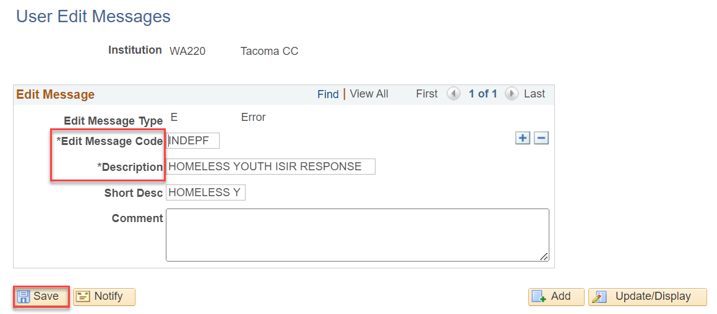
Creating user edit messages
EXAMPLE ONLY:
Navigation: Set Up SACR > Product Related > Financial Aid > Disbursement > Create User Edit Messages

Slide 11
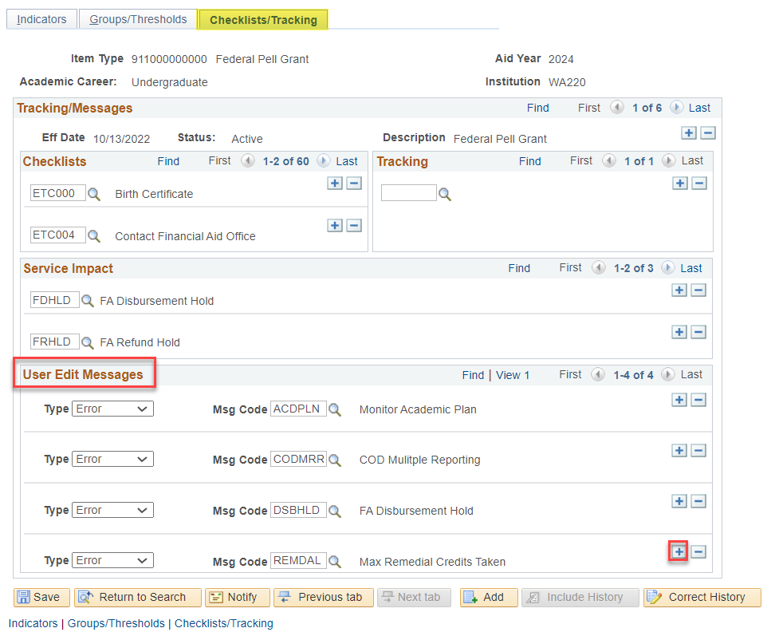
Assigning a user edit message
DEPENDENCY: Must be defined in Define Item Type Rules page
Navigation: Set Up SACR > Product Related > Financial Aid > Disbursement > Define Item Type Rules

Slide 12
ASSIGNING USER
EDIT MESSAGES
(BATCH & MANUAL)

Slide 13
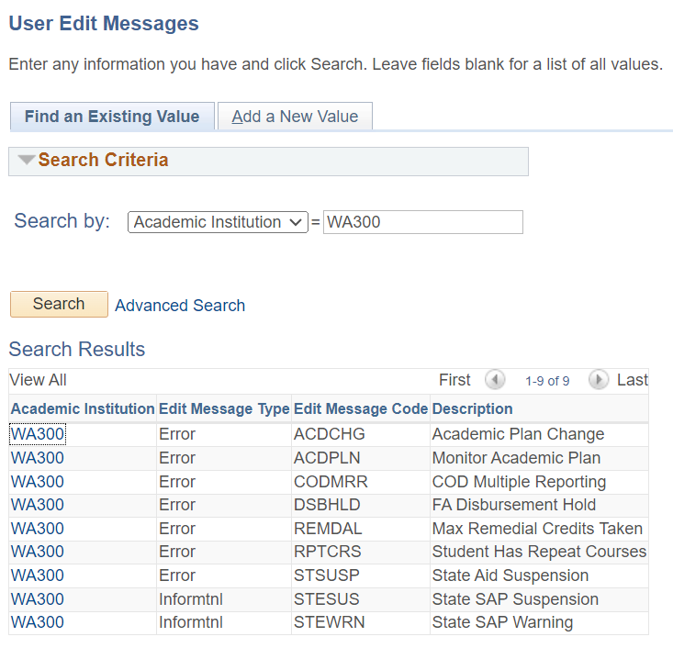
ASSIGNING USER EDIT MESSAGES
AVAILABLE GLOBAL UEMs
Navigation: Set Up SACR > Product Related > Financial Aid > Disbursement > Create User Edit Messages

Slide 14
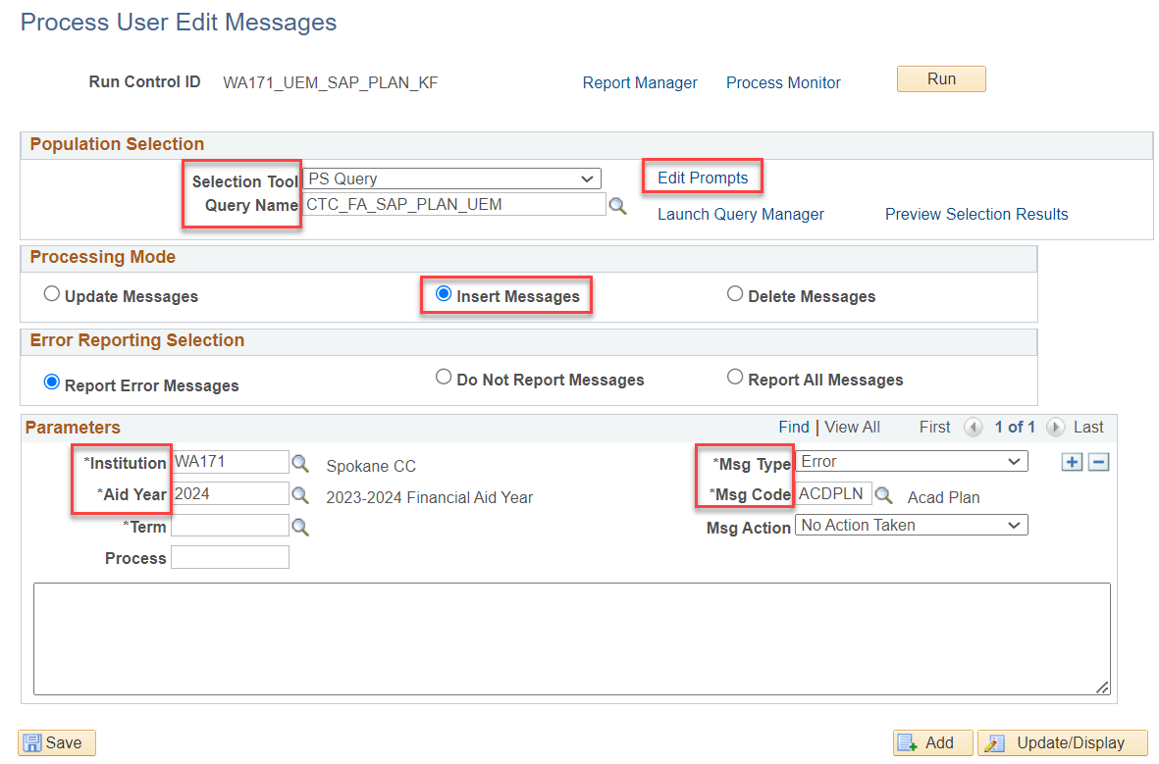
Assigning a user edit message
BATCH ASSIGNING
Navigation: Financial Aid > Disbursement > Process User Edit Messages

Slide 15
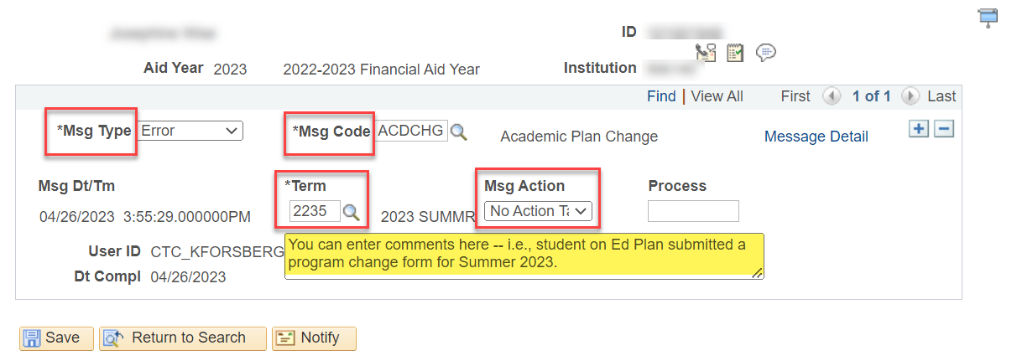
Assigning a user edit message
MANUALLY ASSIGNING
Navigation: Financial Aid > Disbursement > Maintain User Edit Messages
You can set any Msg Code for multiple reasons – students can have more than 1 UEM

Slide 16
TRACK ELIGIBILITY CHANGES
USING UEMs

Slide 17
Global user edit messages for track eligibility changes
REMDAL - Remedial Units Exceeding 45 Units
ACDCHG - Academic Plan Changes
INELGC - Ineligible Coursework
Use these eligibility change UEMs when you are doing your backend processing and packaging

Slide 18
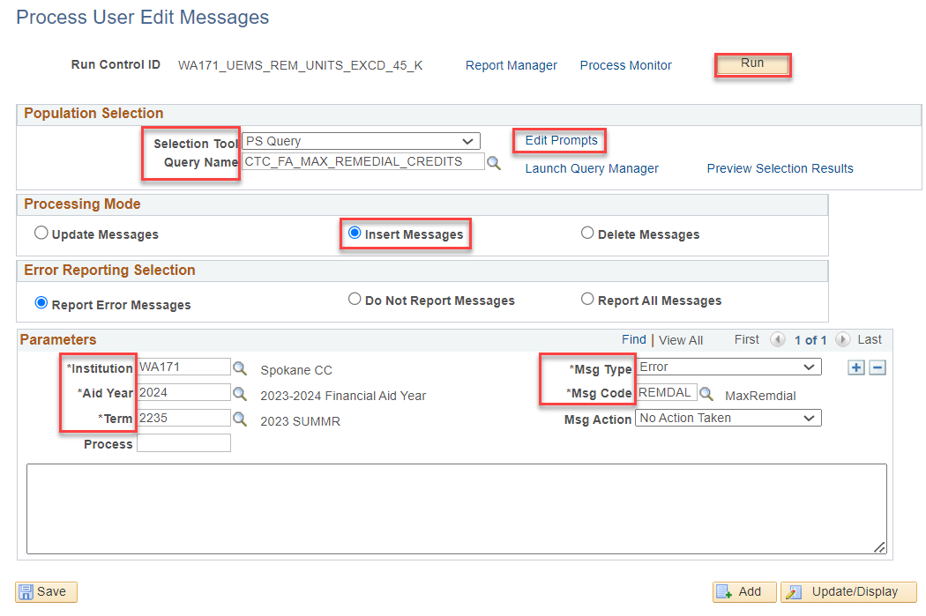
REMDAL - REMEDIAL UNITS EXCEEDING 45 UNITS
Navigation: Financial Aid > Disbursement > Process User Edit Messages
BATCH ASSIGNING
Query pulls students who are considered enrolled for classes numbered less than 100 in the current or previous term that total more than the number of units (i.e. 45). Basic skills CIP Code 32 are excluded

Slide 19
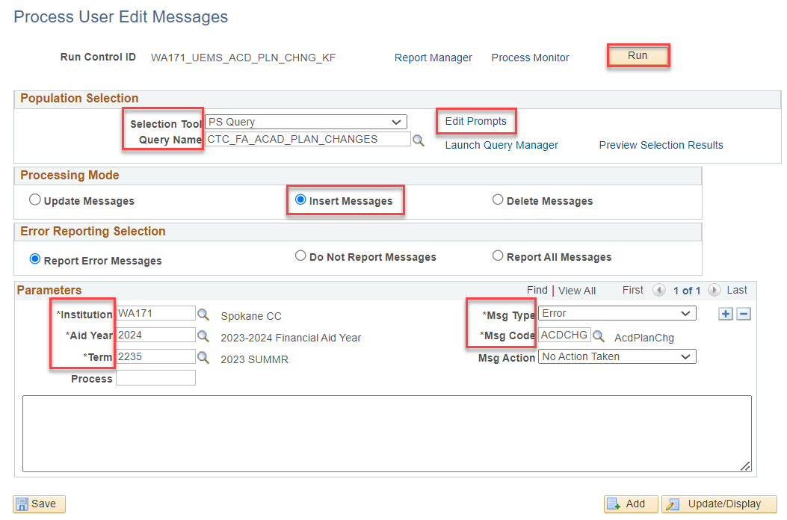
Acdchg - Academic plan changes in a term
Navigation: Financial Aid > Disbursement > Process User Edit Messages
BATCH ASSIGNING
Query pulls students who have academic plan changes, for the prompted term on the FA Term component, has total Accepted greater than zero for the term, and ACDCHG UEM has not been set to ‘Resolved’ for the term being processed.

Slide 20
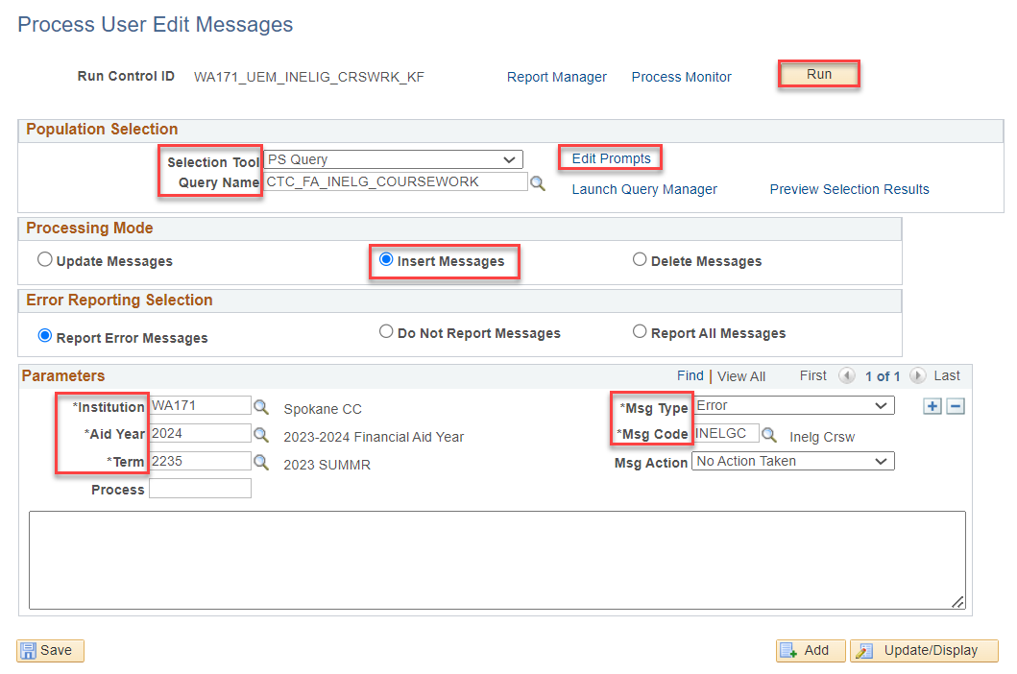
Inelgc - INELIGIBLE COURSEWORK IN A term
Navigation: Financial Aid > Disbursement > Process User Edit Messages
BATCH ASSIGNING
Assigns INELGC UEM to students enrolled in courses, for the prompted term, that are not part of their current active program(s)/plan(s).

Slide 21
DEMONSTRATION

Slide 22
RUNNING AND READING
THE TRACK ELIGIBILITY
CHANGES
REPORT

Slide 23
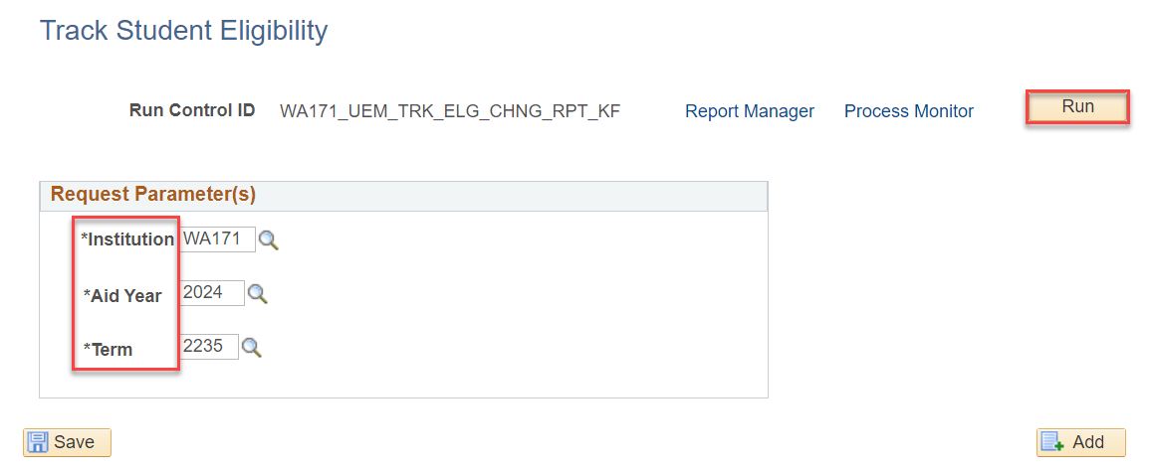
TRACK ELIGIBILITY CHANGES REPORT
RUNNING THE REPORT
Navigation: Financial Aid > CTC Custom > CTC Reports > Track Student Eligibility
You can also run the query QCS_FA_UEM_CODE to run a list of all UEMs assigned, and then filter down for the ones that are for track eligibility changes – however, the report will give you more comprehensive information

Slide 24
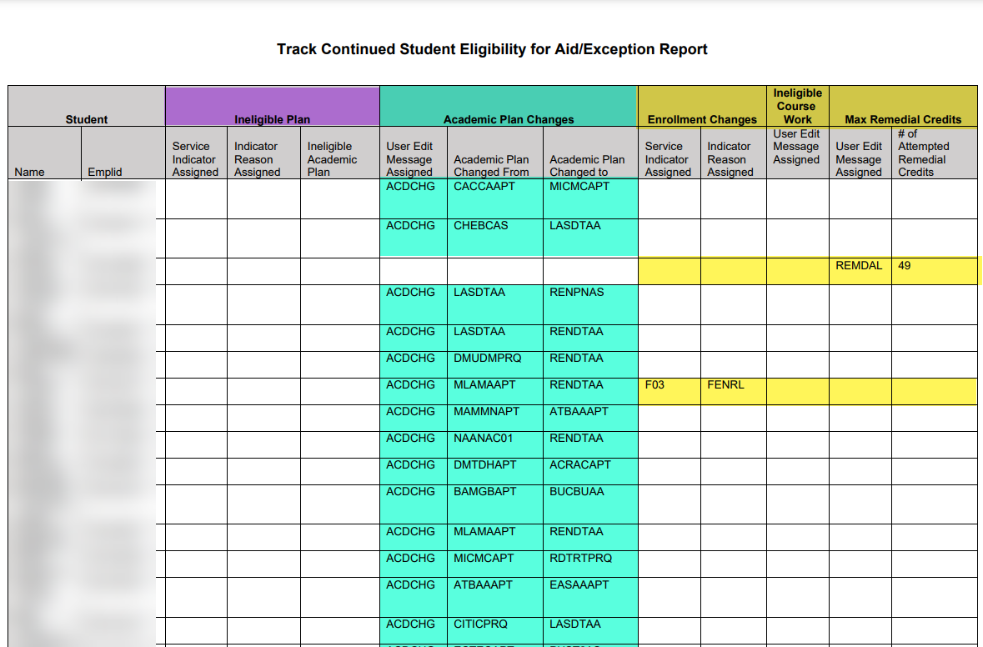
TRACK ELIGIBILITY CHANGES REPORT CONT
READING THE REPORT
Review the different columns to see the students who have Ineligible course work and/or Academic Plan Changes or Ineligible Plans

Slide 25
DEMONSTRATION

Slide 26
AVAILABLE QUERIES

Slide 27
queries
Ineligible Plan – CTC_FA_INELIG_PLAN_RPT
Remedial Exceeding 45 Units - CTC_FA_MAX_REMEDIAL_CREDIT_RPT
Academic Plan Changes - CTC_FA_ACAD_PLAN_CHANGES_RPT1 & CTC_FA_ACAD_PLAN_CHANGES_RPT2
Ineligible Coursework - CTC_FA_INELG_COURSEWORK_RPT
You may run these queries once the UEMs have been assigned
You can run the assign queries ahead
of time to see who will be assigned

Slide 28
Queries cont’d
UEMs by Code – QCS_FA_UEM_CODE
UEMs All – QCS_FA_UEM_ALL
Run these to maintain your list of outstanding UEMs and their code statuses

Slide 29
RESOLVING UEMS

Slide 30
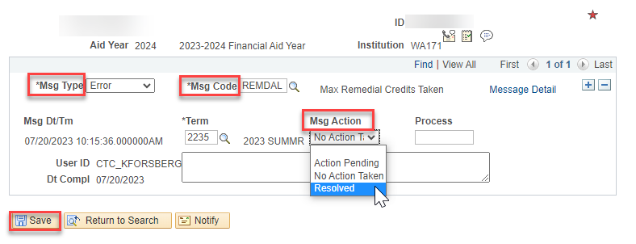
RESOLVING UEMS
MANUAL RESOLVING
Navigation: Financial Aid > Disbursement > Maintain User Edit Messages
Set the Msg Action to Resolved and Save. Removing manually keeps the history of the UEM being assigned.
Note: If you batch remove the UEMs, the history is gone.

Slide 31
DEMONSTRATION

Slide 32
Outcomes
At training completion, you should be able to:
Understand how and why you would use UEMs versus or in addition to Service Indicators
Understand Assigning a UEM in batch and manually
Track Financial Aid eligibility changes using UEMS:
UEM for Remedial Units Exceeding 45 Units
UEM for Students with Academic Plan Changes within a Term
UEM for Ineligible Coursework
Understand to how run and read the Track Student Eligibility Report
Understand what Queries/Reports are available
Understand how to resolve UEMs

Slide 33
Congratulations!
UEM Fundamentals Training Complete!
Please review the videos and additional resources in the ctcLink Reference Center as your progress through the steps
Thank you for your participation today!

