Slide 1
Disbursement refresher
Kelly Forsberg
ctcLink Functional Trainer | Financial Aid
July 2023

Slide 2
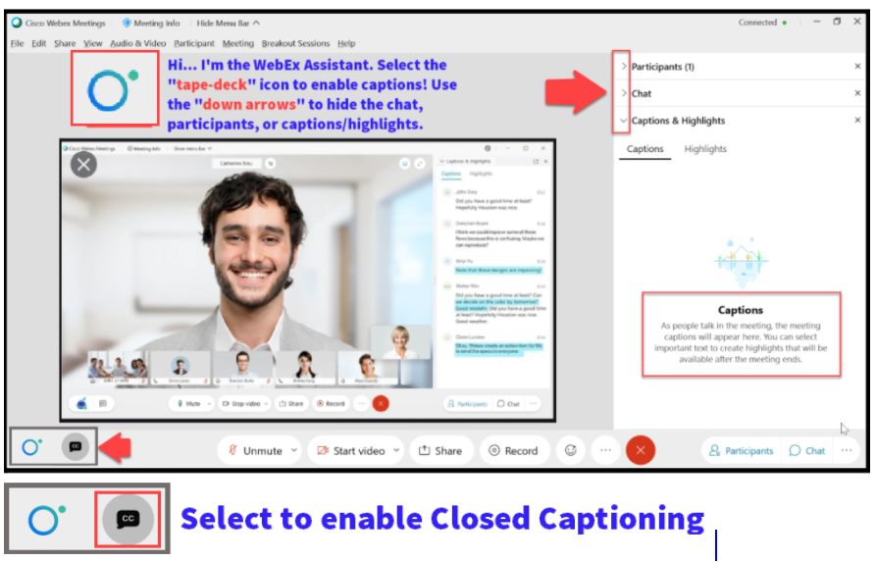

Slide 3
Agenda
Times | Activity
9:00 – 9:05 | Sign-In/Greet/Objectives
9:05 – 9:20 | Manual and batch Disbursement
9:20 – 9:45 | Steps involved to block disbursement and refunds
9:45 – 9:50 | Queries & Cust Acct review
9:50 – 10:00 | Session Wrap-Up
Some processes will have demonstrations, but due to data scrubbing, available data in the environment, demo examples are not ideal

Slide 4
ground rules
Be ready to participate
Remove external distractions
Mute your line when not speaking
Do NOT place Webex line on hold. Use Mute.
Please leave your line on Mute unless you are speaking
Sessions are being recorded
Allow your peers to complete their thoughts before beginning yours

Slide 5
Objectives
After completing this training, you should be able to:
Understand how to run batch disbursement and manual disbursement
Understand the steps involved to block refunds due to withdrawn students
Understand the available queries to help track disbursement
Understand how to review the Customer Account
Notes:
At course completion, you should now be able to:

Slide 6
BATCH
DISBURSEMENT

Slide 7
Disbursement in batch
Navigation: Financial Aid > Disbursement > Process Disbursements
Remember you can process more than one AY and Term at a time.

Slide 8
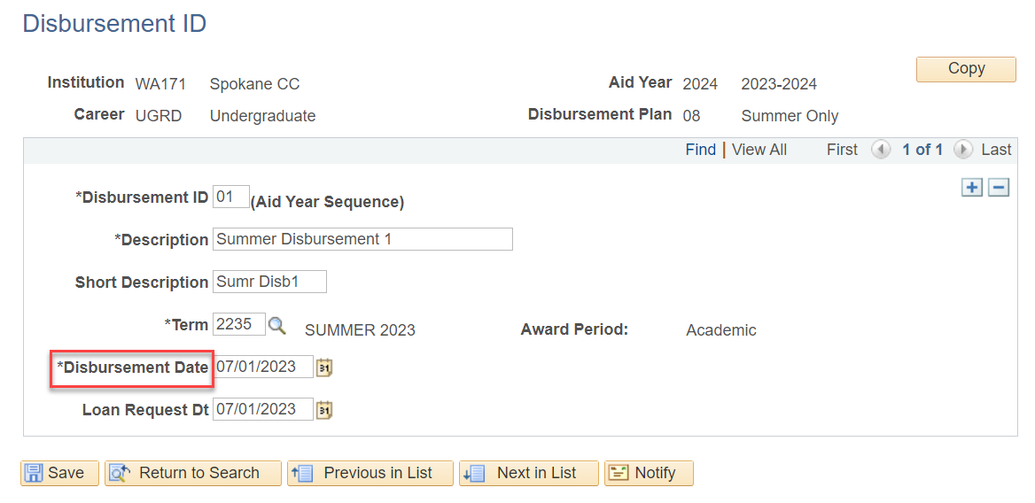
Disbursement in batch HONOR DISBURSEMENT Date
Navigation: Set Up SACR > Product Related > Financial Aid > Awards > Disbursement ID Table
The Honor Disbursement Date checkbox is tied to the Disbursement ID Table set up and honors the day you have set up there in that table.

Slide 9
Disbursement in batch GRACE PERIOD (DAYS)
Tip! If you are not able to run Batch Disbursement until the published Disbursement Date, you can enter a value into the Grace Period (Days) field and Disbursement will run in Batch, in this example, 5 days earlier, and will still display the July 1 Disbursement Date for records that go out to COD.

Slide 10
DEMONSTRATION

Slide 11
MANUAL
DISBURSEMENT

Slide 12
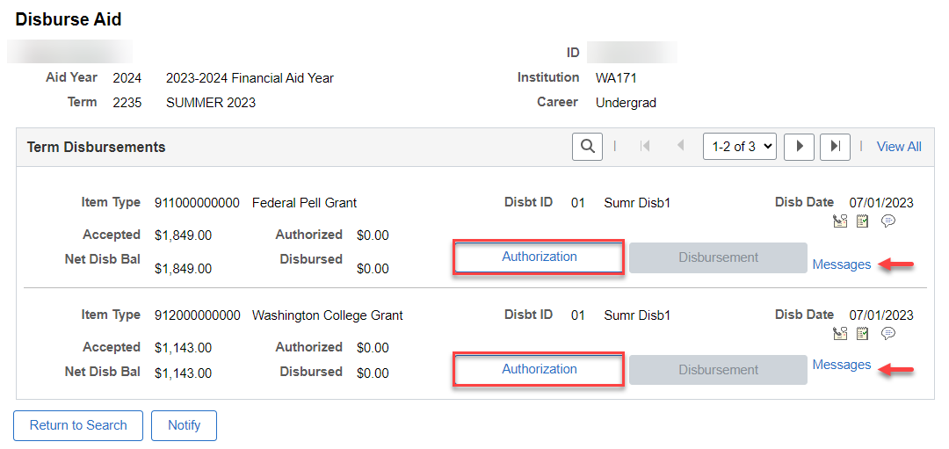
Manual disbursement
Navigation: Financial Aid > Disbursement > Disburse Aid
Note: Check any messages in this page on each Item Type before proceeding; they usually will display an Authorization Failure Message as to why it did not disburse during batch disbursement.

Slide 13
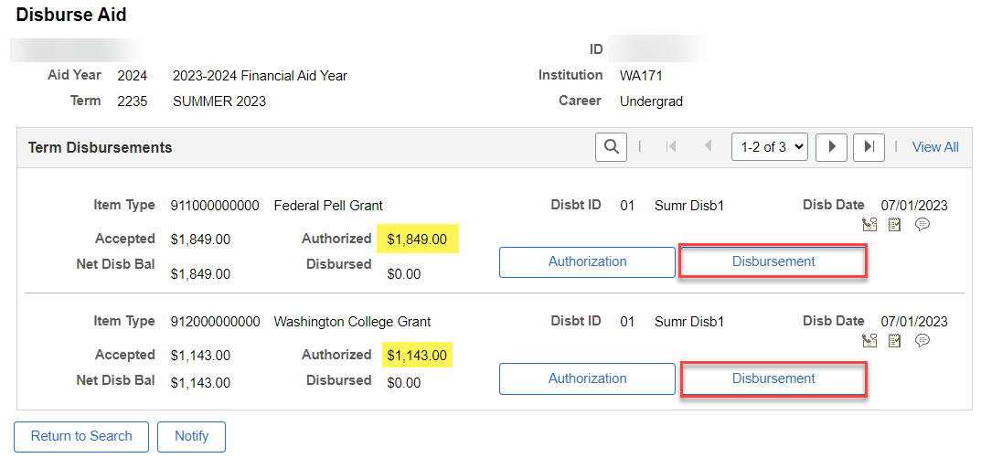
Manual disbursement
Select the Disbursement button and the amount in the Authorized row will move into the Disbursed row.

Slide 14
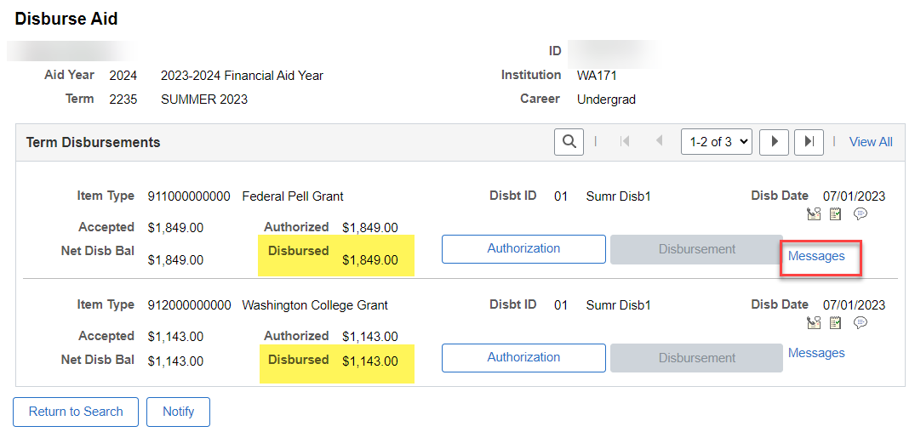
Manual disbursement
Once the aid moves to the Disbursed row, you can check the Messages link to confirm.

Slide 15
DEMONSTRATION

Slide 16
DISBURSE AID
WITH OVERRIDE

Slide 17
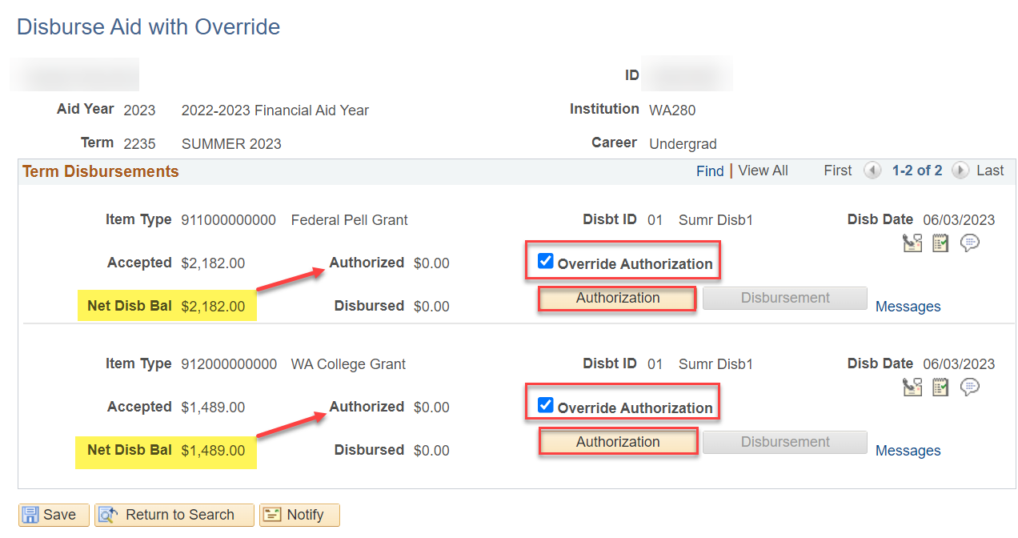
Disburse WITH OVERRIDE
Navigation: Financial Aid > Disbursement > Disburse Aid with Override
Note: Use with caution! This override function bypasses all federal, state and system rules. The one message it will not bypass is the Funds for this disbursement have not been recorded in the system message.

Slide 18
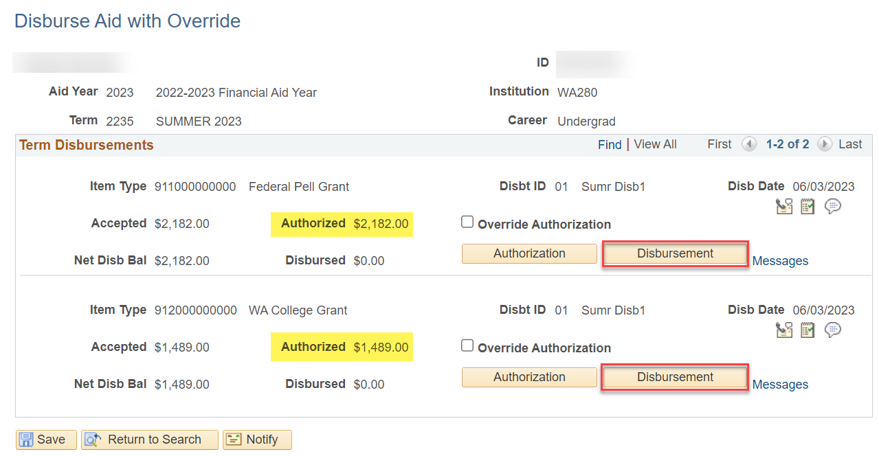
Disburse WITH OVERRIDE
Select the Disbursement button, and the Authorized amount will move into the Disbursed row.

Slide 19
DEMONSTRATION

Slide 20
BLOCKING REFUNDS ON WITHDRAWN STUDENTS

Slide 21
Available resources to track students who have withdrawn
Business Process Guide (for both FA & SF):
Blocking FA Refunds Due to Withdrawals Business Process Guide | 9.2 FA - Financial Aid Business Process Guides | ctcLink Reference Center
Assigning and managing your Service Indicators:
F03s (FA) – Blocking Disbursement
B03s (SF) – Blocking Refunds

Slide 22
QUERIES

Slide 23
QUERIES
USEFUL QUERY TO TRACK THE GROUP POST AMOUNT FOR YOUR DISBURSEMENT RUN
CTC_FA_DISBURSED_BY_DATE
Run and save this query with each disbursement run / share with SF

Slide 24
QUERIES
USEFUL QUERY TO TRACK WITHDRAWALS UP UNTIL CENSUS
CTC_FA_LOAD_COMP_BETWEEN_DATE – compares students with different FA load level when disbursed to date entered in prompt
Run and work this query daily up until Census

Slide 25
CUSTOMER ACCOUNTS

Slide 26
VIEW CUSTOMER ACCOUNTS FEE001, TUT001 ACCOUNTS
Navigation: Student Financials > View Customer Account
Two accounts you always want to look at for the Term: the TUT001 and the FEE001 accounts. Select Account Details to view what aid was applied to what charge

Slide 27
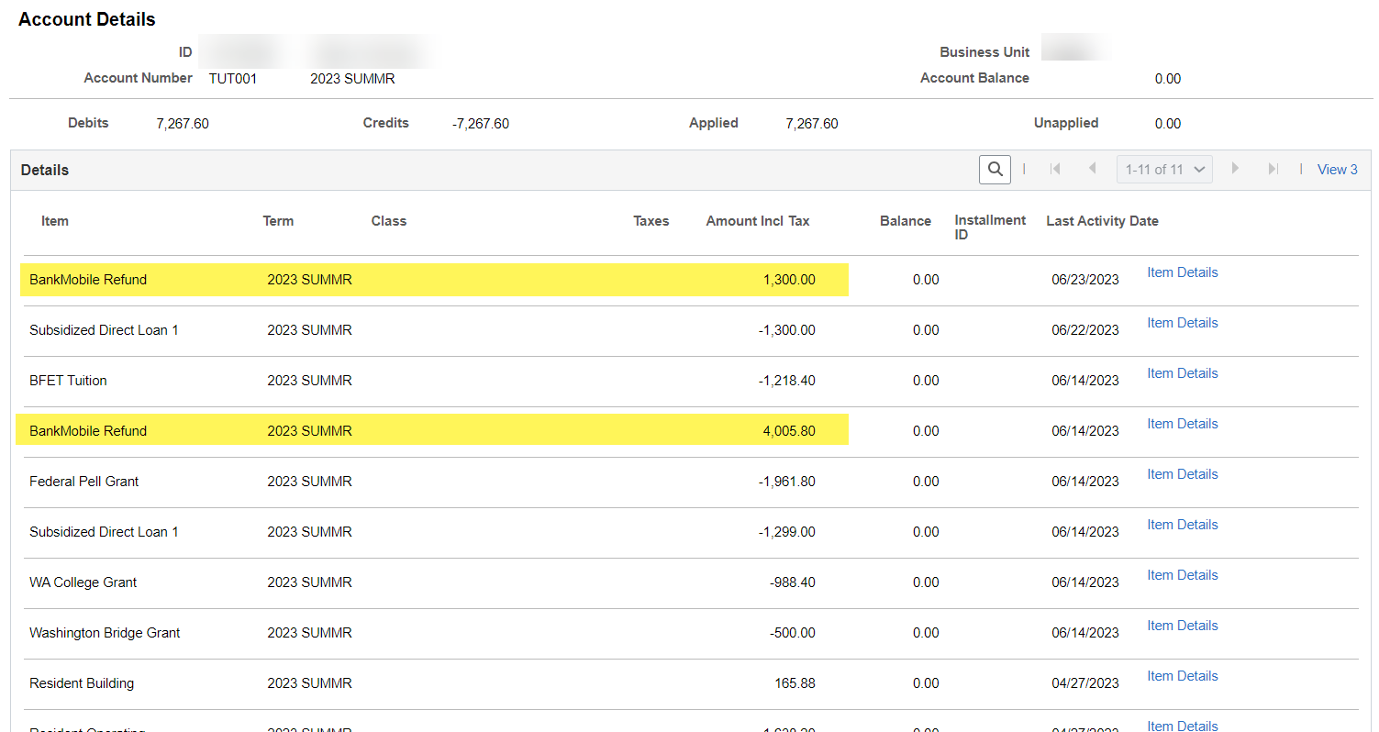
VIEW CUSTOMER ACCOUNTS cont’d TUT001 ACCOUNT
In the TUT001 account, you typically will see Operating, Resident, and S&A charges

Slide 28
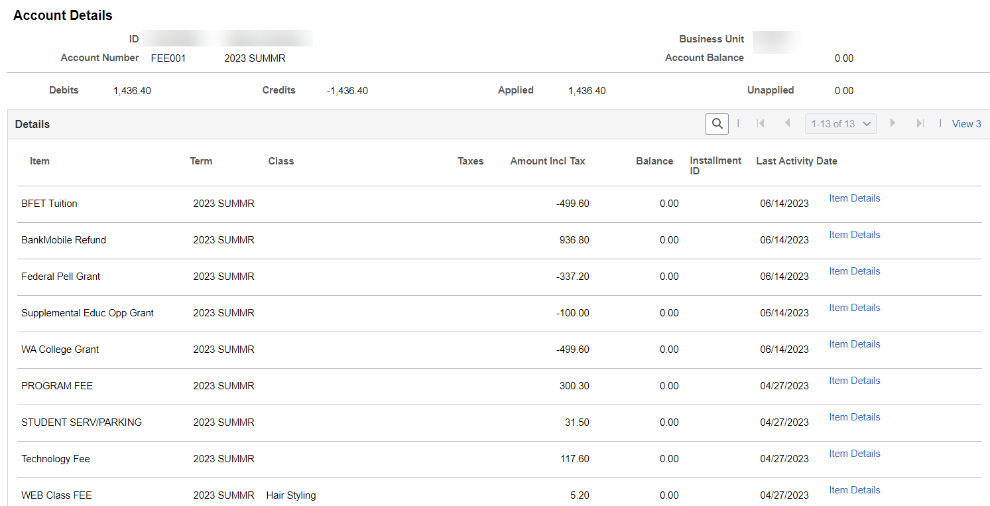
VIEW CUSTOMER ACCOUNTS cont’d FEE001 ACCOUNT
In the FEE001 account, you typically will see lab, program and technology fees

Slide 29
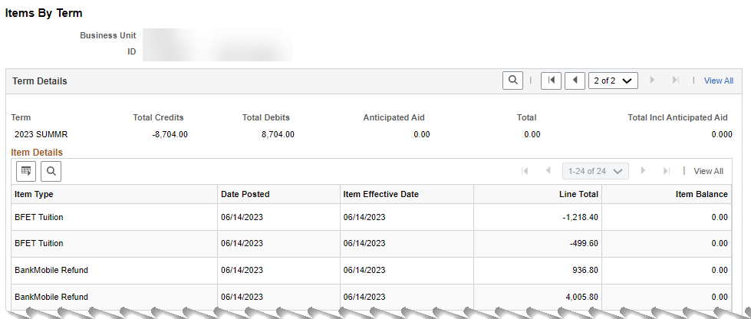
VIEW CUSTOMER ACCOUNTS cont’d items by term
Both FEE001 and TUT001 debits and credits for the term display in the Items by Term pagelet

Slide 30
DEMONSTRATION

Slide 31
Outcomes
At training completion, you should be able to:
Understand how to run batch disbursement and manual disbursement
Understand the steps involved to block refunds due to withdrawn students
Understand the available queries to help track disbursement
Understand how to review the Customer Account

Slide 32
Congratulations!
Disbursement Refresher Training Complete!
Please review the relevant business processing guide resources shared in the chat, as you are processing your disbursements
Thank you for your participation today!

