Slide 1
CENSUS PROCESSING refresher
Kelly Forsberg
ctcLink Functional Trainer | Financial Aid
July 2023

Slide 2
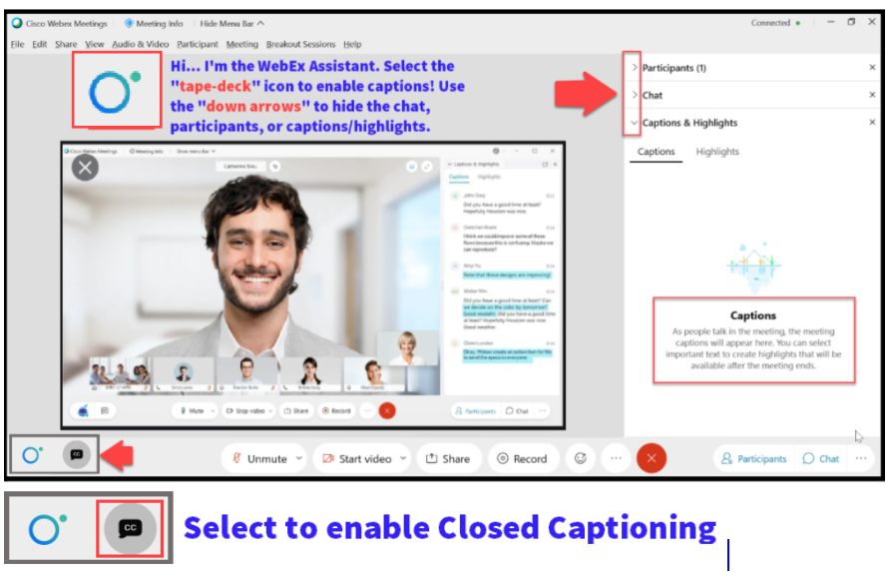

Slide 3
Agenda
Times | Activity
9:00 – 9:05 | Sign-In/Greet/Objectives
9:05 – 9:45 | Build Equation Engines and FA Term Run Control to enter into a Jobset
9:45 – 10:00 | Building the JobSet
10:00 – 10:15 | Queries to run
10:15 – 10:30 | Session Wrap-Up/Canvas Overview
Some processes will have demonstrations, but due to data scrubbing, available data in the environment, demo examples are not ideal

Slide 4
ground rules
Be ready to participate
Remove external distractions
Mute your line when not speaking
Do NOT place Webex line on hold. Use Mute.
Please leave your line on Mute unless you are speaking
Sessions are being recorded
Allow your peers to complete their thoughts before beginning yours

Slide 5
Objectives
After completing this training, you should be able to:
Build Equation Engines and FA Term Run Control used for Processing Census
Build and Run the Census JobSet
Understand the available queries used to track changes in enrollment at Census
Notes:
At course completion, you should now be able to:

Slide 6
BUILDING CENSUS
EQUATION ENGINE & FA TERM

Slide 7
CENSUS EQUATION ENGINE
3-STEP PROCESS
Step 1: Build Equation Engine
Step 2: Build FA Term
Step 3: Build Equation Engine Again

Slide 8
Process census EQUATION ENG cont’d
Navigation: Set Up SACR > Common Definitions > Equation Engine > Run Equation
This example shown is from an institution assuming a Summer term start date of 07/01/2023. Choose a date 7 days past your published Census Date

Slide 9
CENSUS equation ENGINE
3-STEP PROCESS
Step 1: Build Equation Engine
Step 2: Build FA Term
Step 3: Build Equation Engine Again

Slide 10
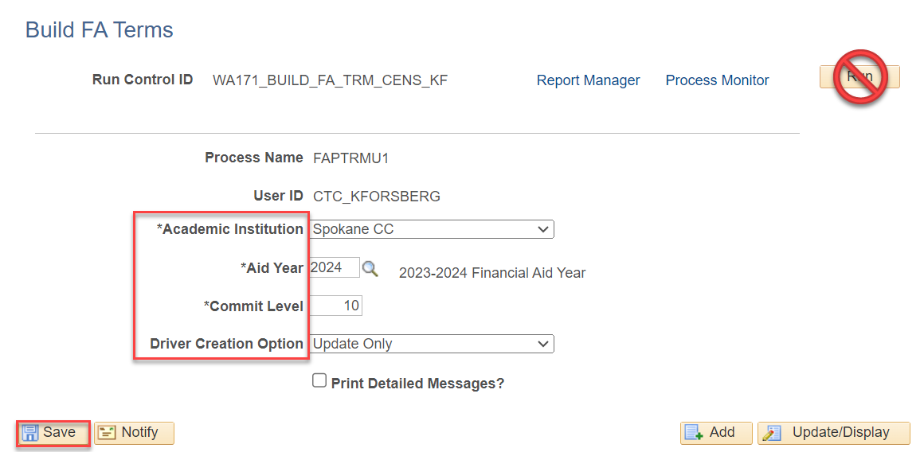
process census EQUATION ENG cont’d
Navigation: Financial Aid > FA Term > Build FA Term
Note: When running FA term process for Census, its purpose is to capture the enrollment data snapshot at the end of census.

Slide 11
CENSUS PROCESSING
3-STEP PROCESS
Step 1: Build Equation Engine
Step 2: Build FA Term
Step 3: Build Equation Engine Again

Slide 12
Process census equation eng cont’d
Navigation: Set Up SACR > Common Definitions > Equation Engine > Run Equation
This step resets FA Term back to the actual enrollment at census date, and locks it

Slide 13
DEMONSTRATION

Slide 14
SCHEDULING JOBSET DEFINITION

Slide 15
CENSUS PROCESSING
Schedule JobSet
Steps 1 - 3
Schedule JobSet

Slide 16
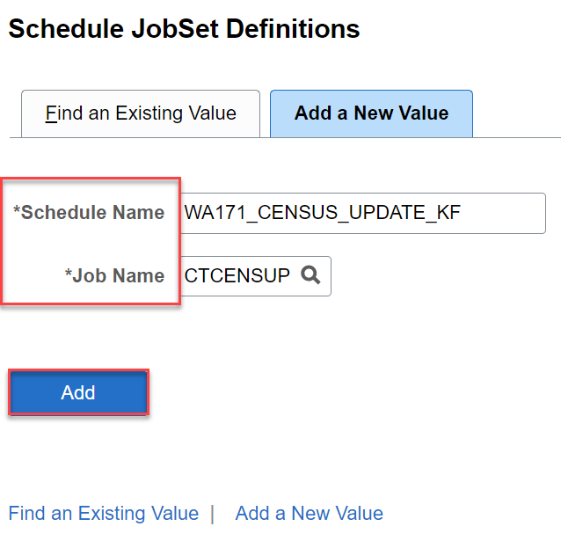
PROCESS CENSUS CONT’D
Schedule JobSet
Navigation: PeopleTools > Process Scheduler > Schedule JobSet Definitions

Slide 17
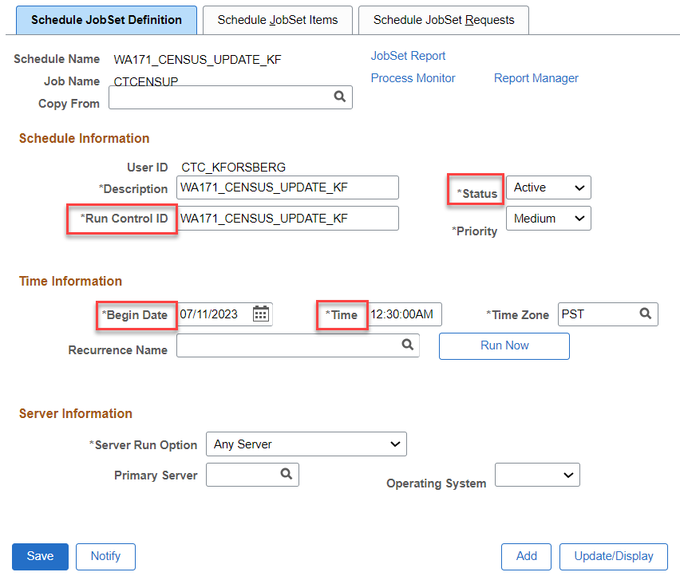
Process census cont’d
Note:
Set a future date* for your JobSet to run, then make the Status “Active”
*The JobSet should be run shortly after midnight on the day after your actual census date.
Schedule JobSet

Slide 18
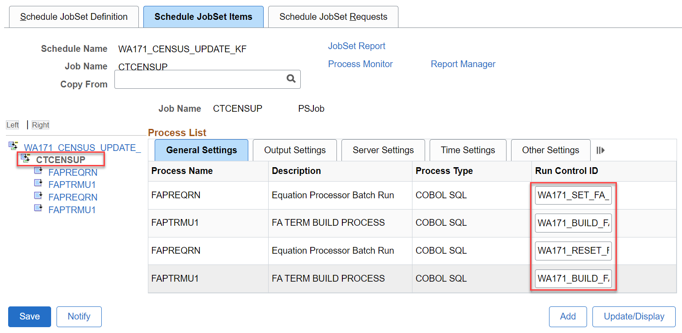
Process census cont’d
Schedule JobSet
Tip! Copy your run control IDs from the previous steps and paste them into the fields on this page to ensure accuracy

Slide 19
DEMONSTRATION

Slide 20
QUERIES

Slide 21
queries
Available queries recommended to run after you’ve begun disbursement, and run daily until Census lock:
CTC_FA_LOAD_COMP_BETWEEN_DATE – Compares students with different FA load level when disbursed to date entered in prompt. Picks up students with all aid
CTC_SERVICE_INDICATOR_LIST – Run to FLF to see who still has an outstanding FLF Service Indicator

Slide 22
Queries CONT’D
Available queries recommended to run after Census lock:
CTC_FA_CENSUS_DATE_LIST – Identifies students with a discrepancy between FA Load captured at most recent Authorization run via the Award Activity page vs. the FA Load in FA Term. Picks up students w/ traditional aid

Slide 23
DEMONSTRATION

Slide 24
Outcomes
At training completion, you should be able to:
Build Equation Engines and FA Term Run Control used for Processing Census
Build and Run the Census JobSet
Understand the available queries used to track changes in enrollment at Census

Slide 25
Congratulations!
Census Processing Refresher Training Complete!
Please review census business processing guide resource as you are doing your census processing
Thank you for your participation today!

