Slide 1
Intermediate auth & disb: authorization failure report troubleshooting
Kelly Forsberg
ctcLink Functional Trainer | Financial Aid
June 2023

Slide 2
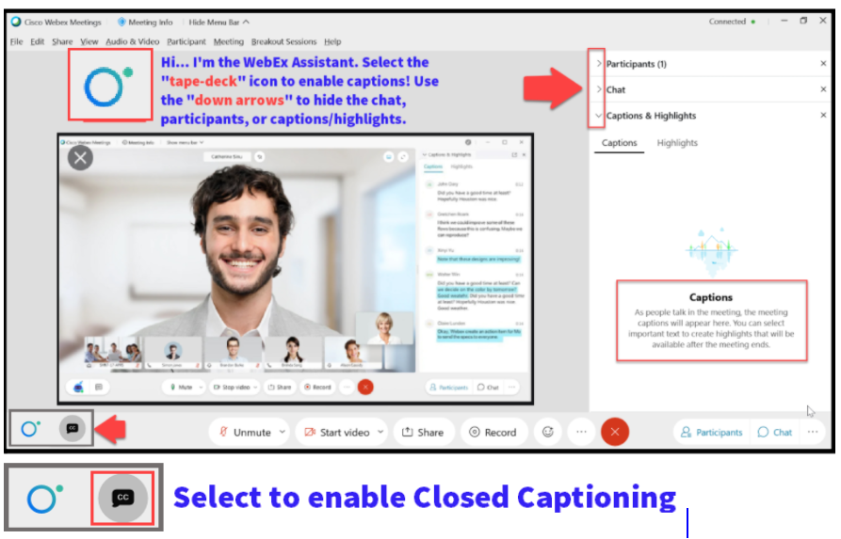

Slide 3
Logistics and Agenda
Times | Activity
9:00 – 9:05 | Sign-In/Greet/Attendance
9:05 – 9:10 | Objectives
9:10 – 9:30 | Known Issues & Workarounds
9:30 – 10:00 | Identify and prioritize Auth Failure Messages
10:00 – 10:45 | Working common errors & how to troubleshoot
10:45 – 11:00 | Session Wrap-Up/Q&A
Some processes will have demonstrations, but due to data scrubbing, available data in the environment, demo examples are not ideal

Slide 4
ground rules
Be ready to participate
Remove external distractions
Mute your line when not speaking
    Do NOT place Webex line on hold. Use Mute.
    Please leave your line on Mute unless you are speaking
    Sessions are being recorded
Allow your peers to complete their thoughts before beginning yours

Slide 5
Objectives
After completing this training, you should be able to:
Understand known issues and their workarounds with the Auth Failure Report
Identify and prioritize Authorization Failure messages
Work the most common Auth Fail Troubleshooting errors

Slide 6
KNOWN ISSUES AND
WORKAROUNDS

Slide 7
Authorization failure report
KNOWN ISSUES AND WORKAROUNDS
KNOWN ISSUE:
  Awards remaining on the Auth Fail Report pdf report
    Awards that are disbursed with override
    Awards that fail Authorization and are later cancelled
WORKAROUNDS:
  Run the Auth Fail Report via Query:
    CTCFA913
    QCS_FA913_WITH_ERROR_COUNT

Slide 8
IDENTIFYING AND PRIORITIZING
AUTH FAILURE MESSAGES

Slide 9
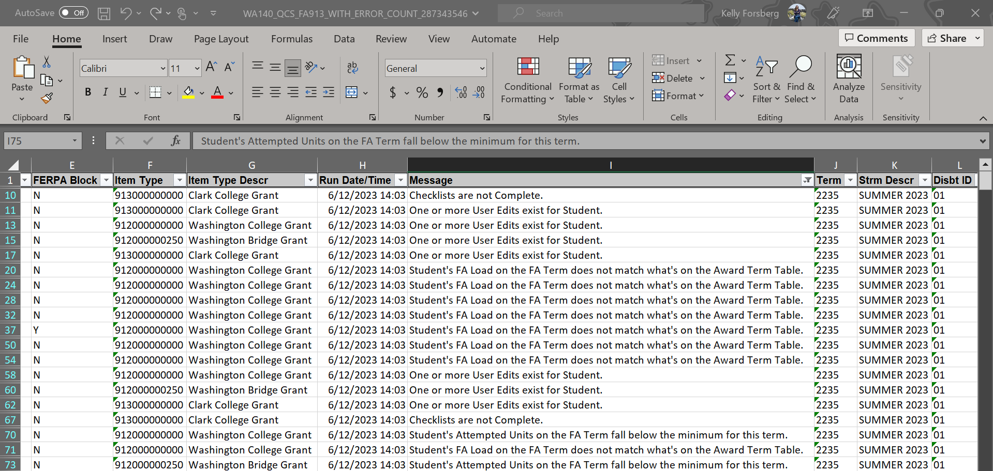
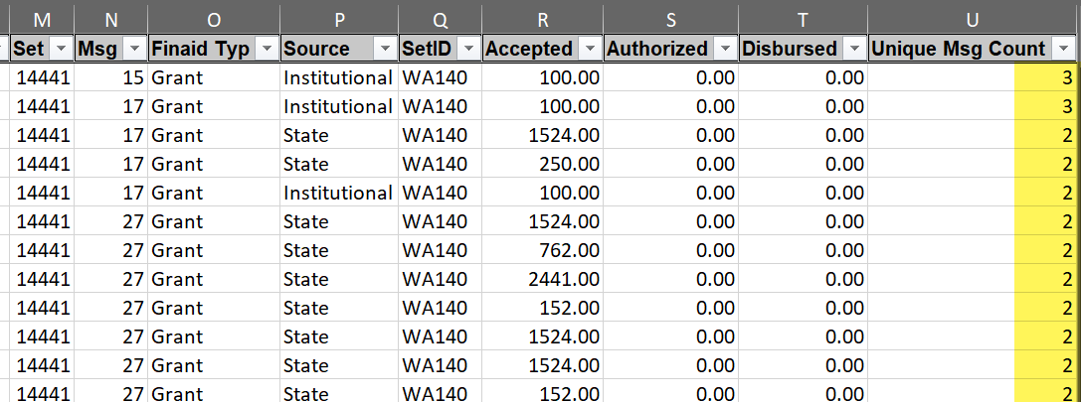
Reviewing the auth failure report
QCS_FA913_WITH_ERROR_COUNT
Running the query, note the Messages. Note the Unique Msg Count. If more than one Unique Msg Count, review the most severe message first.

Slide 10
DEMONSTRATION

Slide 11
WORKING THE MOST COMMON
AUTH FAILURE MESSAGES

Slide 12
MOST COMMON AUTH FAIL MESSAGES
Student's FA Load on the FA Term does not match what's on the Award Term Table
Student's Attempted Units on the FA Term fall below the minimum for this term
Funds for this disbursement have not been recorded in the system
You must disburse this award in sequential order
Student’s EFC is unofficial
Student's Federal Over Award amount > 0
Enrollment data does not exist for this student

Slide 13
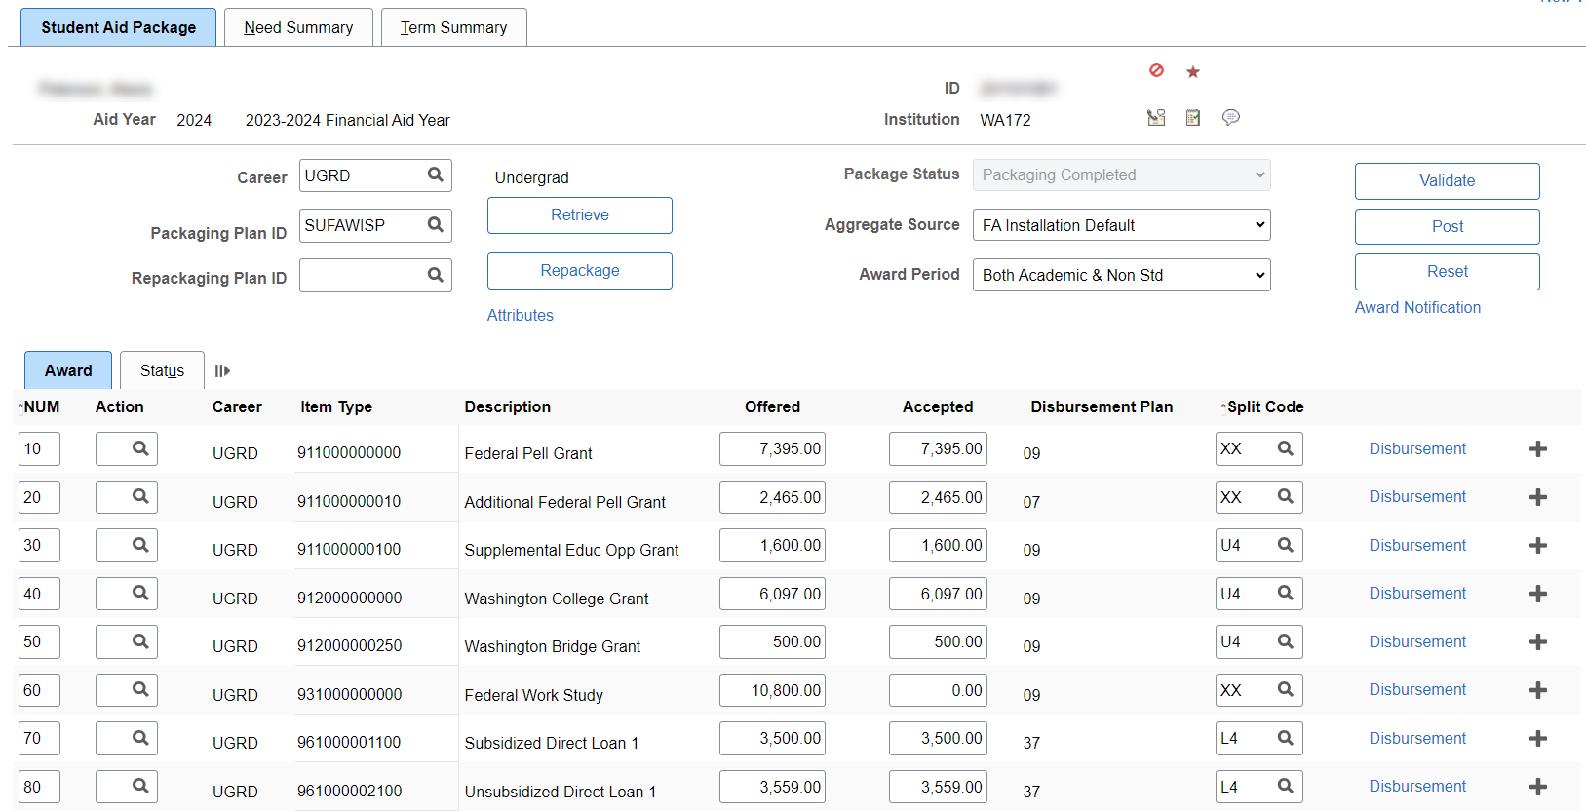
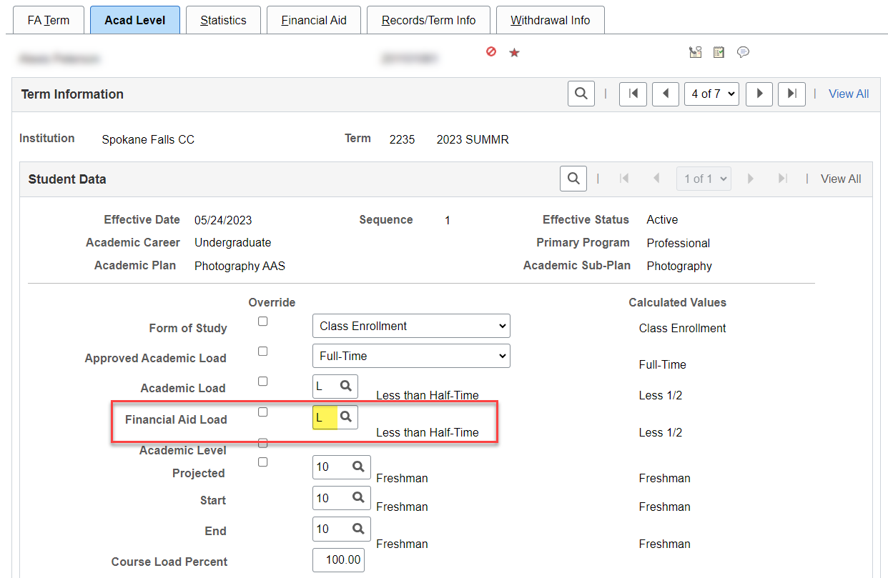
MOST COMMON AUTH FAIL MESSAGES
Student's FA Load on the FA Term does not match what's on the Award Term Table
Solution: Cancel the award, and re-award it to reflect the FA Load
Notes:
The Validation and Post process evaluated the award at a full-time FA Load at the time of awarding.
Now, as of the time Authorization was run, there is a mis-match on the award term table compared to FA Load.

Slide 14
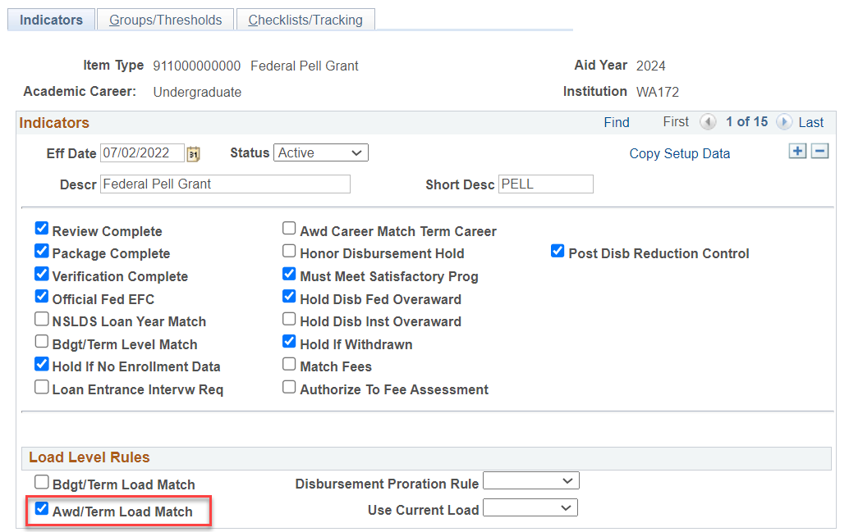
MOST COMMON AUTH FAIL MESSAGES
Student's FA Load on the FA Term does not match what's on the Award Term Table (CONT’D)
Navigation: Set Up SACR > Product Related > Financial Aid > Disbursement > Define Item Type Rules
Load Level Rules are driving the error message

Slide 15
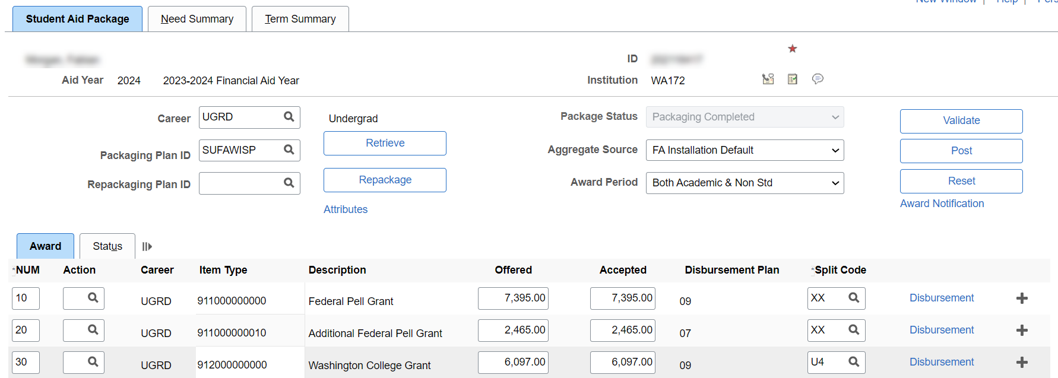
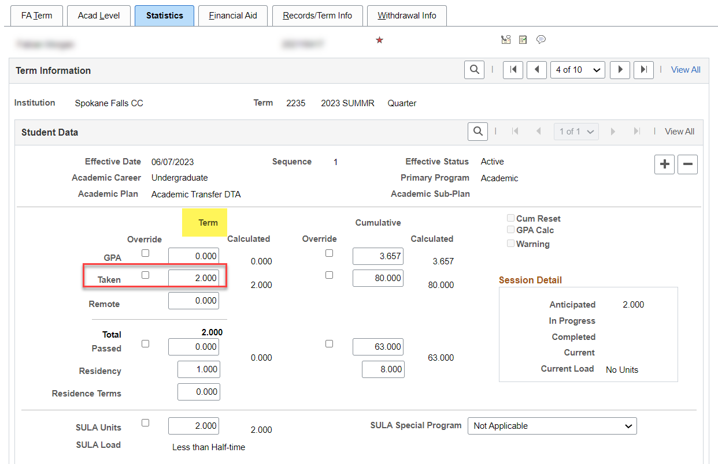
MOST COMMON AUTH FAIL MESSAGES
Student's Attempted Units on the FA Term fall below the minimum for this term
Solution: Cancel the award; student is ineligible

Slide 16
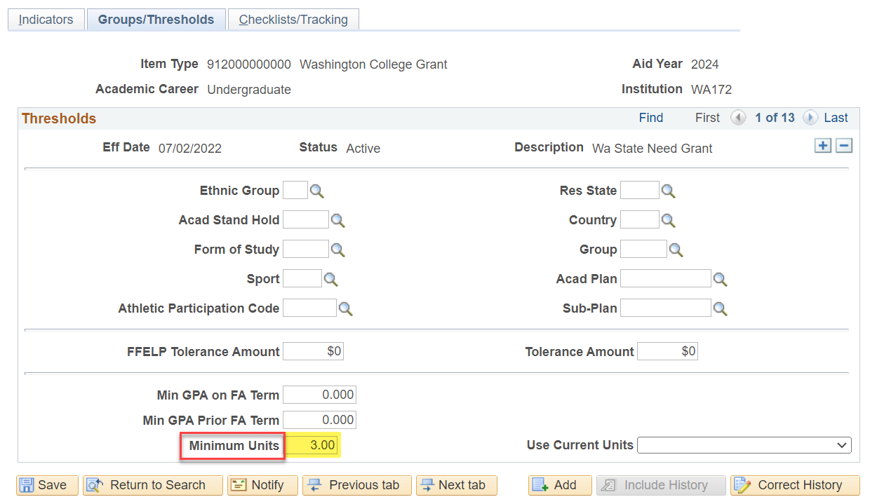
MOST COMMON AUTH FAIL MESSAGES
Student's Attempted Units on the FA Term fall below the minimum for this term (CONT’D)
Navigation: Set Up SACR > Product Related > Financial Aid > Disbursement > Define Item Type Rules
What is the minimum units a student must take to be eligible for WCG?

Slide 17
MOST COMMON AUTH FAIL MESSAGES
Student's Attempted Units on the FA Term fall below the minimum for this term
Solution: Cancel the award; student is ineligible

Slide 18
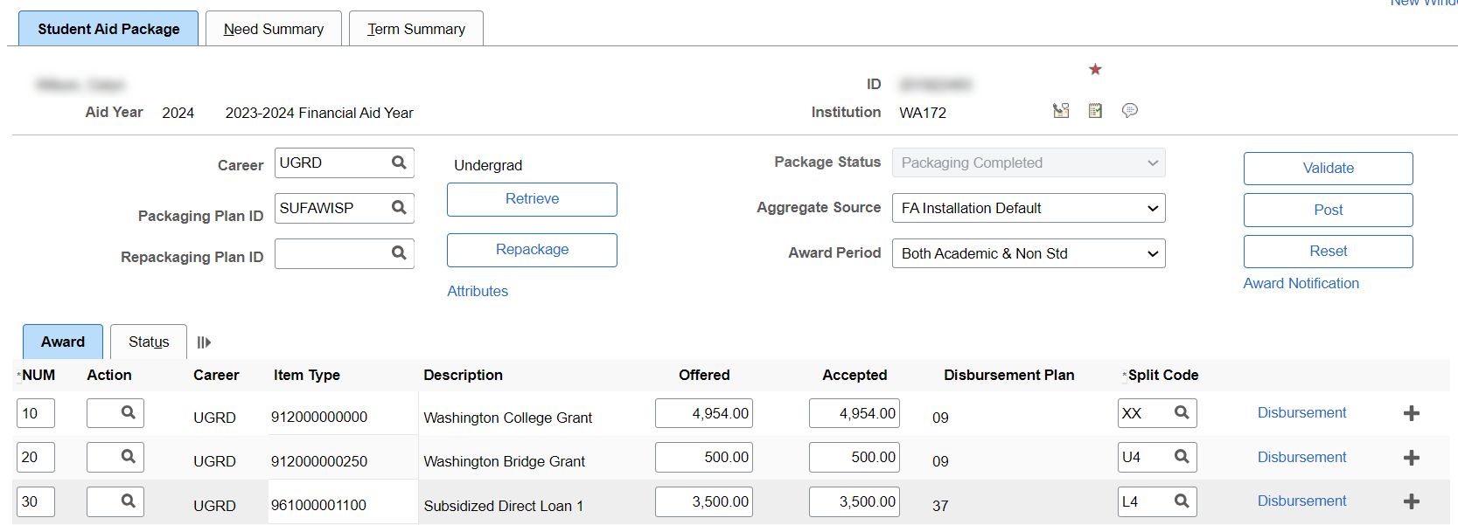
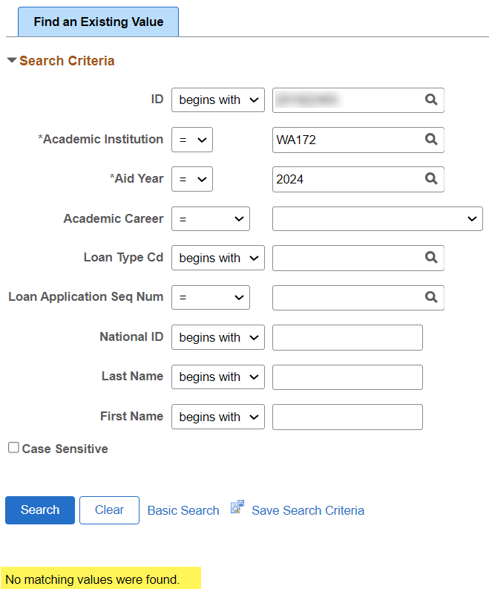
MOST COMMON AUTH FAIL MESSAGES
Funds for this disbursement have not been recorded in the system
Solution: Originate the loan. Ensure the MPN and Entrance Counseling acknowledgments are loaded.

Slide 19
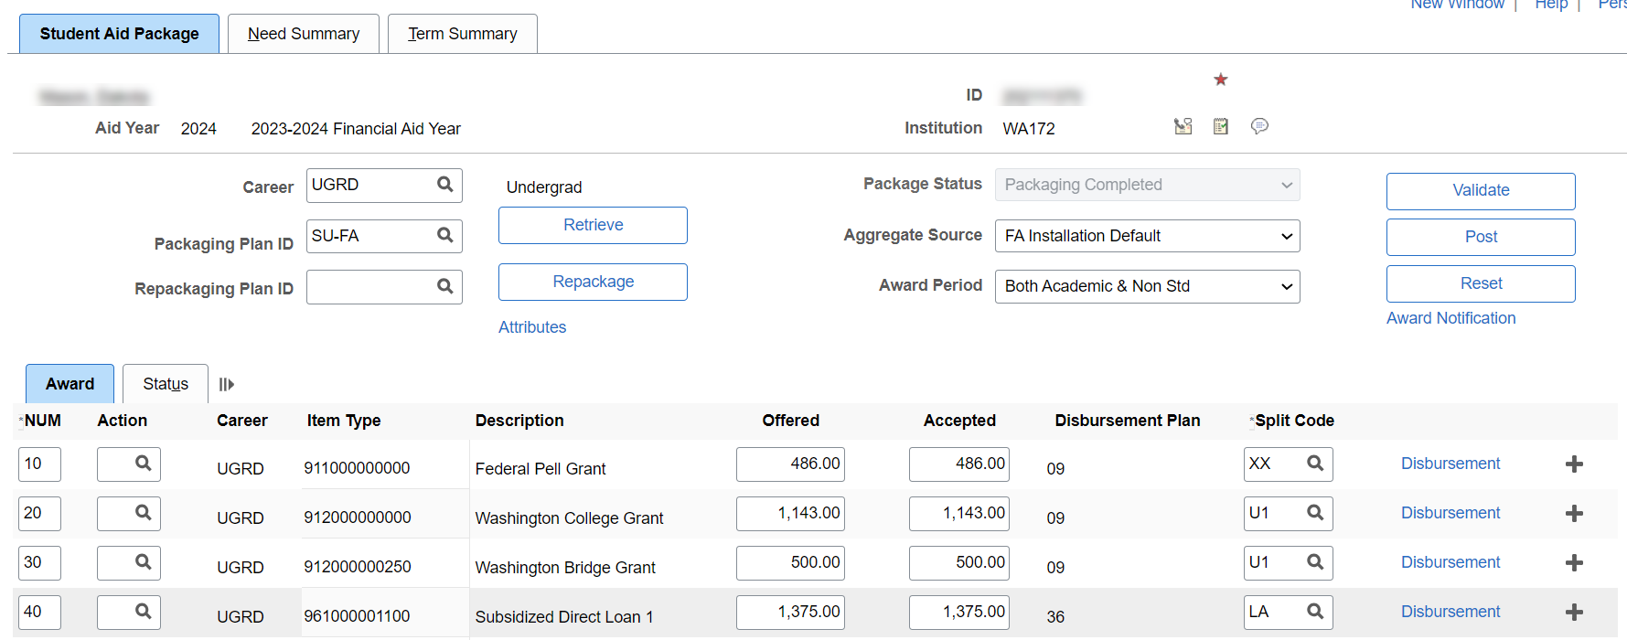
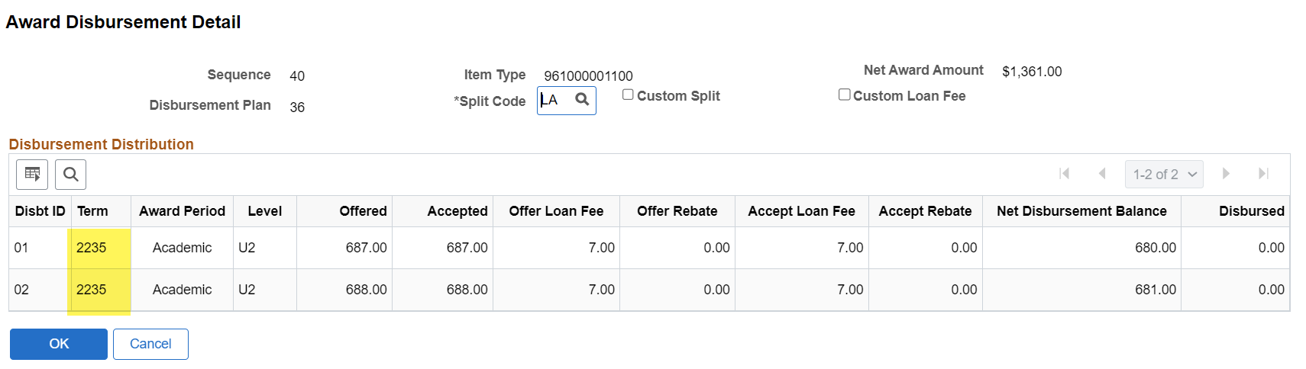
MOST COMMON AUTH FAIL MESSAGES
You must disburse this award in sequential order
Solution: Single-term split loans must have first disbursement disburse first. Then, at the mid-point, second disbursement can disburse.

Slide 20
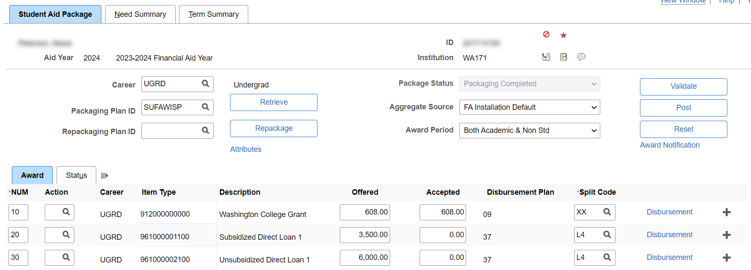
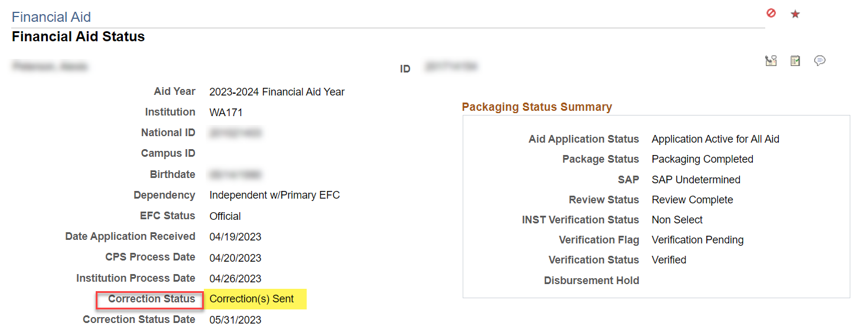
MOST COMMON AUTH FAIL MESSAGES
Student’s EFC is unofficial
Solution: Check ISIR Suspense to see if there is an ISIR that has not yet been loaded.

Slide 21
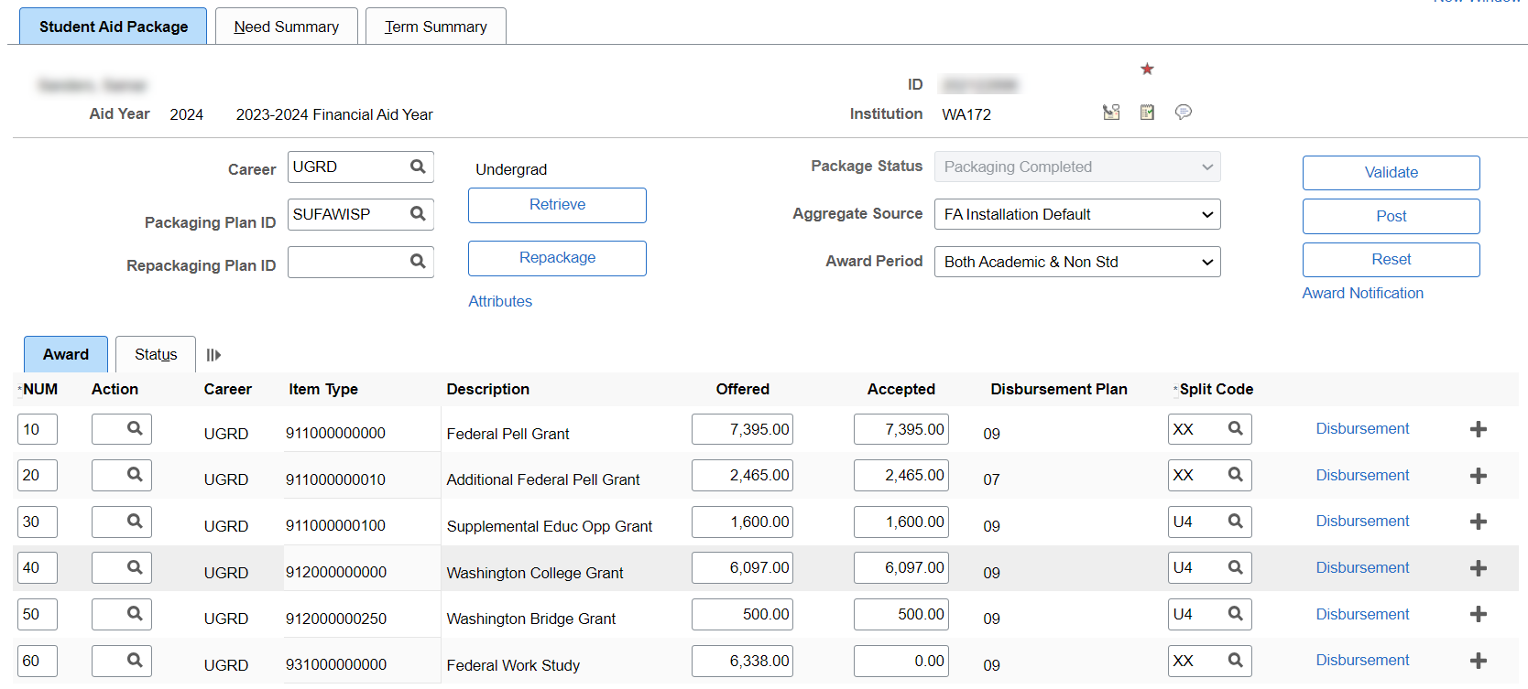
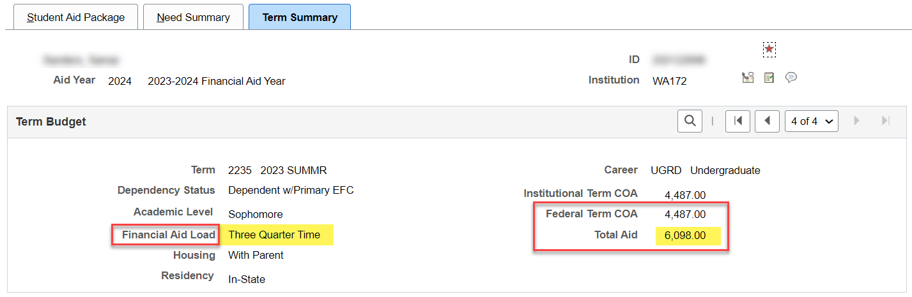
MOST COMMON AUTH FAIL MESSAGES
Student's Federal Over Award amount > 0
Solution: Adjust aid to ensure student is not over awarded. Which award would you adjust?

Slide 22
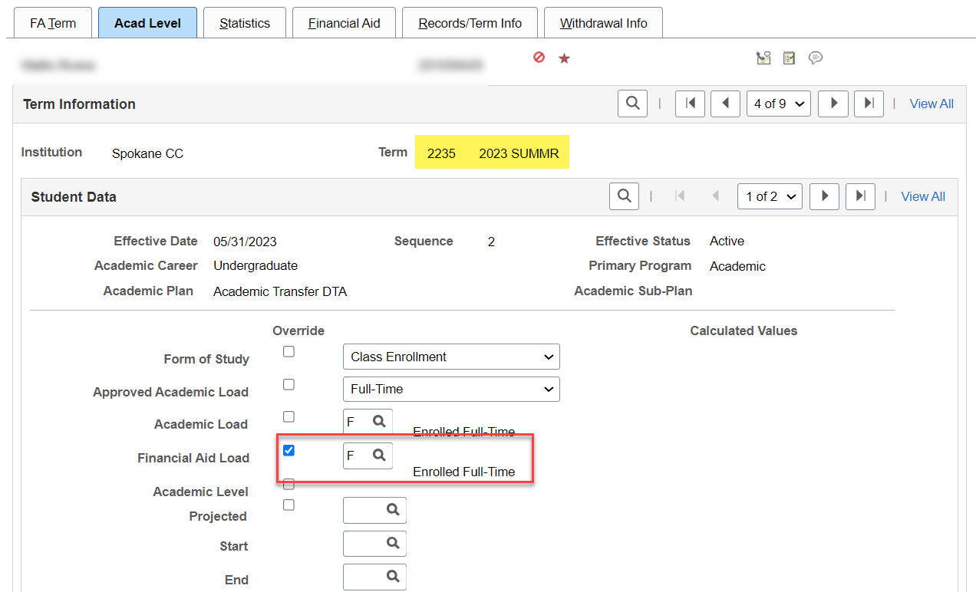
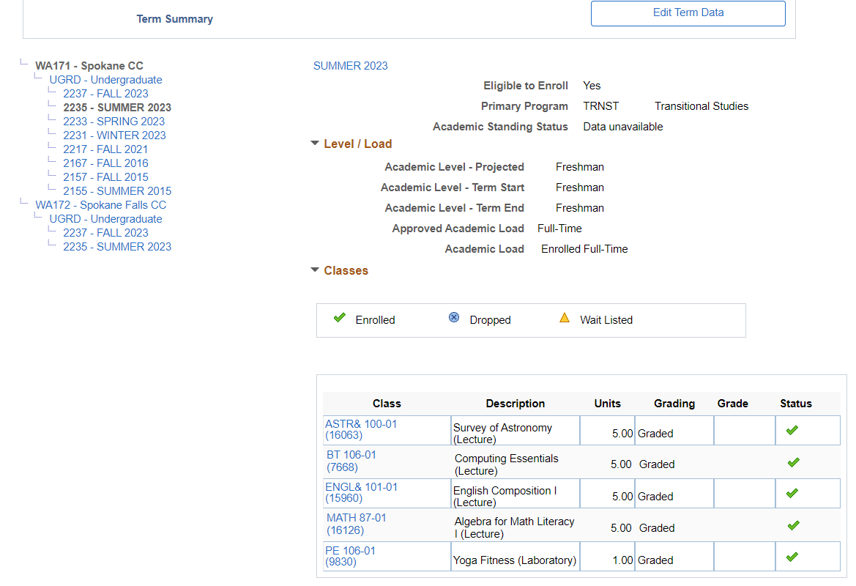
MOST COMMON AUTH FAIL MESSAGES
Enrollment data does not exist for this student
Solution: Disburse with Override.

Slide 23
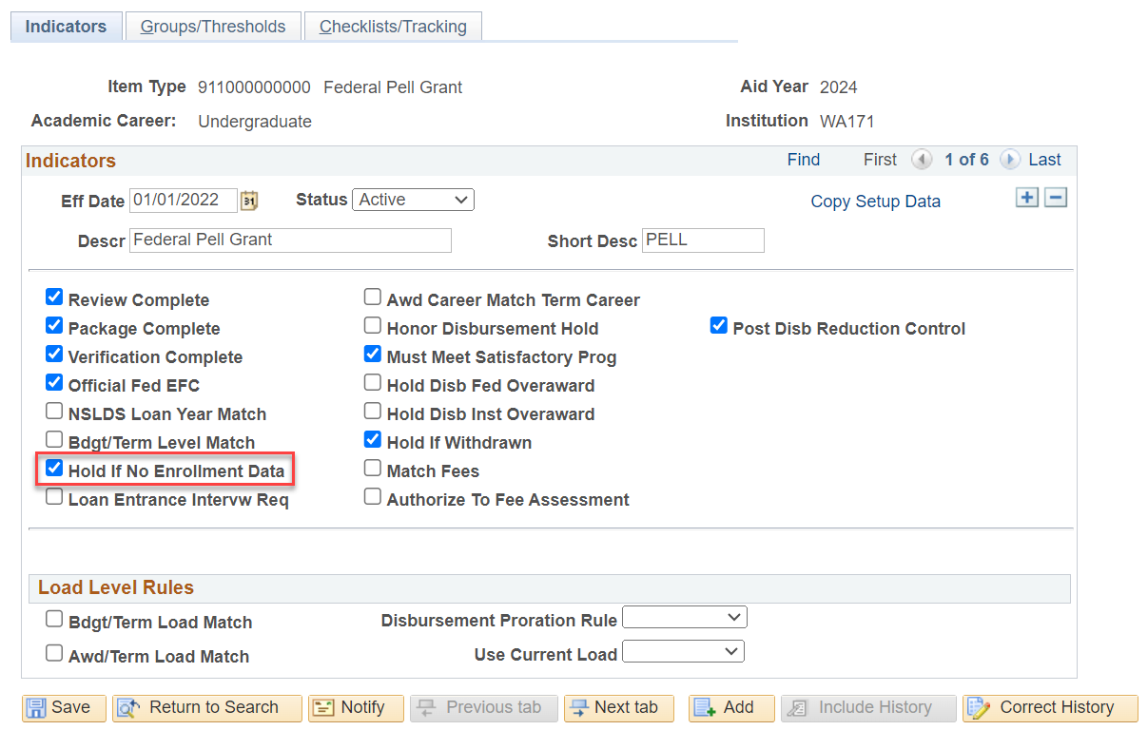
MOST COMMON AUTH FAIL MESSAGES
Enrollment data does not exist for this student (CONT’D)
Navigation: Set Up SACR > Product Related > Financial Aid > Disbursement > Define Item Type Rules
TRNST Plan stack is not an eligible FA Plan, and is driving the “Enrollment data does not exist” error

Slide 24
DEMONSTRATION

Slide 25
Outcomes
At training completion, you should be able to:
Understand known issues and their workarounds with the Auth Failure Report
Identify and prioritize Authorization Failure messages
Work the most common Auth Fail Troubleshooting errors

Slide 26
Congratulations!
Intermediate Authorization and Disbursement – Authorization Failure Report Troubleshooting Training Complete!
Please review additional resources in the ctcLink Reference Center as your progress through the steps
Thank you for your participation today!

