Slide 1
flf and AUTHORIZATION refresher
Kelly Forsberg
ctcLink Functional Trainer | Financial Aid
June 2023

Slide 2
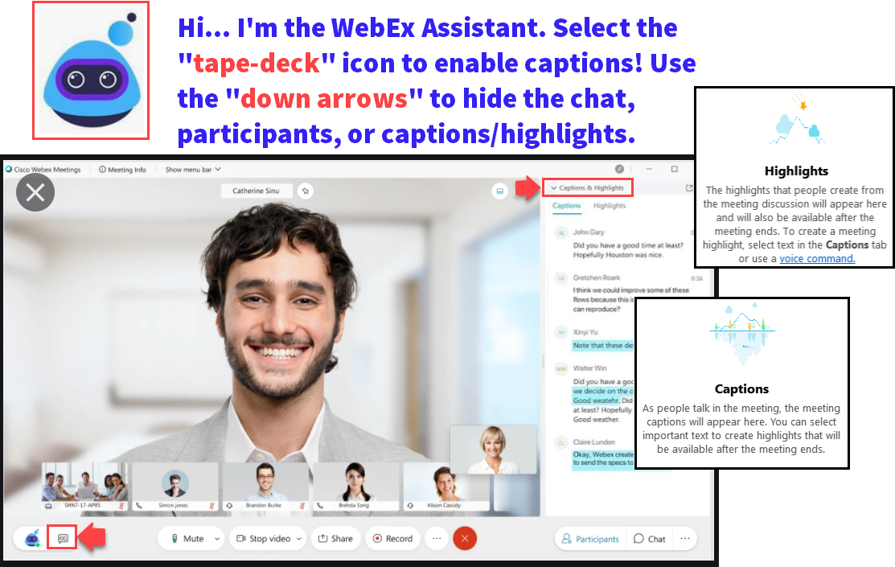

Slide 3
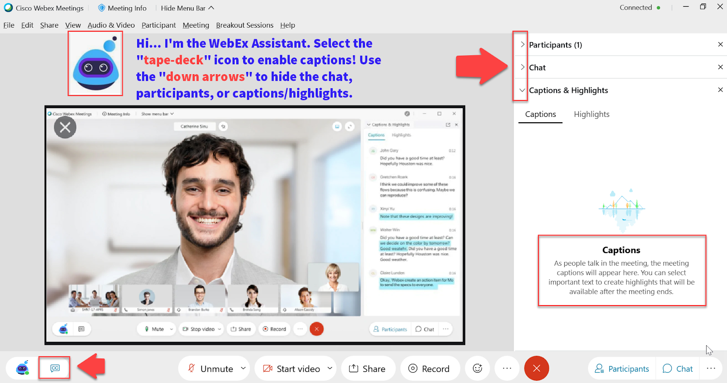

Slide 4
ground rules
Be ready to participate
Remove external distractions
Mute your line when not speaking
Do NOT place Webex line on hold. Use Mute.
Please leave your line on Mute unless you are speaking
Sessions are being recorded
Allow your peers to complete their thoughts before beginning yours

Slide 5
Objectives
After completing this training, you should be able to:
Understand all the steps in the FLF Process
Populate Packaging Variables
Mass Assign FLF Service Indicator
Service Indicator List
Work Awards
Update Packaging Variables
Run Batch Authorization
Run and Work Authorization Failure Report
Run Batch Authorization Again

Slide 6
Steps in the process

Slide 7
FLF PROCESS

Slide 8
Populate packaging variables
Navigation: Set Up SACR > System Administration > Utilities > Population Update > Population Update Process

Slide 9
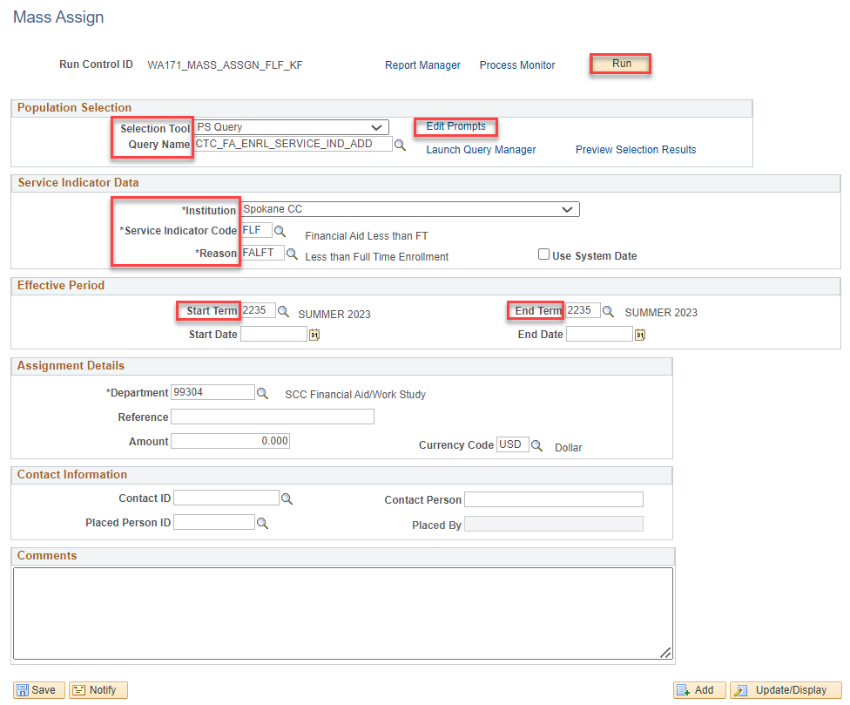
Mass assign flf service indicator
Navigation: Campus Community > Service Indicators (Student) > Mass Assign
Use Term 2235
Do not enter Start or End Dates
Tip! To get a list of who will be assigned a FLF, you can this query independently in Query Viewer before mass assigning

Slide 10
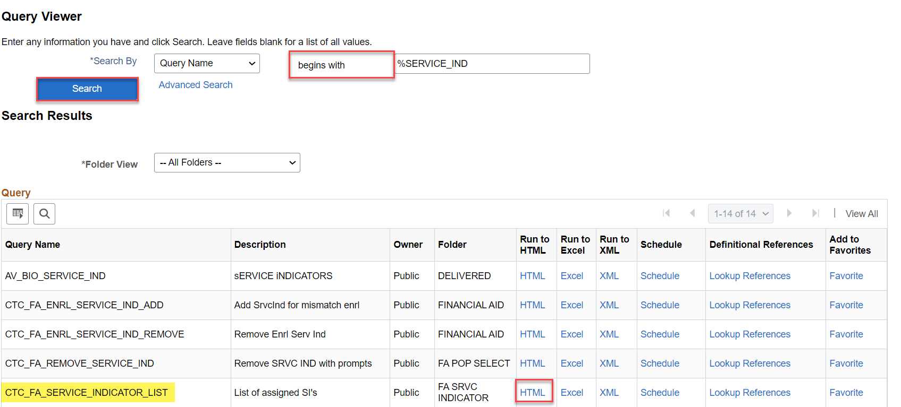
Run service indicator list query
Navigation: Nav Bar > Navigator > Campus Community > Service Indicators (Student) > Mass Assign
Run this list to see who has a FLF, and work the list to see who need to have:
Awards adjusted to reflect proper enrollment
Packaging Variables updated for the term

Slide 11
Flf process
NEXT STEPS:
Adjust Aid to reflect enrollment
Manually update Packaging Variables to reflect enrollment
Manually, or Batch, remove FLF Service Indicator
Re-run Authorization in Batch
Run Disbursement in Batch

Slide 12
BATCH AUTHORIZATION

Slide 13
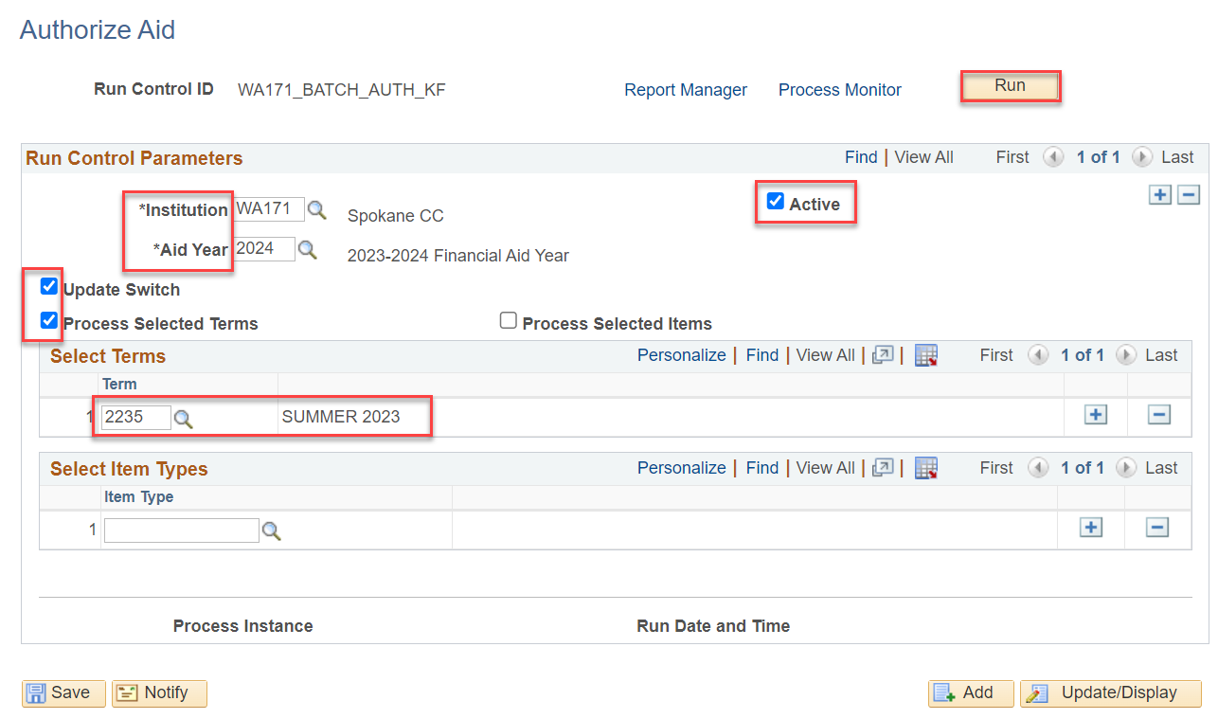
BATCH AUTHORIZATION
Navigation: Financial Aid > Disbursement > Process Authorization
You can process multiple terms at a time.
You can also process specific Item Types at a time

Slide 14
DEMONSTRATION

Slide 15
Disbursed, now what?
NEXT STEPS:
Contact SF and let them know you have disbursed, and that they should be ready to perform a:
Group Post!

Slide 16
DEMONSTRATION

Slide 17
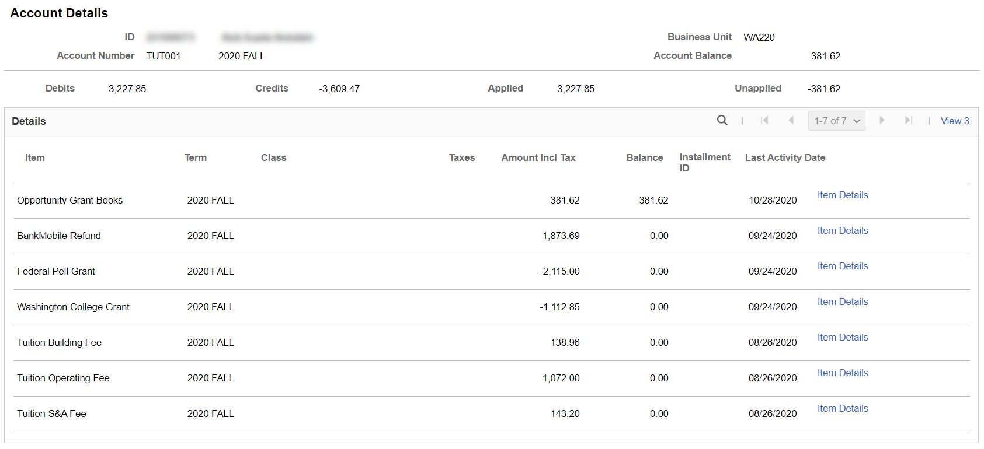
VIEW CUSTOMER ACCOUNTS
Navigation: Student Financials > View Customer Accounts
DISPLAYS ACCOUNT ACTIVITY:
Example only – review Account Details after Pell has posted and Refund has been issued.

Slide 18
QUERIES

Slide 19
QUERIES
USEFUL QUERY TO TRACK THE GROUP POST AMOUNT FOR YOUR DISBURSEMENT RUN
CTC_FA_DISBURSED_BY_DATE
Run and save this query with each disbursement run / share with SF

Slide 20
QUERIES
USEFUL QUERY TO TRACK WITHDRAWALS UP UNTIL CENSUS
CTC_FA_LOAD_COMP_BETWEEN_DATE – compares students with different FA load level when disbursed to date entered in prompt
Run and work this query daily up until Census

Slide 21
Outcomes
At training completion, you should be able to:
Understand all the steps in the FLF Process
Populate Packaging Variables
Mass Assign FLF Service Indicator
Service Indicator List
Work Awards
Update Packaging Variables
Run Batch Authorization
Run and Work Authorization Failure Report
Run Batch Authorization Again

Slide 22
Congratulations!
FLF Process and Authorization Refresher Training complete!
Have more questions? Come to the Drop In Q&A Support Session!
Please review the videos and additional resources in your canvas course material as you progress through testing
Thank you for your participation today!

