Slide 1
FA File Mapping
FA ERP Support
May 2023

Slide 2
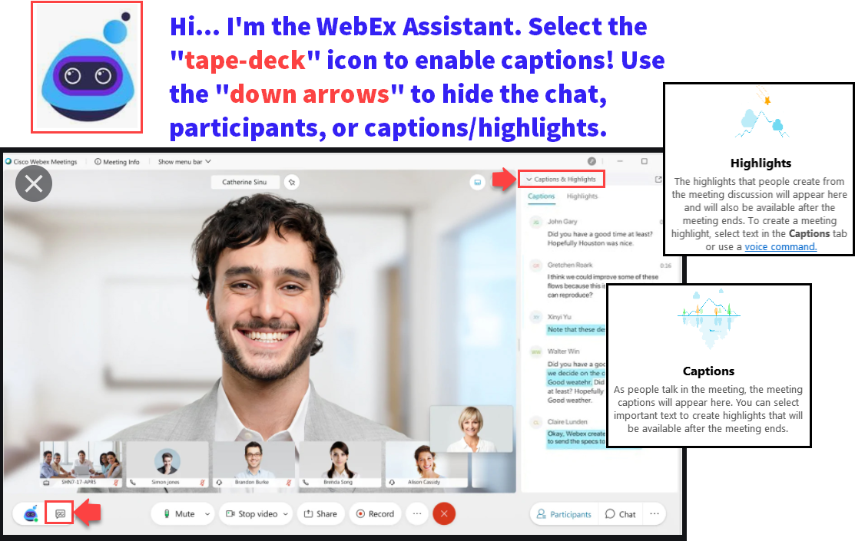

Slide 3
ground rules
Remove external distractions
Hold questions until Q&A Time of each section
Mute your line when not speaking
Do NOT place Webex line on hold. Use Mute.
Please leave your line on Mute unless you are speaking
Sessions are being recorded

Slide 4
Objectives
During this work session, we will review:
What is File Mapping
Where & When to Use File Mapping
File Mapping Recommendations
Errors
Security

Slide 5
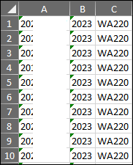
What is file mapping
File mapping provides staff the ability to set up field to field mapping to load data in batch using a .csv format

Slide 6
Where to use file mapping
File mapping is a form of Population Selection via External File
Common pages include:
Checklists
Communications
Service Indicators
Student Groups

Slide 7
When to use file mapping
File mapping can be used when:
Query does not exist to select an identified population
Another department provides a list and action should be taken quickly (i.e. Assign Service Indicator)

Slide 8
File mapping recommendations
When to use an existing mapping vs create a new one:
In most cases, there are existing file mappings that can be used to load the External File
No need to create a new file mapping if one already exists
If there is not an existing file mapping that suits your needs, a new one can be created

Slide 9
Using existing file mapping
Load a csv file (can be empls only)
Use the look up tool to find existing File Mapping
Select Edit File Mapping to view required fields
If you aren’t the creator, you can view the mapping, but can’t edit
Notes:
If a csv file is not loaded prior to selecting existing file mapping name, staff will not be able to Edit File Mapping to see required fields

Slide 10
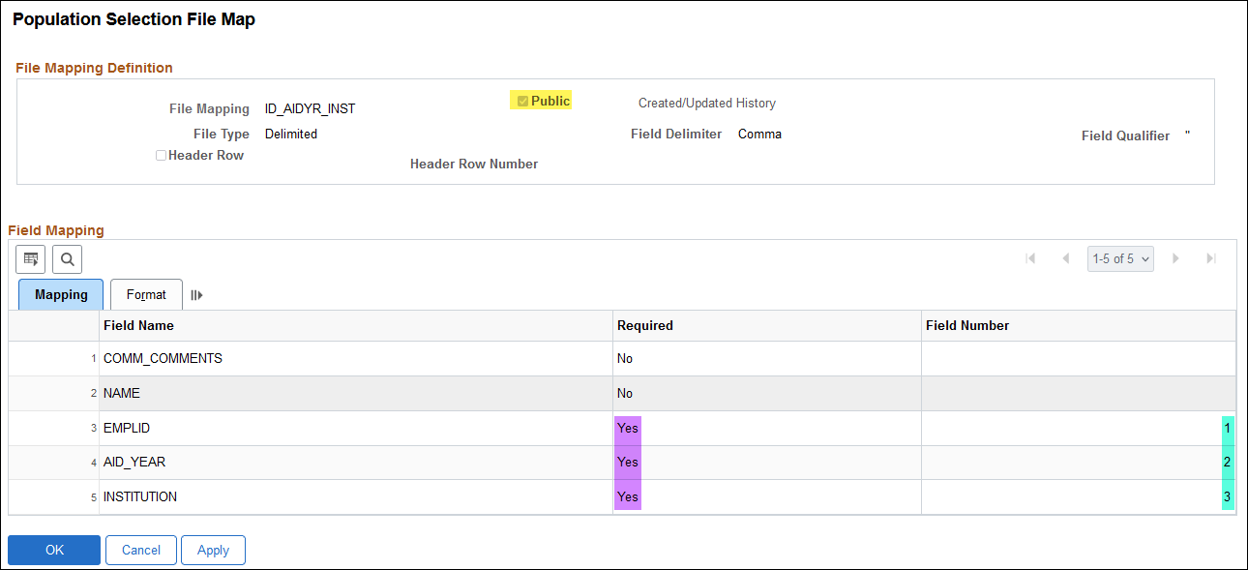
Using existing file mapping
View the fields and their order
Public: File Mapping available to all users
Required: Indicates these values must exist in file
Field Number= Order of required values in file

Slide 11
Using existing file mapping
File Button Selections
Upload File : Allows file to be retrieved
Delete File: Select to remove the attached file*
View File= Allow to view file without removing csv or opening & causing errors
Notes:
For some older run controls, Delete File button may not remove the attached file. Staff can Upload a new csv file to replace the file to be deleted.

Slide 12
Demo

Slide 13
How to Create file mapping
Load a csv file (to see Req’d fields)
Select Create File Mapping
System automatically identifies necessary Bind Record and Required Fields
Recommend naming File Mapping based on fields

Slide 14
Demo

Slide 15
Errors in file mapping
Select Preview Selection Results
Review field order
Error indicates that the value in row 1 doesn’t match mapping order for ID_AIDYR_INST, not that AID YEAR value should be in row 1

Slide 16
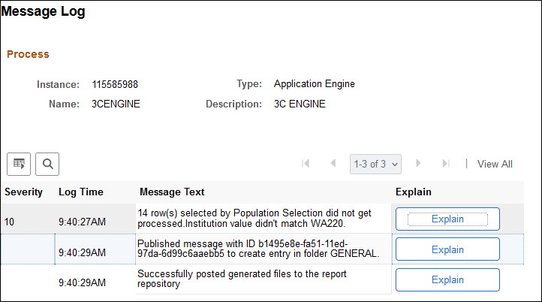
Errors in file mapping
Process ran to Success and Posted but Message Log indicates file not processed due to value mismatch
Review Preview Selection Results on Run Control page to ensure values are in correct order(i.e. Institution value appears in correct column)

Slide 17
Demo

Slide 18
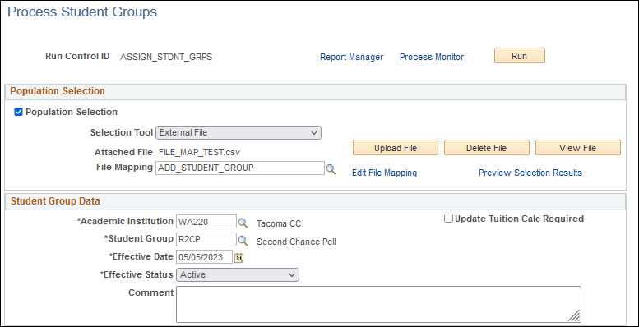
Security for file mapping
To use External File, no additional security required
If you have access to the page for Population Selection, can use existing file mapping

Slide 19
Security for file mapping
To Edit or Create File Mapping, additional role may be required
Consult your LSA to determine the appropriate role

Slide 20
Congratulations!
You are now equipped with more knowledge of File Mapping!
Please refer to the ctcLink Reference Center for additional resource materials on today’s topics
Sign up for our listserv if you haven’t already ☺
https://lists.ctc.edu/mailman/listinfo/ctclinkfinaidsupport_lists.ctc.edu
Thank you for your participation today!

