Slide 1
Intermediate awarding: award troubleshooting
Kelly Forsberg
ctcLink Functional Trainer | Financial Aid
May 2023

Slide 2
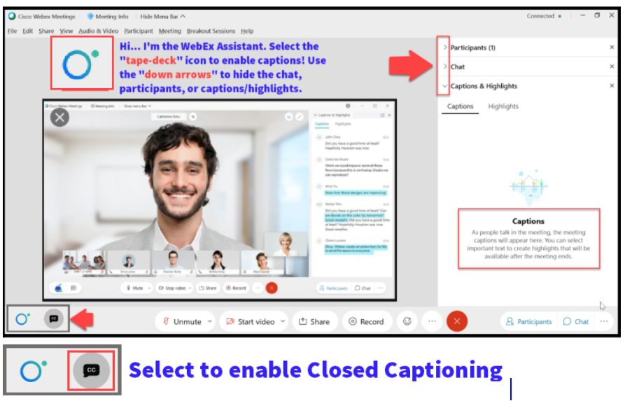

Slide 3
Logistics and Agenda
Times | Activity
9:00 – 9:05 | Sign-In/Greet/Attendance
9:05 – 9:10 | Objectives
9:10 – 9:20 | Awarding Lessons Learned
9:20 – 9:45 | Common Award Posting Errors
9:45 – 10:30 | Troubleshooting APEs
10:30 – 11:00 | Session Wrap-Up/Q&A
Some processes will have demonstrations, but due to data scrubbing, available data in the environment, demo examples are not ideal

Slide 4
ground rules
Be ready to participate
Remove external distractions
Mute your line when not speaking
Do NOT place Webex line on hold. Use Mute.
Please leave your line on Mute unless you are speaking
Sessions are being recorded
Allow your peers to complete their thoughts before beginning yours

Slide 5
Objectives
After completing this training, you should be able to:
Understand how to identify an award posting error
Understand how to resolve some of the most common award posting errors

Slide 6
AWARDING
LESSONS LEARNED

Slide 7
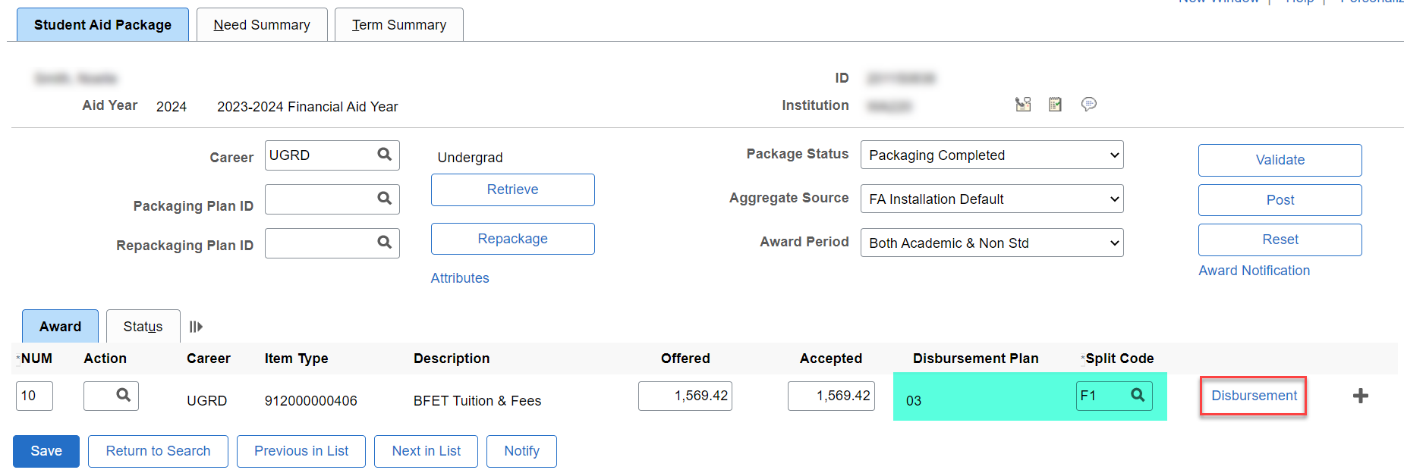
AWARDING LESSONS LEARNED
KNOWLEDGE SHARING
Refrain from using one-term only disbursement plans in the beginning of the AY
This Photo by Unknown Author is licensed under CC BY-NC

Slide 8
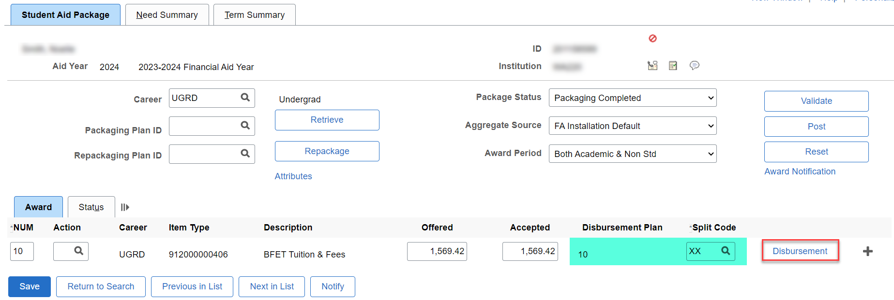
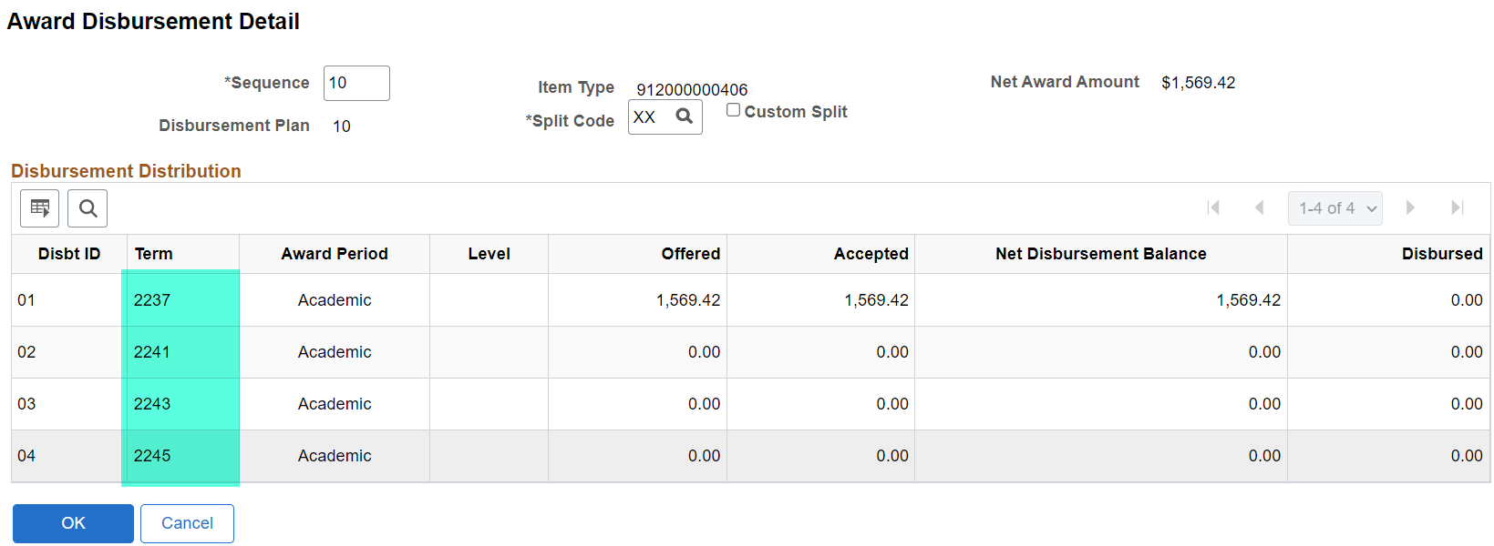
AWARDING LESSONS LEARNED CONT’D
KNOWLEDGE SHARING CONT’D
Open all four term buckets by using multi-term disbursement plan* (EXCEPTION: LOANS & PELL)

Slide 9
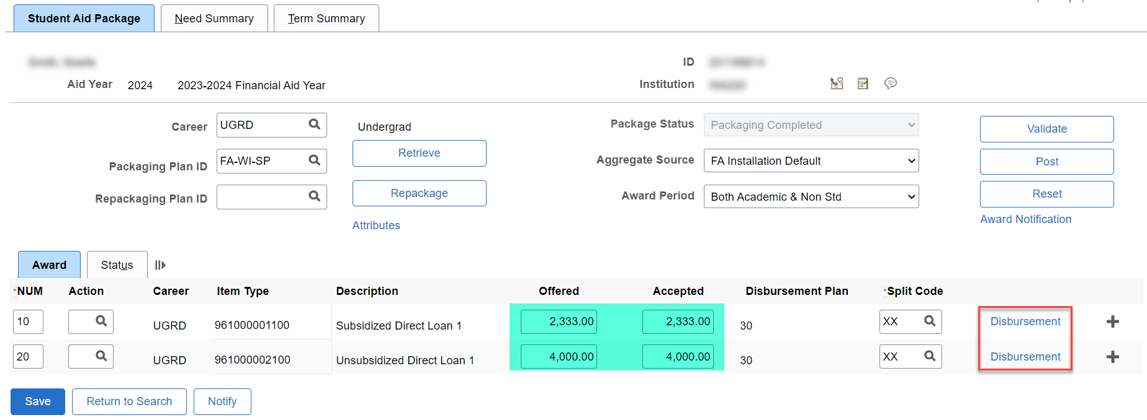
AWARDING LESSONS LEARNED CONT’D
KNOWLEDGE SHARING CONT’D
When awarding loans, you cannot have one-term at $0 in the middle of the AY

Slide 10
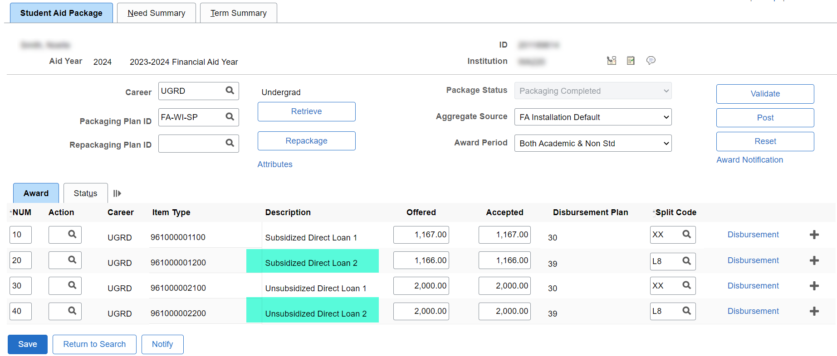
AWARDING LESSONS LEARNED CONT’D
KNOWLEDGE SHARING CONT’D
Clean up the Direct Loan 1 Item Type, and then use the Direct Loan 2 Item Type to award more loan in the AY

Slide 11
AWARDING LESSONS LEARNED
KNOWLEDGE SHARING
Refrain from using Custom Loan Fees on the Disbursement page

Slide 12
AWARDING LESSONS LEARNED CONT’D
KNOWLEDGE SHARING CONT’D
Let the system calculate the loan fees when adjusting – it may take extra Validation attempts before posting

Slide 13
AWARDING LESSONS LEARNED CONT’D
KNOWLEDGE SHARING CONT’D
Can you think of any others?
Share with the community at large . . .
This Photo by Unknown Author is licensed under CC BY-NC

Slide 14
DEMONSTRATION

Slide 15
COMMON AWARD
POSTING ERRORS
This Photo by Unknown Author is licensed under CC BY-NC

Slide 16
Common award posting errors
FISCAL ITEM TYPES PAGE IS AT $0 OR AWARDED UP TO ALLOCATION
Solution:
Increase the Fiscal Item Types page award amounts
Set Up SACR > Product Related > Financial Aid > Awards > Fiscal Item Types

Slide 17
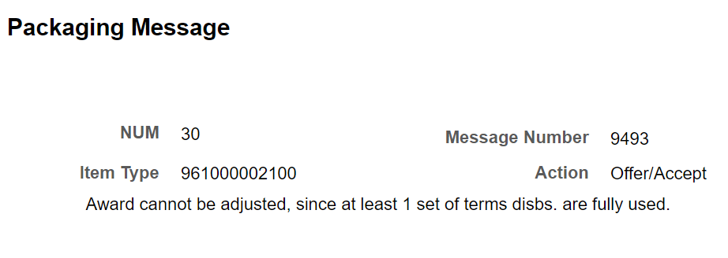
Common award posting errors
ENTERING AWARD ON AN ITEM TYPE ALREADY IN USE/NOT CANCELLED
Solution:
Increase the award on the existing Item Type (This gets tricky with Direct Loans, if you need to change a Disbursement Plan).
Notes:
The way I've found to change a disbursement plan on a loan is to cancel the award, un-disburse any amounts, insert a new row using the previously canceled item type to re-award the loan using a different disbursement plan. In this case, when you Post the award, the two rows collapse together, and you don't get the APE.

Slide 18
Common award posting errors
STUDENT REACHED AGGREGATE LIMITS
Solution:
Check Update Incoming Aggregates page
Financial Aid > Awards > Aggregates > Update Incoming Aggregates
Also, check to see if student is at the award limit for that Item Type

Slide 19
COMMON AWARD POSTING ERRS CONT’D
KNOWLEDGE SHARING
Can you think of any others?
Share with the community at large . . .
This Photo by Unknown Author is licensed under CC BY-NC

Slide 20
Outcomes
At training completion, you should be able to:
Understand how to identify an award posting error
Understand how to resolve some of the most common award posting errors

Slide 21
Congratulations!
Intermediate Awarding – Awarding Troubleshooting Training Complete!
Please come to the 5/11 Q & A Support Session if you have specific examples you would like to work through
Thank you for your participation today!

