Slide 1
CROSS-PILLAR FA/SF/FIN END TO END RECONCILIATION TRAINING
Kelly Forsberg (FA), Alec Risk (SF), Karen Ebert (FIN)
ctcLink Functional Training
April 2023

Slide 2
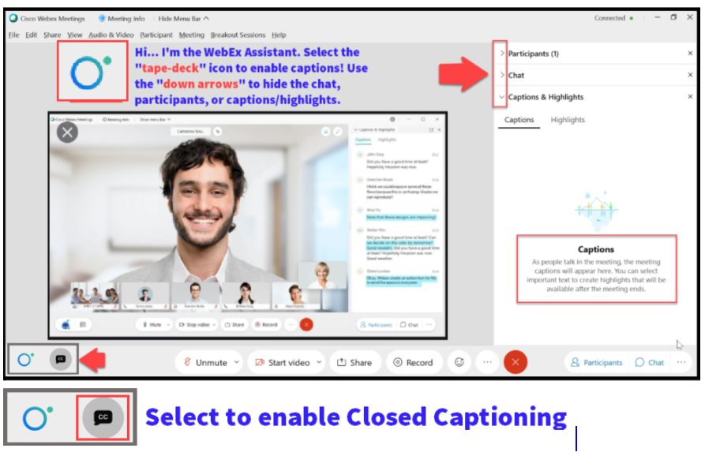

Slide 3
GROUND RULES
Be ready to participate
Remove external distractions
Mute your line when not speaking
Do NOT place Webex line on hold. Use Mute.
Please leave your line on Mute unless you are speaking
Sessions are being recorded
Allow your peers to complete their thoughts before beginning yours

Slide 4
OBJECTIVES
After completing this training, you should be able to:
(FA/SF/FIN) - Understand the high-level flow of the cross-pillar end-to-end reconciliation process

Slide 5
OBJECTIVES
After completing this training, you should be able to:
(FA) - Understand the available FA reconciliation queries that should be run on weekly, semi-monthly, and monthly basis
(FA) - Understand the high-level process in FA regarding what queries and reports to run for varying funding sources
(FA) - Understand the timing in which SAS files are available to use for FA/COD reconciliation

Slide 6
OBJECTIVES
After completing this training, you should be able to:
(SF) - Understand how the GL is sent to FIN via SF/SFC journals
(SF) - Understand how Second Journal Sets are created and processed

Slide 7
OBJECTIVES
After completing this training, you should be able to:
(FIN) - Understand Fund 145 Grants and Non-Fund 145 Grants Budgets & Item Types Setup
(FIN) - Overview of the SF Journal Process into Finance
(FIN) - Review SF/GL Journals & Queries for Analysis
(FIN) - Understand the Reimbursement/Drawdown Process Options

Slide 8
FINANCIAL AID:
HIGH-LEVEL RECON FLOW

Slide 9
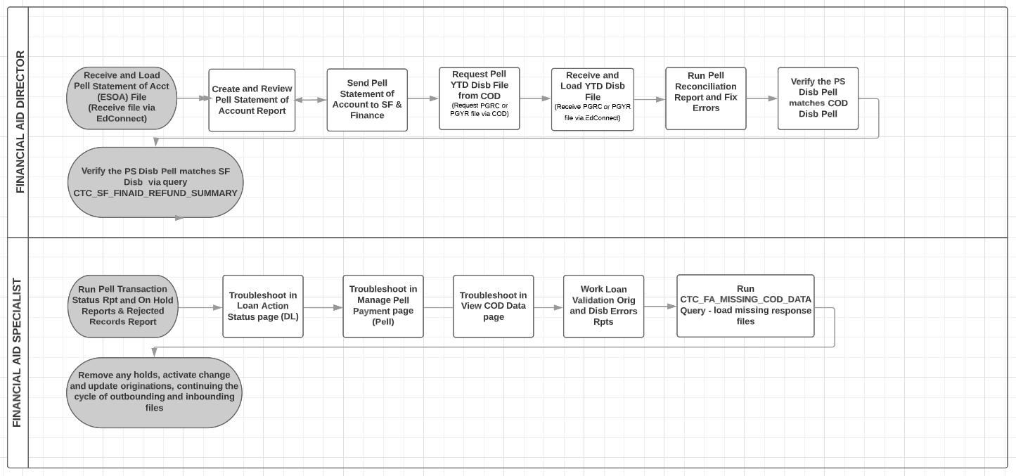
FA: STEPS IN THE PROCESS HIGH-LEVEL RECON

Slide 10
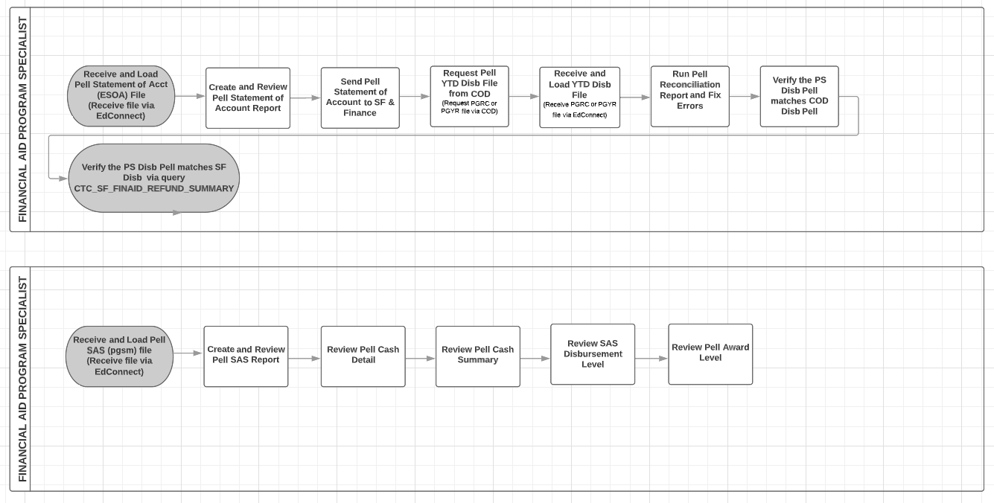
FA: STEPS IN THE PROCESS CONT’D HIGH-LEVEL PELL GRANT

Slide 11
FA: STEPS IN THE PROCESS CONT’D HIGH LEVEL DIRECT LOANS

Slide 12
FINANCIAL AID:
QUERIES

Slide 13
FA QUERIES (RECONCILING TO SF)
CTC_FA_SF_DISCREPANCY
QCS_SF_CREDIT_BAL_NONREF
CTC_FA_DISBURSED_BY_DATE_UNITS
QCS_SF_FA_SA_APPLIED_SUMMARY
QCS_SF_FA_SA_APPLIED_DETAILS
Run daily/weekly (suggested)

Slide 14
FA QUERIES (RECONCILING TO SF CONT’D)
QCS_SF_ITM_TYPE_GL_INTERFACE
CTC_FA_ITEM_DISBURSED
CTC_FA_CBS_AND_SNG_LIST
CTC_FA_WAITLISTED_AWARDS
CTC_FA_TERM_ITEM_TYPE_AWARDED
CTC_FA_THIRD_PARTY_PYMNTS
CTC_FA_MISSING_COD_DATA
Run semi-monthly (suggested)

Slide 15
FA QUERIES (RECONCILING TO SF CONT’D)
CTC_FA920 (FUND ROSTER)
CTC_FA801 (AWARD DATA BY ITEM TYPE)
QCS_FA_FISCAL_ITEM_TYPE_BUDGET
Run monthly (suggested)

Slide 16
FINANCIAL AID:
SAS FILES AND ESOA STATEMENTS

Slide 17
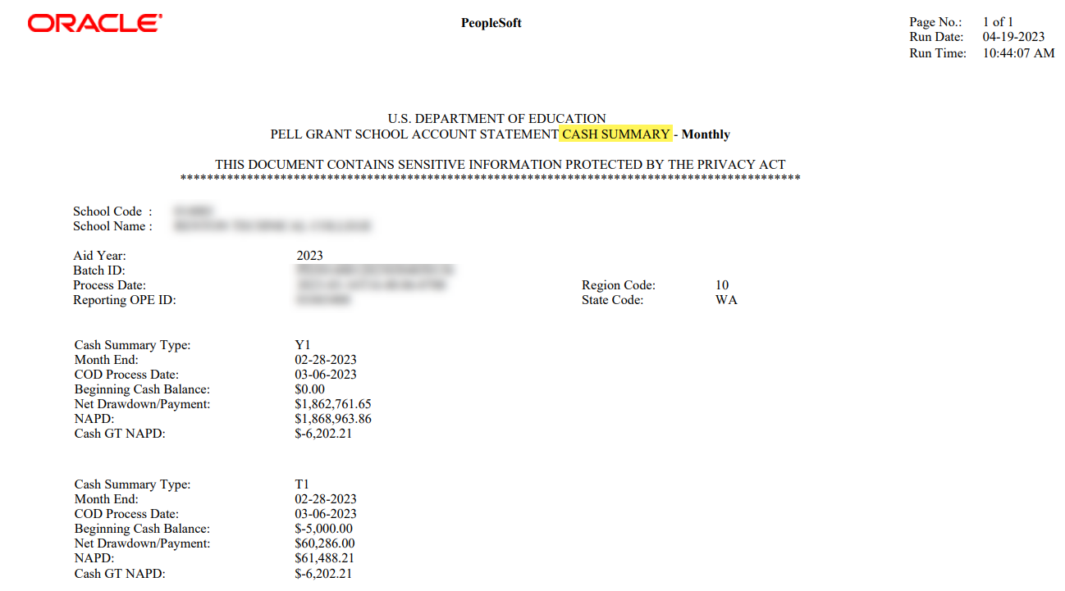
FINANCIAL AID SAS FILES
PELL SAS IMPORT PROCESS: Generates a monthly statement, similar to a bank statement, which summarizes the school's processing activity for that month.

Slide 18
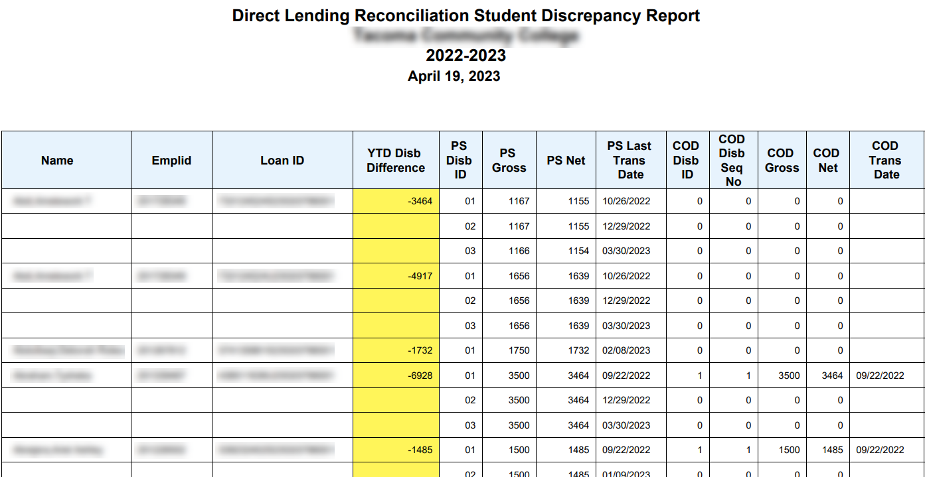
FINANCIAL AID SAS FILES CONT’D
DIRECT LOAN RECON – Contains DSDF comparative disbursement to ctcLink data for the AY.

Slide 19
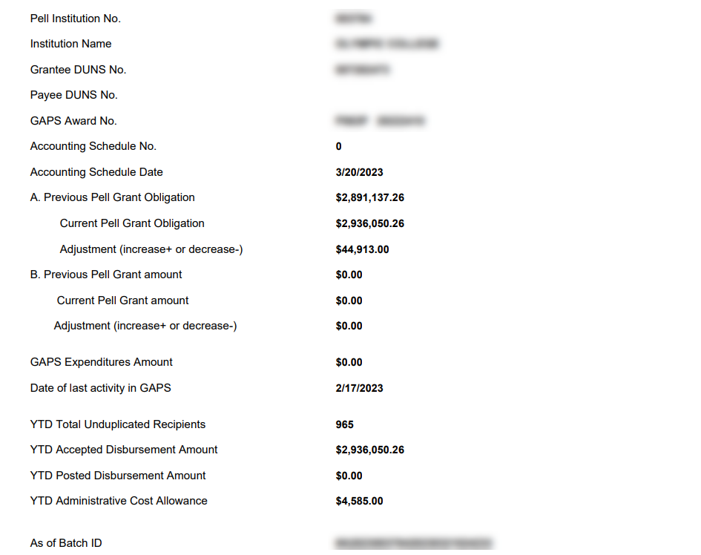
FINANCIAL AID ESOA
ELECTRONIC STATEMENT OF ACCOUNT – Generates a statement on previous Pell Grant Obligation and compares it to current Pell Grant Obligation, showing where the adjustment is needed in COD and/or G5.

Slide 20
FINAL RECONCILIATION
TIPS FOR RECON SUCCESS
After you are done running FA Disbursement to SF, immediately run Pell and DL Out to report those disbursements
Work disbursement rejects immediately after receiving the COD response file(s).
Report new student disbursements to WSAC often, so you can request those funds from CSAW.

Slide 21
STUDENT FINANCIALS
Alec Risk – SBCTC SF Functional Trainer

Slide 22
ITEM TYPE FLOW
Student/Corp Account
GL
Item Type Configuration

Slide 23
What is an Item Type?
Item Types are the “blood” of the system
They tell a story of a student or organization
They are influenced by many individuals (internal and external)
They come in many classifications:
Payments
Cash/Check/Credit Card
Charges
Tuition/Fees
Financial Aid
Waivers
Refunds
They are posted to the GL nightly!

Slide 24
SF: STEPS IN THE PROCESS - ITEM TYPE TO GL

Slide 25
PILLAR FLOW
Student Financials
Financial Aid
Finance

Slide 26
FA TO SF (BASIC SF PERSPECTIVE)
SF/FA work together to create/update Financial Aid item types on the SF side of configuration
Financial Aid awards student funds
SF posts the funds to the Student Account
SF/FA work together on refunding eligible students

Slide 27
SF TO FIN (BASIC SF PERSPECTIVE)
GL is posted nightly
E214(SF)/E215(SFC)
GL and SJS is sent to FIN

Slide 28
FIN TO SF (BASIC SF PERSPECTIVE)
Huh?
What??
Uoy deen ot xif taht tpiecer!
Corrections: “You need to fix that receipt!”

Slide 29
WHAT IS THE SECOND JOURNAL SET?
A Student Financials to Finance process that assists with accounting entries required for the General Ledger.
Only select payment Item Types (9*** and 75**) are configured.
It generates, based on configuration, expense data lines that offset internal cash and the data lines are posted to the GL.

Slide 30
WHAT IS THE SECOND JOURNAL SET? (CONTINUED)
The expense data can be used as documentation for invoicing funds or drawing down funds in G5.
SBCTC currently runs the SJS and is sent to your college either weekly or monthly.

Slide 31
SF: STEPS IN THE PROCESS - SJS

Slide 32
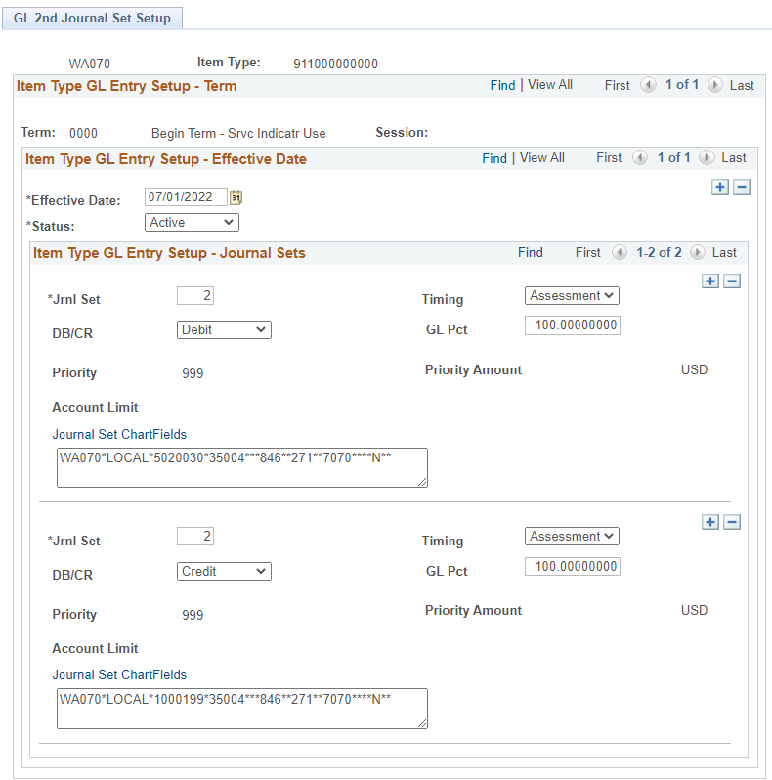
SECOND JOURNAL SET CREATION/UPDATES
Set Up SACR > Product Related > Student Financials > CTC Custom > GL 2nd Journal Set Setup

Slide 33
RELATED QUERIES
E214
Item types that posted to Student Accounts
Accounting transactions from SF sent nightly
Creates additional accounting entries in the SF_ACCTG_LN table
Journals labeled as SF
Fund balanced debit/credit transactions which includes:
Financial Aid
Payments
Waivers

Slide 34
RELATED QUERIES (CONTINUED)
E215
Specific to Departmental Receipts in SF
Journals labeled as SFC
QCS_SF_COLLECT_DEPT_RECEIPTS
QCS_SF_DEPT_RECEIPTS_GL

Slide 35
RELATED QUERIES (CONTINUED)
E218
Second Journal Set
Can include item lines with SJS
QCS_SF_2ND_JOURNAL_SET
QCS_SF_ITEM_1ST_2ND_ACCOUNTS
QCS_SF_ITEM_GL_1ST_2ND_DETAIL

Slide 36
Useful SF Queries!
QCS_SF_ITEM_1ST_2ND_ACCOUNTS
QCS_SF_ITEM_GL_1ST_2ND_DETAIL
QCS_SF_DEPT_RECEIPTS_GL
QCS_SF_FA_SA_APPLIED_SUMARY
QCS_SF_FA_SA_APPLIED_DETAILS
QCS_SF_ITEMTYPES_TO_CPL

Slide 37
STUDENT FINANCIALS RESOURCES
9.2 SF – General Ledger Interface
SF – Finance Integration
SF Month End Playbook (Aug2020)
Currently being updated!
9.2 Understanding Item Types
CS: SF106 Term Roll/Item Types/GL Canvas Course
ctcLink Pillar Work Session Information Canvas Course

Slide 38
FINANCE
Karen Ebert – SBCTC FIN Functional Trainer

Slide 39
FA > SF > FINANCE
Difference between Fund 145 and Non-145 Grant: Budgets & Item Types Setup
How does SF Data process into Finance
Review SF/GL Recon Queries
Reimbursement/Drawdown Process Options

Slide 40
FIN: STEPS IN THE PROCESS HIGH LEVEL FLOW GL PROCESSING

Slide 41
FUND 145 VS. NON-145 GRANTS: SETUP, BUDGETS & ITEM TYPES
What’s the difference?

Slide 42
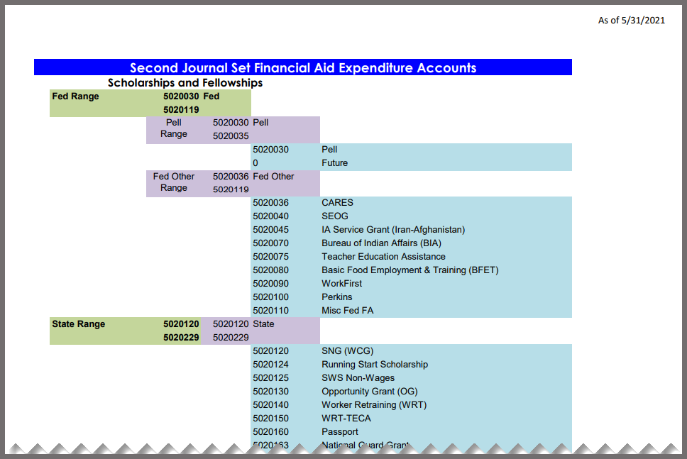
SBCTC | GL ACCOUNT GUIDANCE
ACCOUNTING & BUSINESS SERVICES Main Web page has the SECOND JOURNAL SET FINANCIAL AID EXPENDITURE ACCOUNTS

Slide 43
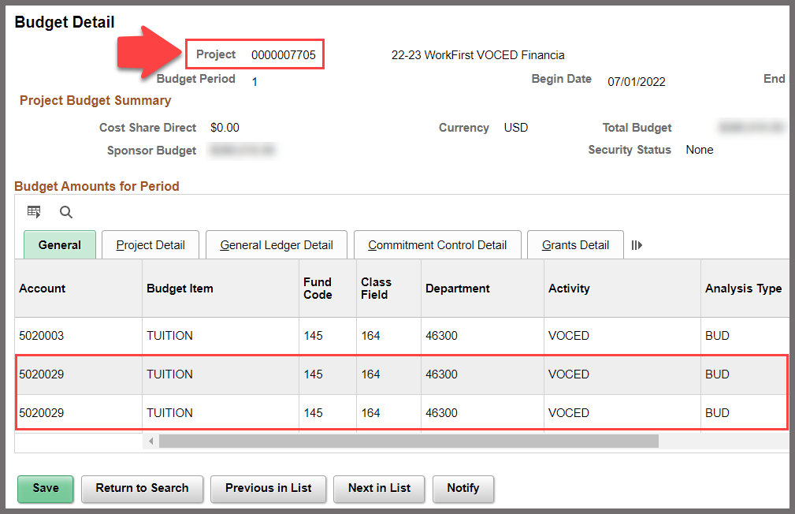
FIN | FUND 145 GRANT BUDGETS EXAMPLE: SBCTC WORKFIRST GRANT
Fund 145 Grant Awards are created and activated in the Grants/Contracts Modules. Budget are created and finalized within Project Costing Module.

Slide 44
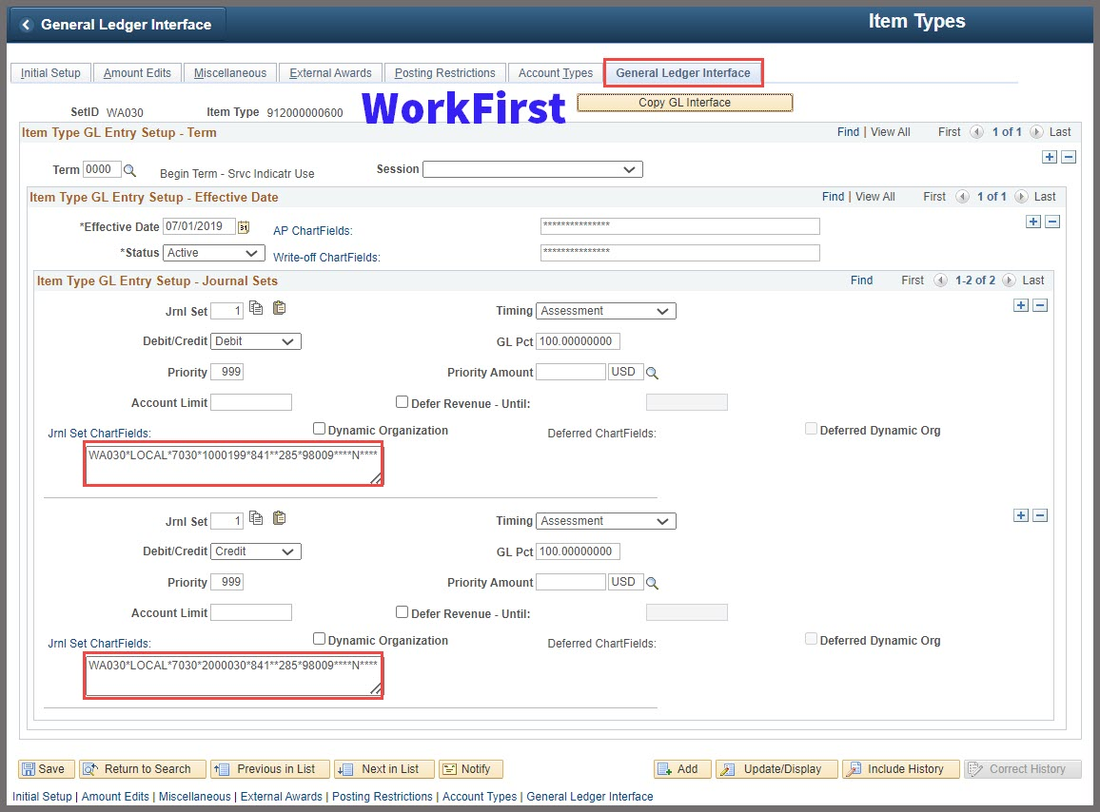
CS | FUND 145 GRANT: WORKFIRST 912XXX600 GL INTERFACE PAGE AKA THE FIRST ITEM TYPE
**GLOBALLY MAINTAINED**
WorkFirst Grant Item Type# 912xxx600
Fund: 841
Class: 285
Dept: 98009

Slide 45
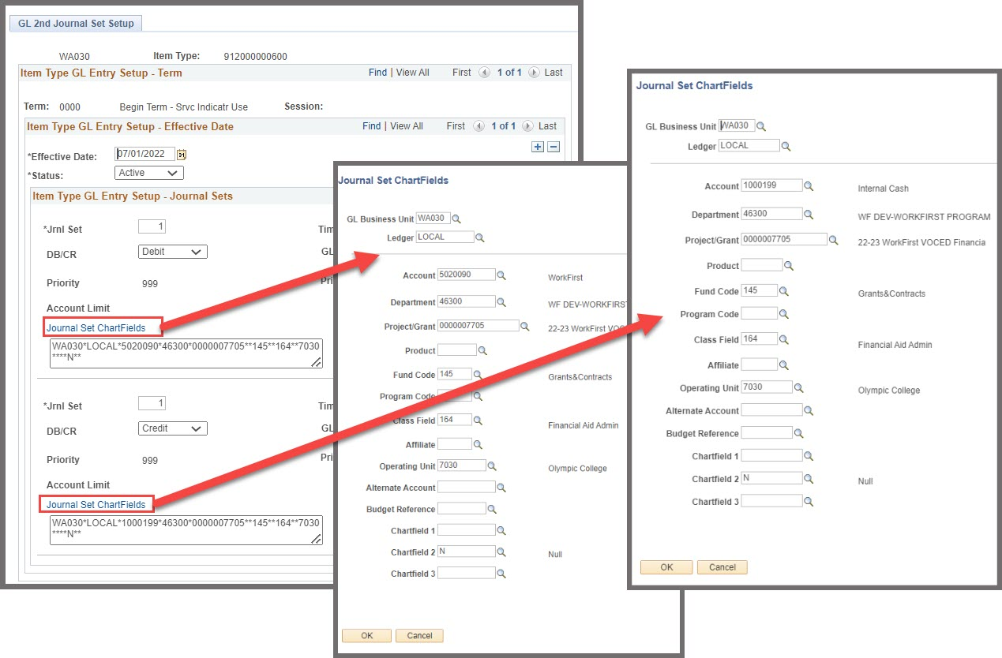
CS | FUND 145 GRANT WORKFIRST 912XXX600 GRANT GL SECOND JOURNAL SET & CHARTFIELDS PAGES
**LOCALLY CREATED & MAINTAINED**

Slide 46
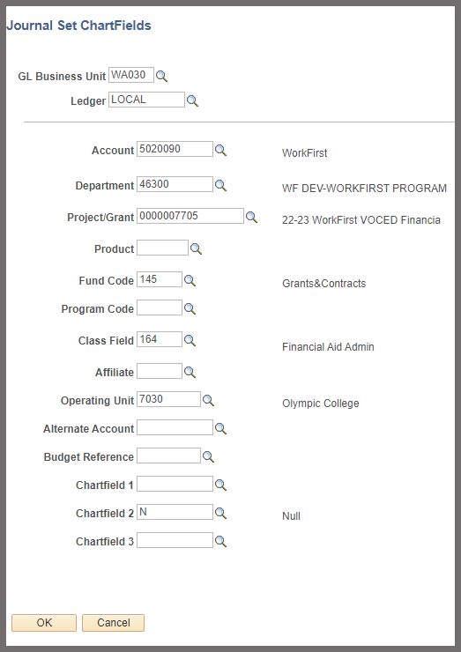
CS | FUND 145 GRANT WORKFIRST 912XXX600 SETUP REQUEST TO CS-SF
Journal Set ChartFields :
ChartString requires a Project in order to run the Reimbursement Process within Grant Billing Process.
Note ONLY the
PC Bus Unit
Project
Activity

Slide 47
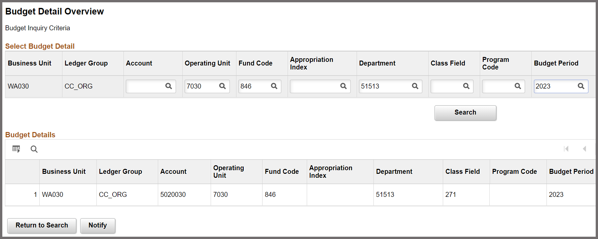
FIN | NON-FUND 145 GRANT BUDGETS EXAMPLE: PELL GRANT
Non-Fund 145 Grant Awards are created and posted in the Commitment Control Module.

Slide 48
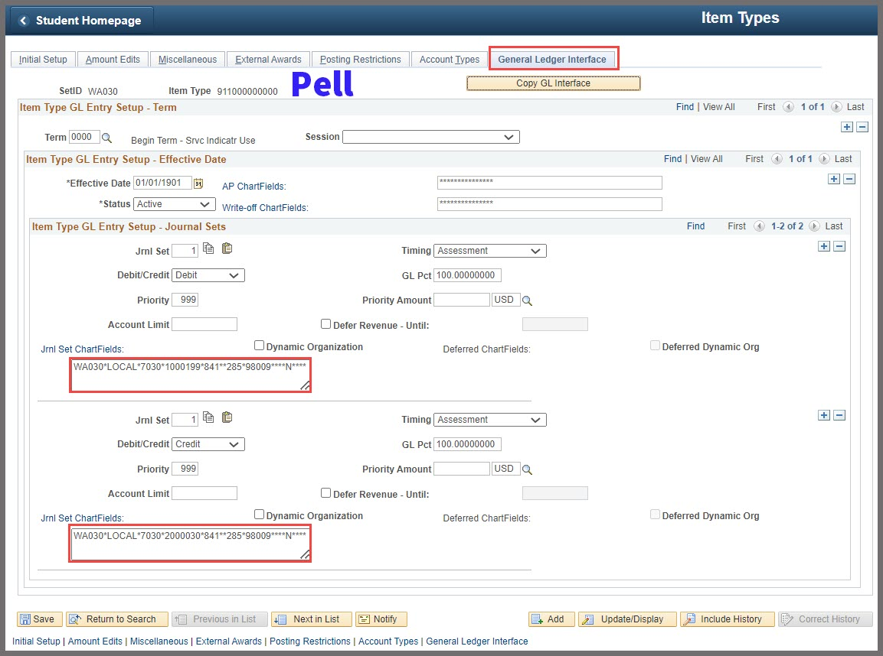
CS | NON-145 GRANT: PELL: 911XXX000 GL INTERFACE PAGE
**GLOBALLY MAINTAINED**
Pell Grant Item Type# 911xxx000
Fund: 841
Class: 285
Dept: 98009

Slide 49
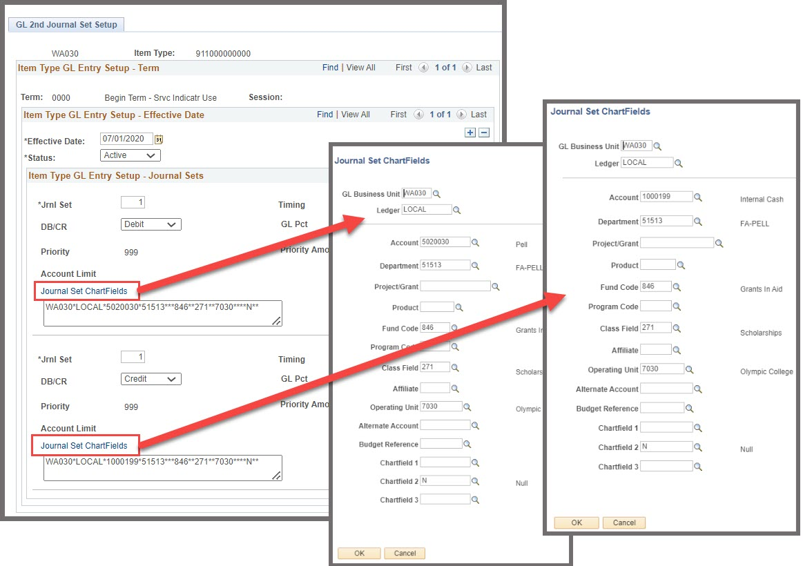
CS | NON-145 GRANT: PELL: 911XXX000 GL SECOND JOURNAL SET & CHARTFIELDS PAGE
**LOCALLY CREATED & MAINTAINED**

Slide 50
SF TO GL PROCESS
How does data process from CS to FIN pillar?

Slide 51
CS to FIN Integration

Slide 52
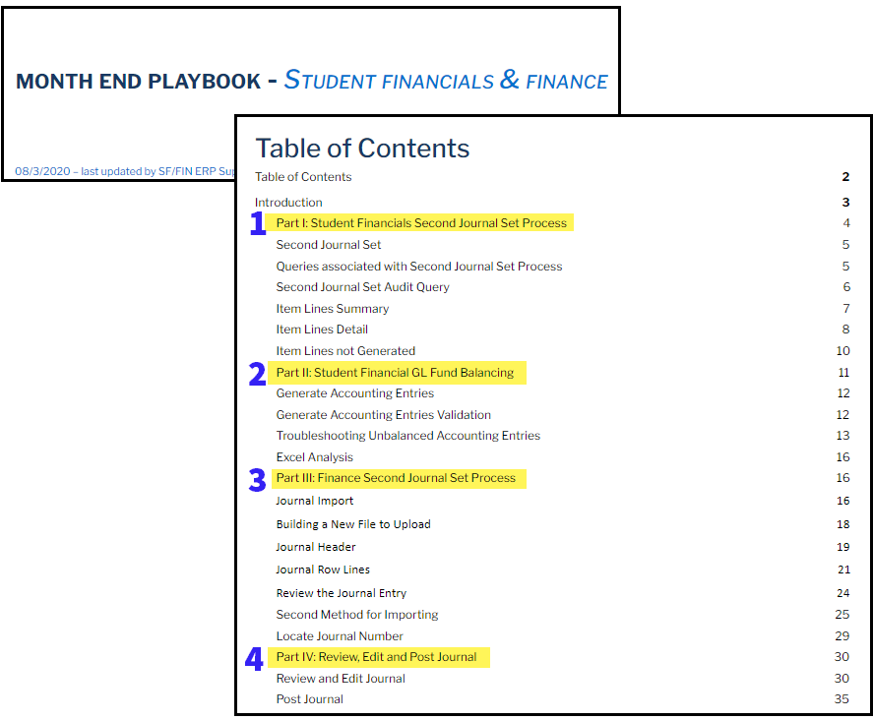
FIN | SF TO GL PROCESS
SJS – FINANCE-SIDE STARTS AT STEP 3
QRG: SF
Month End Playbook – Second Journal Set*

Slide 53
FIN | SECOND JOURNAL SETS
SJS – FINANCE-SIDE BREAKDOWN
NOTE: After the SF side has been processed, amounts verified and reconciled, an email is generated with a .csv file by SBCTC Functionals to your institution's designated Finance recipients.
1 – IMPORT SF JOURNAL FILE - copy and paste data from .csv file into Excel spreadsheet and import or upload into PeopleSoft GL as a ‘SF0001234’ Journal
2 – REVIEW/EDIT SF JOURNAL
3 – APPROVE
4 – POST JOURNAL

Slide 54
SF/GL JOURNALS & QUERIES
Utilizing FIN Journals & Queries for Analysis

Slide 55
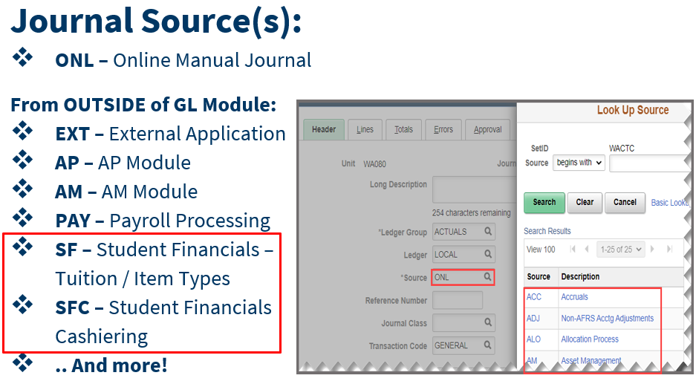
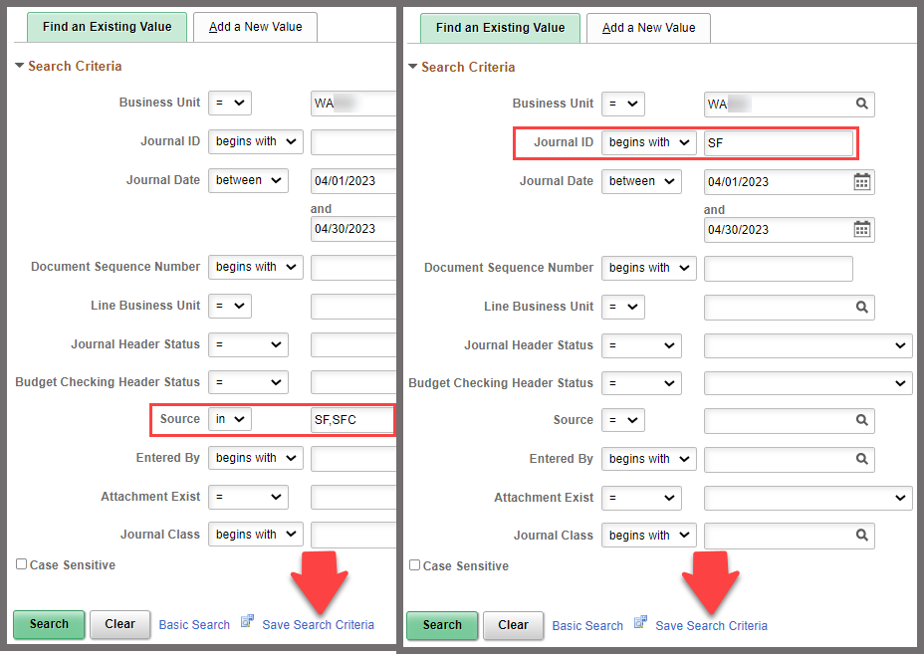
FIN | SF/GL JOURNALS
SF & SFC JOURNALS – LOOKING UP BY SOURCE

Slide 56
FIN | SF/GL QUERIES
FINANCE QUERIES FOR ANALYSIS
Common Reconciliation/Analysis Queries:
QFS_GL_ACCT_ANALYSIS – High level summary data
QFS_GL_ACCOUNT_ANALYSIS – Detailed level; contains the Grant Activity
QFS_GL_JRNL_ACCT_ANALYSIS - Report with Trial Balance
QFS_GL_SF_JRNL_VERIFY_BY_CF – SF System to Journal to Ledger
QRG: 9.2 Student Financials to Finance GL Recon
QRG: SF - Finance Integration (aka Month End Playbook)

Slide 57
REIMBURSEMENT/DRAWDOWN PROCESS
What are some options for Fund 145 Grant/Contract
& Non-145 Pell Grant?

Slide 58
FIN | REIMBURSEMENT PROCESS FUND 145 GRANT AWARDS: SBCTC WORKFIRST
Fund 145 Grant Billing: Reimbursable or
Fixed Price process to bill for reimbursement.
Grant & General Resources:
Accounting & Business Services
ctcLink Accounting Manual
Managing a Grant
Financials Process Schedule

Slide 59
FIN | DRAWDOWN PROCESS
NON-FUND 145 GRANT AWARDS: PELL
Example: PELL with Department of Education (G5)
Option 1*: Create a Manual Journal Entry > Posts to GL.
Per SBCTC Accounting, this method should not be done for it does not create an entry in Banking. *Please contact SBCTC ACCTG for questions.
Option 2: Receive a Direct Journal Deposit > Posts an AR Journal > Posts to GL
Option 3: Create an Express Bill > Receive an Express Deposit & Apply Payment to Bill > Posts to GL

Slide 60
FIN | QUESTIONS
Any questions… Please reach out to:
Accounting@sbctc.edu – for Accounting questions or General Guidance, Teri Sexton, Director of Accounting & Business Services
FIN-ERPSupportTeam@sbctc.edu – for Functional or process questions contact Brandy Eismon, Finance Functional General Ledger
ctcLinkTrainingManagement@sbctc.edu – for Training help Karen Ebert, Finance Functional Trainer

Slide 61
FA / SF / FIN GENERAL QUESTIONS

Slide 62
OBJECTIVES
At training completion, you should now be able to:
(FA/SF/FIN) - Understand the high-level flow of the cross-pillar end-to-end reconciliation process
(FA) - Understand the available FA reconciliation queries that should be run on weekly, semi-monthly, and monthly basis
(FA) - Understand the high-level process in FA regarding what queries and reports to run for varying funding sources
(FA) - Understand the timing in which SAS files are available to use for FA/COD reconciliation

Slide 63
OBJECTIVES continued…
(SF) - Understand how the GL is sent to FIN via SF/SFC journals
(SF) - Understand how Second Journal Sets are created and processed
(FIN) - Understand the differences between “Fund 145 Grant” vs. “Non-Fund 145 Grant” Budgets & Item Type Setup
(FIN) - Understand the high-level process in FIN in regards to how data processes into GL
(FIN) - Deciphering data using Queries
(FIN) - Understand the options for Reimbursement and Drawdowns

Slide 64
CONGRATULATIONS!
Cross-Pillar (FA-SF-FIN) End-to-End Reconciliation Training complete!
Please review the processing guides and additional recon training resources in your canvas course material as you progress through recon
Thank you for your participation today!

