Slide 1
College User Acceptance Testing
SAP Item #3: MAXT with Developmental Credits over 45
Amanda Hoover, Jed Lara, Ana Ybarra, Tara Keen, Stephanie Casino, Bhuvana Samraj, Reuth Kim
April 12, 2023

Slide 2
Agenda
Maximum Attempted Units Functionality
Solution Design
Demo
User Acceptance Testing
Next Steps

Slide 3
Implementation Timeline
College User Acceptance Testing | April 12 to 18
College Testing Sign Off | April 18, end of day
Targeted Production Release Date | April 27

Slide 4
Two Primary Issues with Maximum Attempted Units (MAXT) Test on SAP Maintenance List
SAP Maintenance List Item #3: MAXT with Developmental Credits over 45
→ Being addressed in this SAP project
SAP Maintenance List Item #6B: Transfer Credits in Calculation (MAXT)
Being address in an upcoming SAP project

Slide 5
Problem Statement
Delivered SAP functionality generates negative numbers and does not properly exclude remedial course work up to the Max Units to Exclude configuration value for the Maximum Attempted Units (MAXT) Test. The State Board reported this bug to Oracle in 2019, and while Oracle acknowledged it as a bug, they have not indicated that a fix will be delivered.

Slide 6
Maximum Attempted Units Test Functionality

Slide 7
Sap delivered processes
3 Quantitative Tests
Academic Standing
→ Maximum Attempted Units ←
Maximum Attempted Terms
5 Qualitative Tests
Minimum Current GPA
Minimum Cumulative GPA
Current Earned Units
Cumulative Earned Units
Two Year GPA

Slide 8
Maximum Attempted Units test
References the Maximum Attempted Units Test configurations in SAP Define Set Up and calculates based on the configurations on the Course Exclusions page.
Calculates the total Attempted Units and assigns a SAP Status for the Test based on unit ranges defined in the configuration.

Slide 9
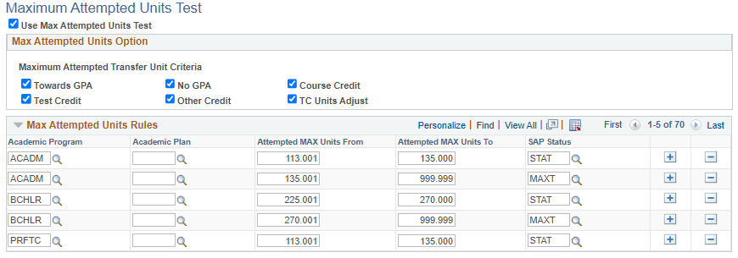
Maximum Attempted Units Configuration
Activates the Maximum Attempted Units Test
Options to include various forms of Transfer Credit in the total Attempted Units value calculated by the SAP program
Options to assign a SAP Status based on the total Attempted Units value calculated by the SAP program
Navigator > NavBar > Set Up SACR > Financial Aid > Satisfactory Academic Progress > Define Set Up Criteria >> Criteria 1 tab

Slide 10
Course Exclusions
College-specific list of all courses that should be excluded from the total Maximum Attempted Units value and designate them as “Remedial” or “ESL” Course Types
Option to define a maximum number of units that can be excluded for “Remedial” and/or “ESL” Course Types
This configuration is only utilized by the Maximum Attempted Units Test

Slide 11
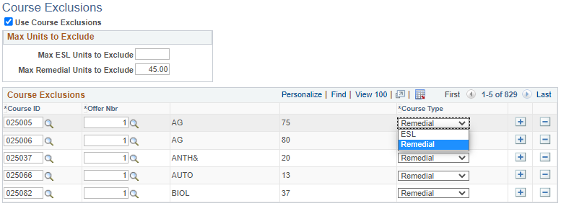
Course Exclusions Configuration
Activates the use of Course Exclusions in the Maximum Attempted Units Test only
Option to set a maximum number of units that can be excluded from the total Attempted Units value, based on Course Type in the configuration below
List of Courses to be excluded from the total Attempted Units value and categorized by Course Type
Navigator > NavBar > Set Up SACR > Financial Aid > Satisfactory Academic Progress > Define Set Up Criteria >> Exclusions tab

Slide 12
Solution Design

Slide 13
Current Program Design (High Level) - Maximum Attempted Units Test
Sum Units Taken from Student Enrollment for Total Attempted Units
Subtract sum of Remedial courses from Total Attempted Units
Up to the maximum configured for Remedial courses
Subtract sum of ESL courses from Total Attempted Units
Up to the maximum configured for ESL courses
Add units that correspond to the Transfer Credit types to Total Attempted Units
Assign SAP Status comparing the final Attempted Units value to configured unit ranges

Slide 14
Bug In Delivered Program Design - Maximum Attempted Units Test
Delivered logic fails on this step:
When ESL Maximum is set to [blank], the program defaults the maximum to 999.99, its own version of “no limit”
When the student’s Remedial units exceed the maximum set for Remedial Course Types, it instead uses the ESL Maximum as the value (999.99) to exclude from the total Attempted Units

Slide 15
Example of Issue
Compare the Remedial Units to the Max Remedial Units value to determine total units to be excluded
Compare the ESL Units to the Max ESL Units value to determine total units to be excluded
Calculate the final Attempted Units value
>
=
55 Units
(Total Attempted Remedial Units)
45 Units
(Max Remedial Units to Exclude)
999.99 Units
(Total Remedial Units that will be excluded)
>
=
5 Units
(Total Attempted ESL Units)
999.99 Units
(Max ESL Units to Exclude)
5 Units
(Total ESL Units that will be excluded)
-
-
=
160 Units
(Total Attempted Units)
5 Units
(Total ESL Units)
999.99 Units
(Max ESL Units value)
-844.99 Units
(Final Max Attempted Units calculation)

Slide 16
Program Solution Design (Customization) - Maximum Attempted Units Test
Copy the delivered Application Engine (AE) for the Maximum Attempted Units Test
Modify the copy to point to the Max Remedial Units to Exclude value when a student’s total Remedial Units exceeds what is in the configuration
Set the college’s Maximum Attempted Units Test to point to the custom Application Engine

Slide 17
Example of Solution
Compare the Remedial Units to the Max Remedial Units value to determine total units to be excluded
Compare the ESL Units to the Max ESL Units value to determine total units to be excluded
Calculate the final Attempted Units value
>
=
55 Units
(Total Attempted Remedial Units)
45 Units
(Max Remedial Units to Exclude)
45 Units
(Total Remedial Units that will be excluded)
>
=
5 Units
(Total Attempted ESL Units)
999.99 Units
(Max ESL Units to Exclude)
5 Units
(Total ESL Units that will be excluded)
-
-
=
160 Units
(Total Attempted Units)
5 Units
(Total ESL Units)
45 Units
(Max Remedial Units value)
110 Units
(Final Max Attempted Units calculation)

Slide 18
Additional Considerations – ESL Course Type
Max ESL Units to Exclude functionality also functions correctly
Max ESL Units to Exclude value is now independent of the Max Remedial Units to Exclude
Max ESL Units to Exclude can be left as “blank” to exclude any course from MAXT on the student’s record list on Course Exclusions as ESL
**Always test thoroughly in a test environment before making any changes to configurations in Production**

Slide 19
Demonstration
Jed Lara, ctcLink Functional Analyst, Campus Solutions (Financial Aid)

Slide 20
Student Example (Problem)
This student has a negative calculated Attempted Units value, due to the bug in the delivered Oracle code. This renders any of the Max Attempted Units Rules for assigning a SAP Status obsolete when their Remedial Credits exceeds the maximum set in the college’s configuration.
In this particular example the program assigned a MEET SAP Status for the Maximum Attempted Units test because the erroneous attempted units value is not in one of the specified ranges on the Maximum Attempted Rules configurations.

Slide 21
Student Example (Solution)
This student now has the correct MAXT status on the Maximum Attempted Units test because the attempted units value calculated correctly and is in one of the specified ranges on the test configurations. Because MAXT has the highest severity level, this student's final SAP Status for the term is MAXT.

Slide 22
User Acceptance Testing
Testing Timeframe: April 12 to April 18
Testing Sign-off Due: April 18, end of day

Slide 23
Testing Scope
In Scope for Testing Bug Fix
Financial Aid applicants who have taken Remedial or ESL courses and…
Had their academic transcript history converted at Go Live
Enrolled for Remedial or ESL courses after your college went live on ctcLink
Out of Scope for Testing Bug Fix
Students who have had their Remedial or ESL courses manually rebuilt in ctcLink from a legacy transcript record
The enhancement that is designed to address this population will come with the FA SAP Maintenance Item #6B

Slide 24
Recommended Testing Steps
Confirm Maximum Attempted Units Test is active in SAP Setup
Process SAP
Manually build SAP for test student
Run SAP in batch or Report Mode and
Hand calculate Maximum Attempted Units and compare to SAP outcome on Student SAP page

Slide 25
Test Scenarios
Students with Converted Data who have…
Remedial Courses
no ESL or Remedial Courses
Optional*
ESL Courses
both ESL and Remedial Courses
Students with ctcLink Enrolled who have…
Remedial Courses
no ESL or Remedial Courses
Optional*
ESL Courses
both ESL and Remedial Courses
*Requires setting selected courses with the “ESL” Course Type in the Course Exclusions SAP Setup

Slide 26
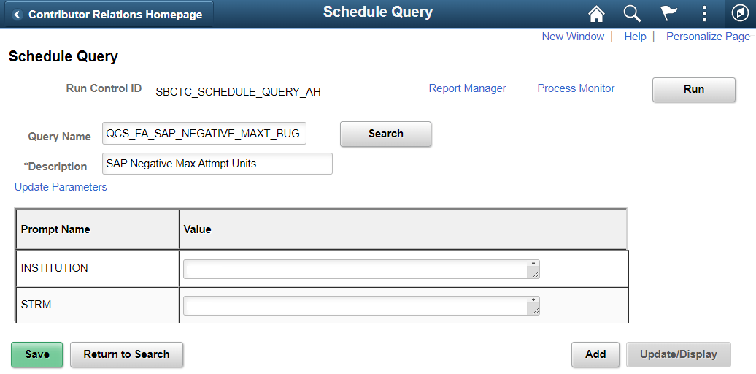
Finding Students with Negative Attempted Units
Schedule Query: QCS_FA_SAP_NEGATIVE_MAXT_BUG

Slide 27
Asking Questions & Reporting Issues
Questions? Trouble Logging In?
Send an email…
To: Amanda Hoover ahoover@sbctc.edu
CC: Ana Ybarra aybarra@sbctc.edu
Found Issues/Errors?
Submit a ticket
Service Desk: https://servicedesk.sbctc.edu/
Request Type: ctcLink Support > Testing
Subject: UAT – FA SAP MAXT – [description of issue]
Include screenshots, IDs used, and detailed steps taken

Slide 28
Testing Environment and Login Information
PQA Test Environment: https://pt-pqa.peoplesoft-nonprod-aws.ctclink.sbctc.edu/psp/ptpqa/?cmd=login
Environment Availability: Monday to Friday, 7am to 7pm
Logging In:
Username = Your EMPLID
Password = [ shared during the session ]

Slide 29
Sign-Off
Survey Monkey link: https://www.surveymonkey.com/r/YT23YDH
One response per college
Complete by end of day on April 18th

Slide 30
Testing Resources
UAT Testing Materials page
https://ctclinkreferencecenter.ctclink.us/m/98421/l/1668930-sap-3-maximum-attempted-units-bug-fix-for-remedial-credit-exclusions
Same information as in this slide deck
Additional resources linked on the page

Slide 31
Next Steps
Session Follow-up Communications
Slide deck and recording link to ctcLinkFinAidSupport and DirFinAid eLists
Email to testers with their passwords and sign off survey link
User Acceptance Testing and sign off (April 12 to 18)
Implementation (if approved)
Target: April 27
Email announcement to ctcLinkFinAidSupport and DirFinAid eLists
SAP Information Guide updates
https://ctclinkreferencecenter.ctclink.us/m/PMO_Info/l/1625563-fa-satisfactory-academic-progress-sap-project-information-guide

Slide 32
Thank you for Testing!

Slide 33
Quantitative: Maximum Attempted Units
This test first Counts the Units Attempted from Enrollment at the institution
Does not include any transfer units.
The total units attempted at the institution are summed from student enrollment,
Counts units that are within and prior to the term or aid year being processed.
The process uses either the units-taken value or, if that value is zero, the Financial Aid progress units to gather this sum of units attempted at the institution.
The student must be enrolled in the maximum term past the fully graded date.
Audited units are not counted.
Second, the Transfer Units are “added” to that sum from Student Career Term (Term History)
Based on the transfer unit options selected on the setup.
If no transfer unit options are selected, then the Maximum Attempted Units test only includes units attempted at the institution.
Additionally, if Course Exclusions are set up and the student is “Enrolled” in any of the defined courses, then those units are subtracted from the attempted unit calculation.

Slide 34
Quantitative: Maximum Attempted Units
You can select any or none of the following options for including transferred units in attempted units:
The Towards GPA option counts transfer units that have been matriculated for any term prior to or including the term being processed as included in GPA units.
The No GPA option counts transfer units that have been matriculated for the term prior to or including the term being processed as no GPA units.
The Course Credit option counts transfer units that have been matriculated for the term prior to or including the term being processed as course credits.
The Test Credit option counts test credit units that have been matriculated for the term prior to or including the term being processed.
The Other Credit option counts other credit units that have been matriculated for the term prior to or including the term being processed.
The TC Units Adjust option subtracts transfer credit adjustments from the attempted unit total that have been entered for any term prior to or including the term being processed.

Slide 35
Quantitative: Maximum Attempted Units
You can use the following Course Exclusion options to subtract Remedial and/or English as a Second Language (ESL) courses from attempted units:
Subtract all remedial course units set up in Course Exclusions that the student is enrolled in unless the value of the total remedial units that the student is enrolled in exceeds the value in the Max Remedial Units to Exclude field. For example, if the student is enrolled in 8 remedial units, and the Max Remedial Units to Exclude value is 3, the SAP process count 5 of the 8 remedial units in the attempted unit calculation.
Subtract all ESL course units set up in Course Exclusions that the student is enrolled in unless the value of the total ESL units that the student is enrolled in exceeds the value in the Max ESL Units to Exclude field.
The setup should cover the entire range of units by career, by career and program, or by career, program, and plan. If no rule match is found, the student is assigned the Career Pass Default Status code. The ranges and statuses that are set here are to find students who are not making progress.

Slide 36
Technical perspective on maximum attempted units
Update the SAP Units actual value with the sum of Units Taken (UNT_TAKEN)
Unless Sum of Units Taken (UNT_TAKEN) is 0 and
Sum of Financial Aid Progress Units (UNT_PRGRSS_FA) is greater than 0,
Then use sum of Financial Aid Progress Units (UNT_PRGRSS_FA) from Student Enrollment (STDNT_ENRL) where:
Student Enroll Status = E and
Audit Grade Basis = N
For all Terms that are less than or equal to the evaluation term for rows.

