Slide 1
Fa TERM fundamentals training
Kelly Forsberg
ctcLink Functional Trainer | Financial Aid
March 2023

Slide 2
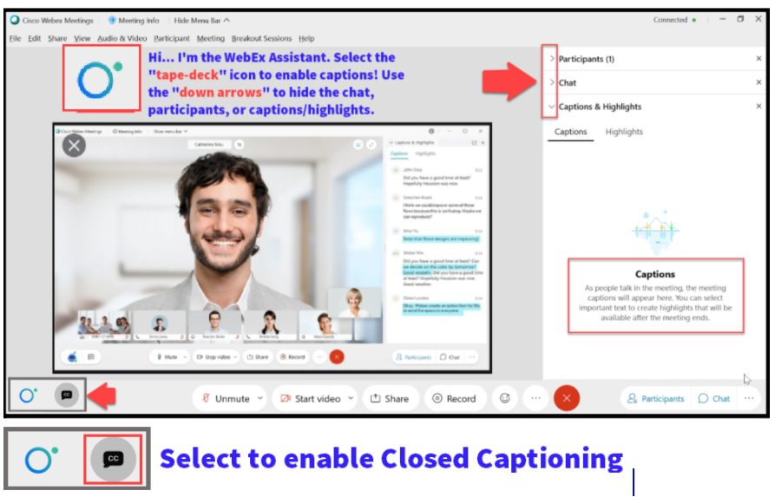

Slide 3
Logistics and Agenda
Times | Activity
9:00 – 9:03 | Sign-In/Greet/Attendance
9:03 – 9:05 | Objectives
9:05 – 9:30 | FA Term (Manually Building with Term Enrollment & w/o Term Enrollment) Budgets (Manually Building)
9:30 – 9:50 | Reviewing the Features on the FA Term Page
9:50 – 10:00 | Session Wrap-Up/Q&A
Some processes will have demonstrations, but due to data scrubbing, available data in the environment, demo examples are not ideal

Slide 4
ground rules
Be ready to participate
Remove external distractions
Mute your line when not speaking
Do NOT place Webex line on hold. Use Mute.
Please leave your line on Mute unless you are speaking
Sessions are being recorded
Allow your peers to complete their thoughts before beginning yours

Slide 5
Objectives
After completing this training, you should be able to:
Understand the steps on how to manually build FA Term and review the features and functions on the FA Term page:
Activate an Aid Year
FA Term Tab
Acad Level Tab
Statistics Tab
Financial Aid Tab
Records/Term Info Tab
Withdrawal Info Tab

Slide 6
AID YEAR ACTIVATE A STUDENT (MANUAL)

Slide 7
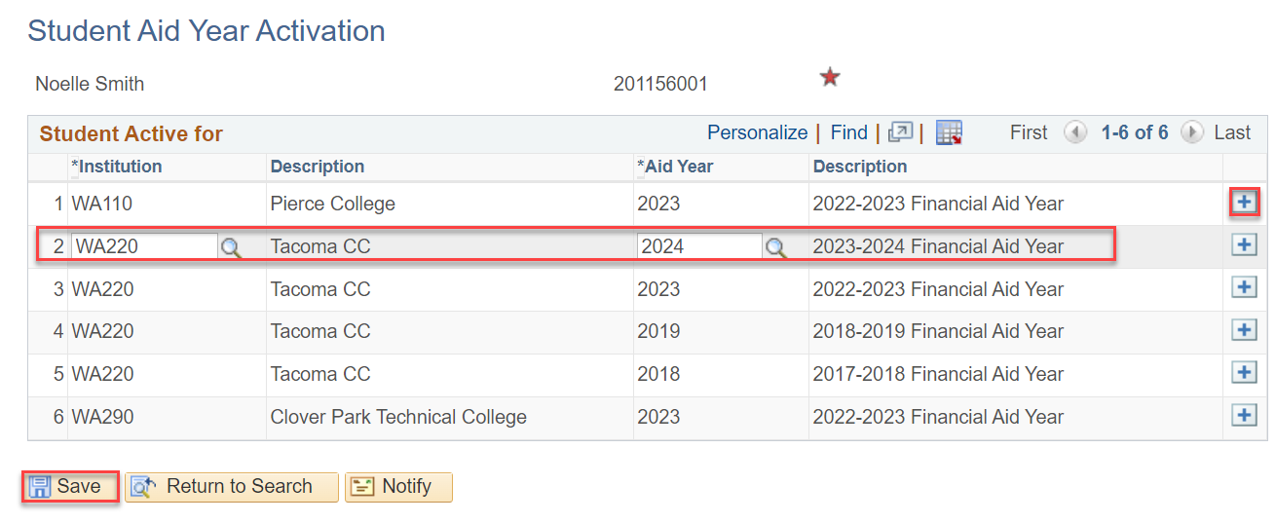
Aid year activate
MANUALLY
Navigation: Nav Bar > Navigator > Financial Aid > Aid Year Activation > Manage Financial Aid Years
Students who have not filed a FAFSA, but need an award (i.e., scholarship, or workforce) will need to be aid year activated before any aid can be awarded

Slide 8
MANUAL
FA TERM
BUILD

Slide 9
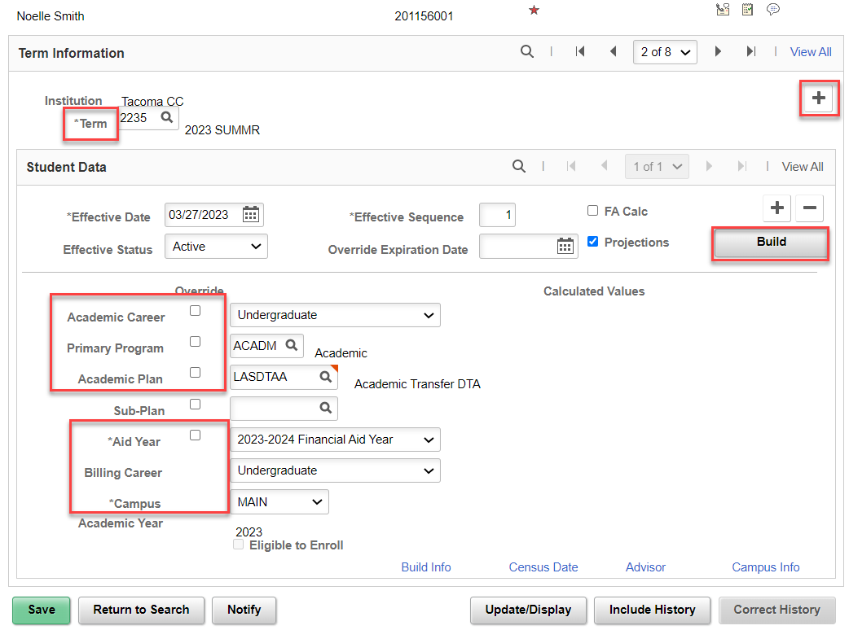
Fa term
MANUAL BUILD
Navigation: Nav Bar > Navigator > Financial Aid > Financial Aid Term > Manage FA Term
The Build button will pre-populate all the necessary fields on this tab if they are Term Activated and Plan Stacked on the Records side.
If they are not enrolled, you will need to put the student in a placeholder program.
Uncheck the override boxes.
Repeat for all 4 terms in the AY

Slide 10
MANUAL
BUDGET
BUILD

Slide 11
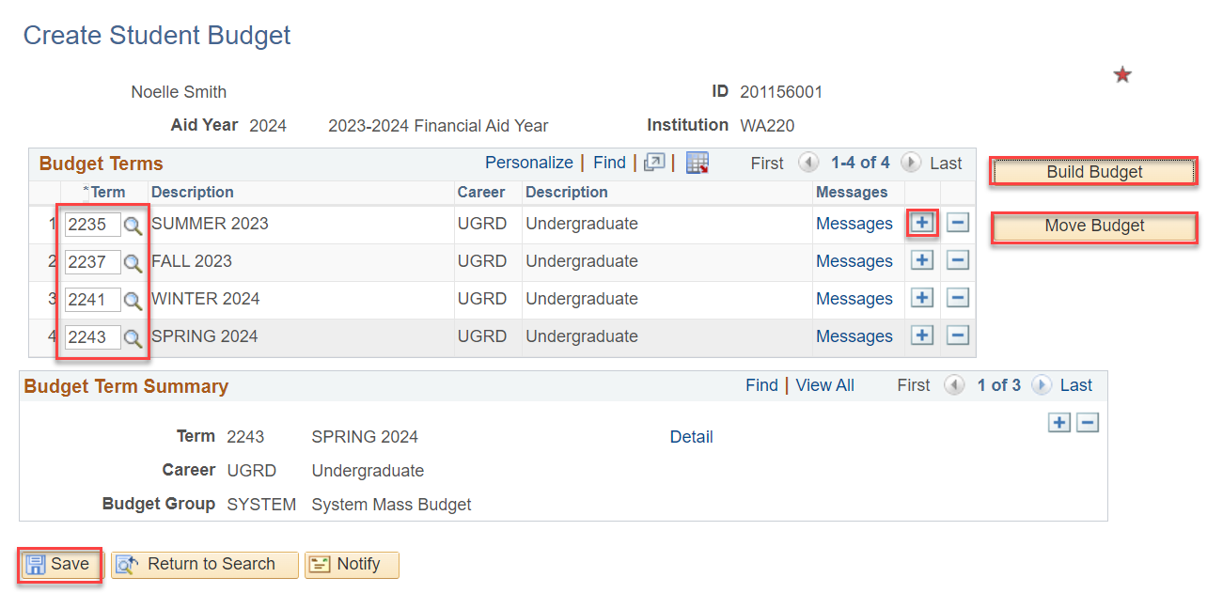
MAINTAIN BUDGETS
MANUAL BUILD
Navigation: Nav Bar > Navigator > Financial Aid > Budgets > Maintain Student Budget
The AY Terms need to be entered in the Term column. If you do not have a selectable Term in the look up tool, this means you have not built out FA Term for that term. Use the Add a New Row + button to add another row for the next term.
Select the Build Budget and then when it grays out, select the Move Budget button.
Select the Detail link to review the budget items.
You are now ready to enter a non-traditional aid award (outside scholarships, workforce aid)

Slide 12
REVIEWING THE FEATURES
ON THE FA TERM PAGE

Slide 13
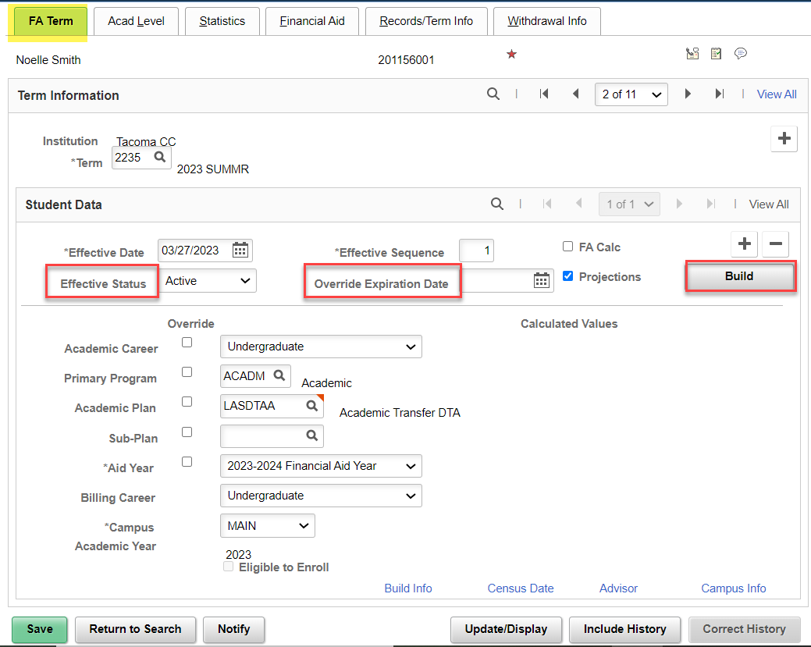
Review of FA term features
Effective Status:
If FA Load is = N at Census Lock, the Effective Status will change to Inactive.
Override Expiration Date:
Can be set to hold overridden data to a specific date. Use sparingly.
Build button:
Student must be Term Activated and Plan Stacked
FA Term Tab
Navigation: Nav Bar > Navigator > Financial Aid > Financial Aid Term > Maintain Student FA Term

Slide 14
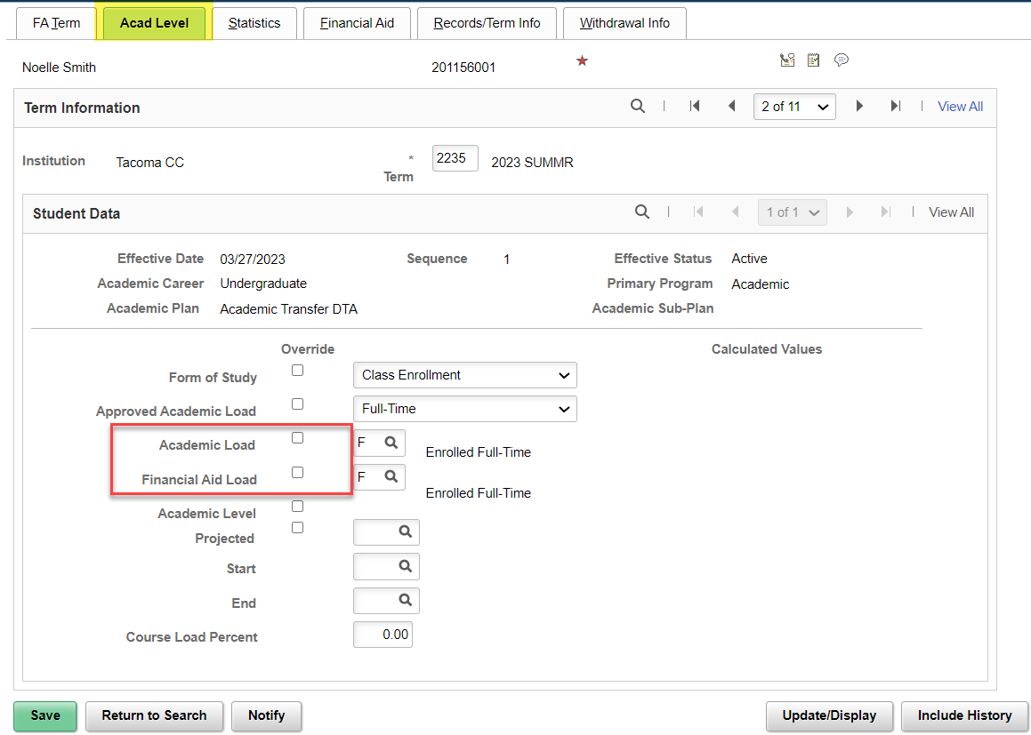
Review of FA TERM features
ACAD LEVEL TAB
Academic Load:
Pulls from Student Records
FA Load:
Is what drives the FA Student Budget
It is common that these may not match all the time, especially if you’re overriding.

Slide 15
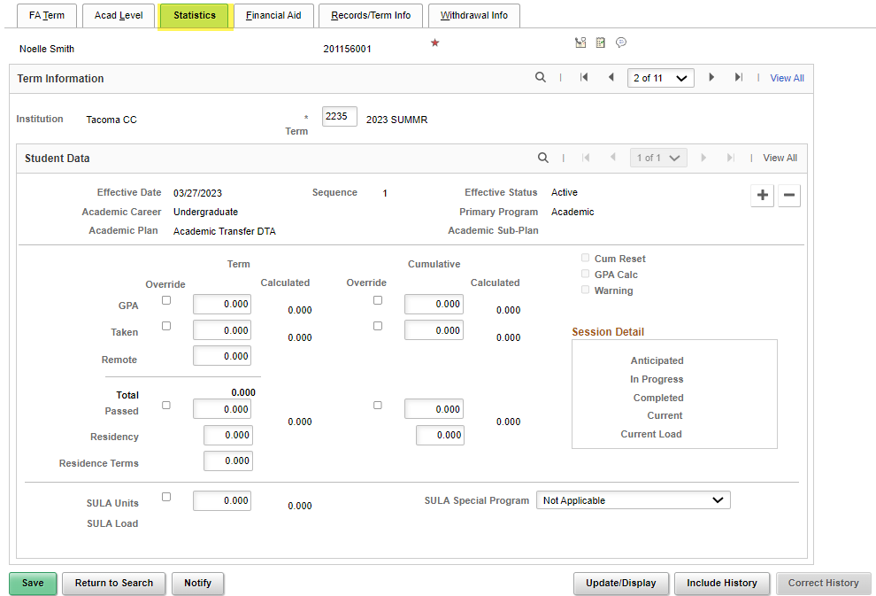
Review of FA TERM features
STATISTICS TAB
Statistics Tab:
Can really leave this tab alone when building manually, but it is reviewable when FA Term process runs in JobSet.
SULA Special Program is a noted feature that displays if this program is a selective Admissions Program.

Slide 16
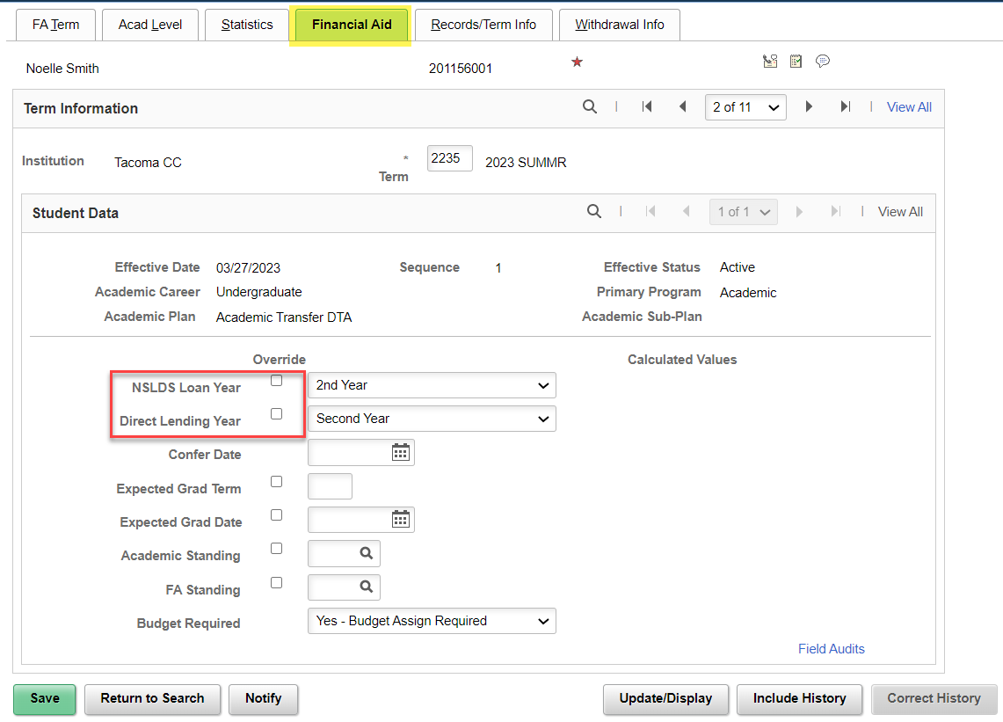
Review of FA TERM features
FINANCIAL AID TAB
Statistics Tab:
NSLDS Loan Year and Direct Lending Year need to be defined.
Will pull in automatically when Batch FA Term process runs from JobSet.
Drives COD reporting data.
Leave other fields blank.

Slide 17
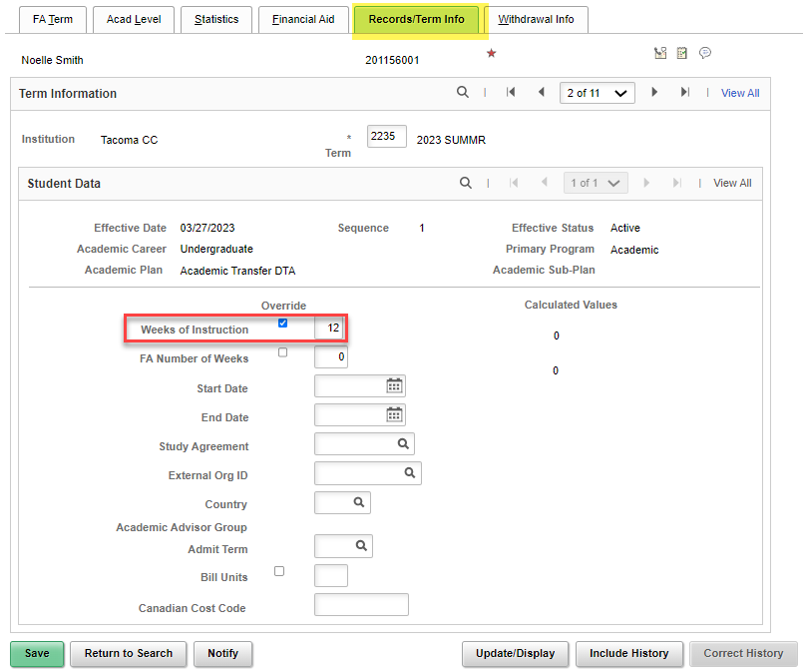
Review of FA TERM features
RECORDS/TERM INFO TAB
Weeks of Instruction:
Override box can remain checked.
Will pull in automatically when Batch Weeks of Instruction Update process runs from JobSet.
Drives COD reporting data.
Leave other fields blank.

Slide 18
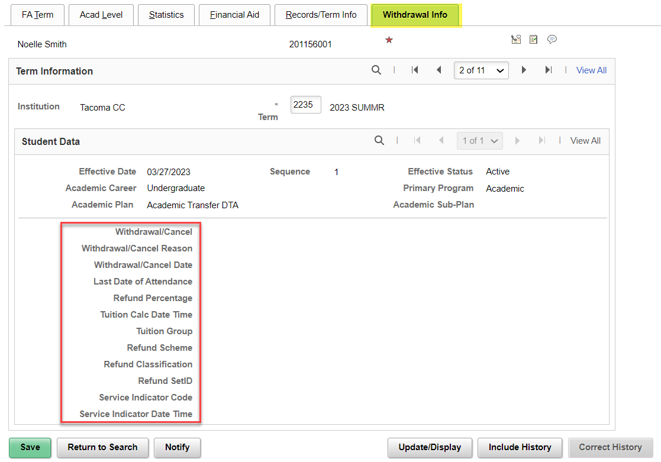
Review of FA TERM features
WITHDRAWAL INFO
Withdrawal Info:
Nothing to build out here, but this information may display when a WD occurs.
Good for review.

Slide 19
FA TERM
MANUALLY BUILD OUT FA TERM W/O & WITH ENROLLMENT
QRGS:
9.2 Building an FA Term | 9.2 FA - Financial Aid Term | ctcLink Reference Center
9.2 Manually Awarding Aid for a Student without a FAFSA | 9.2 FA - Packaging and Awards | ctcLink Reference Center
9.2 View a Financial Aid Term | 9.2 FA - Financial Aid Term | ctcLink Reference Center

Slide 20
DEMONSTRATION

Slide 21
Outcomes
At training completion, you should be able to:
Understand the steps on how to manually build FA Term and review the features and functions on the FA Term page:
Activate an Aid Year
FA Term Tab
Acad Level Tab
Statistics Tab
Financial Aid Tab
Records/Term Info Tab
Withdrawal Info Tab

Slide 22
Congratulations!
FA Term Fundamentals Training Complete!
Please review the videos and additional resources in your canvas course material and the reference center as you progress through students to prep for awarding
Thank you for your participation today!

