Slide 1
3Cs for YOU AND ME
FA ERP Support
March 2023

Slide 2
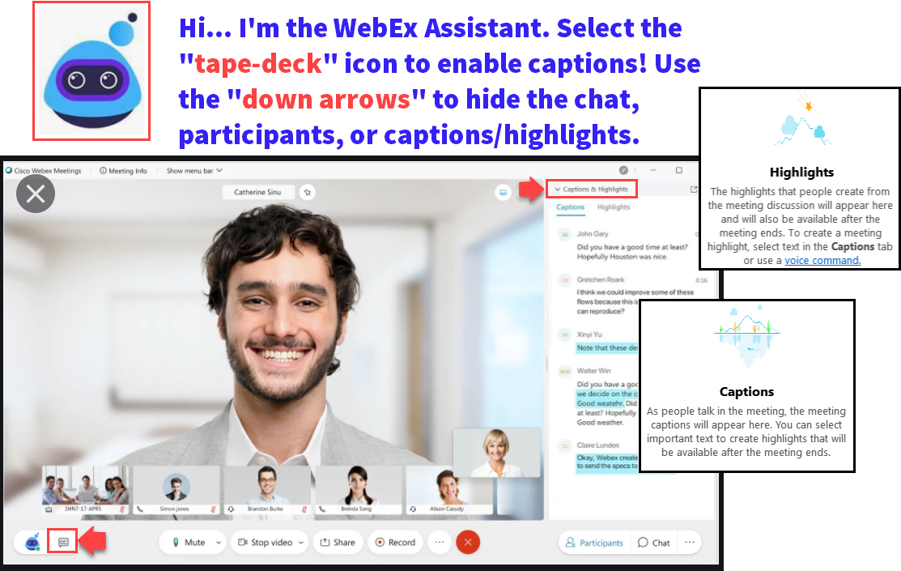

Slide 4
Logistics and Agenda
Times | Activity
1:00 – 1:10 | Greet/Attendance/Objectives
1:10 – 1:20 | Quick overview of FA 3Cs
1:20 – 1:30 | Comments
1:30 – 1:45 | Checklists
1:45 – 2:00 | Communications
2:00 – 2:15 | Individualized Communications to students
2:15 – 2:30 | Bonus: Preview of new award offer template
2:30 – 3:00 | Session Wrap-Up

Slide 5
ground rules
Remove external distractions
Hold questions until Q&A Time of each section
Mute your line when not speaking
Do NOT place Webex line on hold. Use Mute.
Please leave your line on Mute unless you are speaking
Sessions are being recorded

Slide 6
Objectives
During this work session, we will review:
Comments
Checklists
Communications
Individualized Communications to students
Bonus: Preview of new Award Offer Template

Slide 7
First, let’s go over FA 3Cs at a
high level ☺

Slide 8
3Cs are being leveraged for:
Communicating with students
To Dos
SAP status
Award offers
Communicating with other staff
File review notes
Packaging notes (i.e. aid adjustments)
Conversation with students
Recording important notes
File review notes
Packaging notes
Capturing specific populations for packaging and disbursements
Limit packaging to students who have/do not have a specific checklist
Prevent disbursements for students who have unresolved checklists

Slide 9
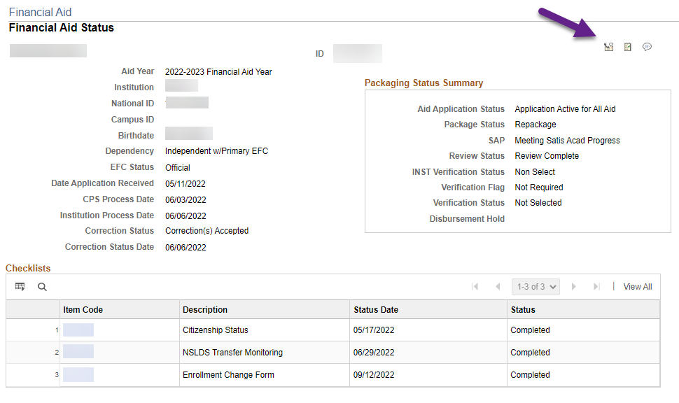
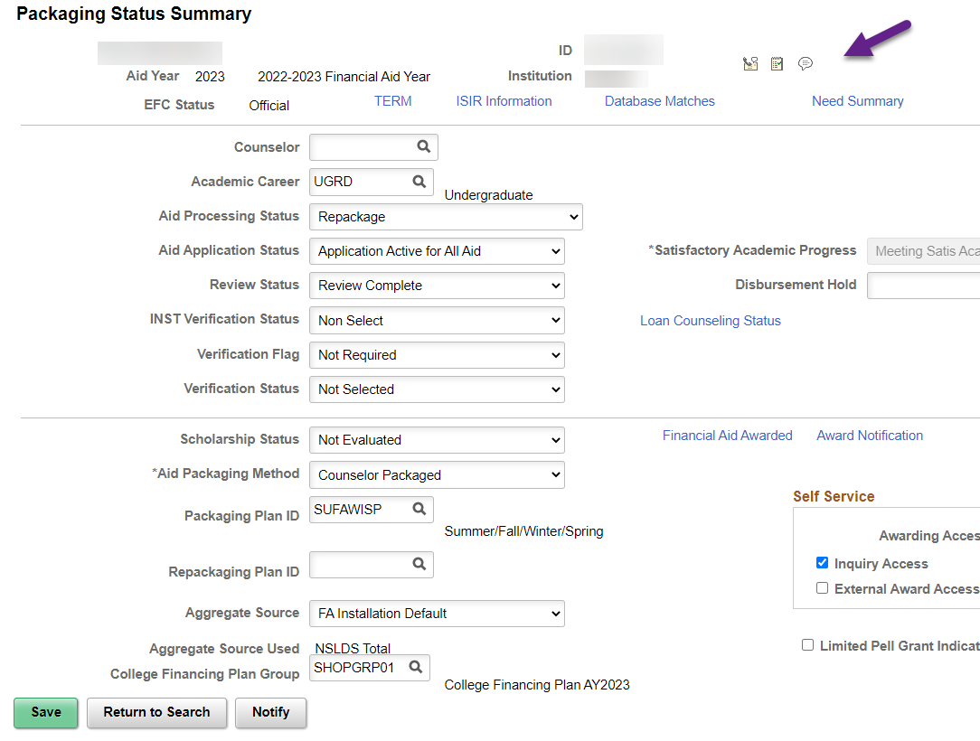
The 3CS Speed keys Are conveniently on the Financial Aid Status Page & Packaging Status Summary page
Navigation: Navigator > Financial Aid > View Financial Aid Status
Navigation: Navigator > Financial Aid > View Packaging Status Summary
Communications
Checklists
Comments

Slide 10
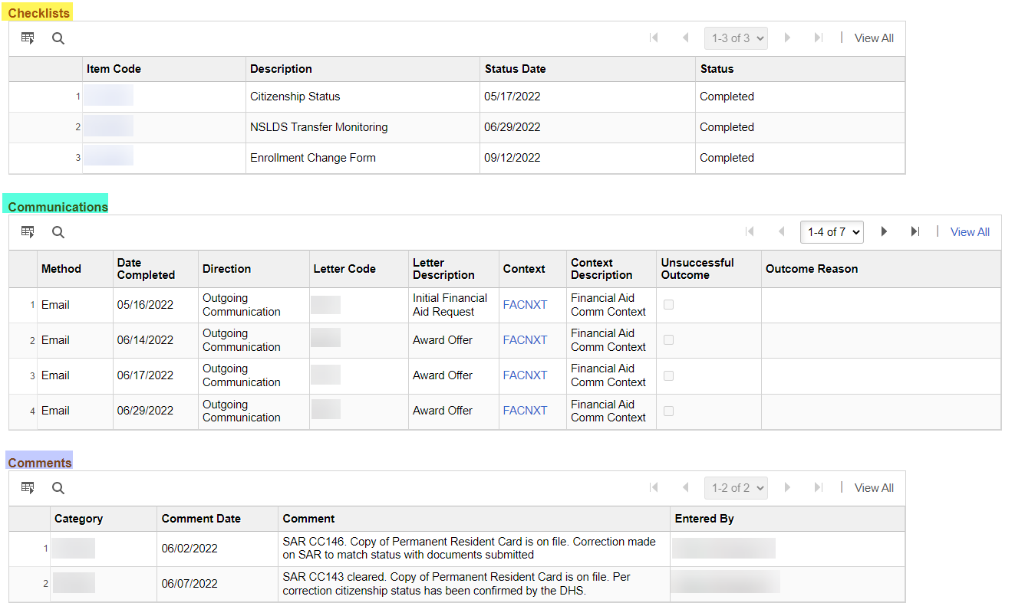
FINA & FINT 3CS populate on the Financial Aid Status Page
Navigation: Navigator > Financial Aid > View Financial Aid Status
Note: BankMobile Demo File checklist and Loan Exit Counseling are GEN so they do not appear on this page
You can navigate to the following pages to see GEN checklists
Campus Community > Communications > Person Communications > Communication Management
or
Campus Community > Communications > Person Communications > Communication Summary

Slide 11
Comments

Slide 12
The Comments Speed key is conveniently on the Financial Aid Status Page & Packaging Status Summary page
Navigation: Navigator > Financial Aid > View Financial Aid Status
Navigation: Navigator > Financial Aid > View Packaging Status Summary
Comments

Slide 13
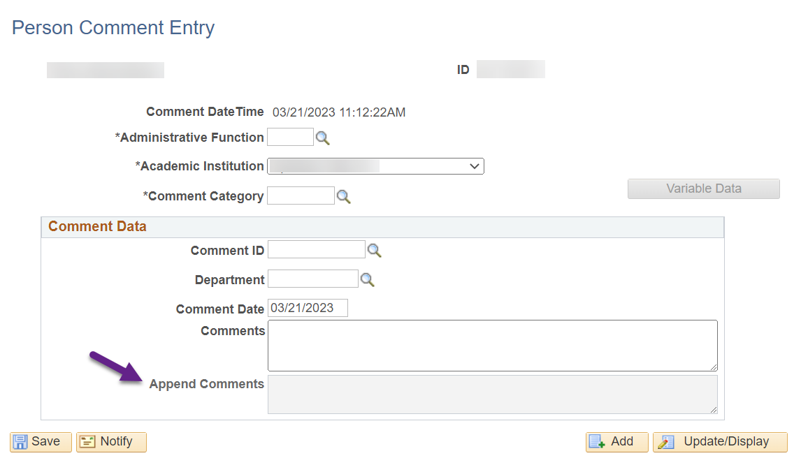
Be careful with typos!
Note: The text written in the Comments section is not editable. If you need to fix a typo, you could delete the Comment and start over or add additional text to the existing text by writing in the Append Comments section.

Slide 14
Examples of Comments across ctcLink
Noting information about eligibility

Slide 15
Examples of Comments across ctcLink
Noting a requirement was reviewed, completed, waived, etc.

Slide 16
Comments Queries
Setup related
CTC_FA_GC_AYRO_COMMENT_CATEGRY
CTC_FA_GC_AYRO_COMMENT_CATGGRP
Student management related
QCS_FA_COMMENT_CATEGORY_AID

Slide 17
Q&A

Slide 18
Checklists

Slide 19
The Checklists Speed key is conveniently on the Financial Aid Status Page & Packaging Status Summary page
Navigation: Navigator > Financial Aid > View Financial Aid Status
Navigation: Navigator > Financial Aid > View Packaging Status Summary
Checklists

Slide 20
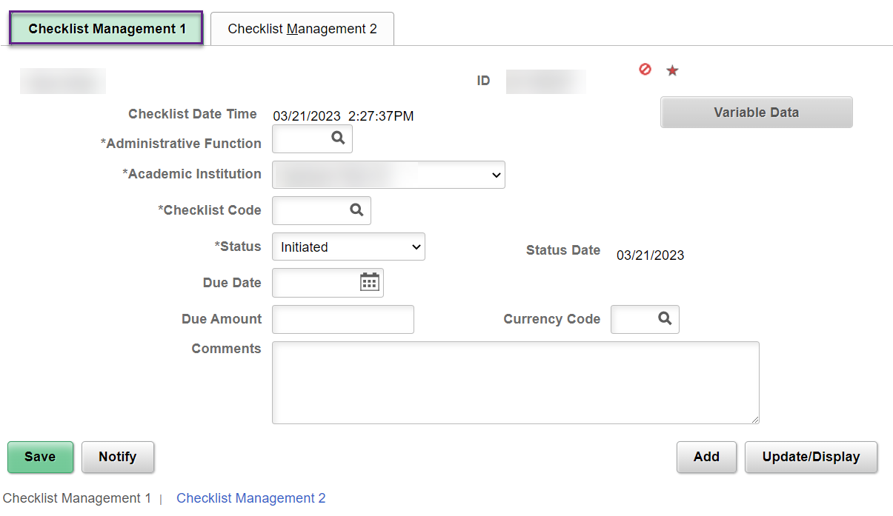
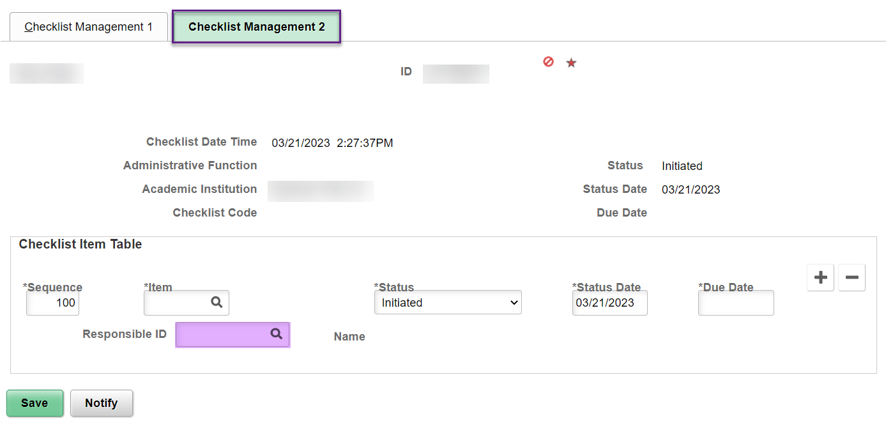
Comments written in checklists are staff facing
Note: Depending on the checklist, your office may have a process of assigning the FA Office ID for the Responsible ID. Don’t forget to update Checklist Management 2 tab in that case.

Slide 21
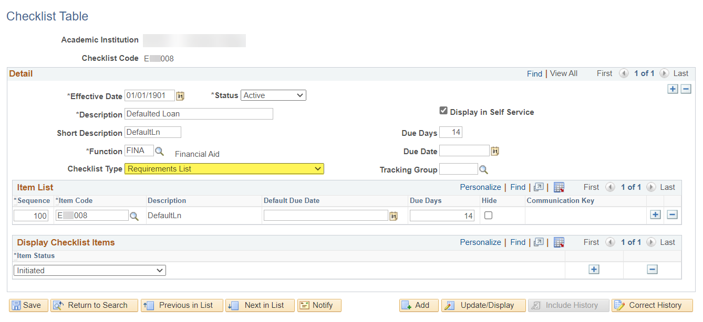
Is your checklist set up to populate on the to-do Communication?
Navigation 1: Navigator > Set Up SACR > Common Definitions > Checklists > Checklist Table
Navigation 2: Navigator > Campus Community > Checklists > Set up Checklists > Checklist Table
Checklist Type
Requirements List = Will populate on To-Do Letter
Staff Assignment List = Will not populate on To-Do Letter

Slide 22
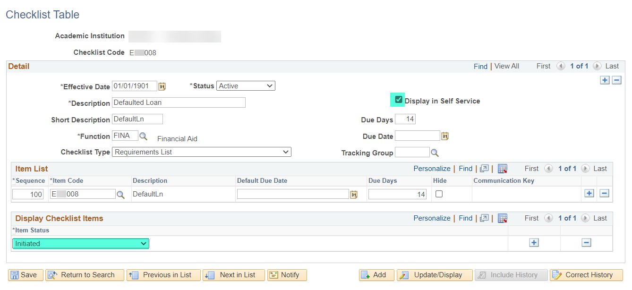
Is your checklist set up to appear on the Student Homepage (AKA Self Service)?
Navigation 1: Navigator > Set Up SACR > Common Definitions > Checklists > Checklist Table
Navigation 2: Navigator > Campus Community > Checklists > Set up Checklists > Checklist Table
Display in Self Service checkbox
Selected = Will appear as a To Do on the Tasks tile if the checklist is in the indicated Item Status
Not Selected = Will not appear on the Student Homepage

Slide 23
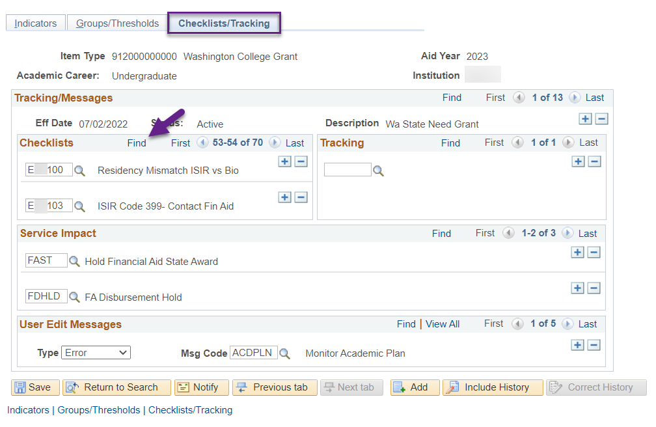
IF A student is Assigned that checklist and it’s unresolved, do you need it to stop disbursements of a specific item-type for that student?
Navigation: Navigator > Set Up SACR > Product Related > Financial Aid > Disbursement > Define Item Type Rules
IMPORTANT
When making changes, the effective date needs to be a certain date. See AYRO Guide for more info!
https://ctclinkreferencecenter.ctclink.us/m/92436/l/1193577-2023-2024-aid-year-roll-over-business-process-guide

Slide 24
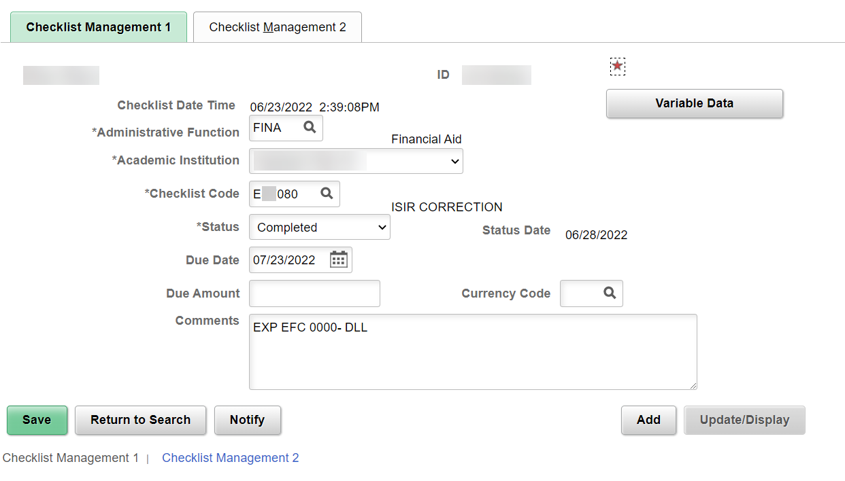
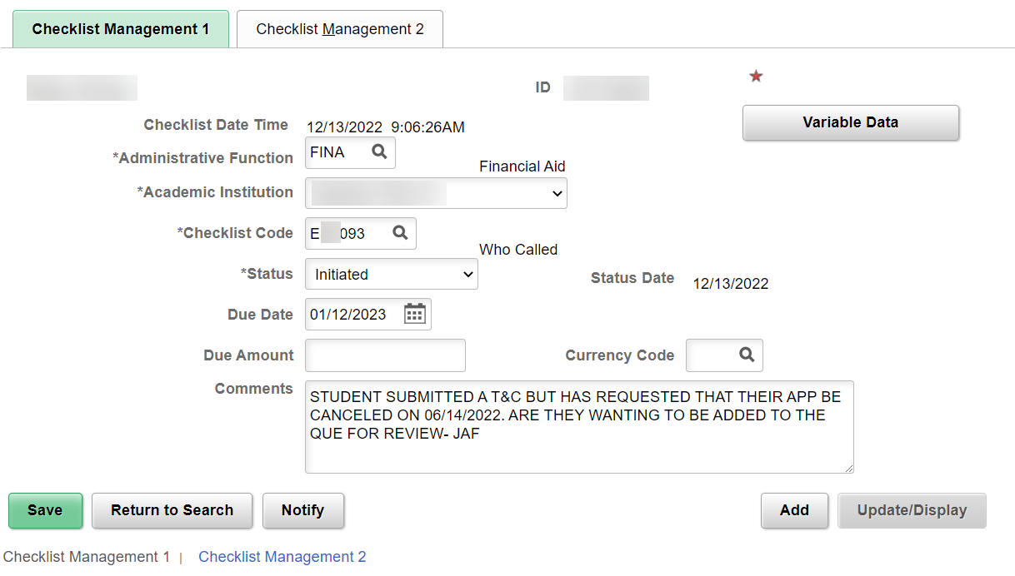
Examples of Checklists across ctcLink
Noting an ISIR correction was sent
Noting who called so other staff know when the student calls back

Slide 25
Checklists Queries
Setup related
CTC_FA_LC_AYRO_CHECKLIST_ITEMS
CTC_FA_LC_AYRO_CHECKLIST_TABLE
CTC_FA_DISB_RULE_CHECKLISTS
Student management related
CTC_FA_CHECKLIST_LIST
CTC_FA_CHECKLIST_LIST2
QCS_FA_MULTI_CHECKLIST_LIST
QCS_FA_CHCKLST_ASSIGNMENT_FINA
QCS_FA_APPLIED_NEED_REVIEW
And many more!

Slide 26
Q&A

Slide 27
Communications

Slide 28
The Communications Speed key is conveniently on the Financial Aid Status Page & Packaging Status Summary page
Navigation: Navigator > Financial Aid > View Financial Aid Status
Navigation: Navigator > Financial Aid > View Packaging Status Summary
Communications

Slide 29
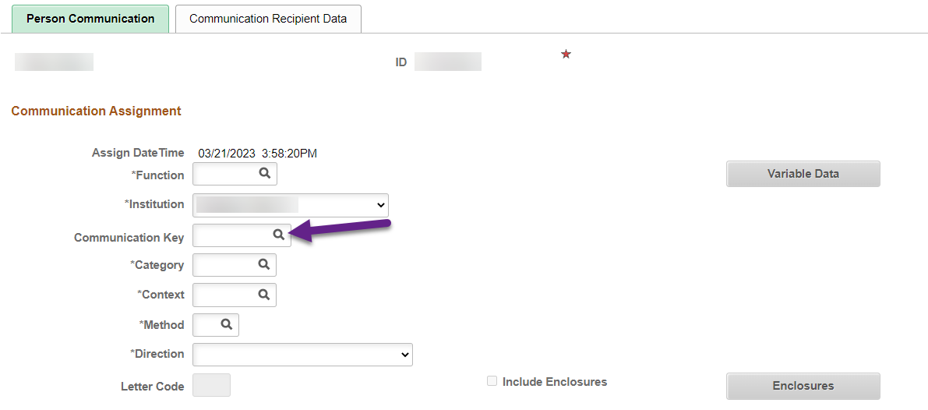
Do you have some communication speed Keys set up on your EMPLID?
Note: If you set up some communication speed keys, assigning communications manually becomes quicker! You only have to fill out Function, Institution (should default to your college), Communication Key, then Variable Data if applicable!
https://ctclinkreferencecenter.ctclink.us/m/92431/l/933217-9-2-communication-speed-keys-set-up

Slide 30
Communication Queries
Setup related
QCS_CC_COMM_INST
Student management related
CTC_COMMUNICATION_LIST_BY_DATE
CTC_FA_INCOMP_COMM_STDNT_LIST
QCS_FA_ASSGN_COM_BY_CKLST_FINA
QCS_FA_ASSGN_COM_BY_CKLST_FINT
CTC_FA_SAP_STATUS_COMM_SAPC
CTC_FA_SAP_STATUS_COMM_SELECT

Slide 31
Q&A

Slide 32
Individualized Communications to Students

Slide 33
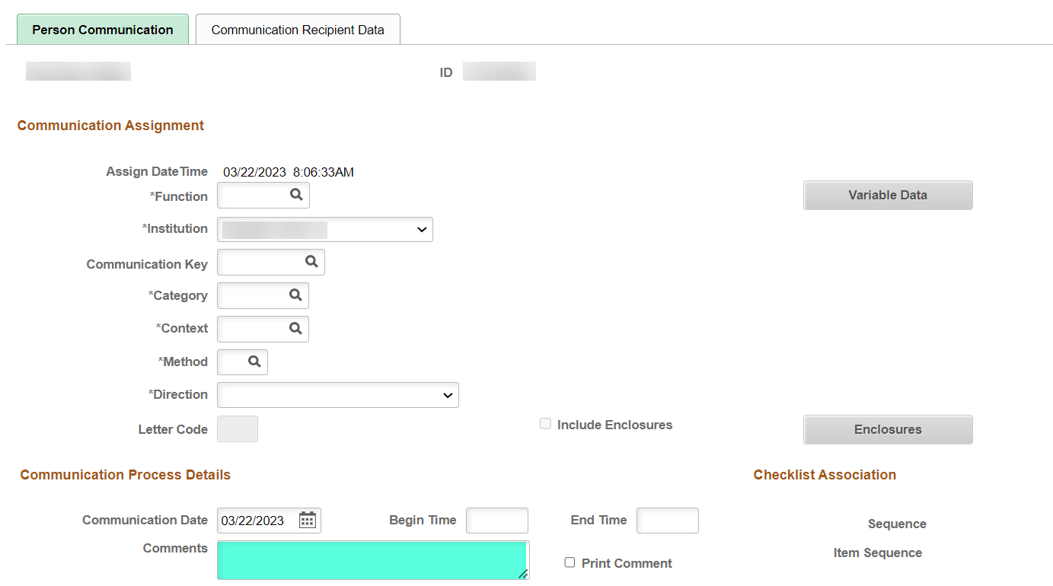
A merge field can be added to Communication templates which will allow you to write a comment on the Communication Management page and it will populate on the communication to that student
Navigation: Navigator > Campus Community > Communications > Person Communications > Communication Management

Slide 34
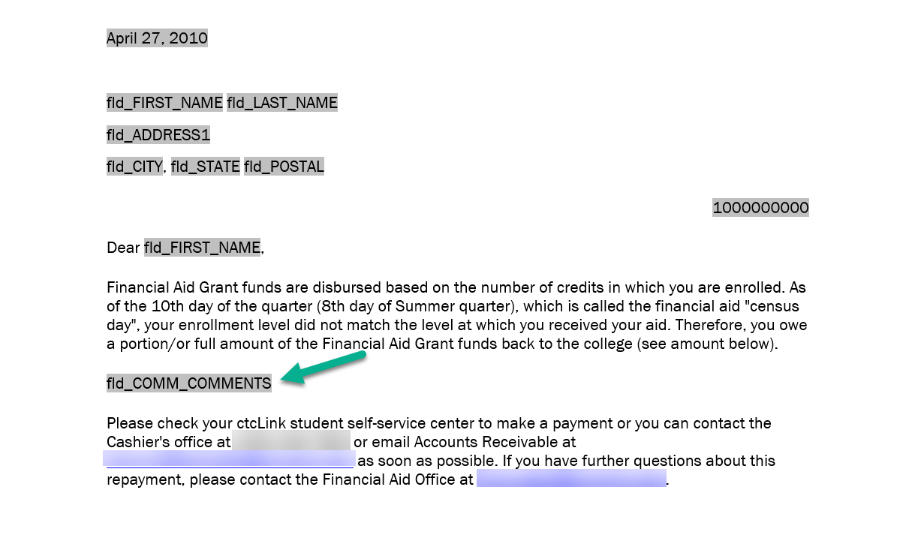
The merge field fld_COMM_COMMENTS can be added to your Communications template to utilize this feature

Slide 35
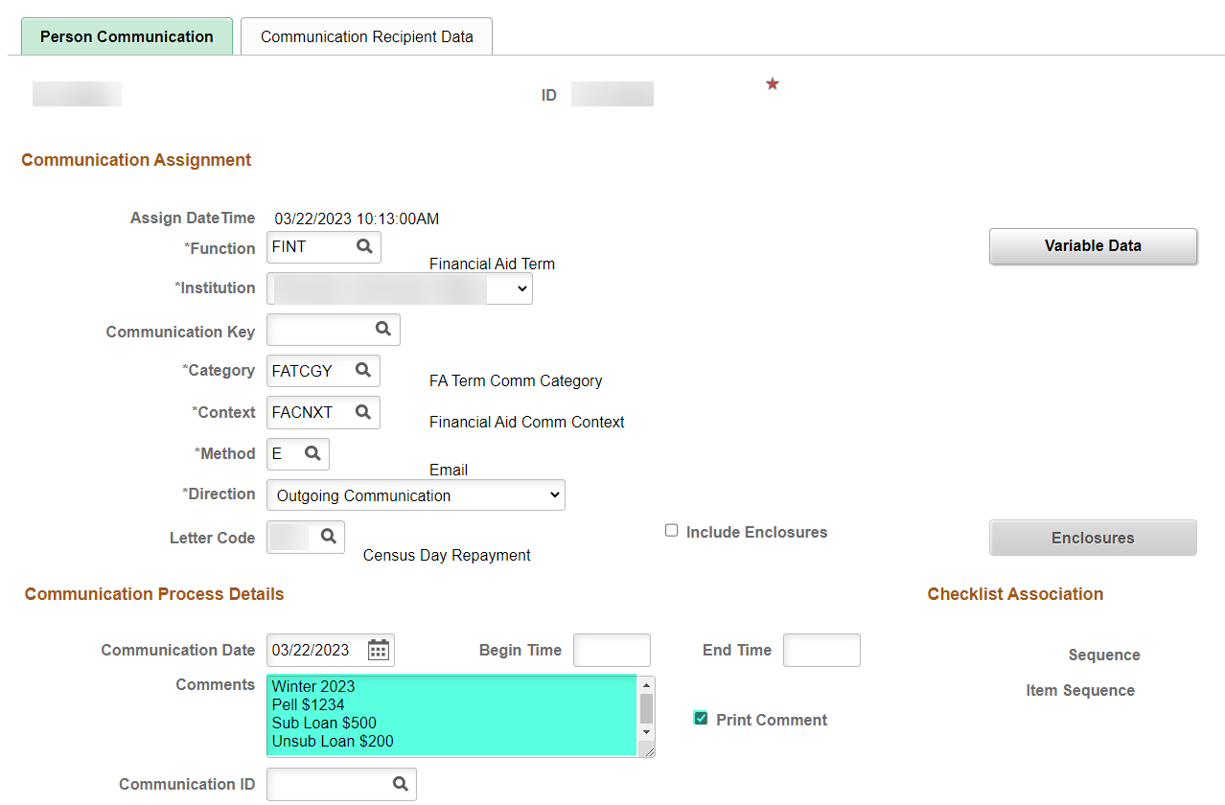
Navigation: Navigator > Campus Community > Communications > Person Communications > Communication Management
Complete all required areas in the Communication Assignment section including Variable Data if applicable
In the Comments box under the Communication Process Details section, write the text you want to populate into the communication
Select the Print Comment checkbox
Select Save

Slide 36
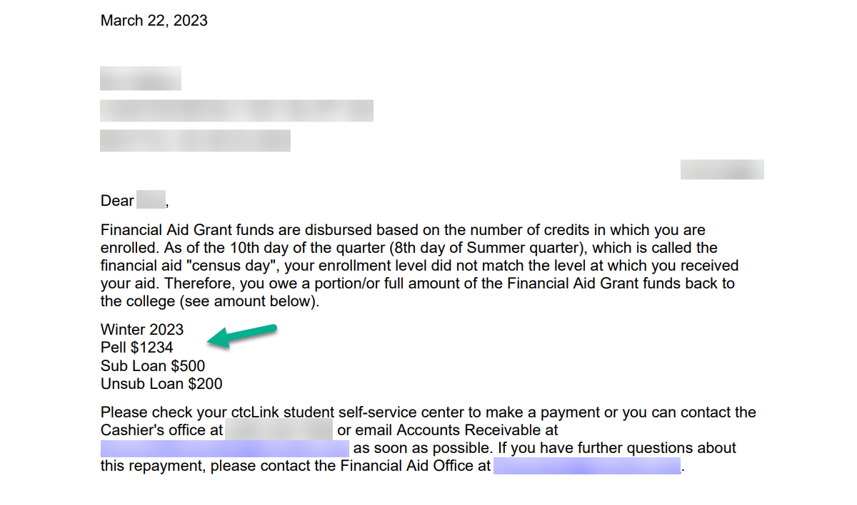
Voila! The text that was entered into the Comments box appears in the Communication!

Slide 37
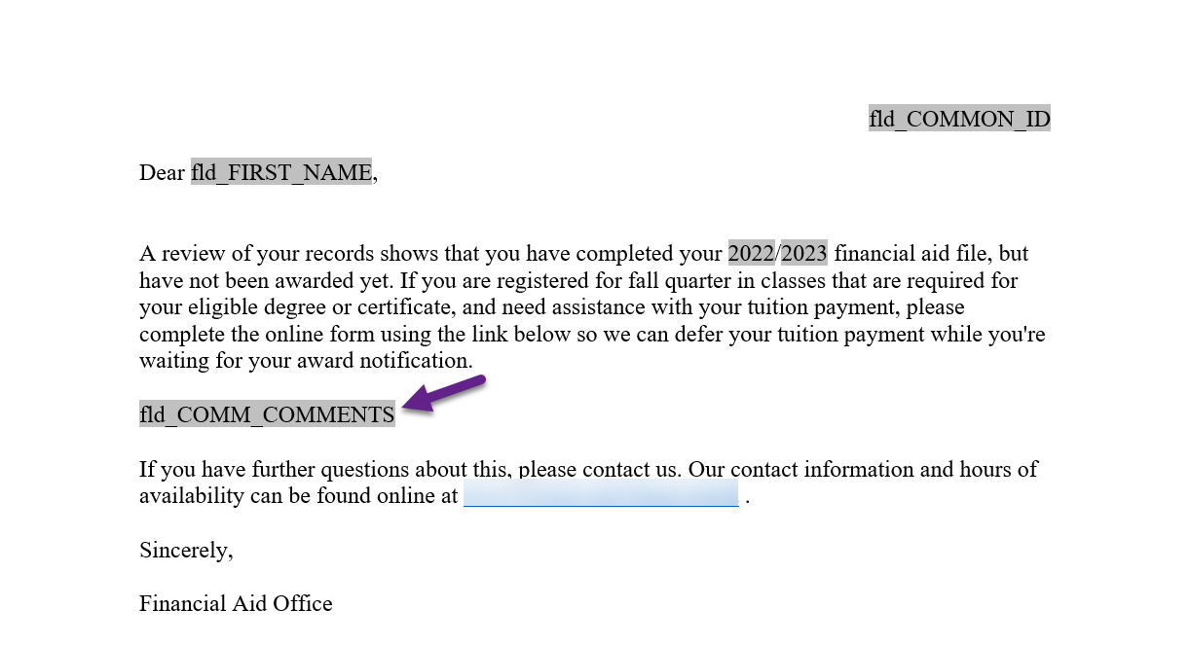
This feature can also be used with Event Definition if you have a need to populate a specific message to a group of students every term instead of having to update the template each term.

Slide 38
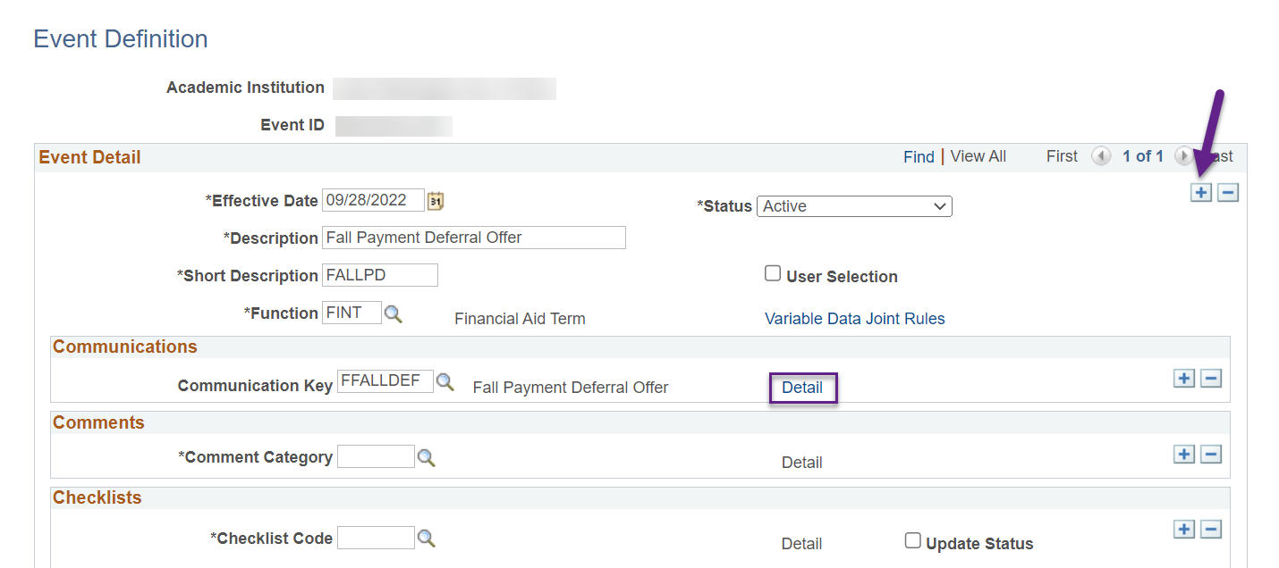
Navigation: Navigator > Campus Community > 3C Engine > Set Up 3C Engine > Event Definition
Add a new effective dated row of today
Select the Communication Key Details link
See next slide

Slide 39
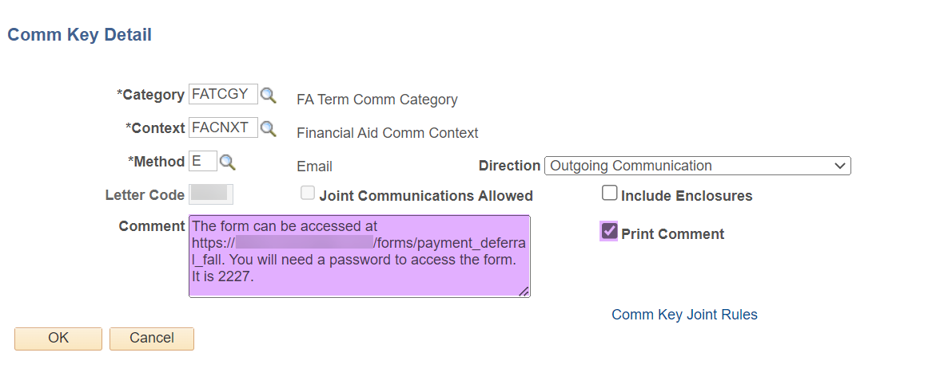
3) In the Comment box, write the text you want to populate into the communication
4) Select the Print Comment checkbox
5) Select OK
6) Select Save

Slide 40
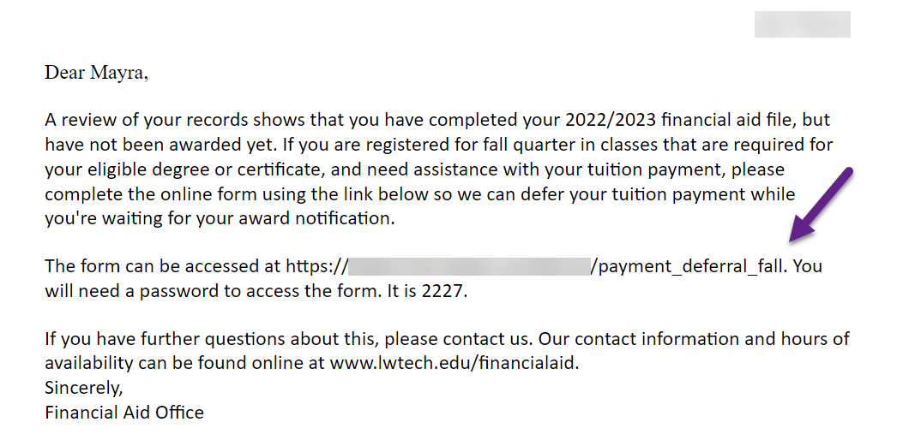
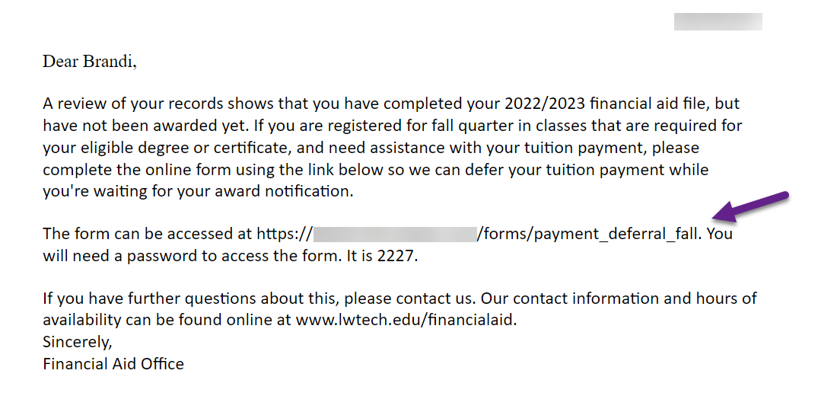
Voila! The text that was entered into the Comment box appears in the Communication for the students that were assigned in batch!

Slide 41
Bonus: Preview of new
Award Offer Template

Slide 42
Congratulations!
You are now equipped with more knowledge of 3Cs!
Please refer to the ctcLink Reference Center for additional resource materials on today’s topics
Sign up for our listserv if you haven’t already ☺
https://lists.ctc.edu/mailman/listinfo/ctclinkfinaidsupport_lists.ctc.edu
Thank you for your participation today!

