Slide 1
ISIR corrections fundamentals TRAINING
Kelly Forsberg
ctcLink Functional Trainer | Financial Aid
March 2023

Slide 2
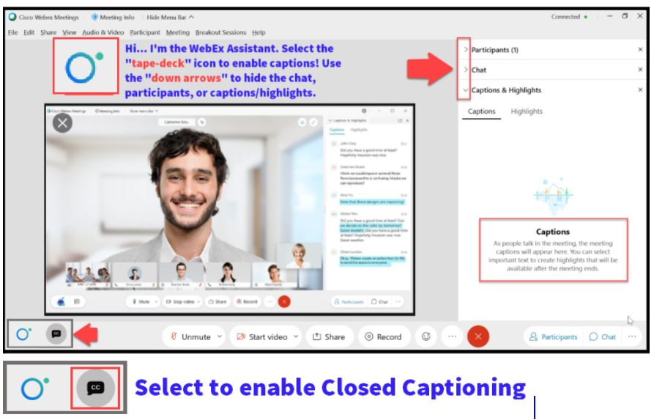

Slide 3
Logistics and Agenda
Times | Activity
9:00 – 9:05 | Greet & Attendance
9:05 – 9:10 | Objectives
9:10 – 10:00 | ISIR Correction Scenarios
10:00 – 10:45 | ISIR Corrections Steps
10:45 – 11:00 | Session Wrap-Up/Q&A
Some processes will have demonstrations, but due to data scrubbing, available data in the environment, demo examples are not ideal

Slide 4
ground rules
Be ready to participate
Remove external distractions
Mute your line when not speaking
Do NOT place Webex line on hold. Use Mute.
Please leave your line on Mute unless you are speaking
Sessions are being recorded
Allow your peers to complete their thoughts before beginning yours

Slide 5
Objectives
After completing this training, you should be able to:
Understand how to make ISIR Corrections on specific scenarios
Making Corrections on an Alien Registration Number
Processing Dependency Override/Homeless Youth Determinations
Processing Special Conditions/Circumstances/EFC Adjustment Request
Understand how to Process ISIR Corrections in ctcLink using the following steps:
Process ISIR Corrections
Create Federal Data File
Upload/Download File Process

Slide 6
ISIR CORRECTIONS
SCENARIOS

Slide 7
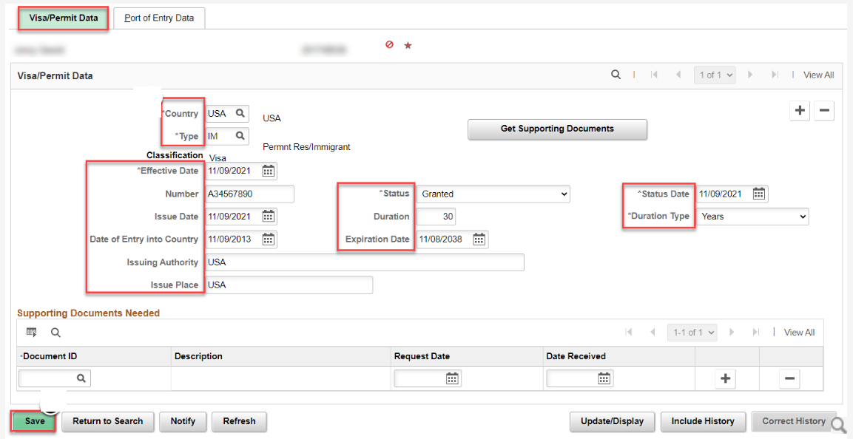
MAKING CORRECTIONS ON AN A#
Navigation: Nav Bar > Navigator > Financial Aid > Correct 20xx-20xx ISIR Records
Navigation: Nav Bar > Navigator > Campus Community > Personal Information (Student) > Identification (Student) > Citizenship > Visa Permit Data
The ISIR Comment Code for Citizenship must be resolved at the Student Records level before a correction can be made on the ISIR.

Slide 8
Processing dependency overrides and homeless youth determinations
Navigation: Nav Bar > Navigator > Financial Aid > Correct 20xx-20xx ISIR Records
You must set the corresponding Dependency Override Indicator in the Corrections page before Sending Corrections on DOs and HYDs so it will process as such through CPS

Slide 9
PROCESSING SPECIAL CIRCUMSTANCES AND EFC ADJUSTMENTS
Navigation: Nav Bar > Navigator > Financial Aid > Correct 20xx-20xx ISIR Records
If doing a special circumstances, check this EFC Calc Requested box before you Send Corrections, so that the ISIR comments reflect a FAA-approved change on the next ISIR TR #

Slide 10
DEMONSTRATION

Slide 11
PROCESSING
ISIR CORRECTIONS

Slide 12
PROCESSING isir corrections (outbound)
Step 1: Process ISIR Corrections
Step 2: Create Federal Data Files
Step 3: Download file
3-STEP PROCESS

Slide 13
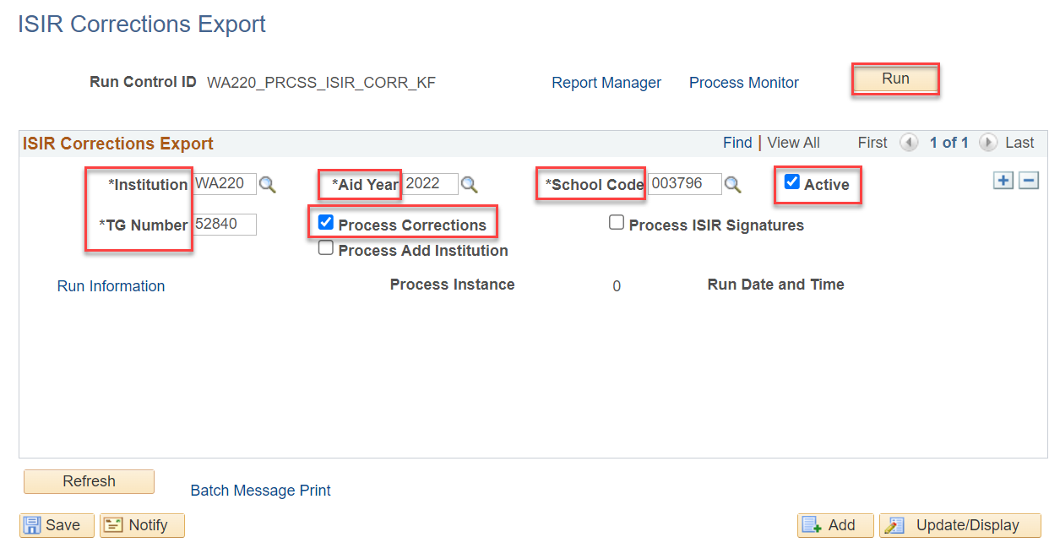
PROCESS isir corrections
STEP 1
Navigation: Nav Bar > Navigator > Financial Aid > File Management > ISIR Corrections > Process ISIR Corrections
Note: Be sure to update the Aid Year before you run this process in the new aid year. You can have two active rows at a time for both aid years in which you are processing corrections. i.e., 2023 & 2024

Slide 14
PROCESSING isir corrections (outbound)
Step 1: Process ISIR Corrections
Step 2: Create Federal Data Files
Step 3: Download file
3-STEP PROCESS

Slide 15
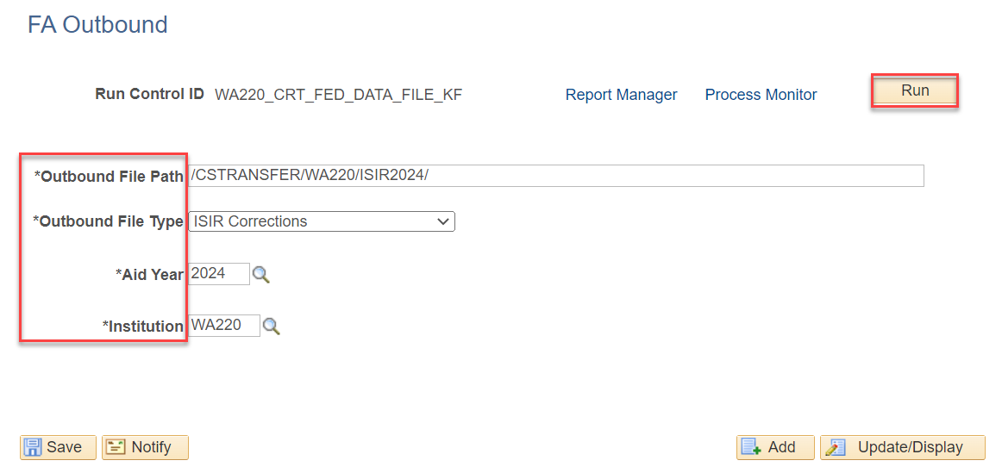
Create federal data file
STEP 2
Navigation: Nav Bar > Navigator > Financial Aid > File Management > Create Federal Data File
Note: To minimize processing errors, please copy the file path from the Upload/Download page and paste it in the Outbound File Path field.
Additionally, you can have two different run controls for this step: one for EY and one for OY, or you can reuse the one Run Control and just change out the Aid Year.

Slide 16
PROCESSING isir corrections (outbound)
Step 1: Process ISIR Corrections
Step 2: Create Federal Data Files
Step 3: Download file
3-STEP PROCESS

Slide 17
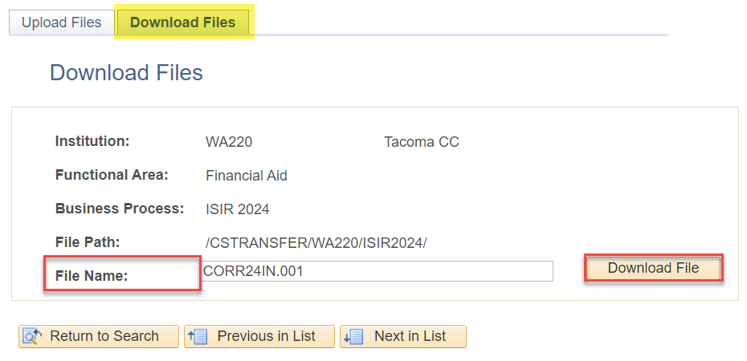
Download file for edconnect
STEP 3
Navigation: Nav Bar > Navigator > PeopleTools > CTC Custom > Extensions > Upload/Download Files
The file name used in the Download step comes from the Message Log Text in the Create Federal Data Files step (Step 2)

Slide 18
DEMONSTRATION

Slide 19
Outcomes
At training completion, you should be able to:
Understand how to make ISIR Corrections on specific scenarios
Making Corrections on an Alien Registration Number
Processing Dependency Override/Homeless Youth Determinations
Processing Special Conditions/Circumstances/EFC Adjustment Request
Understand how to Process ISIR Corrections in ctcLink using the following steps:
Process ISIR Corrections
Create Federal Data File
Upload/Download File Process

Slide 20
Congratulations!
Your ISIR Corrections Fundamentals Training is complete!
Please review the videos and additional resources in your canvas courses as needed
Thank you for your participation today!

