Slide 1
ISIR suspense Management: best practices
Spokane Falls Community College
February 23, 2023

Slide 2
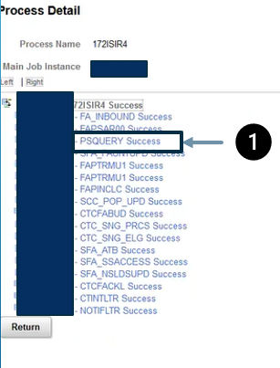
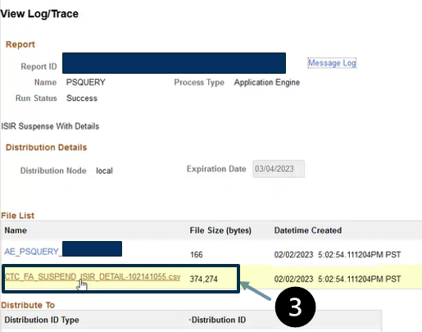
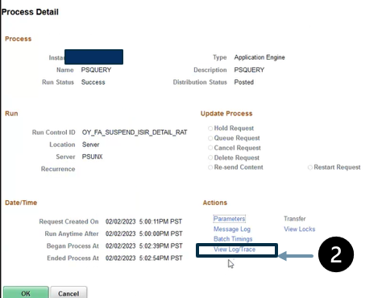
Gathering the report
SFCC saves report ISIR Jobset daily on shared drive- allows multiple staff to access
Go to ISIR jobset
Based on Jobset will be a PSQUERY output you will select
View log trace
Download CSV file to review
OR Could run via Schedule

Slide 3
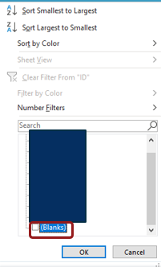
Filtering the report
Hide Unnecessary Columns A-G (SSN Repeated in later column) and AA- AE
From ID column take out Blanks
Shows all students who have ctcLink record or ID
Once we see what we are working with we prioritize based on the time of year….

Slide 4
Prioritizing the report and frequency
Review Report Daily
Peak Times may have multiple processors (new year loaded)
If worked daily, takes SFCC 15-30 minutes to work entire report
#1- School Corrections- Transaction Source= School
#2- EFC Changes Filter by Suspend Reason and EFC Change to Identify
#3- CPS Changes- Default Resolved, Overpayment Initiated/Resolved
#4 From there everything else- usually then review Max Match Codes 20-50

Slide 5
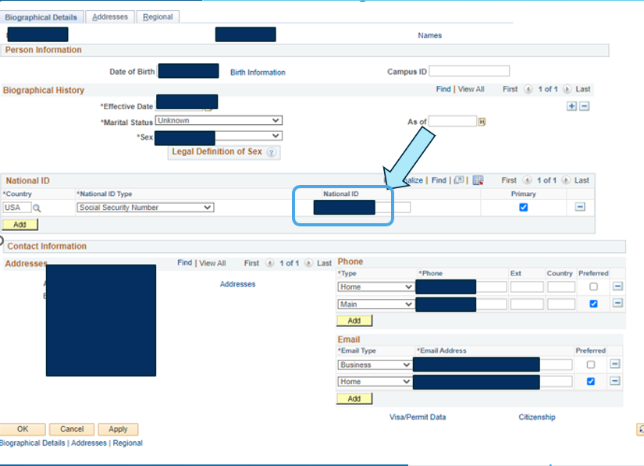
Review Max Match Level
Review 20-50 Match levels Codes first
Match Level 20- Usually missing SSN or need to correct SSN
Check to ensure there is a SSN, NAME, and DOB Match
If matched, our FA office updates SSN per our established business process with A/R
Update Via Student Services Center or Add/Update Person if correcting SSN
Updating via Add/Update Person Screen

Slide 6
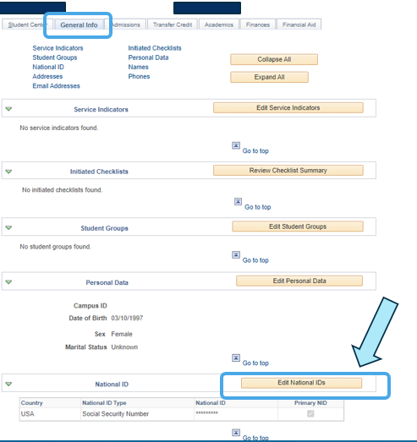
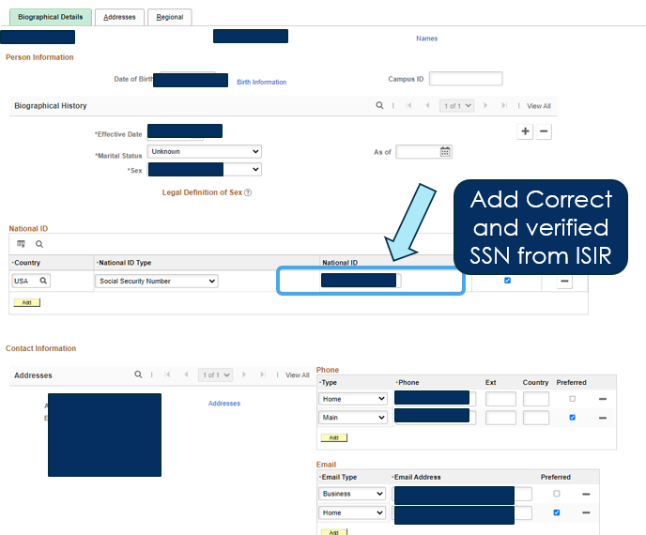
Review Max Match Level
Review 20-50 Match levels Codes first
Match Level 20- Usually missing SSN or need to correct SSN Cont.
Depending on Access may have to edit via Student Services Center under General Info tab

Slide 7
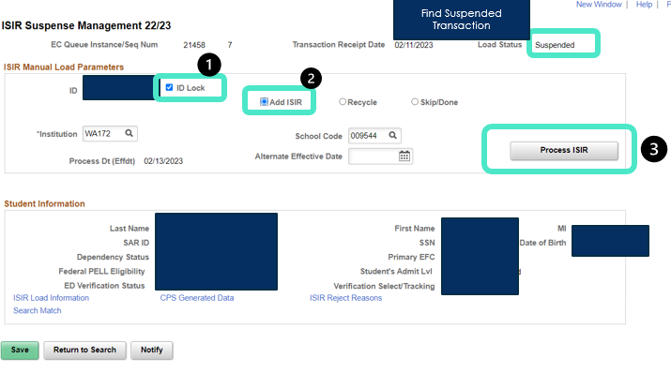
Review Max Match Level
Review 20-50 Match levels Codes first
Match Level 20- Usually missing SSN or need to correct SSN
Cont.
Once SSN Corrected- Process ISIR via Suspense Management Screen
Ensure you are in correct suspended transaction
ID Lock
Add ISIR
Process ISIR

Slide 8
Review Max Match Level
Review 20-50 Match levels Codes first
Match Level 30-40
Usually, first or last name is incorrect, or DOB is wrong.
SFCC Loads ISIRs and then adds Apply/Update Admissions Checklist
Comments added within Checklist with exactly what needs to be updated
Must go through official Name Change process with A/R

Slide 9
Tips for working suspense report at start of new year
With Larger reports filter by category that you know fix for
i.e. SSN missing so you can go through and update those
Working out of Sequence resolution resolve a lot of the report in the start of the year

Slide 10
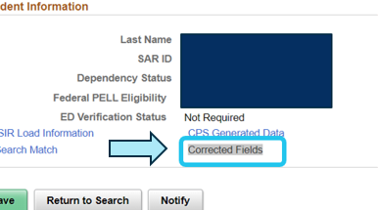
Reviewing Out of Sequence ISIRs
Working Out of Sequence can resolve a lot of the report in the start of the year
SFCC always works ONLY students with IDs
Sort report by suspend reason to find out of sequence
Pull up by student in suspense management screen
SFCC Reviews transactions and ensure most recent ISIR loaded, SFCC may skip depending on changes made on transactions by student (i.e. added another school) but always ensure most recent loaded
To review changes
on the transaction in
suspense management

Slide 11
Business process: isir efc change after awarding
If your setup is like SFCC
and you correct an ISIR, update review status to incomplete and wait to update verified status until correction back so it does not suspend!
SFCC Jobset Setup
Suspend if Institutional Review Status Complete
Suspend if ED Verification Completed
Find EFC Changes
Filter for Suspend Reason- Review Status Complete or Ed Verification Complete and EFC Change Column
School source are usually PJs, checked to ensure and loaded
Applicant changes are selected for verification

Slide 12
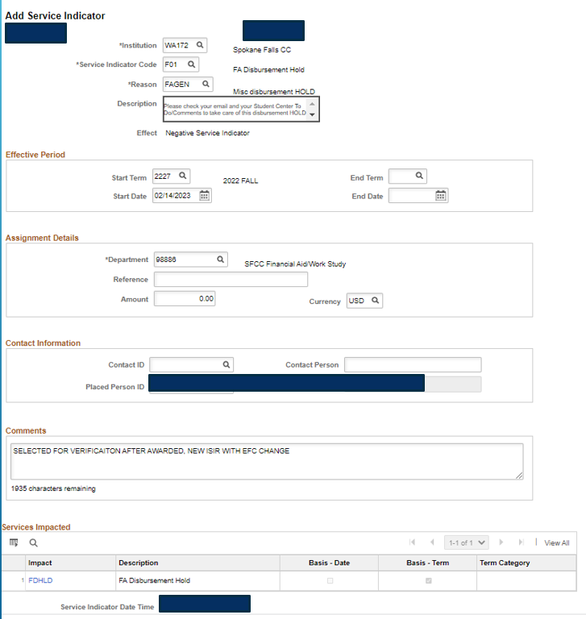
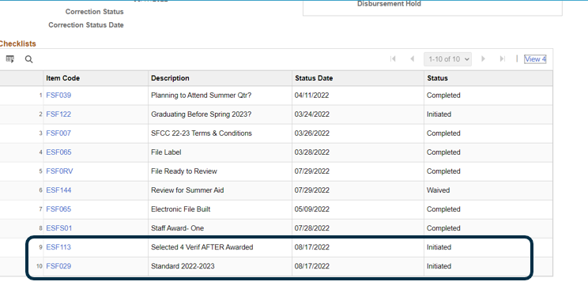
Business process: isir efc change after awarding
ISIR Received with EFC Change
Selected for verification, checklists added for V1 or V5 (if V4 before)
Applicable Tax Checklist added based on FAFSA (If not 02 DRT)
ESF113 Checklist Initiated
F01 Service Indicator added to stop all disbursements

Slide 13
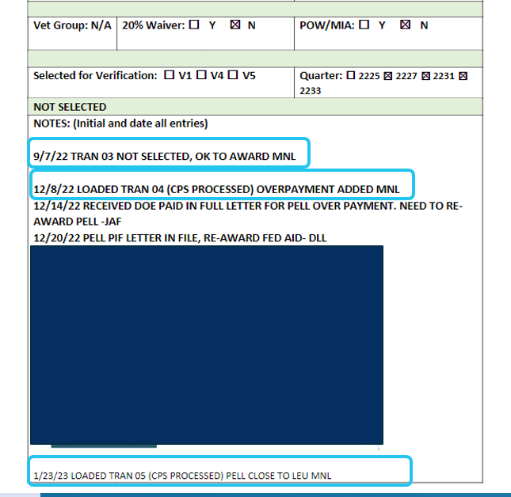
Business process: how sfcc documents
Updating File Jackets
All students who are Ready to Review or Awarded have electronic file jacket to document notes on student’s eligibility
All CPS Changes where re-review is not needed but new transaction loaded
Any other transaction where FAFSA loaded and electronic file jacket made, notes are added.
Always document transaction funded under on these file jackets

Slide 14
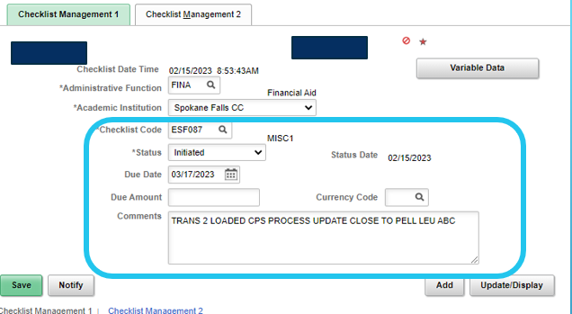
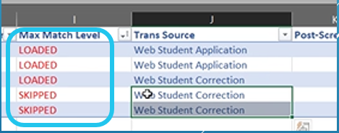
Business process: how sfcc documents
If student has not been funded (no file jacket made)
Add MISC checklist or Comment
Always Document Suspended ISIR report with actions- Loaded or Skipped etc.
All reports saved on share drive for access to all FA office
Document System
Document Report

Slide 15
Questions?

