Slide 1
ISIR SUSPENSE MANAGEMENT BEST PRACTICES
Kelly Forsberg
ctcLink Functional Trainer | Financial Aid
February 2023

Slide 2
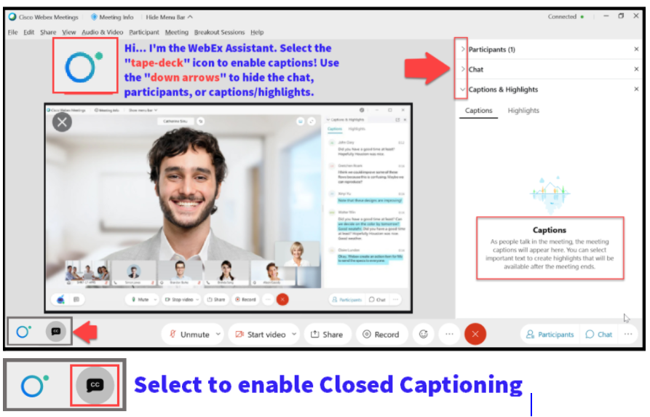

Slide 3
ground rules
Be ready to participate
Remove external distractions
Mute your line when not speaking
Do NOT place Webex line on hold. Use Mute.
Please leave your line on Mute unless you are speaking
Sessions are being recorded
Allow your peers to complete their thoughts before beginning yours

Slide 4
Objectives
After completing this FA Work Session, you should be able to:
Understand the global ISIR load parameters that are set up for your institution
Understand the recommended best practices are they come from State Board
Understand that each institution has their own established business practice
Understand that our guest speakers at SFCC are sharing their unique best practices that work for their own institution

Slide 5
ISIR DATA LOAD PARAMETERS
PAGE IN CTCLINK

Slide 6
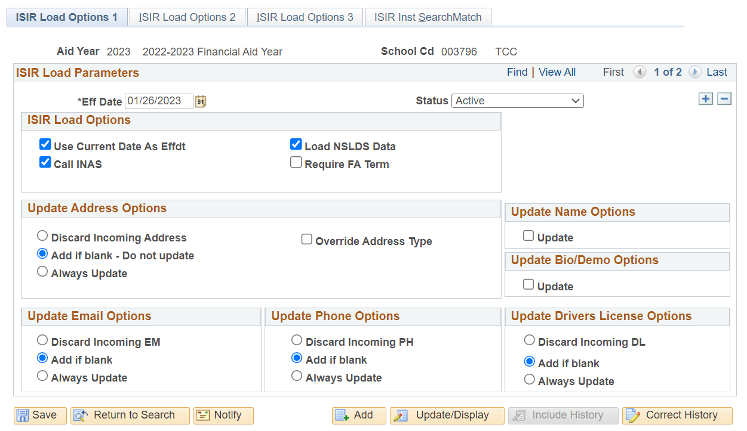
ISIR LOAD OPTIONS 1 TAB
Navigation: Nav Bar > Navigator > Set Up SACR > Product Related > Financial Aid > File Management > ISIR Data Load Parameters
Notes:
In the ISIR Load Options, note the option to update any record from the ISIR. For example, if any value is blank in student data, if there is a value on the ISIR, it will add the data from the ISIR if it is blank in student data table. Scenario: Student did not list their Driver’s license the first time they did their FAFSA, but on the second correction, they added it. It will now be added to student data if the value is now on the FAFSA.

Slide 7
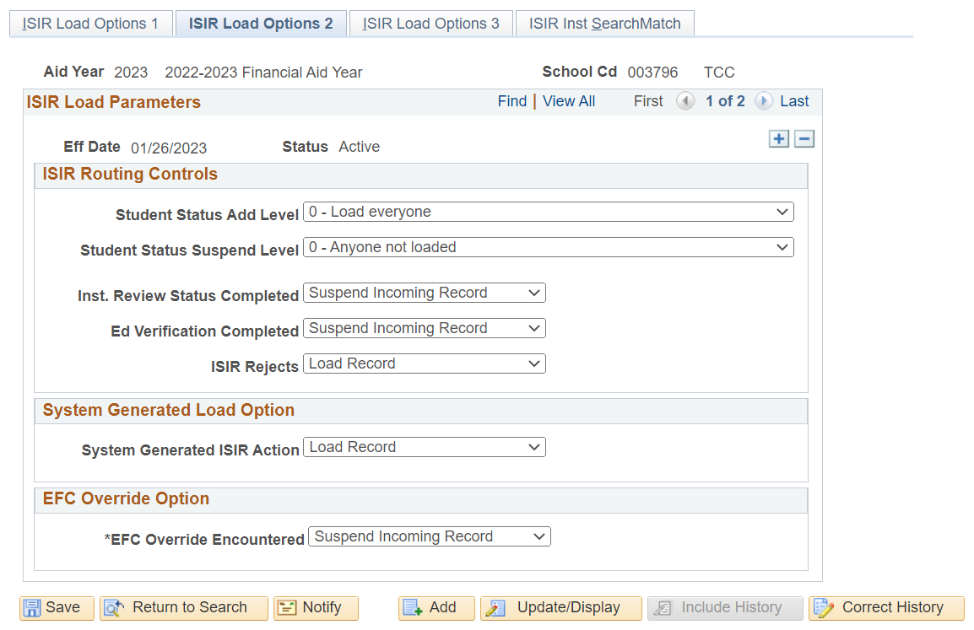
ISIR LOAD OPTIONS 2 TAB
Navigation: Nav Bar > Navigator > Set Up SACR > Product Related > Financial Aid > File Management > ISIR Data Load Parameters
Notes:
In the ISIR Routing Controls, the value is to load everyone, unless of course, it does not meet load criteria, the record will then suspend. The load criteria loads in this order:
Inst. Review Status Completed
Ed Verification Completed
ISIR Rejects
Add Admit Level/ Suspend Admit Level
EFC Override Encountered
The incoming ISIR record must meet the criteria defined at each processing step in order to be eligible to load.

Slide 8
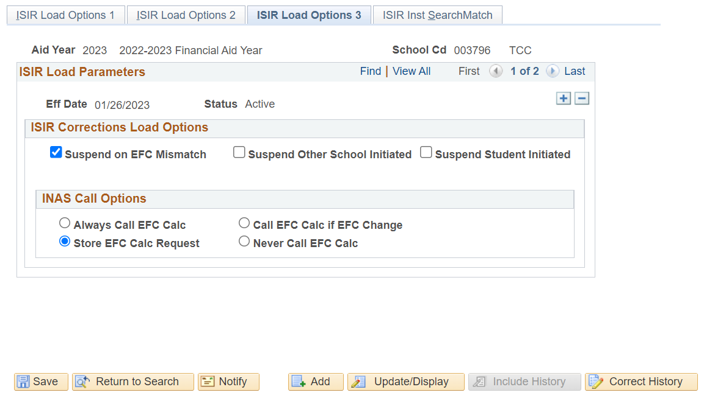
ISIR LOAD OPTIONS 3 TAB
Navigation: Nav Bar > Navigator > Set Up SACR > Product Related > Financial Aid > File Management > ISIR Data Load Parameters
Notes:
ISIR Corrections load options, note the Suspend Other School Initiated and Suspend Student Initiated checkboxes are not selected. This means that if another school initiates a correction, you may get a record of it, if the student has applied to both your institution and your institution. You must be mindful not to load records from suspense that belong to other institutions. In the INAS Call Options, the EFC Calc Requests (professional judgments, etc.) will be stored when the appropriate radio button is selected in the Correct ISIR Records page.

Slide 9
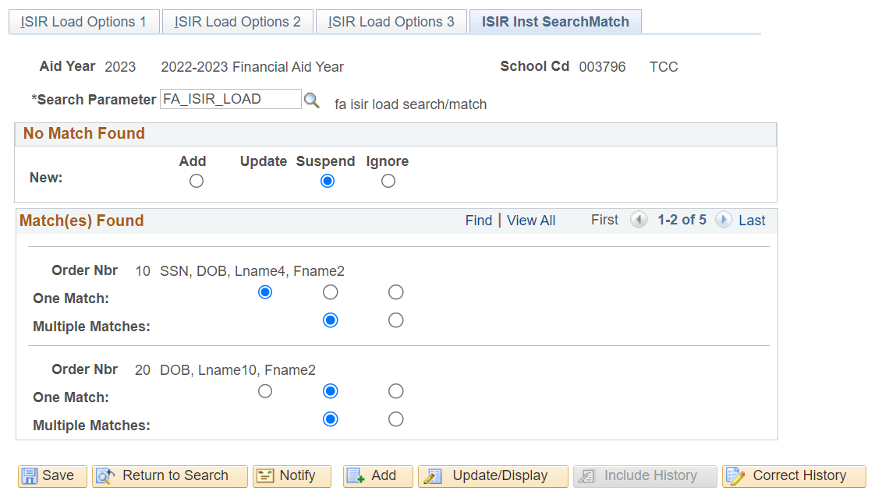
ISIR inst search match TAB
Navigation: Nav Bar > Navigator > Set Up SACR > Product Related > Financial Aid > File Management > ISIR Data Load Parameters
Notes:
In the ISIR Inst Search Match tab, we can see the set up is to suspend if No Match Found. If there are matches found, they will suspend based on Max Match Level 10 – 50. Note that in Max Match Level 10, if there is one match, the record will update.

Slide 10
Sbctc recommended best practices for isir suspense management
Be mindful on which ISIRs you are loading from suspense – do not load other institutions ISIRs
After review of a suspended ISIR, setting the suspended ISIR to Skip/Done will pull the ISIR off the Suspense List.
Do review ISIRs in suspense for discrepant data. i.e., your Review Status has been set to Review Completed, but the student submits ISIR Correction. It must be reviewed for changes.
Do review the ISIR Suspense Management list often– weekly is a minimum!

Slide 11
Outcomes
After completing this FA Work Session, you should be able to:
Understand the global ISIR load parameters that are set up for your institution
Understand the recommended best practices are they come from State Board
Understand that each institution has their own established business practice
Understand that our guest speakers at SFCC are sharing their unique best practices that work for their own institution

