Slide 1
Enhancement request #159
SF ITEM TYPE SECURITY
Brandon Reed, Associate Director & Charles Velasquez, Senior Functional Analyst
ctcLink SF Customer Support

Slide 2
SF ITEM TYPE SECURITY
What is ctcLink Item Type Security
Functional Areas Impacted
Examples of Item Type Access
Implementation/Roll Out
Notes:
Topics that will be covered today are;
CLICK – Briefly review CS to Fin integration
CLICK – Go over what’s next for second journal sets, verifying fund 145 projects and managing corrections
CLICK – Discussion on SF to GL
CLICK – Review the SF Refund process and how it interfaces into Finance
CLICK – and provide some queries to troubleshoot errors and hop into the system to review some current SJS errors
<NEXT SLIDE>

Slide 3
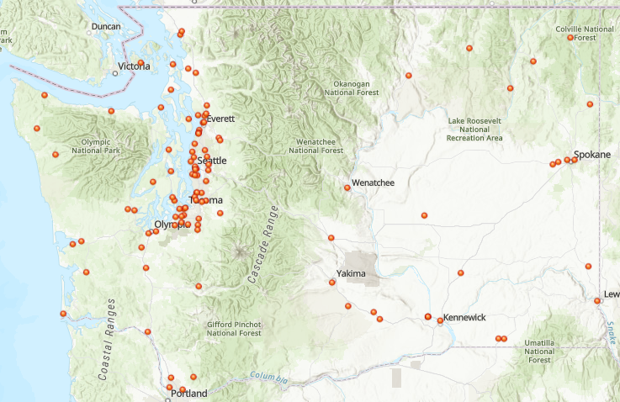
WHAT IS ITEM TYPE SECURITY?
The State Board Student Financials team would like to facilitate the configuration of User ID Item Type Security in ctcLink in order to allow WA State CTCs to gain more control over which staff have access to item types.
Currently, 761 Washington State CTC staff can add virtually any item type charge or payment to a student account. This is a liability and should be drastically reduced. We know that item type security is designed to do this job and safeguard us from this liability.
Notes:
Topics that will be covered today are;
CLICK – Briefly review CS to Fin integration
CLICK – Go over what’s next for second journal sets, verifying fund 145 projects and managing corrections
CLICK – Discussion on SF to GL
CLICK – Review the SF Refund process and how it interfaces into Finance
CLICK – and provide some queries to troubleshoot errors and hop into the system to review some current SJS errors
<NEXT SLIDE>

Slide 4
WHAT IS ITEM TYPE SECURITY?
In ctcLink, item types represent the charges and payments which make up a student’s account. Currently, all CTC staff who have access to certain pages may post a charge or payment even though most should be posted (added to the student account) via the tuition calculation process.
The tuition calculation process reviews student criteria in order to properly charge students. Financial aid item types (behave like payments) are also impacted and CTC staff currently may skip the important awarding & disbursing processes.
Item Type examples:
Locked down for everyone with respect to manual/quick post:
600000000260 = Athletic Resident Waiver
911000000000 = Federal Pell Grant
100000100000 = Resident Operating
210000034225 = Chemistry Class Fee
961000001100 = Subsidized Direct Loan 1
Should have staff with limited access:
300000157875 = Parking Permit (parking dept.)
300000157975 = Printing (outsourced dept.)
709610000000 = Financial Aid Refund Adjust (SF dept)
Notes:
Topics that will be covered today are;
CLICK – Briefly review CS to Fin integration
CLICK – Go over what’s next for second journal sets, verifying fund 145 projects and managing corrections
CLICK – Discussion on SF to GL
CLICK – Review the SF Refund process and how it interfaces into Finance
CLICK – and provide some queries to troubleshoot errors and hop into the system to review some current SJS errors
<NEXT SLIDE>

Slide 5
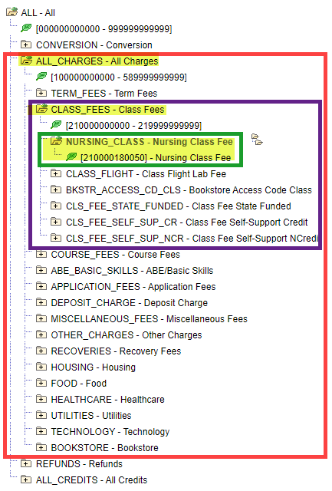
WHAT IS ITEM TYPE SECURITY?
Item Types are organized in ctcLink with a Tree.
The tree groups similar Item Types and allows different processes to access its organization. The organized item types are called Nodes. Within Nodes may be additional organized groups of item types, which are also called Nodes. This allows for different grouping of similar item types within a larger group.
For example, within the All Charges node of a tree resides the Class Fees node, within that node are 6 nodes of item types, of which, you may select the Nursing Class node, which contains the Nursing Class Fee item type.
TREE
Notes:
Topics that will be covered today are;
CLICK – Briefly review CS to Fin integration
CLICK – Go over what’s next for second journal sets, verifying fund 145 projects and managing corrections
CLICK – Discussion on SF to GL
CLICK – Review the SF Refund process and how it interfaces into Finance
CLICK – and provide some queries to troubleshoot errors and hop into the system to review some current SJS errors
<NEXT SLIDE>

Slide 7
SF ITEM TYPE SECURITY
What is ctcLink Item Type Security
Functional Areas Impacted
Examples of Item Type Access
Implementation/Roll Out
Notes:
Topics that will be covered today are;
CLICK – Briefly review CS to Fin integration
CLICK – Go over what’s next for second journal sets, verifying fund 145 projects and managing corrections
CLICK – Discussion on SF to GL
CLICK – Review the SF Refund process and how it interfaces into Finance
CLICK – and provide some queries to troubleshoot errors and hop into the system to review some current SJS errors
<NEXT SLIDE>

Slide 8
Functional areas impacted
Student Financials Staff
Financial Aid Staff
Outsourced Processors
(Other departments granted limited access to Group Post/Quick Post)
Local Security Administrators

Slide 9
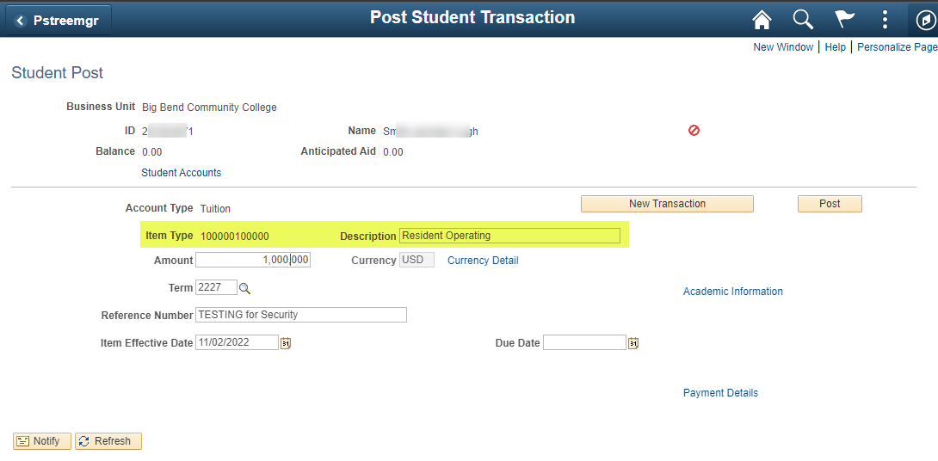
Areas impacted - Student Financials Staff
ctcLink page = Post Student Transactions
Use:
Grants certain item types to pay charges and create charges grouped to be paid in several installments
Users:
Back Office SF Staff & Cashiers
Role:
ZZ SF Charges and Payments
RISKS:
Posting improper payment & charge item types

Slide 10
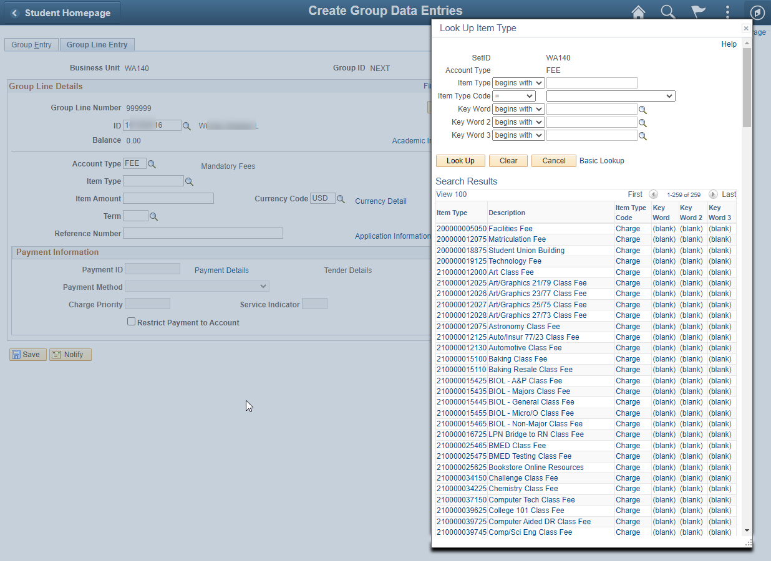
Areas impacted - Student Financials Staff
ctcLink page = Group Posting Charges
Use:
Grants the ability to post ‘batches’ of transactions at once typically all related to a specific ‘type’ of transaction.
Users:
Back Office SF Staff
Roles:
ZZ SF Group Processing
RISKS:
Posting to an Item Type that the user should not be able to utilize for that purpose.
Allows accidental use of an FA Item Type that does not exist on a student’s FA Award page.

Slide 11
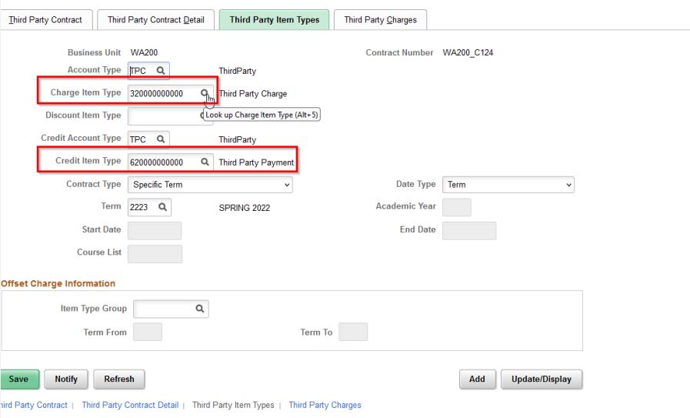
Areas impacted - Student Financials Staff
ctcLink page = Third Party Contracts
Use:
Grants staff the ability to create contracts that will pay student account balances for outside agencies
Users:
Student Financials Staff & Cashiers
Role:
ZZ SF Third Party Contracts
RISKS:
Posting improper payment item types to students or to corporate accounts

Slide 12
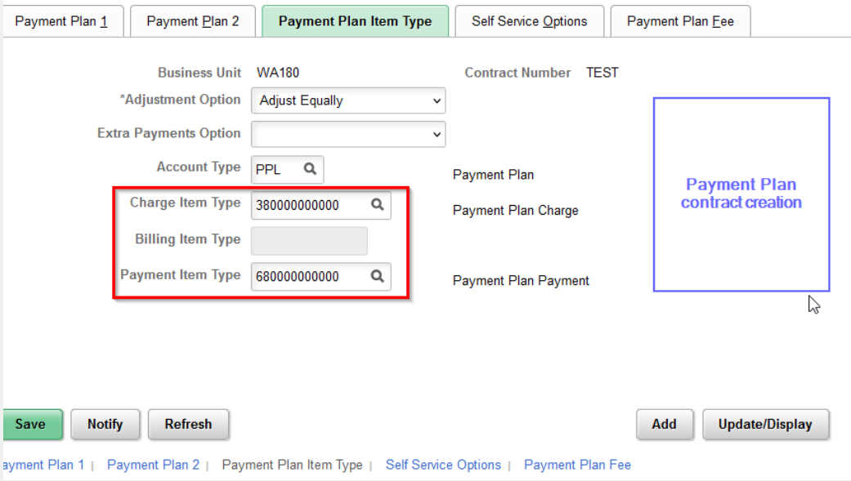
Areas impacted - Student Financials Staff
ctcLink page = Payment Plans
Use:
Grants certain item types to pay charges and create charges grouped to be paid in several installments
Users:
Back Office SF Staff & Cashiers
Role:
ZZ SF Payment Plan
RISKS:
Posting improper payment & charge item types

Slide 13
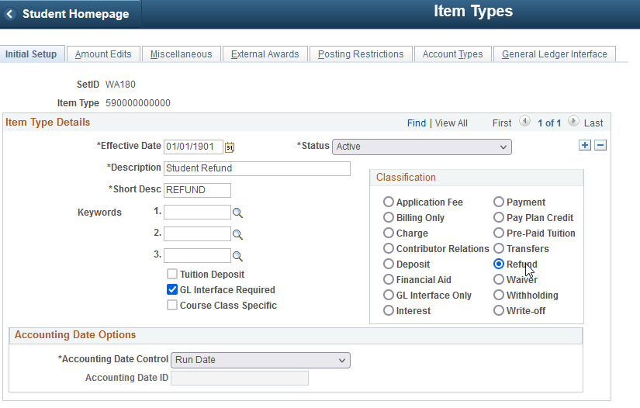
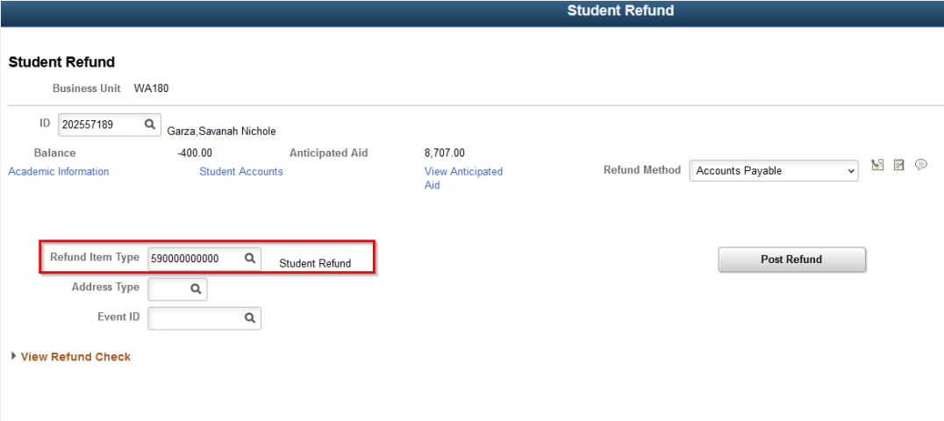
Areas impacted - Student Financials Staff
ctcLink Refund pages not impacted
Role: ZZ SF Refunds
The Student Refund page does not use Item Type security
The page will display Item Types with a Refund classification

Slide 14
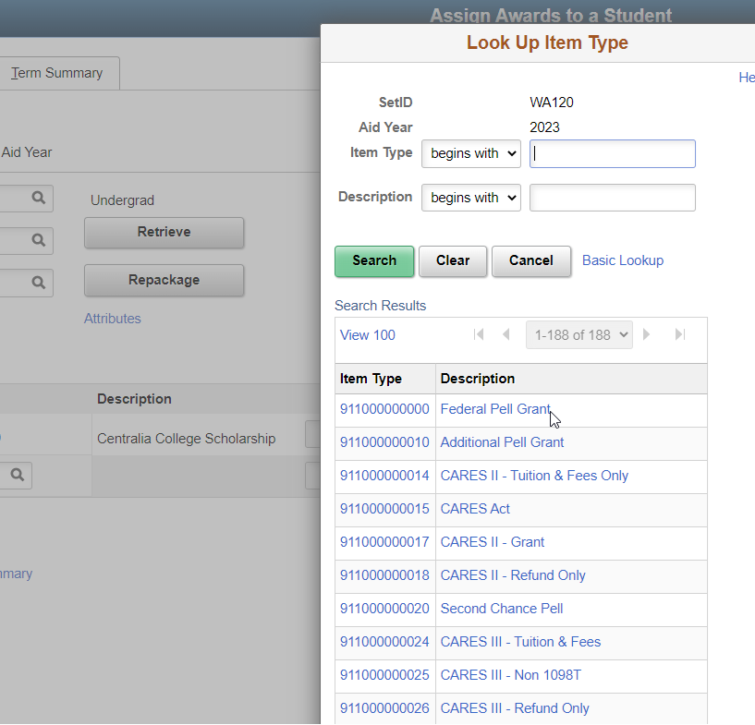
Areas impacted – Financial Aid staff
Awarding financial aid
Use:
Financial aid item types work as payments in the student account
Users:
Financial aid staff
Role:
ZZ FA Award Processor
ZZ FA Award Processing

Slide 15
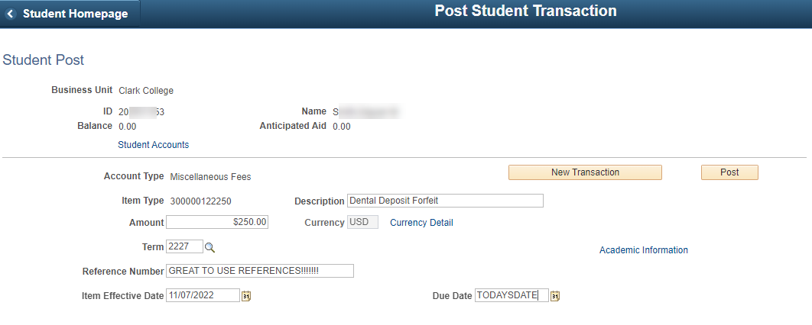
Areas impacted – Outsourced processors
Outsourced processors =
Other departments granted limited access to add charges/payment on the ctcLink Group Post/Quick Post pages.
Examples = Parking (fines, permits, tickets), course & class fees, international insurance, nursing equipment fees, bookstore…
Most often, outsourced processors will use either the group post or quick post ctcLink page
RISKS: Posting improper payment & charge item types

Slide 16
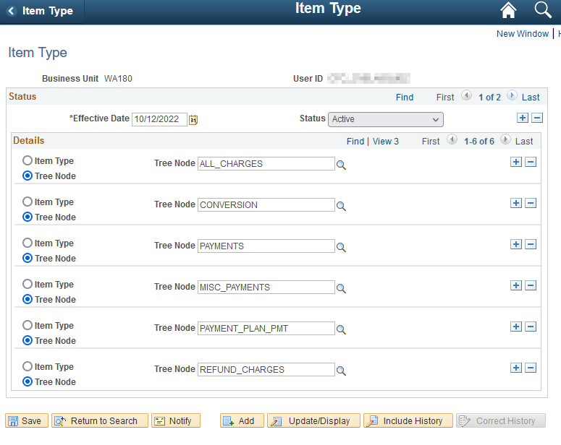
Areas impacted – Local security administrators
LSA’s will grant limited item type access to certain item types or nodes.
Staff/Manager send email request to LSA with specific access requirements.
LSA adds additional new Status row with updated effective date .
Add or removes new Detail row
Selects either the Item Type or Tree Node box
Adds requested Item Type or Tree Node
Save
(it is not recommended to use Correct History)

Slide 17
SF ITEM TYPE SECURITY
What is ctcLink Item Type Security
Functional Areas Impacted
Examples of Item Type Access
Implementation/Roll Out
Notes:
Topics that will be covered today are;
CLICK – Briefly review CS to Fin integration
CLICK – Go over what’s next for second journal sets, verifying fund 145 projects and managing corrections
CLICK – Discussion on SF to GL
CLICK – Review the SF Refund process and how it interfaces into Finance
CLICK – and provide some queries to troubleshoot errors and hop into the system to review some current SJS errors
<NEXT SLIDE>

Slide 18
EXAMPLES OF ITEM TYPE ACCESS
Currently –
All staff have access to all item types (not good)
Future -
Item type security will give access to staff that are granted security roles for ctcLink pages which require item type usage (like quick post/group post.) Fewer (way fewer) item types will be included though (for example no financial aid) …plenty to still process!
SF staff will need to work closely with LSA’s (and other department leads) to ensure that proper access is given by either NODE or individual item type per staff member.

Slide 19
EXAMPLES OF ITEM TYPE ACCESS
The following security rolls will give access to certain ctcLink pages and will be given a standard item type access:
ZZ SF Charges and Payments
ZC SF SACR Local Configuration
ZZ SACR SF Charges Fees Config
ZC CM Class Builder
ZZ SF Refunds
ZZ SF Payment Plan
ZZ SF Third Party Contracts
ZZ SF Group Processing
3rd Party Contracts
Corporate Post
Quick Post
Payment Plans
205 ctcLink pages
Copy Term Fees
Group Post
Adjust Calendars
Course/Class Fees

Slide 20
EXAMPLES OF ITEM TYPE ACCESS
The following security rolls will be given the standard item type access by the State Board.
ZZ SF Charges and Payments
ZC SF SACR Local Configuration
ZZ SACR SF Charges Fees Config
ZC CM Class Builder
ZZ SF Refunds
ZZ SF Payment Plan
ZZ SF Third Party Contracts
ZZ SF Group Processing

Slide 21
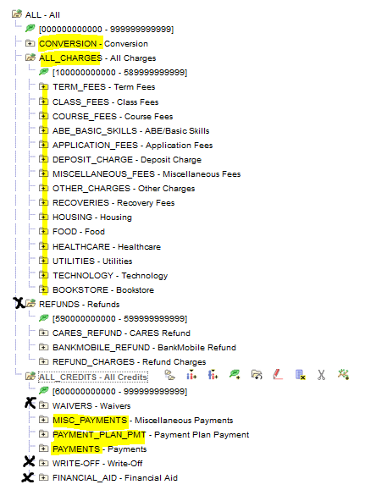
EXAMPLES OF ITEM TYPE ACCESS
Student Financials example

Slide 22
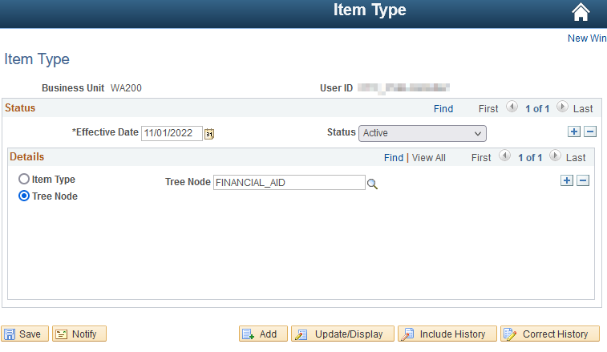
EXAMPLES OF ITEM TYPE ACCESS
The 2 below security roles will be given the financial aid node for Item Type Security.
ZZ FA Award Processor (60 pages)
ZZ FA Award Processing (12 pages)

Slide 23
SF ITEM TYPE SECURITY
What is ctcLink Item Type Security
Functional Areas Impacted
Examples of Item Type Access
Implementation/Roll Out
Notes:
Topics that will be covered today are;
CLICK – Briefly review CS to Fin integration
CLICK – Go over what’s next for second journal sets, verifying fund 145 projects and managing corrections
CLICK – Discussion on SF to GL
CLICK – Review the SF Refund process and how it interfaces into Finance
CLICK – and provide some queries to troubleshoot errors and hop into the system to review some current SJS errors
<NEXT SLIDE>

Slide 24
IMPLEMENTATION/ROLL OUT
The State Board will give out broad access to item types.
The CTCs will grant additional access to item types.
OR
Currently – all staff have access to all item types (not good)
Item type security will retain access to staff that are granted security roles for ctcLink pages which require item type usage (like quick post/group post.) Fewer (way fewer) item types will be included though (for example no financial aid) …however, plenty to still process normal daily activities
Staff may then have additional item type access given by either NODE or individual item type via LSAs

Slide 25
IMPLEMENTATION/ROLL OUT
Review the standardized relationship between security roles and item type access.
The State Board updates the PCD (testing environment) with the standardized access via script.
CTC SF staff work with LSA’s to determine appropriate item type security for current employees in PCD.
Local Security Administrators (LSAs) test updating individual staff member security access within PCD. SF staff validate updated item type security.
The State Board updates PRD (production environment) with the standardized access via script.
Local Security Administrators (LSAs) adjust individual staff member security depending on access needs in PRD.
Department managers communicate with LSAs regarding new hires and other item type security adjustments.

Slide 26
IMPLEMENTATION/ROLL OUT
 | Task | Start Date | End Date
1 | Review the standardized relationships between security roles and item type access. | Week 1 | 7 Days
2 | The State Board updates the PCD (testing environment) with the standardized access via script. | Week 1 | 7 Days
3 | CTC SF staff work with LSA’s to determine appropriate item type security for current employees in PCD. | Week 2 | 7 Days
4 | Local Security Administrators (LSAs) test updating individual staff member security access within PCD. SF staff validate updated item type security. | Week 3 | 14 Days
5 | The State Board updates PRD (production environment) with the standardized access via script. | Week 5 | 1 Day
6 | Local Security Administrators (LSAs) adjust individual staff member security depending on access needs in PRD. | Week 5 | On Going
7 | Department managers communicate with LSAs regarding new hires and other item type security adjustments. | On Going | On Going

Slide 27
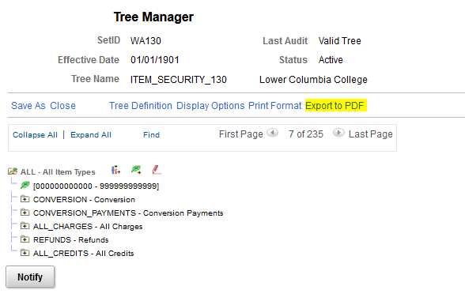
IMPLEMENTATION/ROLL OUT
Know your tree!
Colleges can view their own Item Security tree on the page, or by exporting their full tree to a PDF.
Run the ‘Export to PDF’ batch process and open the PDF from the Report Manager.
Security role = ZD_Tree_Viewer
Navigation: Navigator > Tree Manager > Tree Viewer

Slide 28
Giving item type security
IMPLEMENTATION/ROLL OUT
Navigation = Set Up SACR > Security > Secure Student Financials > View Item Type Security
Users can be granted access to a group of Item Types under a specific Tree Node, and/or to individual Item Types.
Colleges have ‘fairly’ common Item Type groupings on the Tree.
Not sure how your college has organized access to Item Types?
Local SF Configuration Guide: Tree Manager
The guide link above talks about the Tree Manager page. Users with access can expand all to see how their college has grouped Item Types, or run a batch process (Export to PDF) to the full tree for your college to help communicate internally around access needs and desired limitations.

Slide 29
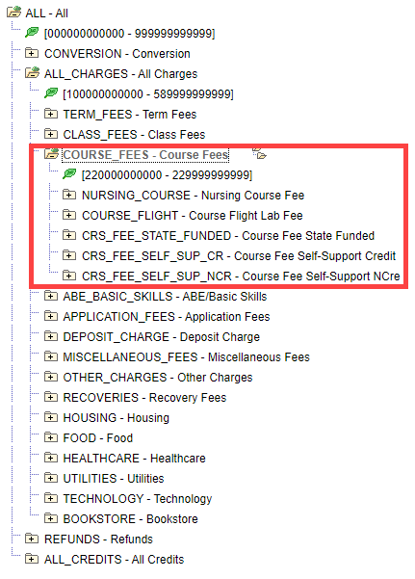
Deciding how much control to apply
IMPLEMENTATION/ROLL OUT
In this sample Tree shown, a college could grant a user access to only the COURSE_FEES node, which results in granting access to Item Types ONLY in the node in that range, which incorporates the access defined in the lower (nested) nodes:
CRS_FEE_STATE_FUNDED
CRS_FEE_SELF_SUP_CR
CRS_FEE_SELF_SUP_NCR
But does not grant access to others, such as ABE_BASIC_SKILLS etc.
Colleges can restrict as far as the lowest node range, or simply grant access to individual Item Types.

Slide 30
SF ITEM TYPE SECURITY
What is ctcLink Item Type Security
Functional Areas Impacted
Implementation/Roll Out
Examples of Item Type Access
Questions?
Notes:
Topics that will be covered today are;
CLICK – Briefly review CS to Fin integration
CLICK – Go over what’s next for second journal sets, verifying fund 145 projects and managing corrections
CLICK – Discussion on SF to GL
CLICK – Review the SF Refund process and how it interfaces into Finance
CLICK – and provide some queries to troubleshoot errors and hop into the system to review some current SJS errors
<NEXT SLIDE>

