Slide 1
Cross-pillar fa/sf end to end disbursement to refunds training
January 30th, 2023 (9:00am – 10:30am)

Slide 2
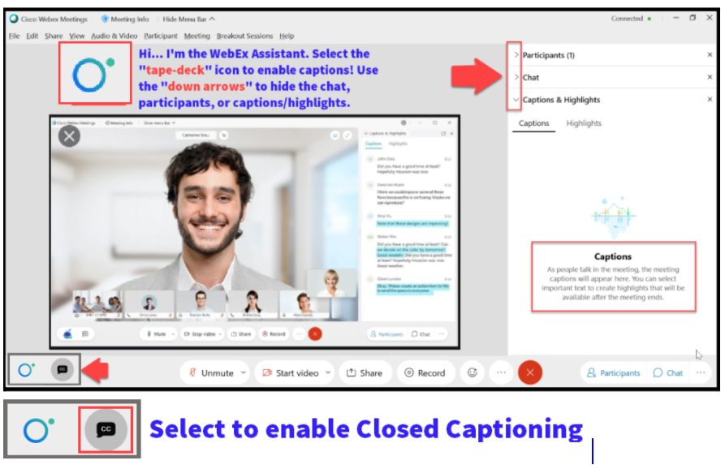

Slide 3
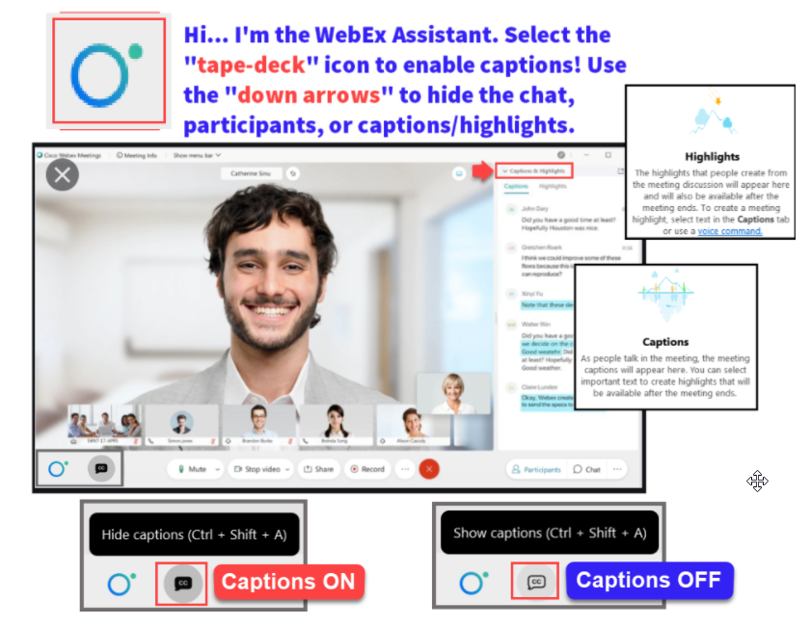

Slide 4
HOUSEKEEPING
Sessions are being recorded - Find session recording in the SF102 & FA 103 Canvas Courses
The law requires consent prior to recording a person’s participation in an event. Your participation in this video conference (training) equals consent to be recorded, as required by law. If you do not consent to being recorded but choose to participate, please turn your camera off and use the chat feature to interact with the other participants.
Please mute your line when not speaking
Do Not Place WebEx line on Hold
Leave your line on Mute unless you are speaking
Be ready to participate & ask questions
If we move too quickly, ask us to slow down or to revisit a topic in the chat

Slide 5
FA/SF: Disbursements/Refunds End to End
Agenda
Authorization/Disbursement
Basics Overview
Configuration
Individual Student Refunds
Reverse/Cancel Refunds
R2T4 (FARP/FARC)
Alternative Loans
Queries

Slide 6
FA Objectives
After completing this training, you should be able to:
Understand the high-level overview concept of all steps involved in Disbursement (FA) to Refund (SF) Processing
Understand which resources are available to you to aid you in your college’s specific disbursement and refund days
Understand the concepts of the timing on managing your Disbursement Holds and your Refund Holds

Slide 7
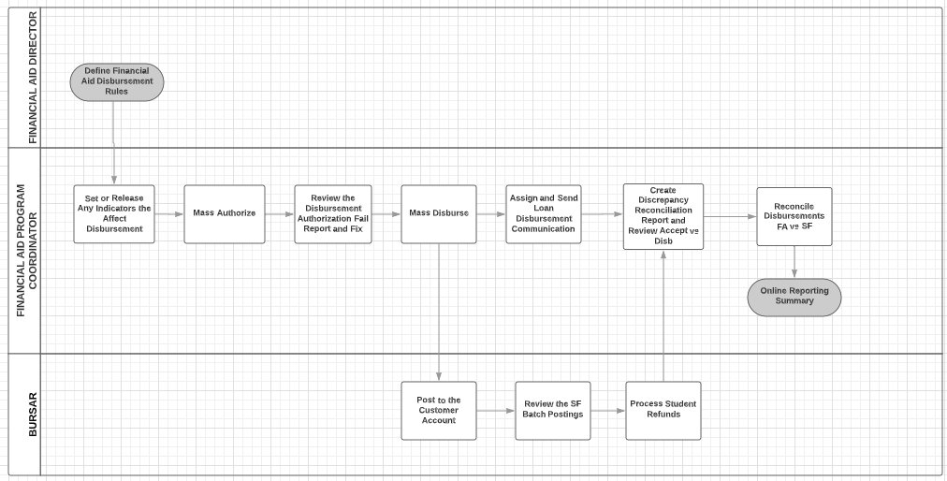
Steps in the process

Slide 8
BATCH DISBURSEMENT

Slide 9
BATCH DISBURSEMENT
DEPENDENCY: AFTER FLF PROCESS, RE-RUN AUTHORIZATION & DISBURSEMENT
Navigation: Nav Bar > Navigator > Financial Aid > Disbursement > Process Disbursements
You can run two terms at a time, or one at a time.

Slide 10
Available resources to track students who have withdrawn
Business Process Guide (for both FA & SF):
Blocking FA Refunds Due to Withdrawals Business Process Guide | 9.2 FA - Financial Aid Business Process Guides | ctcLink Reference Center
Assigning and managing your Service Indicators:
F03s (FA) – Blocking Disbursement
B03s (SF) – Blocking Refunds

Slide 11
Disbursed, now what?
NEXT STEPS:
Contact SF and let them know you have disbursed, and that they should be ready to perform a:
Group Post!

Slide 12
QUERIES

Slide 13
QUERIES
USEFUL QUERY TO TRACK THE GROUP POST AMOUNT FOR YOUR DISBURSEMENT RUN
CTC_FA_DISBURSED_BY_DATE
Run and save this query with each disbursement run / share with SF

Slide 14
QUERIES
USEFUL QUERY TO TRACK WITHDRAWALS UP UNTIL CENSUS
CTC_FA_LOAD_COMP_BETWEEN_DATE – compares students with different FA load level when disbursed to date entered in prompt
Run and work this query daily up until Census

Slide 15
FA Outcomes
At training completion, you should be able to:
Understand the high-level overview concept of all steps involved in Disbursement (FA) to Refund (SF) Processing
Understand which resources are available to you to aid you in your college’s specific disbursement and refund days
Understand the concepts of the timing on managing your Disbursement Holds and your Refund Holds

Slide 16
SF Objectives
After completing this training, you should be able to:
Understand how refunds and disbursement relate between FA and SF
Understand refund configuration
Tools available for individual refunds
How to reverse refunds
The difference between Legacy and ctcLink with R2T4 processing

Slide 17
Refunds Basics
Refunding Students & External Orgs
A. SF Refund process types (Post – Stage – Deliver)
CyberSource - Direct
BankMobile – Places file on secure server for pickup
A/P Checks – Voucher is sent to Finance Pillar
Students
Corporate/Business
Sponsor – Deceased students/someone other than the refund holder
Post (Disbursement) = The act of the Group Posting process which places the financial aid item type into each student’s account.
Stage (Refund) = The act of turning a credit balance from a payment item type into a refund on each student’s account.
Deliver = The act of sending the refund to the student. An original interface process (between your institution and the student) exists for CyberSource, BankMobile, and printed checks. The Deliver process must follow the staging process regardless if was via a batch or an individual set.

Slide 18
Individual vs. Batch Processing
Individual Pros
Used for one-off occasions of payment item types with a credit on them
Better for immediate refund needs and Third Party (Organization)
QRG
Batch Pros
Used for group of students with a range of payment item types with a credit on them
Better for group processing
QRG

Slide 19
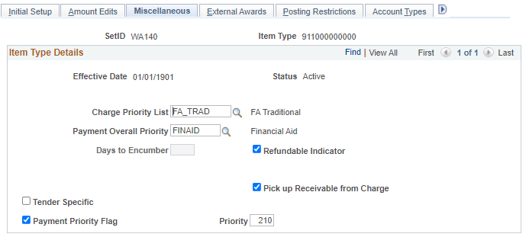
Configuration-Payment Shuffle
The “Payment Shuffle” occurs with multiple payment item types being applied on a student account.
Why does it occur?

Slide 20
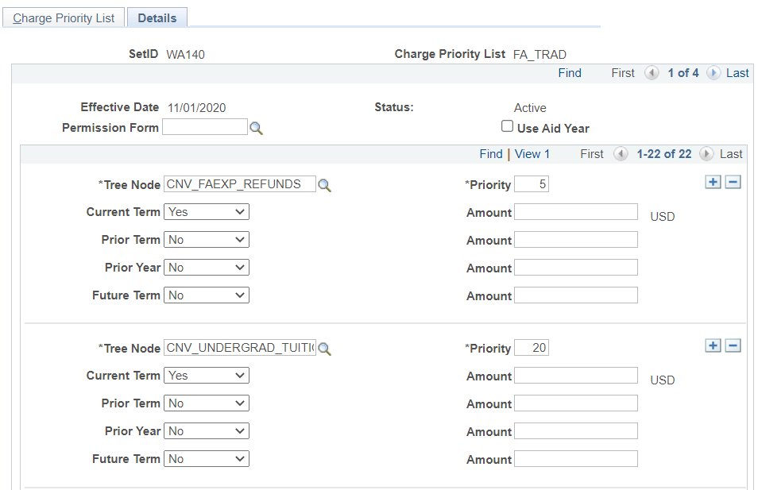
Configuration-Charge Priority List (CPL)
QCS_SF_ITEMTYPES_TO_CPL
Navigation: Nav Bar > Navigator > Set Up SACR > Product Related > Student Financials > Charges and Payments > Charge Priority List

Slide 21
Payment Shuffle Examples:
You have a student who had their WCG paying off tuition charges. Pell is awarded to the student and it bumps the WCG award paying off charges. The end result is the student receives a credit (and potential refund) for WCG.
A non-refundable item type is paying off a charge. A refundable item type is awarded and bumps the N-RIT. The RIT is now paying the charges and the N-RIT is sitting on the student account as a credit. This will not refund to the student.

Slide 22
Configuration-Refundable Indicator
Refundable Indicator…It’s always a check box
Navigation: Nav Bar > Navigator > Set Up SACR > Product Related > Student Financials > Item Types > Item Types

Slide 23
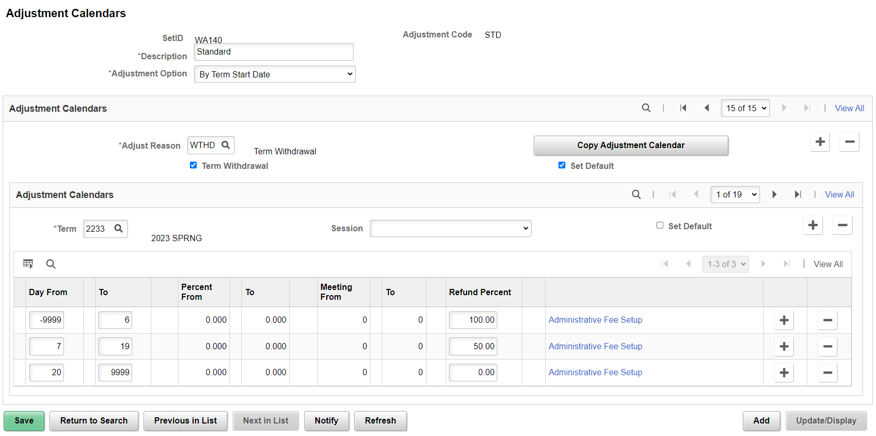
Configuration-Adjustment Calendar
Adjustment Calendars provide the appropriate refund percentage
Navigation: Nav Bar > Navigator > Set Up SACR > Product Related > Student Financials > Tuition and Fees > Adjustment Calendar

Slide 24
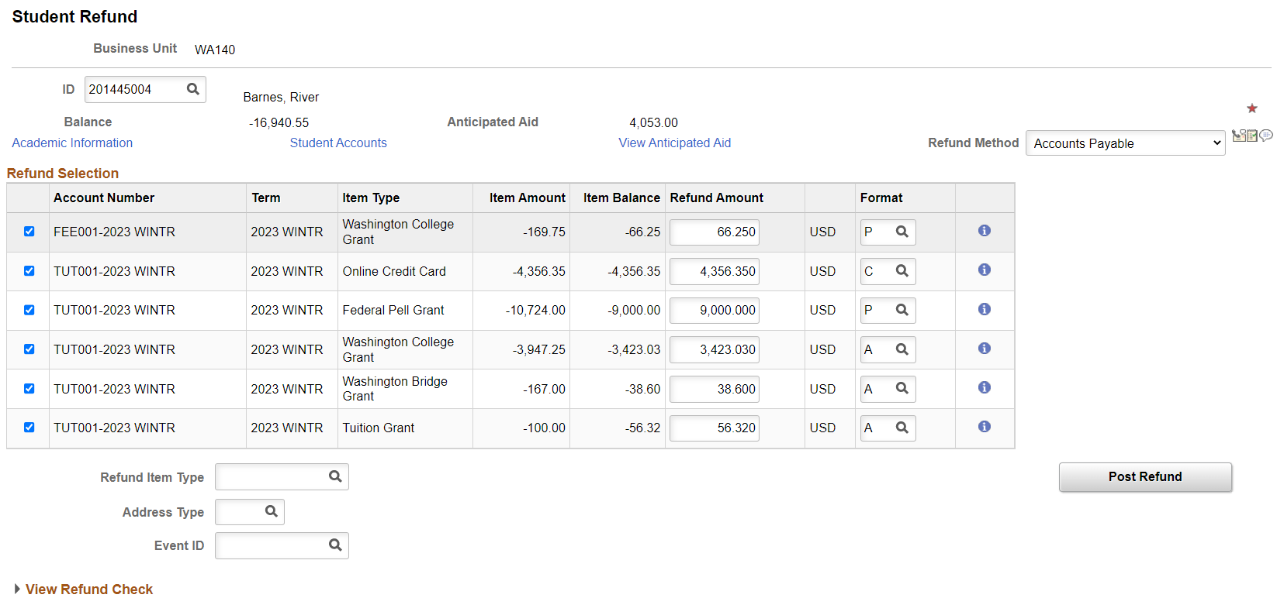
Individual Student Refunds
$10,000 Max/refund
Select correct Refund Method
Select lines
Choose correct Format
Select correct Refund Item Type
Can do partial amounts

Slide 25
REVERSE/CANCEL REFUNDS
To Reverse or to Cancel – that is the Question…
VERY IMPORTANT TO START WITH, WHERE IS THE MONEY?
Is the system stuck…has just the stage step been completed…is the refund days old and already been spent by the student…was there a double refund…Were the funds returned…???
Canceling Refunds = If the system generates an error during the posting of a refund, you cannot continue processing the refund, and you cannot reverse it because the posting process did not finish. You must cancel the refund and post it again. This doesn’t happen very often…
Reversing Refunds = If the process has completed all the way to success (staging & posting the refund) use reverse to credit the refund back onto the student’s account. Be sure to follow up with the manner for which the refund was delivered to ensure the funds are properly returned/credited. CyberSource cannot be reversed.

Slide 26
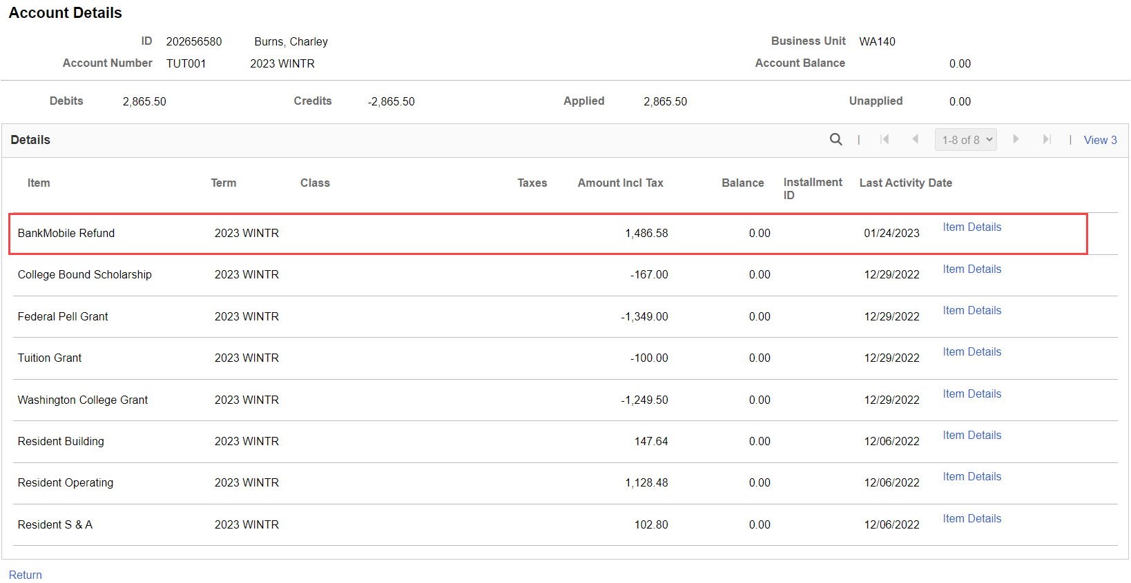
Reverse a Refund
Funds were returned from BankMobile

Slide 27
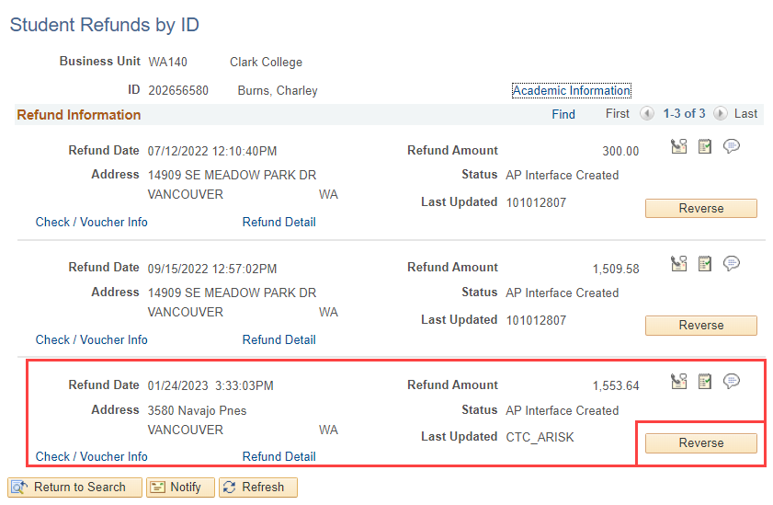
Reverse a Refund Cont.
Navigation: Nav Bar > Navigator > Student Financials > Refunds > Reverse and Cancel Refunds > Student Refunds by ID
Funds were returned from BankMobile
Reverse correct refund then work with your FA office

Slide 28
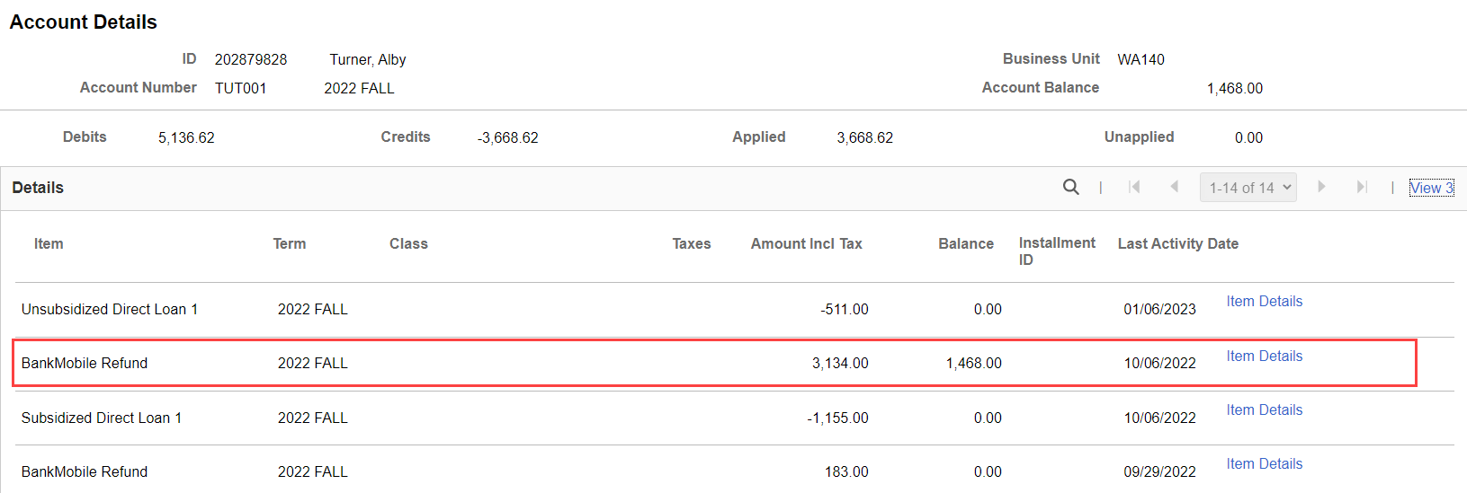
FARP/FARC (R2T4)
FA reduces the award and it is picked up in the “POST” stage of Refunds
If the student received a refund after the reduction in award, FARP/FARC is used

Slide 29
FARP/FARC (R2T4) Cont.
Find these students with Query:
QCS_SF_FA_REFUNDS_DUE
9.2 Financial Aid Refund Adjustments

Slide 30
Alternative Loans
QRG has been unpublished, pending active changes
SF/FA Work Session: Alternative Loans Processing on February 17th, 9am-11am

Slide 31
Queries
QCS_SF_ITEMTYPES_TO_CPL
QCS_SF_FA_REFUNDS_DUE
QCS_SF_ITEM_TYPE_OPEN_BALANCE
QCS_SF_ITEM_TYPE_CREDIT_AMT
QCS_SF_CREDIT_BAL_NONREF
QCS_SF_ITM_TYP_CREDIT_BAL_SI
QCS_SF_FA_SA_APPLIED_DETAILS
QCS_SF_FA_SA_APPLIED_SUMARY
CTC_FA_DISBURSED_BY_DATE

Slide 32
SF Objective(s) and Outcome(s)
Expected Session Outcome(s)
Gained a better understanding of:
Refund processing order
Refund configuration
Individual Student Refund page
Difference between Cancel and Reverse for refunds
FARP/FARC

