Slide 1
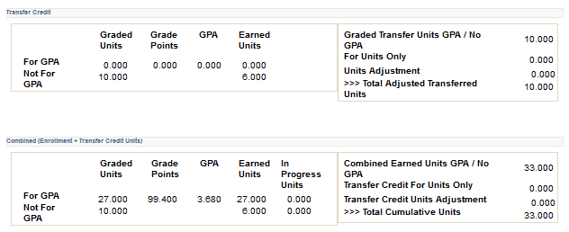
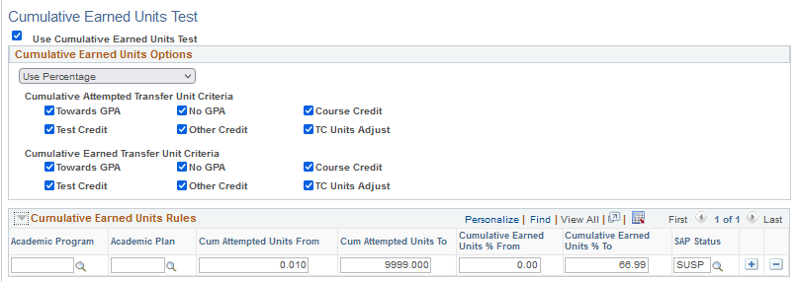
Qualitative: cumulative earned units - CORRECTED
UPDATED CONTENT
(This content differs from the incorrect information provided in the session on 12/16/2022.
Earned Units are calculated different than Attempted Units:
Grade Exclusion Disabled:
Reads the Student Career Term table (Term History> Cumulative Statistics page) in the Combined (Enrollment + Transfer Credit Units) section and sums the “For GPA” Earned Units and “Not for GPA” Earned Units:
Cumulative Statistics where the Term is the MAXIMUM Term (less than or equal to Processing Term) and has active Enrollment with no Audit Grading basis checked and fully graded.
SAP Setup-Cumulative Earned Transfer Unit Criteria:
Towards GPA or No GPA if boxes are CHECKED, no reduction is made to the Combined Enrollment + Transfer (GPA/No GPA) for Total Earned Units.
Towards GPA or No GPA if boxes are UNCHECKED, the program will DECREASE the Total Earned Units (Earned GPA Units from the sum of For GPA and/or Not for GPA), since it is “Combined” Enrollment + Transfer.
Leaving unchecked will essentially remove transferred units from the earned unit total. In ctcLink, because we use this section for rebuilding of legacy transcripts we DO NOT want to remove those values as it will negatively impact the student’s Pace of Progress %.
If the TC Units Adjust box is CHECKED, then the program will DECREASE the Total Earned Units by the Total Transfer Credit Units Adjustment value.
Don’t do This!
(*Hidden fields, do not display on Cumulative Statistics page, but can be seen in Query of Student Career Term table)
Do This!
*
*

