Slide 1
SAP processing refresher just-in-time training
Kelly Forsberg
December 2022
Notes:
Welcome to the world of Financial Aid SAP in ctcLink, your End User Training session!

Slide 2
ground rules
Be ready to participate
Remove external distractions
Mute your line when not speaking
Do NOT place Webex line on hold. Use Mute.
Please leave your line on Mute unless you are speaking
Sessions are being recorded
Allow your peers to complete their thoughts before beginning yours

Slide 3
Logistics and Agenda
Times | Activity
9:00 – 9:10 | Greet/Attendance/Objectives
9:10 – 10:00 | Standard/Normal SAP
10:00 – 10:15 | Overriding SAP
10:15 – 10:30 | Career and Term Exception Processing
10:30 – 10:45 | Assigning and Sending Out SAP Status Notifications
10:45 – 11:00 | Session Wrap-Up/ Q&A

Slide 4
Objectives
After completing this training, you should be able to:
Understand the varying SAP processes (Pass 1 & Pass 2)
Understand how to Override SAP
Understand when and how to use SAP Career and Term Exception Processing
Understand how to assign SAP Notification Statuses, and send out notifications

Slide 5
NORMAL SAP
PROCESSING

Slide 6
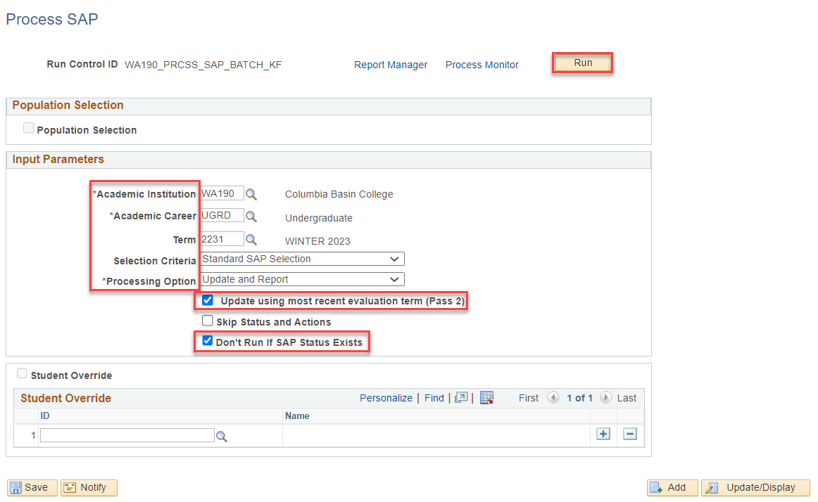
Standard/normal SAP PROCESSING
Navigation: Nav Bar > Navigator > Financial Aid > Satisfactory Academic Progress > Process SAP
WINTER SAP 2231, FALL GRADES
Run in “Report Only” for a preliminary report.
Run in “Update and Report” for a final report and update to SAP status in Maintain Student SAP Data page.

Slide 7
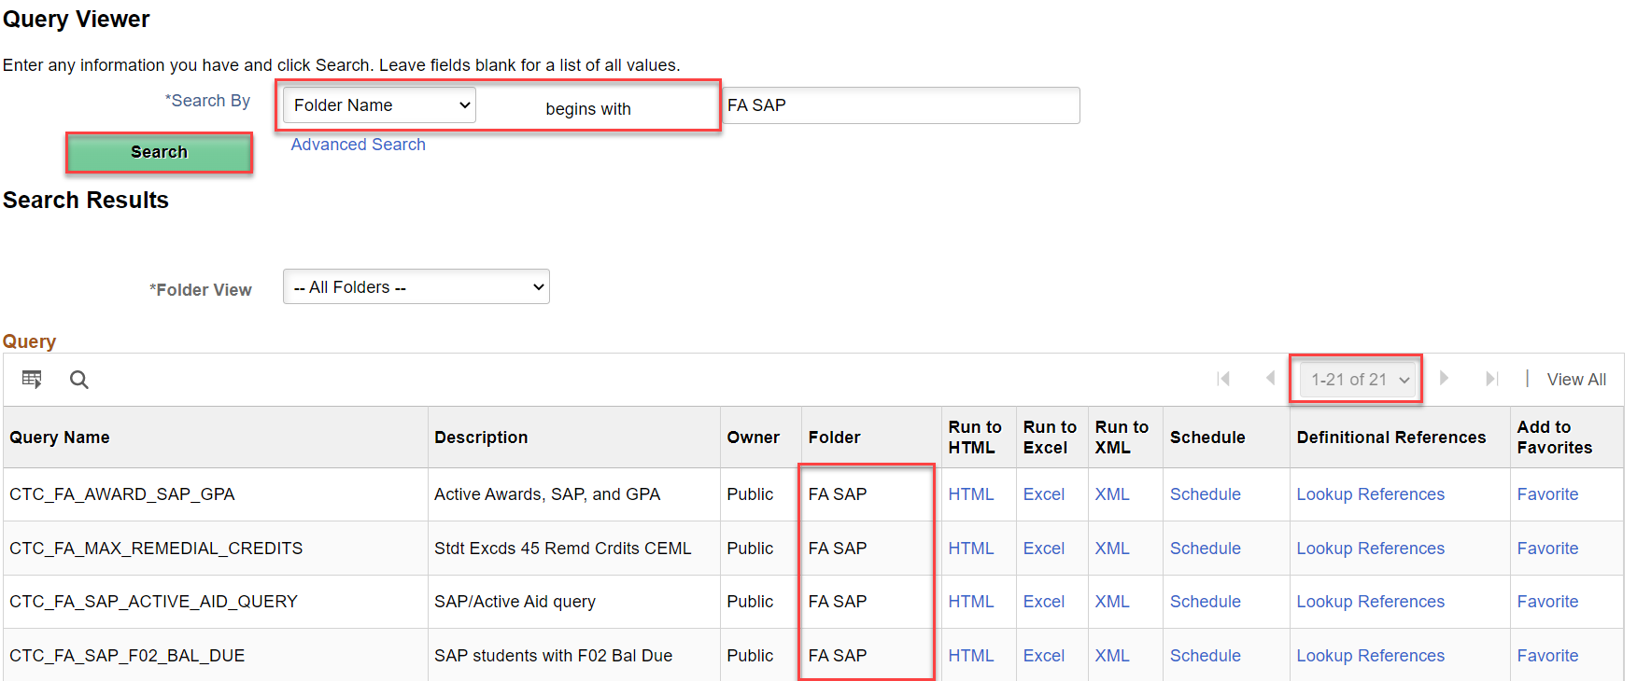
Helpful queries!
The SAP Business Processing Guide has a wonderful list of query to help with finding populations of students that may need adjustment or Overrides put back in place: i.e students on PLAN
Nav: Reporting Tools > Query > Query Viewer

Slide 8
OVERRIDING SAP

Slide 9
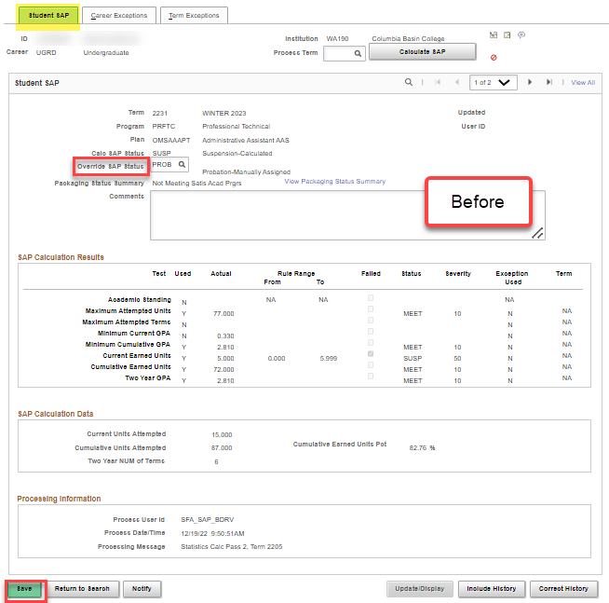
OVERRIDING SAP
Navigation: Nav Bar > Navigator > Financial Aid > Satisfactory Academic Progress > Maintain Student SAP Data
MAINTAIN STUDENT SAP DATA
Enter the desired SAP Status value to be overridden in the Override SAP Status field.
Select Save.

Slide 10
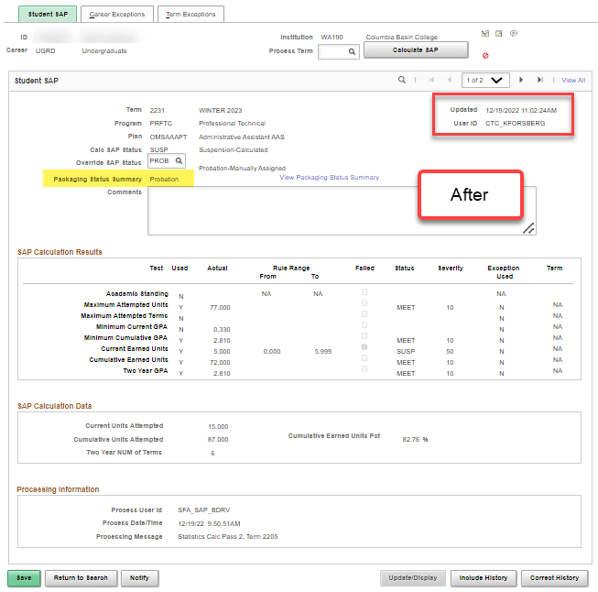
OVERRIDING SAP
MAINTAIN STUDENT SAP DATA
After override is performed, date timestamp and user ID is displayed in the row.

Slide 11
CAREER AND TERM
EXCEPTION
PROCESSING

Slide 12
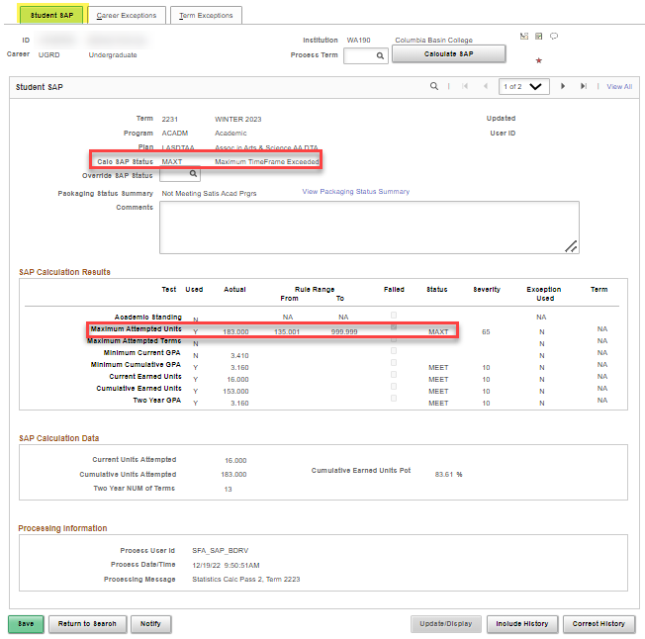
EXCEPTION PROCESSING
CAREER EXCEPTION
Student was MAXT (SUSP) for exceeding 150% (not meeting max timeframe)

Slide 13
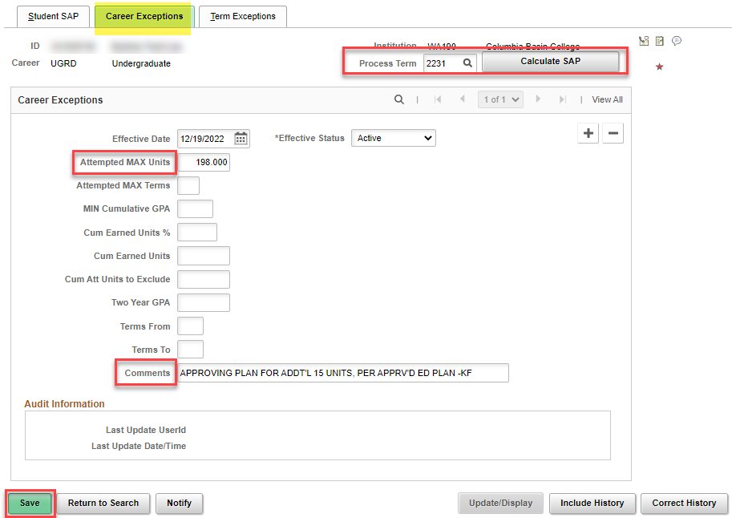
EXCEPTION PROCESSING CONT’D
CAREER EXCEPTION CONT’D
After student appeals/follows your business process, you can allow the student to complete 150 units for this program so that they are “Meeting SAP”
Enter comments as needed so staff know what is being updated.

Slide 14
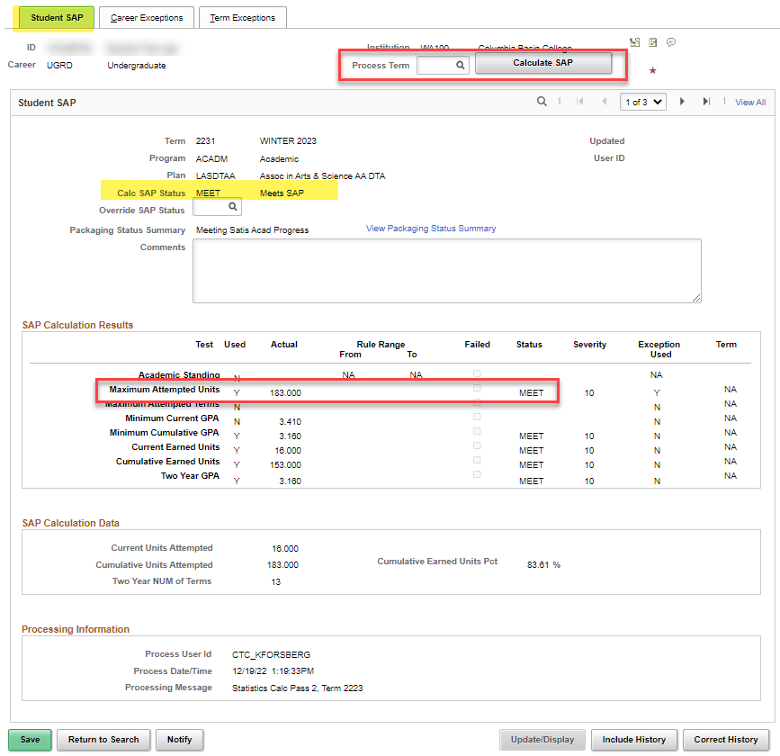
EXCEPTION PROCESSING CONT’D
CAREER EXCEPTION CONT’D
After re-running Calculate SAP for the SAME term, a new row is added and the student is now as “Meets SAP”

Slide 15
DEMONSTRATION

Slide 16
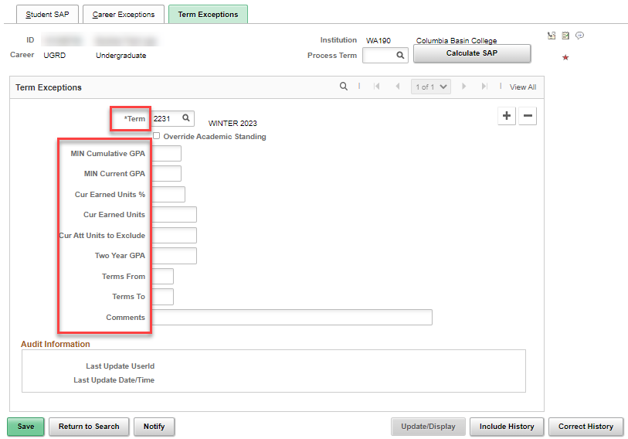
Term exception processing
Very similar to Career Exceptions processing, however, it is limited to the term specified.

Slide 17
Additional queries!
Here are some additional “clean up” queries to work BEFORE sending your communications.
CTC_FA_SAP_PASS_2_LIST
CTC_FA_SAP_ZERO_PASS_2_LIST
Refer to SAP BPG for additional queries!

Slide 18
ASSIGNING AND
SENDING SAP NOTIFICATIONS

Slide 19
Notifying students about sap status
Log in to ctcLink and ensure you have all the available Event Definitions for WARN, PROB, SUSP, etc.
When ready to run, use the QRG:
9.2 Assigning and Generating SAP Status Notifications to Students | 9.2 FA - SAP | ctcLink Reference Center

Slide 20
Additional queries!
Here are some additional “clean up” queries to work AFTER sending your communications.
CTC_FA_INCOMP_COMM_STDNT_LIST
CTC_FA_COMM_LIST_FINT
Refer to SAP BPG for some additional queries!

Slide 21
DEMONSTRATION

Slide 22
Outcomes
At training completion, you should be able to:
Understand the varying SAP processes (Pass 1 & Pass 2)
Understand how to Override SAP
Understand when and how to use SAP Career and Term Exception Processing
Understand how to assign SAP Notification Statuses, and send out notifications

Slide 23
Congratulations!
You have successfully completed Processing SAP!
Please refer to the ctcLink Reference Center for additional resource materials on today’s topics
Thank you for your participation today!

