Slide 1
JUST IN TIME TRAINING VETERANS’ BENEFIT PROCESSING
Tanjagay Martin (CS), Kelly Forsberg (FA), Alec Risk (SF)
ctcLink Functional Trainers (Campus Solutions)
November 2022

Slide 2
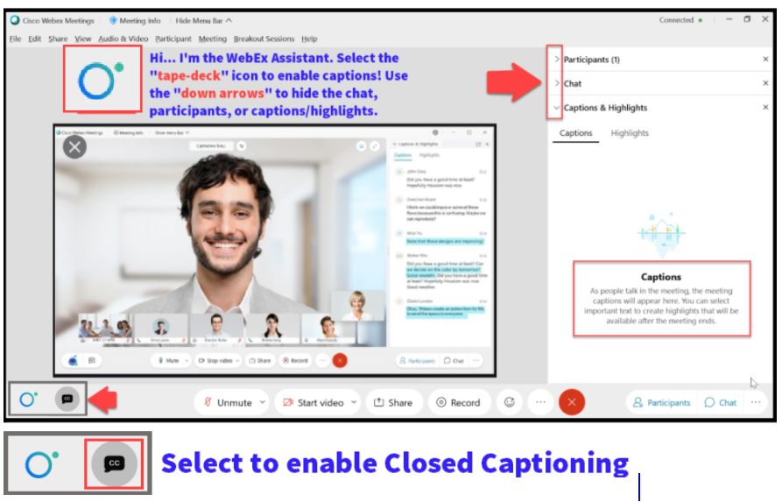

Slide 3
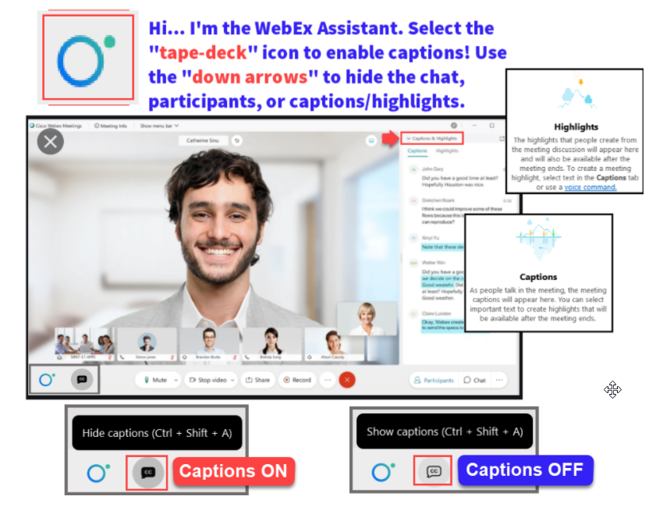

Slide 4
Logistics and Agenda
Times | Activity
9:00 – 9:05 | Greet/Attendance/Objectives
9:05 – 9:20 | Tracking Veterans at Different Stages
9:20 – 9:35 | Understand how to code residency (demo on Choice Act)
9:35 – 9:50 | Tuition Discounts and Waivers
9:50 – 10:00 | Tracking Veteran Awards in FA
10:00 – 10:45 | Managing Veteran Benefit Info
10:45 – 10:55 | Queries for enrollment & student group
10:55 – 11:00 | Session Wrap-Up / Q & A
Some processes will have demonstrations, but due to data available in the environment, demo examples are not ideal

Slide 5
ground rules
Be ready to participate
Remove external distractions
Mute your line when not speaking
Do NOT place Webex line on hold. Use Mute.
Please leave your line on Mute unless you are speaking
Sessions are being recorded
Allow your peers to complete their thoughts before beginning yours

Slide 6
Objectives
After completing this training, you should be able to:
Understand how to track Veteran students at different phases
Understand how to code for in-state tuition for Veteran's Choice Act
Describe the different Types of Veteran Tuition Discounts
Understand how to apply the 100% State Tuition Waiver for Dependents of Veterans
Managing Veterans Benefit Information
Understand how to use query to track enrollment changes, track student groups, and recon on third-party payments

Slide 7
HIGH-LEVEL FLOW OF VETERANS’ BENEFIT PROCESSING

Slide 8
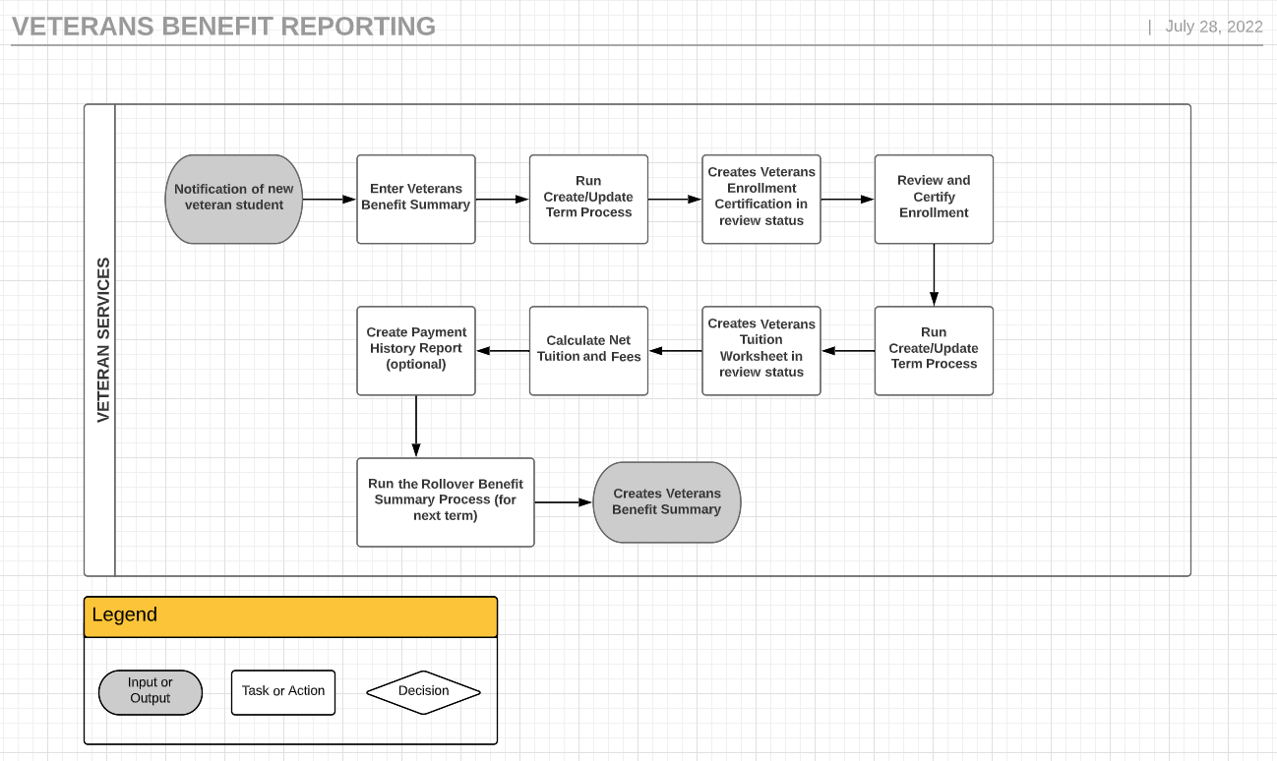
VETERANS’ BENEFIT PROCESSING flow

Slide 9
TRACKING VETERANS
AT DIFFERENT PHASES

Slide 10
Tracking veterans
Prospective Students
New Students
Returning Students
Residency

Slide 11
CODING RESIDENCY FOR
VETERANS

Slide 12
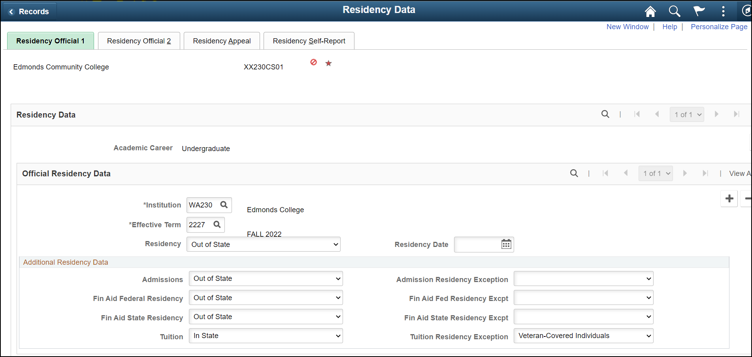
CODING RESIDENCY for veterans
Navigation: Campus Community > Personal Information (Student) > Identification (Student) > Residency Data
Notes:
This is the equivalent of the Legacy coding (2, 29) in SM7001

Slide 13
APPLYING VETERANS’
TUITION WAIVER

Slide 14
Applying waivers
Navigation: NavBar > Records and Enrollment > Career and Program Information > Student Groups
Tuition Waivers and Residency Classifications:
W70 – Eligible Veterans/National Guard
W71 – Other Military or Naval Veterans
W72 – Dependent of Eligible Veteran
W75 – Building and S&A Fee Waiver
How to Apply Waivers
Criteria
Connects Waivers and Tuition Groups through Student Groups or Equation Variables
Waiver
The actual Waiver configuration
Tuition Groups
Populations of students (Ex. UNGRD, High/Low, BCHLR, etc.)
Student Groups
Once the Criteria, Waiver, and Tuition Groups are set up, you will apply the Appropriate Student Group to the student account which will then have the waiver apply to the appropriate charges.

Slide 15
Third Party Contracts
Navigation: Navigation: NavBar > Student Financials > Payment Plans > Third Party Contract
Similar to a scholarship
Pays the Customer (Student) Account
Moves charges to Corporate (Third Party) Account
Payments received are posted to the Corporate Account
Student Enrolls
Third Party
Invoice
Charges assessed on Student Account
9.2 Create a Third Party Contract
9.2 Assign and Cancel a Student from a Third Party Contract
9.2 Invoice a Third Party Contract
Third Party Contract Invoice Query

Slide 16
TRACKING VA IN THE
FINANCIAL AID AWARD

Slide 17
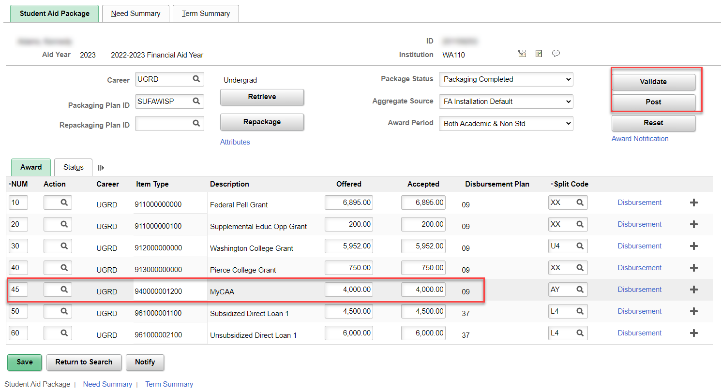
tracking VA IN Financial aid award
Navigation: Financial Aid > Awards > Award Processing > Assign Awards to a Student
When reporting VA funds to reflect in Fin Aid COA, typically, the awards will be a non-disbursable Item Type

Slide 18
Managing Veterans reporting

Slide 19
Manage veterans reporting

Slide 20
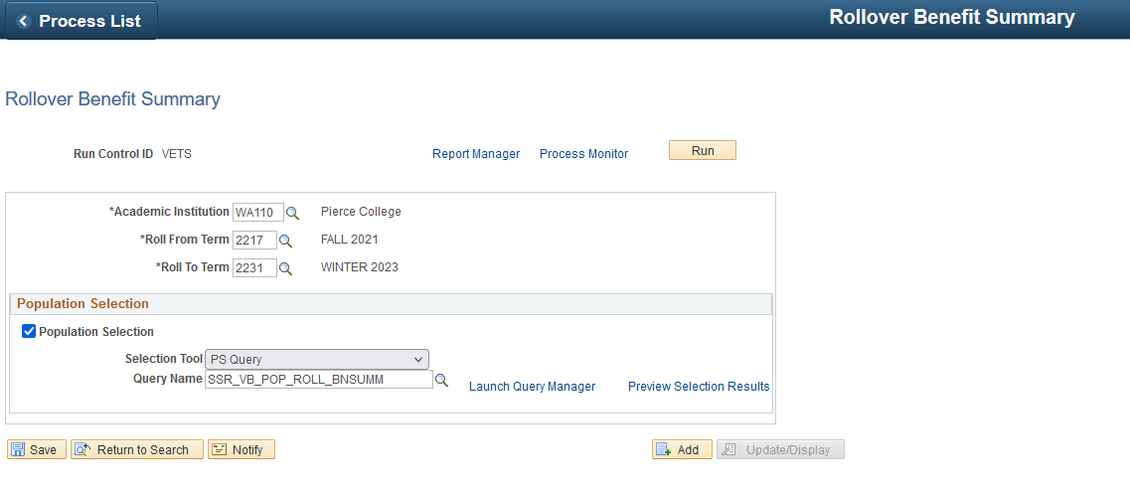
Rollover Benefit Summary
Navigation: Records and Enrollment > Enrollment Reporting > Veterans Benefit Reporting > Rollover Benefit Summary

Slide 21
VETERANS BENEFIT SUMMARY
Navigation: Records and Enrollment > Enrollment Reporting > Veterans Benefit Reporting > Veterans Benefit Summary

Slide 22
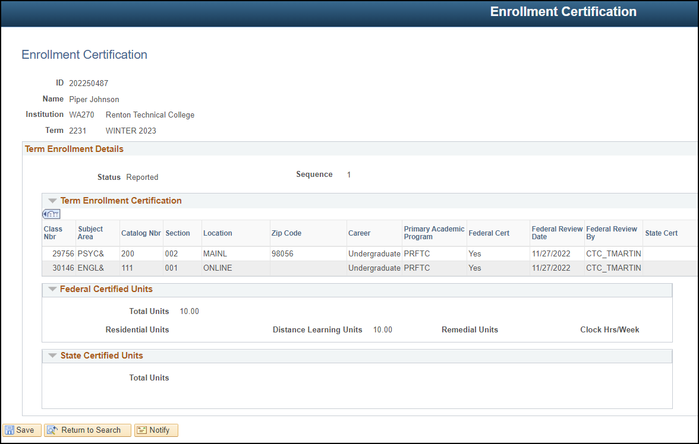
VERIFY ENROLLMENT FOR VA CERTIFICATION
Navigation: Records and Enrollment > Enrollment Reporting > Veterans Benefit Reporting > Enrollment Certification

Slide 23
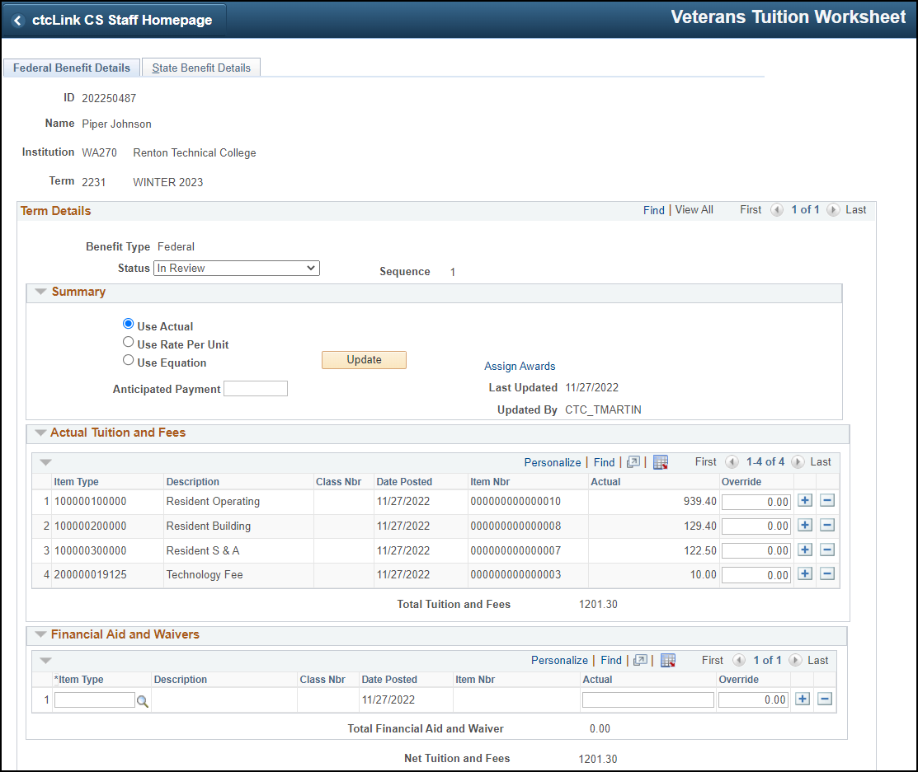
Veterans Tuition Worksheet
Navigation: Records and Enrollment > Enrollment Reporting > Veterans Benefit Reporting > Veterans Tuition Worksheet
Tuition Calculation before generating Veterans Tuition Worksheet

Slide 24
Veterans payment history
Navigation: Records and Enrollment > Enrollment Reporting > Veterans Benefit Reporting > Veterans Payment History

Slide 25
DEMONSTRATION

Slide 26
QUERY TO TRACK
ENROLLMENT CHANGES

Slide 27
QUERIES TO TRACK ENROLLMENT CHANGES
Navigation: Reporting Tools > Query > Query Viewer

Slide 28
QUERY FOR RECON ON
VET STUDENT GROUPS

Slide 29
QUERIES FOR RECON ON VET STUDENT GROUPS
Navigation: Reporting Tools > Query > Schedule Query

Slide 30
QUERIES/REPORTS FOR RECON ON
THIRD PARTY CONTRACTS

Slide 31
QUERIES/REPORTS FOR RECON ON THIRD PARTY CONTRACTS
Navigation: Reporting Tools > Query > Schedule Query
QCS_SF_THIRD_PRTY_VNDR_PAY_RCN
CTC_FA_THIRD_PARTY_PYMNTS
QCS_SF_3RD_PARTY_STUDENT_DTL
QCS_SF_3RD_PRTY_INVOICE_BI_CQP

Slide 32
Outcomes
At training completion, you should be able to:
Understand how to track Veteran students at different phases
Understand how to code for in-state tuition for Veteran's Choice Act
Describe the different Types of Veteran Tuition Discounts
Understand how to apply the 100% State Tuition Waiver for Dependents of Veterans
Managing Veterans Benefit Information
Understand how to use query to track enrollment changes, track student groups, and recon on third-party payments

Slide 33
Congratulations!
You have successfully completed the Veterans’ Benefit Processing Cross-Pillar Just in Time Training!
Please refer to the ctcLink Reference Center for additional resource materials on today’s topics
Thank you for your participation today!

