Slide 1
Aid Year Rollover (AYRO) Prep
Deborah Englehardt
ctcLink Functional Analyst | Financial Aid
November 2022

Slide 2
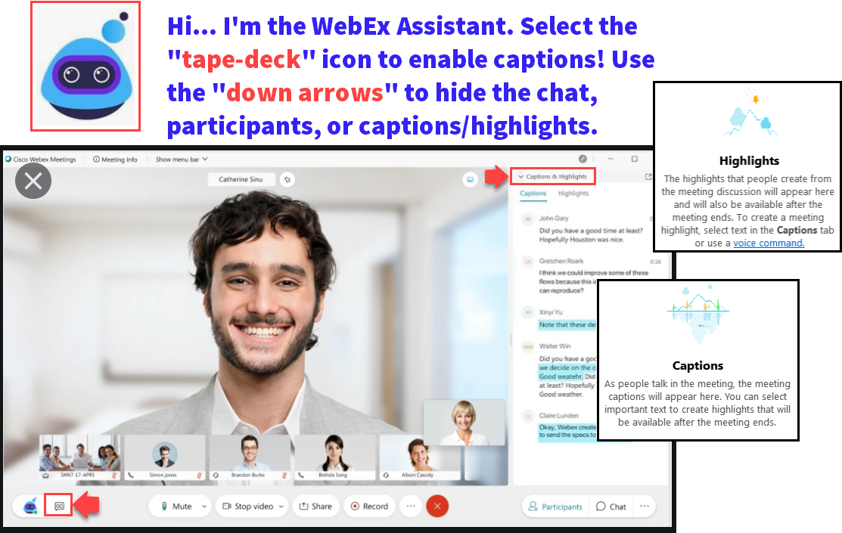

Slide 3
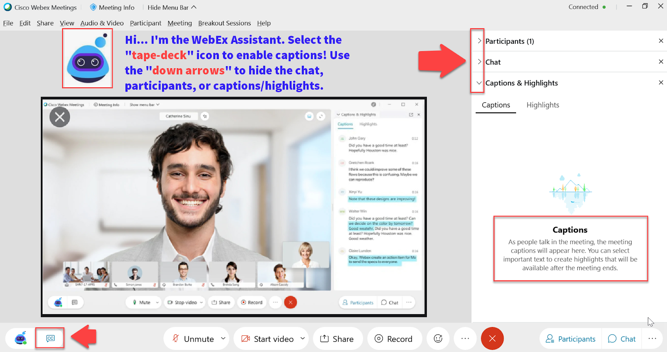

Slide 4
Logistics and Agenda
Times | Activity
13:00 – 13:10 | Greet/Attendance/Objectives
13:15 – 13:30 | Loading 2023-2024 ISIRs early
13:30 – 13:45 | Timeline of upcoming events leading up to turning on ISIR Jobsets
13:45 – 14:45 | AYRO College List Review
14:45 – 15:00 | Session Wrap-Up

Slide 5
ground rules
Be ready to participate
Remove external distractions
Mute your line when not speaking
Do NOT place Webex line on hold. Use Mute.
Please leave your line on Mute unless you are speaking
Sessions are being recorded
Allow your peers to complete their thoughts before beginning yours

Slide 6
Objectives
During this work session, we will be walking through the following:
How to load 2023-2024 ISIRs early
Aid Year Rollover College Review List
Timeline of upcoming events leading up to turning on ISIR Jobsets

Slide 7
Loading 2023-2024 ISIRs early

Slide 8
The situation
2023-2024 ISIRs submission is open on October 1st but the 2023-2024 PS Image does not go into the system until early December
By the time 2023-2034 AYRO is completed and Even-Year ISIR Jobset parameters are updated, colleges have hundreds of ISIR files to load
Due to the system being shared by 33 colleges and the ISIR Jobset slowing the system down significantly, colleges are asked to be mindful on how many ISIR files are loaded in one instance so that all ISIR Jobsets finish running between 5PM – 7AM Monday - Friday. Depending on the size of the college, this leads to weeks or months of loading backlogged ISIR files
Colleges have the option of requesting an Year-to-Date ISIR file
Notes:
New aid year image is released from Oracle at the end of October. After SBCTC receives the image, testing starts and issues and bugs are logged. Oracle releases patches late November so early December is our quickest turnaround for uploading the aid year image.

Slide 9
What isir process does not require an aid year image?
PS ISIR Processing has three steps with two of them requiring an aid year image to be added into the system (early December)
File Upload/Download
Import Federal Data Files Requires 2023-2024 Image
Process ISIRS
Requires 2023-2024 Image

Slide 10
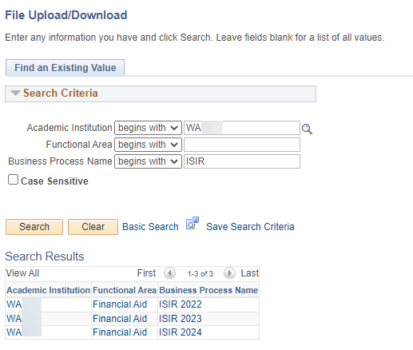
We have created the ISIR 2024 folders in production so that colleges can start loading 2023-2024 ISIR Files on the pS server!!
Navigation: Navigator > People Tools > CTC Custom > Extensions > Upload/Download Files
If you are a college that has been and will continue to request Year-to-Date ISIR files, please feel free to continue doing so. ☺
We created the ISIR2024 folders for colleges that want to start loading all the 2023-2024 ISIR files they received from Edconnect.

Slide 11
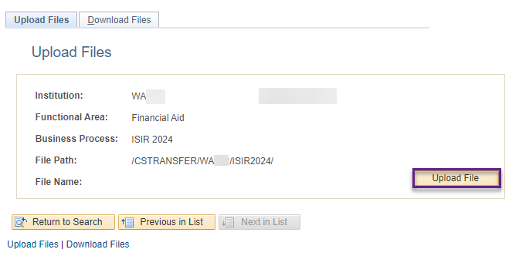
What you Can DO NOW Upload 2024 isir files into the ISIR2024 folder in the order of when the files were received
Navigation: Navigator > People Tools > CTC Custom > Extensions > Upload/Download Files
If you upload the 2024 ISIR files out of order, you will end up with many ISIR files in suspense with the reason: Out of Sequence
Notes:
Reminder, Edconnect files expire after 90 days.

Slide 12
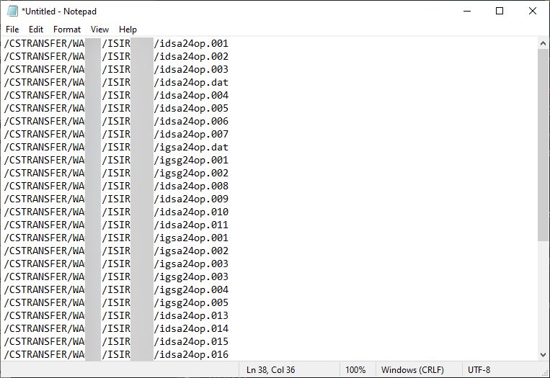
When you are ready to turn on your iSIR JOBSET SUBMIT A TICKET TO FA ERP TO GET A text file of all the files your college loaded in the ISIR2024 folder
The text file will list the ISIR files in the order the files were loaded into the ISIR2024 folder

Slide 13
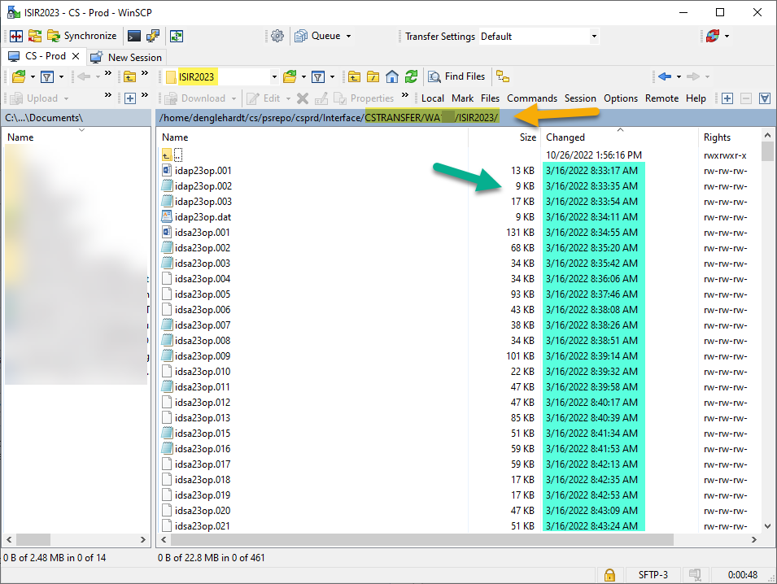
How will we make the text file?
We will grab the files names in from your college’s /CSTRANSFER/Waxxx/ISIR2024 file path
Note: The example in the screenshot is the ISIR2023 folder since we don’t have any ISIR files in the ISIR 2024 folders)
We will put the file names in the order of the earliest ISIR file loaded first

Slide 14
Timeline of Upcoming Events Leading up to Turning On ISIR Jobsets

Slide 15
ISIR Jobset timeslots will be changing
With the current design, there are not enough timeslots for 33 colleges to run two aid years during 5PM – 7AM, Monday – Friday,
We have been working with App Services to optimize different processes in the ISIR Jobset so that multiple colleges can run their ISIR Jobset at the same time. Right now, there is a maximum of two colleges per timeslot.
Once we have a good amount of colleges that have completed 2023-2024 Aid Year Rollover and have their Even-Year ISIR Jobset ready to turn on, we’ll be testing the ISIR Jobset in our testing environment to observe how long each ISIR Jobset takes with our ISIR Jobset optimization work to determine the new ISIR Jobset timeslots.
In addition, Image 2023-2024 may affect our ISIR Jobsets…

Slide 16
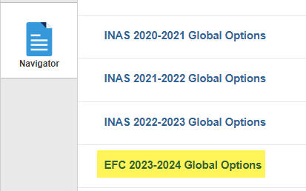
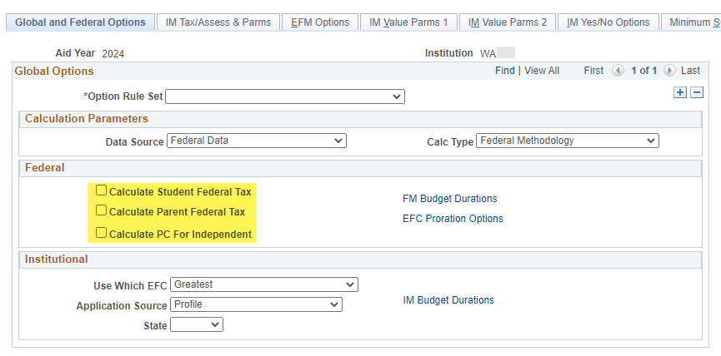
2023-2024 image bugs are still being addressed
INAS Calculation is gone and replaced by Mass EFC Calculation for 2023-2024
Some issues PS colleges have reported:
ISIR Jobsets having issues with Mass EFC Calculation when multiple ISIR files are loaded within them are students with multiple ISIR transactions
Mass EFC Calculation stops processing when encountering a record where there is an assumption made on a Student or Parent Taxes Paid
We have been keeping an eye on the reported issued and will be loading available patches in December but not all bugs are being addressed in these patches.

Slide 17
Timeline of upcoming events leading up to turning on ISIR jobsets
December 2022 – February 2023
Colleges complete Aid Year Rollover and update Even-Year ISIR Jobset parameters
January 2023 – mid February 2023
SBCTC Testing Period
- Run available 2023-2024 ISIR Jobsets with the new EFC Calc function
- Run all available ISIR Jobsets between 5PM – 7AM to determine new ISIR Jobset timeslots
Mid February 2023
Colleges will be informed of testing results:
- Whether a modification of ISIR Jobset shell is needed or not
- New Timeslots for ISIR Jobsets announced

Slide 18
AYRO College List Review

Slide 19
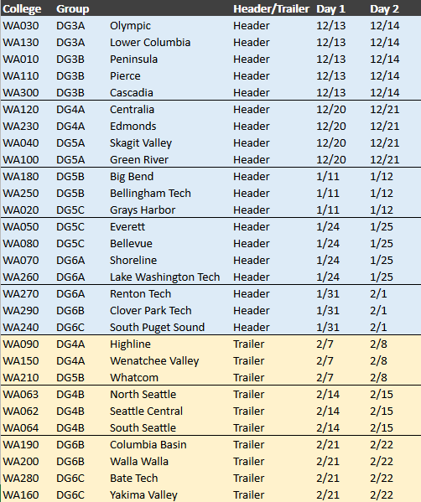
2023-2024 AYRO Schedule
The 2023-2024 AYRO Guide is still being created and will be available closer to the first 2023-2024 AYRO session
‘Save the Dates’ went out on the listserv on November 1st. Calendar invites will be sent shortly with the agenda attached

Slide 20
AYRO college review Lists 2023-2024
The College Review list has been revamped into a spreadsheet!
The first two tabs were sized so that they are printer friendly for those who are wanting to print the lists. ☺
Please go to the 2023-2024 AYRO page to download the list:
https://ctclinkreferencecenter.ctclink.us/m/92436/l/1627344-2023-2024-aid-year-roll-over-prep

Slide 21
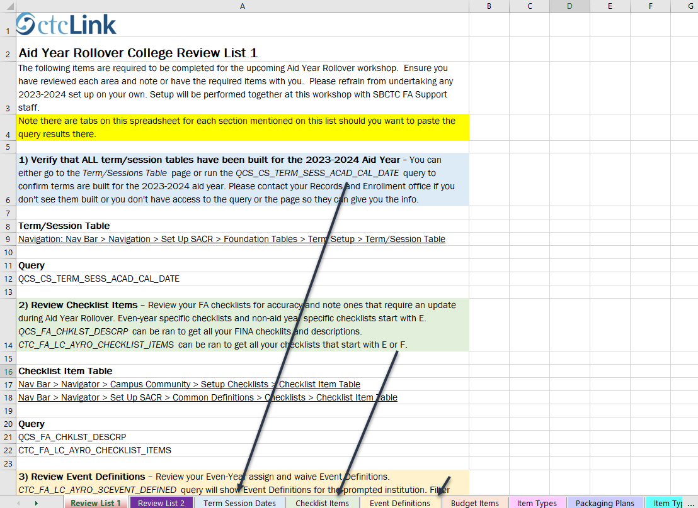
The first tab is Review list 1
Every section on List 1 has a tab associated with it so you can put your query results in there so that you don’t have to come to AYRO with multiple spreadsheets. ☺

Slide 22
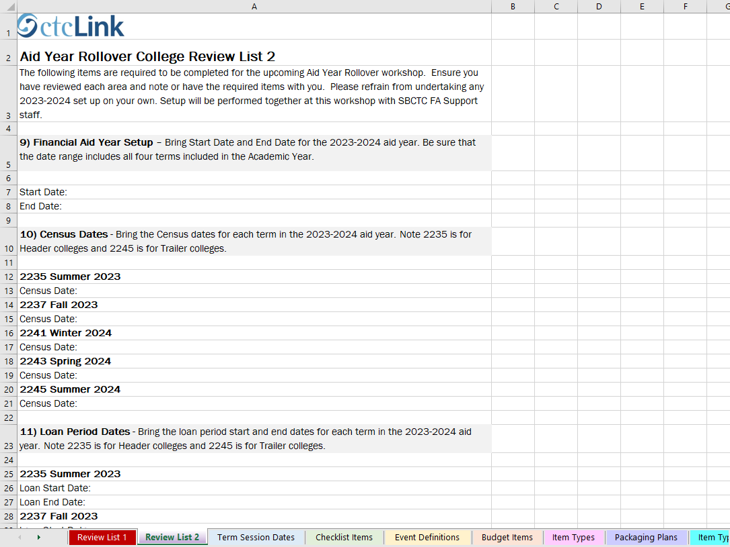
The second tab is Review list 2
List 2 sections do not have tabs associated to them but feel free to create new tabs as you see fit. 😊

Slide 23
Go ahead and start reviewing the two lists and let us know if you have any questions or need some clarification ☺

Slide 24
Outcomes
At work session completion, you should be able to:
Load 2023-2024 ISIRs early
Understand the timeline of upcoming events leading up to turning on ISIR Jobsets
Understand the information that needs to be gathered before attending Aid Year Rollover

Slide 25
Congratulations!
Prepare for Aid Year Rollover Work Session complete!
Thank you for your participation today!
We look forward to working with you during your Aid Year Rollover Workshop!

