Slide 1
Fa r2t4 Just In Time training
Kelly Forsberg
ctcLink Functional Trainer | Financial Aid
October 2022

Slide 2
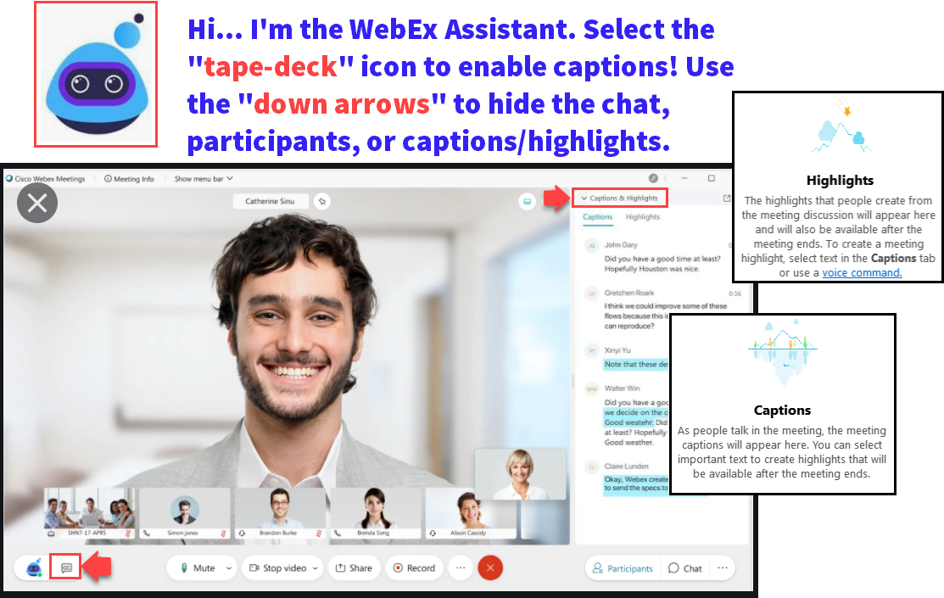

Slide 3
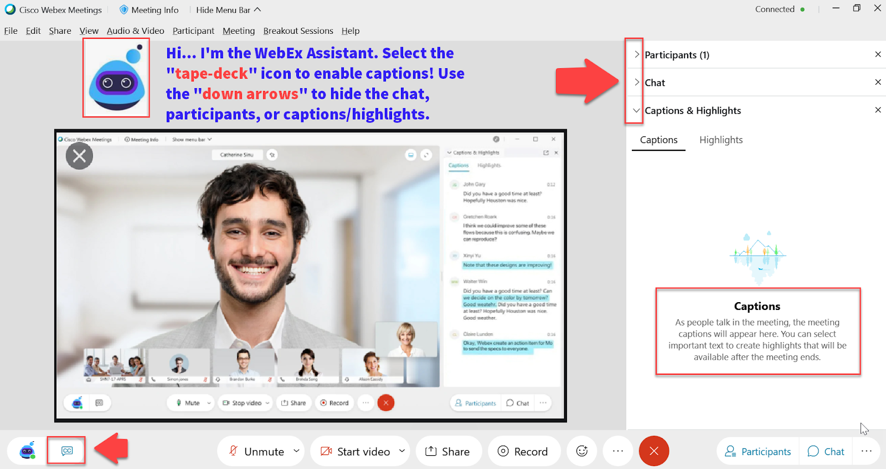

Slide 4
Logistics and Agenda
Times | Activity
9:00 – 9:05 | Sign-In/Greet/Attendance
9:05 – 9:10 | Objectives
9:10 – 9:15 | Overview of R2T4 Process
9:15 – 9:20 | Identify R2T4 Students (F03)
9:20 – 9:25 | Tracking Last Date of Attendance
9:25 – 9:30 | Identifying Post Withdrawal Disbursement Students
9:30 – 10:00 | Adjust Aid/Undisbursing/Disbursing
10:00 –10:20 | Checking Customer Acct
10:20 – 10:30 | Adding F05 Service Indicator
10:30 – 11:00 | Session Wrap-Up / Q & A
Some processes will have demonstrations, but due to data scrubbing, available data in the environment, not all processes will be able to be demo’d

Slide 5
ground rules
Be ready to participate
Silence phones, please
Allow your peers to complete their thoughts before beginning yours
On WebEx, mute your line when not speaking
Do NOT place WebEx line on hold. Use mute.

Slide 6
Objectives
After completing this training, you should be able to:
Identify students to be reviewed for R2T4 by Mass Assigning F03 Service Indicator
Understand what the two different F03 queries pull and when to run them
Understand where in ctcLink you can determine last date of academic related activity or last date of attendance
Understand how to identify post-withdrawal disbursement students
Reduce aid and undisburse/redisburse
Review Customer Account
Add a F05 Service Indicator

Slide 7
OVERVIEW OF
R2T4 PROCESS

Slide 8
R2t4 processing high level overview

Slide 9
R2t4 processing high level cont’d

Slide 10
MASS ASSIGNING F03 (REFUND HOLD) SERVICE INDICATOR

Slide 11
Identifying r2t4 students
2-STEP PROCESS
Step 1: Mass Assign F03 (Refund Hold) SI
Query by Service Indicator F03

Slide 12
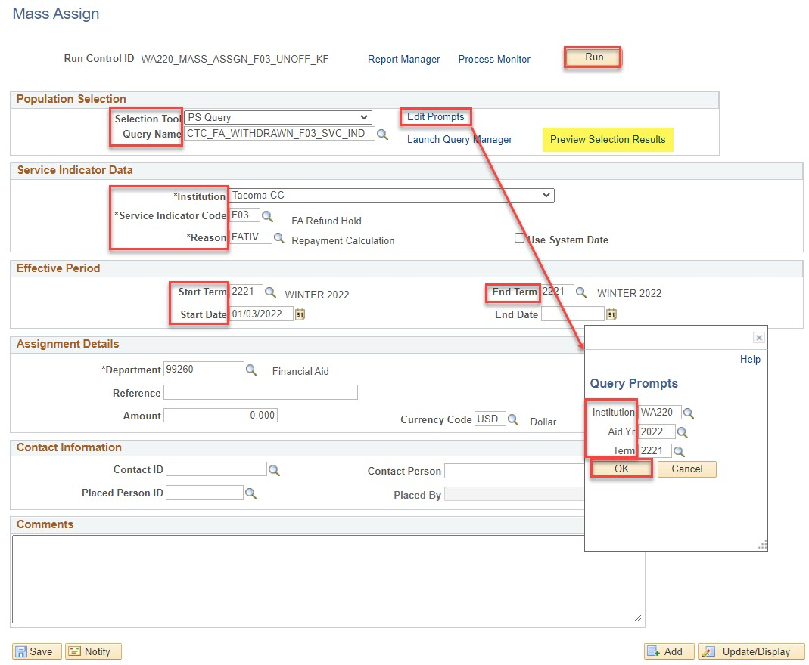
Mass assign f03 service indicator
CTC_FA_WITHDRAWN_F03_SVC_IND
Navigation: Nav Bar > Navigator > Campus Community > Service Indicators (Student) > Mass Assign
This specific query is to be run before grades post . . .
Review the R2T4 Processing Guide for a query to run after grades post.

Slide 13
SERVICE INDICATOR LIST QUERY

Slide 14
Fa term (batch)
2-STEP PROCESS
Step 1: Mass Assign F03 (Refund Hold) SI
Query by F03 Service Indicator

Slide 15
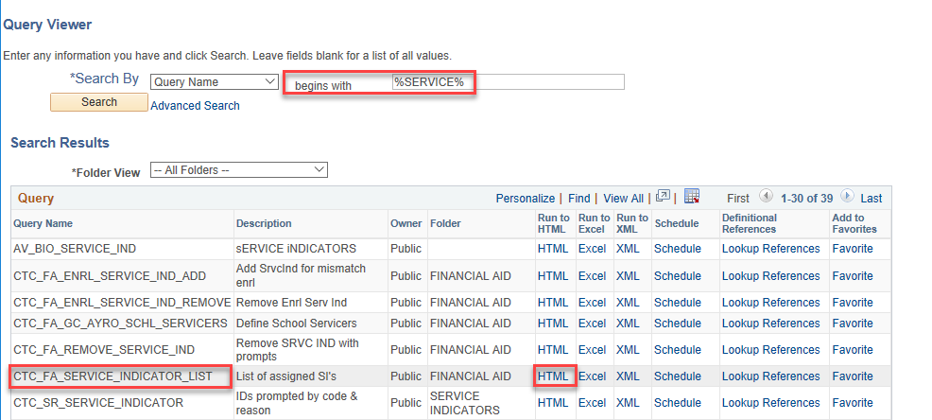
R2t4 processing cont’d
RUN SERVICE INDICATOR LIST QUERY
Navigation: Nav Bar > Navigator > Reporting Tools > Query > Query Viewer

Slide 16
R2t4 processing cont’d
RUN SERVICE INDICATOR LIST QUERY

Slide 17
REVIEWING LDA

Slide 18
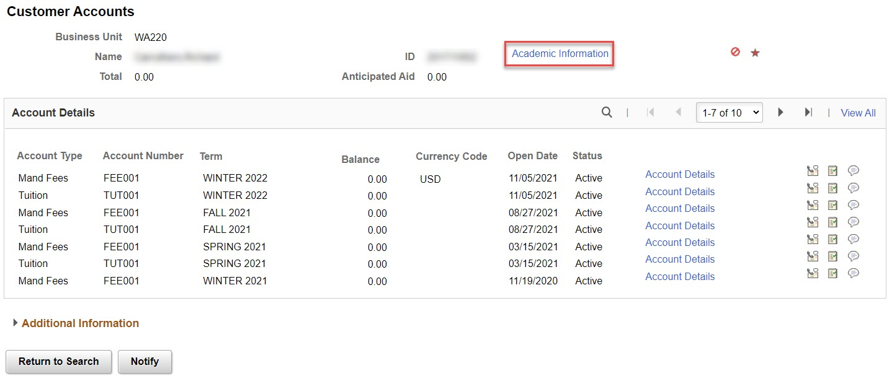
VIEW CUSTOMER ACCOUNTS
REVIEWING LDA
Navigation: Nav Bar > Navigator > Student Financials > View Customer Account

Slide 19
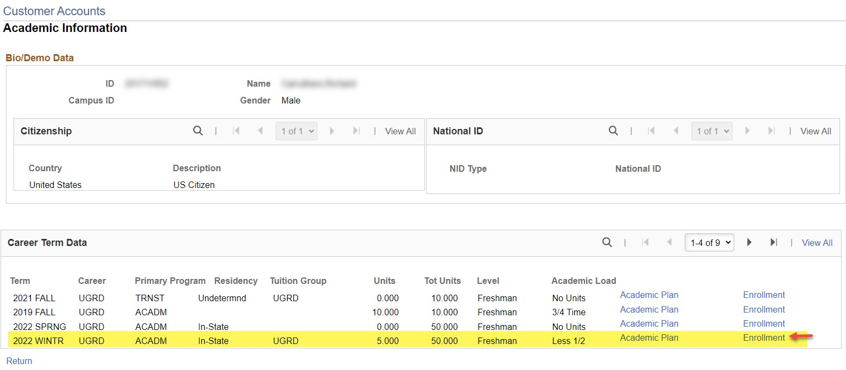
VIEW CUSTOMER ACCOUNTS
REVIEWING LDA CONT’D

Slide 20
VIEW CUSTOMER ACCOUNTS
REVIEWING LDA CONT’D

Slide 21
IDENTIFYING POST-WITHDRAWAL DISBURSEMENT STUDENTS

Slide 22
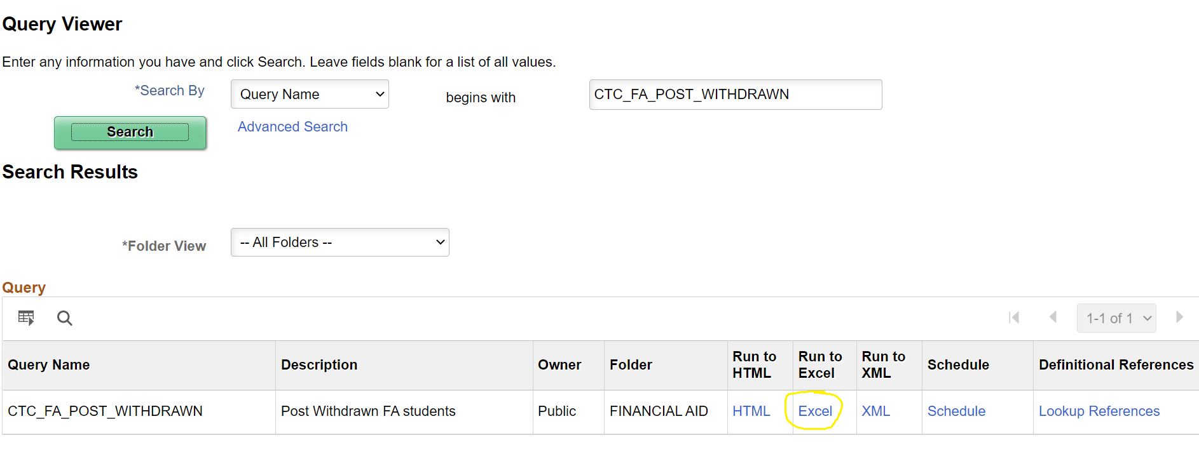
R2t4 processing cont’d
POST-WITHDRAWAL DISBURSEMENT QUERY
Navigation: Nav Bar > Navigator > Reporting Tools > Query > Query Viewer

Slide 23
ADJUST AND UNDISBURSE

Slide 24
Adjust aid & undisburse aid cont’d
Navigation: Nav Bar > Navigator > Financial Aid > Return to Title IV Funds
Notes:
Find the value in row I – TIV aid earned and add this to the amount awarded in the Assign Awards to a Student page for the term.

Slide 25
Adjust aid & undisburse cont’d
Navigation: Nav Bar > Navigator > Financial Aid > Awards > Award Processing > Assign Awards to a Student

Slide 26
Adjust aid & undisburse aid cont’d
Notes:
Find the value in row I – TIV aid earned and add this to the amount awarded in the Assign Awards to a Student page for the term.

Slide 27
Adjust aid & undisburse aid cont’d
Navigation: Nav Bar > Navigator > Financial Aid > Disbursement > Disburse Aid
Before – select Authorize and Disburse and the new amount the student earned will reflect in the Auth & Disb rows.
After – the amount of Pell the student earned is now reflected in Auth & Disb, and also in View Customer Accounts

Slide 28
Adjust aid & undisburse aid cont’d
Navigation: Nav Bar > Navigator > Student Financials > View Customer Accounts
The correct amount of Pell the student earned now reflects in View Customer Accounts. Contact SF to set the amount the student now owes.

Slide 29
Demonstration

Slide 30
REVIEWING
CUSTOMER ACCOUNT

Slide 31
Demonstration

Slide 32
ASSIGN F05
SERVICE INDICATOR

Slide 33
F05 service ind ASSIGNMENT CONT’D
MANUALLY ASSIGN F05 SERVICE INDICATOR
Navigation: Nav Bar > Navigator > Campus Community > Service Indicator (Student) > Manage Service Indicators

Slide 34
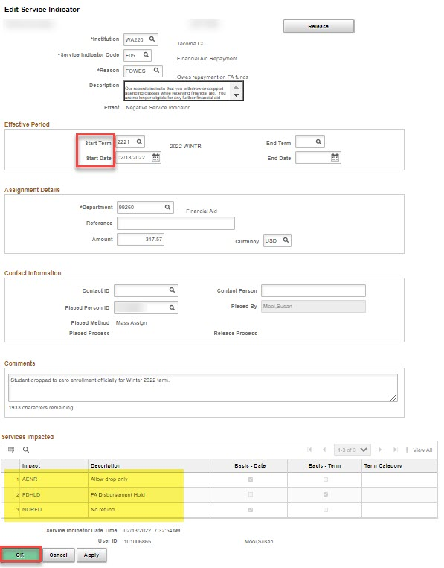
F05 service ind ASSIGNMENT CONT’D
MANUALLY ASSIGN F05 SERVICE INDICATOR
Navigation: Nav Bar > Navigator > Campus Community > Service Indicator (Student) > Manage Service Indicators
Note: Service Impacts can be different for each institution

Slide 35
Demonstration

Slide 36
Outcomes
At training completion, you should be able to:
Identify students to be reviewed for R2T4 by Mass Assigning F03 Service Indicator
Understand what the two different F03 queries pull and when to run them
Understand where in ctcLink you can determine last date of academic related activity or last date of attendance
Understand how to identify post-withdrawal disbursement students
Reduce aid and undisburse/redisburse
Review Customer Account
Add a F05 Service Indicator

Slide 37
Congratulations!
Training for R2T4 Processing is complete!
Please review the R2T4 Processing Guide before processing
Thank you for your participation today!

