Slide 1
Top 10 Loan Rejects and Troubleshooting

Slide 2
Presenters
Lorena Saucedo
Assistant Director
Susan Mooi
Program Specialist

Slide 3
Top 10 Loan Rejects
Citizenship
HS Diploma
Address Incomplete
Consortium Agreement
Program Plan Stack
Loan Limits
Duplicate Match on CPS
Expected Graduation Date
Funds not Recorded on the System
Questions

Slide 4
Before we start our presentation, I just want to say, we are Lucky we are not dealing with Sequestration and Sula.

Slide 5
TCC’S Loan Process
Award Loans Up Front
Student Accept, Decline, Reduce Loans on line thorough the Student Center
Advisors will cancel any loans if not for the entire year, Proration
Not enough Need may not Award up front
Once the loan is originated (DL Out) Checklists are Track
Communication goes to the student indicating any requirements
Direct Loan Entrance Counseling or MPN
Once the loans disbursed to the student’s account Origination goes out to Flipped DRI to True.
Every term runs a query to look for loans not accepted that may need cancelation, like fall only for instance.

Slide 6
Citizenship/ Invalid Student’s Citizenship

Slide 7
Citizenship / Invalid Student’s Citizenship
In COD
Check on Rejected
Filter by the Status
Apply Filter

Slide 8
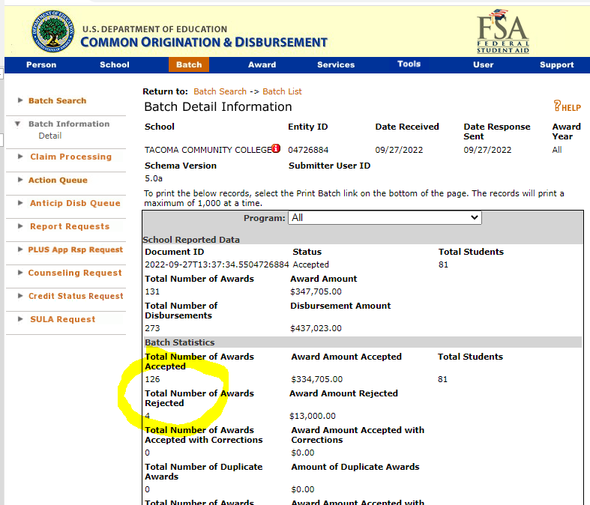

Slide 9
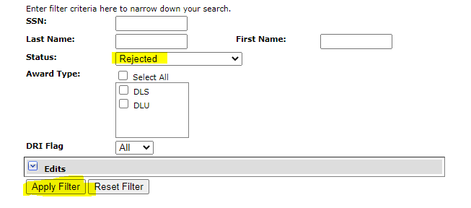

Slide 10
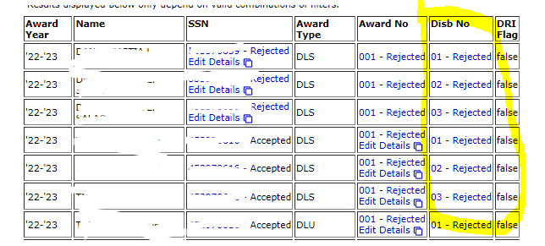
Will Check for any rejects in Cod before bringing the File back to PS

Slide 12
Navigation: NavBar > Navigator > Financial Aid > Loans > Direct Lending Reconciliation > Loans on Hold Report
Once you bring files back run the loans on Hold Report. I use the same Run Control as with my DL Inbound/ Outbound Process.
Be sure you are running it for the right year.
Check why loan is rejecting, for ex. Citizenship. We check our main FA Status page to see if the student submitted documents.
If they did and everything looks good, we proceed to Override, Release the Loan from HOLD, Activate change, Update Origination and send to COD with our next DL Out. Next slide…

Slide 13
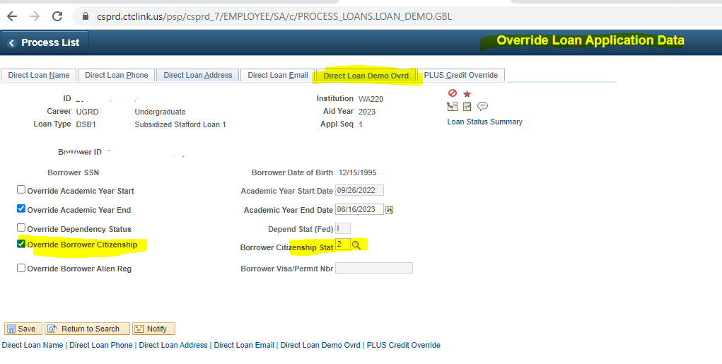
Check Invalid Student’s Citizenship
Navigation: NavBar > Navigator > Financial Aid > Loans > Direct Lending Management > Override Loan Application Data >

Slide 14
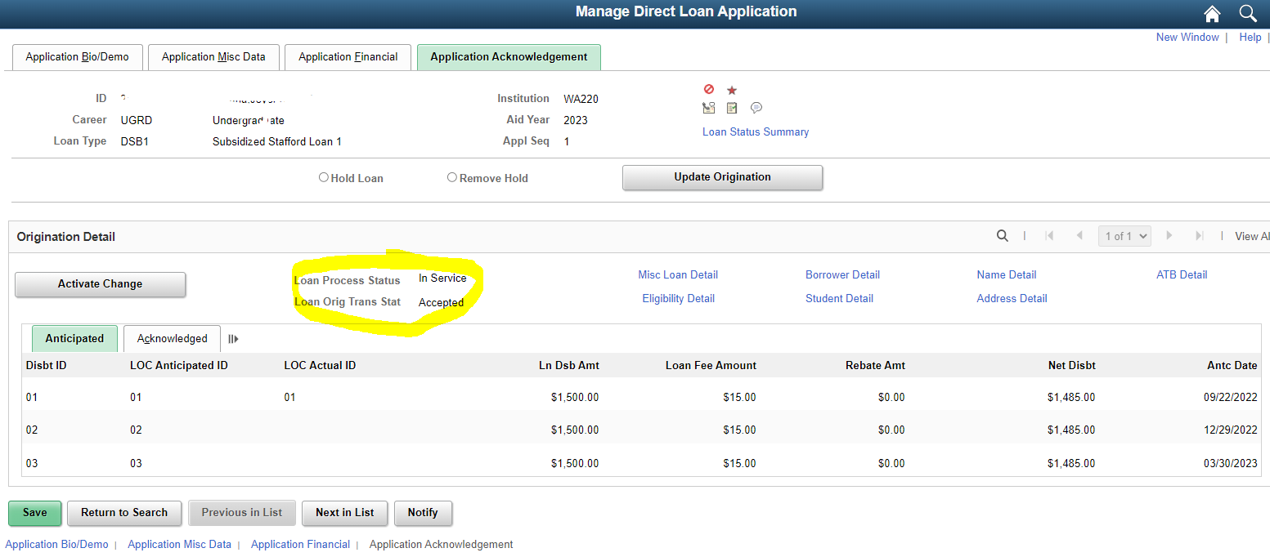
Navigation: NavBar > Navigator > Financial Aid > Loans > Direct Lending Management > Manage Direct Loan Application (MDLA Page) remove Loan from hold

Slide 15
HS Diploma, GED, ATB

Slide 16
HS Diploma Rejects
Navigation: NavBar > Navigator > Financial Aid > Ability to Benefit > Manage Ability To Benefit

Slide 17
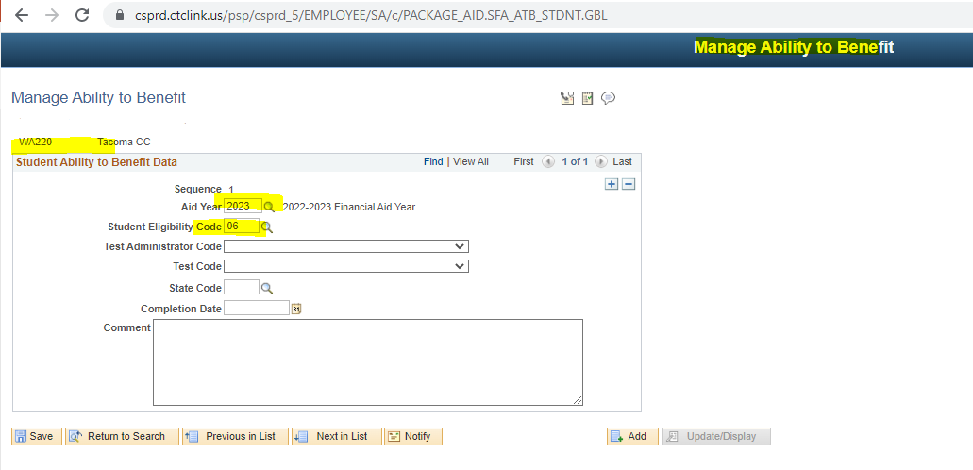

Slide 18
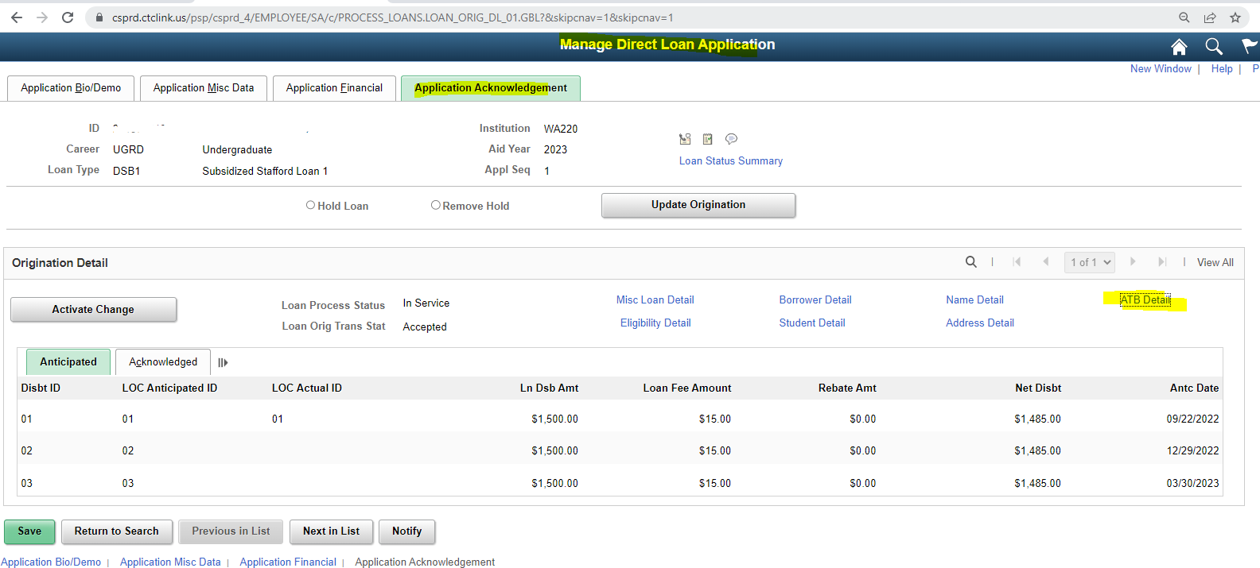
After corrections are made, come to the MDLA Page, Activate change, Update Origination, Save

Slide 19
Student Address is Incomplete

Slide 20
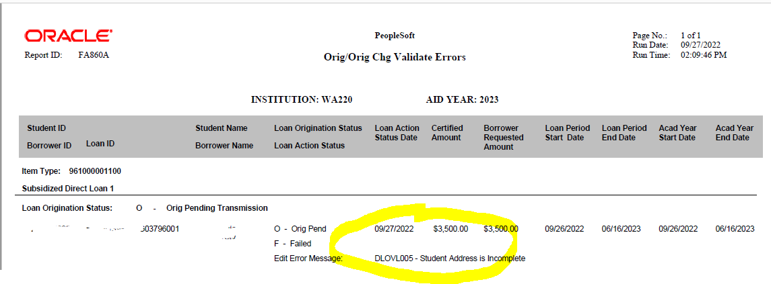

Slide 22
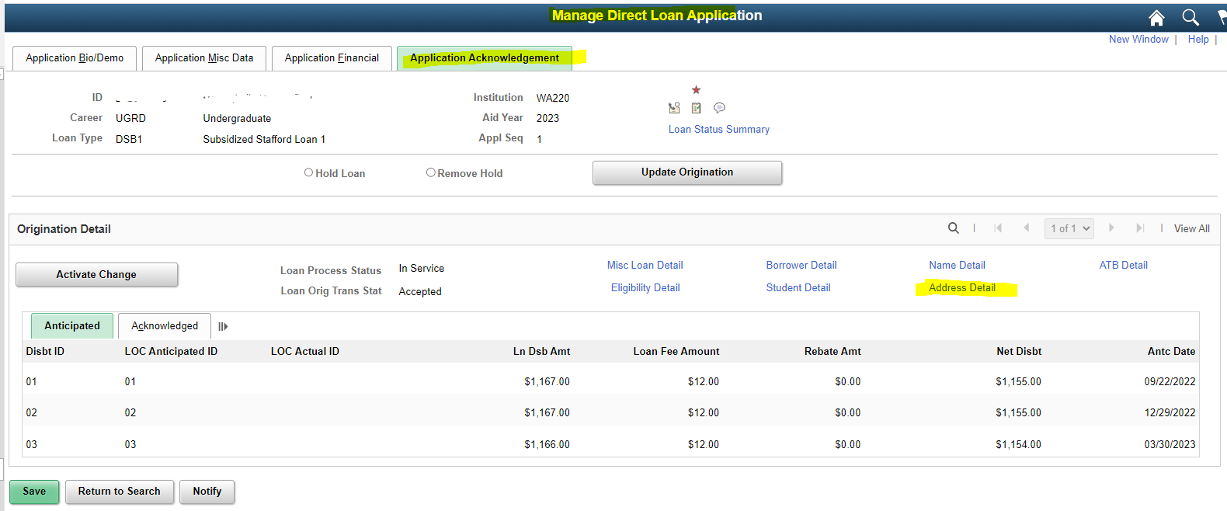
Remember to Activate change & Update Origination

Slide 23
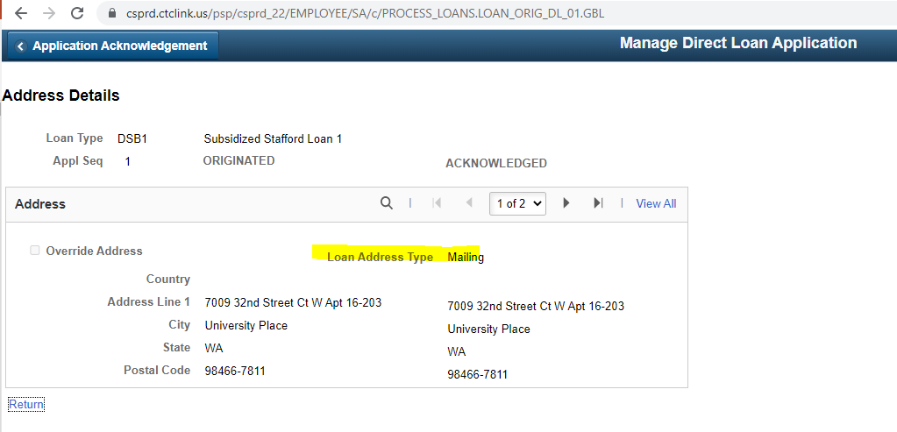
Whenever you get the Invalid Address, have the enrollment services update the address to Home or Mail, Activate change on the MDLA page, Update Origination and Process loans for the student. It should get pick next time you do a DL Out.

Slide 24
Consortium Agreements

Slide 25
Enrollment Status is Invalid
Comments
At this time only one person is doing Cosortium agreements at TCC and she is good at adding comments for anyone to know what is going on.
Override- FA Term
Be sure to OV FA Term to reflect the amount of credtis student is enrolled for in total before making any updates or changes on the MDLA/SULA page

Slide 26
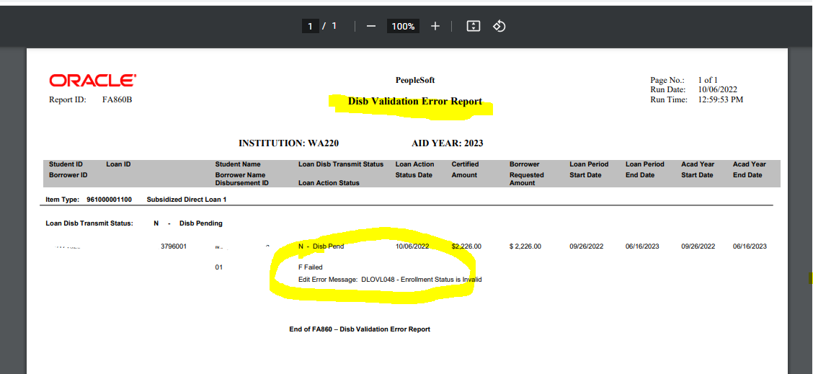
Consortium Agreements Student is enrolled in less than half time at your school. FA Term has to be Overridden

Slide 27
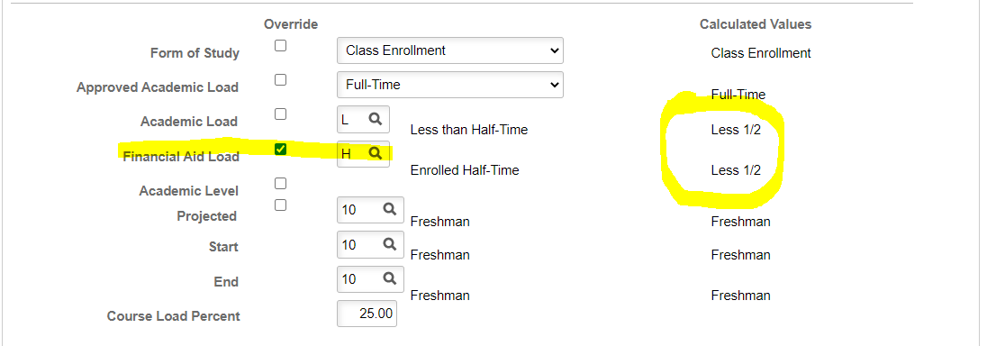
Navigation: NavBar > Navigator > Financial Aid > Financial Aid Term > Maintain Student FA Term

Slide 28
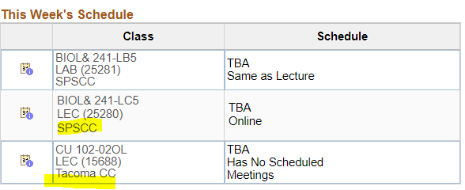
A picture is worth a thousand words
On top of adding comments on the FA Page you can also check actual enrollment under the Student Services Ctr.

Slide 29
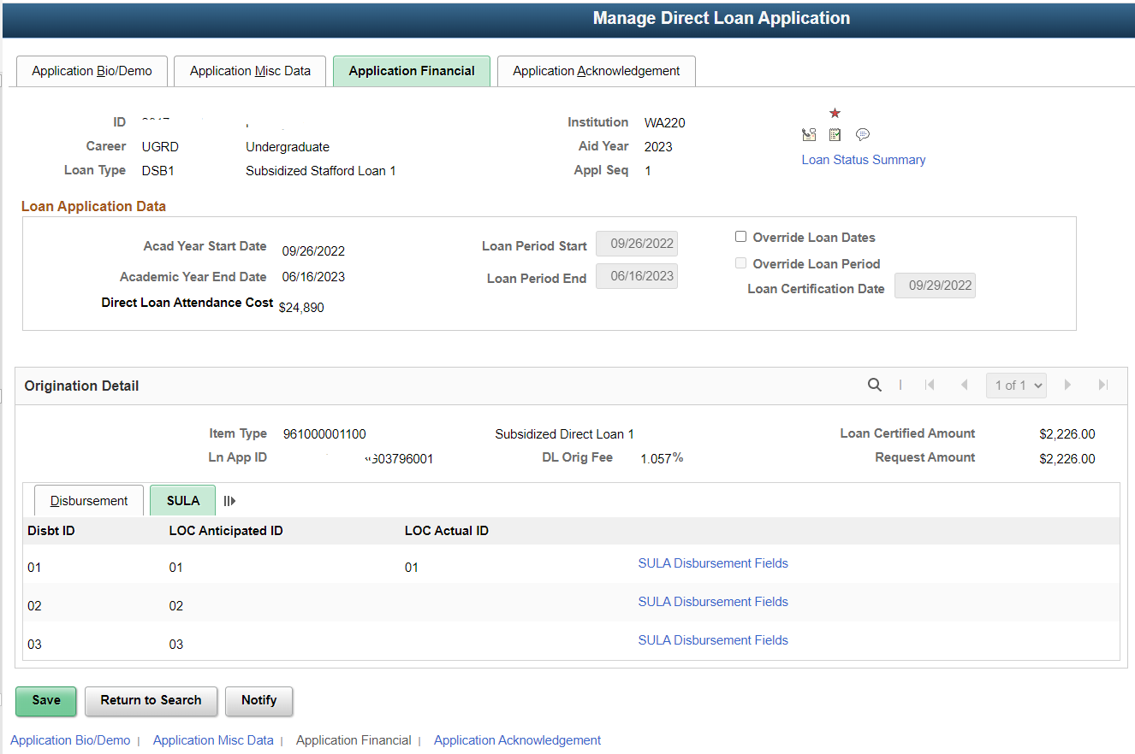

Slide 30
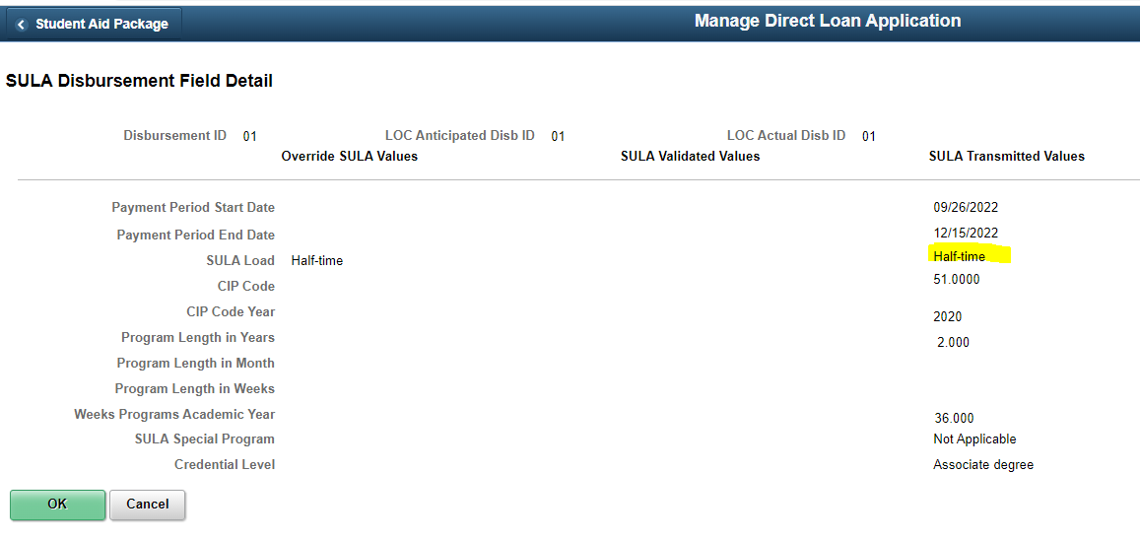
SULA Page on the MDLA Needs to be updated to Current enrollment.

Slide 31
Program Plan Stack

Slide 32
When Enrollment adds new programs, they should let FA know so that way FA can update the SULA Credential Cross Reference page. Once the cross reference has been updated, you would update origination and activate change on each student's MDLA page. Then run process loans for those students. Process Loans sets up the data. To verify that the data gets pushed to their proper places, you could run DL Out in validate mode. Once satisfied, run DL Out in final.

Slide 33
If records has added FA Eligible programs this table will need to be periodically updated to include the new programs so the information is accurately submitted to COD. You will need to update the table with the new program plan. Navigation: Main Menu > Set Up SACR > Product Related > Financial Aid > COD > Credential Cross Reference You’ll want to make sure you are updating for the 2023 aid year. You can select Retrieve with Caution from Acad Plan at the top of the page. Once you have verified that Program has been added to the list, select Save. From there you should be able to click “Update Origination” and "Activate Change" on the MDLA page and Save, then process loans for those students.

Slide 35
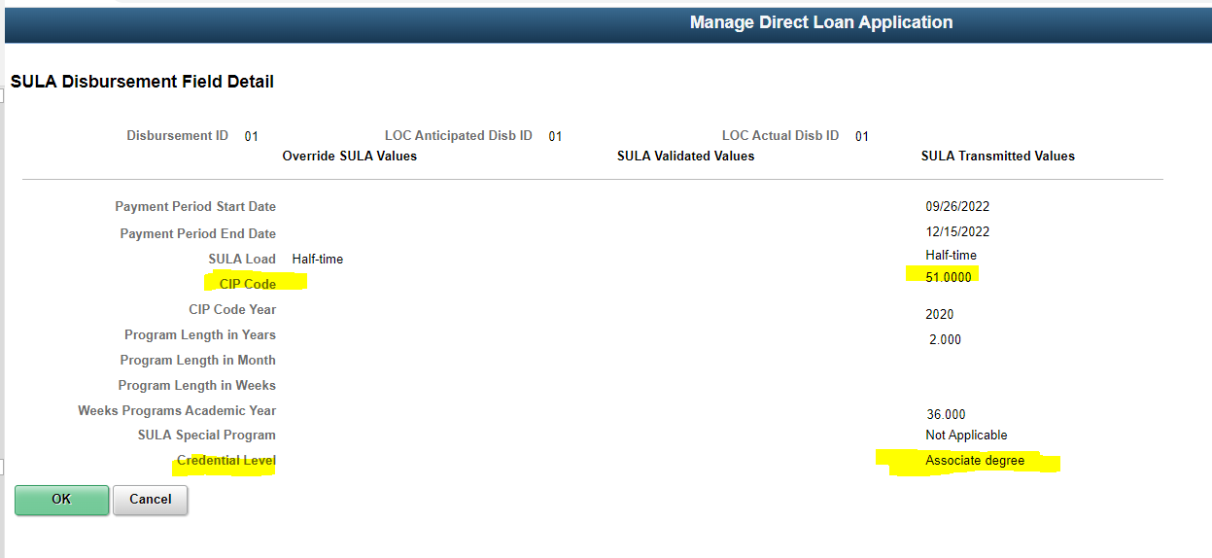
New Program Plan Stack will display in here with CIP Code information under the SULA Filed

Slide 36
Loan Limits (Transfer Students)

Slide 37
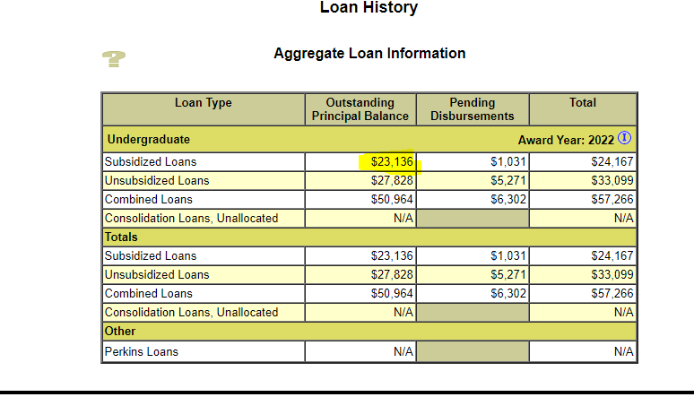
New ISIR was received with the message Loan Exceed the limits

Slide 38
Try to Check the ISIR Suspense list as often as you can
Original Loan was canceled to prevent n Over Award situation. New loan was added with correct amounts.

Slide 39
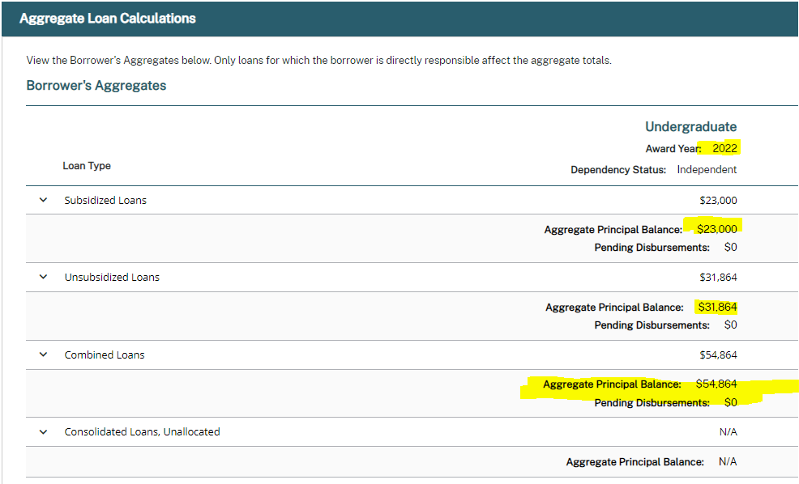
New amounts on NLSDS After the corrections to the loans were made.

Slide 40
Duplicate Match on CPS

Slide 41
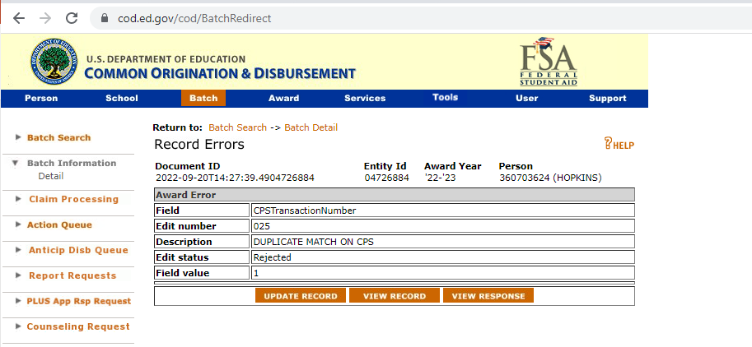

Slide 42
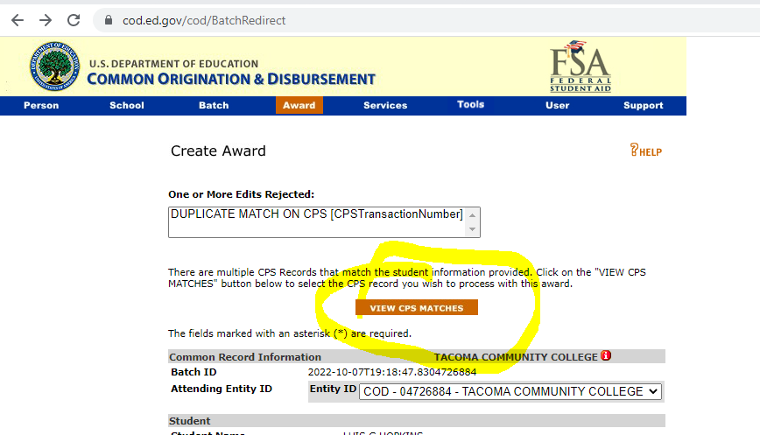

Slide 43
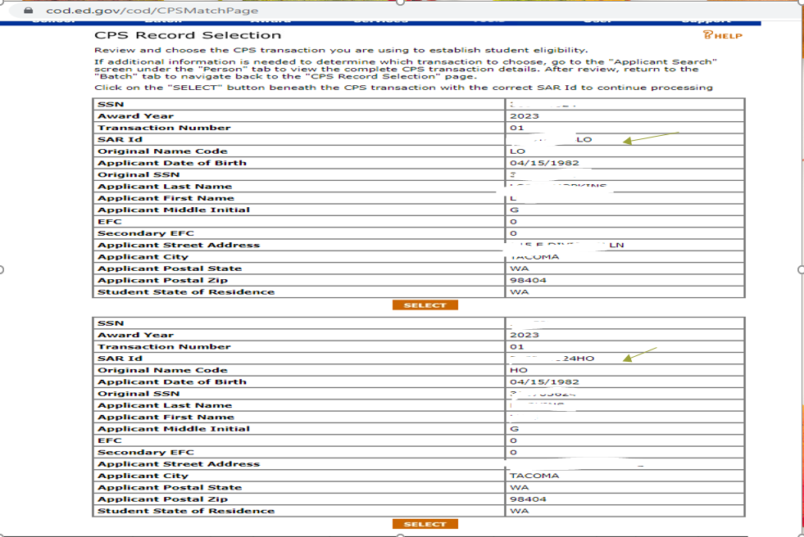

Slide 44
The following is the correct procedure in COD to fix an Edit 025 for a Duplicate Match on COD:
1. Click on “Batch” in the blue navigation bar at the top of the page.
2. Enter the Student’s Social Security Number (SSN) in the SSN field.
3. Select the appropriate Award Year.
4. Click “Search”.
5. Batches that match the search criteria will display.
6. Select Status “Rejected” to filter search results.
7. Locate the rejected record based on search criteria.
8. Click on the word “Rejected” in the “Award No” column.
9. Click on “Update Record”.
10. Click on “View CPS Transactions”.
11. Click the “Select” button to choose the correct CPS Transaction for the student.
12. Click “Submit”.

Slide 45
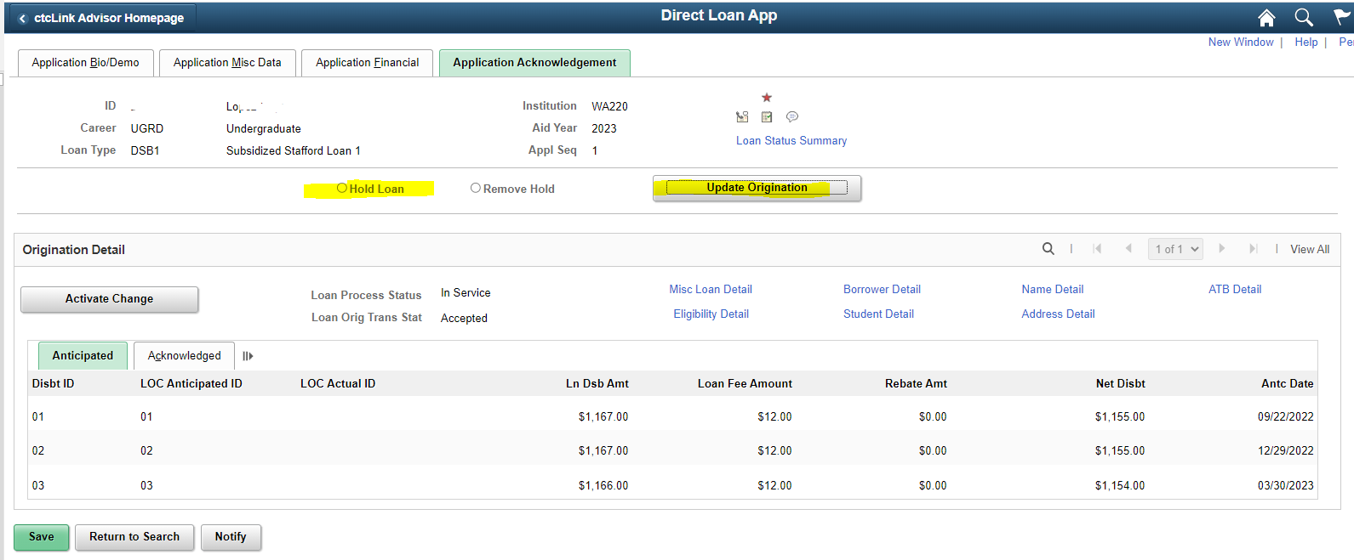
Loan will go out next time you send an Outbound file
On the MDLA page, remove the loan(s) from hold and update origination.

Slide 46
Expected Graduation Date

Slide 47
Records and Enrollment will add the Expected Graduation date
Student Services Center/ Academic Tab
Expected graduation date
Check the Assign Awards to Students/ Term Summary Tab/ if listed there, the loan may reject

Slide 48
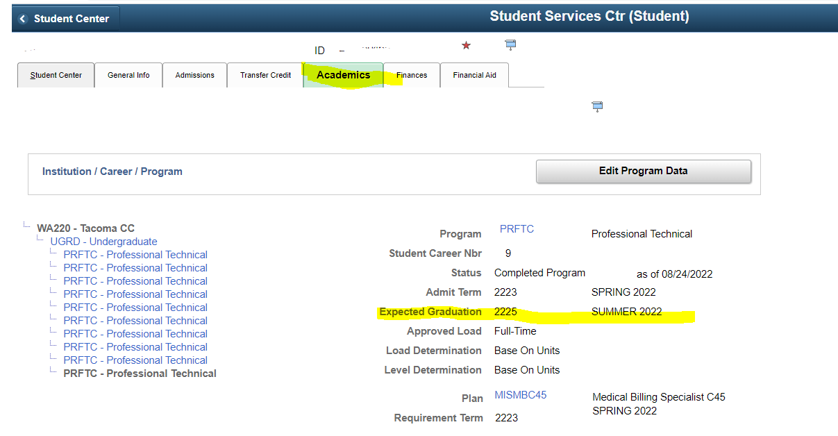

Slide 49
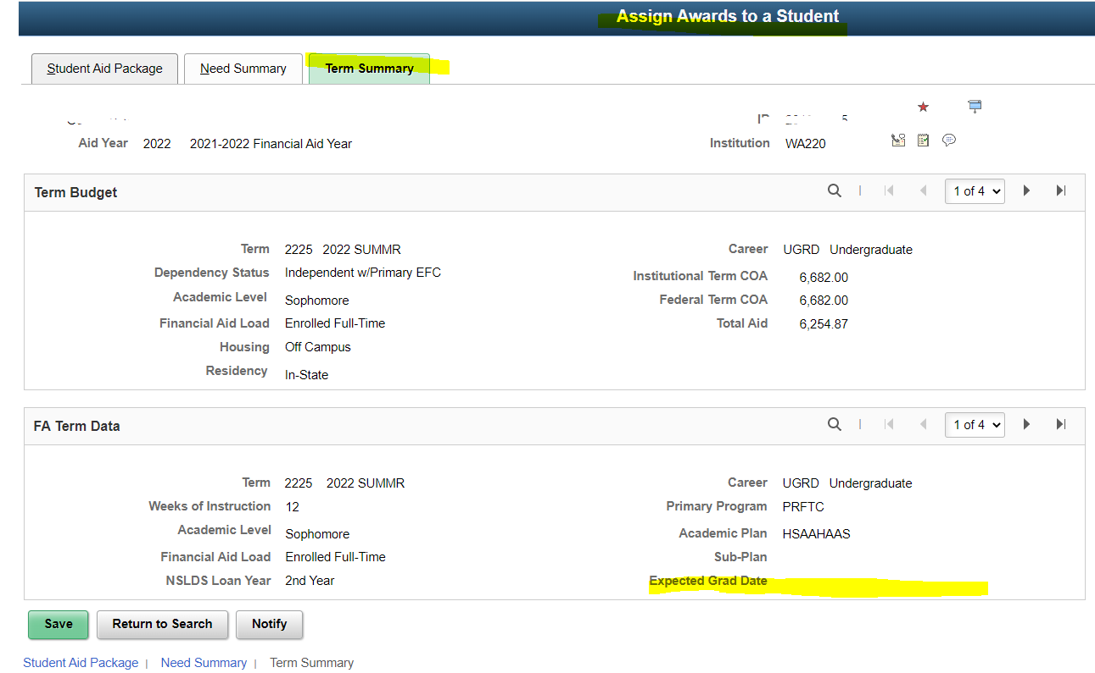

Slide 50
Funds not Recorded on the System

Slide 51
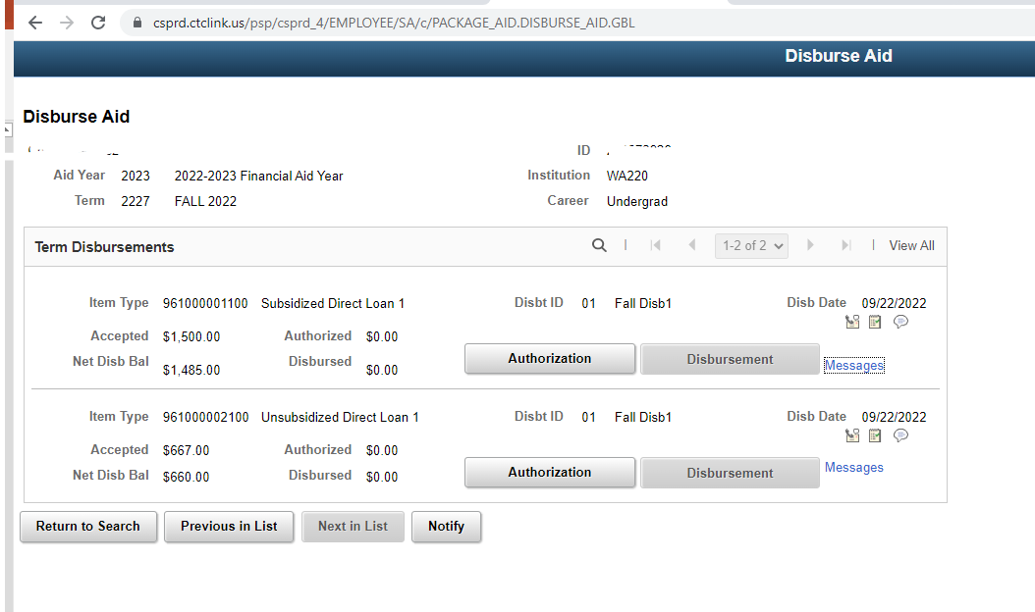

Slide 52
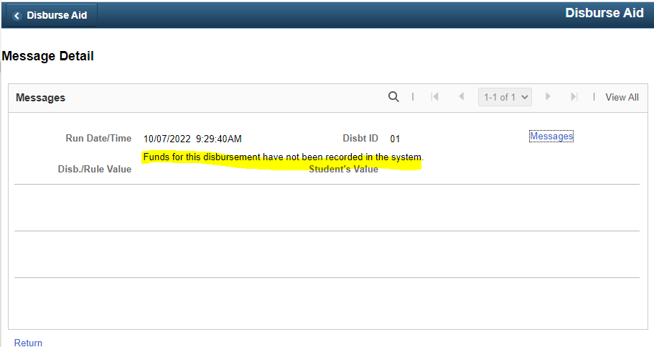
Usually this means is a brand new loan and funds area not recorded or the student is missing a MPN.

Slide 53
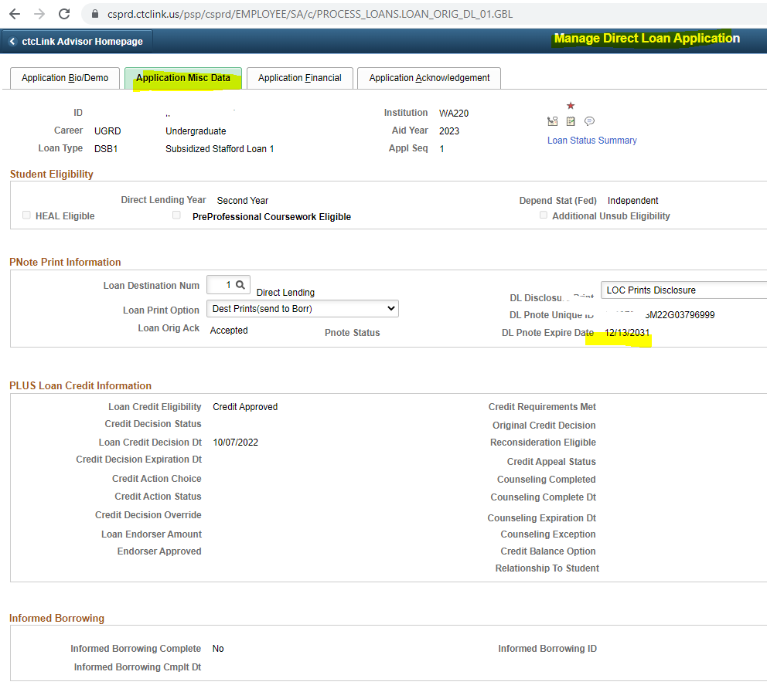
Student did complete MPN so is a new loan we just need to complete checklists and release funds.

Slide 54
Thanks!
Any questions?
You can find us at
lsaucedo@tacomacc.edu
smooi@tacomacc.edu

