Slide 1
Top 10 Loan Rejects and Troubleshooting

Slide 2
Presenters
Lorena Saucedo
Assistant Director
Susan Mooi
Program Specialist

Slide 3
Top 10 Loan Rejects
Citizenship
High School Diploma
Address Incomplete
Consortium Agreement
Program Plan Stack
Federal Loan Limits
Duplicate Match on CPS
Expected Graduation Date
Funds not Recorded on the System
Questions

Slide 4
Before we start our presentation, I just want to say, we are Lucky we are not dealing with Sequestration and Sula.

Slide 5
TCC’S Federal Loan Process
Federal loans are offered up front during packaging
Student can Accept, Decline, or Reduce Loans online via Student Homepage
Advisors will cancel any loans if not awarded for the entire year such as Proration, not enough FA Need, received other aid such as Workforce Education, Scholarship, and Veteran funding
Once the loan is originated (DL Out) Checklists are assigned
Communication goes to the student indicating any federal requirements
Federal Direct Loan Entrance Counseling or Master Promissory Note (MPN)
Once the loans are disbursed to the student’s account, the Origination goes out to Flipped Disbursement Release Indicator (DRI) to True

Slide 6
Citizenship/ Invalid Student’s Citizenship

Slide 7
Citizenship / Invalid Student’s Citizenship
In COD
Check on Rejected
Filter by the Status
Apply Filter

Slide 8
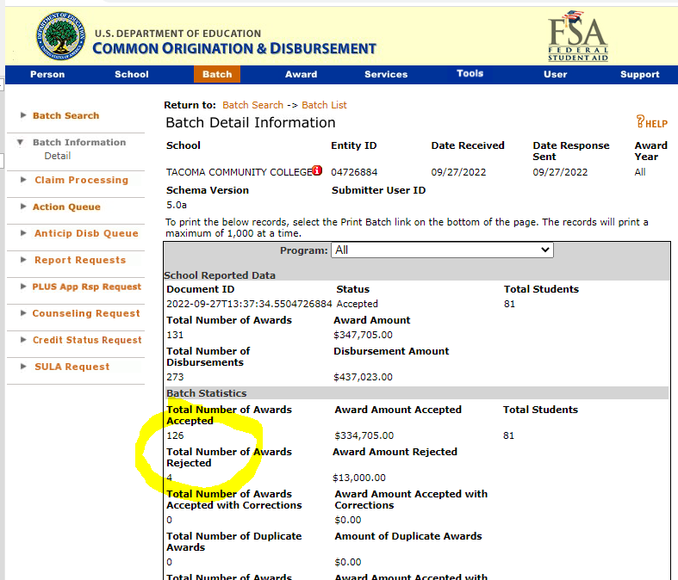

Slide 9
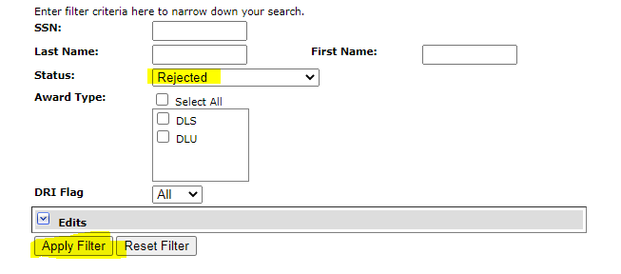

Slide 10
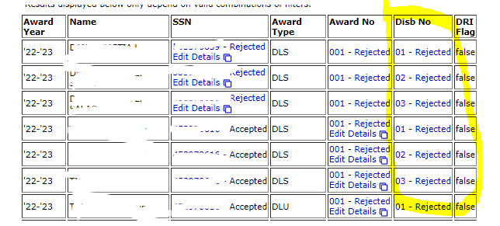
Will Check for any rejects in Cod before bringing the File back to PS

Slide 12
Navigation: NavBar > Navigator > Financial Aid > Loans > Direct Lending Reconciliation > Loans on Hold Report
Once files are brought back, run the loans on Hold Report. I use the same Run Control as with my DL Inbound/Outbound Process.
Be sure to run it for the right year.
Check why federal loan is rejecting, for example, Citizenship
We check the View FA Status page to see if the student submitted documentation for citizenship.
If they did and everything looks good, we proceed to Override, Release the Loan from HOLD, Activate change, Update Origination and send to COD with our next DL Out. Next slide…

Slide 13
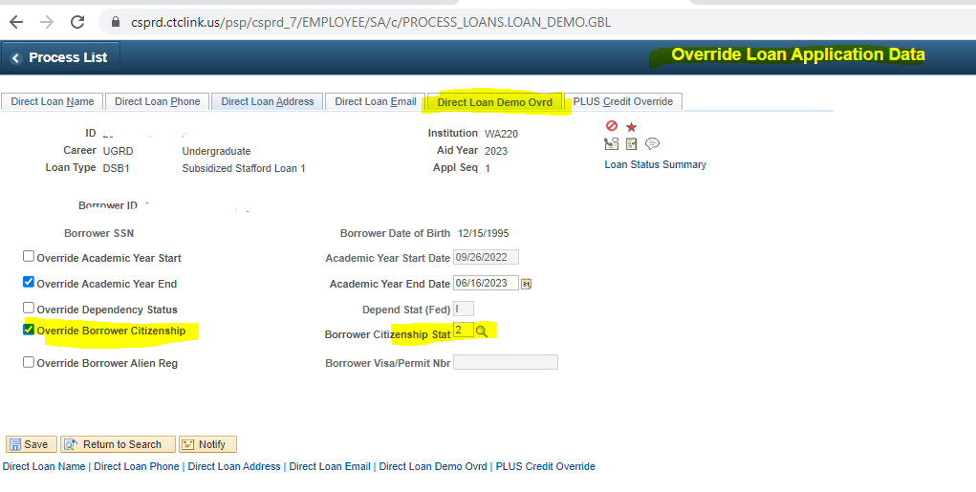
Check Invalid Student’s Citizenship
Navigation: NavBar > Navigator > Financial Aid > Loans > Direct Lending Management > Override Loan Application Data >

Slide 14
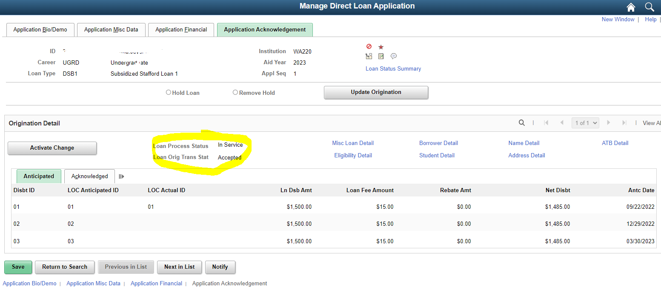
Navigation: NavBar > Navigator > Financial Aid > Loans > Direct Lending Management > Manage Direct Loan Application (MDLA Page) remove Loan from hold

Slide 15
HS Diploma, GED, ATB

Slide 16
High School Diploma Rejects
Navigation: NavBar > Navigator > Financial Aid > Ability to Benefit > Manage Ability To Benefit

Slide 17
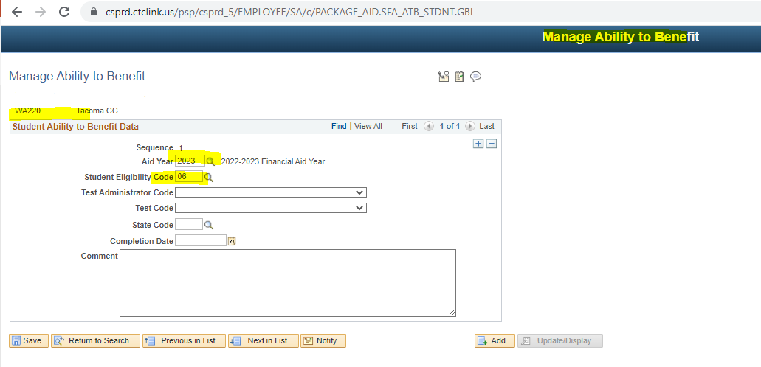

Slide 18
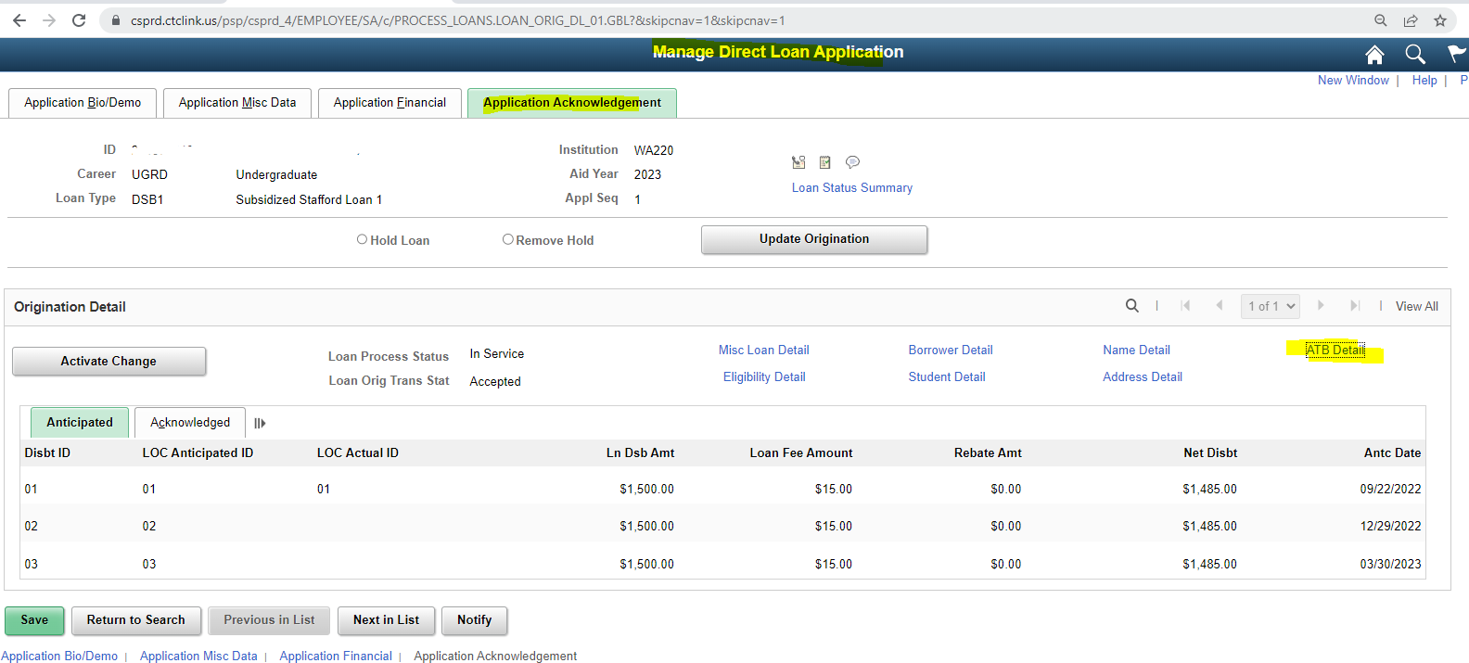
After corrections are made, come to the MDLA Page, Activate change, Update Origination, Save

Slide 19
Student Address is Incomplete

Slide 20
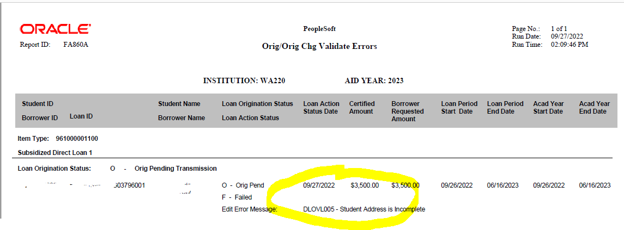

Slide 22
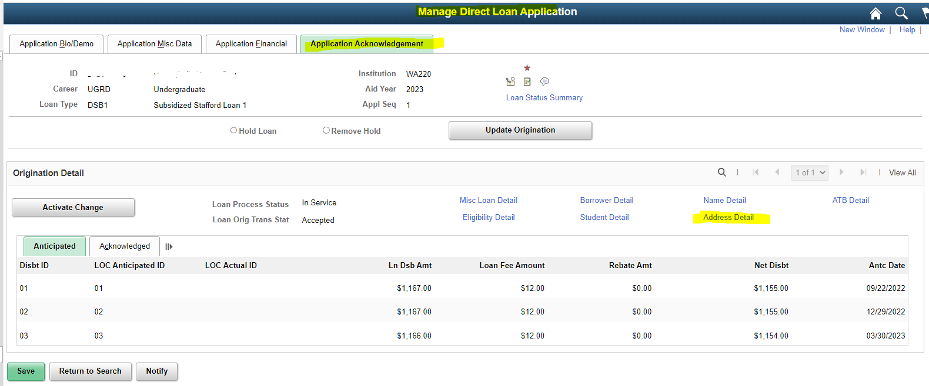
Remember to Activate change & Update Origination

Slide 23
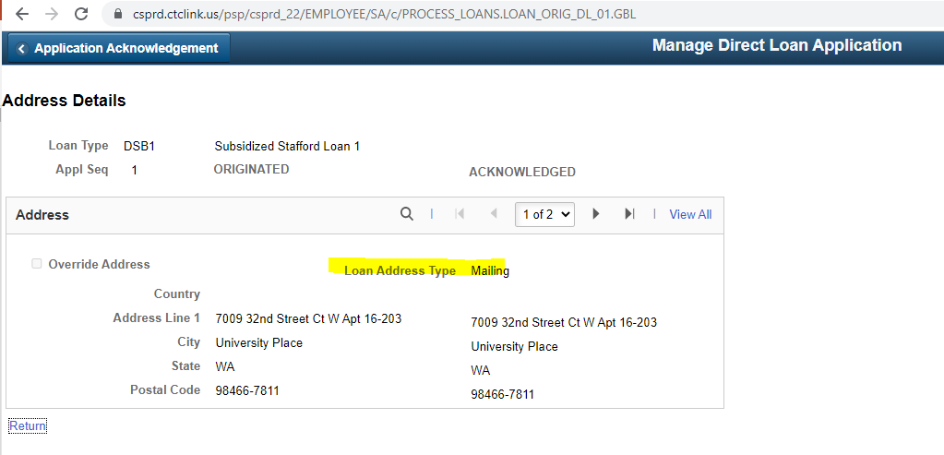
Whenever you get the Invalid Address, have the enrollment services update the address to Home or Mail, Activate change on the MDLA page, Update Origination and Process loans for the student. It should get pick next time you do a DL Out.

Slide 24
Consortium Agreements

Slide 25
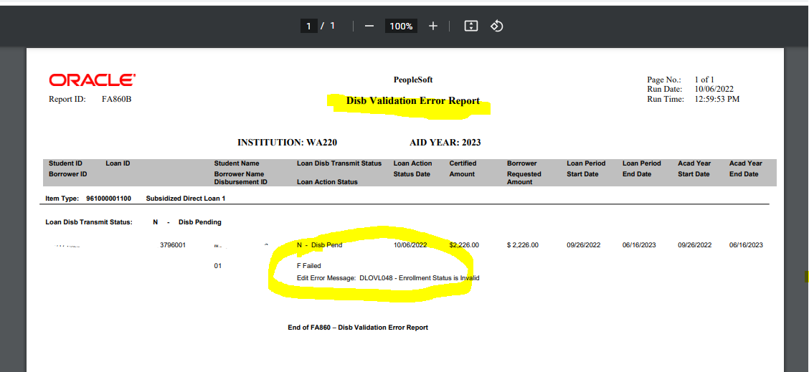
Consortium Agreements Student is enrolled in less than half time at your school. FA Term has to be Overridden

Slide 26
Enrollment Status is Invalid
Comments
At this time only one person is processing Consortium agreements at TCC and do a good job by adding FA comment for staff to view.
Override- FA Term
Be sure to overide FA Term Acad Level tab and select “Financial Aid Load” to reflect the total credits student is enrolled before making any updates or changes on the MDLA/SULA page

Slide 27
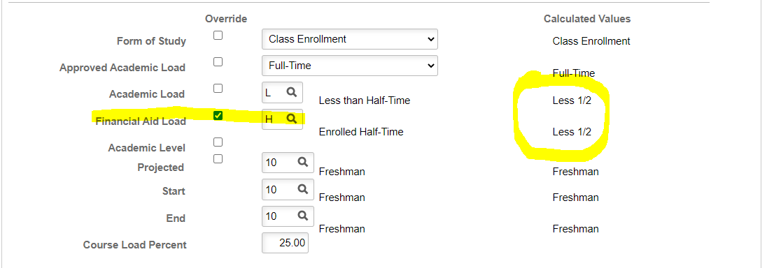
Navigation: NavBar > Navigator > Financial Aid > Financial Aid Term > Maintain Student FA Term

Slide 28
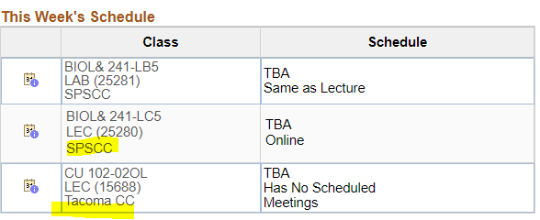
A picture is worth a thousand words
In addition to FA comments on the View FA Status Page, you can also check actual enrollment under the Student Services Center

Slide 29
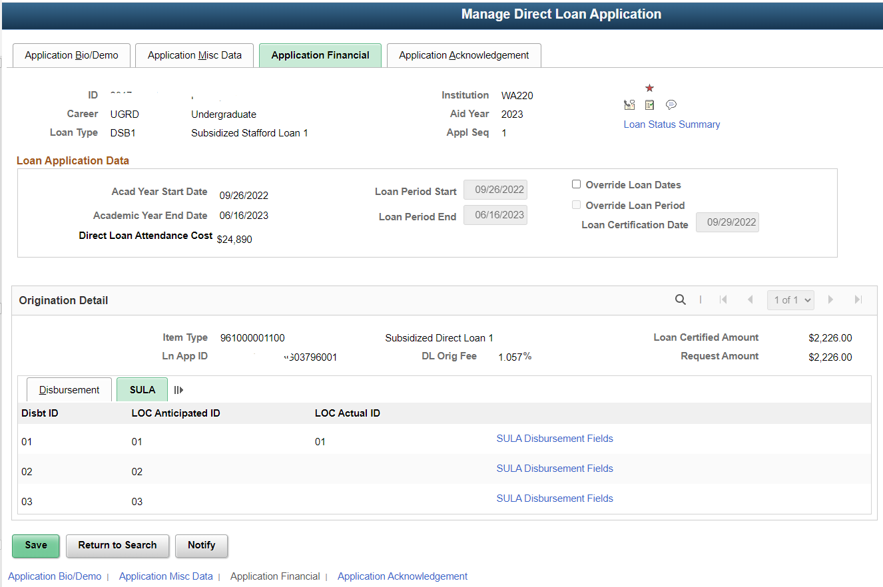

Slide 30
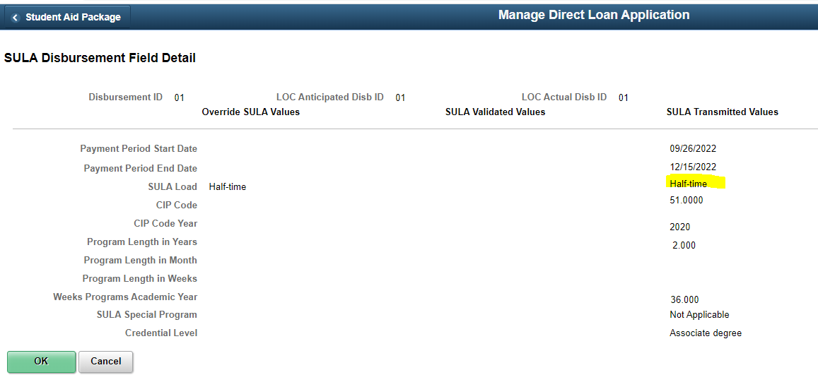
SULA Page on the MDLA Needs to be updated to Current enrollment.

Slide 31
Program Plan Stack

Slide 32
Navigation: Main Menu > Set Up SACR > Product Related > Financial Aid > COD > Credential Cross Reference
When Enrollment Services adds new programs, they should let FA know so that way FA can update the SULA Credential Cross Reference page.
You will want to make sure you are updating for the 2023 aid year. You can select Retrieve with Caution from Acad Plan at the top of the page. Once you have verified that Program has been added to the list, select Save.
Once the cross reference has been updated, you would update origination and activate change on each student's MDLA page.
Then run process loans for those students. Process Loans sets up the data.
To verify that the data gets pushed to their proper places, you could run DL
Out in validate mode.
Once satisfied, run DL Out in final.

Slide 34
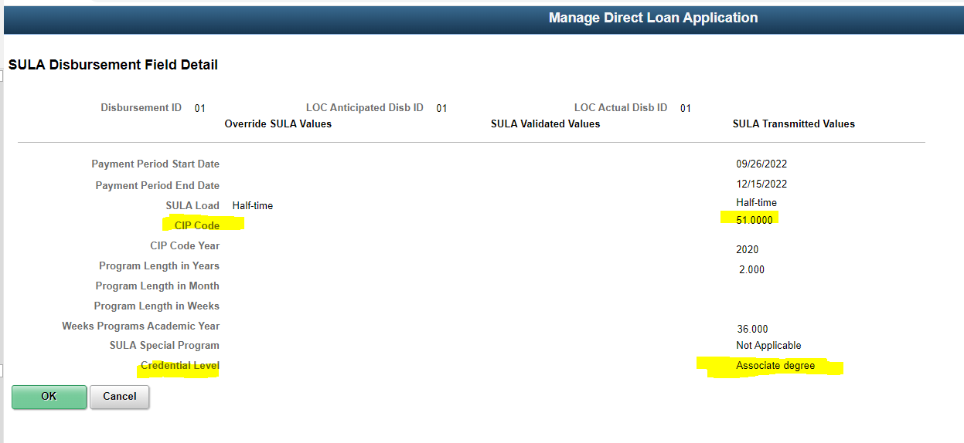
New Program Plan Stack will display in here with CIP Code information under the SULA Filed

Slide 35
Loan Limits (Transfer Students)

Slide 36
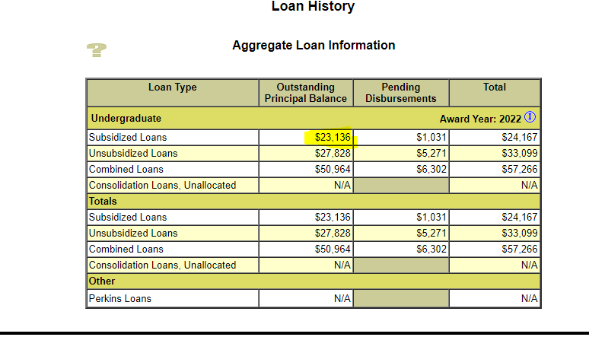
New ISIR was received with the message Loan Exceed the limits

Slide 37
Try to Check the ISIR Suspense list as often as you can
Original Loan was canceled to prevent n Over Award situation. New loan was added with correct amounts.

Slide 38
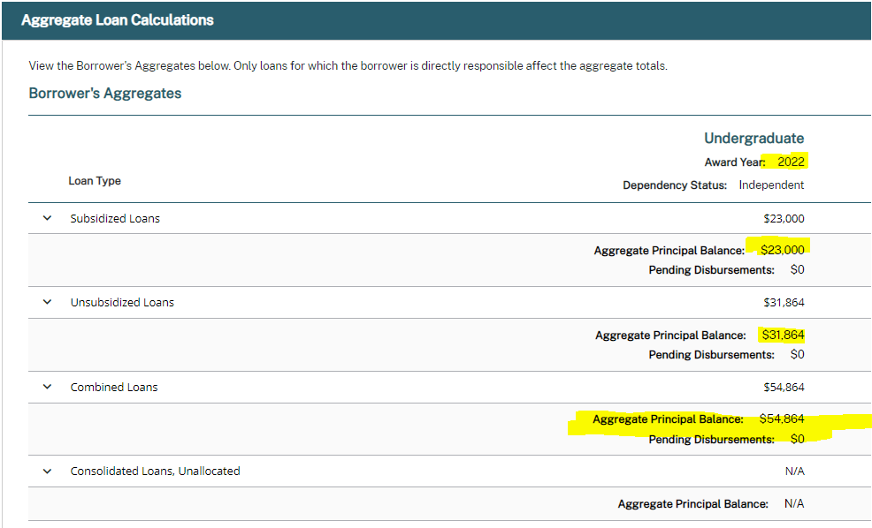
New amounts on NSLDS after the corrections to the loans were made.

Slide 39
Duplicate Match on CPS

Slide 40
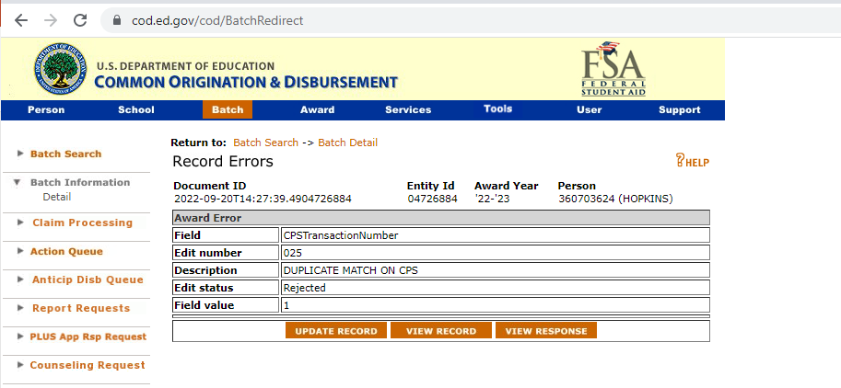

Slide 41
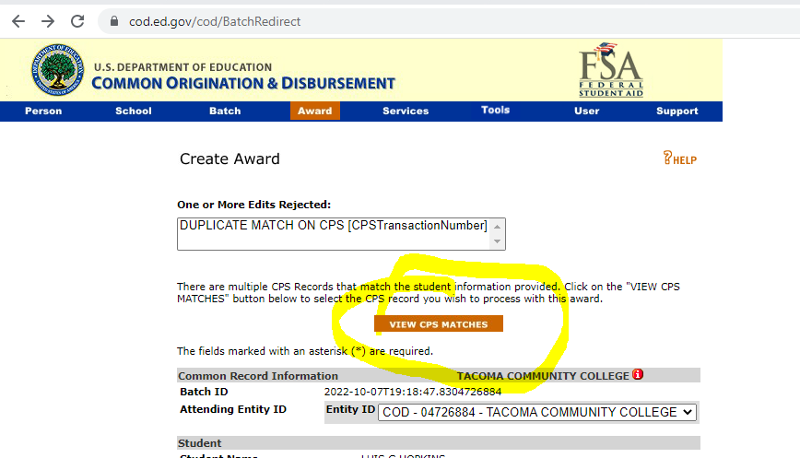

Slide 42
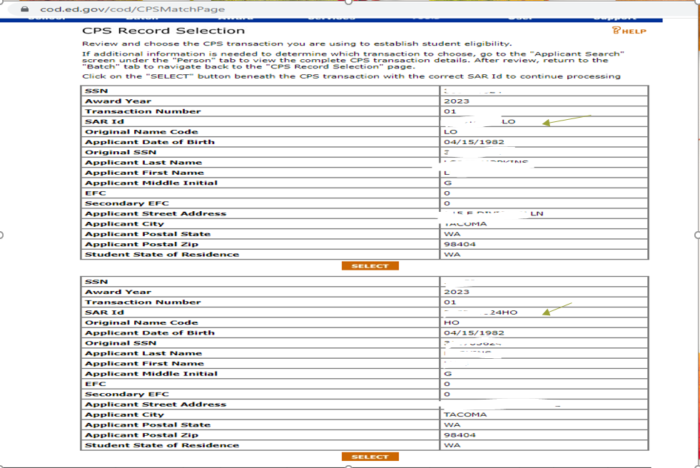

Slide 43
The following is the correct procedure in COD to fix an Edit 025 for a Duplicate Match on COD:
Click on “Batch” in the blue navigation bar at the top of the page
Enter the Student’s Social Security Number (SSN) in the SSN field
Select the appropriate Award Year
Click “Search”
Batches that match the search criteria will display
Select Status “Rejected” to filter search results
Locate the rejected record based on search criteria
Click on the word “Rejected” in the “Award No” column
Click on “Update Record”
Click on “View CPS Transactions”
Click the “Select” button to choose the correct CPS Transaction for the student
Click “Submit”

Slide 44
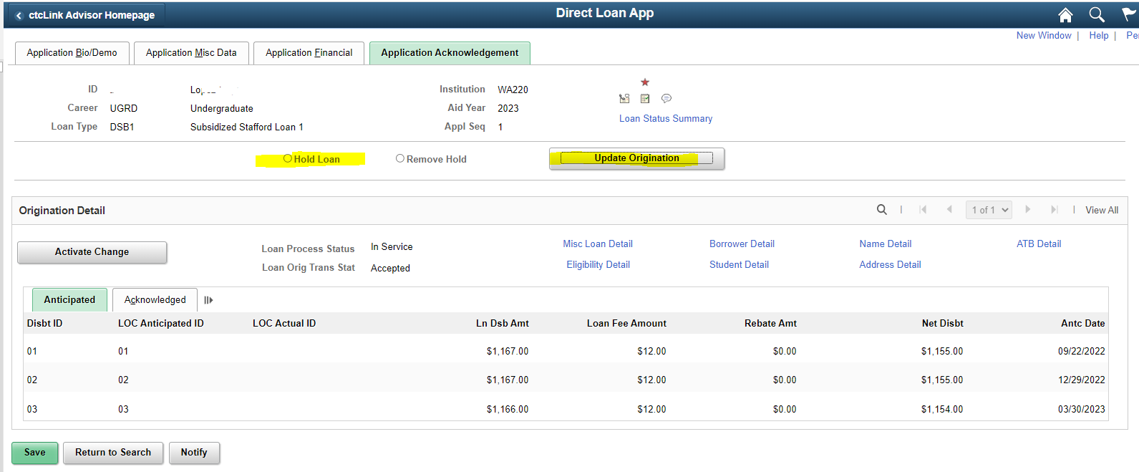
Loan will go out next time you send an Outbound file
On the MDLA page, remove the loan(s) from hold and update origination.

Slide 45
Expected Graduation Date

Slide 46
Records and Enrollment will add the Expected Graduation date
Student Services Center/ Academic Tab
Expected graduation date
Check the Assign Awards to Students/ Term Summary Tab/ if listed there, the loan may reject

Slide 47
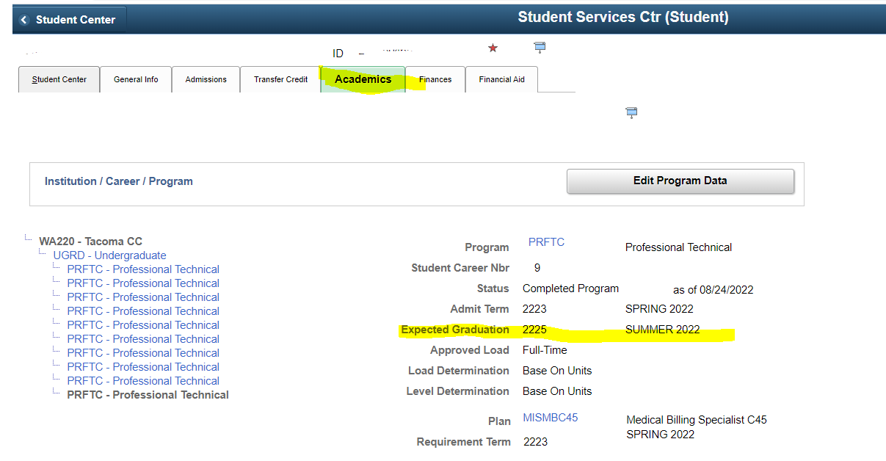

Slide 48
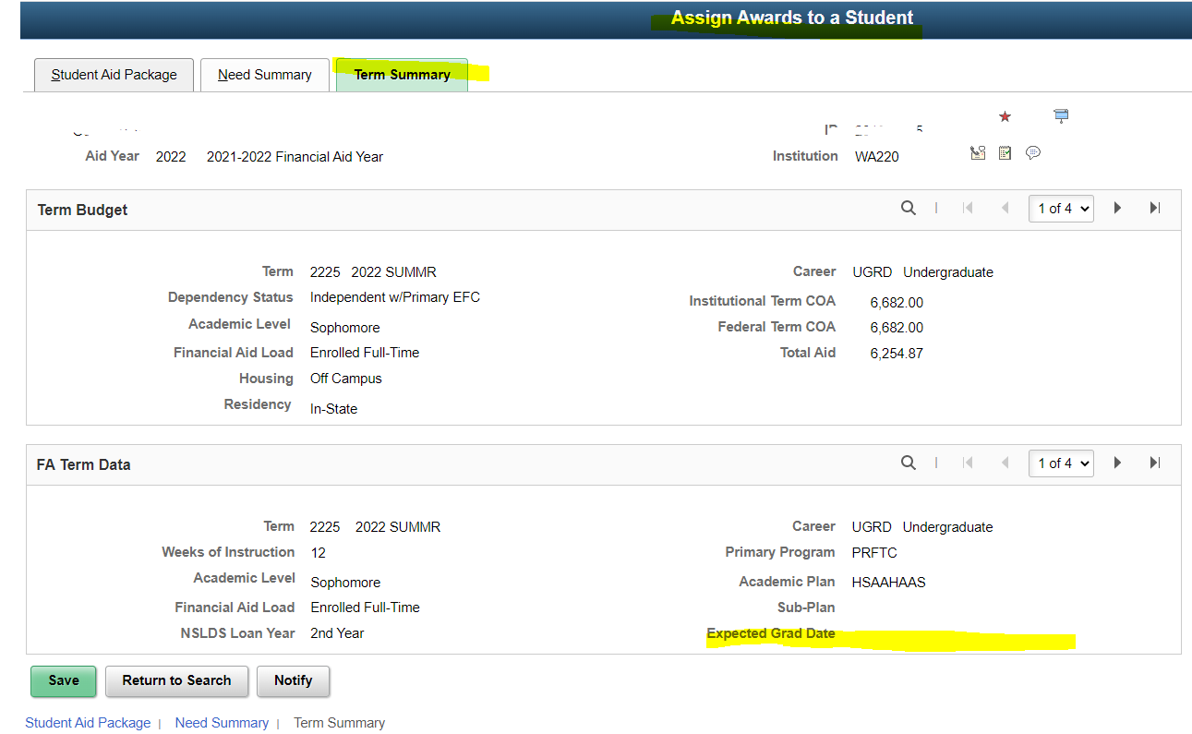

Slide 49
Funds not Recorded on the System

Slide 50
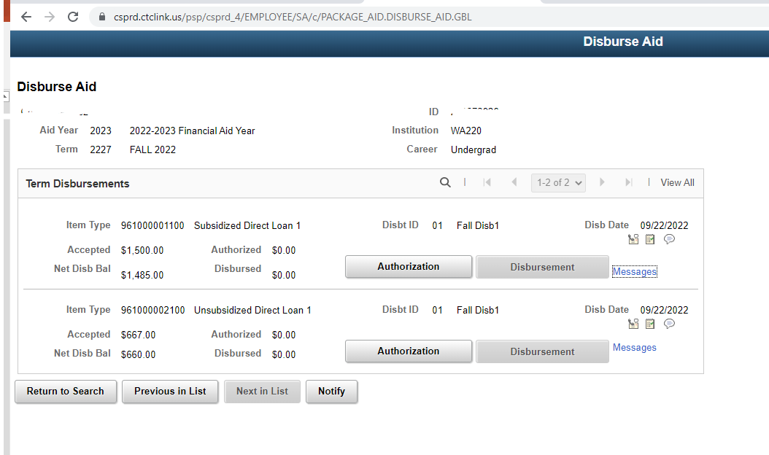

Slide 51
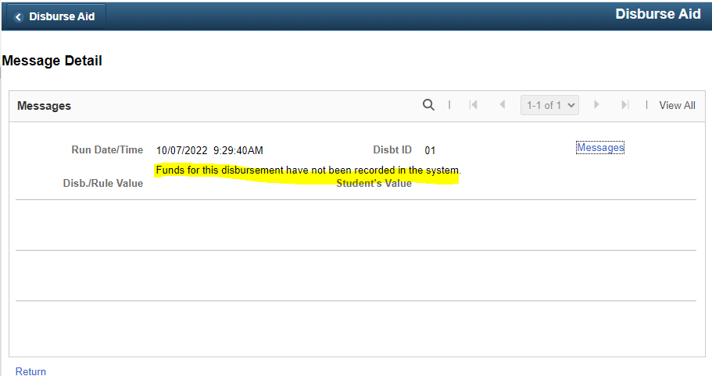
Usually this means it is a brand new federal loan and funds are not recorded or the student is missing a MPN.

Slide 52
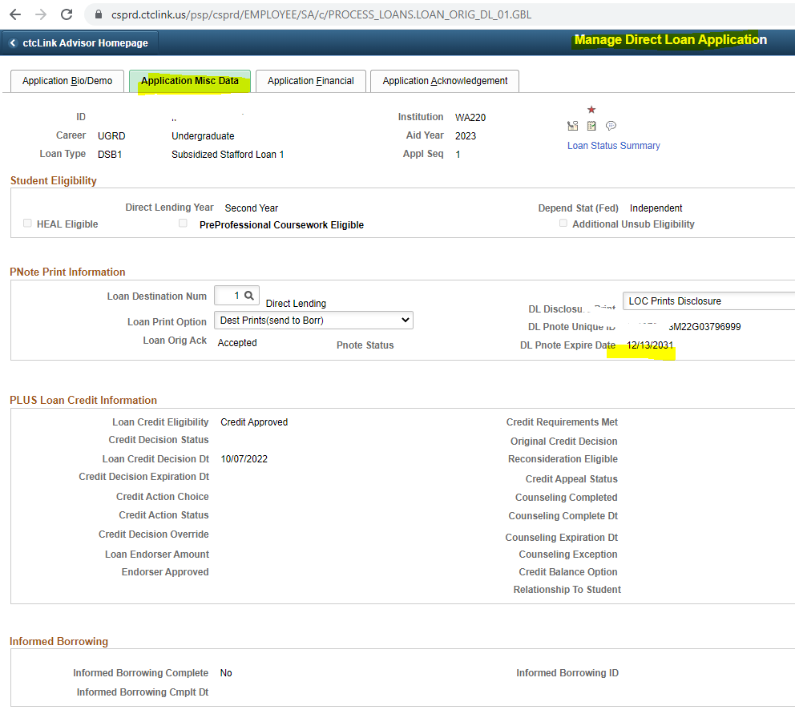
Student did complete MPN so is a new federal loan we just need to complete checklists and release funds.

Slide 53
Thanks!
Any questions?
You can find us at
lsaucedo@tacomacc.edu
smooi@tacomacc.edu

