Slide 1
Work Study Processing resources (FWS, SWS & WFWS)
FA ERP Support
October 2022

Slide 2
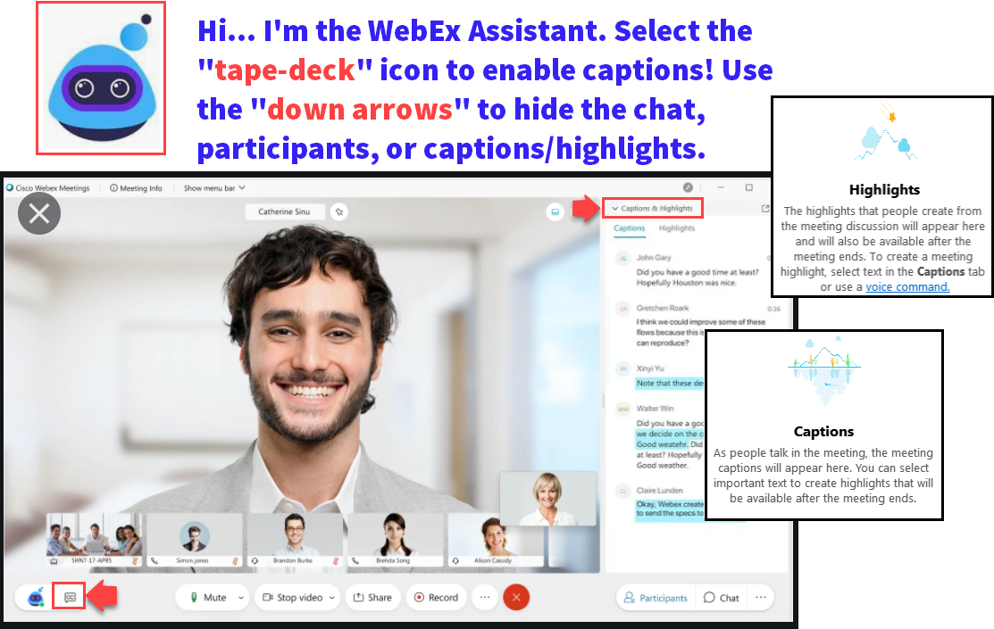

Slide 3
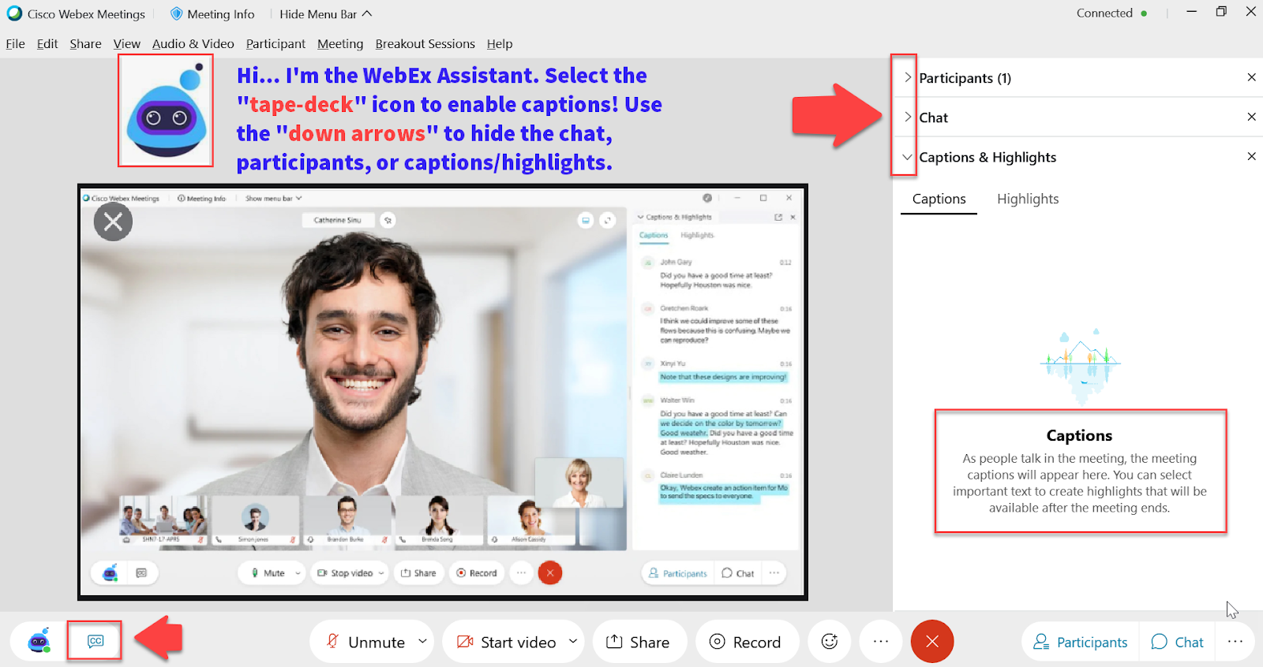

Slide 4
Logistics and Agenda
Times | Activity
9:00 – 9:10 | Greet/Attendance/Objectives
9:10 – 9:30 | Gathering Awarded Students
9:30 – 10:30 | WS Earnings Reconciliation Resources
10:30 – 11:00 | Session Wrap-Up/ Q&A

Slide 5
ground rules
Remove external distractions
Hold questions until Q&A time after each section
Mute your line when not speaking
Do NOT place Webex line on hold. Use Mute.
Please leave your line on Mute unless you are speaking
Sessions are being recorded

Slide 6
Objectives
During this Just-In-Time session, we will review:
Ways to locate students that have been awarded WS or those who have indicated they’re interested in WS
Queries to pull Work Study earnings to reconcile
HCM queries
CS queries
State Work Study Setup screen
Other helpful queries

Slide 7
Find Awarded Students

Slide 8
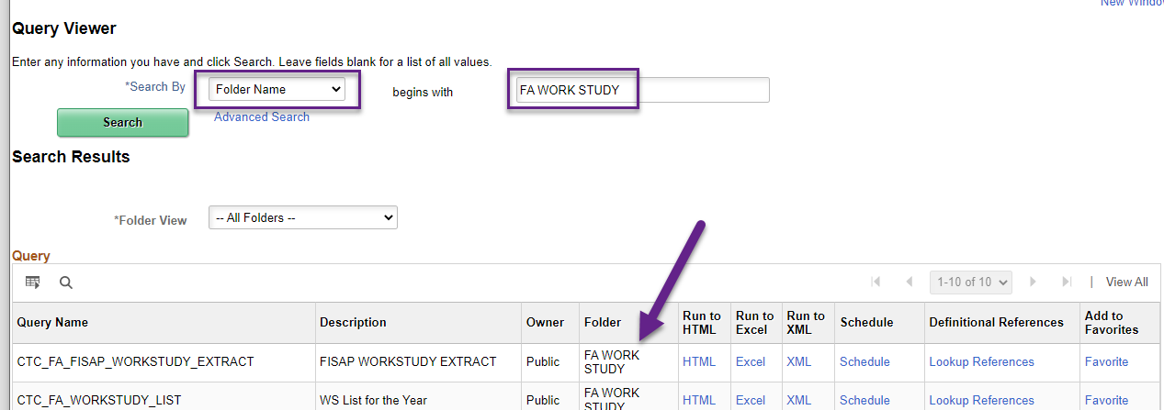
Navigation: Nav Bar > Navigator > Report Definitions > Query > Query Viewer
Work Study can be very “query heavy” or “query driven”. In Query Viewer, many queries have been sorted into the FA Work Study Folder to help with searching for applicable queries.

Slide 9
Find My Awarded Students!
How to find your Work Study students that have been awarded or who to consider to award:
CTC_FA_WORKSTUDY_LIST
Students with any WS award offer greater than 0
QCS_FA_WORKSTUDY_ELIG_REQ
Awarded WS item type, FA Load, and SAP status

Slide 10
Find My Potential Students!
How to find students to consider awarding Work Study:
QCS_FA_APPLIED_4_WORKSTUDY_1
Official EFC, marked 'Yes' on FAFSA, SAP is not ‘Not Meets’
QCS_FA_APPLIED_4_WORKSTUDY_2
Same as above, plus a checklist prompt

Slide 11
Reconciliation: HCM Queries

Slide 12
Navigation: HCM Pillar > Navigator > Reporting Tools > Query > Query Viewer
CTC_172_WS_RPTD_TIME
Provides WS time sheet information
QHC_PY_WORKSTUDY_PROMPTED
Assists with providing paid payroll information and budget strings
Access to the HCM pillar is different amongst institutions. Some have this security while others do not, this is up to the pillar leads or security administrators at each school to decide of granting access.

Slide 13
Reconciliation: CS Queries

Slide 14
Initial Setup: State Work Study Report

Slide 15
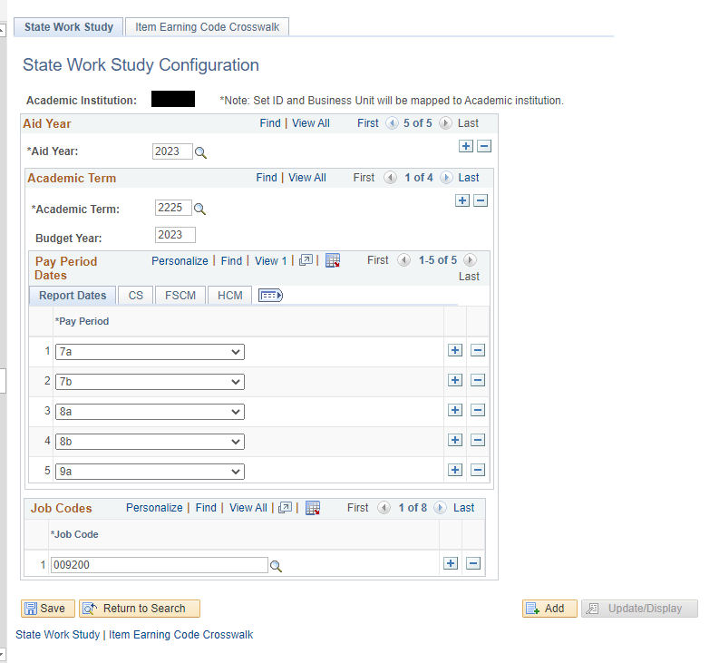
Navigation: Navigator > Set Up SACR > Product Related > Financial Aid > CTC Custom > State Work Study Report
The State Work Study Report configuration enables the ability to run the CS Work Study Queries. In-depth steps to setup these screens are found in the Aid Year Rollover Guide.

Slide 16
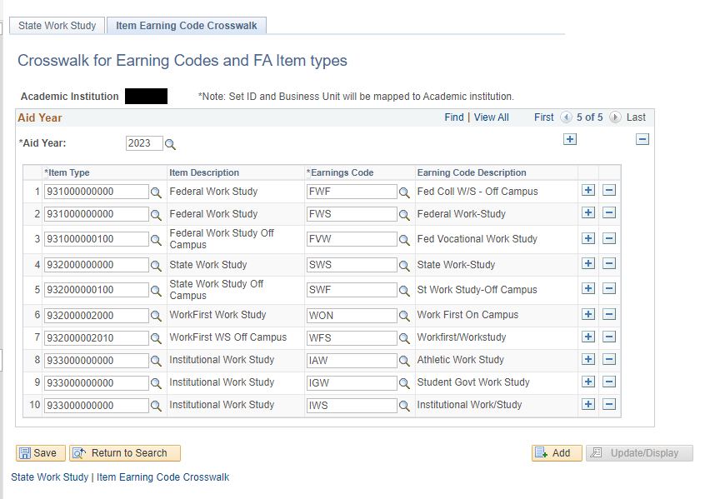
Navigation: Navigator > Set Up SACR > Product Related > Financial Aid > CTC Custom > State Work Study Report
On the 2nd Tab, make sure you have all your Work Study System item types and Earnings Codes are mapped correctly for the Aid Year you will be running reports for.

Slide 17
Navigation: HCM Pillar > Navigator > Reporting Tools > Query > Query Viewer
QCS_FA_WORKSTUDY_PAY_PERIOD
Payroll information based on Pay Period
QCS_FA_WORKSTUDY_TERM
Payroll information based on Term
These queries MUST be run in Schedule Query as they are Cross-Pillar

Slide 18
What about my Off-Campus Students??
Off-Campus Work Study Student payroll information will not show up on any of the prior mentioned queries.
Depending on how your institutional processes Off-Campus pay, this is actually a reimbursement to the Off-Campus employer. The WS student does not have a PeopleSoft (ctcLink) Timesheet for these queries to pull information. The reimbursement is not expensed as “Payroll data” as it was not administered via a payroll function at your institution. You will need to work with your Business Office for proper reconciliation for Off-Campus Work Study.

Slide 19
Other Helpful Queries

Slide 20
Navigation: HCM Pillar > Navigator > Reporting Tools > Query > Query Viewer
QCS_FA_WORKSTUDY_UNDER18
Students with WS Item Type under 18 years old
QCS_FA_WORKSTUDY_WA_RES
Students with a WS item type and Residency Status
QCS_FA_WS_AWARD_FOR_MM
Students with a WS Item Type and their contact information awarded

Slide 21
Q&A Time

Slide 22
Outcomes
After this session, you have an understanding of:
How to gather your Work Study population
Running reconciliation queries
Having some additional resources to assist with your Work Study program

Slide 23
Congratulations!
You are now equipped with additional knowledge and resources to assist with Work Study!
Thank you for your participation today!

