Slide 1
JUST IN TIME TRAINING track agency funding
Kelly Forsberg
ctcLink Functional Trainer | Financial Aid
October 2022

Slide 2
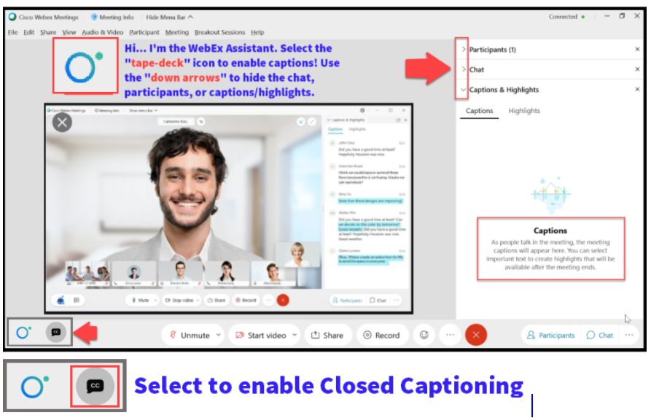

Slide 3
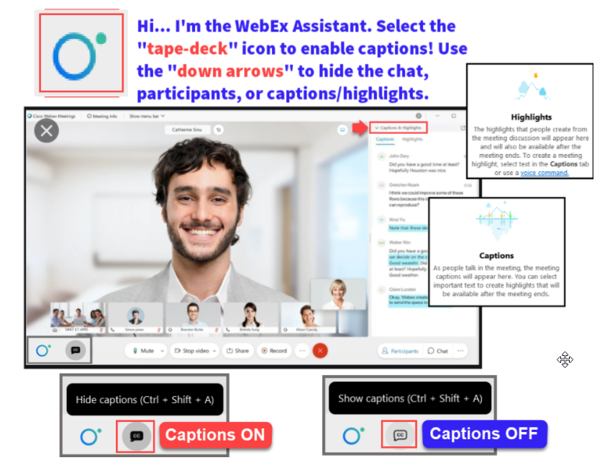

Slide 4
Agenda
Times | Activity
9:00 – 9:05 | Sign-In/Greet/Objectives
9:05 – 9:30 | Run the Third Party Payment Query
9:30 – 10:00 | Review the query results
10:00 – 10:30 | Assign Awards to a Student Page
10:30 – 11:00 | Demo/Session Wrap-Up
Some processes will have demonstrations, but due to data scrubbing, available data in the environment, demo examples are not ideal

Slide 5
ground rules
Be ready to participate
Remove external distractions
Mute your line when not speaking
Do NOT place Webex line on hold. Use Mute.
Please leave your line on Mute unless you are speaking
Sessions are being recorded
Allow your peers to complete their thoughts before beginning yours

Slide 6
Objectives
After completing this training, you should be able to:
Understand how and when to run the Third Party Payment Query
Understand in what priority to review the Third Party Payments
Understand how to account for the Third Party Payments using a Non-Disbursable Item Type in the Assign Awards to a Student Page

Slide 7
RUNNING THE THIRD PARTY PAYMENT QUERY

Slide 8
Running third party payment query
Navigation: Nav Bar > Navigator > Reporting Tool > Query > Schedule Query
Run the CTC_FA_THIRD_PARTY_PYMNTS query in Schedule Query. You can set it to a recurrence and send it to specific staff for weekly review.

Slide 9
Running third party pmt query cont’d
Select the query, and then enter the parameters

Slide 10
Run third party pmt query cont’d
The Posted From Date and the Posted To Date are optional. The bigger the ranger, the longer it will take to get query results.
Additionally, if you run it on an occurrence, do not define the dates.

Slide 11
Find query results in view/log trace
Grab your .csv from the View Log/Trace pagelet

Slide 12
sort third party pmnt qry results
Apply a filter and sort on Column G – Description of the Item Type
Sort on Column J – Aid Processing Status. Work in order: Review Packaging Completed 1st, Ready for Counselor Review 2nd, and Applied 3rd

Slide 13
REVIEWING THE THIRD PARTY PAYMENT ITEMS

Slide 14
Reviewing third party pmnts query
Review the items line by line, and bring them up in Assign Awards to a Student page. You will need to make the determination on which third party payments need to be accounted for in the Assign Awards to a Student page using a non-disbursable Item Type.
In this example, the Department of Vocational Rehab FA Item Type should be used in the Assign Awards to a Student page.

Slide 15
ASSIGN AWARDS
TO A STUDENT PAGE

Slide 16
Assign awards to a student page
Navigation: Nav Bar > Financial Aid > Awards > Award Processing > Assign Awards to a Student
Add a new row, and select the Item Type to reflect the appropriate Third Party Payment so it is accounted for in the Cost of Attendance

Slide 17
Add non-disbursable item type awd
Confirm the amount to be added from the spread sheet, then add it into the Offered column. Tab out.
Assign the desired Disbursement Plan and proper Split Code.
Check the Disbursement link, and then when satisfied, select Validate and Post.
Be sure to check Need Summary tab to ensure the student is not over-awarded as a result of adding the Third Party Payment.

Slide 18
DEMONSTRATION

Slide 19
Outcomes
At training completion, you should be able to:
Understand how and when to run the Third Party Payment Query
Understand in what priority to review the Third Party Payments
Understand how to account for the Third Party Payments using a Non-Disbursable Item Type in the Assign Awards to a Student Page

Slide 20
Congratulations!
Track Agency Funding Processing Just In Time Training Complete!
Please review census business processing guide resource as you are doing your census processing
Thank you for your participation today!

