Slide 1
File Review in ctcLink
Spokane Community College

Slide 2
Get to Know Your Icons
Icons
Home – this takes you to your homepages. You can select which homepage is your default.
Search – can’t find that page you want? Search is the icon for you!
Notifications – SCC doesn’t use notifications, but if you do, here’s where you’ll find any sent to you.
Kebab menu (I had to Google that one) – this menu contains your options for the page that you’re on.
NavBar – this pulls up your NavBar, where you find My Favorites, Navigator, and any custom tiles you’ve added to the NavBar.

Slide 3
Set Up to Speed Through
Populate My Favorites and the NavBar, and Create Custom Pages

Slide 4
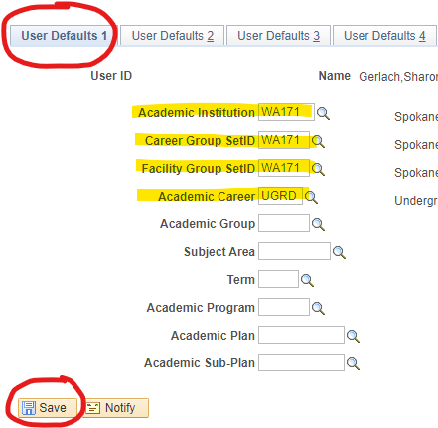
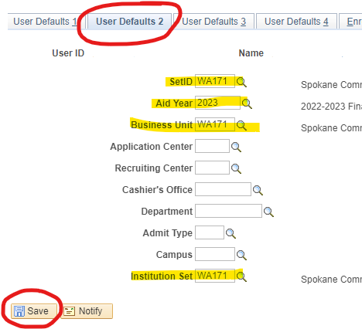
Set Up SACR – User Defaults
Navigation: NavBar > Navigator > Set Up SACR > User Defaults
SACR lets you save certain data so you don’t have to enter it into each page when you’re looking up a student. Here is the data I set up in SACR:

Slide 5
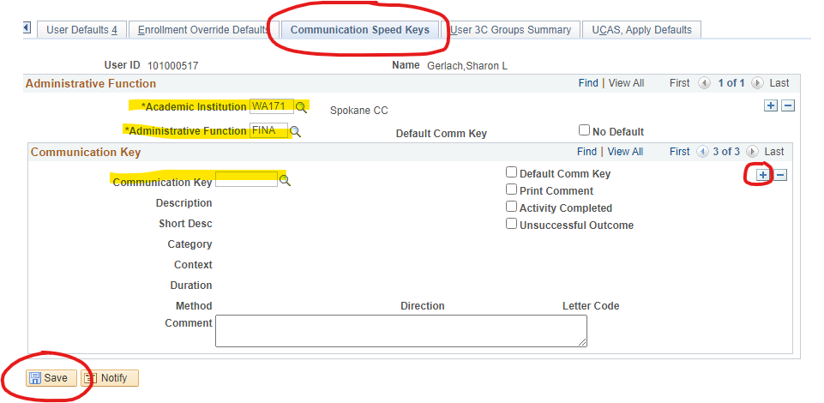
Set Up SACR – Speed Keys
Navigation: NavBar > Navigator > Set Up SACR > User Defaults
Speed Keys are steps set up ahead of time to allow you to assign communications quickly.
Administrative Function only needs to be set up with the first Speed Key you create.
For additional Speed Keys:
Click the  in the Communication Key section
Click the search icon to find the communication you want to link to the speed key
Save.
All the rest populates automatically.

Slide 6
My Favorites, the NavBar, and Custom Pages
There are MANY pages in ctcLink. To speed up navigation to your commonly used pages, set up quick links.
Set up custom Homepages
Set up your Favorites list
Set up your NavBar

Slide 7
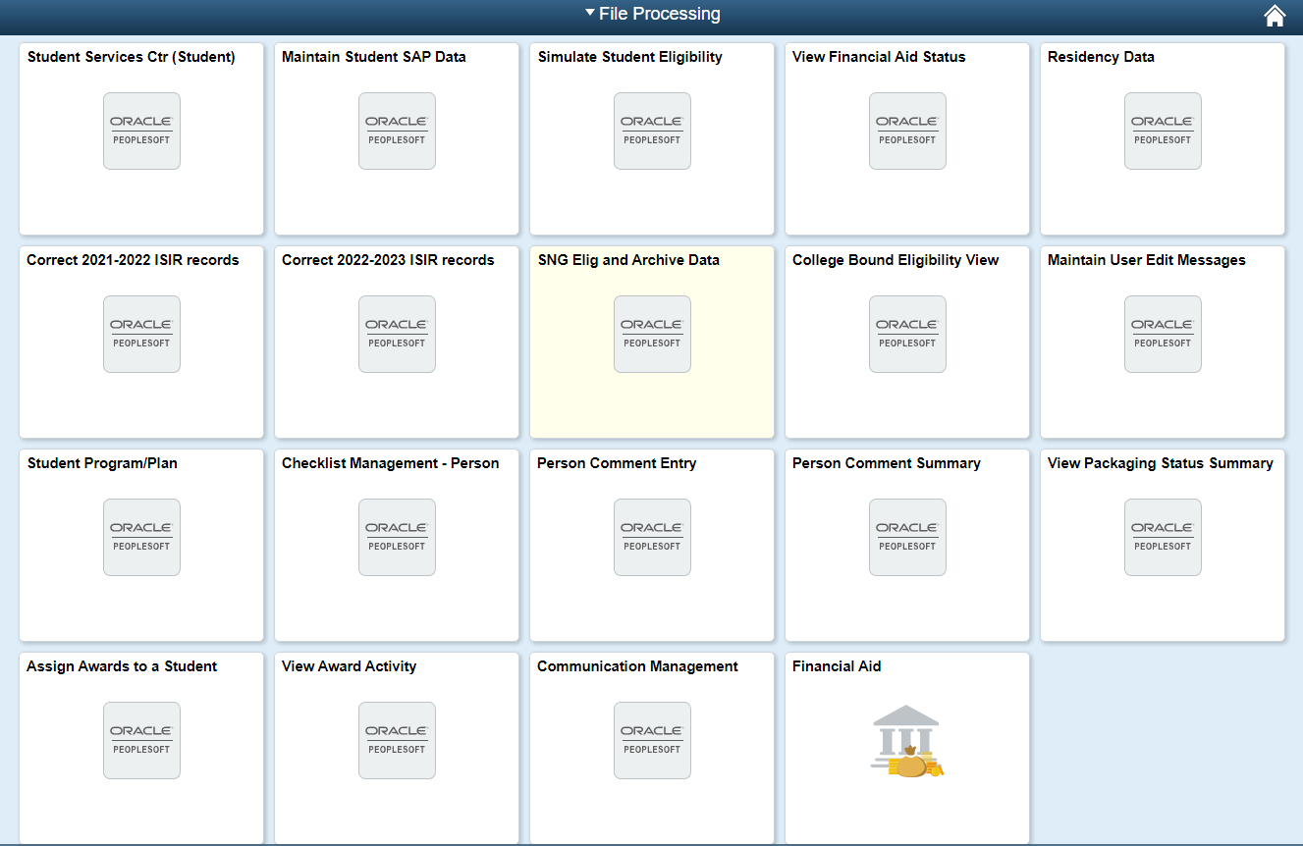
Creating Custom Homepages
Navigate to the page you want to add to a custom homepage
Click the kebab menu
Select Add to Homepage
Select the homepage you want to add it to, or choose to create a new homepage
NOTE: Do this in a clean screen (before you enter any student information). Otherwise, that student’s information will always pull up when you click on the tile to load the page. (Don’t ask me how I know this… ☺)

Slide 8
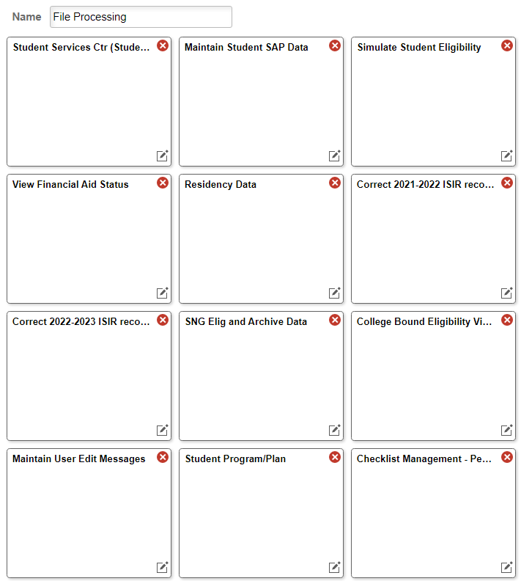
Personalizing Custom Homepages
Navigate to the custom home-
page you want to personalize
Click the kebab menu
Select Personalize Homepage
Pages display as clickable tiles. Here you can delete outdated pages and rearrange the order of the pages.
Did You Know?
You can rearrange tiles on the homepage without going into Personalize Homepage. Just drag
and drop into new location.

Slide 9
The NavBar
The NavBar is, to simplify, a handy-dandy one-click Top Favorites list. You might want to personalize your NavBar with pages you navigate to what seems like a zillion times a day. I use it for my most common customer service pages (as shown on the left).
Navigate to the page you want to add to the Nav Bar
Click the kebab menu
Select Personalize Homepage
Pages display as clickable tiles. Here you can delete outdated pages and rearrange the order of the pages.

Slide 10
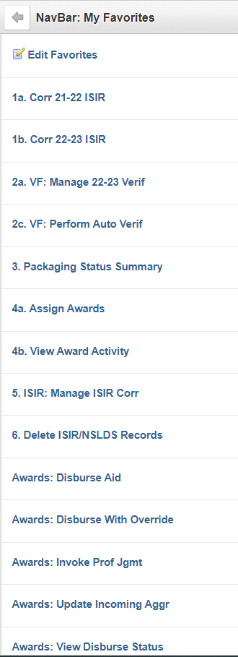
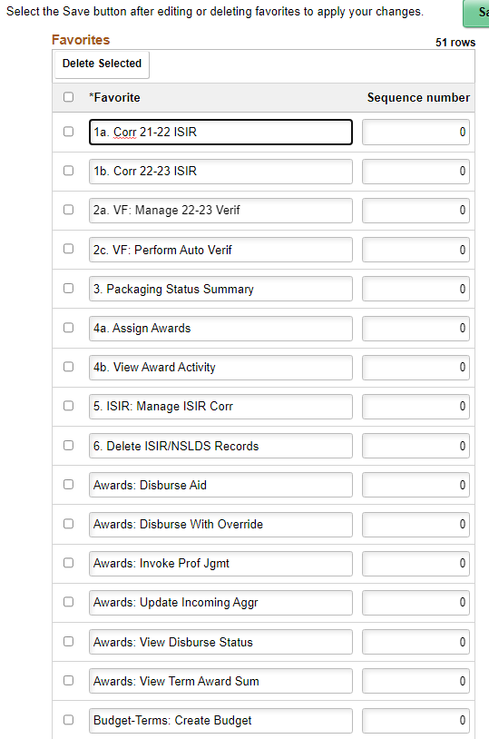
My Favorites
What you “bookmark” in My Favorites will depend on what you use the most, and how you order them will depend on how your brain works. The example shown on the left is my My Favorites list, but you can order them any way you like.
Navigate to the page you want to add to the Nav Bar
Click the kebab menu
Select Add to Favorites
To edit (shown on the right), click the Edit Favorites at the top
To edit the order in which they display, change the sequence number on the right side.
To edit the name and maintain alphabetic order, edit only the name on the left side.

Slide 11
Identifying Students for Review
Using Queries and Physical/Electronic Files to Manage File Review

Slide 12
Using Completed Checklist Items to Identify Students for Review
SCC uses a Terms and Conditions form to collect the various authorizations we need to disburse aid, and still currently utilizes physical files.
Completed Terms and Conditions forms trigger the file review process
The file label checklist item (ESP065) is added to the student record at the time the Terms and Conditions form is tracked in, even if other required documents have not been received
Labels are run based on the completed File Label checklist item, and physical files are created, containing the submitted documents
Files are grouped in sections according to date ranges
FA staff pulls from these sections in date order
At the same time, we run queries to identify applicants who have not been reviewed and who do not have a physical file; this way we can initiate personal contact with them and either clear them as not attending or help them get all their requirements completed
The query we use to make file labels is CTC_FA_SB_FILE_LABEL_NEW

Slide 13
Queries to Identify Student for Review
Navigation: NavBar > Navigator > Reporting Tools > Query > Query Viewer
Queries are like our clean-up crew, pulling in students who have applied but have done nothing else. This enables us to initiate personal contact with the students and help them resolve issues or get the proper documents submitted.
The queries we use to pull students to review depends on who is running the list and when the list is being run. Here are some of the queries we use:
CTC_FA_CHECKLIST_LIST2 If you use a Terms and Conditions form or a data sheet, you can filter these out on the resulting Excel spreadsheet to include only Incomplete status (our system assigns the Terms and Conditions checklist item when ISIRs load, so we can be assured only financial aid applicants pull on this list)
CTC_SR_ENROLLED_STUDENTS This pulls a list of all enrolled students that can be compared to those with a federal application (such as the results of CTC_FA_CHECKLIST_LIST2)
QCS_FA_VER_STATS This pulls all financial aid applicants, whether reviewed and funded or not. Filter out the students with no counselor name or counselor ID to get a list of students who have not been reviewed.

Slide 14
Queries to Identify Student for Review, cont’d
QCS_FA_BASIC_ELIG_DATA_ALL Pulls just about everything under the sun for FA applicants. Schedule this one to run, because you’ll probably get a proxy error if you try to run to HTML or Excel; retrieve your report in Report Manager (Navigation: NavBar > Navigator > Reporting Tools > Report Manager). Can be filtered by Review Status to identify the Incomplete statuses.
QCS_FA_APPLIED_INCOMPLETE
Another query that pulls students whose review status is incomplete. This will pull all students, even if completed; filter out the Review Complete statuses. CAUTION: don’t rely on the Processing St column – if other funding such as scholarships or agency funds have been entered in the system, this will trigger the Packaging Completed status to be assigned and could cause you to miss students whose federal/state aid has not been funded.
QCS_FA_APPLIED_NEED_REVIEW
This query can be run by checklist item of choice. I run it using either our file label checklist item type or our Terms and Conditions checklist item type, depending on what group I want to look at (either what physical files haven’t been reviewed, or what students with no physical files haven’t been reviewed).
QCS_FA_APPLIED_NO_FED_STAT_AID
Another query that pulls FA applicants with no FAFSA aid; also pulls in enrollment data and application received date.
QCS_FA_ENR_APPL_NO_AWD
This is my standard go-to query once we’ve stopped reviewing everyone and start focusing on reviewing students who are enrolled for the upcoming term. We run this throughout the current term as well to pick up any stragglers. This pulls enrolled students with no federal or state aid. Filter out those with a counselor name or number to get those who need to be reviewed.

Slide 15
Pages We Use for File Review
What to Use and Where to Find It

Slide 16
Our Favorite Pages for File Review
The best/proper/preferred methods to use when reviewing financial aid file is very subjective. Some information is displayed on more than one page, and everyone will have their preferences on where to access the information they need. These are the pages we recommend and have adopted as our best practices at SCC.
Maintain Student SAP Data Navigator > Financial Aid > Satisfactory Academic Progress > Maintain Student SAP Data
Simulate Student Eligibility Navigator > Financial Aid > Satisfactory Academic Progress > Simulate Student Eligibility
Student Services Center Navigator > Campus Community > Student Services Center > Academic tab (for current program of study)
Student Program/Plan Navigator > Records and Enrollment > Career and Program Information > Student Program/Plan
Residency Data Navigator > Campus Community > Personal Information > Identification > Residency Data
Manage 20xx-20xx Verification Navigator > Financial Aid > Verification > Manage 20xx-20xx Verification
cont’d on next page

Slide 17
Our Favorite Pages for File Review, cont’d
Perform Auto Verification Navigator > Financial Aid > Verification > Perform Auto Verification
Correct 20xx-2-xx ISIR Navigator > Financial Aid > Federal Application Data > Correct 20xx-20xx ISIR
View Financial Aid Status Navigator > Financial Aid > View Financial Aid Status
Student Grades (a quick look to see if the student is enrolled and in what courses) Navigator > Records and Enrollment > Student Term Information > Student Grades
Maintain User Edit Messages Navigator > Financial Aid > Disbursement > Maintain User Edit Messages
WCG and CBS Interfaces Navigator > Financial Aid > CTC Custom > CTC Interfaces
View Package Status Summary Navigator > Financial Aid > View Packaging Status Summary
Assign Awards to a Student Navigator > Financial Aid > Awards > Award Processing > Assign Awards to a Student

Slide 18
My Method of File Review
Everyone in our office has their own style of reviewing files. This is mine; again, this area is very subjective, so feel free to take what works for you and leave the rest.
I don’t work in multiple browser tabs. I have two open: the first, the one I’m actively working in; and the second, a tab I use if I have to dash over to another page to look at something really quick. The reason for this is if you have Carry ID checked in Set Up SACR (User Defaults 4 tab), ctcLink has a tricky habit of changing students on you if you happen to have a tab open with a different student’s data. You may think you’re reviewing John Smith and the next thing you know, you somehow find yourself in Jane Doe’s record without quite knowing how it happened.
I “stack” tasks, a nifty method I learned from, of all things, a computer game called Diner Dash. For example, if I pull 20 files to review; I will look at the SAP for all 20, then look at Residency Status for all 20, then move on to the next thing I need to review. Yes, I am entering EMPLIDs for these students multiple times, but this method works for how my brain keeps track of what I’m doing and has done wonders for my ten-key skill.
I have set up my custom homepages more or less in the order I review information. Since I am very fond of lists, this method works for me but may not work for you, so be sure to set up your custom homepages, My Favorites list, and your NavBar in a way that makes sense to your brain.
I review information in a specific order, using specific pages. EVERY. TIME. EVERY. FILE. This routine helps me to be confident that I have not missed a step. Information in ctcLink is so spread out (i.e. ctcLink is a bewildering labyrinth of data tucked into sometimes unlikely places) that I developed my routine to keep from getting confused. The next slides

Slide 19
My Method of File Review: The Order I Review Information
Pages I always use:
Student Services Center > Academic tab (for program of study, term activated)
Residency (if the student applied for admission to other schools, you may need to scroll through to your school)
Corr 20xx-20xx ISIR
View Financial Aid Status (for missing checklist items, to add comments, checklist items, or communcations)
View Packaging Status Summary (to mark Review Complete and add my EMPLID number in the Counselor field)
Assign Awards to a Student
Pages I sometimes use:
Maintain User Edit Messages – we use this to block disbursements if the student is waitlisted for a program or has specific, limited coursework to complete. We review these when working our before-quarter reports
Student Program/Plan – if the current or upcoming term is linked to a Student Career Number (aka CAR) that is not in their program stack in Student Services center > Academic tab
Simulate Student Eligibility – this allows you to check a student’s SAP status without actually running SAP, which is helpful when a student returns after an extended absence

Slide 20
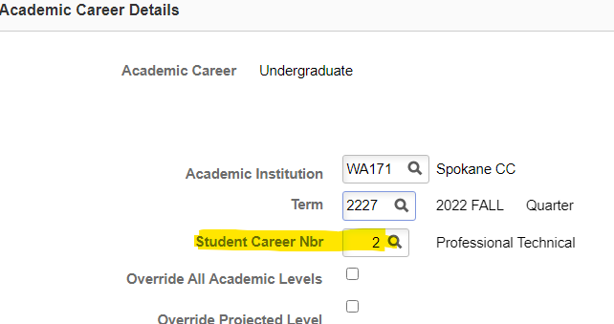
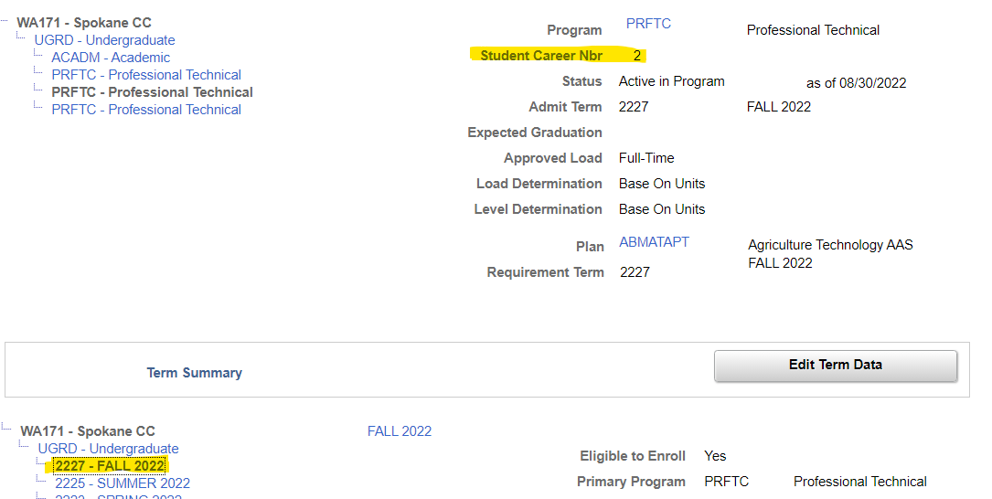
A Note About Career Numbers
Student Services Center > Academic tab
Make sure the student’s active program is the program linked to the term you’re awarding. The Career Number (CAR) should match in the Institution/Career/Program section and the Term Summary > Edit Term Data section. The program listed in Maintain FA Terms and Maintain Student SAP Data should match each other AND the CAR in the Academics tab.

Slide 21
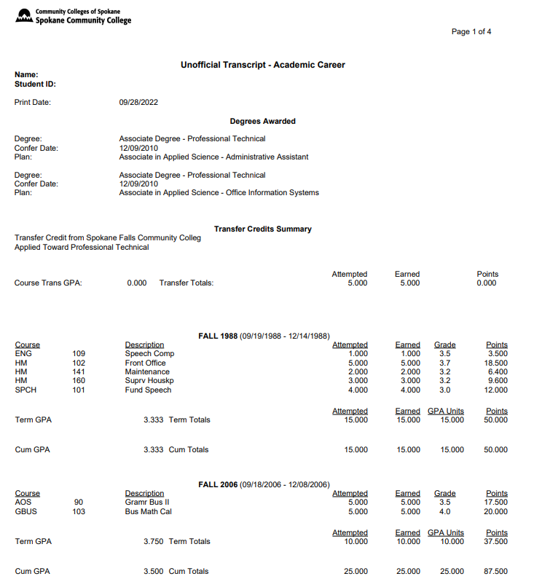
Printing Unofficial Transcripts
Navigator > Records and Enrollment > Transcripts > Transcripts Request
You may not be able to view this page, depending on your security role. To evaluate remaining credits the student needs to complete or repeated coursework that is not eligible for funding, SCC uses Course History on the Student Center tab and the Academics tab in the Student Services Center.
Navigator > Self Service > Academic Records > View Unofficial Transcript
This will only pull up your own transcript, but it helps to know what the student is looking at, so I’ve included an example.
Student Self-Serve
Students can print their own unofficial transcript by going to their Homepage, clicking the Academic Records tile, and selecting View Unofficial Transcript.

Slide 22
Reports Before the Start of the Quarter
Catch Problems Before They Become Disasters

Slide 23
Queries to Catch Eligibility Issues
A week or two before each quarter, we run a series of queries designed to catch students with eligibility issues so we don’t disburse aid and create our own disasters. Here are the queries we use. I have included our guide in the handouts, which you are free to chop or revise as meets your needs.
QCS_FA_PRE_REQ_PLANS
CTC_FA_RUNNING_START_AWARDED
QCS_FA_UEM_ALL (preferred) or QCS_FA_UEM_CODE_AWARD (can select by specific code)
QCS_FA_MAX_REMEDIAL_CREDITS
CTC_FA_OVERAWARDED
QCS_FA_REPEAT_CRSES
CTC_FA_OVRD_BOX_CHKD_FA_LOAD
QCS_FA_CLASS_ROSTER_ACTIVE_AID
QCS_FA_ACTIVE_AID_INELIG_PLAN
CTC_FA_INELG_COURSEWORK_2

Slide 24
Hang On – Help Is On The Way!
Feel free to call or email if you are stuck on something and can’t figure it out. This system can be complicated. We’re happy to help.
Sharon Gerlach
Program Specialist 2
Financial Aid Office
Spokane Community College
Sharon.Gerlach@scc.spokane.edu
(509) 533-8134
Zoya Zhuk
Associate Director
Financial Aid Office
Spokane Community College
Zoya.Zhuk@scc.spokane.edu
(509) 533-8189

