Slide 1
JUST IN TIME TRAINING LOAN PROCESSING REFRESHER
Kelly Forsberg
ctcLink Functional Trainer | Financial Aid
September 2022

Slide 2
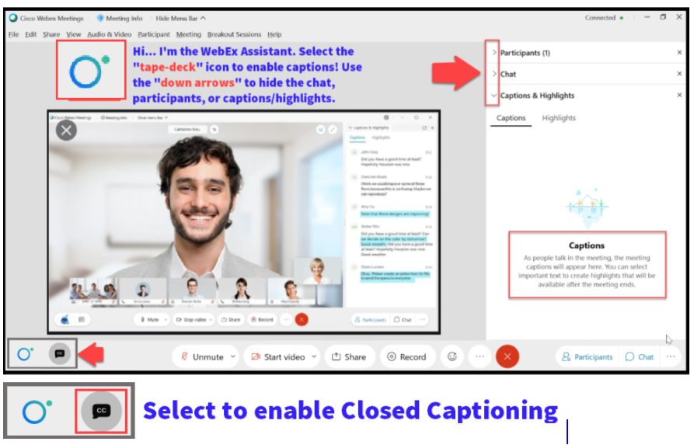

Slide 3
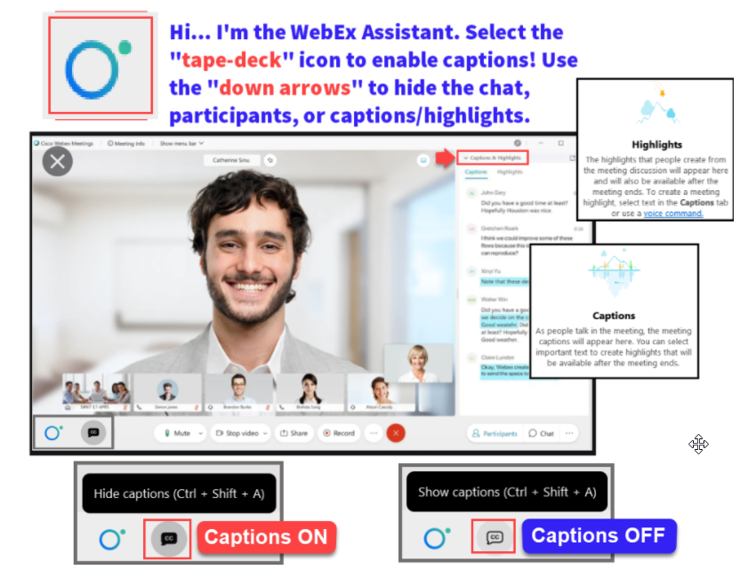

Slide 4
Logistics and Agenda
Times | Activity
9:00 – 9:05 | Greet/Attendance/Objectives
9:05 – 9:30 | Loan Origination (Batch & Single Student)
9:30 – 9:45 | Loan Origination Outbound/Inbound Process
9:45 – 10:00 | Loan Disbursement Outbound/Inbound Process
10:00 – 10:10 | Query for Missing COD Files
10:10 – 10:30 | Award and Originate a PLUS Loan
10:30 – 10:50 | Award and Process a Private/ALT Loan
10:50 – 11:00 | Session Wrap-Up
Some processes will have demonstrations, but due to data available in the environment, demo examples are not ideal

Slide 5
ground rules
Be ready to participate
Remove external distractions
Mute your line when not speaking
Do NOT place Webex line on hold. Use Mute.
Please leave your line on Mute unless you are speaking
Sessions are being recorded
Allow your peers to complete their thoughts before beginning yours
Please return from breaks on time

Slide 6
Objectives
After completing this training, you should be able to:
Understand the Loan Origination (Batch and Single Student) Process
Understand the Loan Origination Outbound and Inbound Process
Understand the Loan Disbursement Outbound and Inbound Process
Understand how to query for missing COD Files
Understand how to award and originate a PLUS Loan
Understand how to award and process a Private/ALT Loan

Slide 7
LOAN ORIGINATION
PROCESS (BATCH)

Slide 8
LOAN origination in batch
4-STEP PROCESS
Step 1: Process Loans
Step 2: Process Loan Dates
Step 3: Population Update
Step 4: Process Loans Again
Notes:
Here is a visual of the 4-step process in Loan Processing.

Slide 9
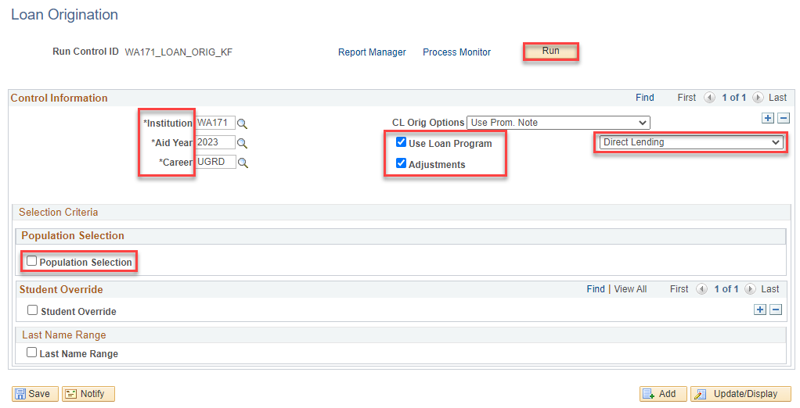
LOAN origination in batch cont’d
RUN PROCESS LOANS
Navigation: Financial Aid > Loans > Process Loans
The Population Selection check box should be unchecked

Slide 10
LOAN origination in batch CONT’D
RUN PROCESS LOANS
Step 1: Process Loans
Step 2: Process Loan Dates
Step 3: Population Update
Step 4: Process Loans Again

Slide 11
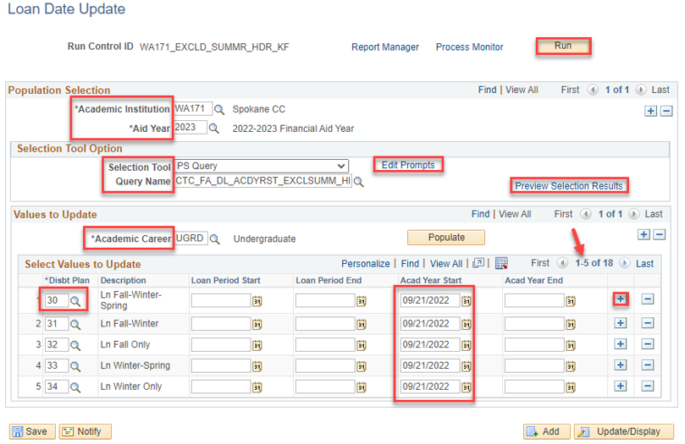
LOAN origination in batch cont’d
PROCESS LOAN DATES (SUMMER EXCLUDE HEADER)
Navigation: Financial Aid > Loans > Process Loan Dates
The set up on these processes is different for Trailer institutions; follow the Loan Processing Guide

Slide 12
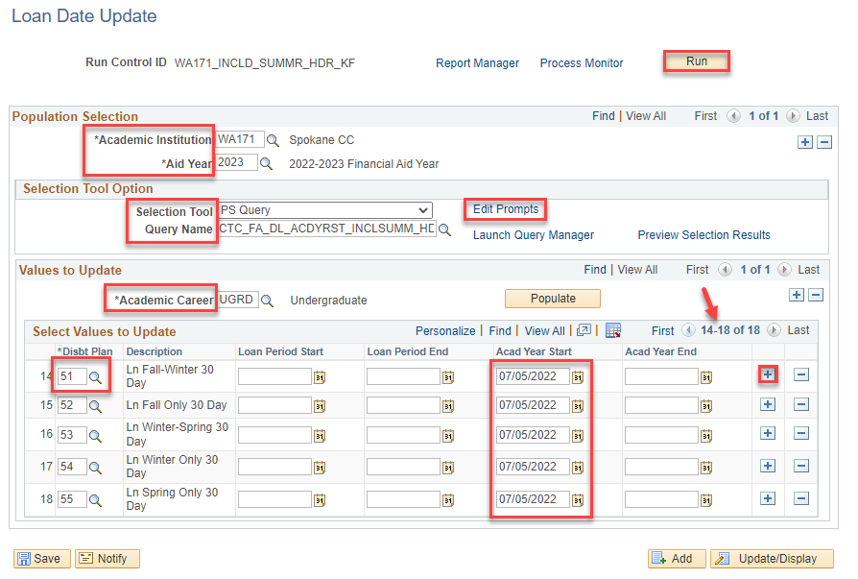
LOAN origination in batch cont’d
PROCESS LOAN DATES (SUMMER INCLUDE HEADER)
Navigation: Financial Aid > Loans > Process Loan Dates
The set up on these processes is different for Trailer institutions; follow the Loan Processing Guide

Slide 13
LOAN origination in batch CONT’D
POPULATION UPDATE (OFFER ACTIVITY)
Step 1: Process Loans
Step 2: Process Loan Dates
Step 3: Population Update
Step 4: Process Loans Again
Notes:
Returning back to the visual chart, we are now going to move into step 3 of the 4-step loan process. Step 3 is Population Update

Slide 14
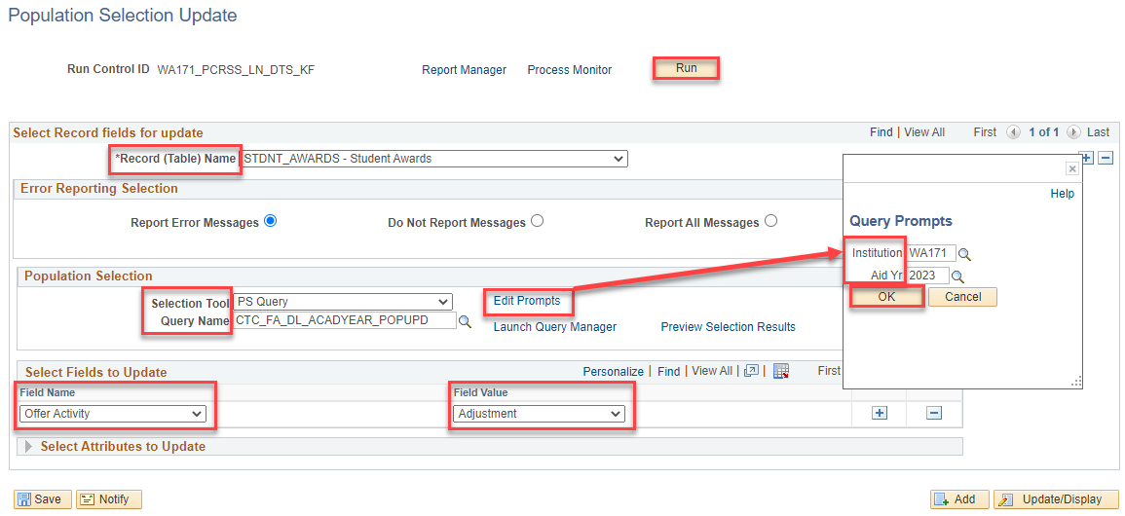
LOAN origination in batch cont’d
POPULATION UPDATE (OFFER ACTIVITY)
Navigation: Set Up SACR > System Administration > Utilities > Population Update > Population Update Process
This process picks up any loans that have had any adjustments to them – it is typical you will not always get results when running this process. Please run it as part of steps in the process.
Notes:
This population update process will move the loan offer activity to an adjustment of accepted.

Slide 15
LOAN origination in batch cont’d
RUN PROCESS LOANS AGAIN
Step 1: Process Loans
Step 2: Process Loan Dates
Step 3: Population Update
Step 4: Process Loans Again
Notes:
We are now at step in processing loans. You will run Process Loans again, which moves all your updates to the MDLA page.

Slide 16
LOAN origination in batch CONT’D
RUN PROCESS LOANS AGAIN
Navigation: Financial Aid > Loans > Process Loans
Notes:
Now that the summer exclude dates have been run, and populated into the MDLA page, you will want to run process loans again so the origination record is updated successfully.

Slide 17
LOAN ORIGINATION
PROCESS (SINGLE STUDENT)

Slide 18
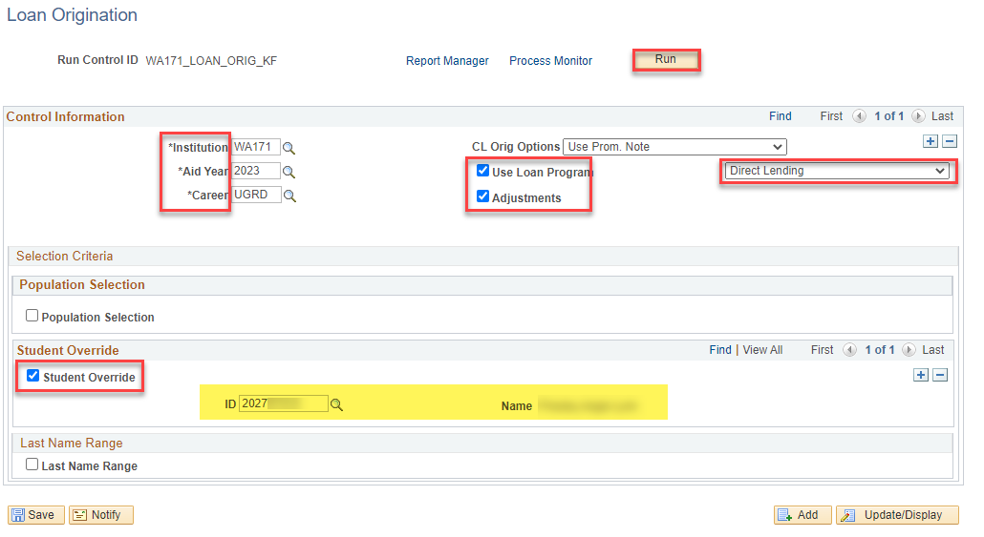
LOAN origination single student
PROCESS LOANS
Navigation: Financial Aid > Loans > Process Loans

Slide 19
DEMONSTRATION

Slide 20
LOAN OUTBOUND/INBOUND PROCESS (ORIGINATION & DISBURSEMENTS)

Slide 21
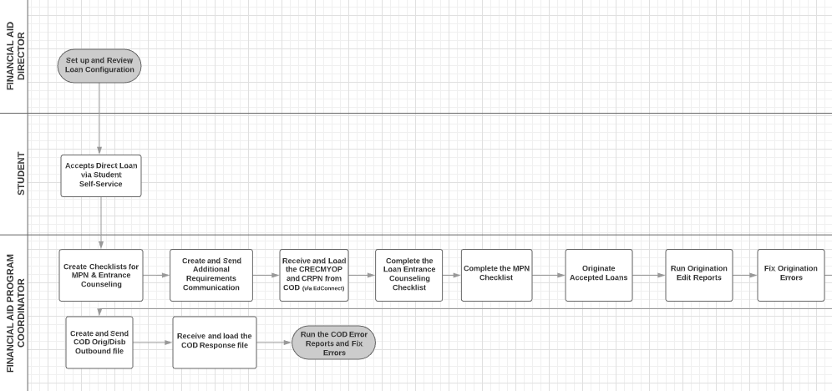
Loan outbound/inbound flow

Slide 22
Loan origination outbound process
3-STEP PROCESS
Step 1: Originate Loans
Step 2: Generate Direct Loan Data
Step 3: Download Process

Slide 23
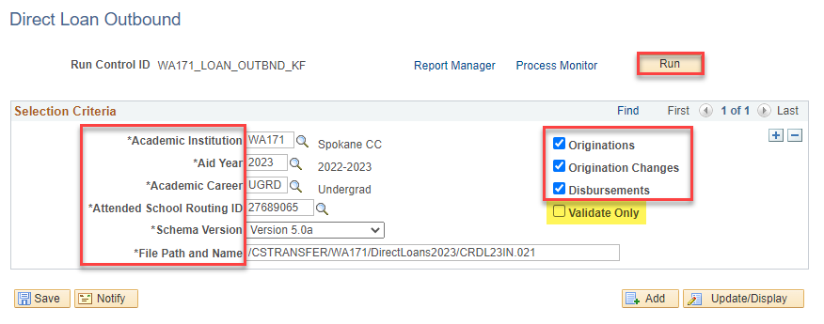
LOAN origination outbound process
GENERATE DIRECT LOAN DATA
Navigation: Financial Aid > File Management > COD Full Participant > Generate Direct Loan Data
Selecting the Originations, Origination Changes, and Disbursements check boxes will run the processes. Selecting Validate Only will run it in simulation mode only

Slide 24
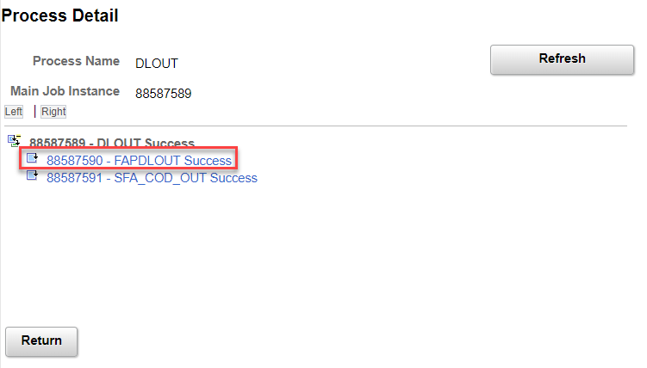
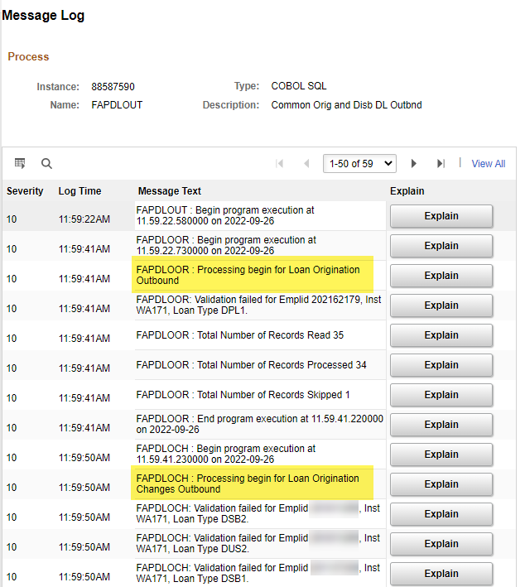
LOAN origination outbound process
GENERATE DL DATA CONT’D
Navigation: Financial Aid > File Management > COD Full Participant > Generate Direct Loan Data
For the records that failed validation, work your Validation Errors Report, then re-run the process

Slide 25
Loan origination outbound process
3-STEP PROCESS
Step 1: Originate Loans
Step 2: Generate Direct Loan Data
Step 3: Download Process

Slide 26
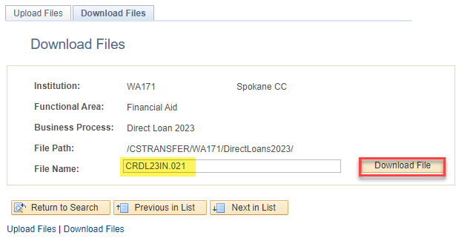
LOAN origination outbound process
DOWNLOAD PROCESS
Navigation: PeopleTools > CTC Custom > Extensions > Upload/Download Files
Find your file in your downloads folder on your computer, and then save it in your network drive. Upload to EdConnect.

Slide 27
QUERY FOR MISSING
COD FILES

Slide 28
QUERY FOR MISSING COD FILES
QCS_FA_MISSING_COD_RESPONSE
Navigation: Reporting Tools > Query > Query Viewer
Run this query to see if you are missing loading any COD response files. When you cannot get funds to disburse, or ctcLink to recognize origination records, it may be due to you missing to load a response file.

Slide 29
AWARDING AND
ORIGINATING
A PLUS LOAN

Slide 30
Loan origination outbound process
5-STEP PROCESS
Step 1: Award PLUS Loan
Step 2: Originate PLUS Loan
Step 3: Establish Relationship for Parent
Step 4: Link Parent to PLUS Loan Record
Step 4: Re-originate PLUS Loan

Slide 31
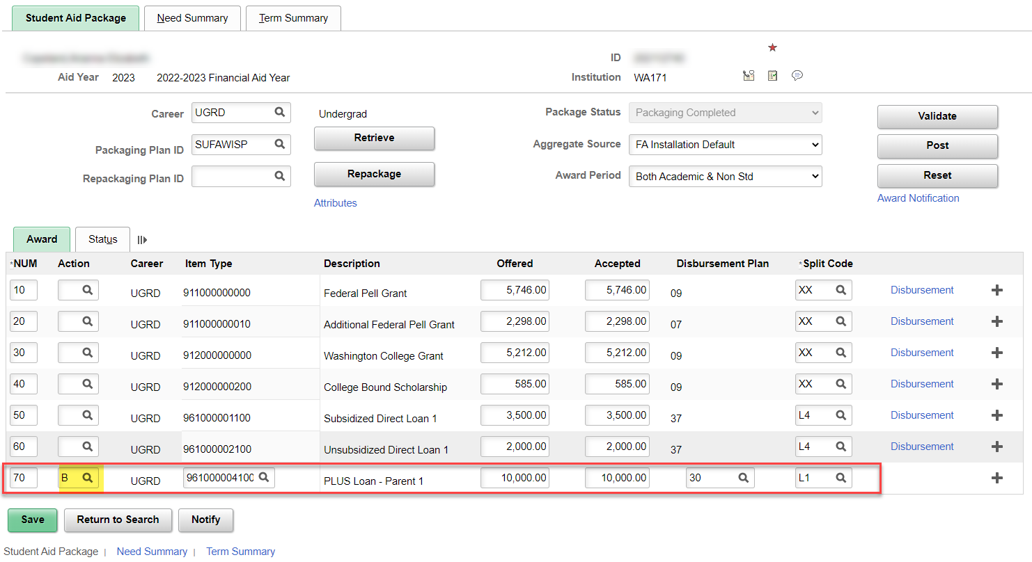
PLUS LOAN PROCESSING
AWARD PLUS LOAN
Navigation: Financial Aid > Awards > Award Processing > Assign Awards to a Student
Always sequence PLUS award at the end of the aid package so it deducts properly from COA

Slide 32
Loan origination outbound process
5-STEP PROCESS
Step 1: Award PLUS Loan
Step 2: Originate PLUS Loan
Step 3: Establish Relationship for Parent
Step 4: Link Parent to PLUS Loan Record
Step 4: Re-originate PLUS Loan

Slide 33
Plus loan processing cont’d
ORIGINATE SINGLE LOAN
Navigation: Financial Aid > Loans > Process Loans

Slide 34
Loan origination outbound process
5-STEP PROCESS
Step 1: Award PLUS Loan
Step 2: Originate PLUS Loan
Step 3: Establish Relationship for Parent
Step 4: Link Parent to PLUS Loan Record
Step 4: Re-originate PLUS Loan

Slide 35
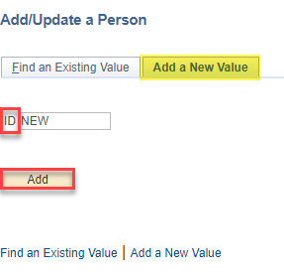
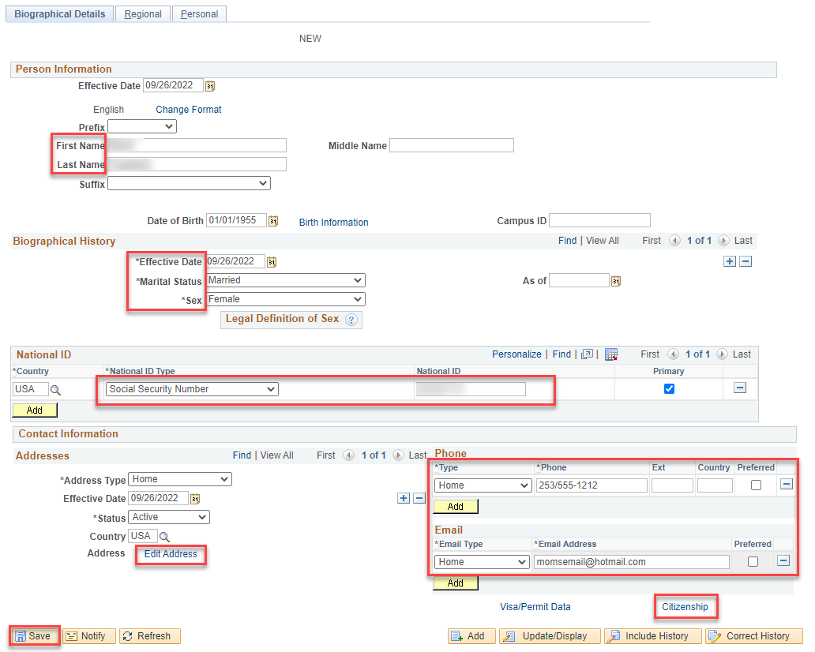
PLUS LOAN PROCESSING CONT’D
CREATE PARENT EMPL RECORD
Navigation: Campus Community > Personal Information > Add/Update a Person
If the parent has no existing EMPL in ctcLink, a EMPL record must be created so you’re able to link the parent borrower to the loan record.

Slide 36
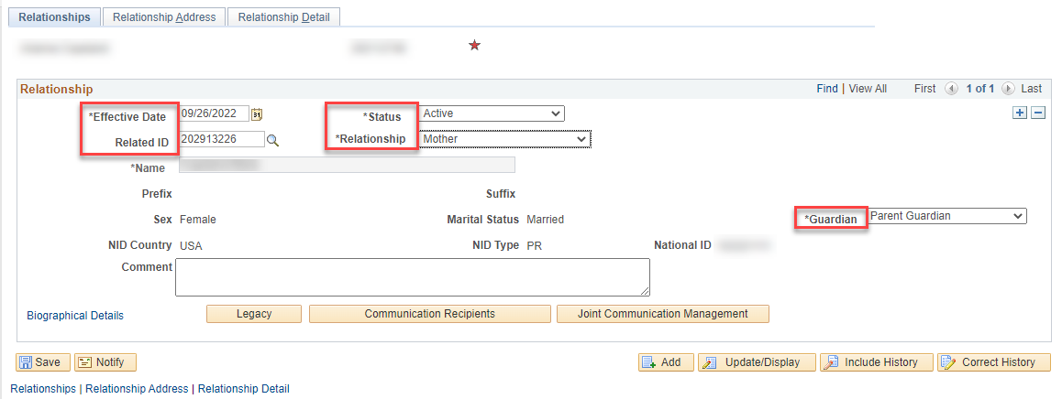
PLUS LOAN PROCESSING CONT’D
ESTABLISH RELATIONSHIP
Navigation: Campus Community > Personal Information > Add/Update a Person
Enter the student’s EMPL when establishing the relationship – not the parent. In the Related ID field, enter the parent’s new EMPL. Define the Relationship and the Guardianship status.

Slide 37
Loan origination outbound process
5-STEP PROCESS
Step 1: Award PLUS Loan
Step 2: Originate PLUS Loan
Step 3: Establish Relationship for Parent
Step 4: Link Parent to PLUS Loan Record
Step 4: Re-originate PLUS Loan

Slide 38
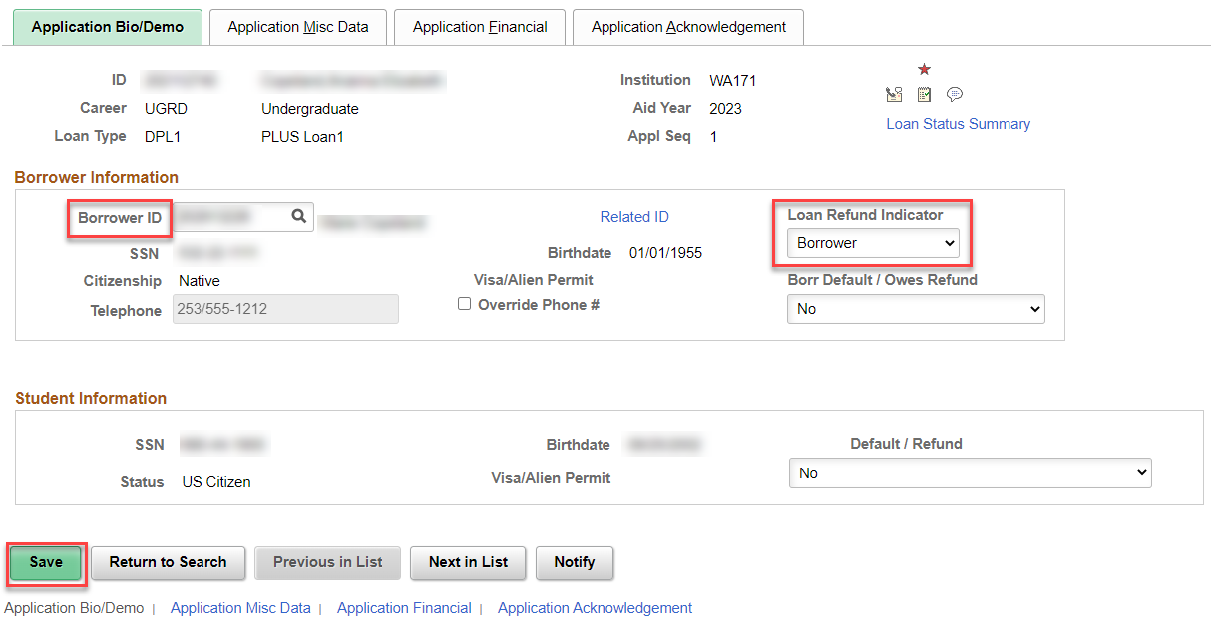
PLUS LOAN PROCESSING CONT’D
LINK PARENT TO PLUS LOAN RECORD
Navigation: Financial Aid > Loans > Direct Lending Management > Manage Direct Loan Application
Enter the parent’s EMPL into the Borrower ID field. Be sure to also define whether or not the refund should go to the Parent Borrower or the Student on the Loan Refund Indicator drop down box. Select Save.

Slide 39
Loan origination outbound process
5-STEP PROCESS
Step 1: Award PLUS Loan
Step 2: Originate PLUS Loan
Step 3: Establish Relationship for Parent
Step 4: Link Parent to PLUS Loan Record
Step 4: Re-originate PLUS Loan

Slide 40
LOAN origination single student
PROCESS LOANS
Navigation: Financial Aid > Loans > Process Loans

Slide 41
AWARDING AND
PROCESSING
A PRIVATE/ALT LOAN

Slide 42
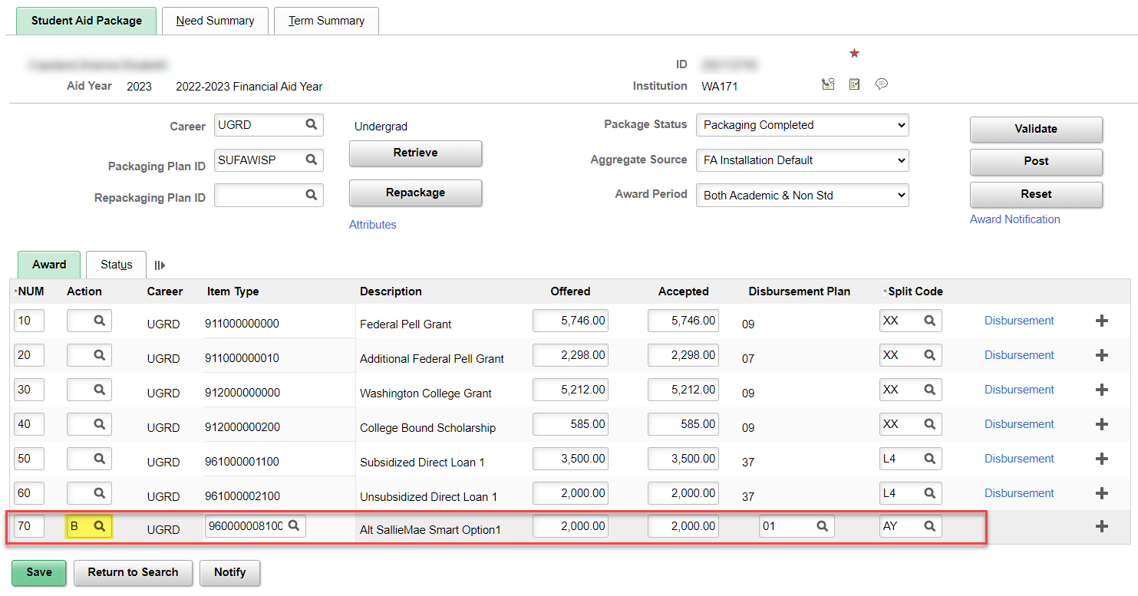
PRIVATE/ALT LOAN PROCESSING
AWARD PRIVATE/ALT LOAN
Navigation: Financial Aid > Awards > Award Processing > Assign Awards to a Student
Always sequence Private/ALT loan awards at the end of the aid package so it deducts properly from COA

Slide 43
PRIVATE/ALT LOAN processing
TWO WAYS TO PROCESS PRIVATE LOANS:
Award using a disbursable Item Type, and SF receives payment toward Customer Accounts
Award using a non-disbursable Item Type, and SF receives payment in Departmental Receipts or Third Party Payment

Slide 44
Outcomes
At training completion, you should be able to:
Understand the Loan Origination (Batch and Single Student) Process
Understand the Loan Origination Outbound and Inbound Process
Understand the Loan Disbursement Outbound and Inbound Process
Understand how to query for missing COD Files
Understand how to award and originate a PLUS Loan
Understand how to award and process a Private/ALT Loan

Slide 45
Congratulations!
You have successfully completed Loan Processing Refresher Just in Time Training!
Please refer to the ctcLink Reference Center for additional resource materials on today’s topics
Thank you for your participation today!

