Slide 1
JUST IN TIME TRAINING packaging plans
Deborah Englehardt
ctcLink Functional Analyst | Financial Aid
September 2022

Slide 2
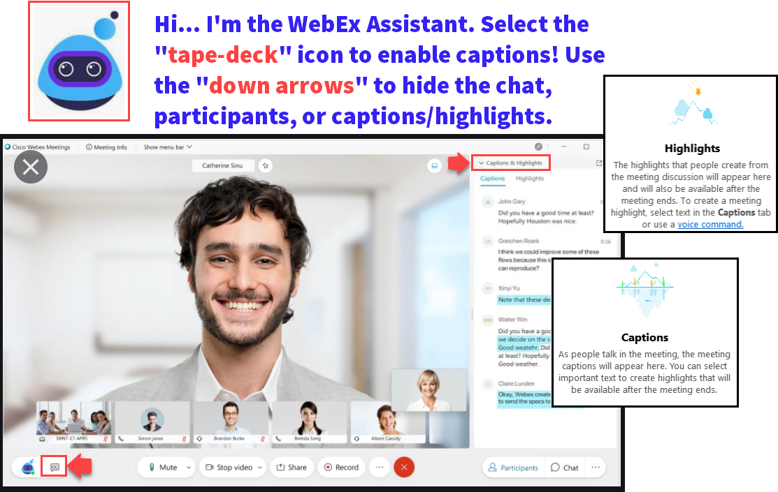

Slide 3
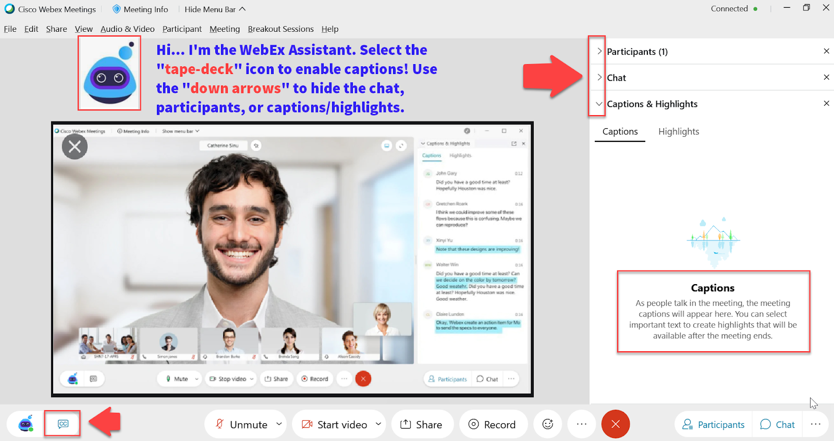

Slide 4
Logistics and Agenda
Times | Activity
9:00 – 9:10 | Greet/Attendance/Objectives
9:10 – 10:10 | Packaging Plans
10:10 – 10:25 | CBS Packaging
10:25– 10:35 | Using CTC_SELCT_NO
10:35 – 10:45 | Repackaging Plans
10:45 – 11:00 | Session Wrap-Up/ Q&A

Slide 5
ground rules
Be ready to participate
Remove external distractions
Mute your line when not speaking
Do NOT place Webex line on hold. Use Mute.
Please leave your line on Mute unless you are speaking
Sessions are being recorded
Allow your peers to complete their thoughts before beginning yours

Slide 6
Objectives
After completing this training, you should be able to:
Understand packaging plans and repackaging plans
Update your packaging and repackaging plans
Understand what to watch out for with CBS packaging
Understand how to use CTC_SELCT_NO

Slide 7
Helpful queries for reviewing packaging plans, Repackaging plans, and related item type groups
Navigation: Navigator > Reporting Tools > Query > Query Viewer
CTC_FA_LC_AYRO_PKG_PLAN_RULES
CTC_FA_LC_AYRO_RLTD_ITEM_TYPES
CTC_FA_LC_AYRO_RPKG_PLAN_RULES

Slide 8
Packaging Plans

Slide 9
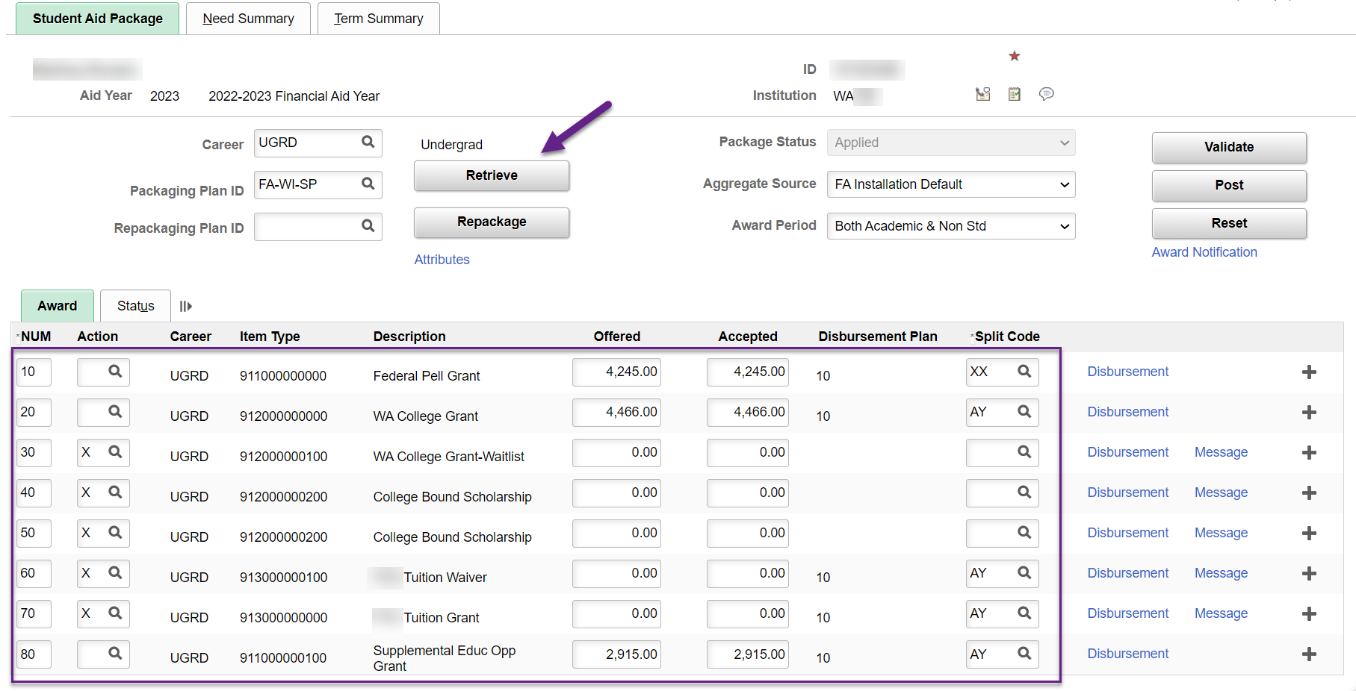
When you select retrieve on the ASSIGN Awards to a student page for an eligible student, what do you see?
Navigation: Navigator > Financial Aid > Awards > Award Processing > Assign Awards to a Student

Slide 10
Packaging plans
Each plan can have a different set of awards, with different award limits, targeted for different populations of students. Your philosophy about financial aid awarding informs the setting up and adding of packaging plans. Packaging plans are aid year-specific but can be copied from year to year and modified to reflect any changes for the new aid year. - Oracle
Institution and Aid Year specific
Equation engines used in the packaging plans can be global or institution specific
Pell, WCG, CBS, DL SUB/UNSUB - global
College grant, SEOG, NBTW, Work Study – tend to be institutional
Each award can be set with it’s own award status of ‘Offer’ or ‘Offer/Accept’
Awards limits other than Pell, are determined by a constant or equation engine

Slide 11
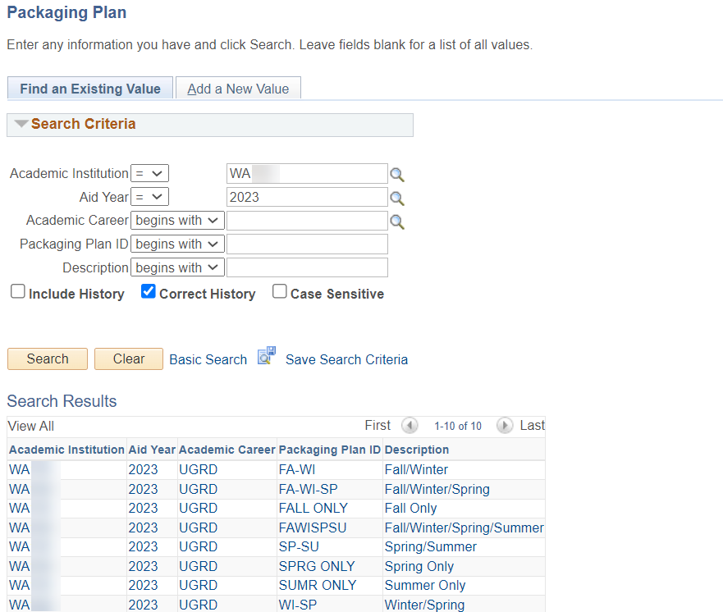
Let’s explore Packaging plans!
Navigation: Navigator > Set Up SACR > Product Related > Financial Aid > Awards > Packaging Plan

Slide 12
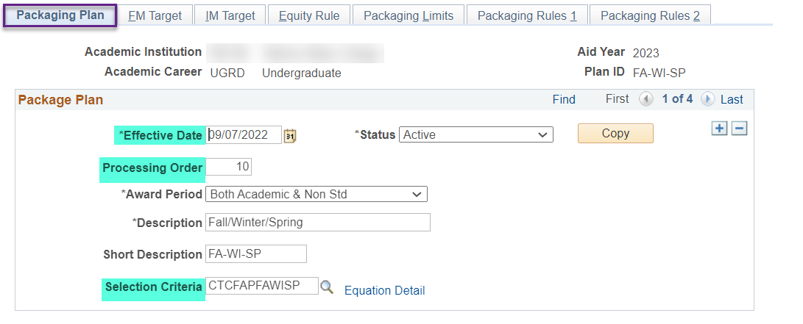
Packaging plan tab
When updating a packaging plan, add a row by selecting the + button which will populate an effective date of today.
Effective date is 01/01/1901 or the most recent date the packaging plan was updated. You can select a future date if needed
Processing Order determines the order in which the packaging plans are reviewed. Numbers will be different header vs trailer
Selection Criteria determines which students are selected to be evaluated for the packaging plan. The global selection equations looks for active FA terms with no withdraw codes of ‘CAN’ or ‘WDR’ and doesn’t have FA Load ‘N’

Slide 13
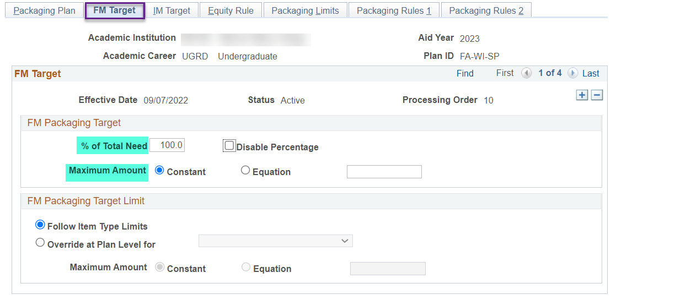
Fm target tab
All packaging plans do not have a FM packaging target less than 100% at this time. Colleges that have gift aid target limits are using the Packaging Rules 1 tab to control certain item types being awarded up to target limits.

Slide 14
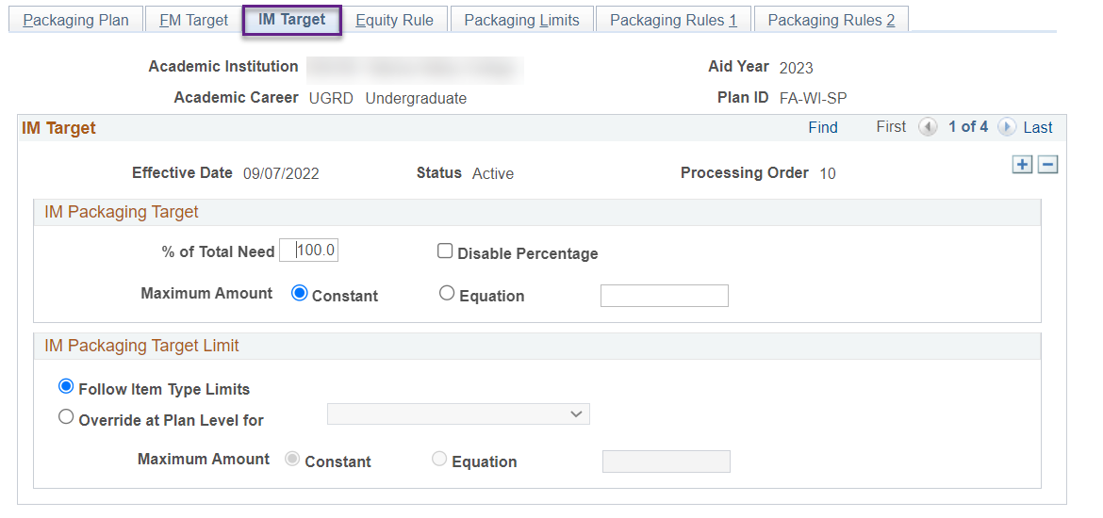
IM Target tab
The system is set up for Federal Methodology no Institutional Methodology. Colleges are not using Institutional Methodology Target.

Slide 15
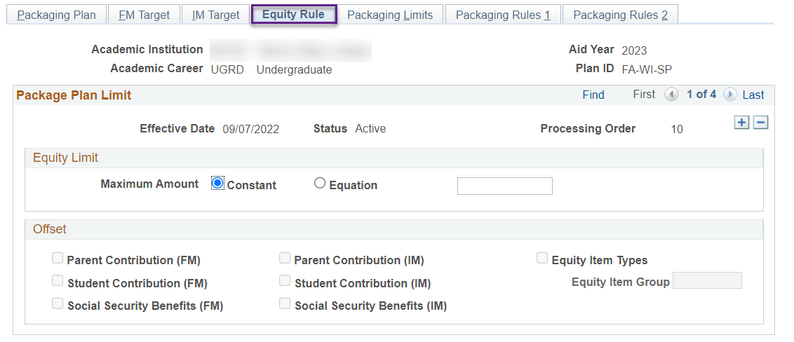
Equity rule tab
No college is currently using this feature. Colleges are using the Packaging Rules 1 tab to select and award item types.

Slide 16
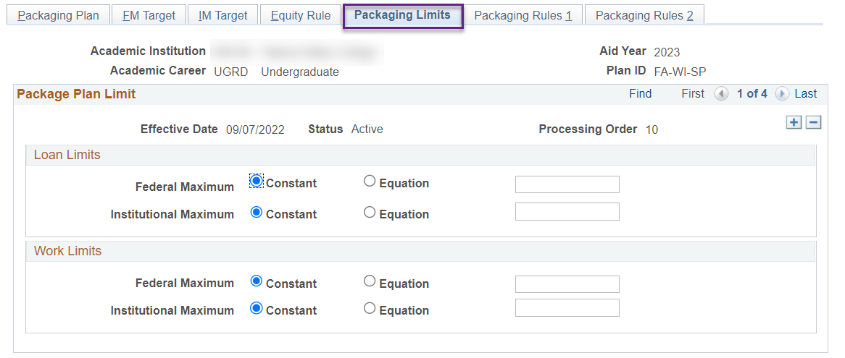
Packaging limits tab
No college is currently using this feature. Colleges are using the Packaging Rules 1 tab to select and award item types.

Slide 17
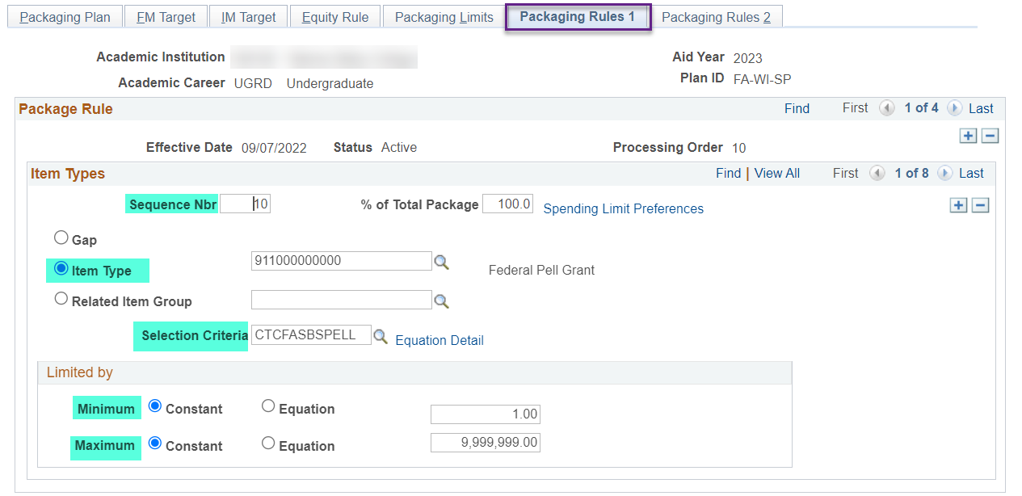
Packaging rules 1 tab
Notes on Gap
Because the Packaging routine dynamically determines the gap financial aid item type based on defaults (aid processing rule set or installation defaults), you do not (and cannot) enter the gap financial aid item type on this page. - Oracle
Sequence number determines the order the packaging rules are processed and should match the order of your packaging policy
Item type only populates item-types that are defined as Auto Package on the Financial Aid Item Types page, tab 2 (Screenshot is on the next slide 😊)
Selection criteria defines the population via the selected global or institution-specific equation engine
Limited by Minimum and Maximum (two options)
Constant = Enter the annual dollar amount limit considering the number of quarters for that packaging plan
Equation = Select the global or institution-specific awarding amount equation engine

Slide 18
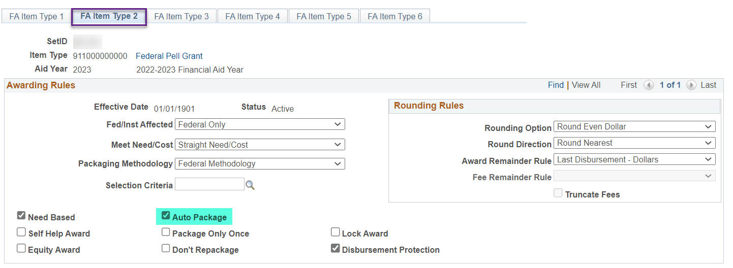
Financial aid item types, tab 2
Navigation: Navigator > Set Up SACR > Product Related > Financial Aid > Awards > Financial Aid Item Types

Slide 19
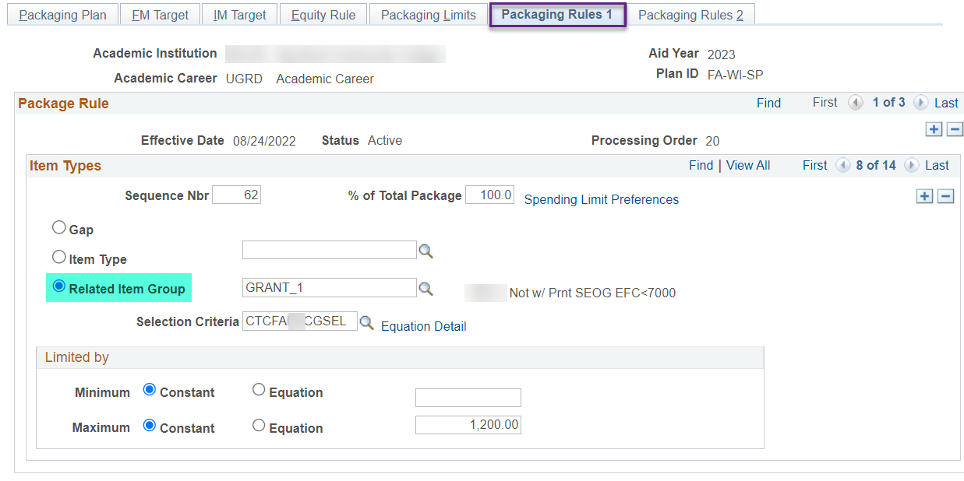
Related Item type group
Related item type groups are used at colleges where there are a group of similar institutional funds that is awarded in a specific order. - Oracle
The Related Item Type Group must be created on the Related Item Type Group page (Set Up SACR > Product Related > Financial Aid > Awards > Related Item Type Group) before it appears as an option to select in the packaging plan.
An example of a college’s Related Item Type Group is on the next slide 😊

Slide 20
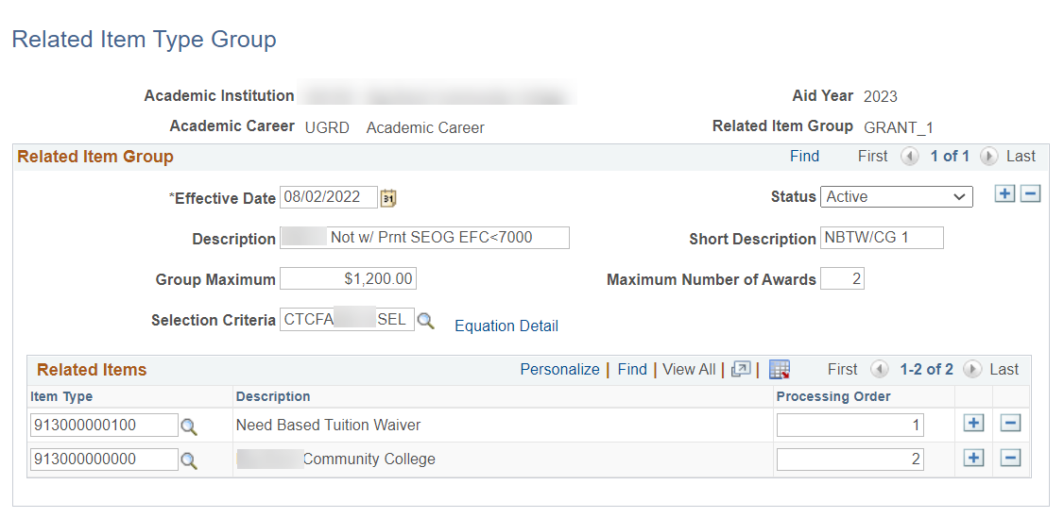
Related Item type group Example
Navigation: Navigator > Set Up SACR > Product Related > Financial Aid > Awards > Related Item Type Group
The college has a packaging policy of awarding $400 per quarter for WA resident students whose housing are not with parents, has no SEOG awarded and EFC is less than 7000
The college is going to award Need Based Tuition Waiver until funds are depleted and wants to switch to awarding Institutional College Grant afterwards

Slide 21
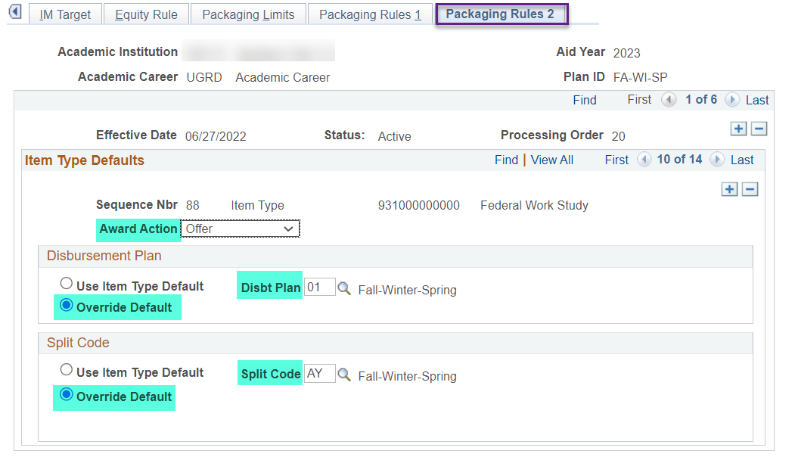
Packaging rules 2 tab
Award Action options are ‘Offer’ or ‘Offer/Accept’. Generally, grants are set up to award in Offer/Accept status while Work Study and DL Sub/Unsub are in awarded in ‘Offer’ status
Override Default needs to checked to honor the Disbt Plan and Split Code values you entered in this tab for that item-type
Disbt Plan will determine the number of buckets that will be opened for that item-type
Split Code will determine how much of the maximum amount defined on the Packaging Rules 1 tab for the item-type will go in which bucket

Slide 22
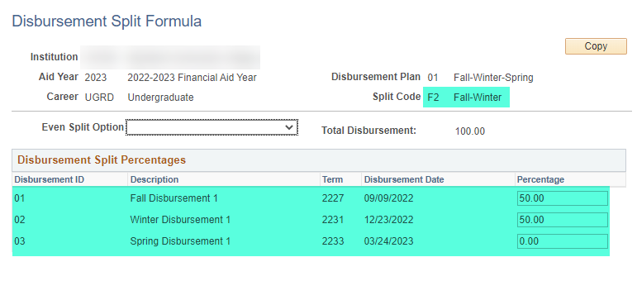
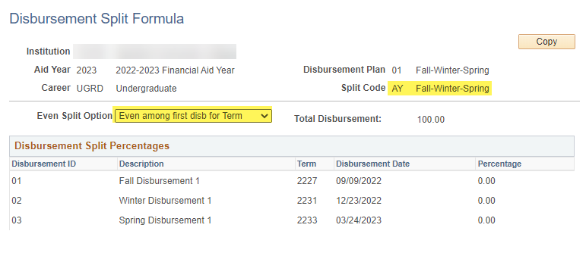
Split code
Navigation: Navigator > Set Up SACR > Product Related > Financial Aid > Awards > Disbursement Split Cd Formula
Example of Fa-Wi-Sp buckets are opened and money is going into Fall and Winter only:
Fall 50%
Winter 50%
Spring 0%
Example of Fa-Wi-Sp buckets are opened and money is evenly split into the three quarters

Slide 23
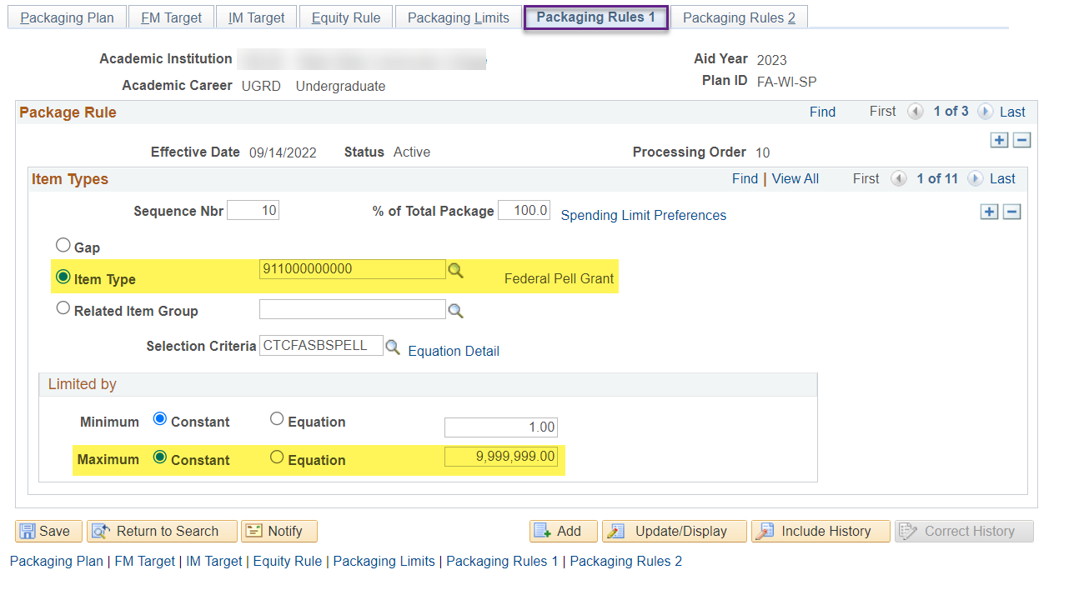
Pell is special
Pell does not look to an equation engine to determine awarding amounts. The system looks at different areas such as Pell Table, Pell Aggregates, FA Load, etc. to determine the award amount per quarter for the student.

Slide 24
CBS Packaging

Slide 25
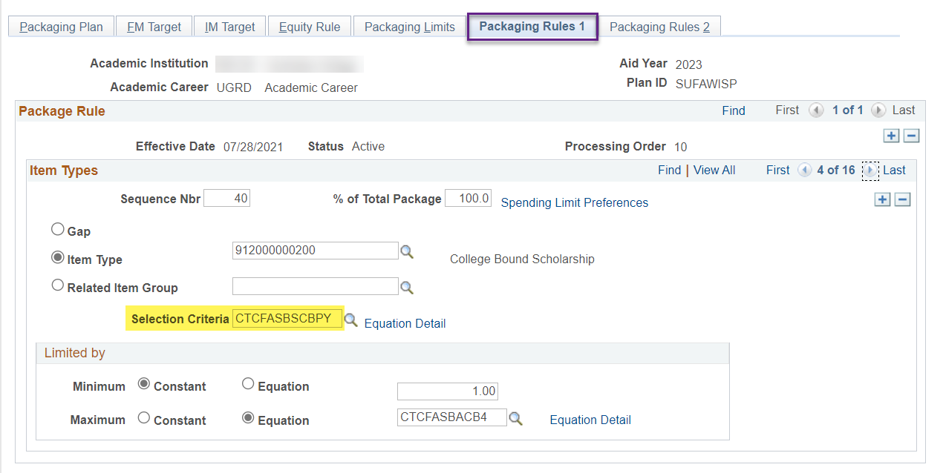
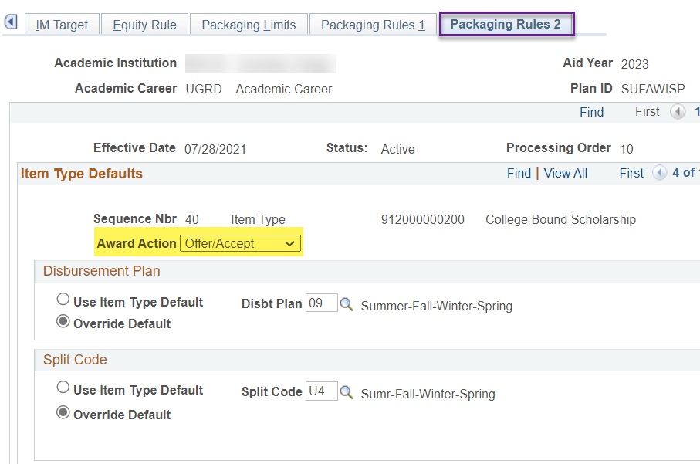
CBS Packaging Okay to Pay
CTCFASBSCPY selects students have a CBS eligibility status of ‘Okay to Pay’ so the award action is ‘Offer/Accept’

Slide 26
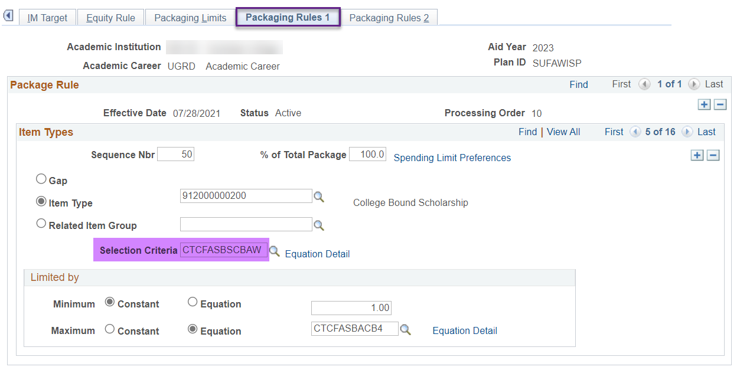
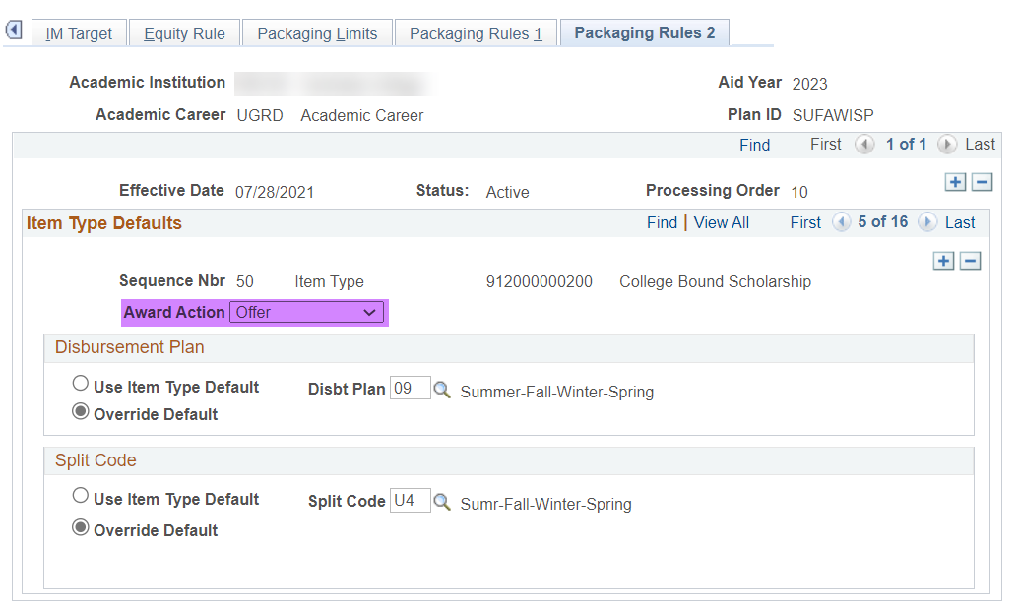
CBS Packaging okay to award
CTCFASBSCBAW selects students have a CBS eligibility status of ‘Okay to Award’ so the award action is ‘Offer’

Slide 27
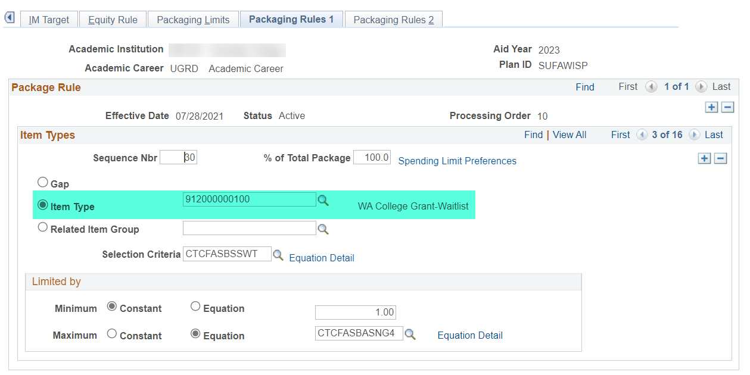
CBS award amount equations and WCG Waitlist item-type
All four of the CBS award amount calculating equation engines (CTCFASBACB1, CTCFASBACB2, CTCFASBACB3 & CTCFASBACB4) look for the existence of the WA College Grant Waitlist 91200000100 in your packaging plans.
Please do no delete the WCG Waitlist item-type from your packaging plans.

Slide 28
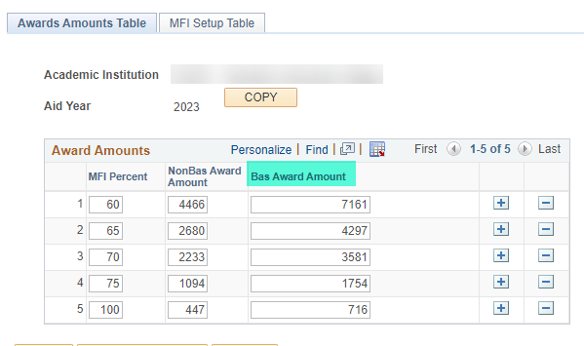
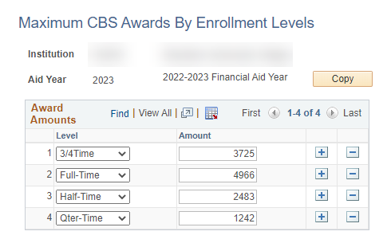
CBS award amount equations and BAS students
All four of the CBS award amount calculating equation engines (CTCFASBACB1, CTCFASBACB2, CTCFASBACB3 & CTCFASBACB4) finds the CBS annual amount for the student and subtracts the WCG amount from it.
Note: For BAS students, the CBS equations engines will not calculate amounts correctly since the CBS Setup table has no BAS Award Amount column.
For example: A BAS student is 60% MFI and CBS eligible. WCG is $7161
CBS is 4966 – 7161 = 2195
Navigation: Navigator > Set Up SACR > Product Related > Financial Aid > CTC Custom > CTC interfaces > WCG Setup
Navigation: Navigator > Set Up SACR > Product Related > Financial Aid > CTC Custom > CTC interfaces > College Bound Setup

Slide 29
Using CTC_SELCT_NO

Slide 30
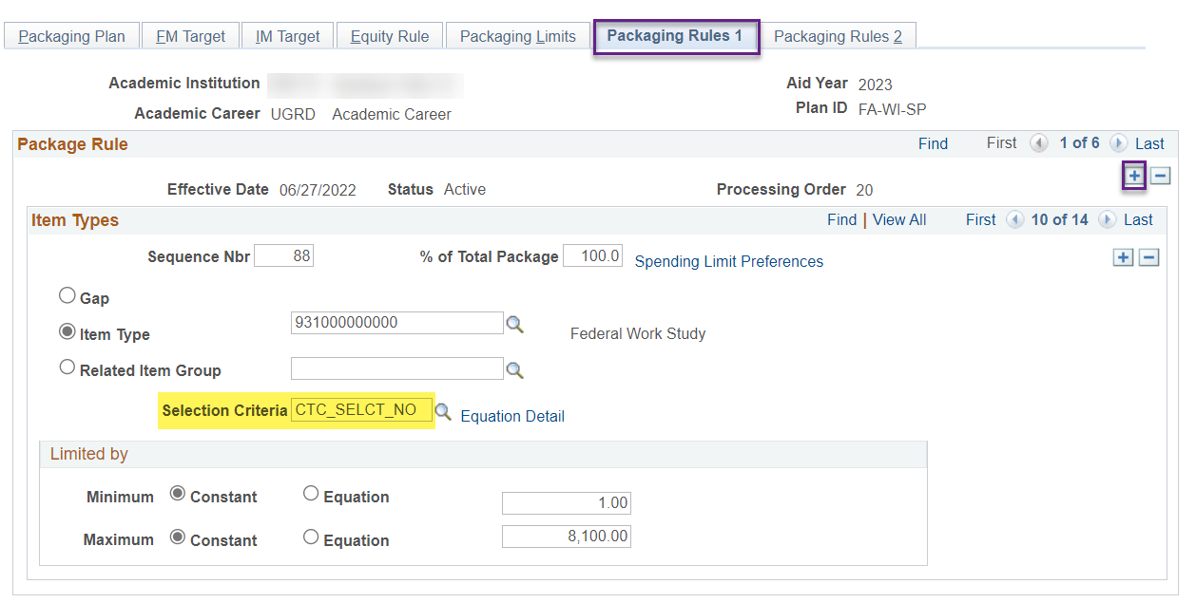
Using CTC_SELCT_NO
Navigation: Navigator > Set Up SACR > Product Related > Financial Aid > Awards > Packaging Plan
Once the item-type reaches its defined budget limits set up on the Fiscal Item Types page (Set Up SACR > Product Related > Financial Aid > Awards > Fiscal Item Types), the packaging plan will no longer award that item-type
If you no longer want an item-type to package on a specific packaging plan to save funds for other packaging plans, add a new effective dated row of today then select CTC_SELECT_NO for the Selection Criteria instead of deleting the item-type from the packaging plan

Slide 31
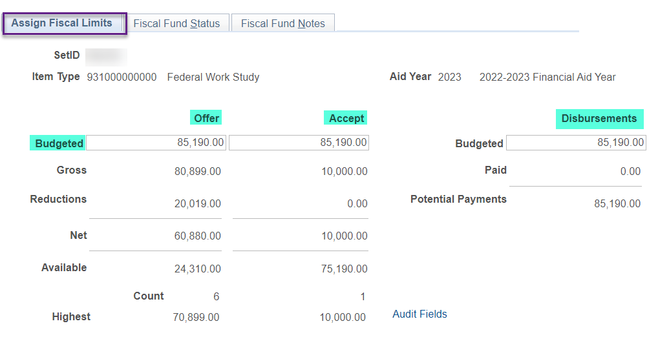
Fiscal item types page
Navigation: Navigator > Set Up SACR > Product Related > Financial Aid > Awards > Fiscal Item Types
You can increase and decrease the Offer, Accept and Disbursements amounts as necessary in real time. There is no effective date on this page.

Slide 32
Repackaging Plans

Slide 33
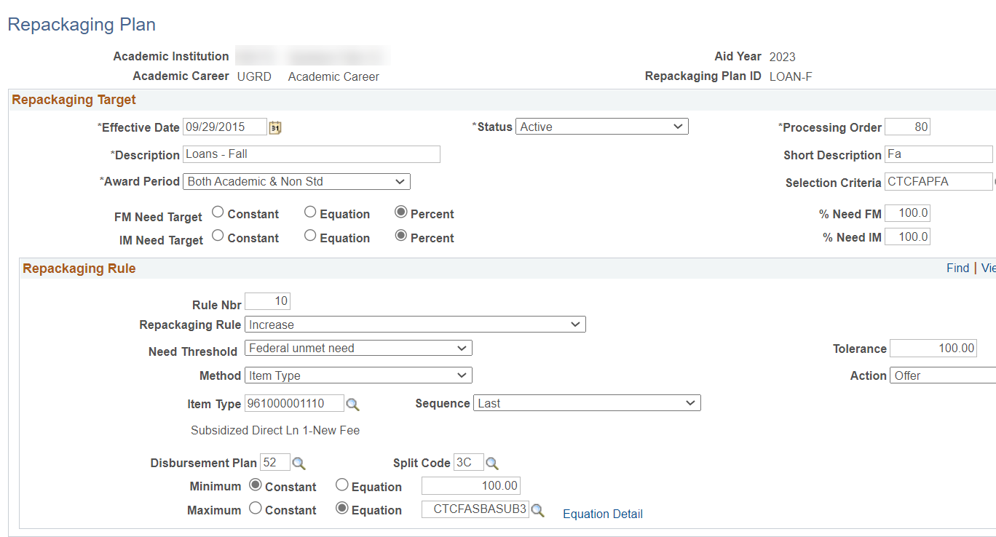
repackaging plans
Navigation: Navigator > Set Up SACR > Product Related > Financial Aid > Awards > Repackaging Plan
If you would like to learn more about repackaging plans, here is the link
Setting Up a Repackaging Plan (oracle.com)
Institution and Aid Year specific
The only repackaging plans SBCTC set up for all colleges are related to DL Sub/Unsub

Slide 34
Outcomes
At training completion, you should be able to:
Understand packaging plans and repackaging plans
Update your packaging and repackaging plans
Understand what to watch out for with CBS packaging
Understand how to use CTC_SELCT_NO

Slide 35
Congratulations!
Just in Time Packaging Plans Training complete!
Join us for the Drop in Q&A Follow Up Session
Please review the videos and additional resources in your canvas course material
Thank you for your participation today!

