Slide 1
JUST IN TIME TRAINING AUTHORIZATION REFRESHER
Kelly Forsberg
ctcLink Functional Trainer | Financial Aid
September 2022

Slide 2
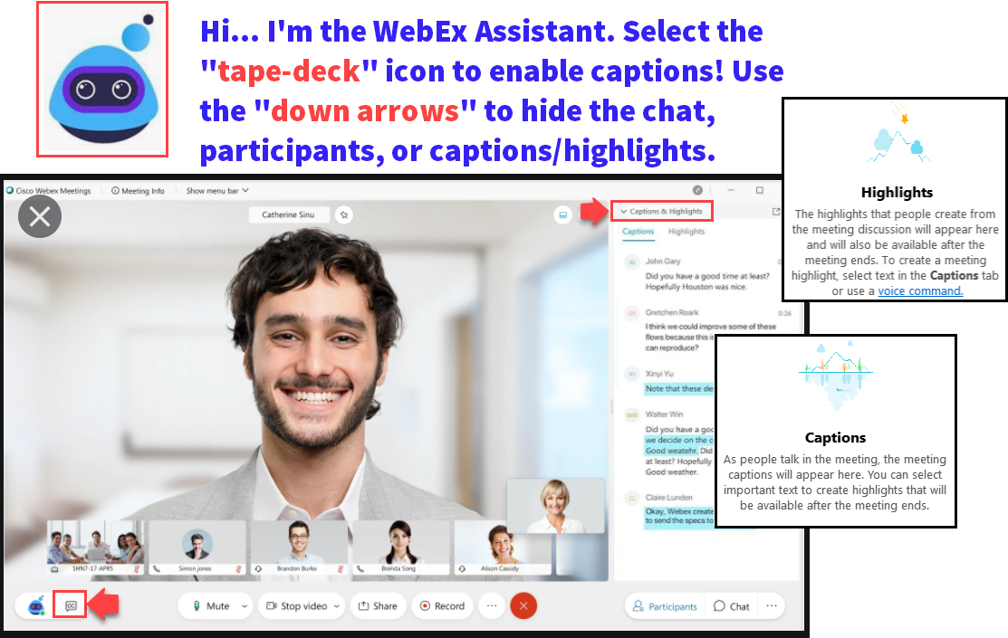

Slide 3
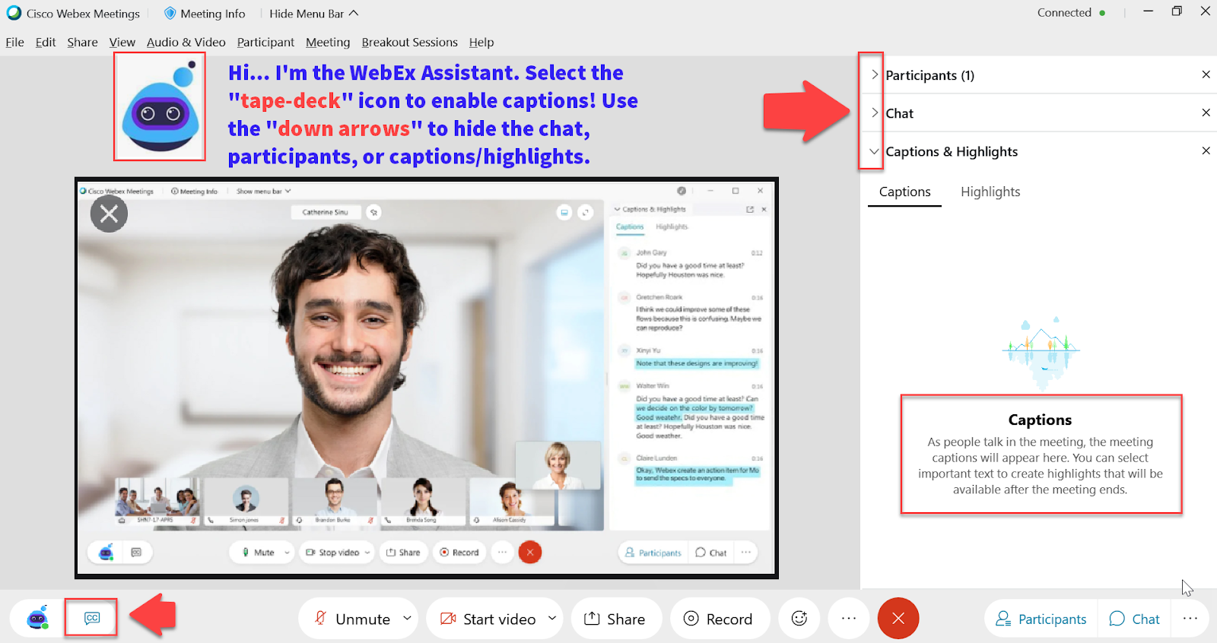

Slide 4
Logistics and Agenda
Times | Activity
9:00 – 9:10 | Greet/Attendance/Objectives
9:10 – 9:30 | Authorization in Batch
9:30 – 10:30 | Authorization Failure Report
10:30 – 11:00 | Session Wrap-Up/ Q&A

Slide 5
ground rules
Be ready to participate
Remove external distractions
Mute your line when not speaking
Do NOT place Webex line on hold. Use Mute.
Please leave your line on Mute unless you are speaking
Sessions are being recorded
Allow your peers to complete their thoughts before beginning yours

Slide 6
Objectives
After completing this training, you should be able to:
Run Batch Authorization
Run and Review the Authorization Failure Report

Slide 7
AUTHORIZATION IN BATCH

Slide 8
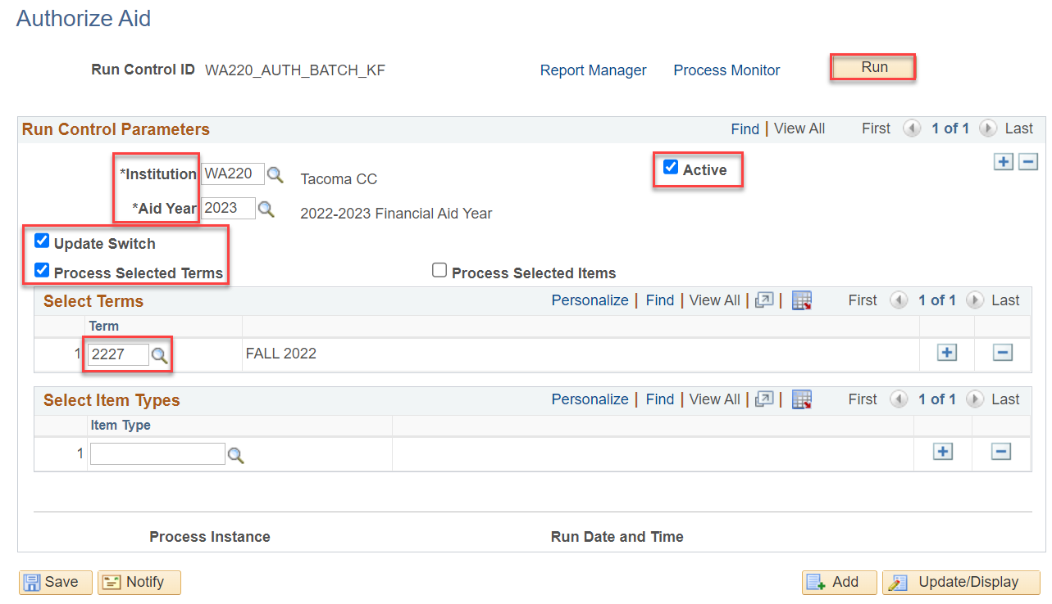
Run authorization process cont’d
PROCESS IN BATCH
Navigation: Nav Bar > Navigator > Financial Aid > Disbursement > Process Award Authorization
*Unselecting “Update Switch” runs authorization in simulation
**Selecting “Update Switch” runs authorization in final mode

Slide 9
DEMONSTRATION

Slide 10
AUTHORIZATION FAILURE REPORT

Slide 11
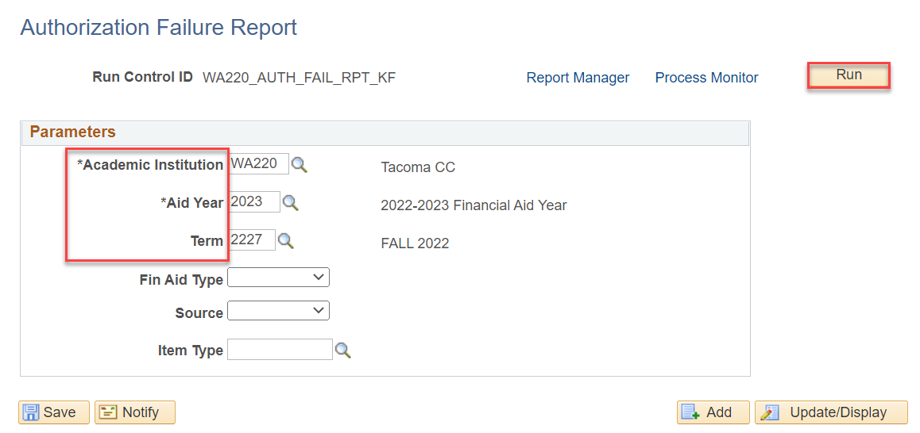
Run authorization failure report
PROCESS IN BATCH
Navigation: Nav Bar > Navigator > Financial Aid > Disbursement > Authorization Failure Report
Use Term 2227 and 2023 AY

Slide 12
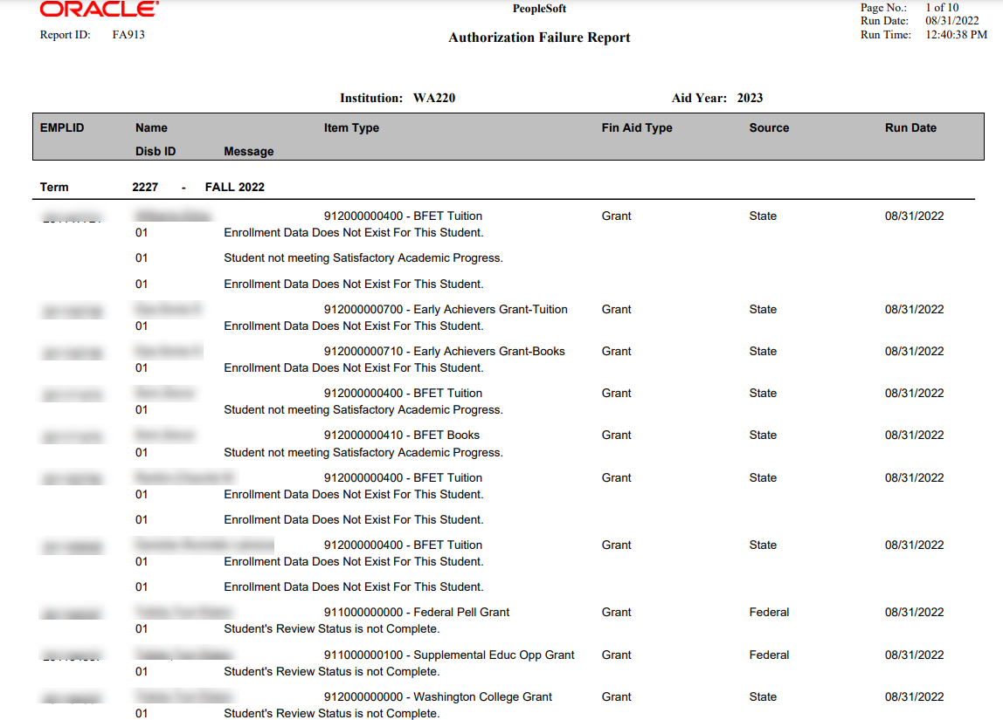
Run authorization failure report
VIEWING THE REPORT
Can be run as a PDF or Sortable Excel Spreadsheet

Slide 13
DEMONSTRATION

Slide 14
Flf process
NEXT STEPS:
FLF Process
Re-run Authorization in Batch
Run Disbursement in Batch

Slide 15
Outcomes
At training completion, you should be able to:
Run Batch Authorization
Run and Review the Authorization Failure Report

Slide 16
Congratulations!
Just in Time Authorization Refresher Training Complete!
Join us for the Drop in Q&A Follow Up Session
Please review the videos and additional resources in your canvas course material as you progress through testing
Thank you for your participation today!

