Slide 1
Just in time training flf and disbursement refresher
Kelly Forsberg
ctcLink Functional Trainer | Financial Aid
September 2022
Notes:
Welcome to your end user training for Authorization and Disbursement for Fin Aid in ctcLink

Slide 2
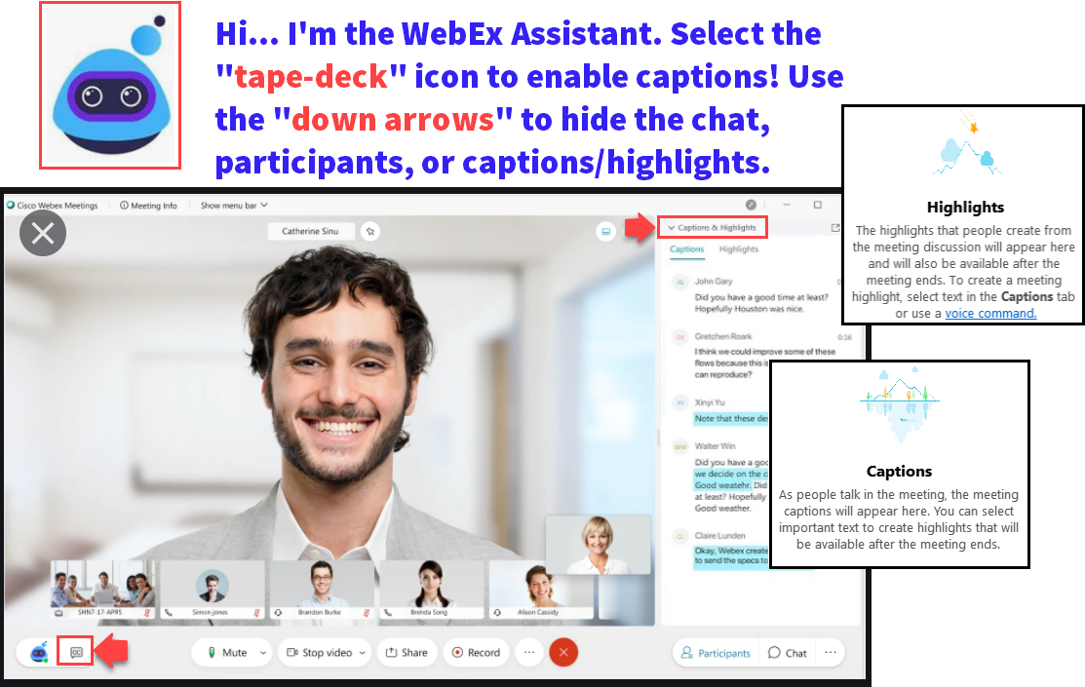

Slide 3
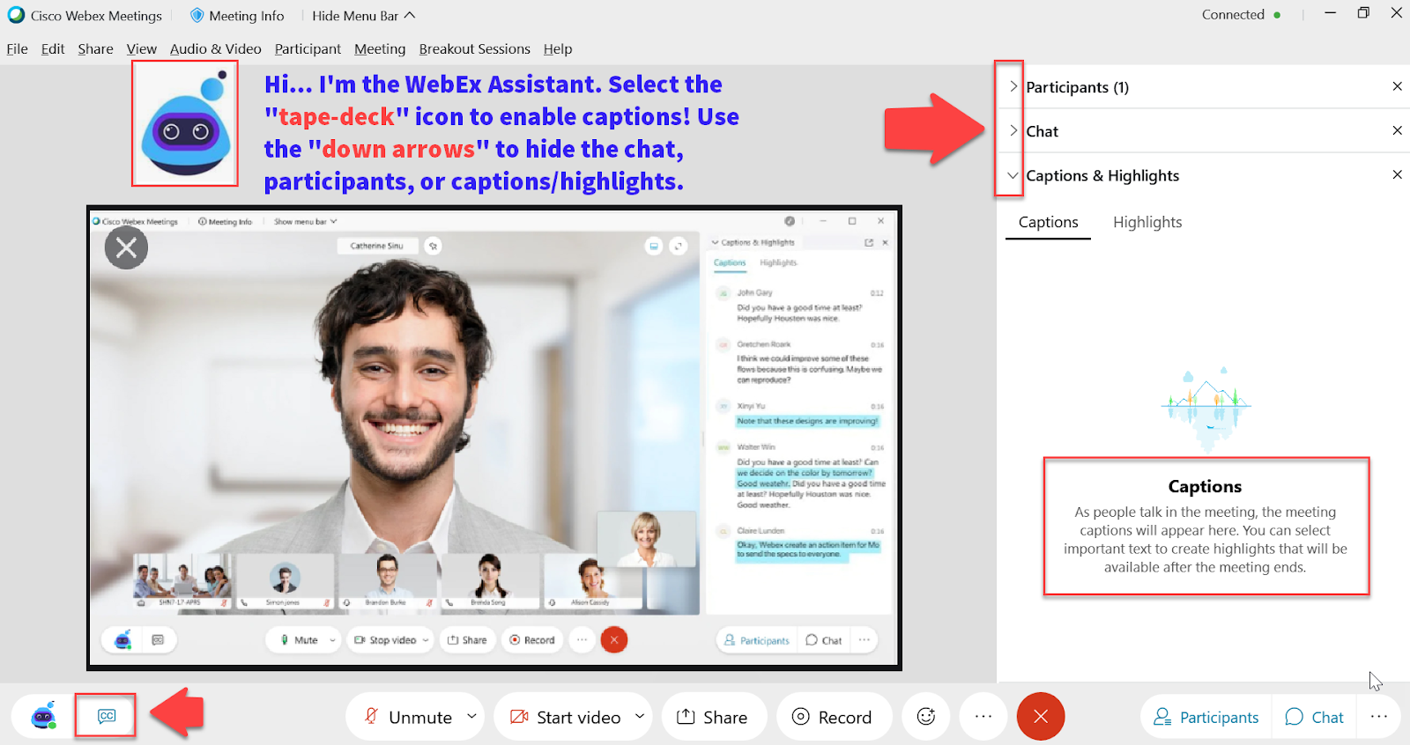

Slide 4
ground rules
Be ready to participate
Remove external distractions
Mute your line when not speaking
Do NOT place Webex line on hold. Use Mute.
Please leave your line on Mute unless you are speaking
Sessions are being recorded
Allow your peers to complete their thoughts before beginning yours

Slide 5
Objectives
After completing this training, you should be able to:
FLF Process:
Assigning Packaging Variables
Mass Assign FLF Service Indicator
Adjust Aid
Remove FLF Service Indicator
Service Indicator List (Query)
Update Packaging Variables
Re-run Authorization in Batch
Disbursement in Batch
Manually Override Disbursement

Slide 6
FLF PROCESS

Slide 7
Populate packaging variables
Navigation: Nav Bar > Navigator > Set Up SACR > System Administration > Utilities > Population Update > Population Update Process
Use the 2023 Aid Year

Slide 8
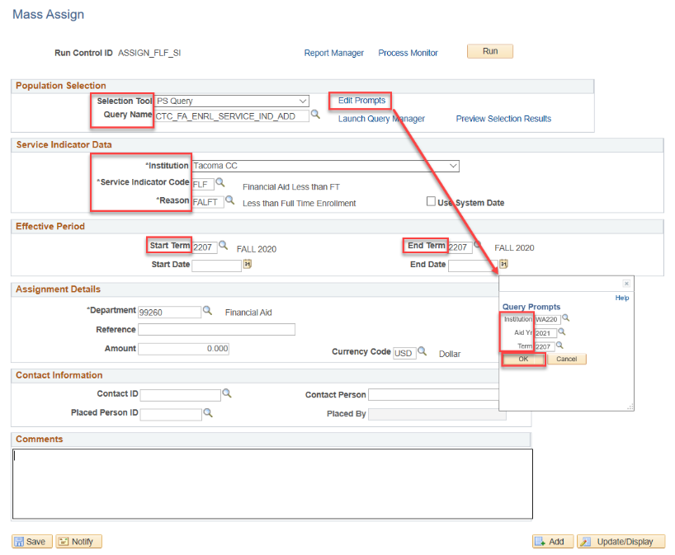
Mass assign flf service indicator
DEPENDENCIES
Navigation: Nav Bar > Navigator > Campus Community > Service Indicators (Student) > Mass Assign
Use Term 2225 and 2023 AY

Slide 9
Flf process
NEXT STEPS:
Manually, or Batch, remove FLF Service Indicator
Re-run Authorization in Batch
Run Disbursement in Batch

Slide 10
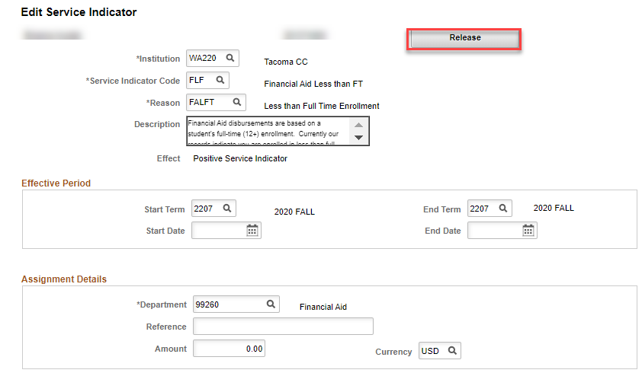
FLF PROCESS – release flf srvc ind
Navigation: Nav Bar > Navigator > Campus Community > Service Indicators > Person > Manage Service Indicators
MANUALLY OR IN BATCH
Release Service Indicator, and proceed to re-run Authorize and Disburse

Slide 11
DEMONSTRATION

Slide 12
BATCH DISBURSEMENT

Slide 13
BATCH DISBURSEMENT
DEPENDENCY: AFTER FLF PROCESS, RE-RUN AUTHORIZATION & DISBURSEMENT
Navigation: Nav Bar > Navigator > Financial Aid > Disbursement > Process Disbursements
You can run two terms at a time, or one at a time.

Slide 14
Disbursed, now what?
NEXT STEPS:
Contact SF and let them know you have disbursed, and that they should be ready to perform a:
Group Post!

Slide 15
DEMONSTRATION

Slide 16
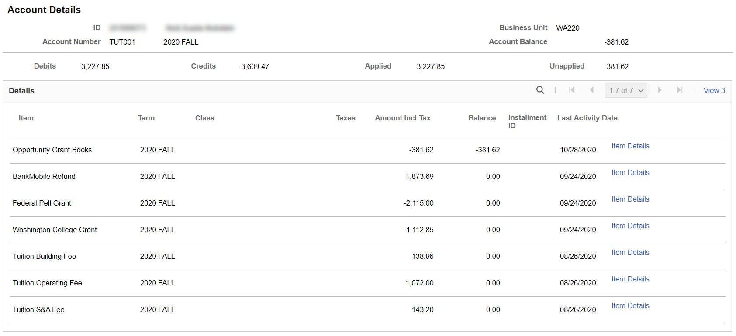
VIEW CUSTOMER ACCOUNTS
Navigation: Nav Bar > Navigator > Student Financials > View Customer Accounts
DISPLAYS ACCOUNT ACTIVITY:
Example only – review Account Details after Pell has posted and Refund has been issued.

Slide 17
QUERIES

Slide 18
QUERIES
USEFUL QUERY TO TRACK THE GROUP POST AMOUNT FOR YOUR DISBURSEMENT RUN
CTC_FA_DISBURSED_BY_DATE
Run and save this query with each disbursement run

Slide 19
QUERIES
USEFUL QUERY TO TRACK WITHDRAWALS UP UNTIL CENSUS
CTC_FA_LOAD_COMP_BETWEEN_DATE – compares students with different FA load level when disbursed to date entered in prompt
Run and work this query daily up until Census

Slide 20
Outcomes
At training completion, you should be able to:
FLF Process:
Assigning Packaging Variables
Mass Assign FLF Service Indicator
Adjust Aid
Remove FLF Service Indicator
Service Indicator List (Query)
Update Packaging Variables
Re-run Authorization in Batch
Disbursement in Batch
Manually Override Disbursement

Slide 21
Congratulations!
FLF Process and Disbursement Refresher Training complete!
Please come to the Drop In Q&A Support Session!
Please review the videos and additional resources in your canvas course material as you progress through testing
Thank you for your participation today!

