Slide 1
JUST IN TIME TRAINING AWARDING/PACKAGING
Kelly Forsberg
ctcLink Functional Trainer | Financial Aid
August 2022

Slide 2
ground rules
Be ready to participate
Remove external distractions
Mute your line when not speaking
Do NOT place Webex line on hold. Use Mute.
Please leave your line on Mute unless you are speaking
Sessions are being recorded
Allow your peers to complete their thoughts before beginning yours
Please return from breaks on time

Slide 3
Objectives
After completing this training, you should be able to:
Packaging without enrollment data
Online package, understanding the difference between the Retrieve button vs. Assigning a packaging plan
Understand how to package financial aid without enrollment data
Understand how to package financial aid without a FAFSA
Understand the Invoke a Professional Judgment award page

Slide 4
ONLINE
PACKAGING

Slide 5
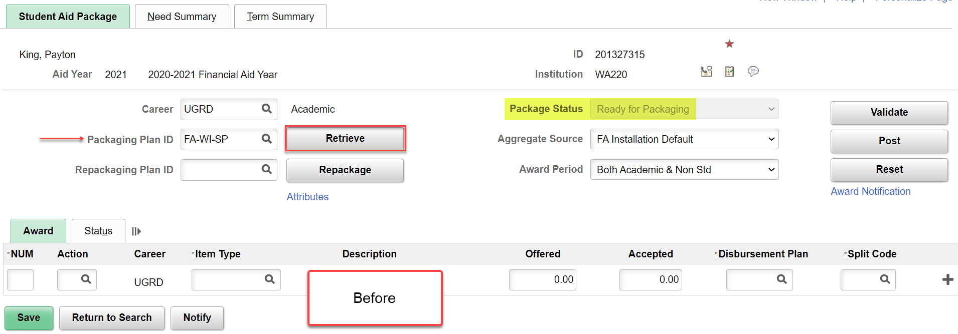
ONLINE PACKAGING
RETRIEVE PACK PLAN ID
Navigation: Nav Bar > Navigator > Financial Aid > Awards > Award Processing > Assign Awards to a Student
Select the Retrieve button or select the desired Packaging Plan ID, and select Retrieve.
*Tip! If awarding at the beginning of the AY, select the Packaging Plan that includes all four quarters, i.e., For trailers, FA-WI-SP-SU

Slide 6
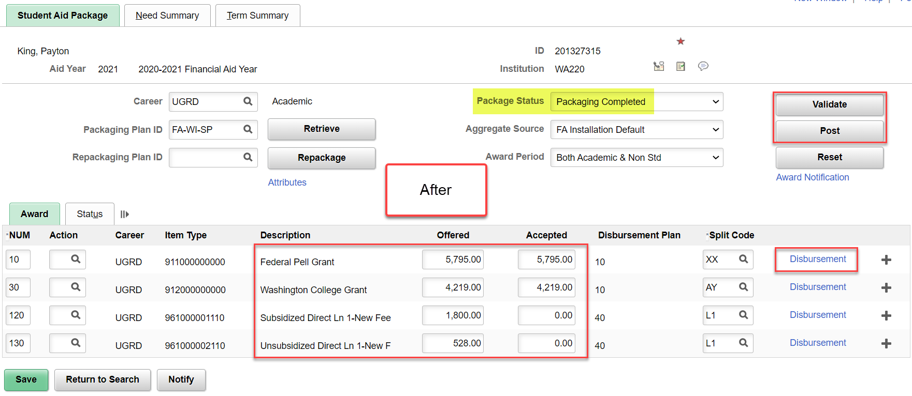
ONLINE PACKAGING
REVIEW AID POST
When satisfied with the award, select Validate and Post. Note the Packaging Status is now “Packaging Completed”
*Tip! Before Posting, select the Disbursement link to view how the system split the aid – manual adjustment may be required.

Slide 7
DEMONSTRATION

Slide 8
ONLINE PACKAGING FINANCIAL AID ON A NON-ENROLLED STUDENT

Slide 9
ONLINE PACKAGING FA FOR A NON-ENROLLED STUDENT
PRELIMINARY STEPS
Step 1: Manual FA Term Build
Step 2: Manual Budget Build

Slide 10
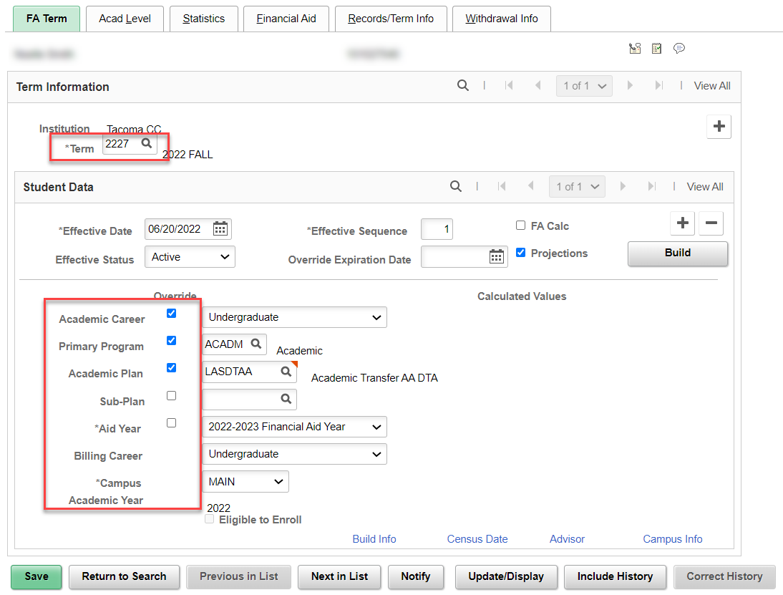
ONLINE PACKAGING A NON-ENROLLD STU
Navigation: Financial Aid > Financial Aid > Financial Aid Term > Maintain FA Term
STEP 1 – BUILD FA TERM
If you have loaded the student’s FAFSA but the overnight processes have not run yet, you will have to Manually Build FA Term. Repeat for all terms in AY.
Enter the most basic required fields in FA Term. Uncheck the override boxes OR, if left checked as overridden, you may opt to use Override Expiration as described in the QRG. Select OK to save.

Slide 11
ONLINE PACKAGING FA FOR A NON-ENROLLED STUDENT
PRELIMINARY STEPS
Step 1: Manual FA Term Build
Step 2: Manual Budget Build

Slide 12
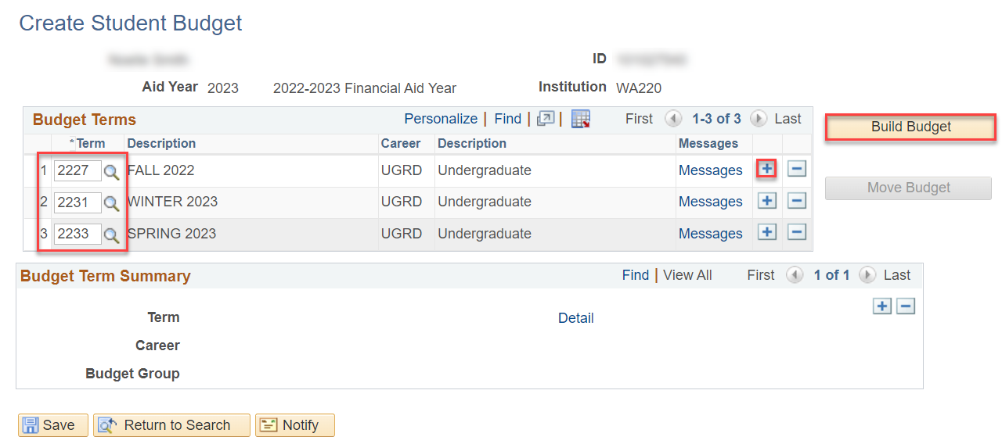
ONLINE PACKAGING FOR NON-ENROLLED
STEP 2 – BUILD STUDENT BUDGET
Navigation: Financial Aid > Financial Aid > Budgets > Create Student Budget
If you have loaded the student’s FAFSA but the overnight processes have not run yet, you will need to Manually Create a Student Budget for all terms in which you wish to award.
Enter the terms in which a budget should be built, adding a new row for each new term. Select the Build a Budget button. Select Move Budget. Select OK to save.

Slide 13
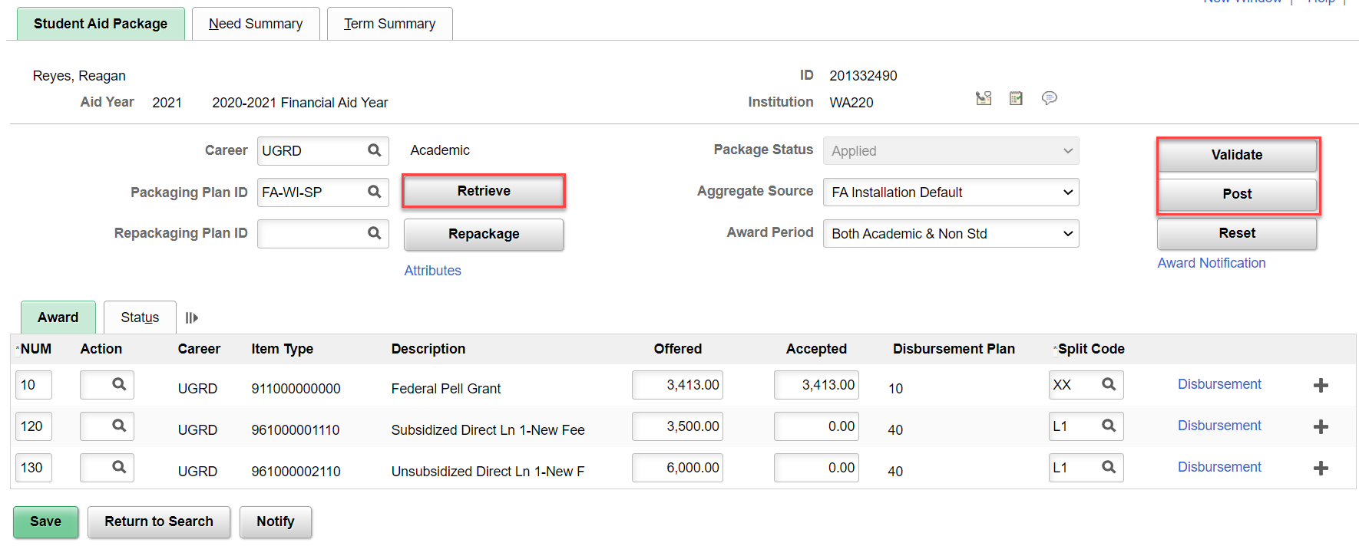
Online PACKAGING for a non-enrl stu
RETRIEVE BUTTON
Navigation: Financial Aid > Assign Awards to a Student > Award Processing > Assign Awards to a Student
Select the Retrieve button to let the system auto-select a Packaging Plan ID based on the FA Term and Student Budgets that have been built for the student. When satisfied, select Validate and Post.
Tip! Check the award detail in the Disbursement link before posting, to ensure aid distributed into the appropriate Term as intended.

Slide 14
DEMONSTRATION &
HANDS ON ACTIVITY

Slide 15
MANUALLY AWARDING AID FOR A STUDENT WITHOUT A FAFSA

Slide 16
MANUALLY AWARDING AID FOR A STUDENT WITHOUT A FAFSA
PRELIMINARY STEPS
Step 1: Aid Year Activation
Step 2: Manual FA Term Build
Step 3: Manual Budget Build

Slide 17
MANUALLY AWARDING AID W/O FAFSA
STEP 1 – AID YEAR ACTIVATION
Navigation: Financial Aid > Aid Year Activation > Manage Financial Aid Years
If the student has not done a FAFSA, and you need to award them, you will need to Aid Year Activate them.
Enter the Aid Year, and select the Save button.

Slide 18
Manually AWARDING AID FOR A STUDENT WITHOUT A FAFSA
PRELIMINARY STEPS
Step 1: Aid Year Activation
Step 2: Manual FA Term Build
Step 3: Manual Budget Build

Slide 19
MANUALLY AWARDING AID W/O FAFSA
STEP 2 – BUILD FA TERM
Navigation: Financial Aid > Financial Aid > Financial Aid Term > Maintain FA Term
If the student has not done a FAFSA, and you need to award them, you will need to Manually Build FA Term. Repeat for all terms in AY.
Enter the most basic required fields in FA Term. Uncheck the override boxes OR, if left checked as overridden, you may opt to use Override Expiration as described in the QRG. Select OK to save.

Slide 20
Manually AWARDING AID FOR A STUDENT WITHOUT A FAFSA
PRELIMINARY STEPS
Step 1: Aid Year Activation
Step 2: Manual FA Term Build
Step 3: Manual Budget Build

Slide 21
MANUALLY AWARDING AID W/O FAFSA
STEP 3 – BUILD STUDENT BUDGET
Navigation: Financial Aid > Financial Aid > Budgets > Create Student Budget
If the student has not done a FAFSA, and you need to award them, you will need to Manually Create a Student Budget.
Enter the terms in which a budget should be built, adding a new row for each new term. Select the Build a Budget button. Select Move Budget. Select OK to save.

Slide 22
Online PACKAGING w/o a fafsa
RETRIEVE BUTTON
Navigation: Financial Aid > Assign Awards to a Student > Award Processing > Assign Awards to a Student
Select the Retrieve button to let the system auto-select a Packaging Plan ID based on the FA Term and Student Budgets that have been built for the student. When satisfied, select Validate and Post.
Tip! Check the award detail in the Disbursement link before posting, to ensure aid distributed into the appropriate Term as intended.

Slide 23
DEMONSTRATION

Slide 24
INVOKING A
PROFESSIONAL JUDGMENT

Slide 25
INVOKING A PROFESSIONAL JUDGMENT
Invoking a Professional Judgment:
Use the professional judgement award page to override all federal and aggregate rules except for fiscal limits when repackaging online. Repackage students without a budget. All item types awarded from this component are set to PJ locked. Once locked, adjustments cannot be made in the normal Award page.
Note! Invoking a Professional Judgment awarding is a ZC security role assigned to only a select few in the office --
USE SPARINGLY

Slide 26
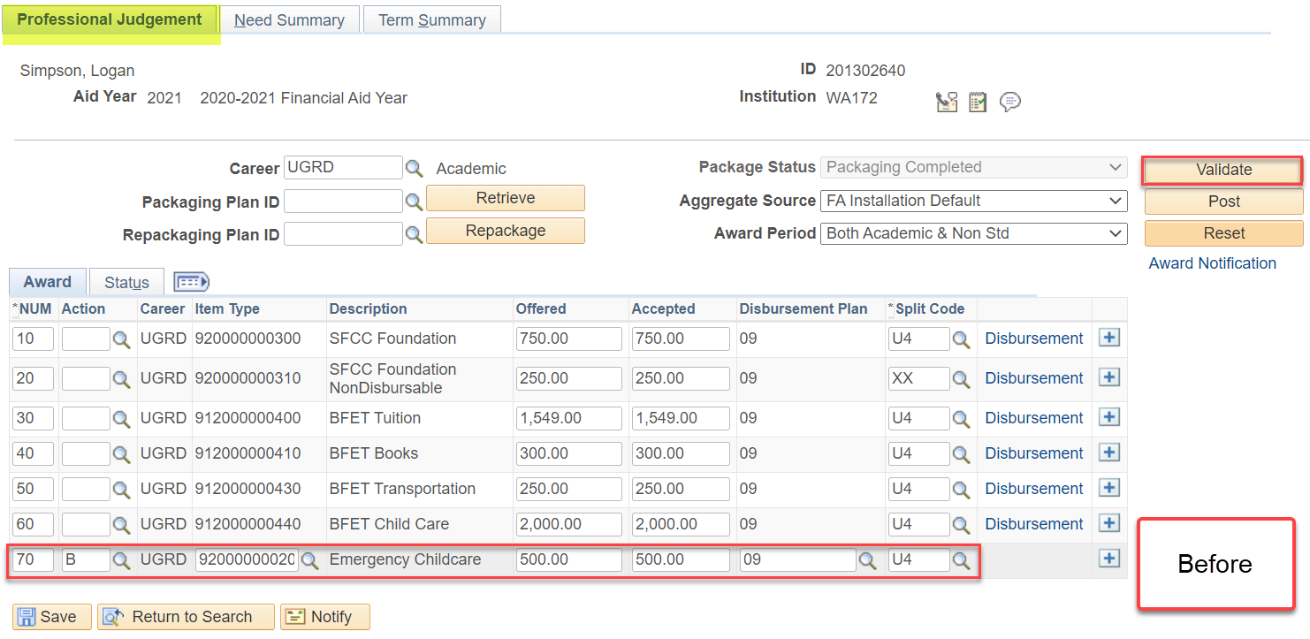
Invoke a professional judgment
ADD THE AWARD
Navigation: Nav Bar > Navigator > Financial Aid > Awards > Award Processing > Invoke a Professional Judgment
Add the desired award, define the Disbursement Plan and Split Code, then select Validate. Check “Disbursement” to verify the award distributed to your satisfaction. Then select Post.

Slide 27
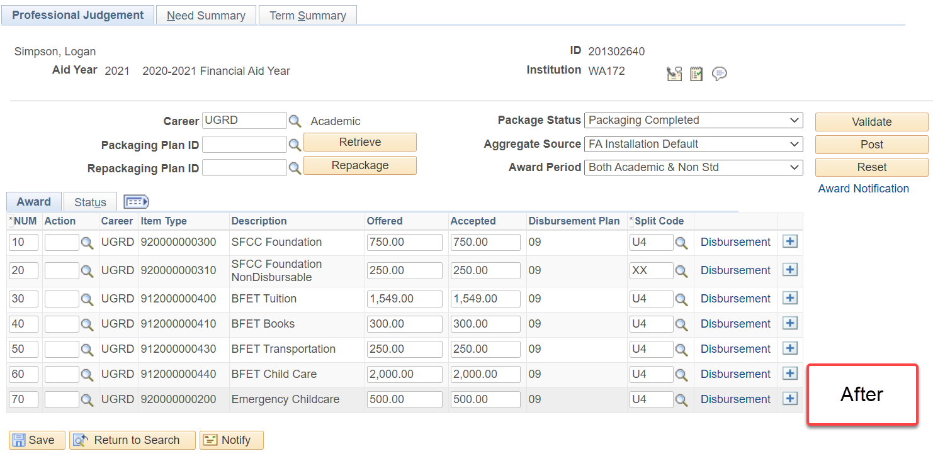
Invoke a professional judgment
AWARD POSTED
Add the desired award, define the Disbursement Plan and Split Code, then select Validate. Check “Disbursement” to verify the award distributed to your satisfaction.

Slide 28
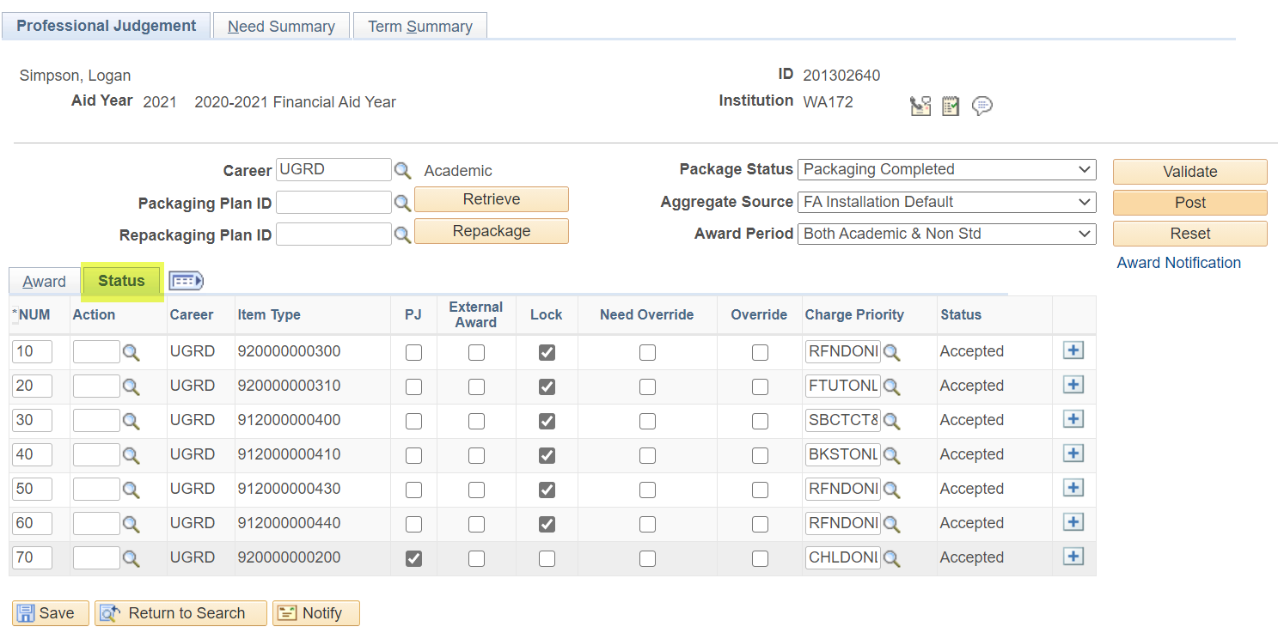
INVOKING A PROFESSIONAL JUDGMENT
STATUS = PJ LOCK
Note on the Status tab, the checkbox in the PJ column is now selected – the award is now locked in PJ, and cannot be edited in the normal awarding page. You must return to the Invoke a Professional Judgment page, if you need to edit this award.

Slide 29
Outcomes
At training completion, you should be able to:
Packaging without enrollment data
Online package, understanding the difference between the Retrieve button vs. Assigning a packaging plan
Understand how to package financial aid without enrollment data
Understand how to package financial aid without a FAFSA
Understand the Invoke a Professional Judgment award page

Slide 30
Congratulations!
You have successfully completed your Awarding Refresher!
Please refer to the ctcLink Reference Center for additional resource materials on today’s topics
Thank you for your participation today!

