Slide 1
JUST IN TIME TRAINING DIRECT LOAN reconciliation
Kelly Forsberg
ctcLink Functional Trainer | Financial Aid
August 2022
Notes:
Welcome to the world of Financial Aid Pell and Direct Loan Processing in ctcLink!

Slide 2
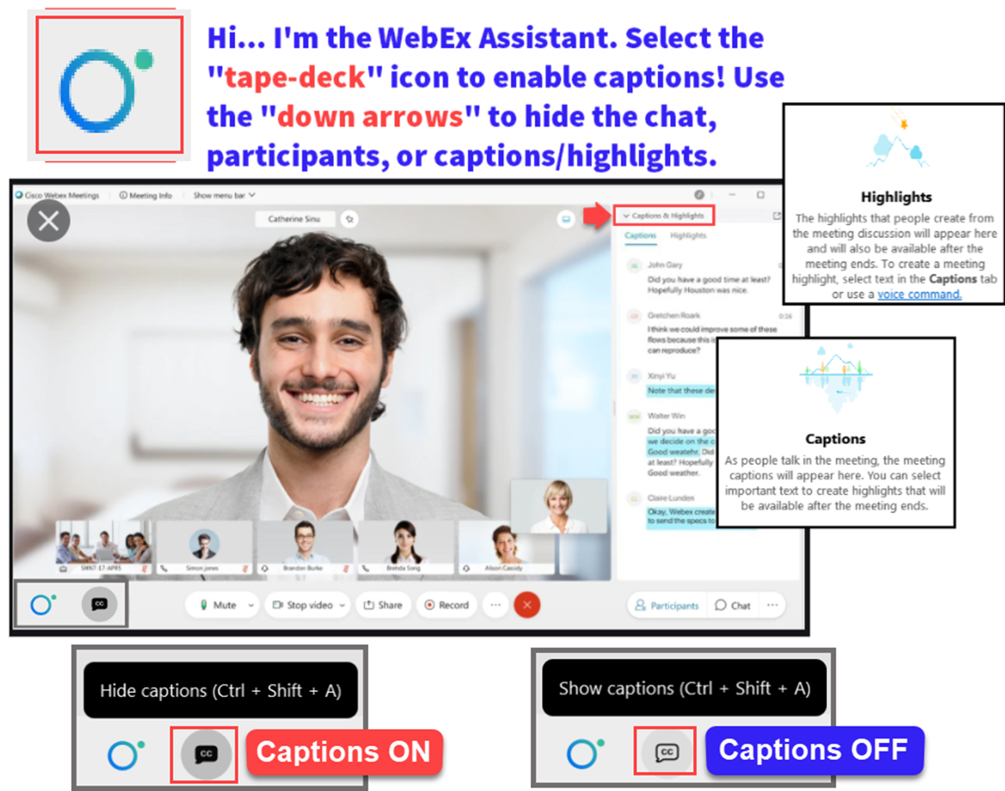

Slide 3
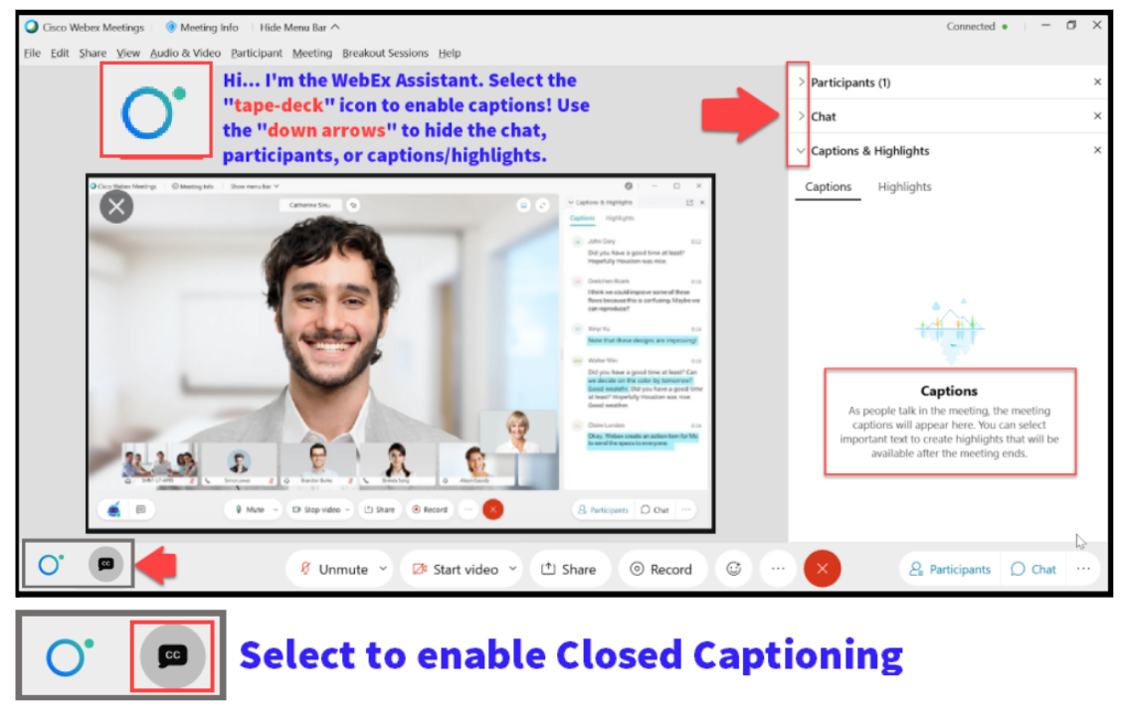

Slide 4
Objectives
After today’s training, you should be able to:
Understand how to run and work the SBCTC custom DL recon report
Understand how to run and work the Oracle-delivered reports
Understand how to navigate through Loan View pages to help troubleshoot through loan errors

Slide 5
SBCTC DL RECONCILIATION
REPORT

Slide 6
DIRECT LOAN RECONCILIATION PROCESS
3-STEP PROCESS
Step 1: Upload dsdf file to ctcLink
Step 2: Import Federal Data File
Step 3: Run SBCTC DL Recon Rpt

Slide 7
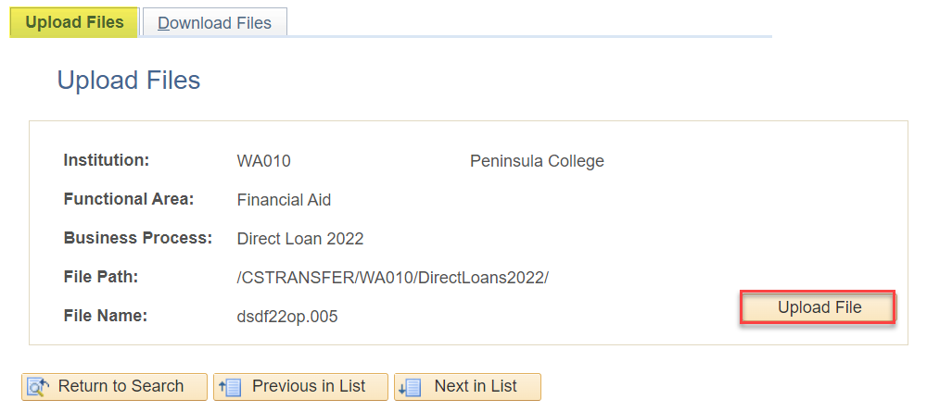
Upload file to ctclink
DSDF MESSAGE CLASS FILE
Navigation: Nav Bar > Navigator > PeopleTools > CTC Custom > Extensions > Upload/Download Files
If you have not seen a dsdf file in your SAIG mailbox, you will need to contact SAIG and/or COD customer service to request the file. The dsdf file is typically delivered every 1st Saturday of the month. The first file may come in as a dsyf file; which is a YTD version of the dsdf file

Slide 8
DIRECT LOAN RECONCILIATION PROCESS
3-STEP PROCESS
Step 1: Upload dsdf file to ctcLink
Step 2: Import Federal Data File
Step 3: Run SBCTC DL Recon Rpt

Slide 9
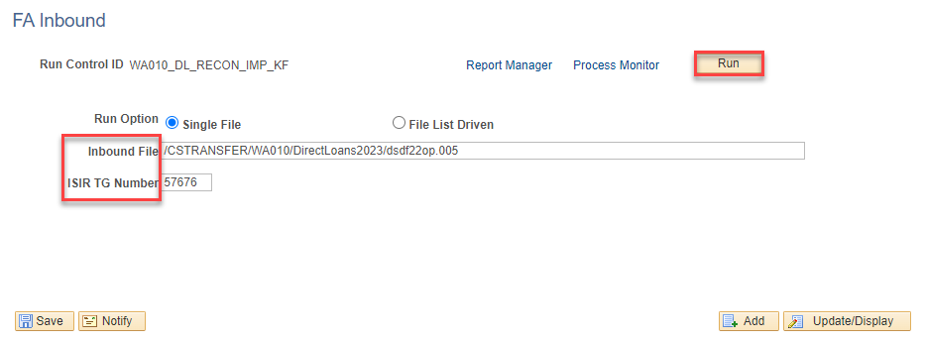
IMPORT FEDERAL DATA FILES
MOVE DATA TO STAGING TABLE
Navigation: Nav Bar > Navigator > Financial Aid > File Management > Import Federal Data Files
Tip! Copy the file path, and file name from the Upload/Download page; doing so reduces the occurrence of errors in processing this step.

Slide 10
DIRECT LOAN RECONCILIATION PROCESS
3-STEP PROCESS
Step 1: Upload dsdf file to ctcLink
Step 2: Import Federal Data File
Step 3: Run SBCTC DL Recon Rpt

Slide 11
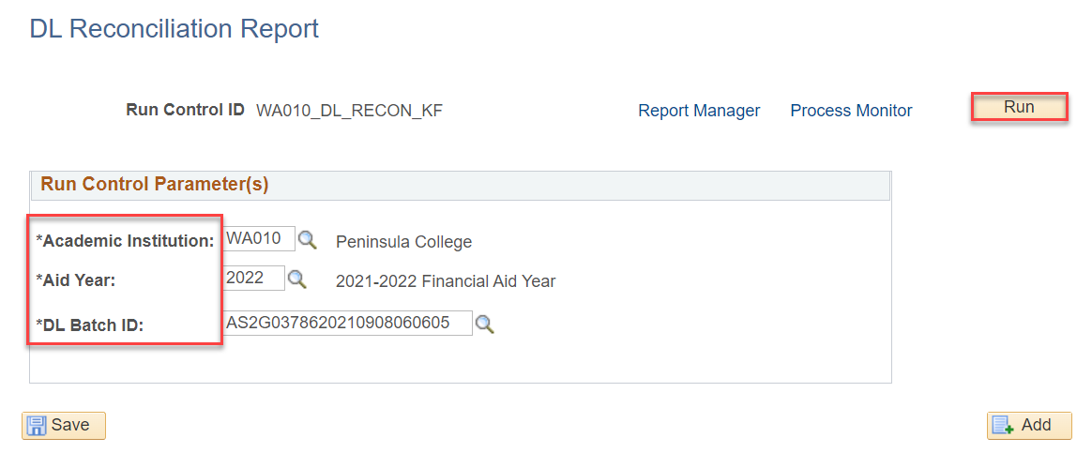
RUN SBCTC DL RECON REPORT
CTC CUSTOM PAGE
Navigation: Nav Bar > Navigator > Financial Aid > CTC Custom > CTC Reports > SBCTC DL Reconciliation
Select the available DL Batch ID, and select Run.

Slide 12
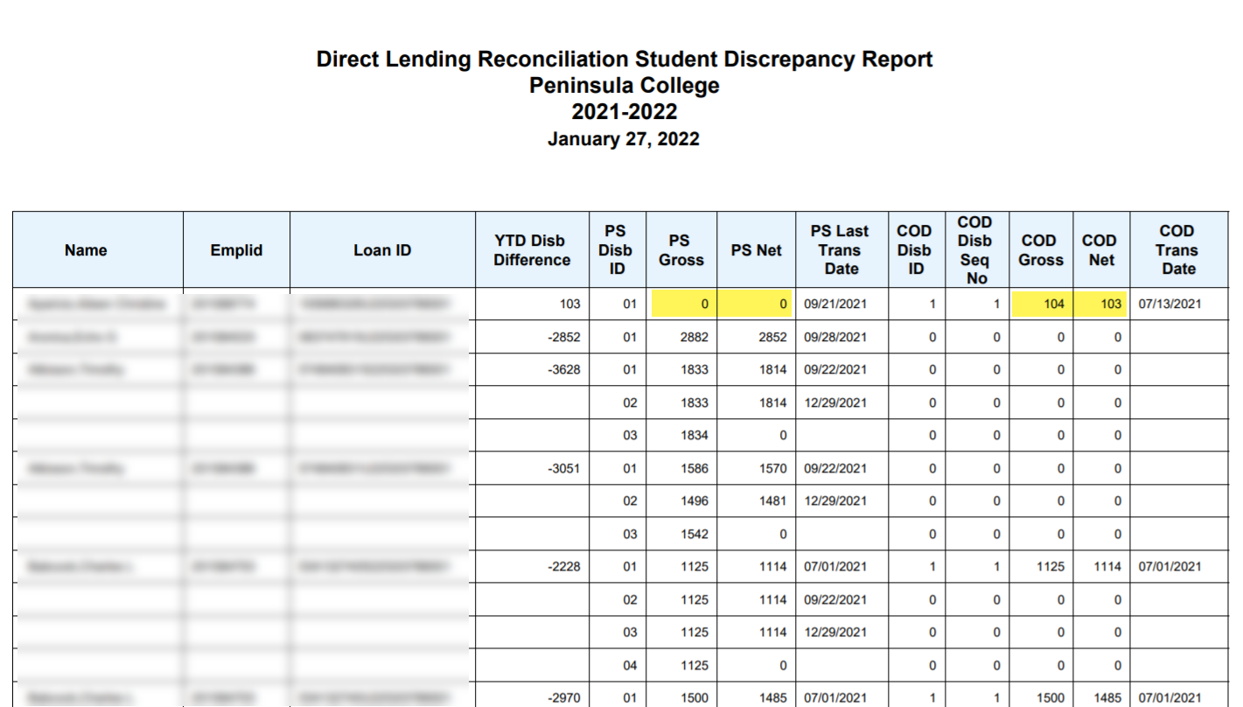
RUN SBCTC DL RECON REPORT CONT’D
DISPLAYS A PDF FILE
Compare the PS Gross/Net to the COD Gross/Net

Slide 13
DEMONSTRATION

Slide 14
LOAN ORIG REPORTS

Slide 15
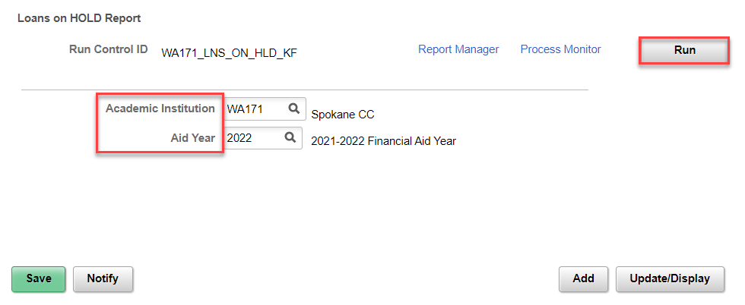
LOAN orig reports
LOANS ON HOLD REPORT
Navigation: Nav Bar > Navigator > Financial Aid > Loans > Direct Lending Reconciliation > Loans on Hold Report
Notes:
This report is for loans that have not left peoplesoft – data in the system is holding it up

Slide 16
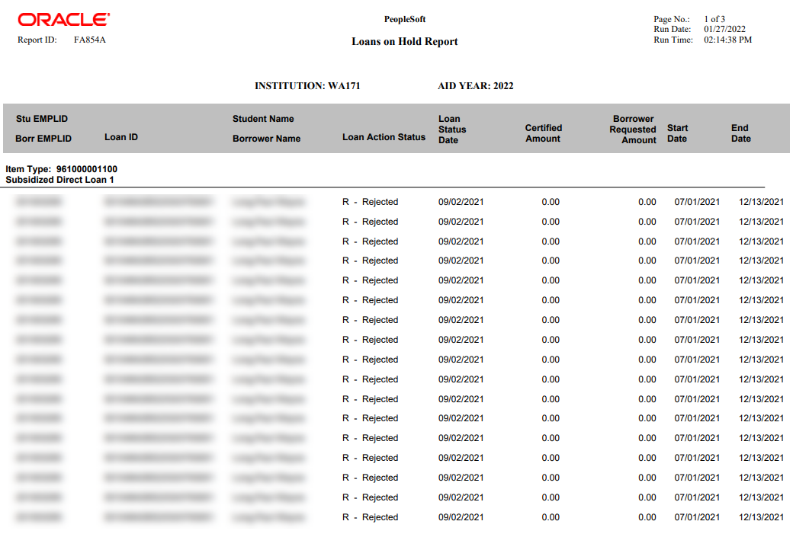
LOAN orig reports
LOANS ON HOLD REPORT
Notes:
Note the Loan Action Status = R. You can view the Loan Action Status Codes in the View Loan Action Codes page. In this example, the R = Rejected

Slide 17
LOAN VALIDATION ERROR
REPORT

Slide 18
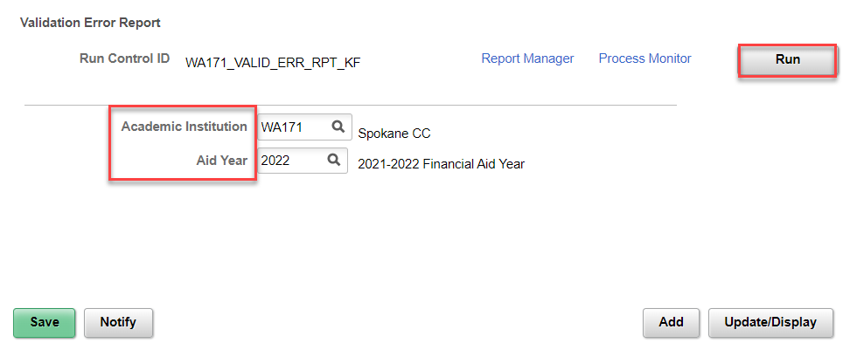
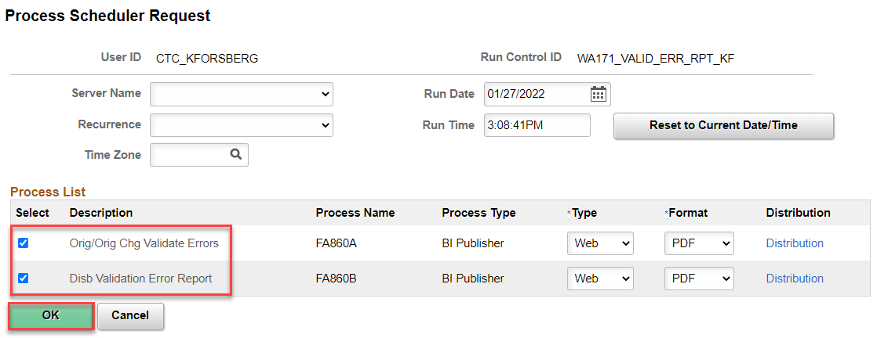
LOAN VALIDATION ERROR REPORT
ORIGINATION ERRORS
Navigation: Nav Bar > Navigator > Financial Aid > Loans > Direct Loan Reconciliation > Validation Errors Report

Slide 19
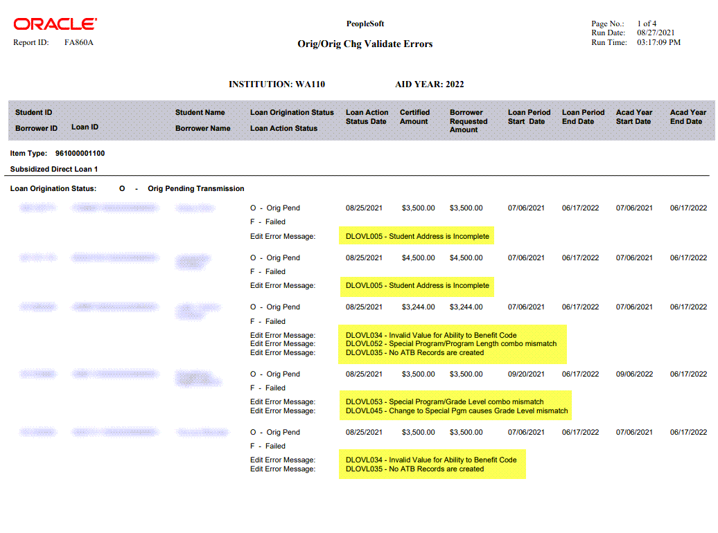
LOAN VALIDATION ERROR REPORT CONT’D
ORIGINATION ERRORS CONT’D
Navigation: Nav Bar > Navigator > Financial Aid > Loans > Direct Loan Reconciliation > Validation Errors Report

Slide 20
LOAN VIEW PAGES

Slide 21
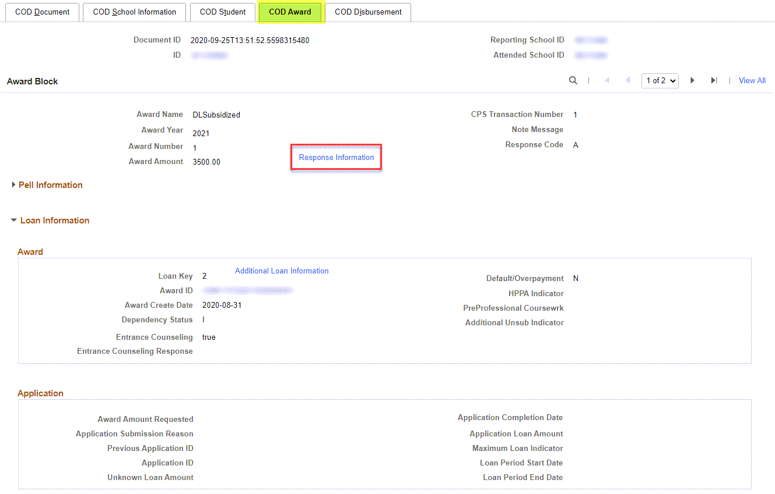
VIEW COD DATA PAGE
Navigation: Nav Bar > Navigator > Financial Aid > File Management > Full COD Participant > View COD Data
COD AWARD TAB
This page is good to assist in troubleshooting, to view the COD response

Slide 22
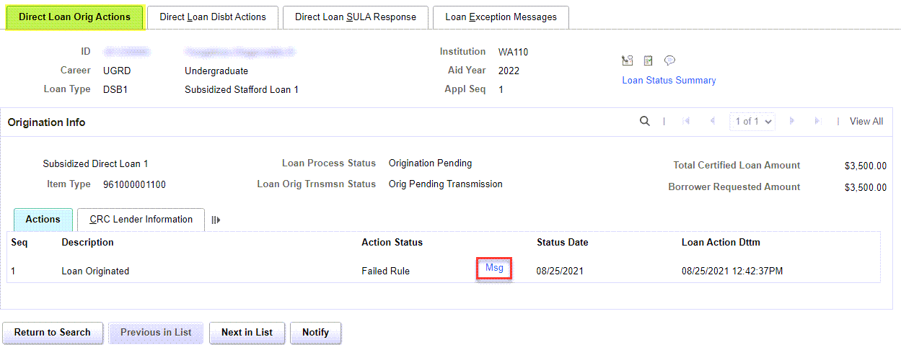
VIEW LOAN PROCESSING ACTIONS
Navigation: Nav Bar > Navigator > Financial Aid > Loans > Manage Direct Lending > View Loan Processing Actions
DL ORIG ACTIONS TAB
This page is also helpful to view why loans are being rejected, or what their origination or booking status is

Slide 23
Outcomes
At this FA Work Session completion, you should be able to:
Understand how to run and work the SBCTC custom DL recon report
Understand how to run and work the Oracle-delivered reports
Understand how to navigate through Loan View pages to help troubleshoot through loan errors

Slide 24
Congratulations!
Direct Loans Reconciliation Just in Time Training Complete!
Please review the videos and additional resources in your canvas course material and the reference center as you progress through students to prep for awarding
Thank you for your participation today!

