Slide 1
Fa-SF CUSTOMER ACCOUNT reconciliation
Kelly Forsberg
July 2022
Notes:
Welcome to the FA Reconciliation to Reporting course!

Slide 2
ground rules
Be ready to participate
Silence phones, please
Allow your peers to complete their thoughts before beginning yours
On WebEx, mute your line when not speaking
Do NOT place WebEx line on hold. Use mute.

Slide 3
Objectives
After this session, you should be able to:
Understand what to look out for in the Fund Roster
Find and work examples in the following queries:
CTC_FA_DISCREPANCY_LIST
QCS_SF_FA_SA_APPLIED_DETAILS
QCS_FA_GRP_PAY

Slide 4
Aid year reconciliation
FUND ROSTER Report / Query
CTC_FA920 (query) and FA920 (BI Report)
Shows Offer/Accept/Authorized/Disbursed amounts
High-level recon report
Details in the Fund Management Process Guide

Slide 5
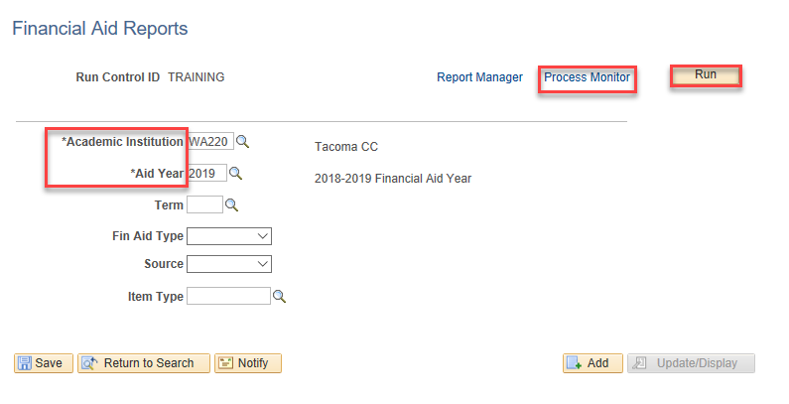
Reconciliation cont’d
FUND ROSTER
FA920
Navigation: Nav Bar > Navigator > Financial Aid > Fund Management > Fund Roster
Note: Create Run Control ID in the Financial Aid page

Slide 6
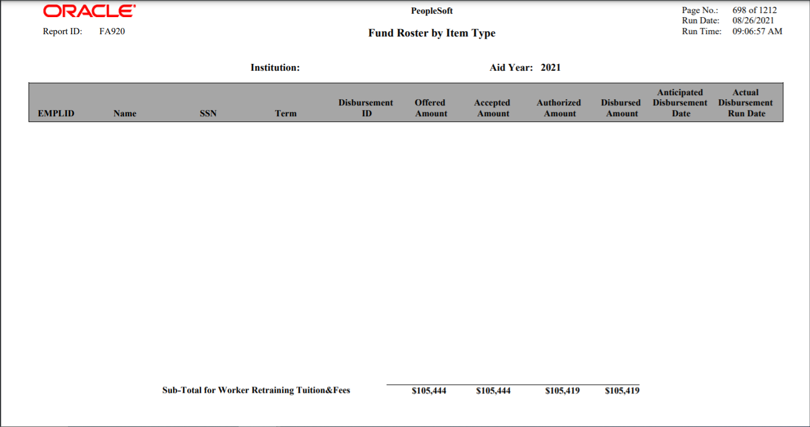
Reconciliation process cont’d
FUND ROSTER
FA920

Slide 7
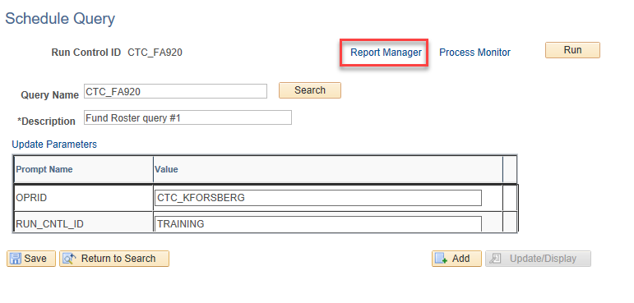
Reconciliation process cont’d
FUND ROSTER – SCHEDULE QUERY
CTC_FA920

Slide 8
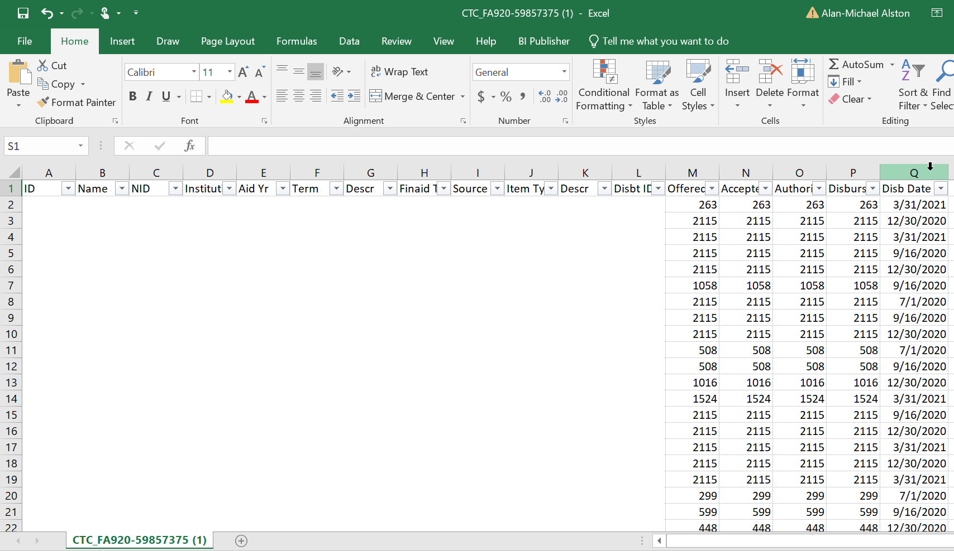
Reconciliation process cont’d
FUND ROSTER – SCHEDULE QUERY
CTC_FA920

Slide 9
DEMONSTRATION

Slide 10
Weekly CUST ACCOUNT Reconciliation Queries
CTC_FA_SF_DISCREPANCY_LIST
Shows discrepancies on Item Types with ‘unapplied’ amounts to the Customer Account
QCS_SF_FA_SA_APPLIED_DETAILS
Shows discrepancies between SF disbursements and FA disbursements
Shows Item Types and what charges to which it applied
Formally known as CTC_SF_FINAID_REFUND_DETAILS

Slide 11
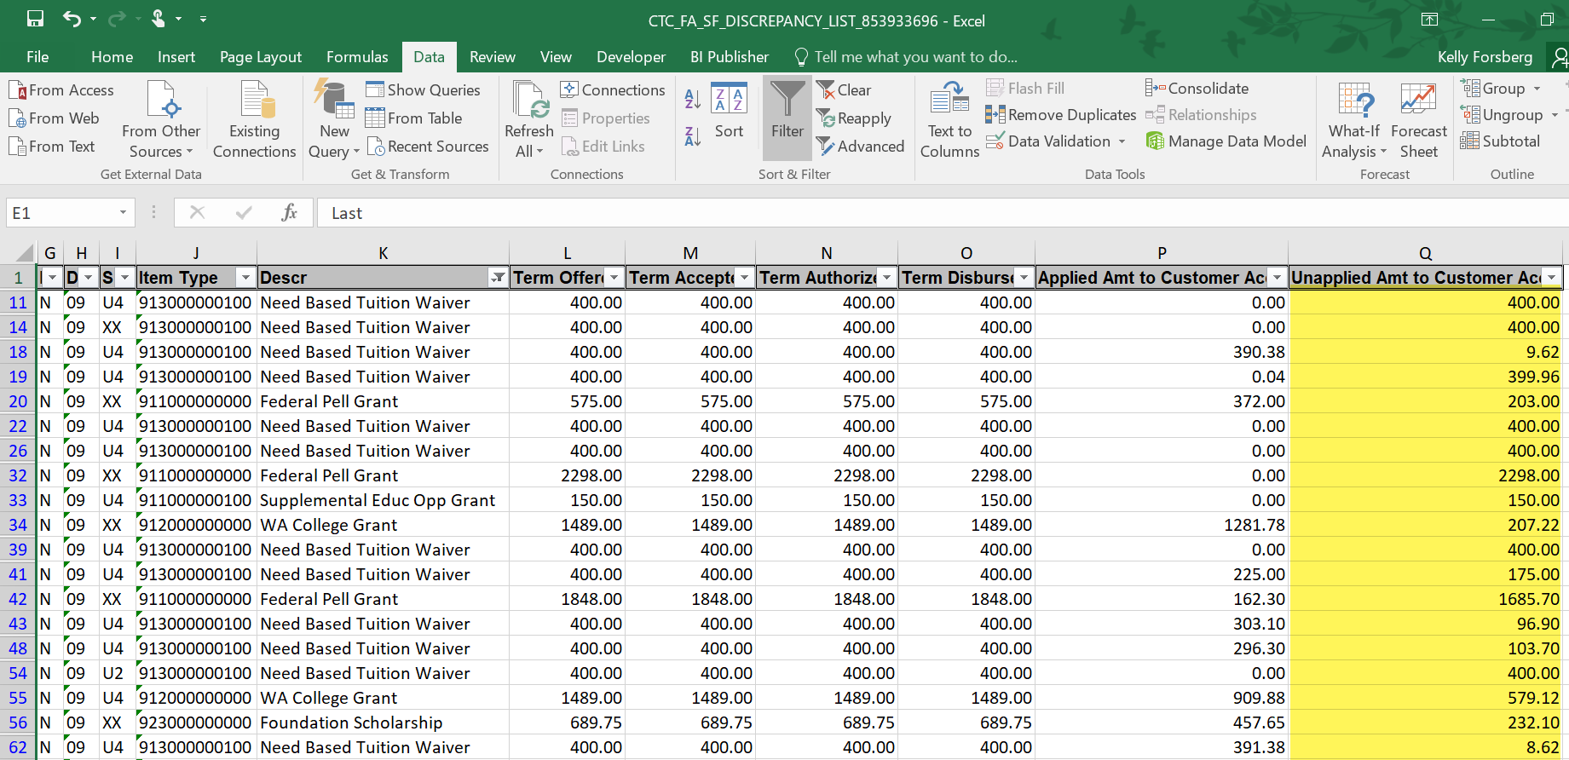
CTC_FA_SF_DISCREPANCY_LIST
Unapplied Amt is the outstanding amount that has not been posted to the Customer Account

Slide 12
REASONS WHY FUNDS MAY NOT HAVE APPLIED
Book awards that were not fully spent on charges
Tuition Waivers where tuition amount was less than the FA award
Refund amount from student dropping classes and a No Refund Service Indicator exists, amounts need to be reduces in FA award page

Slide 13
AddT’L queries to assist in WHY charges did not apply to CUSROMER ACCOUNTS
QCS_SF_CREDIT_BAL_NONREF - Identifies students with a credit balance from nonrefundable item types
QCS_SF_ITM_TYPE_GL_INTERFACE – Lists item-type set-up including charge priority, payment priority, etc.

Slide 14
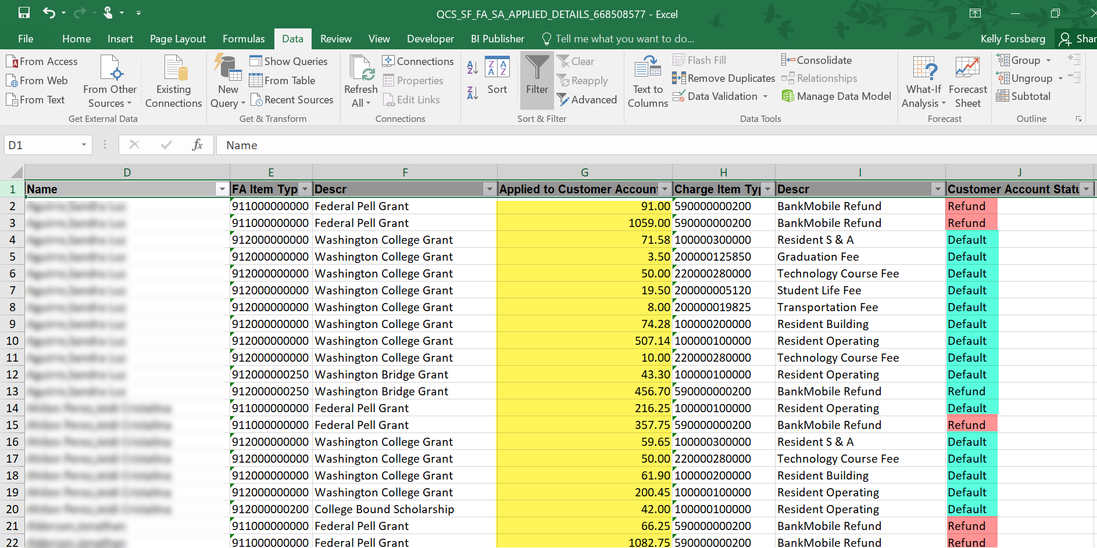
QCS_SF_FA_sa_Applied_details
Default row displays charges paid
Refund displays the amount the student rec’d in a refund

Slide 15
DEMONSTRATION

Slide 16
MONTHLY CUST ACCOUNT Recon QuerY
QCS_FA_GRP_PAY
Shows Item Types paid which charges on students in a selected Student Group
Ideal for Workforce Education and Veteran’s Benefits Reconciliation

Slide 17
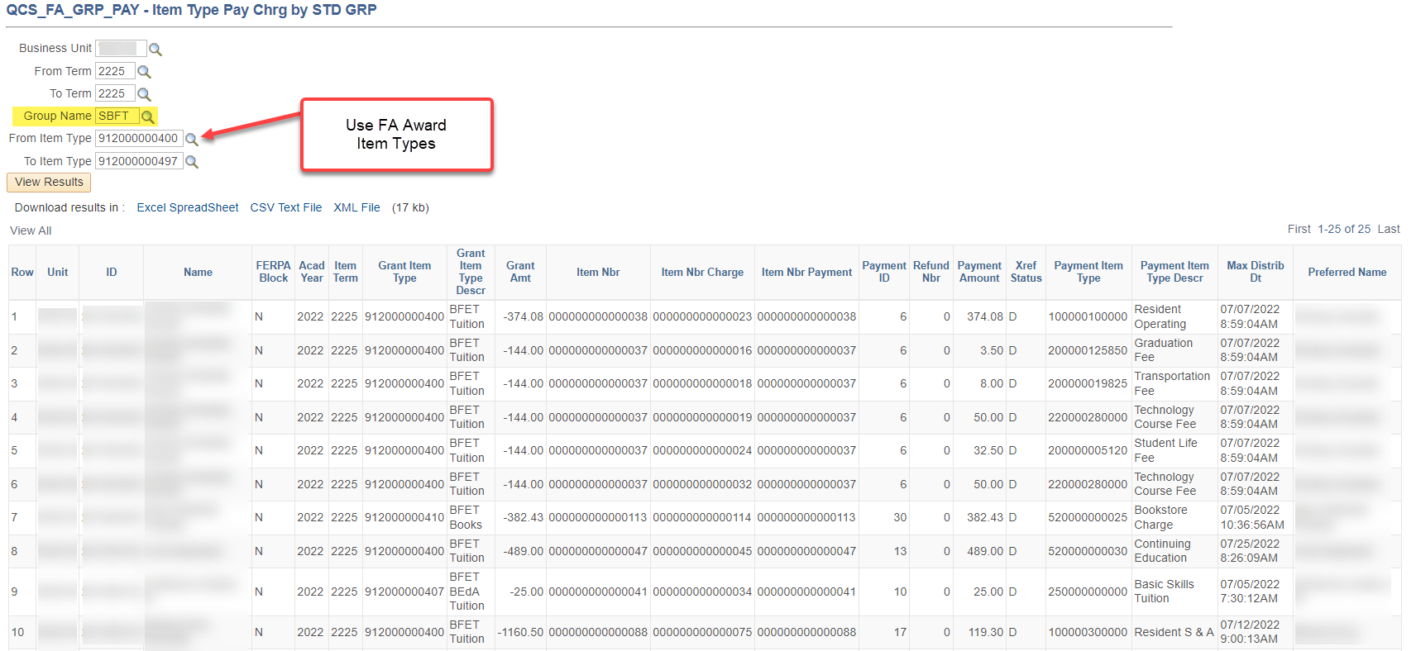
QCS_fa_pay_grp

Slide 18
DEMONSTRATION

Slide 19
Congratulations!
You are now equipped with resources and tips for reconciling FA funds!
Please refer to the ctcLink Reference Center for additional resource materials on today’s topics
Thank you for your participation today!

