Slide 1
Entrance counseling & MPN Processing
Alan-Michael Alston, Functional Analyst (Financial Aid)
October 2020

Slide 2
Obtain Ec/PN Files
Beginning of a 4-Step Process
Step 1: Obtain EC/PN files
Step 2: Upload to PS Server
Step 3: Upload to COD tables
Step 4: Process Checklists

Slide 3
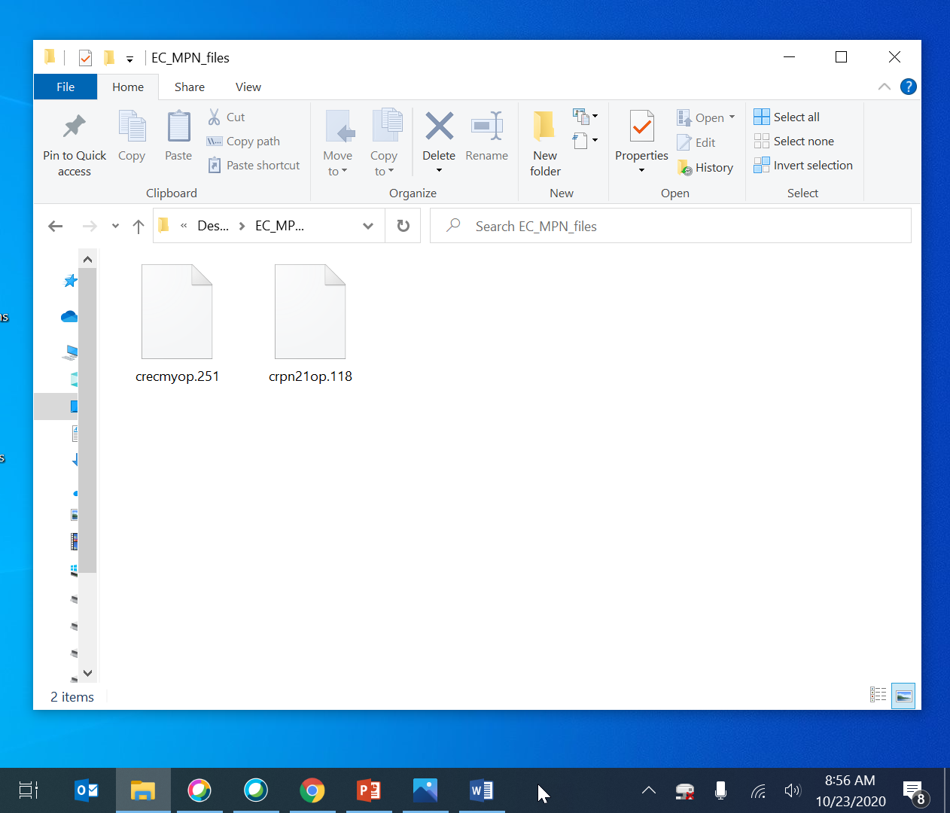
Obtain ec/pn files cont’d
Saved locally to your drive. Stay organized!

Slide 4
EC/MPN Files Cont’d – Helpful links
https://ifap.ed.gov/help-contact-information-cpssaig-technical-support-and-tfa-support-center
http://lists.ctc.edu/mailman/listinfo/dirfinaid_lists.ctc.edu

Slide 5
Upload to peoplesoft server
Nav > Peopletools > CTC Custom > Extensions > Upload/Download Files
Step 1: Obtain EC/PN files
Step 2: Upload to PS Server
Step 3: Upload to COD tables
Step 4: Process Checklists

Slide 6
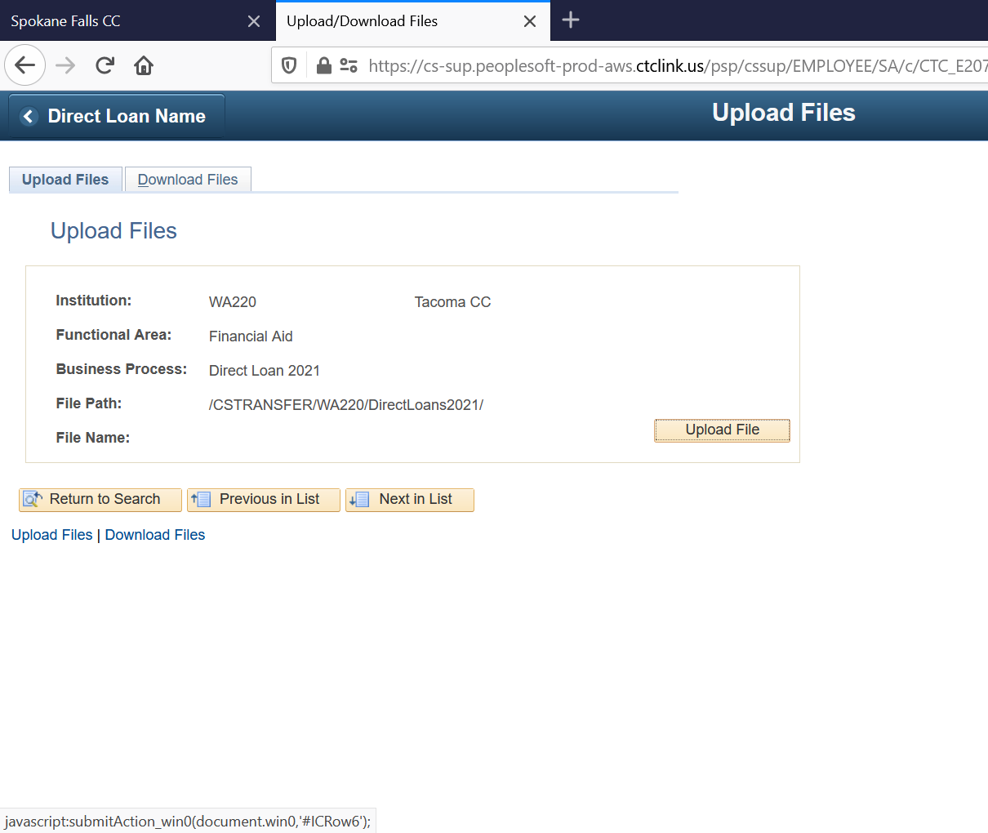
Upload to PS cont’d
Upload your crpn and crecmyop files

Slide 7
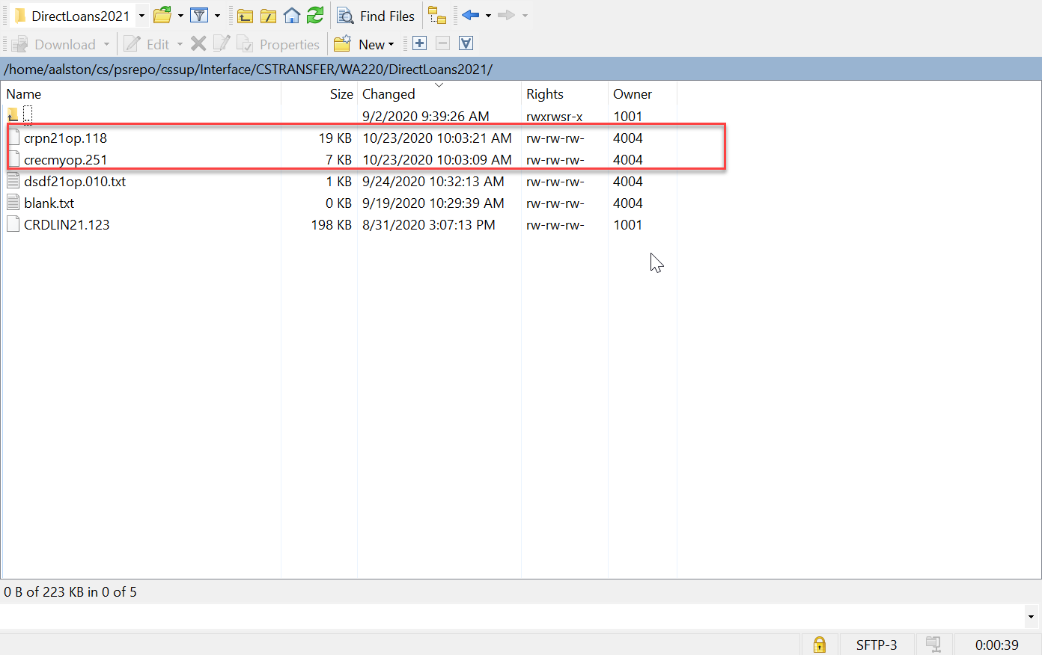
Upload to PS cont’d
These files actually “go somewhere”

Slide 8
Upload to cod tables
Nav > Financial Aid > File Management > COD Full Participant > Import COD Response Data
Step 1: Obtain EC/PN files
Step 2: Upload to PS Server
Step 3: Upload to COD tables
Step 4: Process Checklists

Slide 9
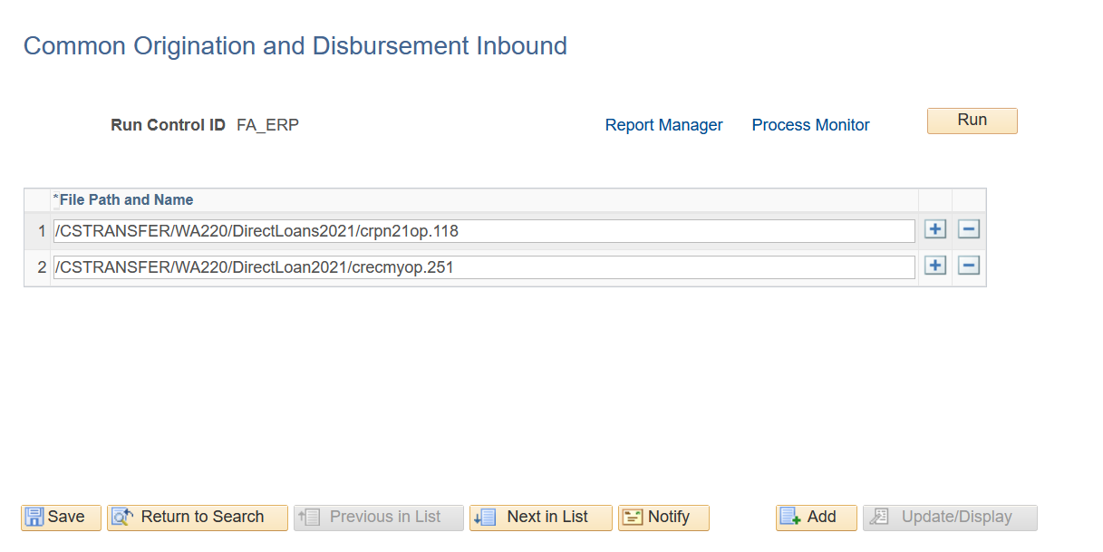
Upload to cod tables cont’d
Watch for mistakes! Can you spot the error?

Slide 10
Upload cont’d – common errors
Duplicate filenames
Typos in filenames or filepaths
Forgetting to load a file

Slide 11
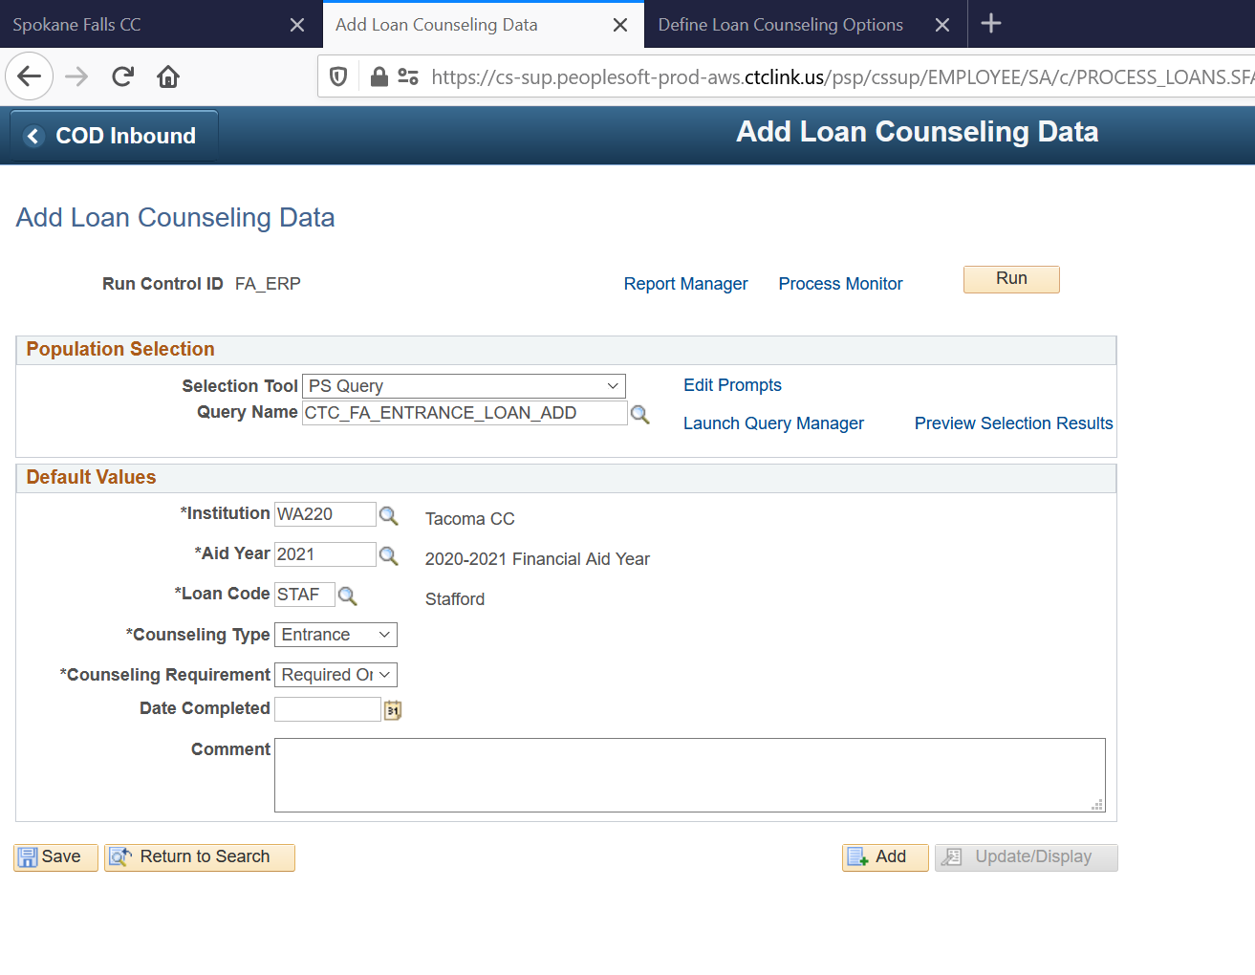
Upload cont’d – entrance counseling
Nav > Financial Aid > File Management > Loan Counseling > Add Loan Counseling Data

Slide 12
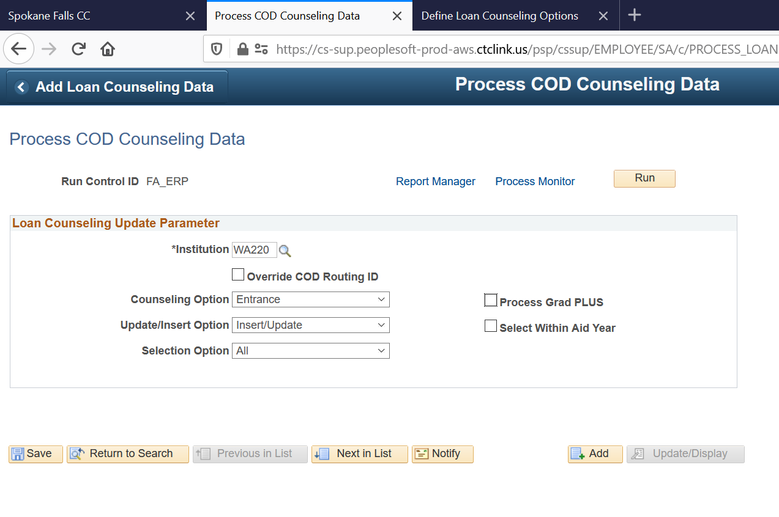
Entrance counseling cont’d
Nav > Financial Aid > File Management > Loan Counseling > Process COD Counseling Data

Slide 13
Process checklists
http://ctclinkreferencecenter.ctclink.us/m/92436/l/798572-loan-processing-business-process-guide
Step 1: Obtain EC/PN files
Step 2: Upload to PS Server
Step 3: Upload to COD tables
Step 4: Process Checklists

Slide 14
Process checklists - notes
Only assigns to students with missing files
Completed checklists do not make loans disbursable
Ignores students who already have files loaded
Known Request: Make these checklists assign to everyone

Slide 15
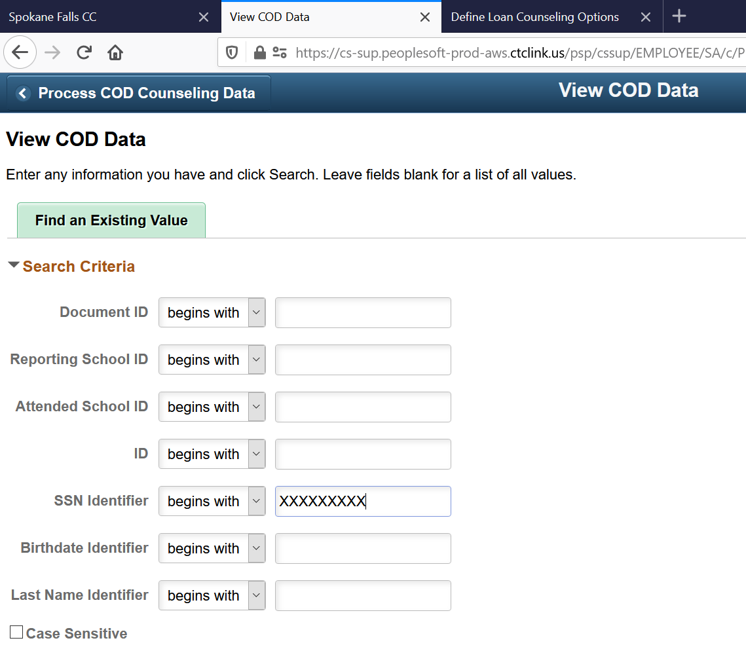
Troubleshooting – Viewing Files
Nav > Financial Aid > COD Full Participant > View COD Data

Slide 16
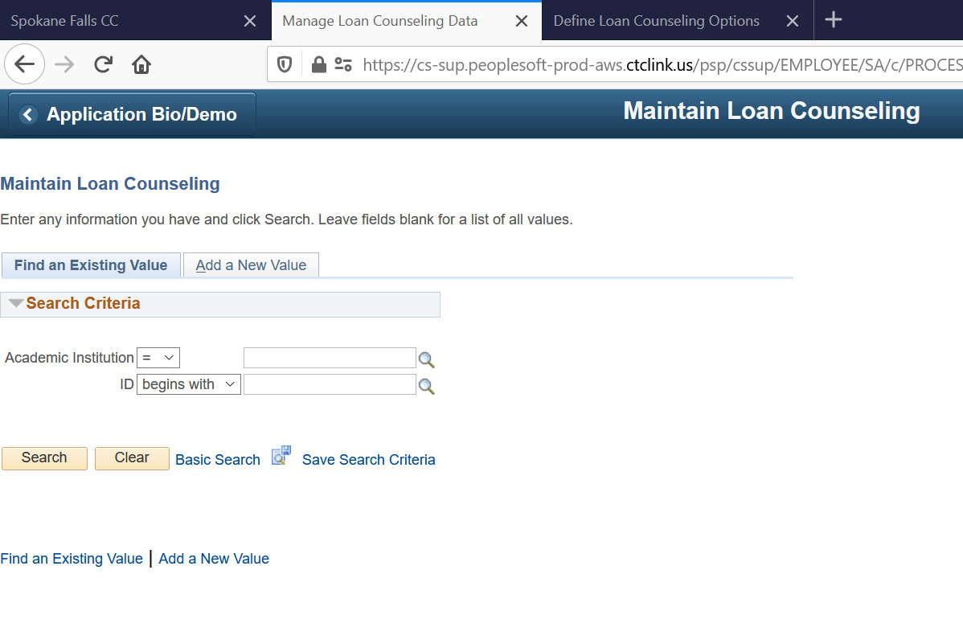
Troubleshooting - overrides
Nav > Financial Aid > Loans > Manage Counseling Data

Slide 17
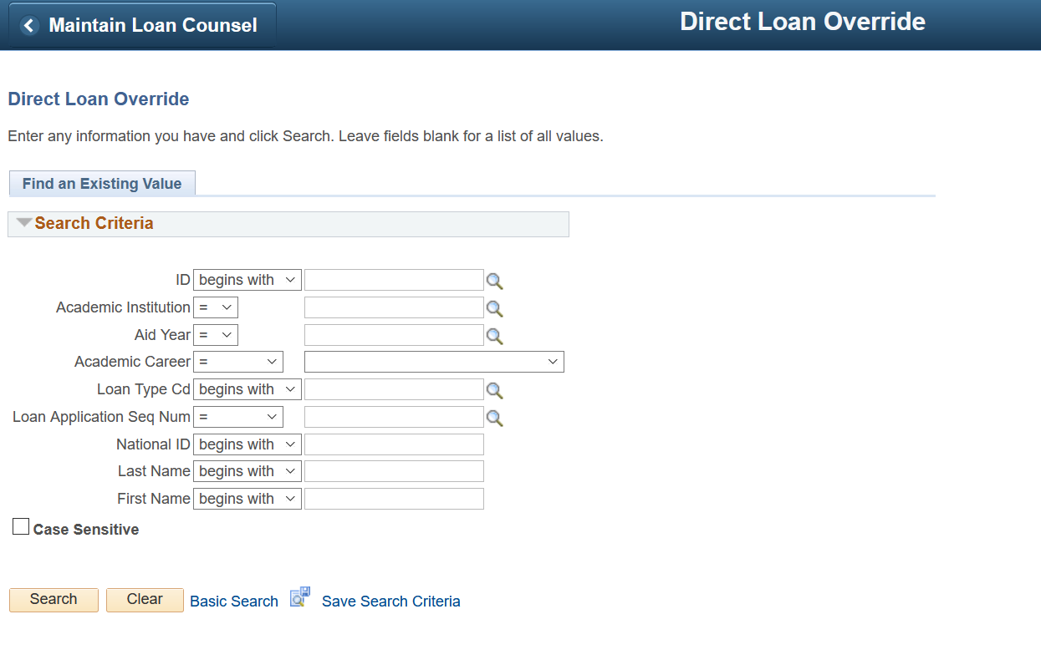
Overrides cont’d - MPN
Nav > Financial Aid > Loans > Direct Lending Management > Override Processing Status

Slide 18
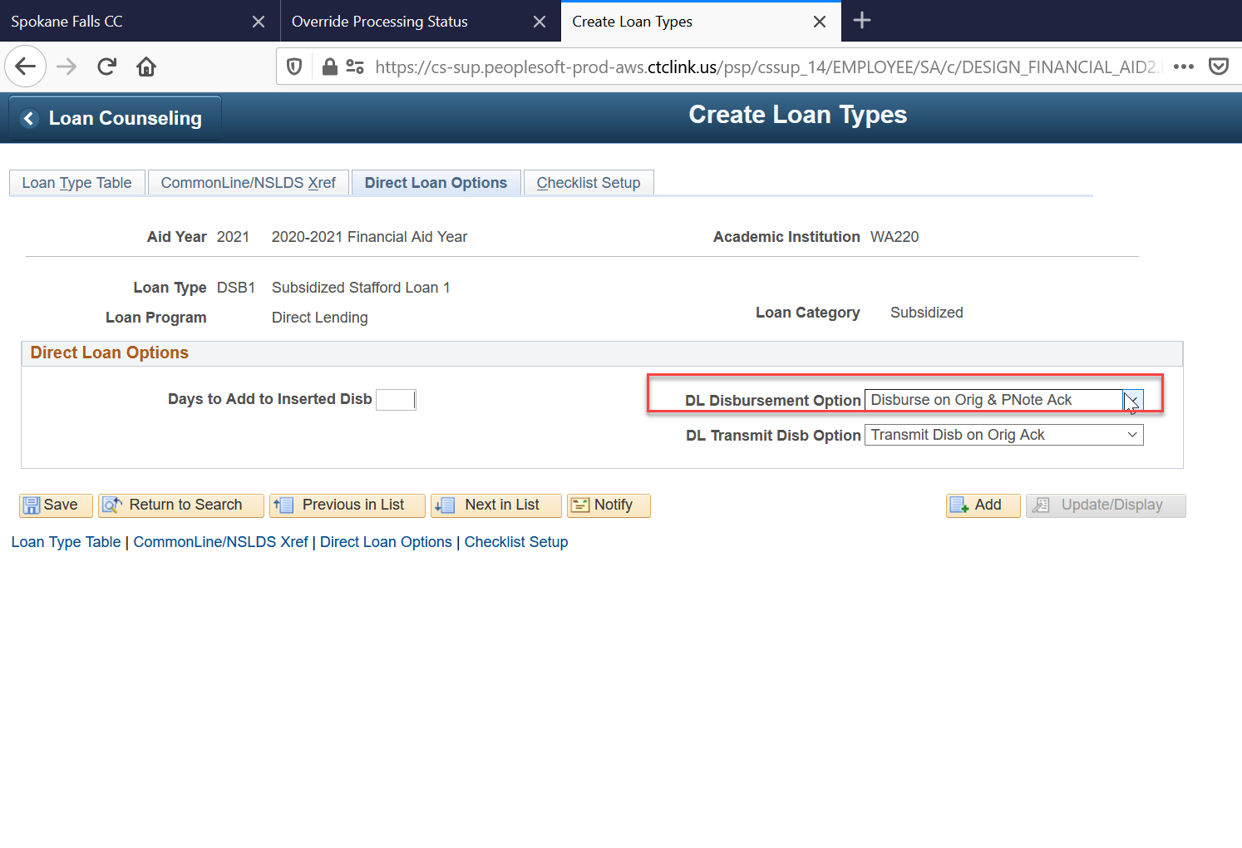
Helpful config pages
Nav > Set Up SACR > Product Related > Financial Aid > Loans > Create Loan Types

Slide 19
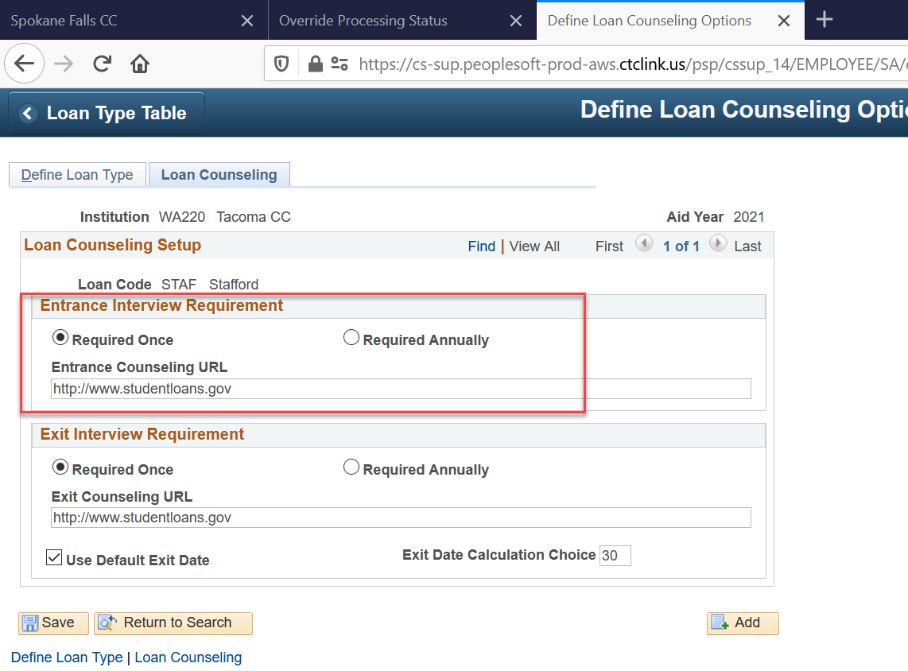
Config pages cont’d – entrance cnsl
Nav > Set Up SACR > Product Related > Financial Aid > Loans > Loan Counseling > Define Loan Counseling Options

Slide 20
fin

