Slide 1
Direct Loan Post-Sequestration
Set Up and Review
FA ctcLink Customer Support, September 2020
ctcLink PeopleSoft Training | Financial Aid Washington State Community and Technical Colleges

Slide 2
Direct Loan Post-Sequestration Objectives
Today’s topics will cover foundational set up areas and review of pages for Post Sequestration.
Topic Learning Objectives
Loan Fees Table
Item Type (Disbursement Plans, Split Code)
Packaging Plans (Disbursement Plans, Split Code)
Repackaging Plans (Disbursement Plans, Split Code)
Identify students with undisbursed loans
Cancel and re-award DL Using “New Fee” Item Type

Slide 3
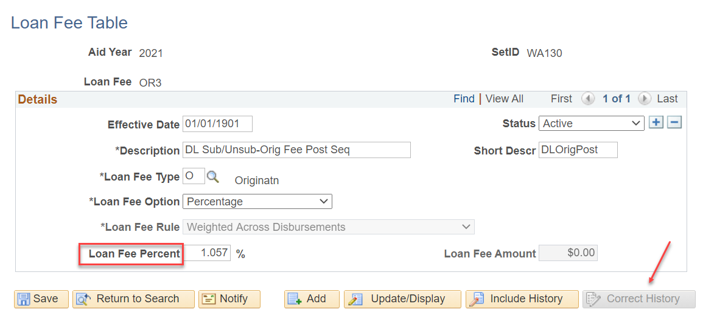
Post-Sequestration Set Up Loan Fee Table
Nav Bar > SACR > Product Related > Financial Aid > Awards > Loan Fee Set Up
Loan Fee Table 10/1/2020
OR3 (Sub/Unsub) = 1.057%
PO3 (PLUS) = 4.228%

Slide 4
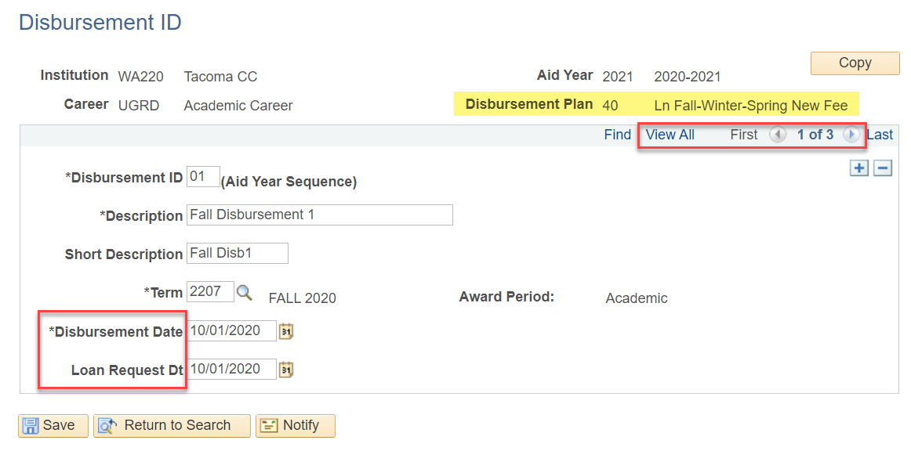
Post-Sequestration Set Up Disbursement ID Table
Nav Bar > SACR > Product Related > Financial Aid > Awards > Disbursement ID
Note— Verify your disbursement dates, and be sure to update them for New Fee Loan Disbursement Plans (30 – 50 series), including Summer & Fall for retroactive loans.

Slide 5
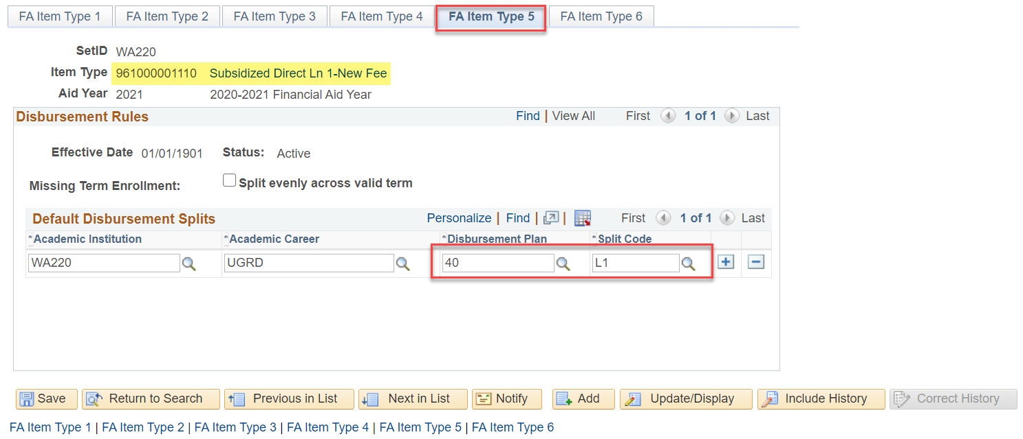
Post-Sequestration Set Up Financial Aid Item Types
Nav Bar > Set Up SACR > Product Related > Financial Aid > Awards > Financial Aid Item Types
Note— Verify the Disbursement Plan and Split Code are for the New Fee. The appropriate Disb Plan and Split Code must be applied to all New Fee Item Types.

Slide 6
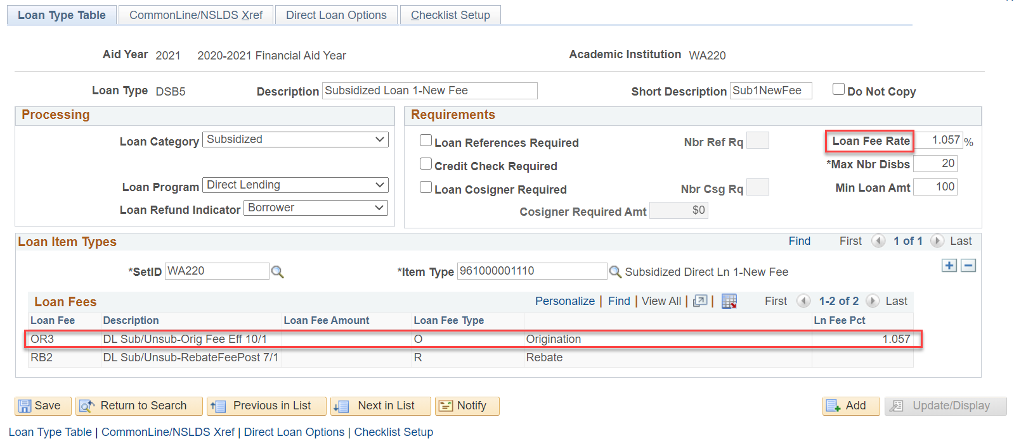
Post-Sequestration Set Up Create Loan Types
Nav Bar > Set Up SACR > Product Related > Financial Aid > Loans > Create Loan Types
Note— Verify the Loan Fee Rate is reflective of the new percentage. Also verify the new Loan Fee appears in the Loan Fee group box. Review/Update each New Fee Item Type.

Slide 7
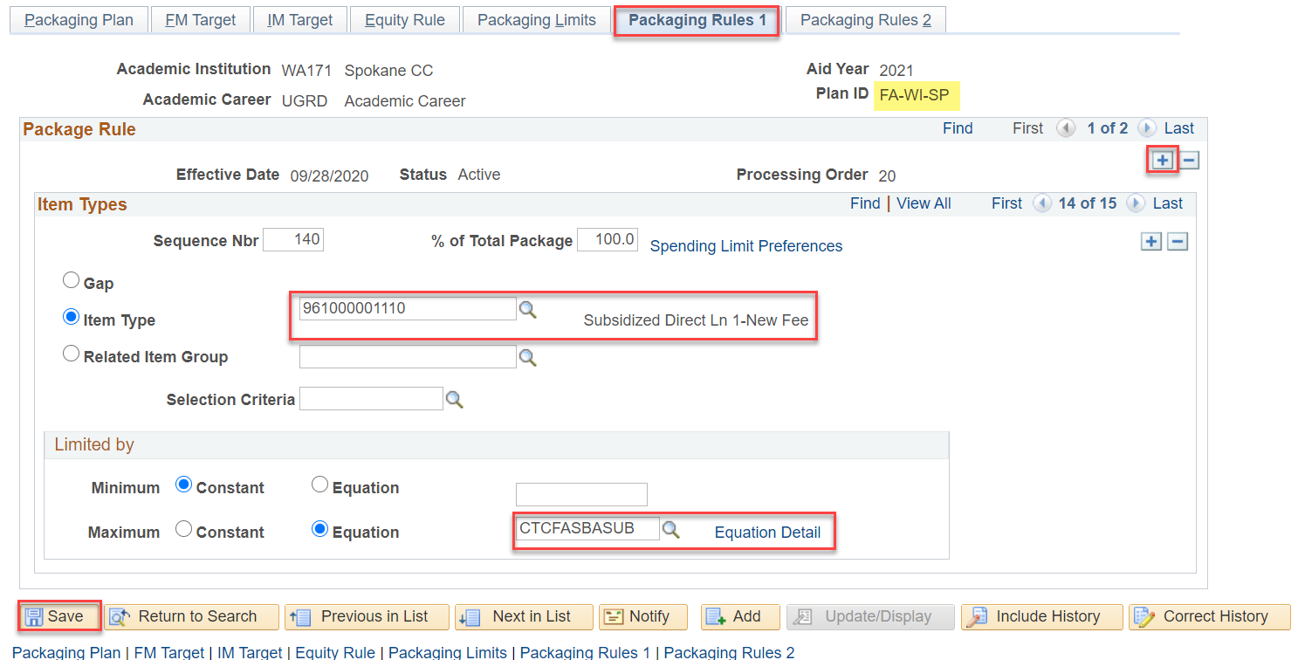
Post-Sequestration Set Up Packaging Plans
Nav Bar > Set Up SACR > Product Related > Financial Aid > Awards > Packaging Plan
Note— Review each Packaging Plan, and ensure the New Fee Item Type is selected, and appropriate Packaging Equation (both 30-day and regular). (Add a new row when making changes)

Slide 8
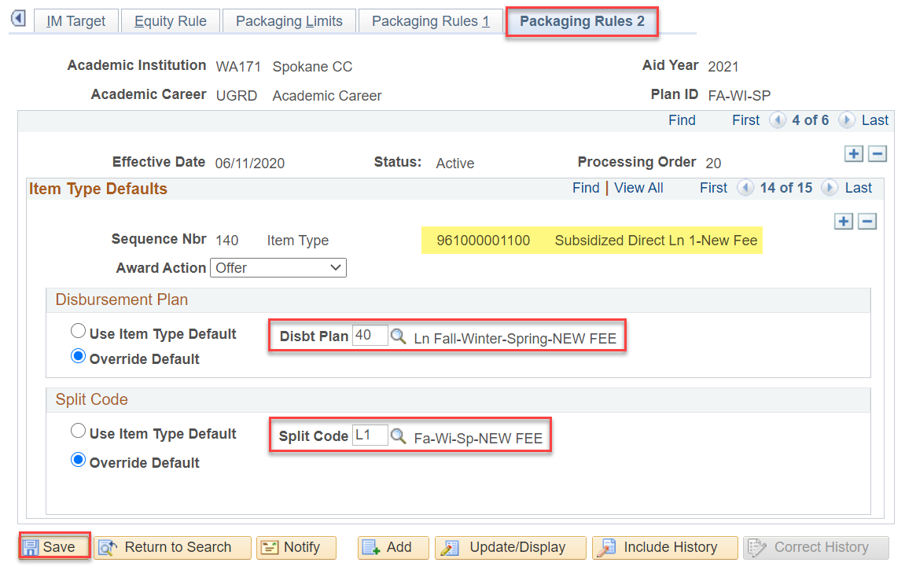
Post-Sequestration Set Up Packaging Plan (Cont’d)
Nav Bar > Set Up SACR > Product Related > Financial Aid > Awards > Packaging Plan
Note— Review each Packaging Plan, and ensure the appropriate Disbursement Plan and Split Code for New Fee are selected, including Plans for retroactive awards.

Slide 9
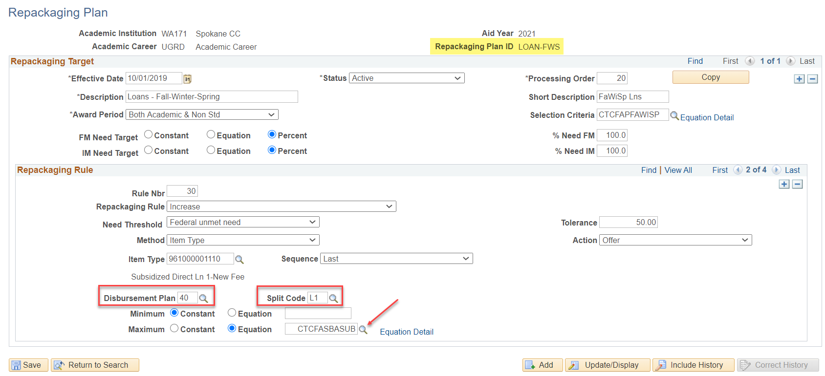
Post-Sequestration Set Up Repackaging Plans
Nav Bar > Set Up SACR > Product Related > Financial Aid > Awards > Repackaging
Note— Review each Repackaging Plan, and ensure the appropriate Disbursement Plan and Split Code for New Fee are selected.

Slide 10
Post-Sequestration Set Up Identify Students with Undisbursed Loans
Query: CTC_FA_SB_LOANS_NOT_DISBURSED
Pulls list of students whose loans have not
disbursed before sequestration date (Oct. 1).
Run in Query Viewer
Questions?

Slide 11
Post-Sequestration Set Up Reaward Undisbursed Loans
Manually cancel all Direct Loan Sub 1 and Unsub 1 Item Types from the students identified in the query and
Replace with the Item Type, reoffering Direct Loan Sub and Unsub New Fee Item Type
Tip! #1 You can use the Retrieve button for Repackage, or you can manually cancel/re-award
Tip! #2 Stop all other awarding until this re-award work is done

Slide 12
DEMONSTRATION

Slide 13
FOR MORE INFORMATION
Visit the ctcLink Reference Center for more information about PeopleSoft/ctcLink Processes
ctclinkreferencecenter.ctclink.us

