Slide 1

Identifying and Tracking State Aid-Eligible MAXT Students
Set Up and End-to-End Process
FA ctcLink Customer Support, September 2020
ctcLink PeopleSoft Training | Financial Aid
Washington State Community and Technical Colleges

Slide 2
State Aid-Eligible MAXT Students Process
Today’s topics will cover foundational set up areas and end-to-end review of identifying and tracking State Aid-eligible students with SAP Status of MAXT.
Topic Learning Objectives
Create the State Aid LEU Checklist
Create the Event Definition
Create a Run Control for New Checklist
Add Run Control into nightly JobSet in Checklist section
Define Item Type Rules for each State Aid checklist
Add New SAP Status in SAP Set Up
Review end-to-end process to identify and track State Aid-Eligible MAXT Students
Review resources to assist with the process

Slide 3
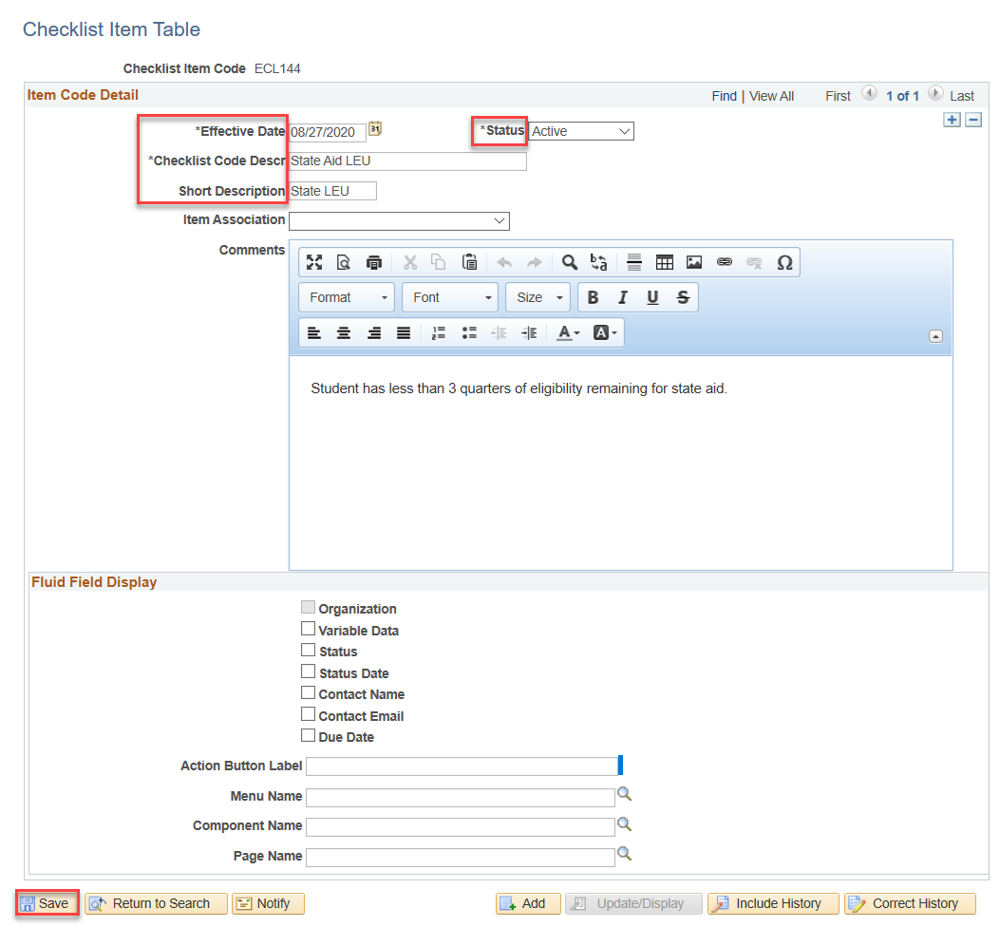
Create State Aid Checklist
Checklist Item Table
Nav Bar > SACR > Common Definitions > Checklists > Checklist Item Table

Slide 4
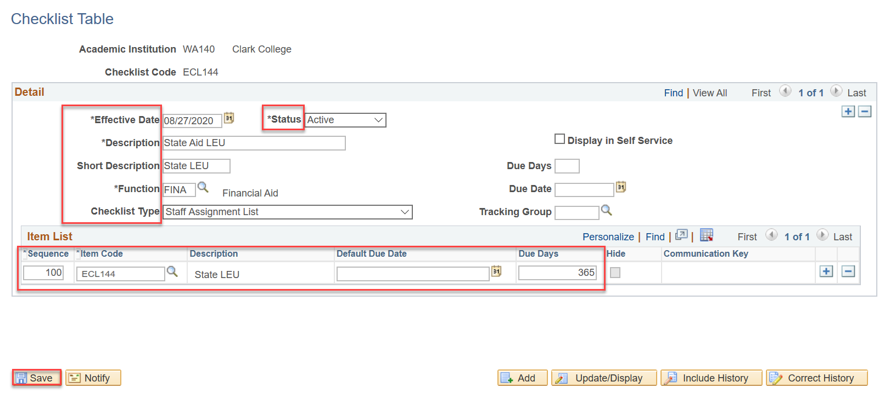
Create State Aid Checklist
Checklist Table
Nav Bar > SACR > Common Definitions > Checklists > Checklist Table
Note— Leave the Display in Self Service Checkbox unselected; all LEU resolution is handled on the back-end through staff review.

Slide 5
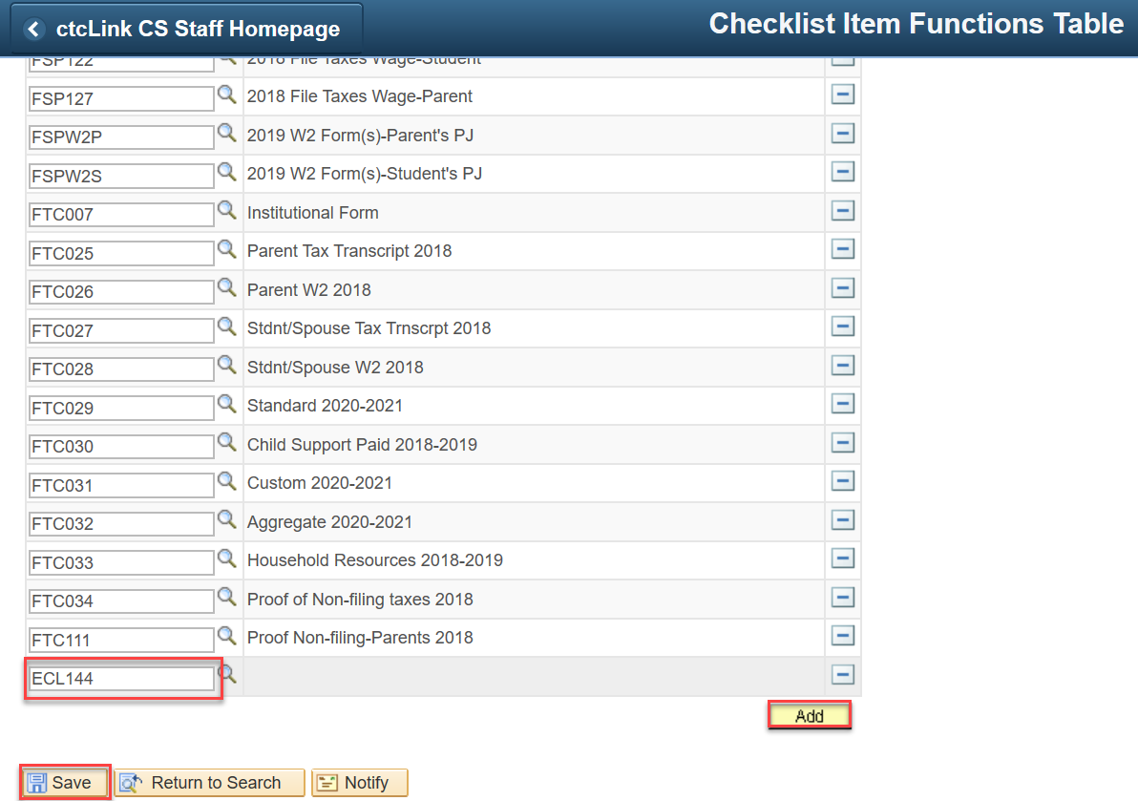
Create State Aid Checklist
Checklist Item Function Table
Nav Bar > SACR > Common Definitions > Checklists > Checklist Item Functions Table

Slide 6
Create State Aid Checklist
Assign Checklist to All FA 3Cs Group
Nav Bar > SACR > Common Definitions > Checklists > Checklist 3C Groups

Slide 7
Create a New Event Definition
Event Definition
Nav Bar > Campus Community > 3C Engine > Set Up 3C Engine > Event Definition

Slide 8
Create New Event Definition
Add New Event ID to All FA 3C Groups
Nav Bar > Campus Community > 3C Engine > Set Up 3C Engine > Event 3C Groups

Slide 9
Create a Run Control ID for New Checklist
Run 3C Engine
Nav Bar > Campus Community > 3C Engine > Run 3C Engine
Remember to define your Manage Duplicate Assignment tab, selecting the “Duplicate Check” checkbox and Variable Data set to “Match”

Slide 10
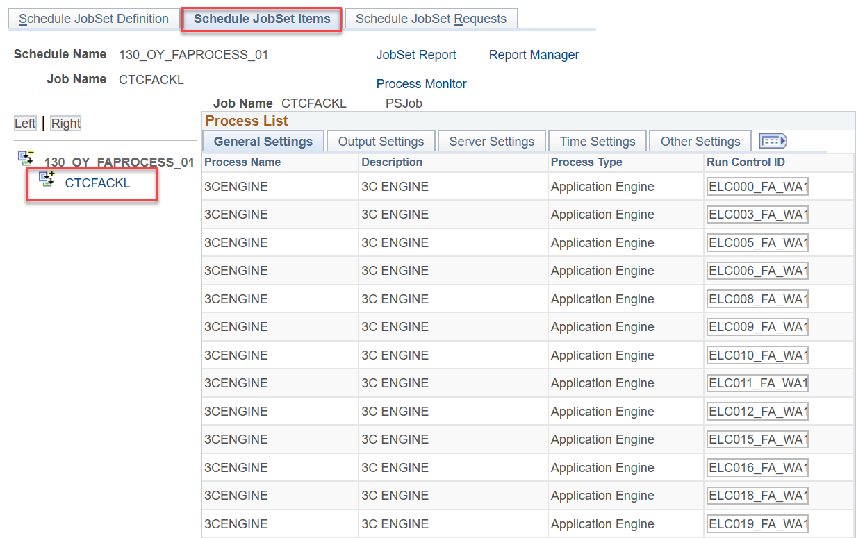
Add New Run Control into JobSet
Checklist Section
Nav Bar > PeopleTools > Schedule JobSet Definitions
Add the newly created 3C Engine Run Control in the CTCFACKL Job and select Save.

Slide 11
Define Item Type Rules
All State Aid Checklists
Nav Bar > Set Up SACR > Product Related > Financial Aid > Disbursements > Define Item Type Rules
In the Checklist Groupbox, insert a new row and add the State Aid LEU Checklist – you are setting the Item Type Rule to for each State Aid Checklist.
Define this rule for all State Aid Item Types:
-Washington College Grant
-College Bound Scholarship
-State Work Study
-Passport to College, etc.

Slide 12
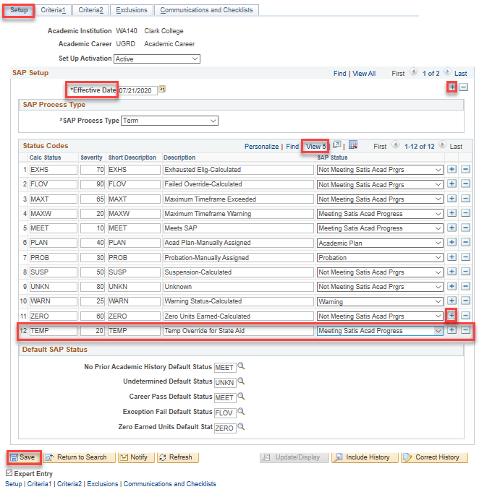
Add New SAP Status to SAP Set Up
TEMP Status
Nav Bar > Set Up SACR > Product Related > Financial Aid > Satisfactory Academic Progress > Define Set Up Criteria
Note your Effective Date for your 2021 Set Up Criteria.
The date used in the example here is the day after the first row.
Check your first row date, and set the date to the day after.

Slide 13


Slide 14
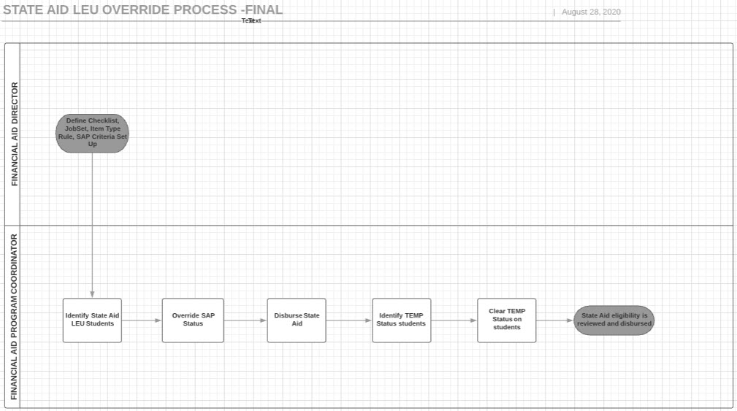
Reviewing End-to-End Process
State Aid LEU Override

Slide 15
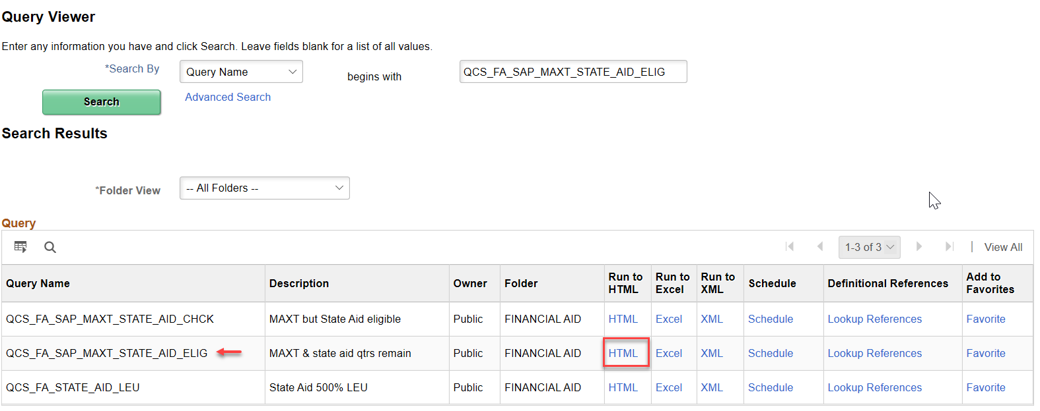
Reviewing End to End Process
Identifying State Aid Students with 3 QER
Nav Bar > Navigator > Reporting Tools > Query > Query Viewer

Slide 16
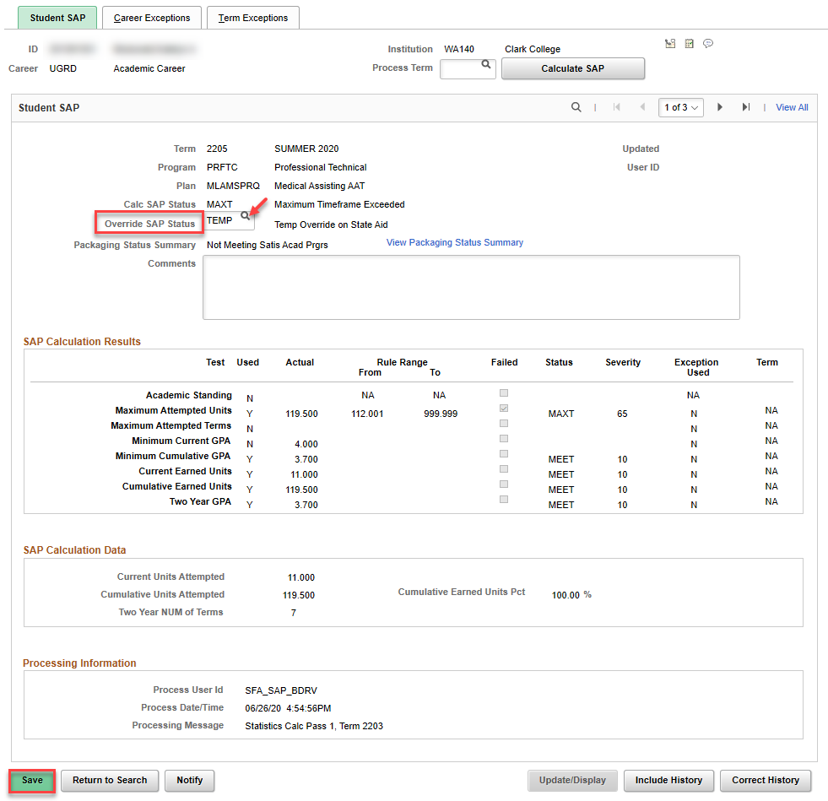
Reviewing End to End Process
Overridding SAP Status to “TEMP”
Nav Bar > Navigator > Financial Aid > SAP > Maintain Student SAP Data

Slide 17
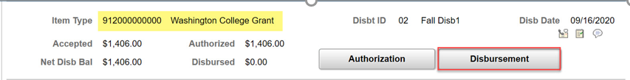
Reviewing End to End Process
Disbursing State Aid
Nav Bar > Navigator > Financial Aid > Disbursement > Disburse Aid
Note! It is not recommended to use the Disburse Aid with Override process.
Use Manual Disbursement.

Slide 18
Reviewing End to End Process
Identify Students in TEMP Status
Nav Bar > Navigator > Reporting Tools > Query > Query Viewer
Re-run query, find students with TEMP Status still remaining

Slide 19
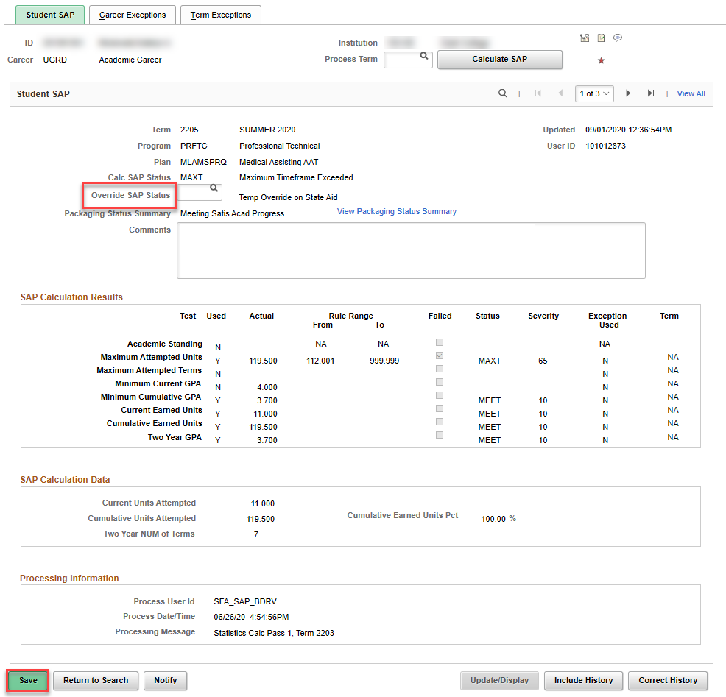
Reviewing End to End Process
Clear SAP “TEMP” Status
Nav Bar > Navigator > Financial Aid > SAP > Maintain Student SAP Data

Slide 20

Reviewing QRG/Resources ctcLink Reference Center
QRG: Identifying and Tracking State Aid-Eligible MAXT Students
Queries: QCS_FA_SAP_MAXT_STATE_AID_CHCK
QCS_FA_SAP_MAXT_STATE_AID_ELIG
QCS_FA_STATE_AID_LEU
Run in 3C Engine, but can be run as standalone query
Questions?

Slide 21
FOR MORE INFORMATION
Visit the ctcLink Reference Center for more information about PeopleSoft/ctcLink Processes
ctclinkreferencecenter.ctclink.us

