Slide 1
FINANCIAL AID FOR PRISON EDUCATION PROGRAMS
Amber Zander
Onsite Academic Coordinator
March 11, 2025

Slide 2
SPECIAL CONSIDERATIONS
University and DPSCS policy
Must be already enrolled
Computer with internet access
Notes:
DPSCS – Department of Public Safety and Correctional Services (MD).
Our process for FAFSA is heavily dependent on current University of Baltimore and DPSCS policies. Please keep this in mind as your university and DOC policies may be different.
We created FAFSA accounts using their student emails. Our students can only receive UBalt emails when they are actively enrolled in class. For potential applicants we use the paper form.

Slide 3
SET UP
Accessing student accounts
Collaborating with OTS
Standardizing passwords
Bypassing two-step authentication
Reserving time
Inside the institution and with students
Computer with internet access
Notes:
OTS – Office of Technology Services
Collaborating with OTS to obtain student ID’s and standardizing passwords for easier record keeping.
Ubalt uses a Microsoft authenticator app for all staff, faculty, and student accounts. We worked with OTS to bypass this. Previously the authenticator app could be bypass via “a token,” which could also be an option if that is something your school does. However, I believe each token may be connected to individual accounts, so you would need a token for each student.

Slide 4
CONSENT FORM
Notes:
Each student fills out a consent form that allows us to be a representative and fill out their FAFSA applications with them.

Slide 5
CREATING A FEDERAL STUDENT AID ACCOUNT
Fill out account
SSN already in use
Notes:
This is where you will find out if an account was already created for a student, only one account can be made be SSN. If we are unable to make an account for the student, they will then need to use the paper forms.
Based on your administration needs, you can decide if you’d prefer email or mailing for communication. It will go to whatever email or mailing address you previously put in. If there are issues with the application, and you opted for email, you will not be alerted of the issues unless you access the student’s email.

Slide 6
NEXT STEPS
Username
Email
Password
Contact Information
Communication Preferences
Notes:
The usernames we use are just typically a variation of the name. Since you can log in with either the email or username, keep note of the username. We use the same passwords as their UBalt student account for easier records keeping. The reason we use individual student email accounts is because FSA (Federal Student Aid) requires unique username, email, and password combinations when logging in (https://studentaid.gov/resources/prepare-for-college/creating-your-account).
FSA recommends NOT using a school or work email address since there is a time when students may not have access to this account. It is a lot of work to change access your account if you do not have access, but at this time this is all we have.
The contact information we use is the students’ incarcerated address or the institution’s address. Due to this students are responsible to communicate to the program’s administration any communication they receive from the Dept of Education. This address is easy to change in the future, if your student gets released and needs to file for FAFSA again. You do not need to put in a mobile phone number.
Based on administrative needs you can choose whether the communication goes to the email or mailing address previously provided.

Slide 7
CHALLENGE QUESTIONS
Notes:
Next students will need to pick four challenge questions. These are personal questions that they should always remember the answer to. This is one way they will be able to access their account if they don’t remember the password or are unable to access their email. Answers must be more than two characters (i.e. “Washington DC”, NOT “DC”) and they cannot have repeating answers.

Slide 8
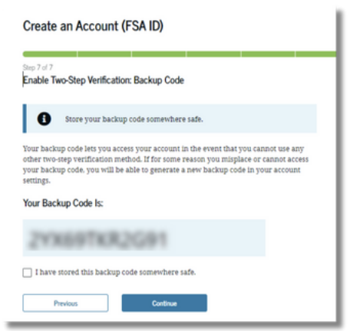
FINAL ACCOUNT STEPS
Email verification
Backup Code
Notes:
You will need to verify the email previously given (their school email). FSA will then provide you with a backup code. This secure backup code is to help access your account if the other verification methods won’t work. ADMINISTRATORS SHOULD RECORD AND STORE SAFELY.
Once the email is verified, that FAFSA account has been created, you will then need to log back in to complete this years FAFSA account.

Slide 9
COMPLETING FAFSA FORM
Notes:
From creating an account to submitting a completed FAFSA form takes approximately 10 minutes per student. You will only have to go through the steps of creating an account the first year. Following years, from log in to submitting a completed form takes approximately 5 minutes. Filing online, the application is processed in approximately 2-3 business days.
If a student selects that they are married, they will need to input their spouse’s email address. Their spouse will then be required to complete the FAFSA form.

