Slide 1
Accessibility Testing Projects
September 12, 2023

Slide 2
Agenda
Okta Dashboard/Verify
Enter Time Page Back Button
HCX 23.2 Testing
LegacyLink and Legacy Transcript
Online Admissions Application Portal (OAAP)

Slide 3
Okta Accessibility Testing
Vicki Walton and Josh Giha teamed up to run accessibility testing on the Okta Verify app mid-June 2023.
Vicki evaluated the MFA sign-in process first by navigating keyboard only on the Okta Dashboard. Then they ran JAWS on Chrome and Firefox in the Okta Dashboard to start the setup and then VoiceOver on an iOS device to test the Okta Verify app.
Josh evaluated the MFA sign-in process using NVDA on Chrome and Firefox in the Okta Dashboard to start the setup and then TalkBack on an Android to test the Okta Verify app.

Slide 4
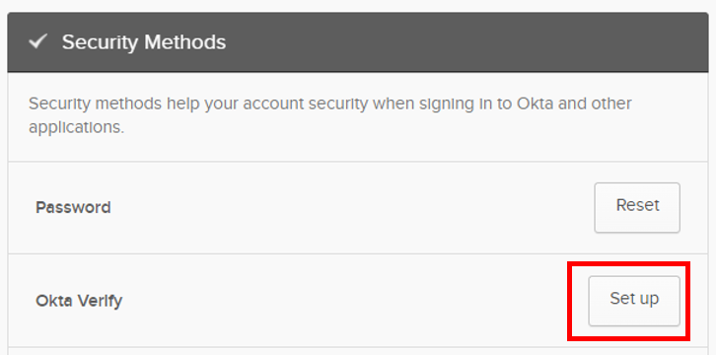
Okta Dashboard
The process starts by going into the Okta Dashboard. Then to Settings and clicking on Okta Verify Set up. This was done on a desktop so we could test it with JAWS and NVDA in Chrome and Firefox.

Slide 5
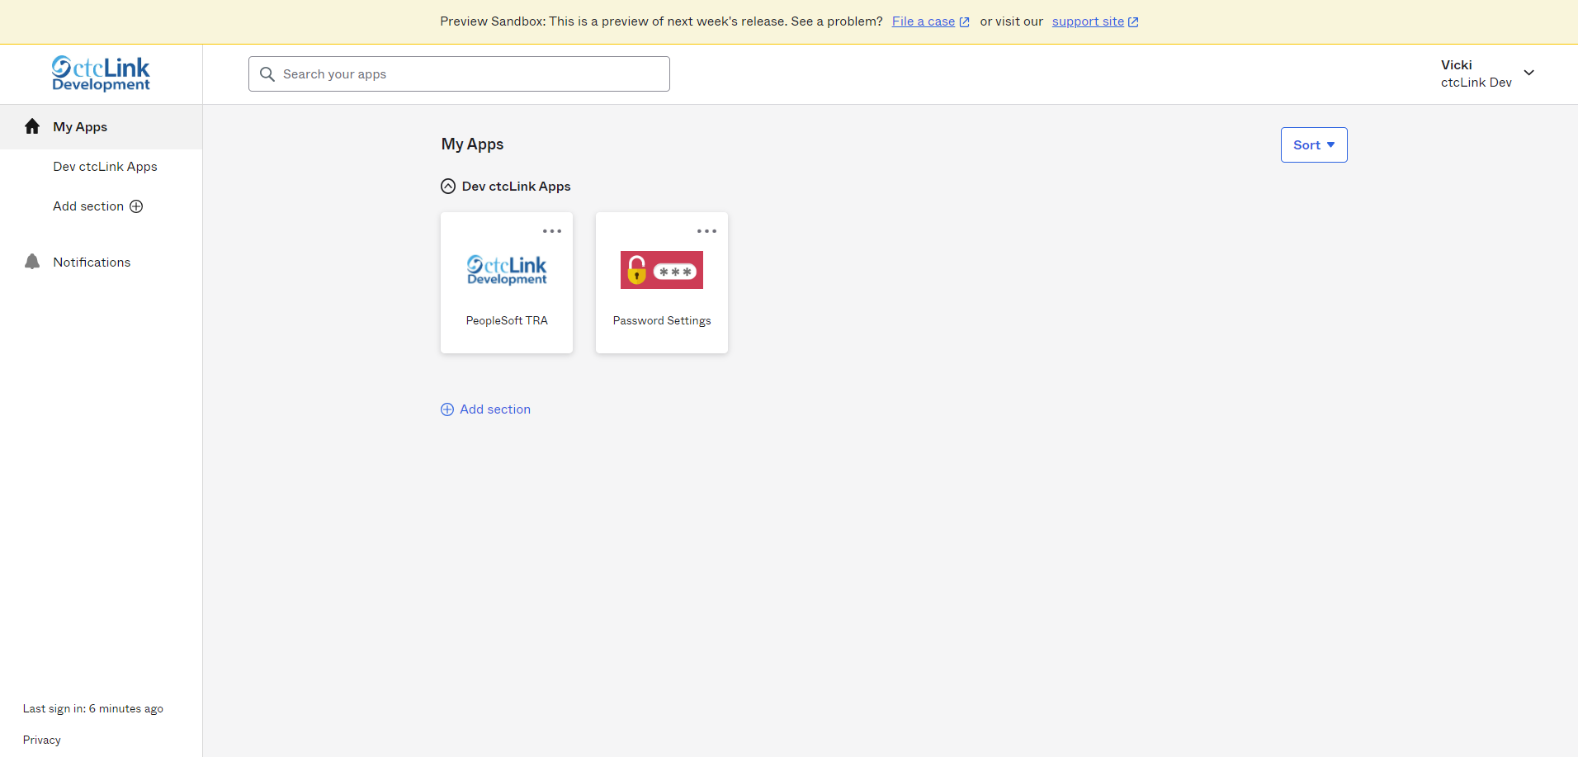
Okta Dashboard and Keyboard only
Once on the Okta Dashboard page,

Slide 6
Okta Dashboard and Keyboard only cont.
The focus is lost after it lands on “Privacy” (lower left of the navigation panel)
After paying attention to this link below,

Slide 7
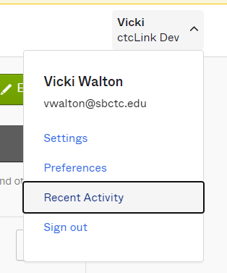
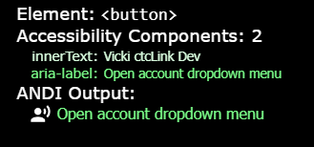
Okta Dashboard and Keyboard only cont.
Vicki realized the keyboard navigation is going into the “Open account dropdown menu” where “Settings”, “Preferences”, “Recent Activity” and “Sign Out” are located. Yet, it does not open that dialog box, but it does navigate through it. Once in it, there is no clear clue where the focus is going.

Slide 8
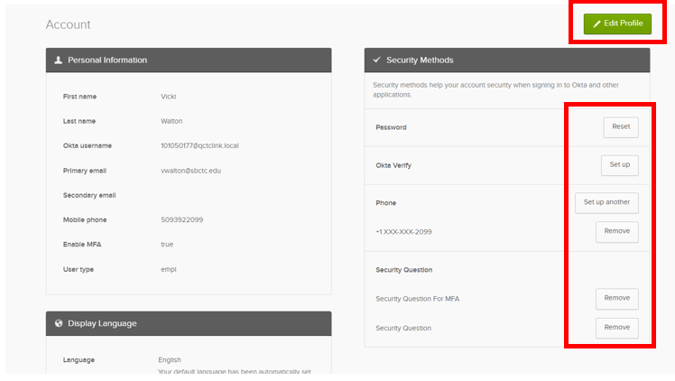
Okta Dashboard and Keyboard only cont.
Location: Settings on Okta Dashboard
No keyboard access to Edit Profile and all the Security Methods

Slide 9
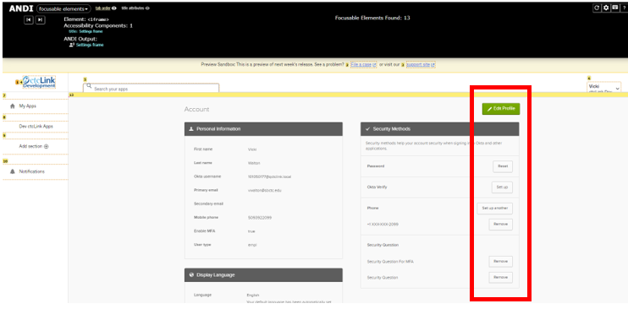
Okta Dashboard and Keyboard only cont.
ANDI tool shows the Edit Profile, and all the Security Methods are not in the tab order.

Slide 10
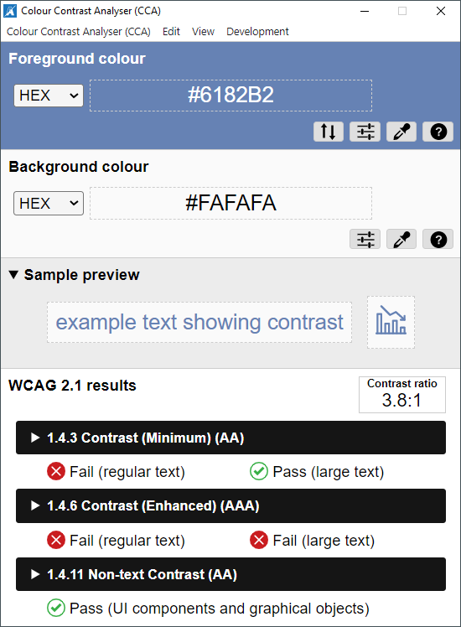
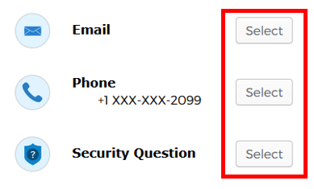
Okta Dashboard and Keyboard only cont.
Color Contrast violations throughout the process
Example: Color contrast on the “Select” links has failed for regular text.

Slide 11
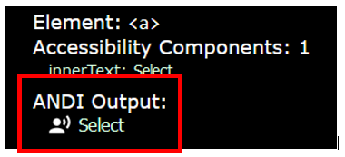
Okta with JAWS
Screen Reader issue of inefficient labeling:
When the option presents itself to select your MFA method, the “Select” links are not linked to the label. They only announce “Select”.
ANDI output showing what is announced when JAWS lands on the Select links.

Slide 12
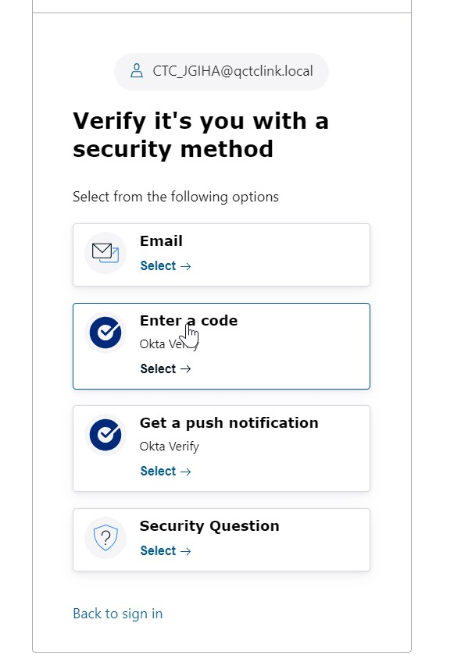
OKTA Buttons
Upcoming update

Slide 13
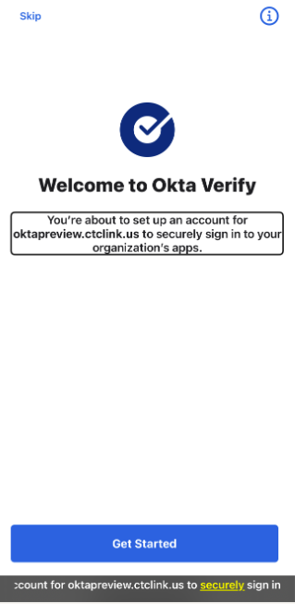
Okta Verify with TalkBack and VoiceOver
Vicki had Okta Verify installed on their iPhone already and there were no issues finalizing the setup process. However, they needed to see how this worked as a first-time setup. So, they uninstalled Okta Verify from their iPhone and removed the Okta Verify Security Method to start fresh. As they went through the process entirely on their iPhone with VoiceOver, they were very confused by some of the content that was presented.
Once the process had us navigating in the Okta Verify app with TalkBack and VoiceOver, there were no issues found. Yet, this is not helpful for first time users that need to set this up.

Slide 14
Final Words on Okta
Josh and Vicki have prepared reports to send to the Okta representatives. Vicki has already reached out to them to let them know that we have been doing some accessibility testing on both the Okta Dashboard and Okta Verify app and will be sending those reports to them so they can plan to fix issues found.
Having gone through these steps multiple times, it appears this process is not consistent. For instance, one run-through at the final step of the Okta Verify process, Vicki is asked for a company URL and another time when they get to the final step, Okta Verify completed on its own, no screen presented to enter a company URL.

Slide 15
Enter Time Page
We are testing turning off the announcement on page activate. It will stop the announcement of the Job Details when back button gets the focus or when employee access the page the first time.
The announcement will, however, remain enabled when employee changes the Job Title from the drop down.
This has been complete and the ticket has been resolved

Slide 16
HCX 23.2 Upgrade Testing
Testing was open from July 12th – August 1st
Following the HCX Accessibility issues (reported by CATO) Spreadsheet Version to check for fixes.

Slide 17
LegacyLink and Legacy Transcript
The HP-UX environment is being shut down, so SBCTC built two new applications. One is called LegacyLink and the other is called Legacy Transcript.
Why? Older data was not migrated but might still be needed when all 34 colleges were moved to ctcLink. Therefore, these two applications were built to house this data.

Slide 18
LegacyLink
A web-based read-only application developed to provide secure access to users to a limited subset of screens and batch reports needed to continue critical business.
Financial management system (FMS)
Payroll/personnel management system (PPMS)
Student Management System (SMS)
Please note, DataExpress will no longer be available as that product relies on the HP-UX platform.

Slide 19
Legacy Transcript
The Legacy Transcript application was developed in collaboration with an advisory group of registrars representing the Admissions and Registration Council (ARC) who assisted with business requirements definition and design.
The application will be a repository of those student transcripts currently stored in the legacy HP-UX system which were not converted into ctcLink during the colleges conversion to PeopleSoft.
The application is web-based, accessible, and provides the functionality required for college staff to process transcript requests.
Please note, due to recent security concerns, students will not have login access to this application

Slide 20
Legacy Projects Accessibility Testing
Vicki was asked to test both applications for accessibility. Three tests were performed on each application. They included keyboard-only navigation, screen reader navigation and voice command navigation using Dragon NaturallySpeaking.

Slide 21
Online Admissions Application Portal
Mid-July, Vicki received an email from an employee at South Seattle College who is a legally blind JAWS user. This is a new job for her, and as part of her training, she had to navigate the OAAP platform and was having issues as some of the form fields were missing labels, so she did know what to put on those fields.
Therefore, Vicki chose to take on this task to run an accessibility evaluation on the OAAP. Currently, there is no deadline.

